Slide 1
Hard-filter of Cayo exome data on chrX

Slide 2
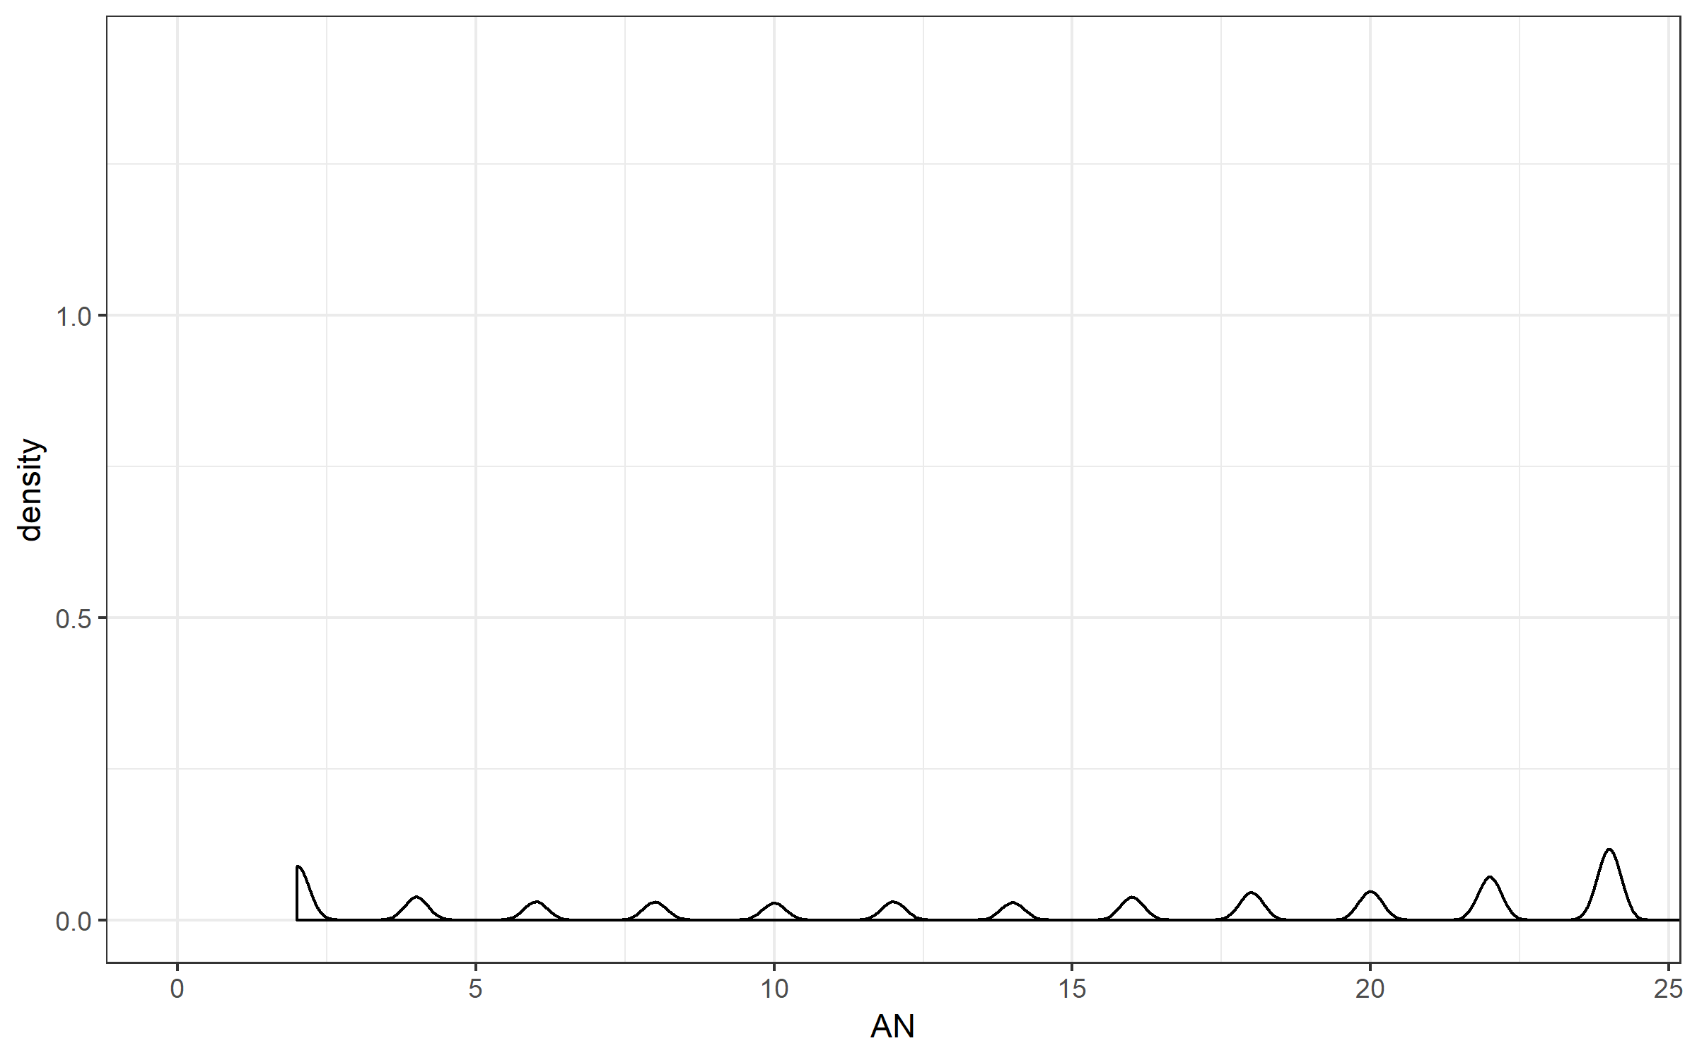
Number of alleles that are genotyped AN
There are 14 exomes → the maximum AN is 28, which means that a variant is genotyped across all 14 exomes
Should we hard-filter based on AN?
For example, we only keep variants where AN >= 6 (genotyped in at least 3 exomes → 25%).
There are 14,794 out of 15,794 (~94%) variants with AN >= 6

Slide 3
Investigating AN
 |  | Number of variants
AN >= 2 | Called in 1 (out of 14) exomes or more | 15,794
AN >= 4 | Called in 2 (out of 14) exomes or more | 15,091
AN >= 6 | Called in 3 (out of 14) exomes or more | 14,794
AN >= 8 | Called in 4 (out of 14) exomes or more | 14,556
AN >= 10 | Called in 5 (out of 14) exomes or more | 14,323
AN >= 12 | Called in 6 (out of 14) exomes or more | 14,100
AN >= 14 | Called in 7 (out of 14) exomes or more | 13,862
AN >= 16 | Called in 8 (out of 14) exomes or more | 13,637
AN >= 18 | Called in 9 (out of 14) exomes or more | 13,337
AN >= 20 | Called in 10 (out of 14) exomes or more | 12,980
AN >= 22 | Called in 11 (out of 14) exomes or more | 12,609
AN >= 24 | Called in 12 (out of 14) exomes or more | 12,047
AN >= 26 | Called in 13 (out of 14) exomes or more | 11,131
AN = 28 | Called in 14 (out of 14) exomes | 0

Slide 4
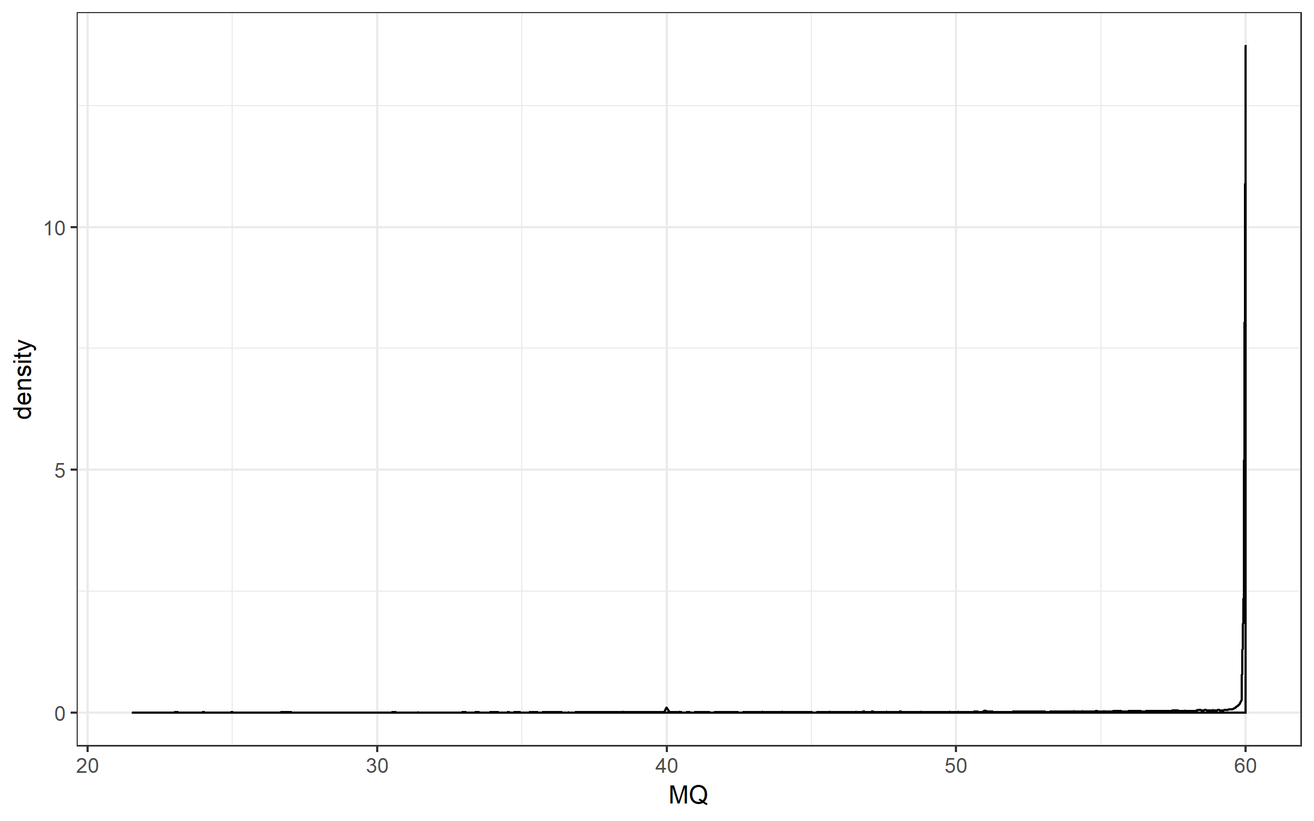
RMSMapping quality (MQ)
From GATK: “This is the root mean square mapping quality over all the reads at the site. Instead of the average mapping quality of the site, this annotation gives the square root of the average of the squares of the mapping qualities at the site.” and “When the mapping qualities are good at a site, the MQ will be around 60.”
GATK’s hard-filter suggests to remove variants with MQ < 40
15,261 out of 15,794 variants with MQ > 40

Slide 5
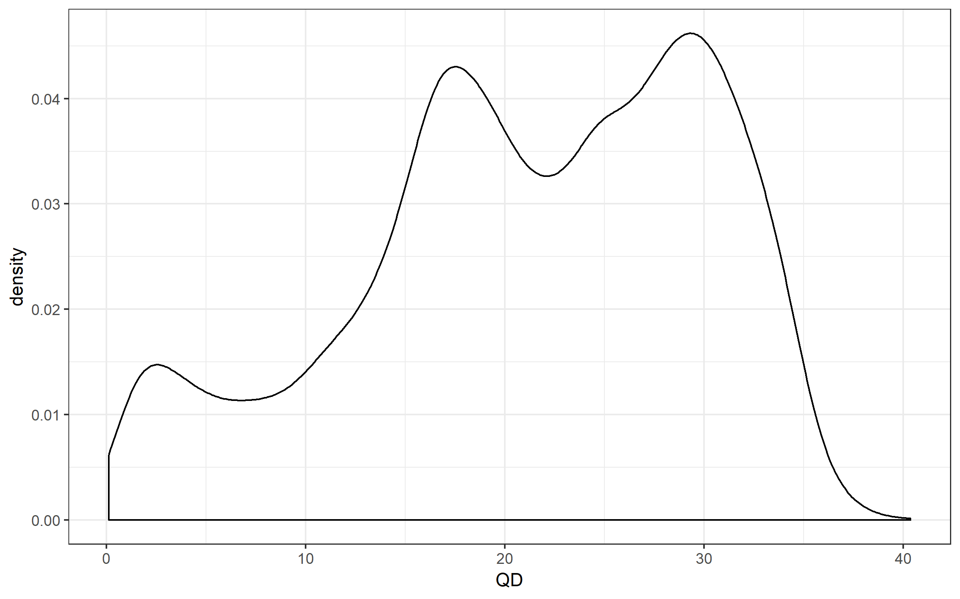
Quality by depth (QD)
This peak represents variants that are mostly heterozygous
This peak represents variants that are mostly homozygous
GATK recommends to remove this peak
Use QD threshold of 5
There are 14,721 out of 15,794 variants with QD > 5

Slide 6
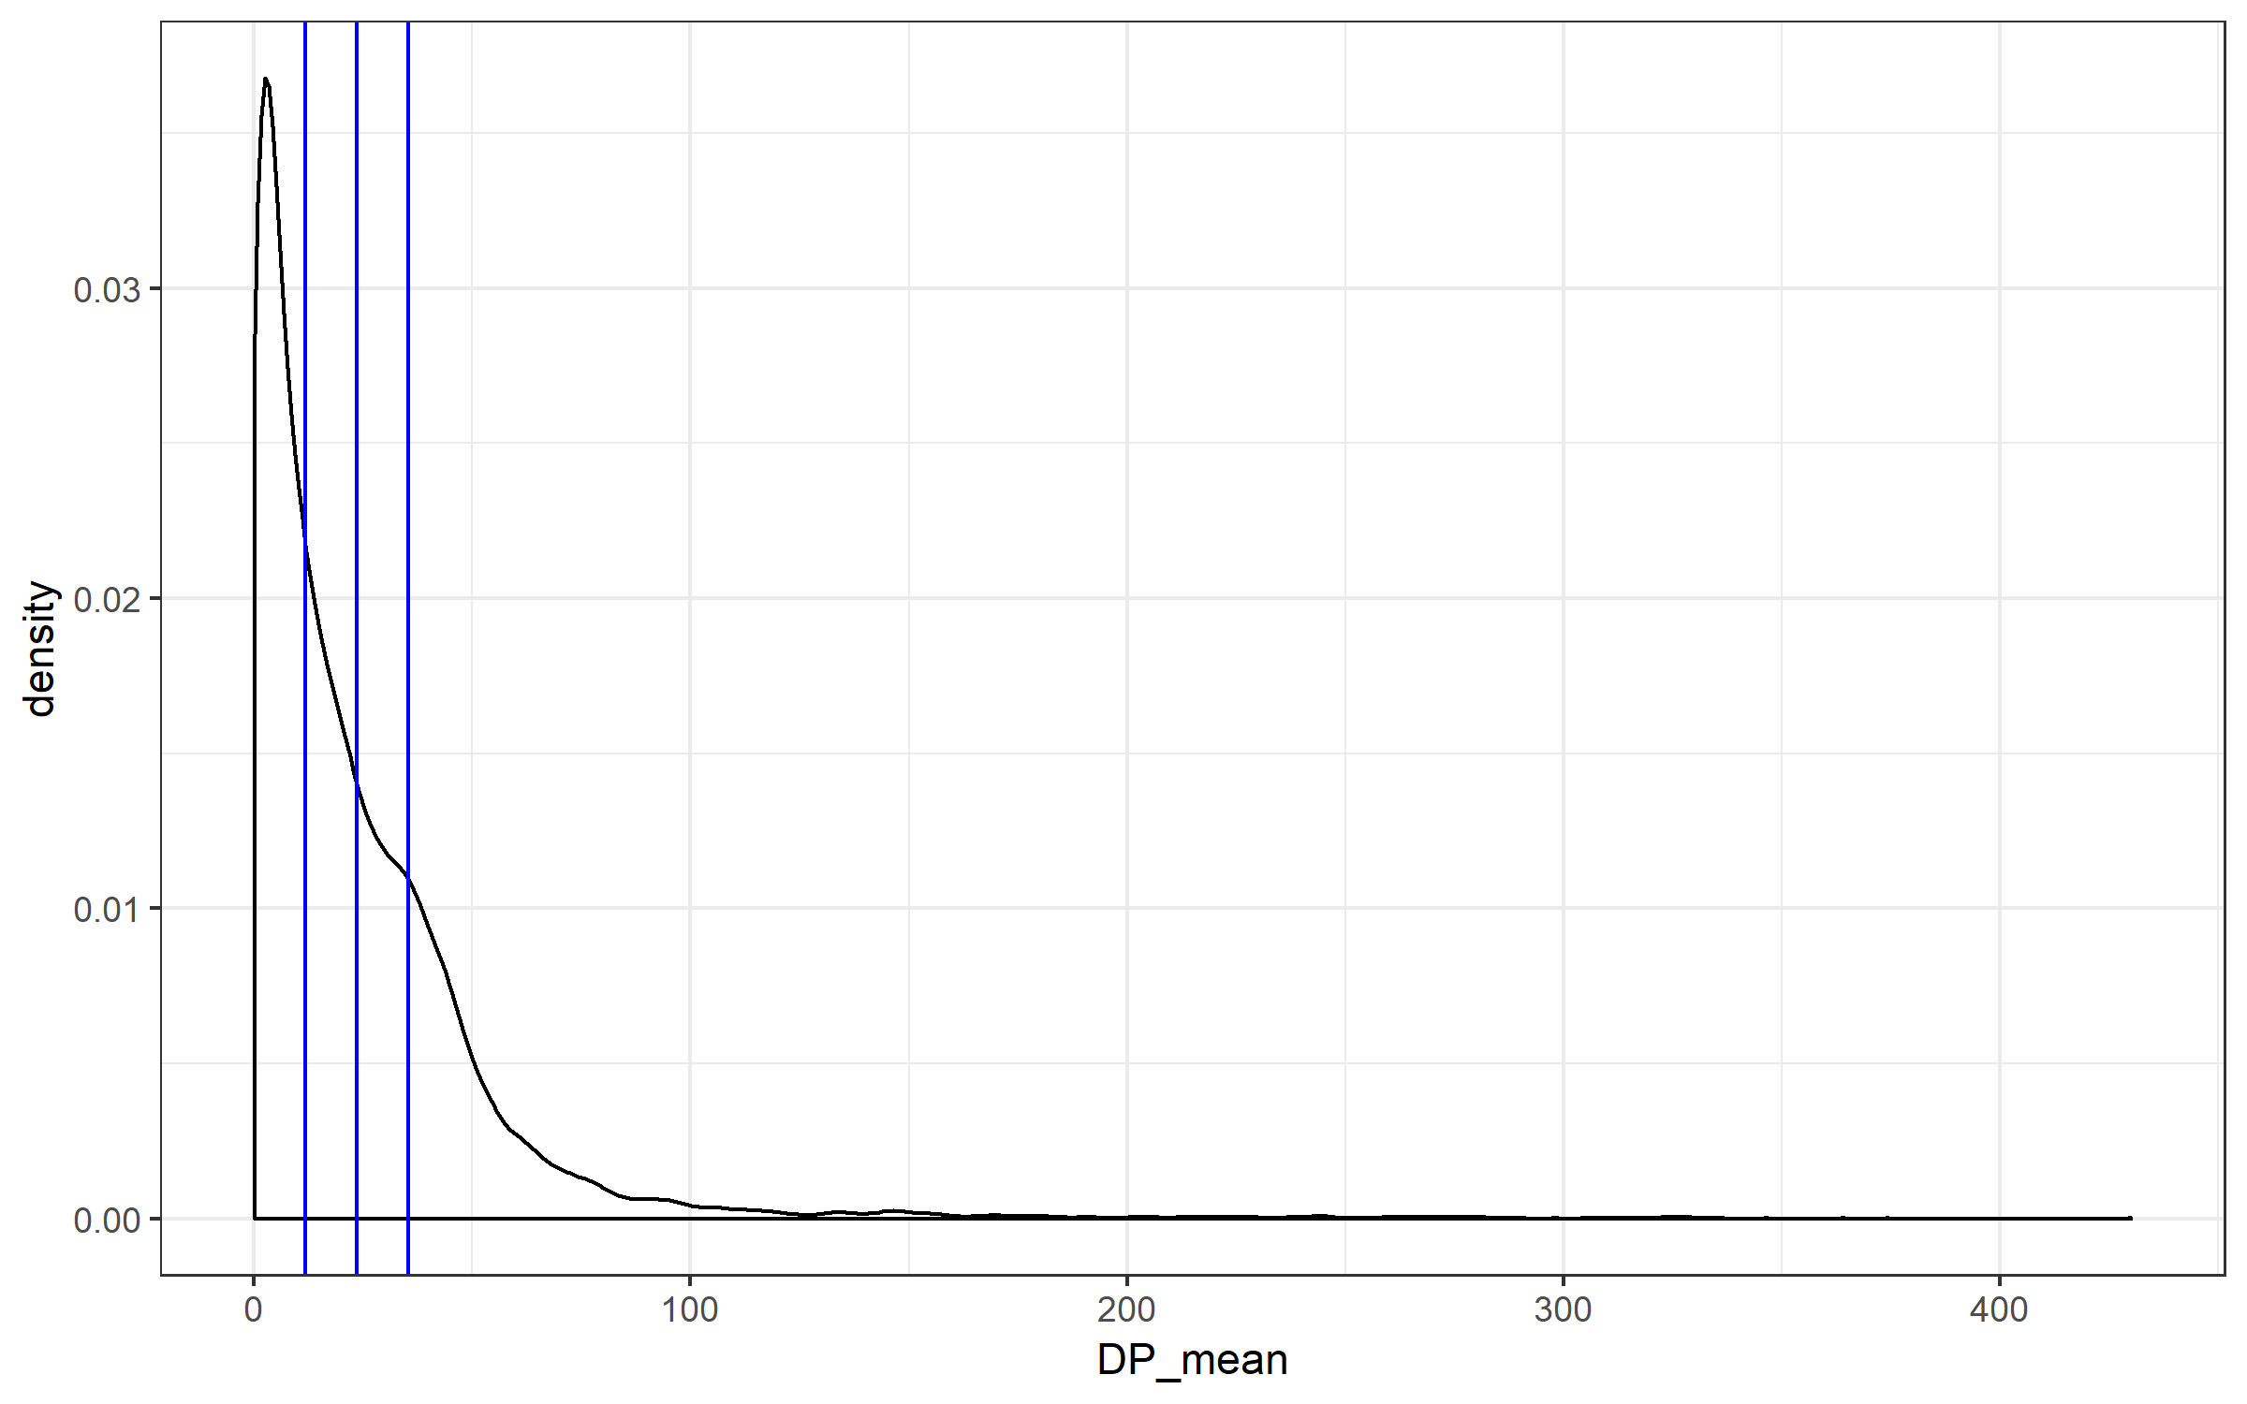
Total depth of coverage over all sample (DP)
50% of mean
mean
Mean = 24
Median = 15
Peak = 3.2
150% of mean

Slide 7
Investigating DP
 | Number of variants
0-25X | 10,292
25-50X | 3,856
50-100X | 1,318
100-150X | 181
150-200X | 63
200-250X | 40
250-300X | 27
300-350X | 14
350-400X | 2
>400X | 1

