Slide 1
Hard-filter of Cayo exome data on chr8

Slide 2
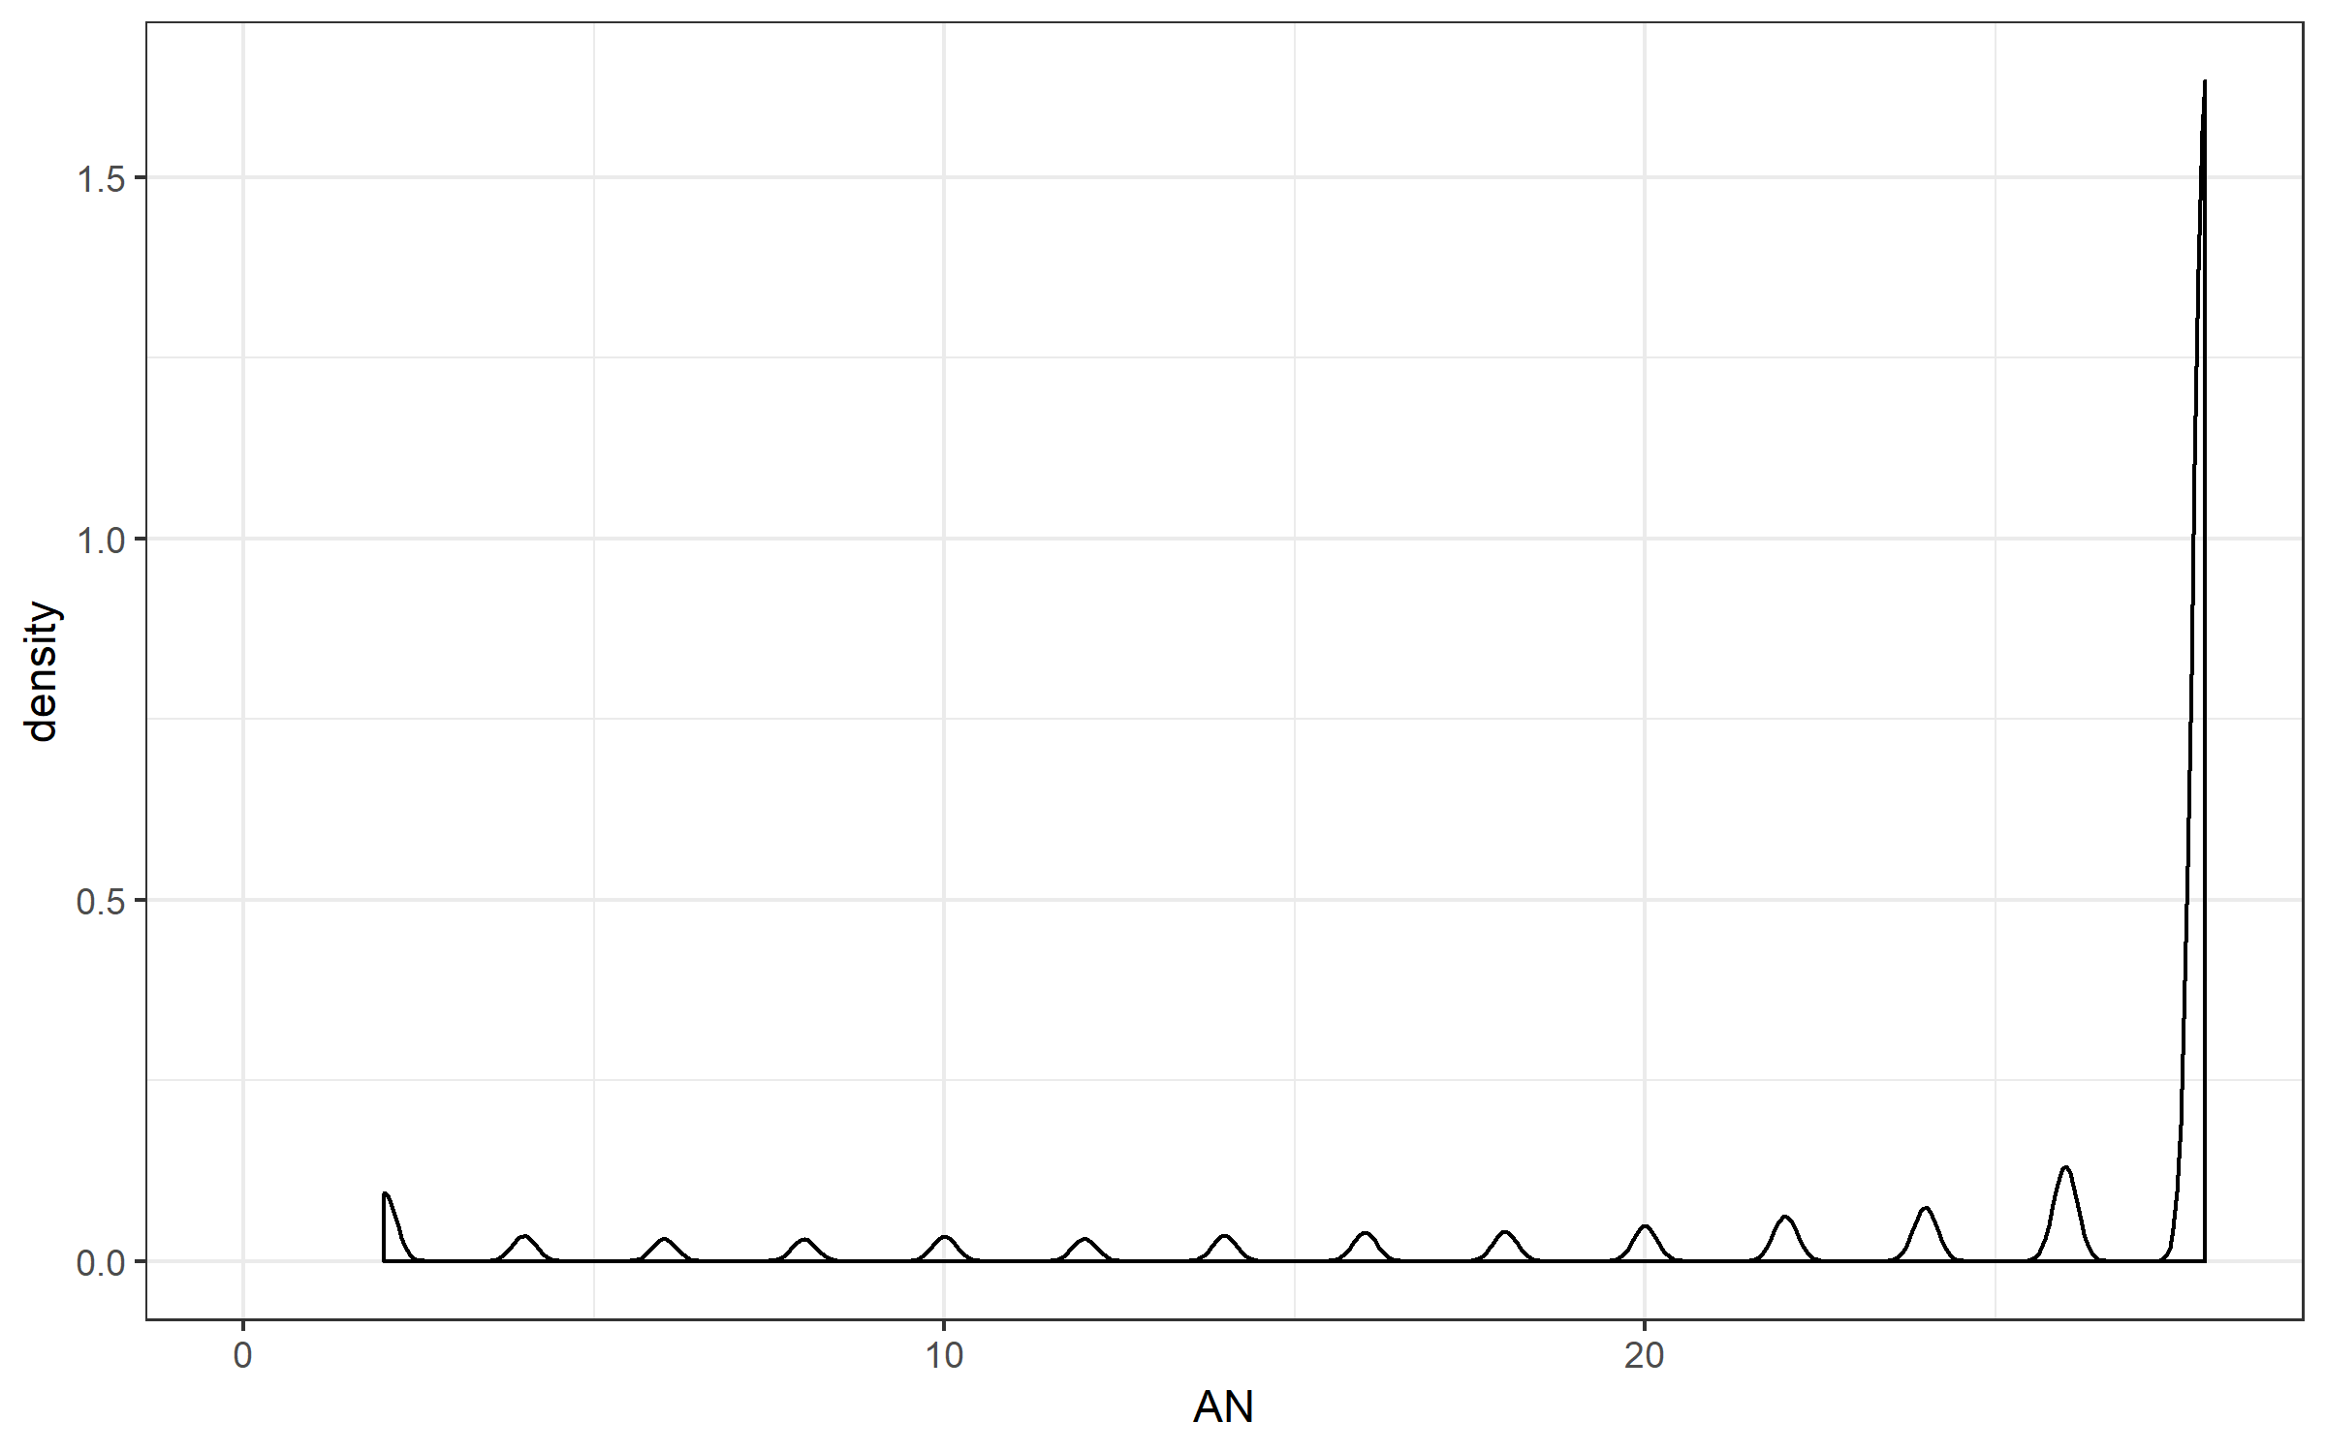
Number of alleles that are genotyped AN
There are 14 exomes → the maximum AN is 28, which means that a variant is genotyped across all 14 exomes

Slide 3
Investigating AN
 |  | Number of variants (total = 16,299)
AN >= 2 | Called in 1 (out of 14) exomes or more | 32,920
AN >= 4 | Called in 2 (out of 14) exomes or more | 31,565
AN >= 6 | Called in 3 (out of 14) exomes or more | 31,069
AN >= 8 | Called in 4 (out of 14) exomes or more | 30,632
AN >= 10 | Called in 5 (out of 14) exomes or more | 30,200
AN >= 12 | Called in 6 (out of 14) exomes or more | 29,716
AN >= 14 | Called in 7 (out of 14) exomes or more | 29,274
AN >= 16 | Called in 8 (out of 14) exomes or more | 28,778
AN >= 18 | Called in 9 (out of 14) exomes or more | 28,222
AN >= 20 | Called in 10 (out of 14) exomes or more | 27,644
AN >= 22 | Called in 11 (out of 14) exomes or more | 26,961
AN >= 24 | Called in 12 (out of 14) exomes or more | 26,083
AN >= 26 | Called in 13 (out of 14) exomes or more | 25,034
AN = 28 | Called in 14 (out of 14) exomes | 23,180

Slide 4
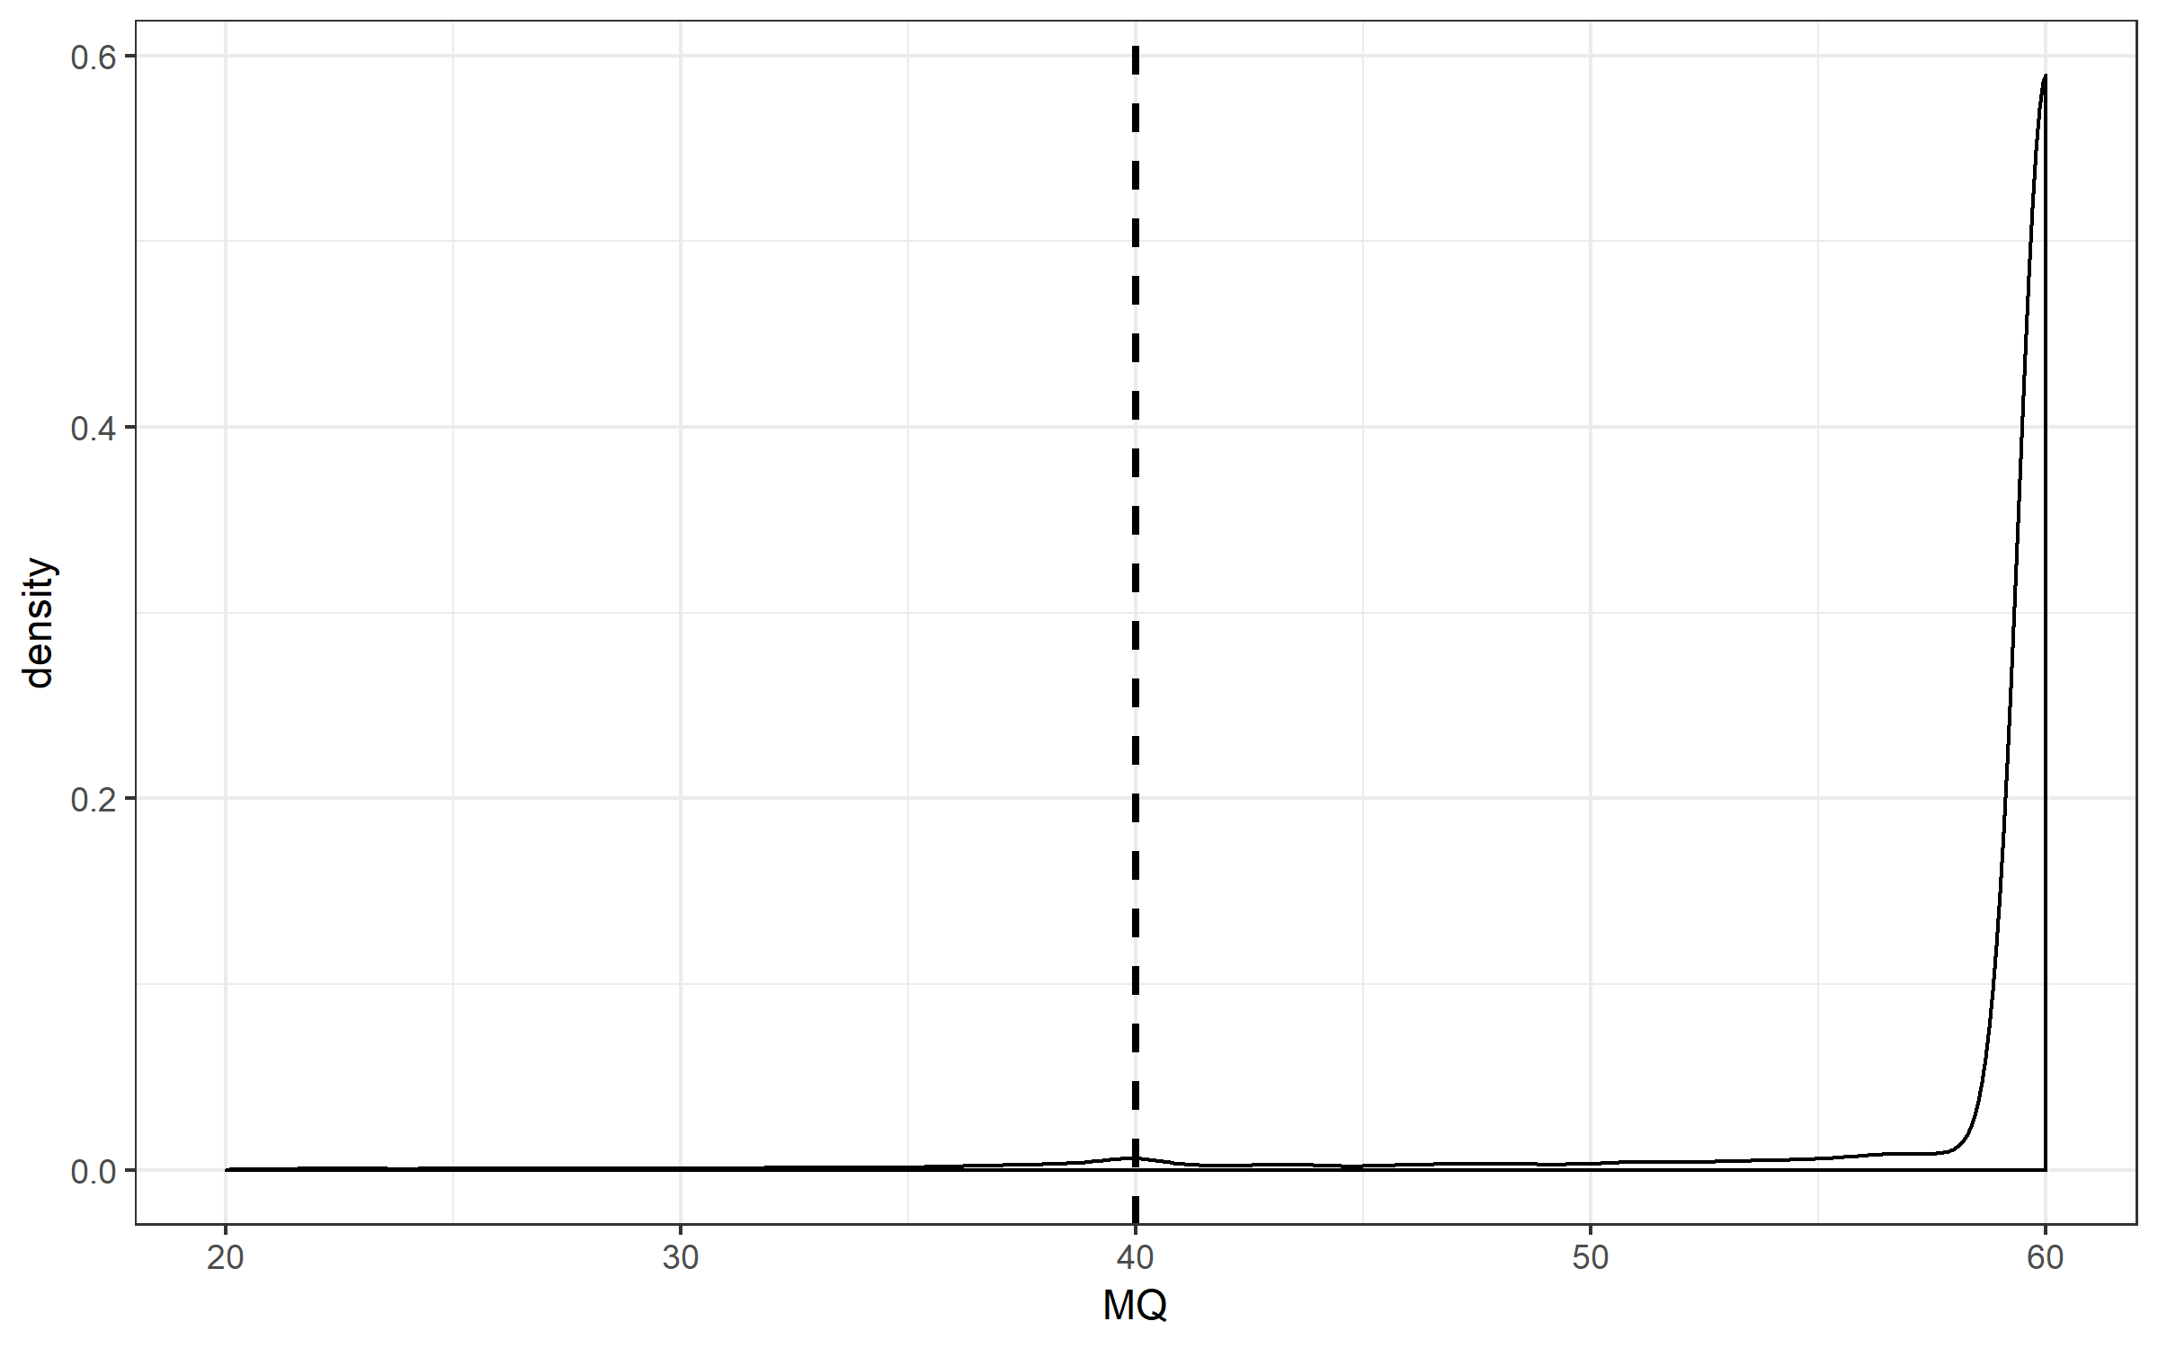
RMSMapping quality (MQ)
From GATK: “This is the root mean square mapping quality over all the reads at the site. Instead of the average mapping quality of the site, this annotation gives the square root of the average of the squares of the mapping qualities at the site.” and “When the mapping qualities are good at a site, the MQ will be around 60.”
GATK’s hard-filter suggests to remove variants with MQ < 40
31,996 out of 32,920 variants with MQ > 40

Slide 5
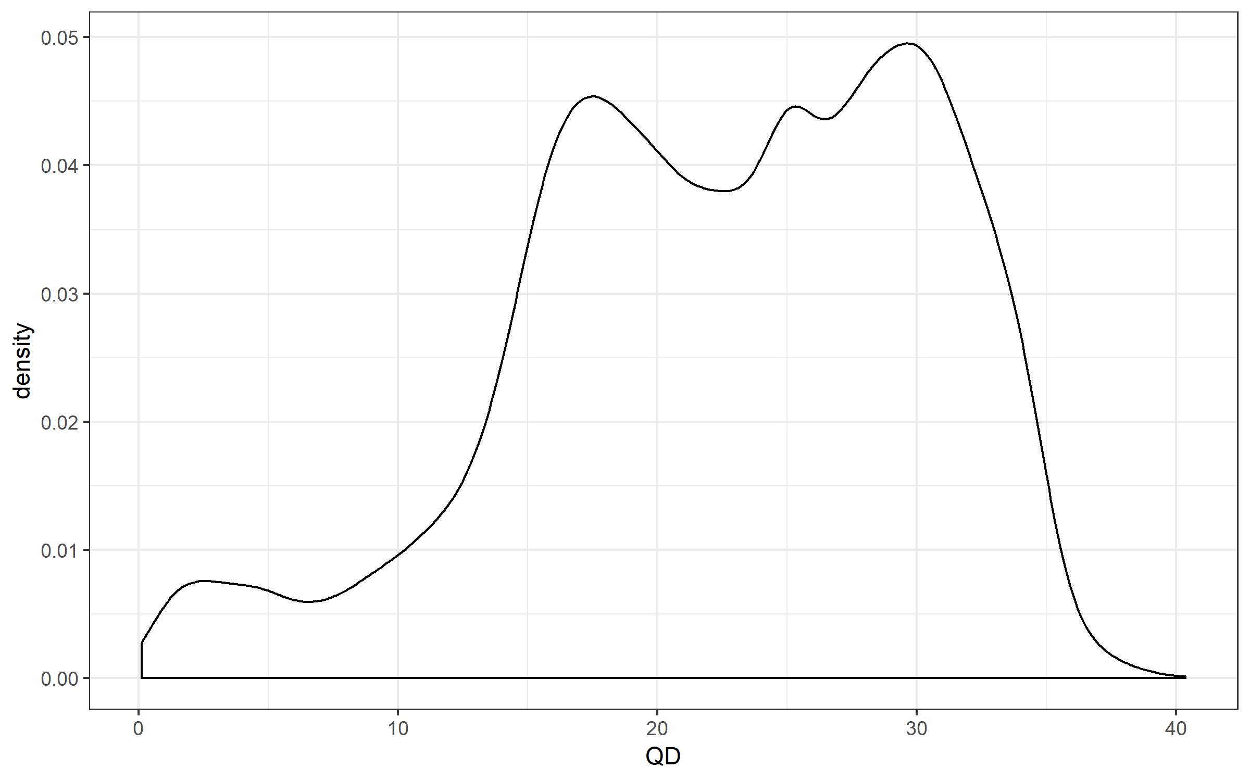
Quality by depth (QD)
This peak represents variants that are mostly heterozygous
This peak represents variants that are mostly homozygous
GATK recommends to remove this peak
Use QD threshold of 7
There are 31,403 out of 32920 variants with QD > 7

Slide 6
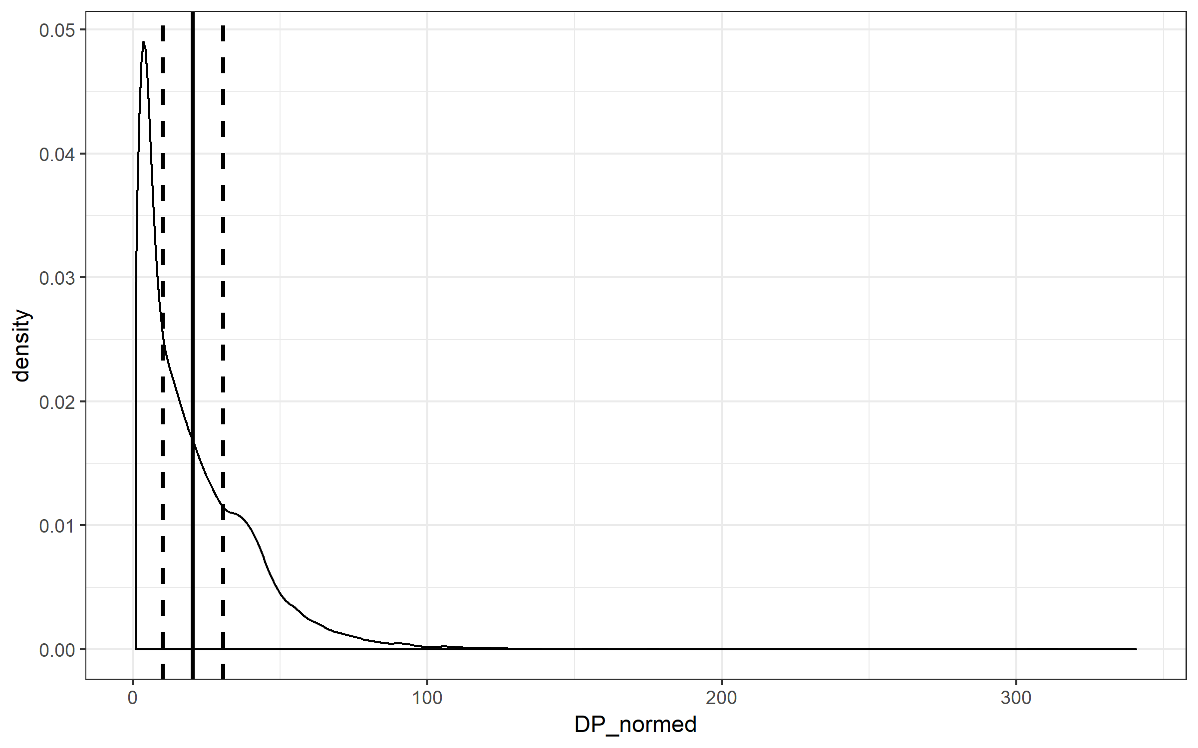
Total depth of coverage over all sample (DP)
DP from the INFO field from VCF file is summed across all samples. To get the mean, I divided DP by (AN/2) for that variant
mean = 20
150% of mean = 31
50% of mean = 10

