Slide 1
Hard-filter of Cayo exome data on chrX

Slide 2
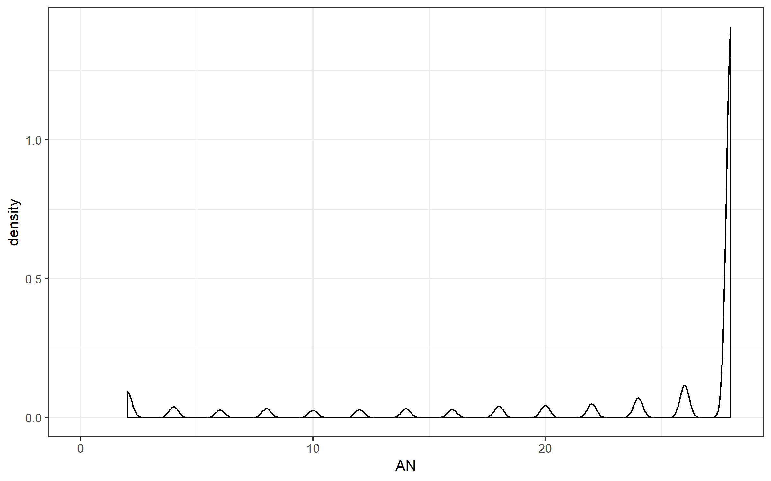
Number of alleles that are genotyped AN
There are 14 exomes → the maximum AN is 28, which means that a variant is genotyped across all 14 exomes

Slide 3
Investigating AN
 |  | Number of variants (total = 16,299)
AN >= 2 | Called in 1 (out of 14) exomes or more | 16,299
AN >= 4 | Called in 2 (out of 14) exomes or more | 15,540
AN >= 6 | Called in 3 (out of 14) exomes or more | 15,232
AN >= 8 | Called in 4 (out of 14) exomes or more | 15,023
AN >= 10 | Called in 5 (out of 14) exomes or more | 14,769
AN >= 12 | Called in 6 (out of 14) exomes or more | 14,563
AN >= 14 | Called in 7 (out of 14) exomes or more | 14,336
AN >= 16 | Called in 8 (out of 14) exomes or more | 14,085
AN >= 18 | Called in 9 (out of 14) exomes or more | 13,859
AN >= 20 | Called in 10 (out of 14) exomes or more | 13,535
AN >= 22 | Called in 11 (out of 14) exomes or more | 13,184
AN >= 24 | Called in 12 (out of 14) exomes or more | 12,795
AN >= 26 | Called in 13 (out of 14) exomes or more | 12,232
AN = 28 | Called in 14 (out of 14) exomes | 11,298

Slide 4
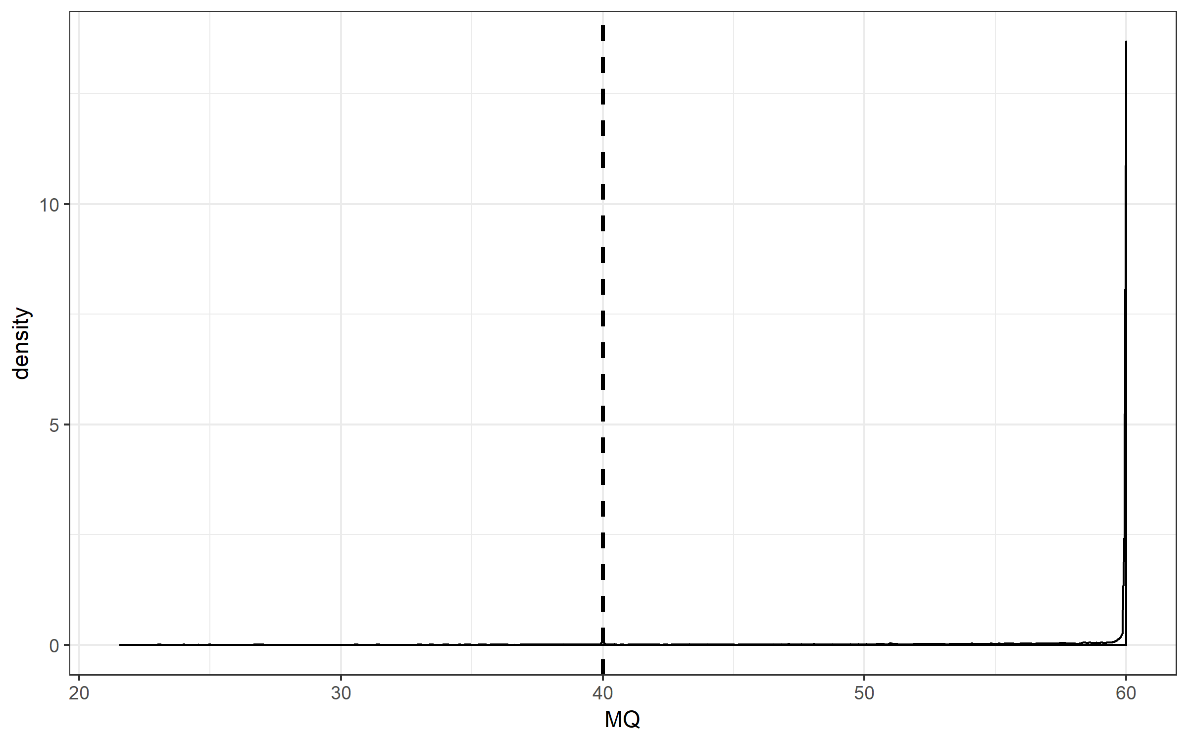
RMSMapping quality (MQ)
From GATK: “This is the root mean square mapping quality over all the reads at the site. Instead of the average mapping quality of the site, this annotation gives the square root of the average of the squares of the mapping qualities at the site.” and “When the mapping qualities are good at a site, the MQ will be around 60.”
GATK’s hard-filter suggests to remove variants with MQ < 40
15,740 out of 16,299 variants with MQ > 40

Slide 5
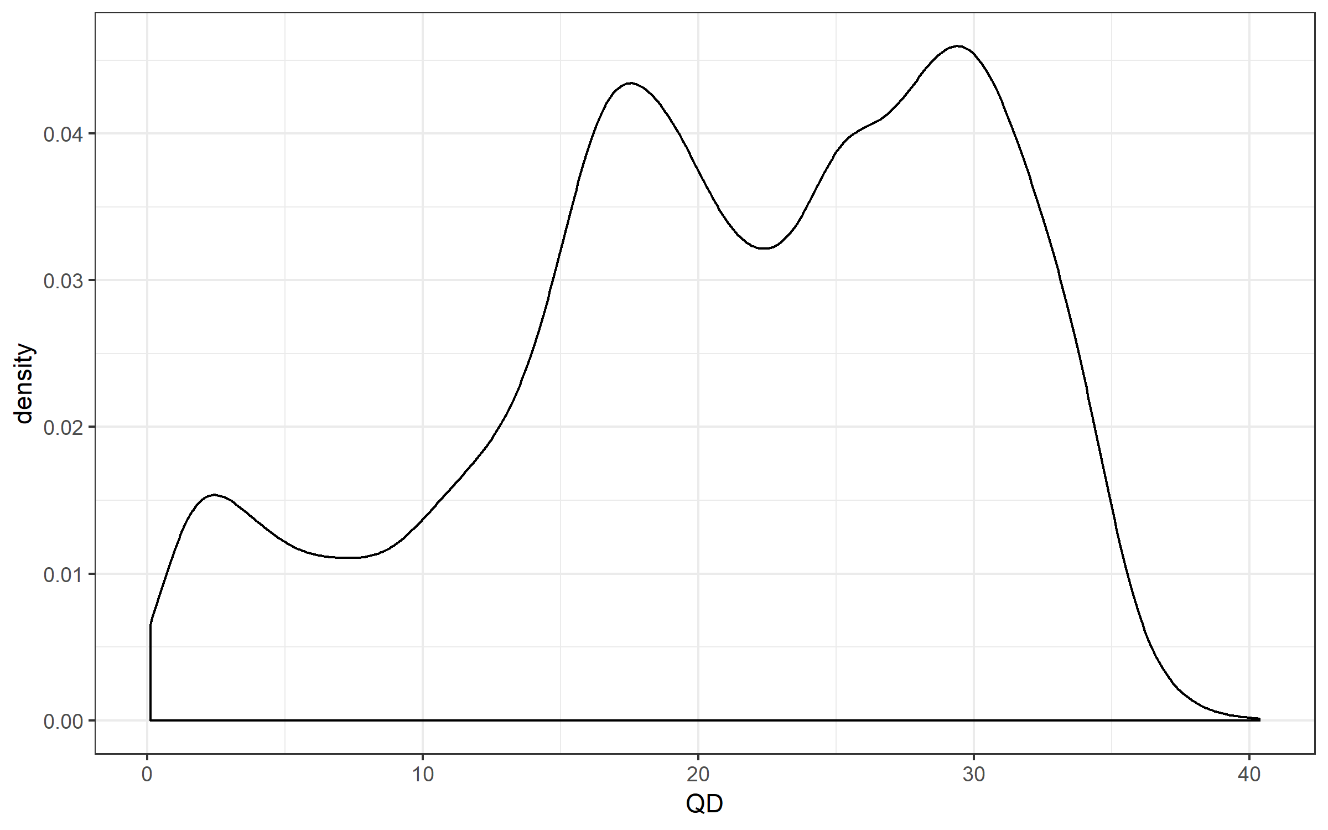
Quality by depth (QD)
This peak represents variants that are mostly heterozygous
This peak represents variants that are mostly homozygous
GATK recommends to remove this peak
Use QD threshold of 5
There are 15,152 out of 16,299 variants with QD > 5

Slide 6
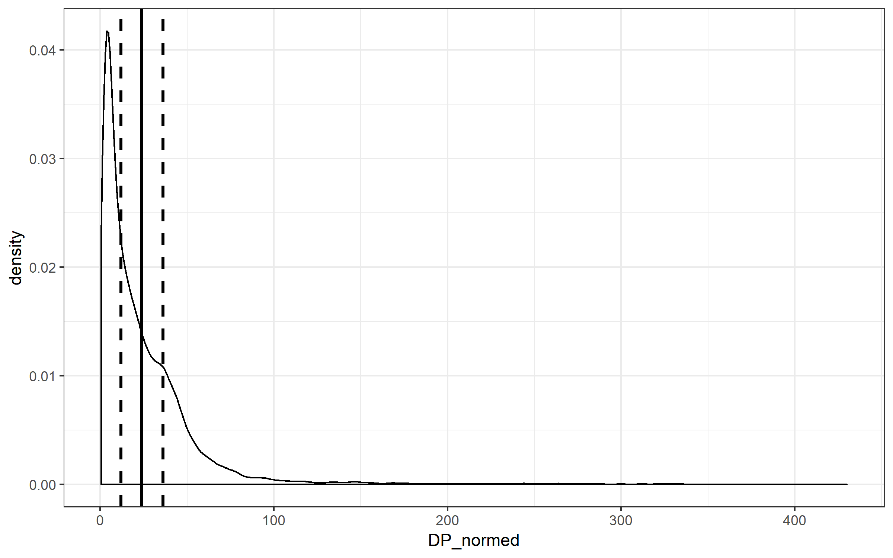
Total depth of coverage over all sample (DP)
DP from the INFO field from VCF file is summed across all samples. To get the mean, I divided DP by (AN/2) for that variant
mean = 24
150% of mean = 36
50% of mean = 12

Slide 7
Investigating DP
 | Number of variants
0-25X | 10,613
25-50X | 3,979
50-100X | 1,366
100-150X | 185
150-200X | 63
200-250X | 43
250-300X | 32
300-350X | 15
350-400X | 2
>400X | 1

