Slide 1
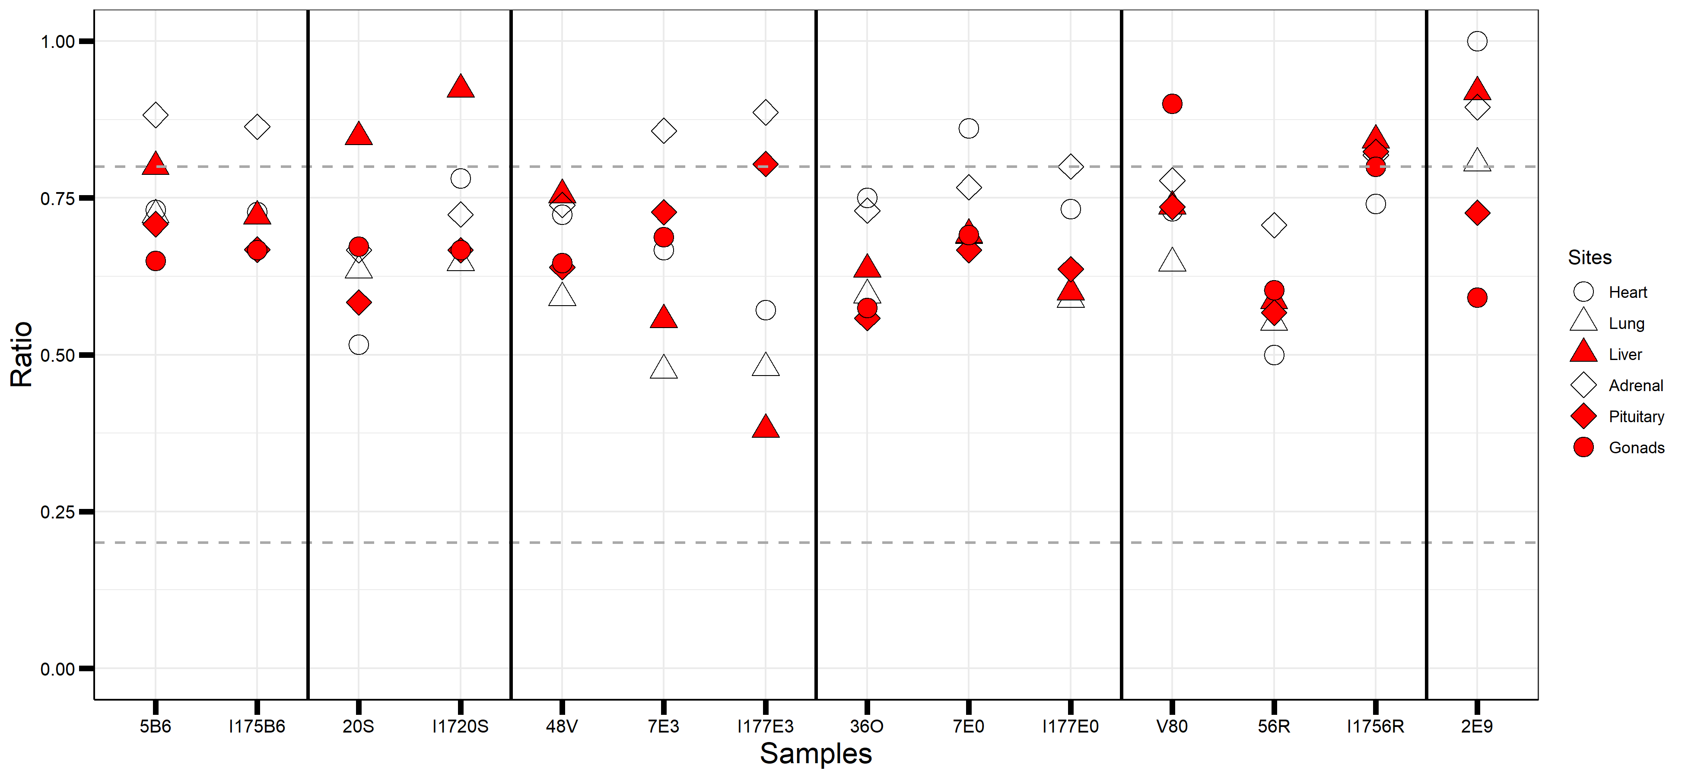
M
D
M
D
GM
M
D
GM
M
D
GM
M
D

