Slide 1
Hard-filter of GTEx WES on chrX and chr8

Slide 2
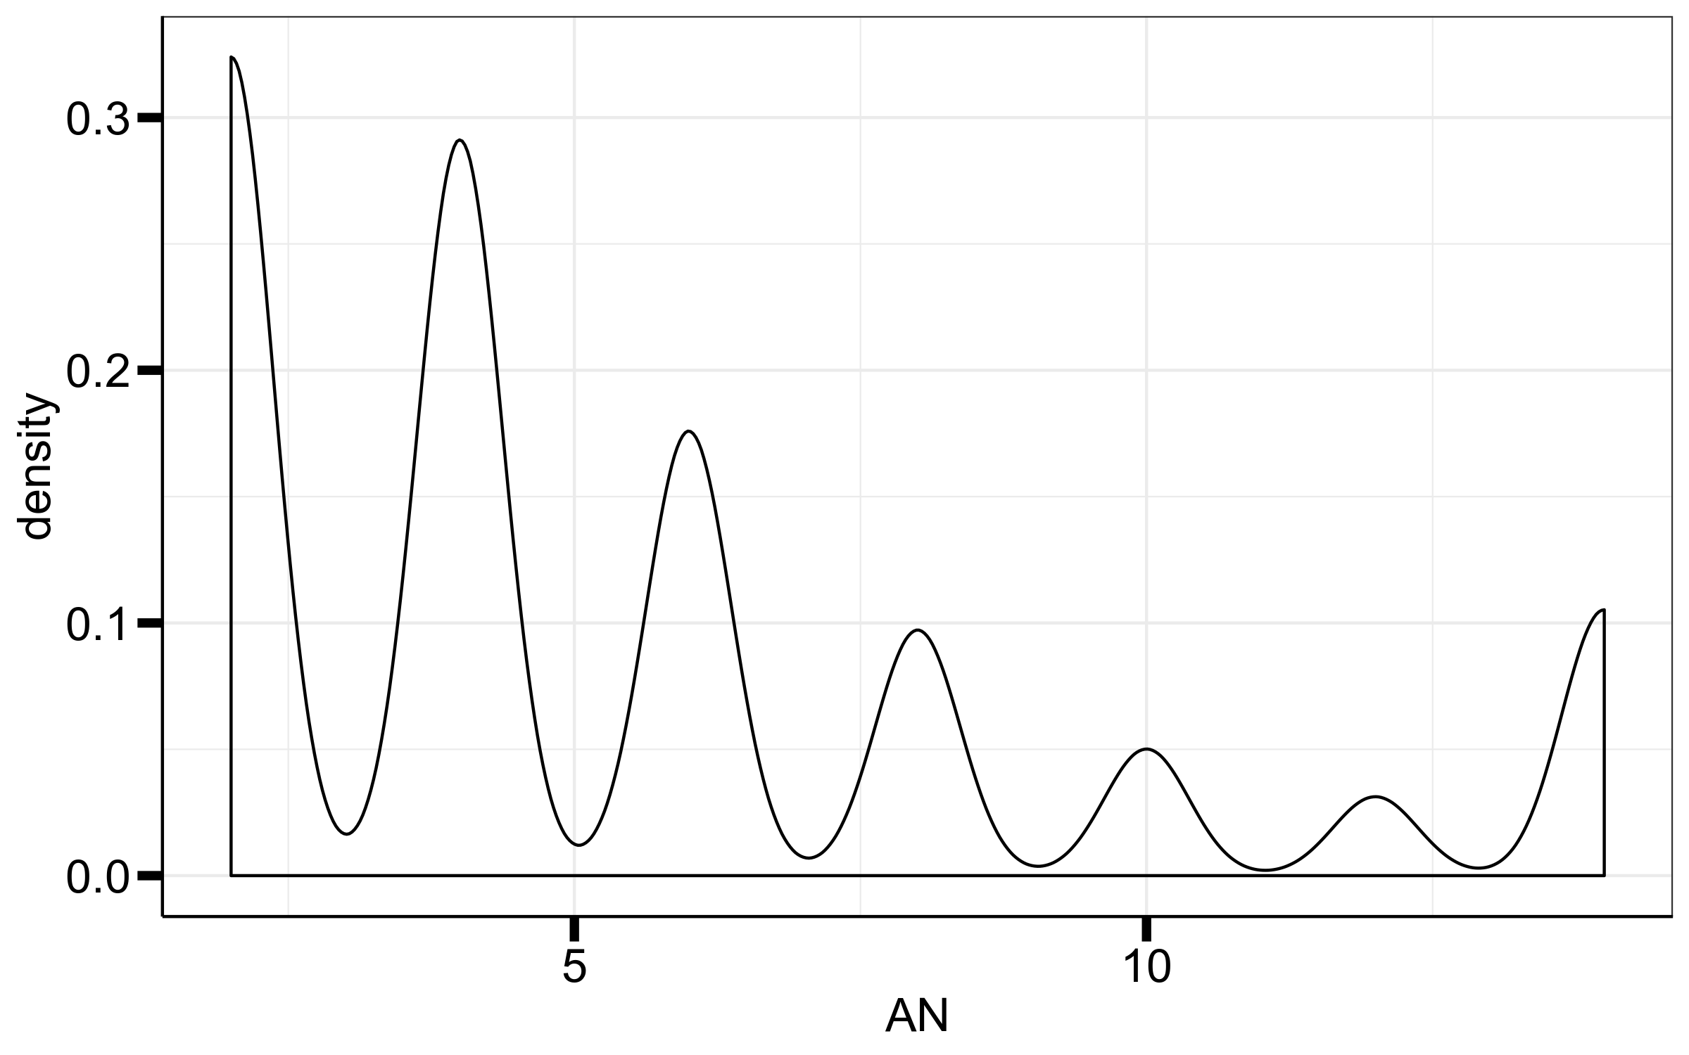
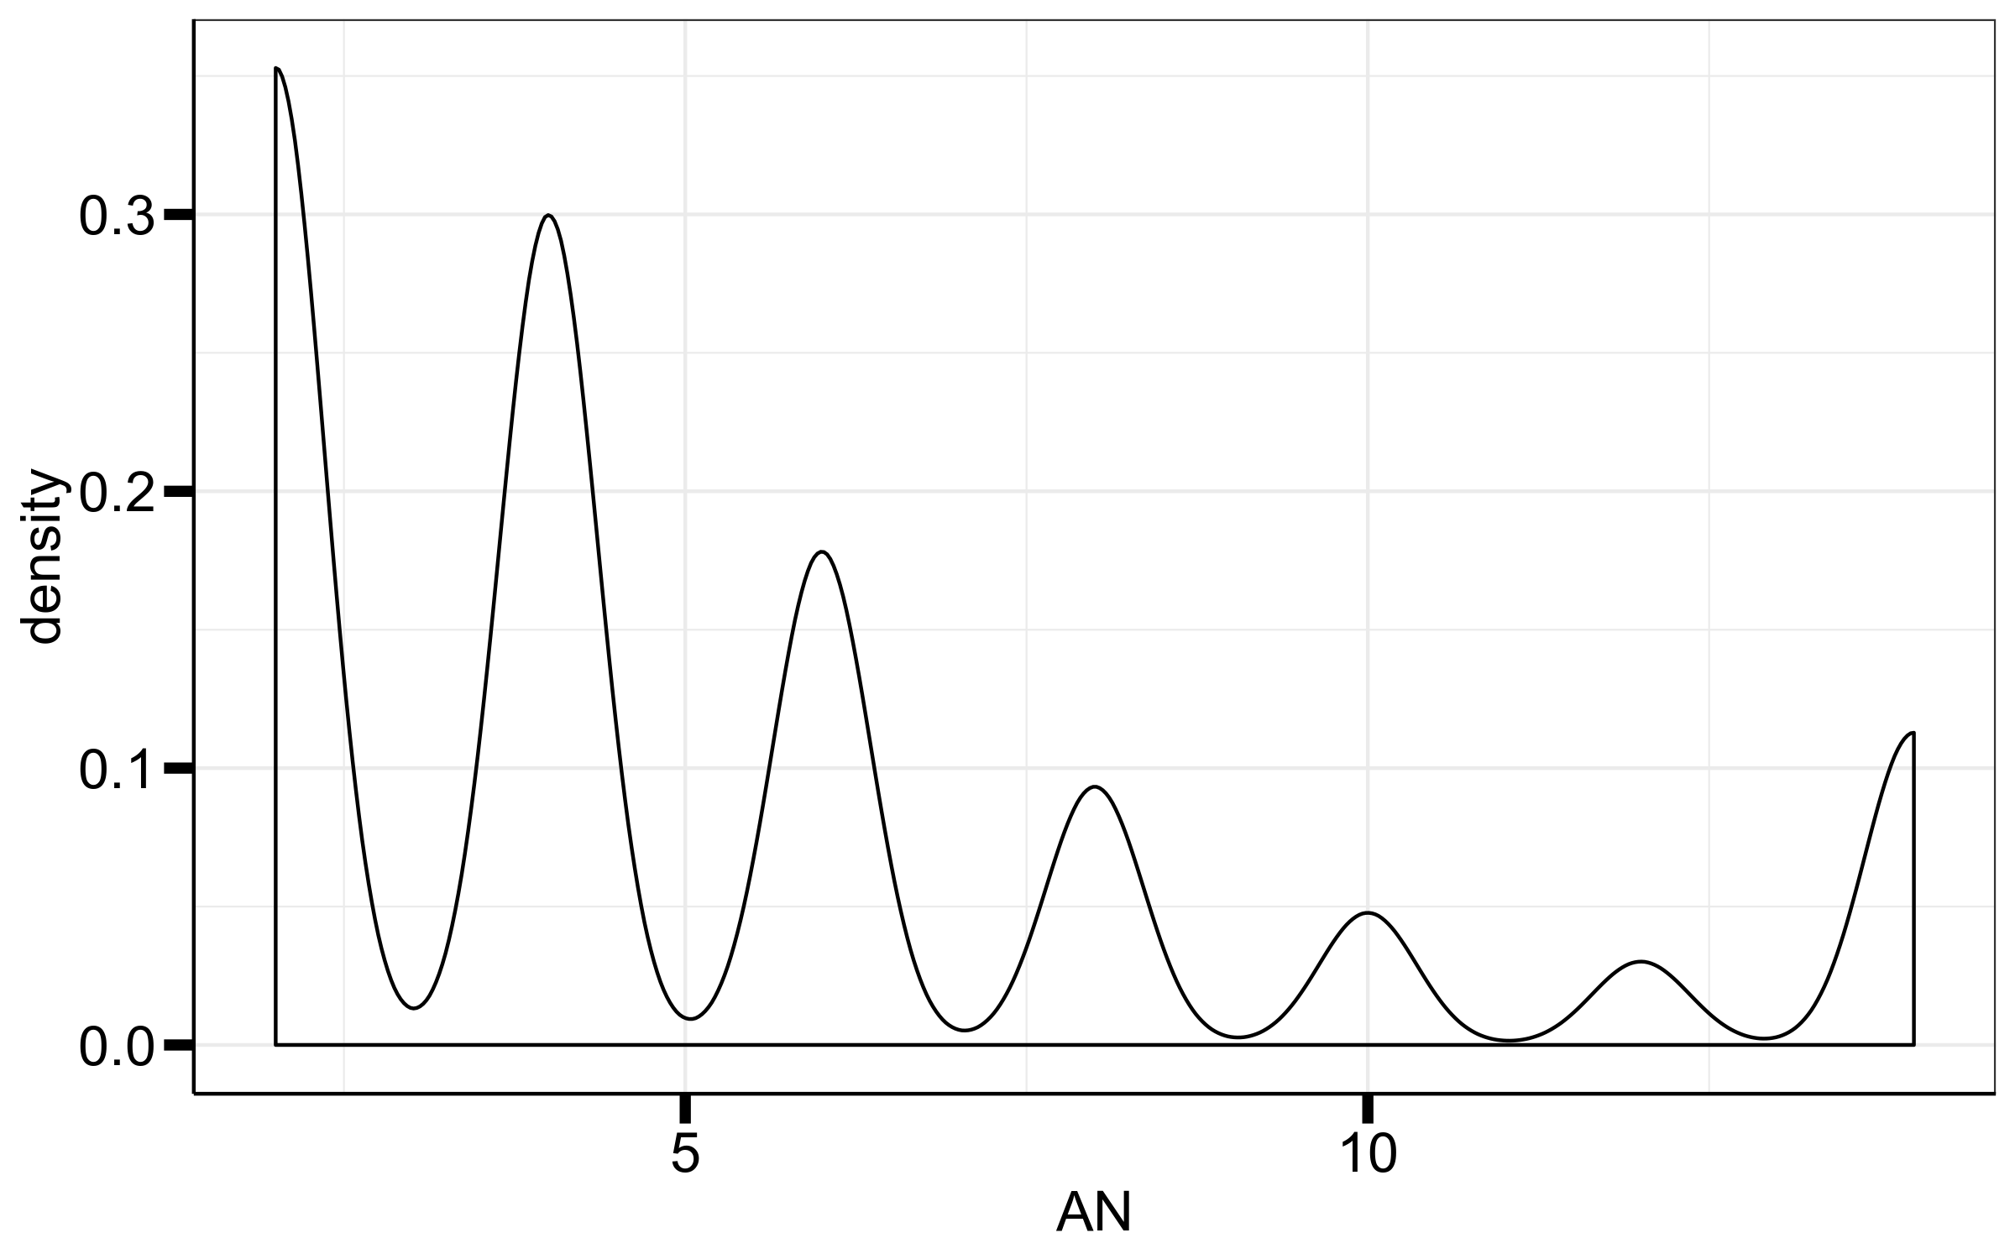
AN
chrX
chr8
Keep variants where AN ≥ 4

Slide 3
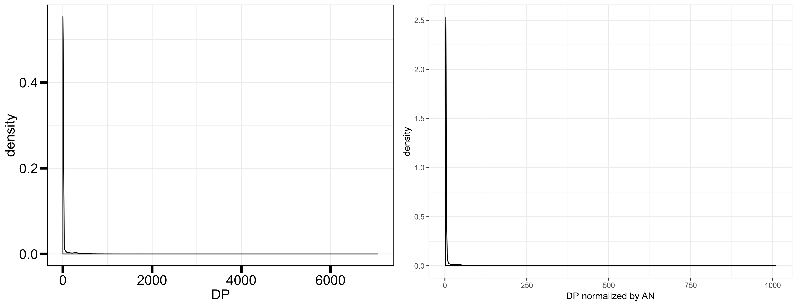
DP chrX
Keep variants where DP ≤ 1000

Slide 4
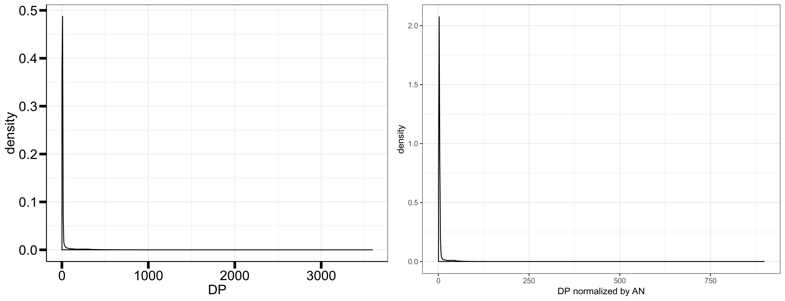
DP chr8
Keep variants where DP ≤ 1000

Slide 5
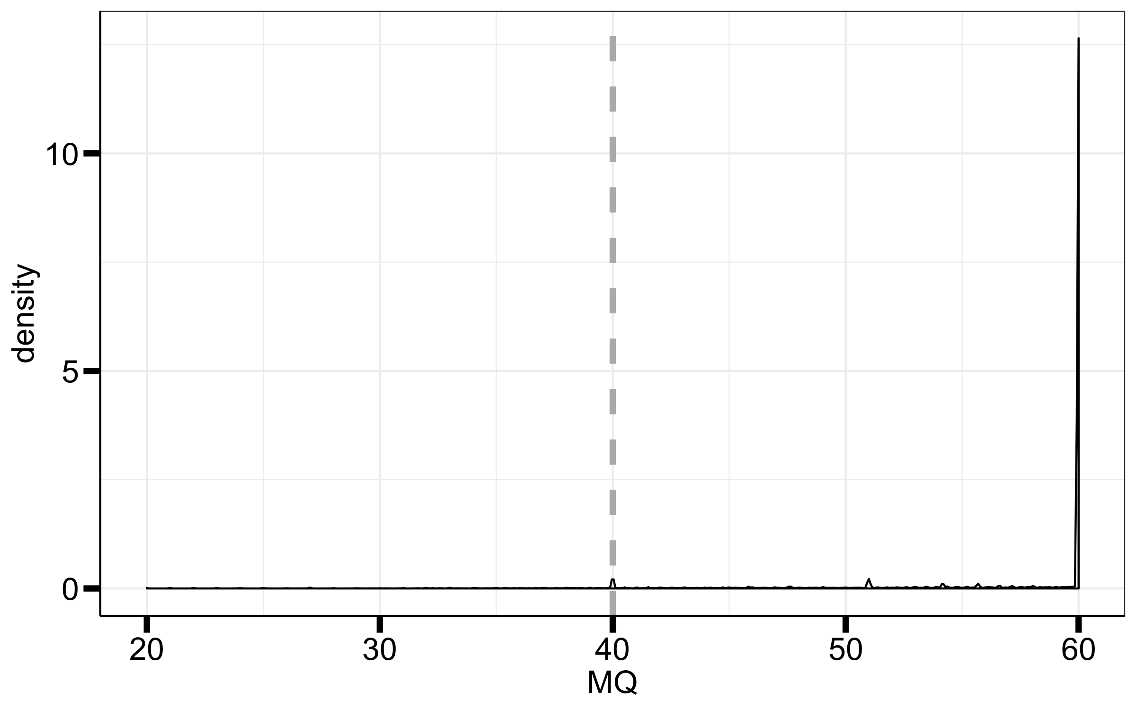
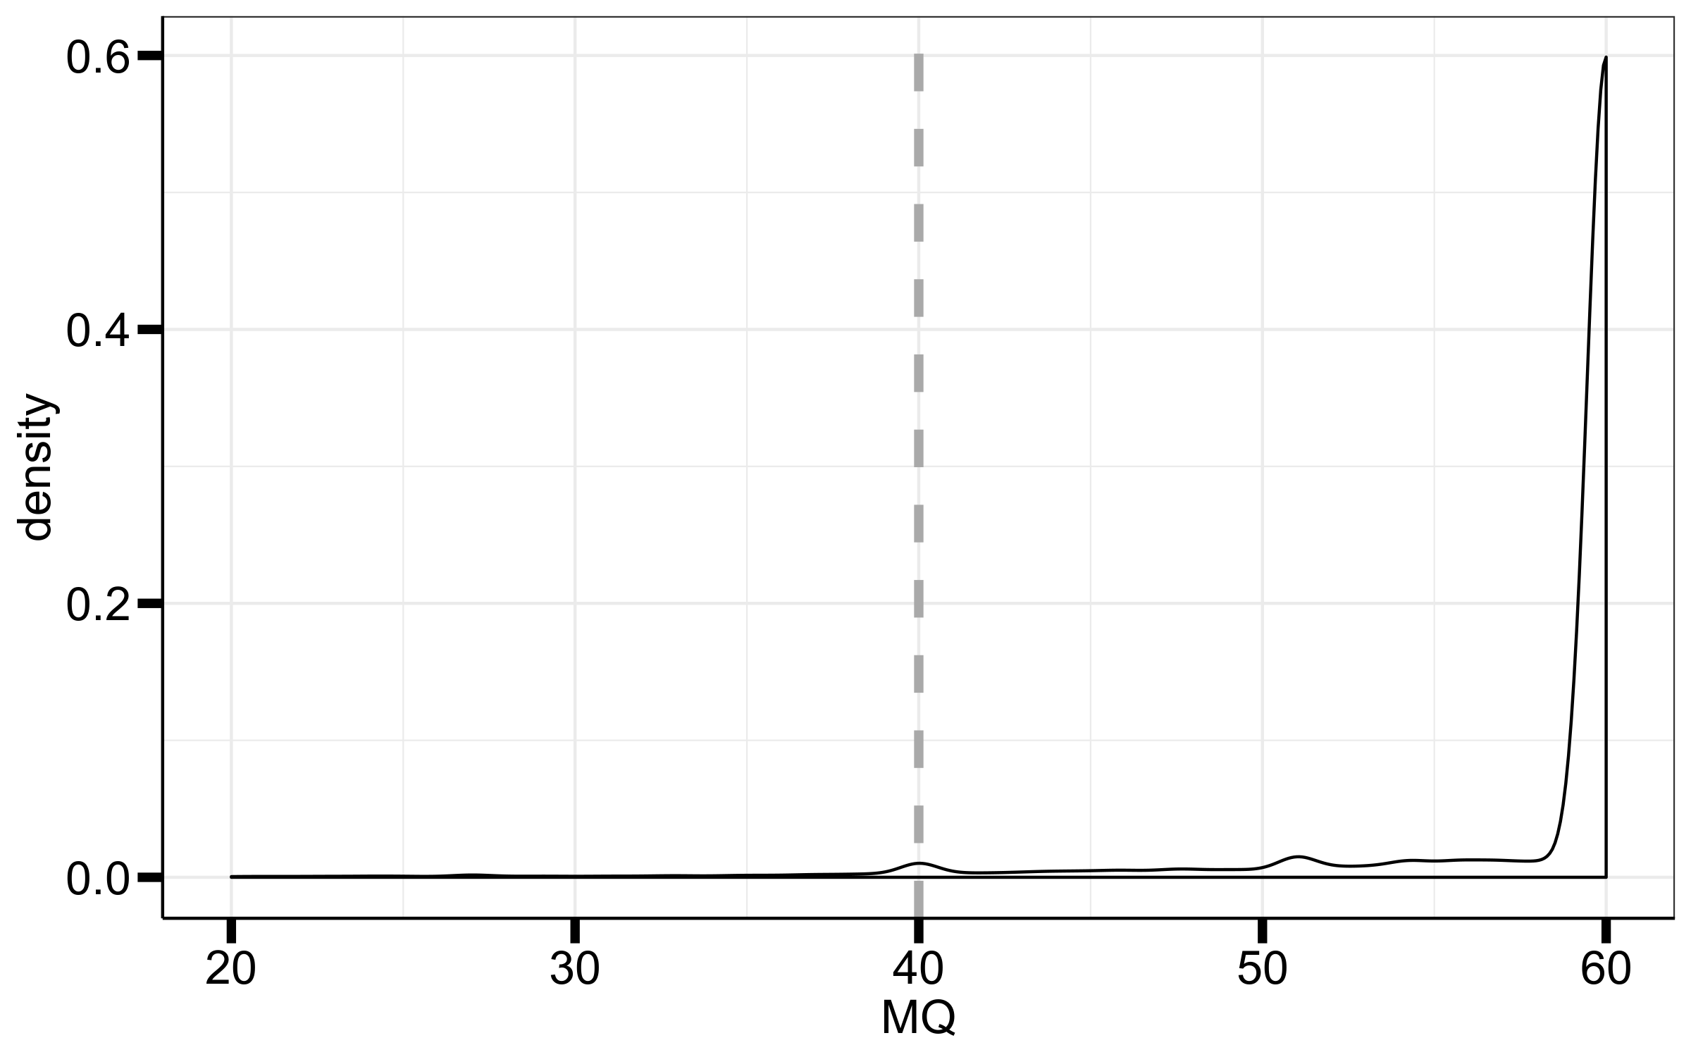
MQ
chrX
chr8
Keep variants where MQ ≥ 55

Slide 6
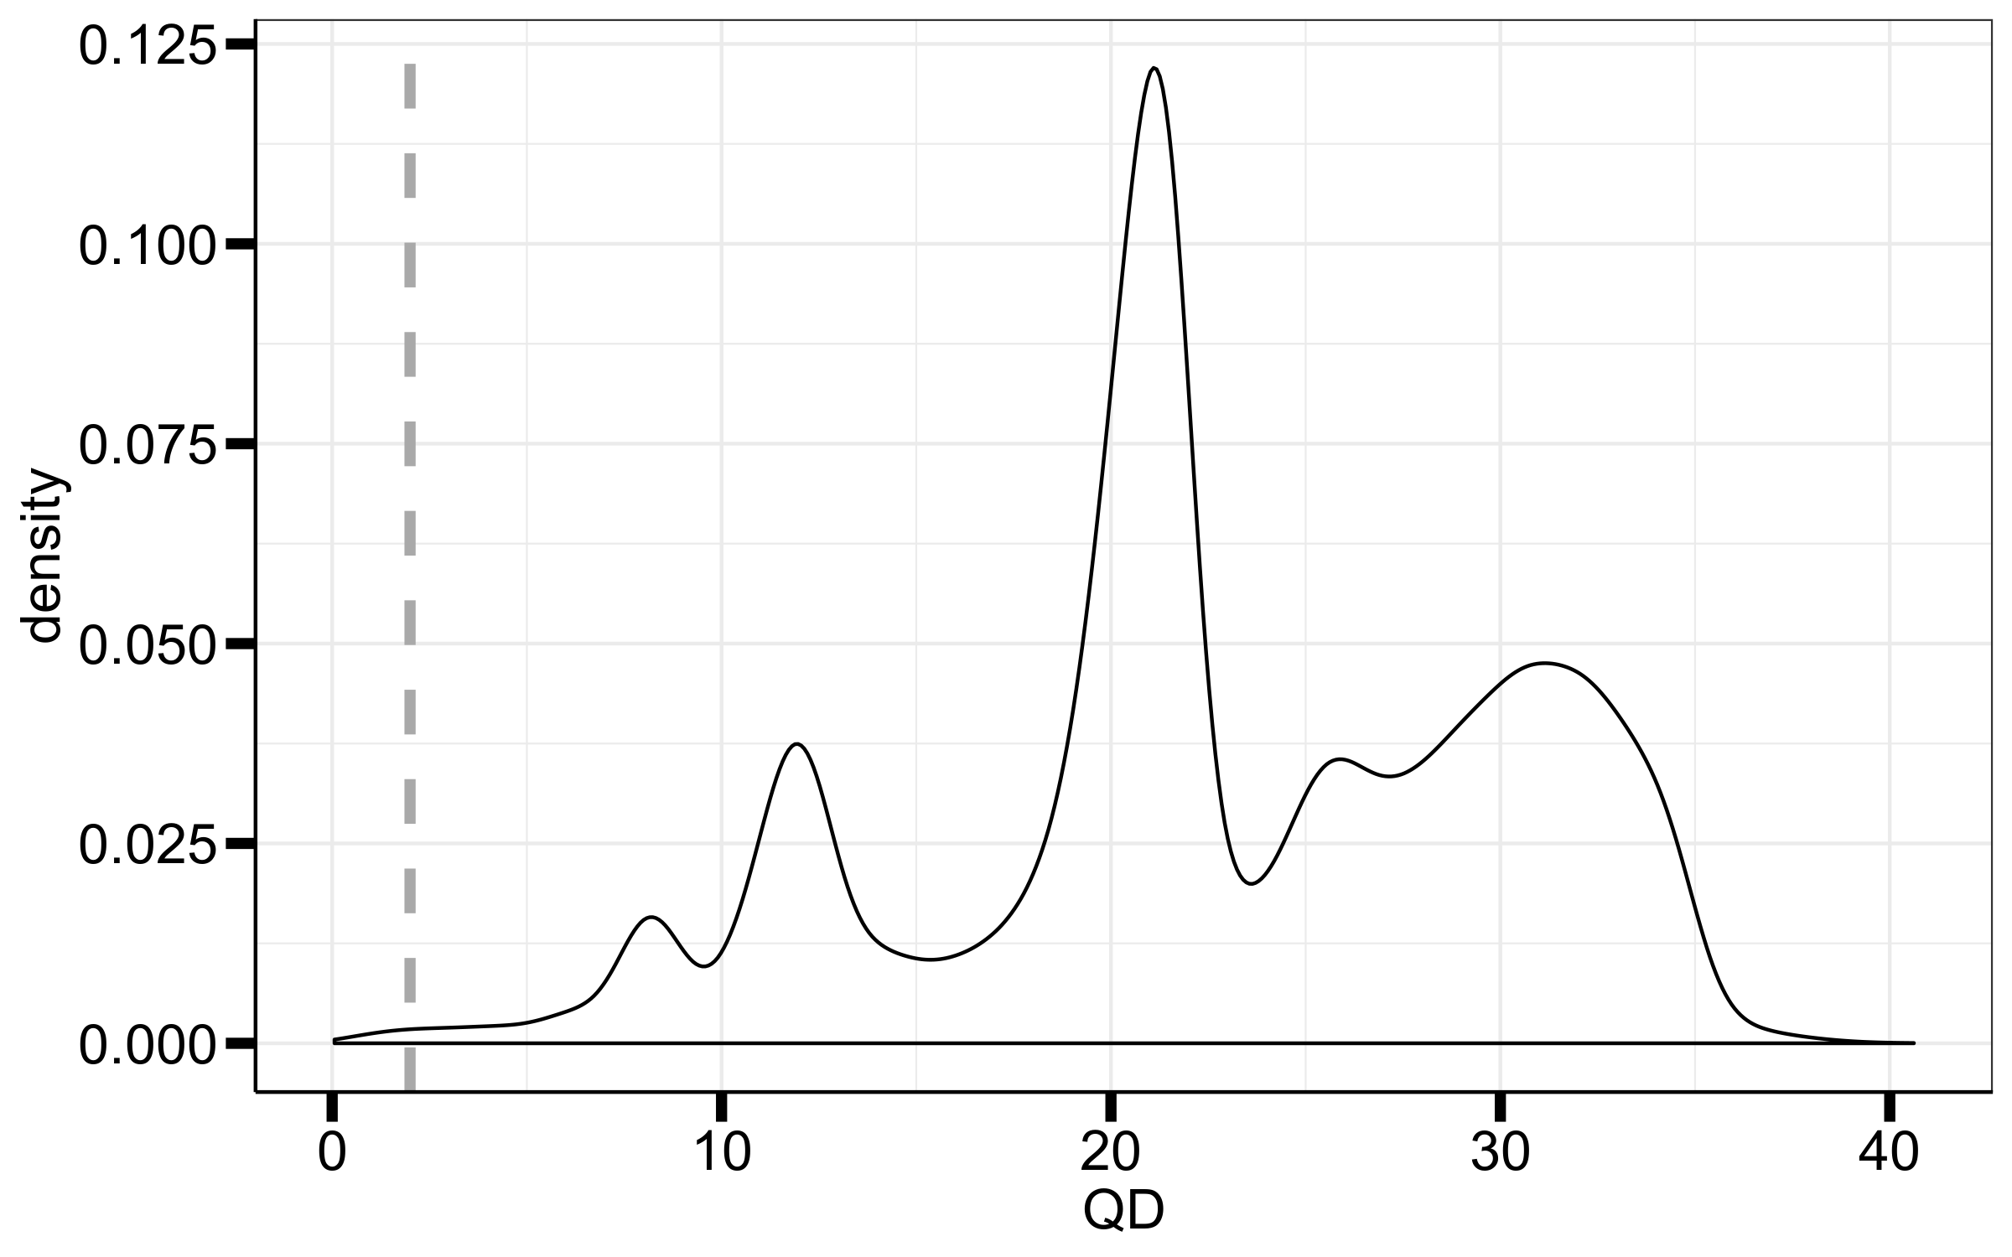
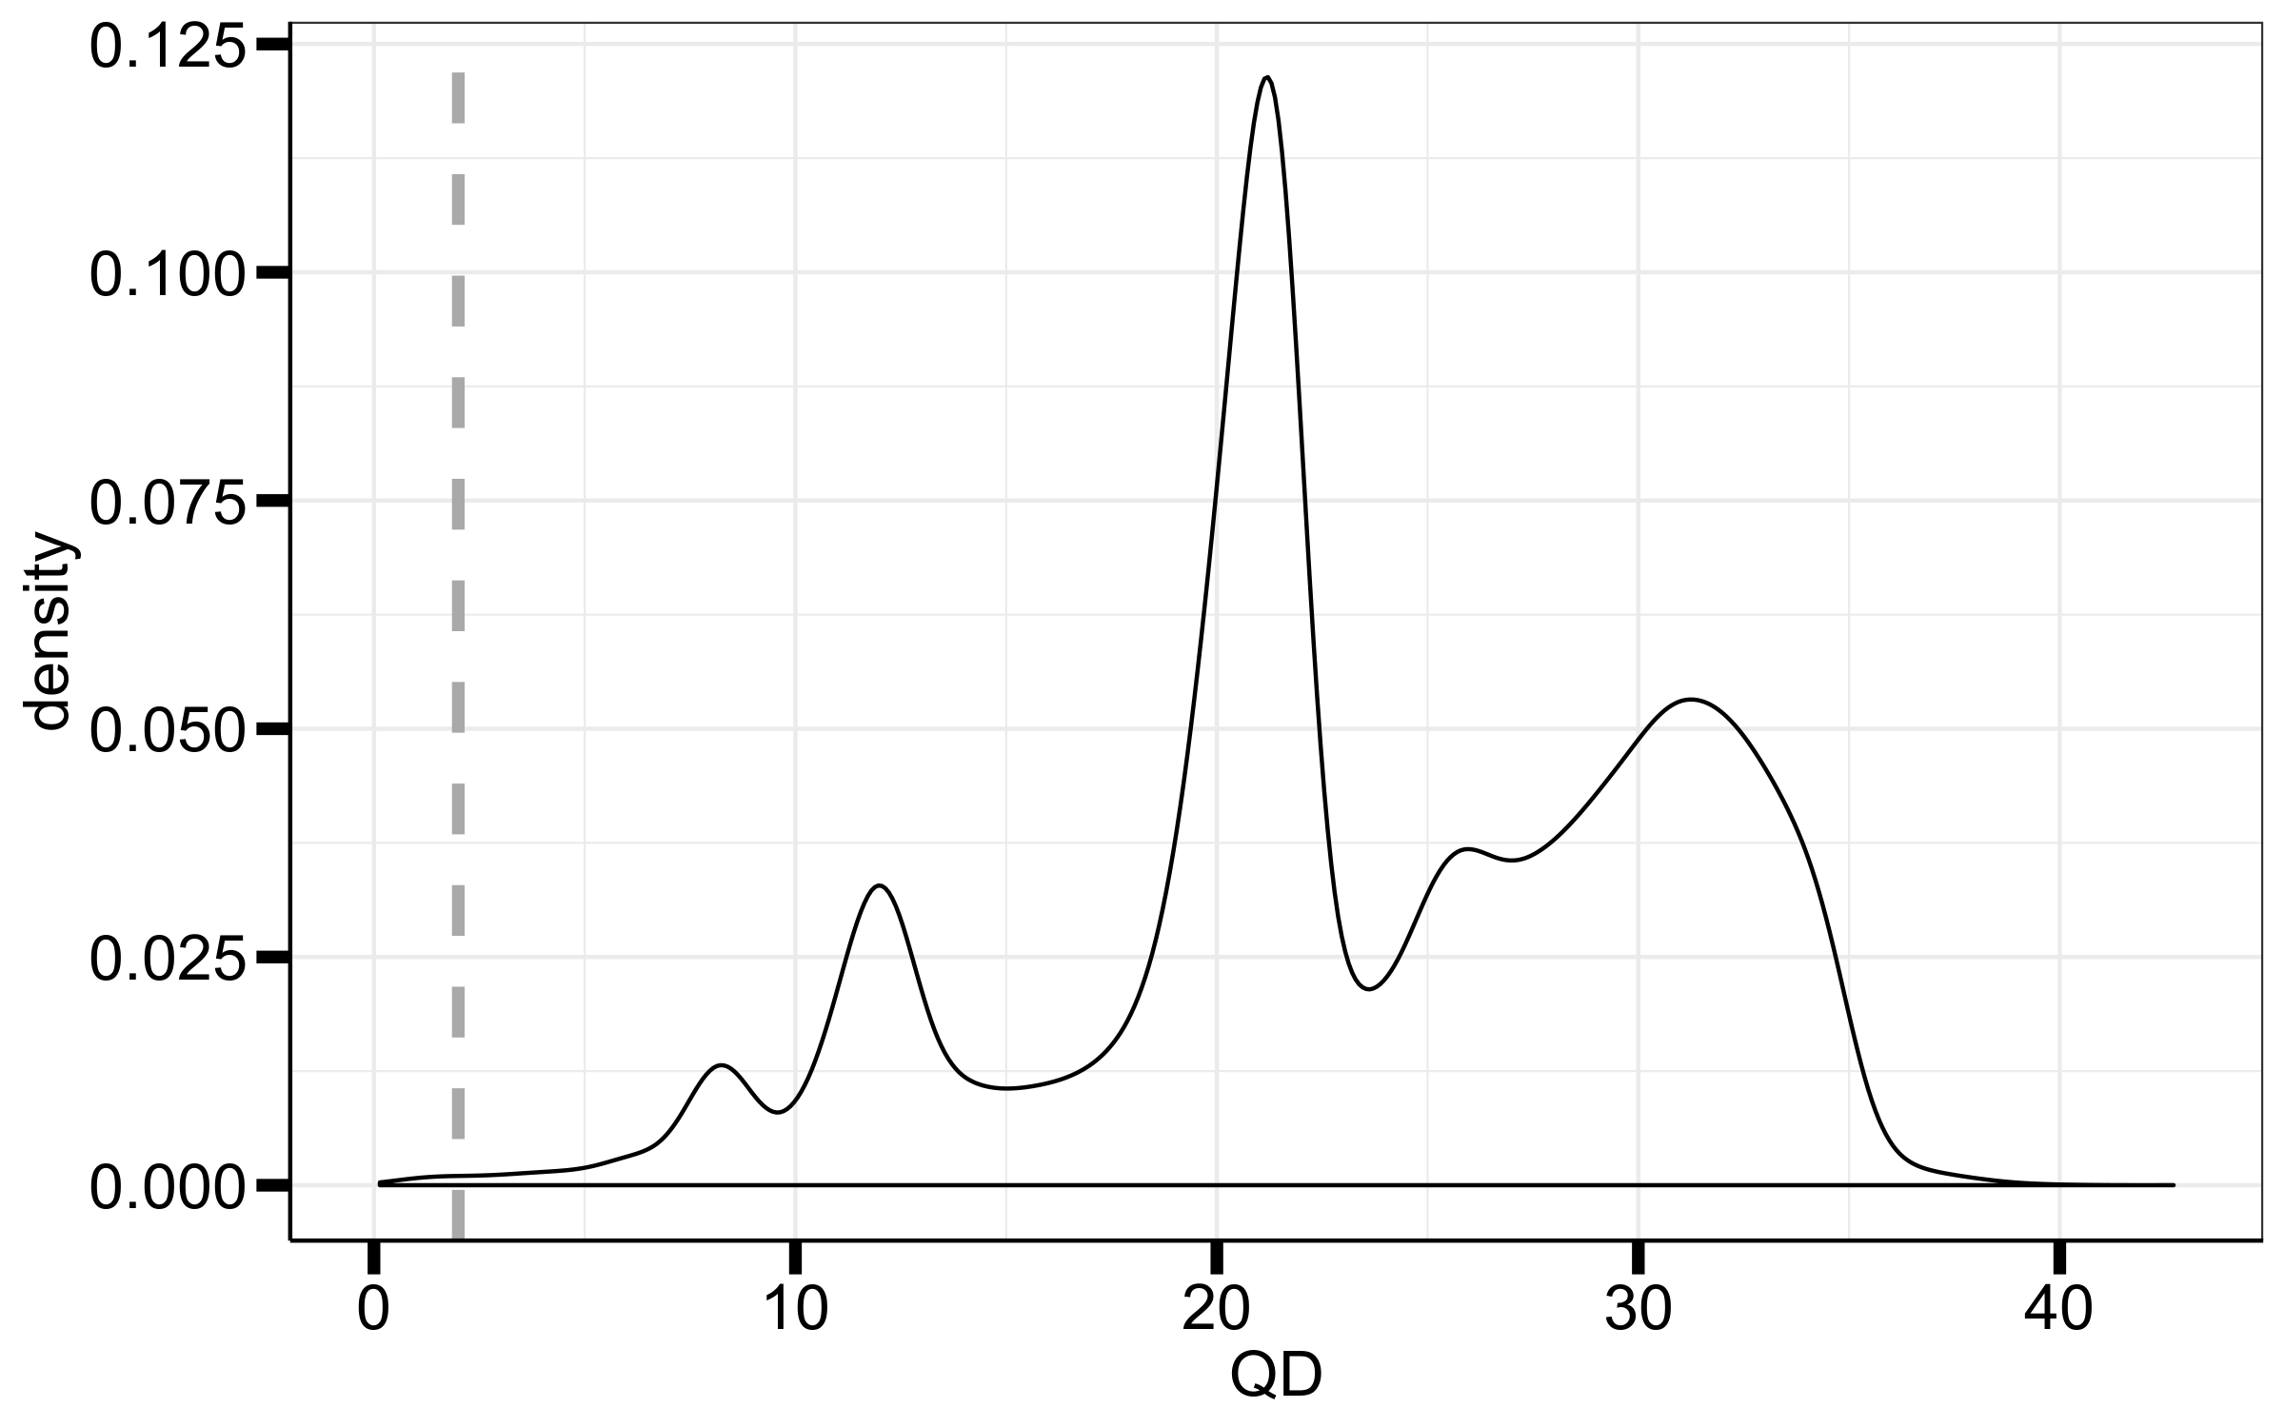
QD
chrX
chr8
I think all of this is bad quality
Keep variants where QD ≥ 15

