Slide 1
Hard-filter of GTEx WES on chrX and chr8

Slide 2
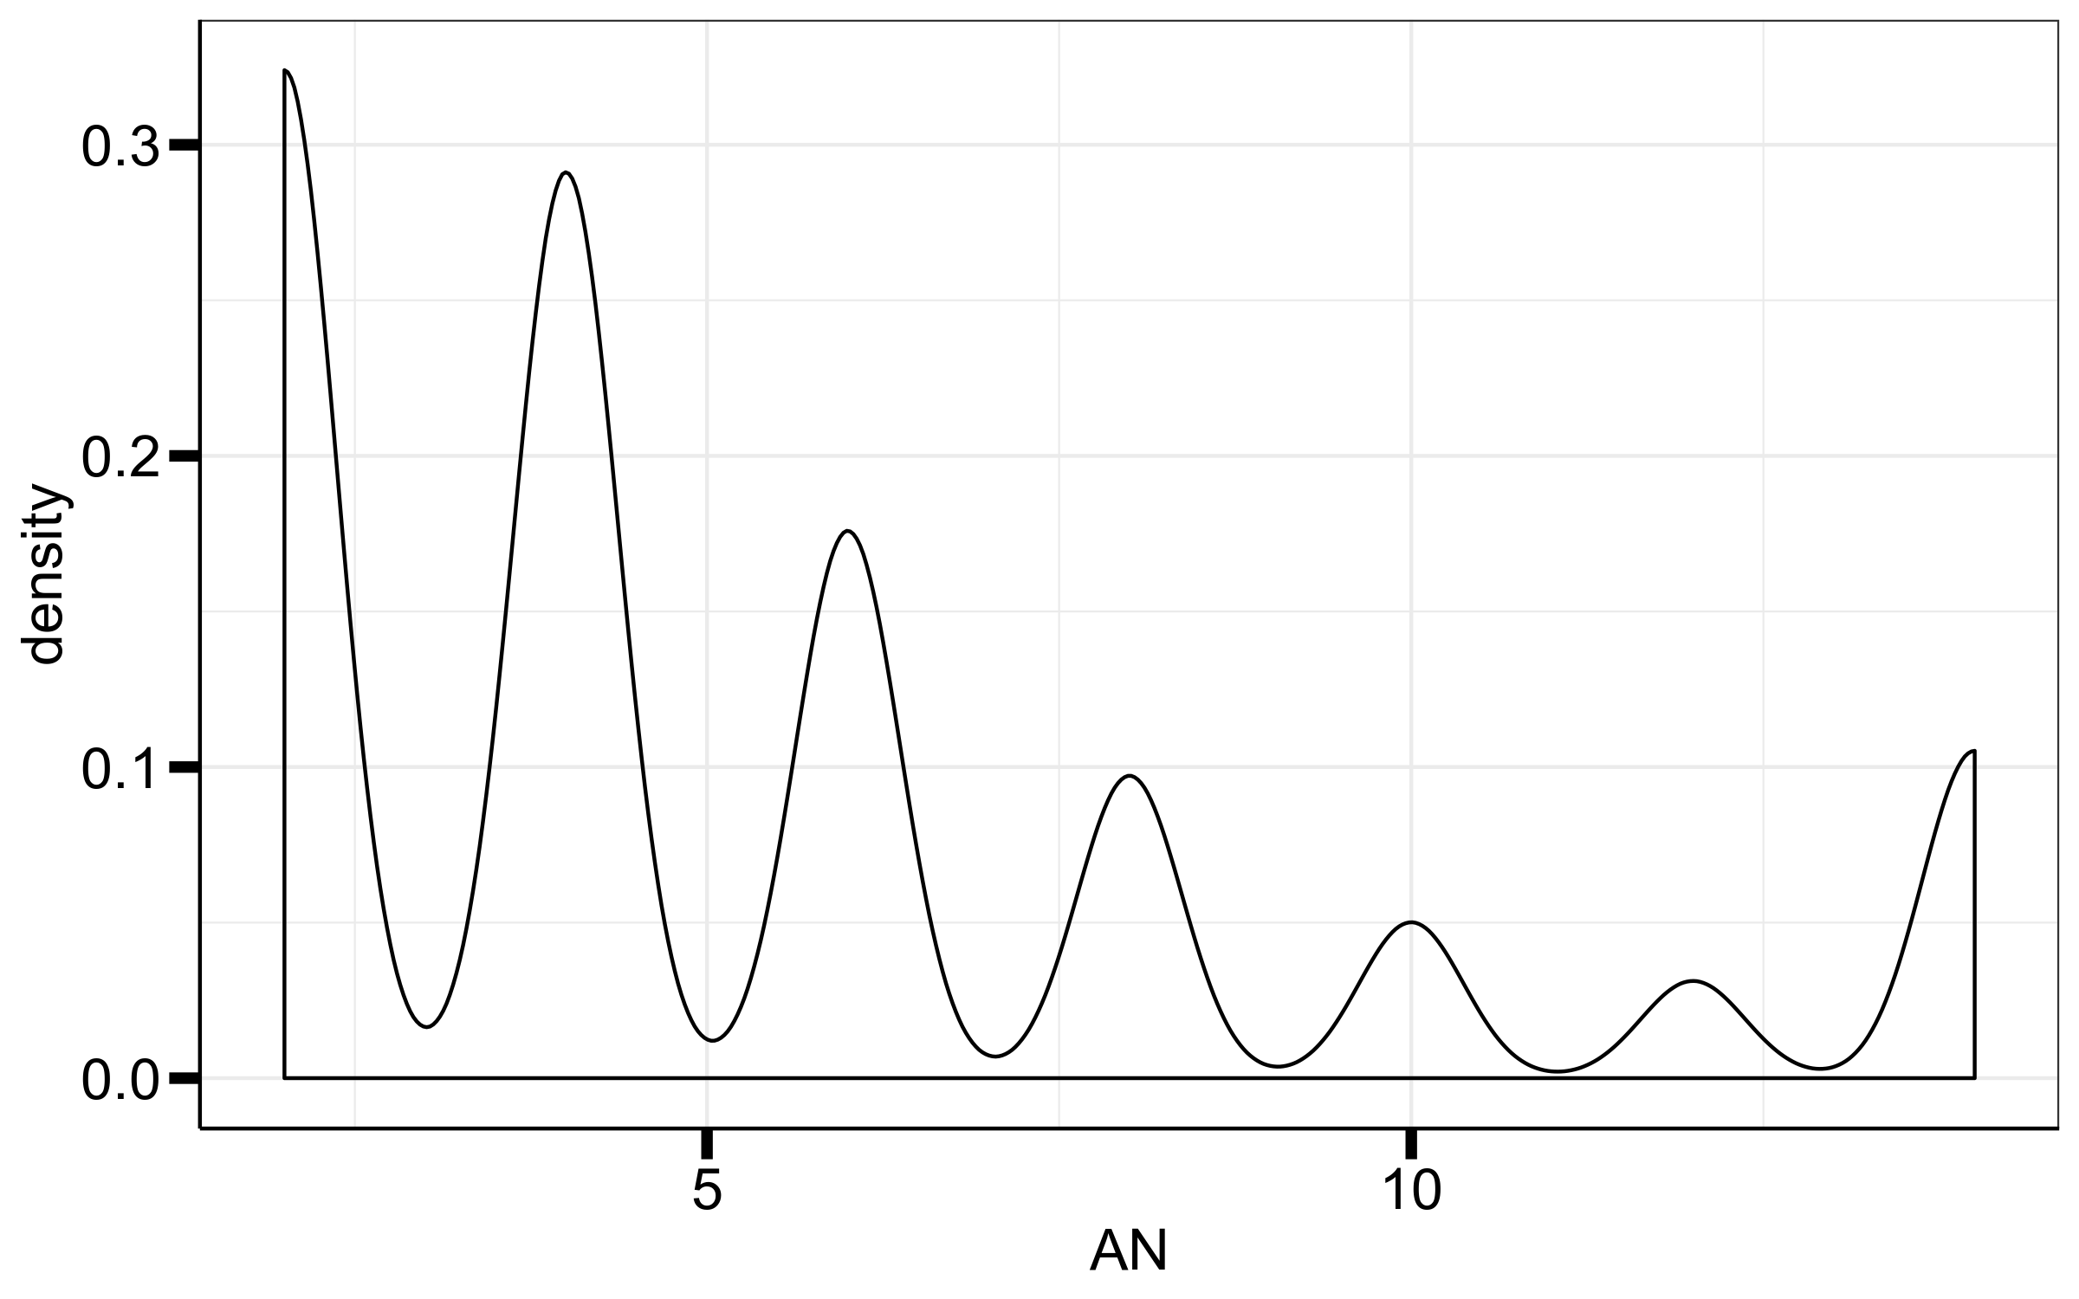
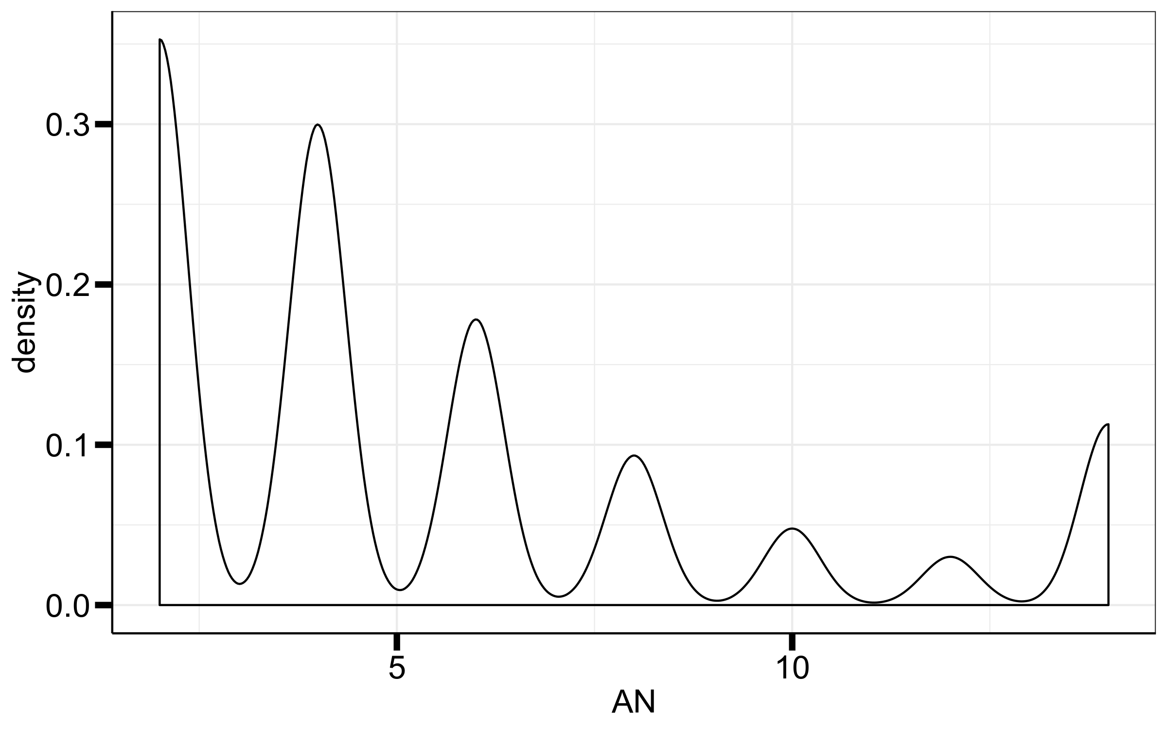
AN
chrX
chr8
Keep variants where AN ≥ 4

Slide 3
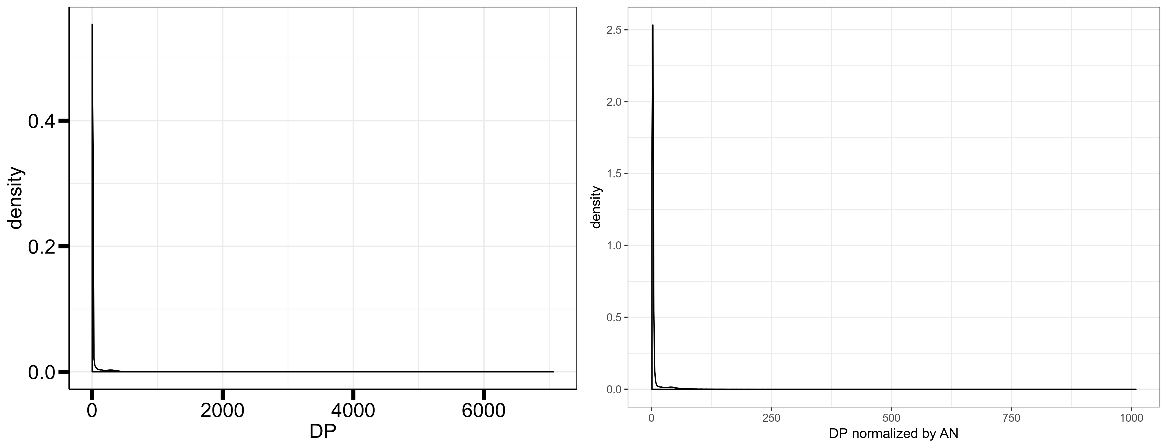
DP chrX
Keep variants where DP ≤ 1000

Slide 4
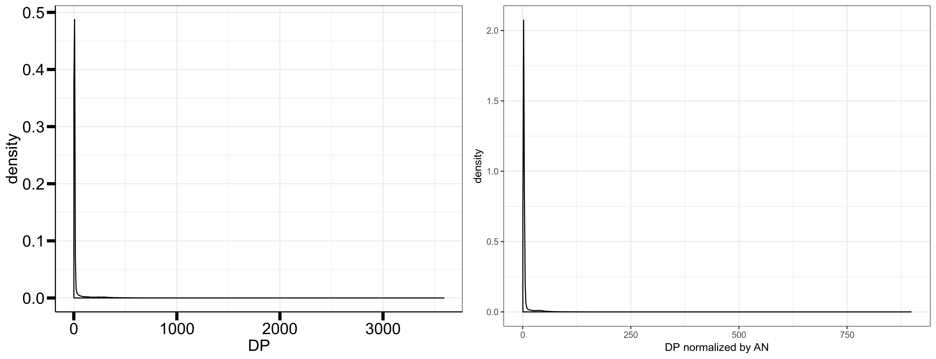
DP chr8
Keep variants where DP ≤ 1000

Slide 5
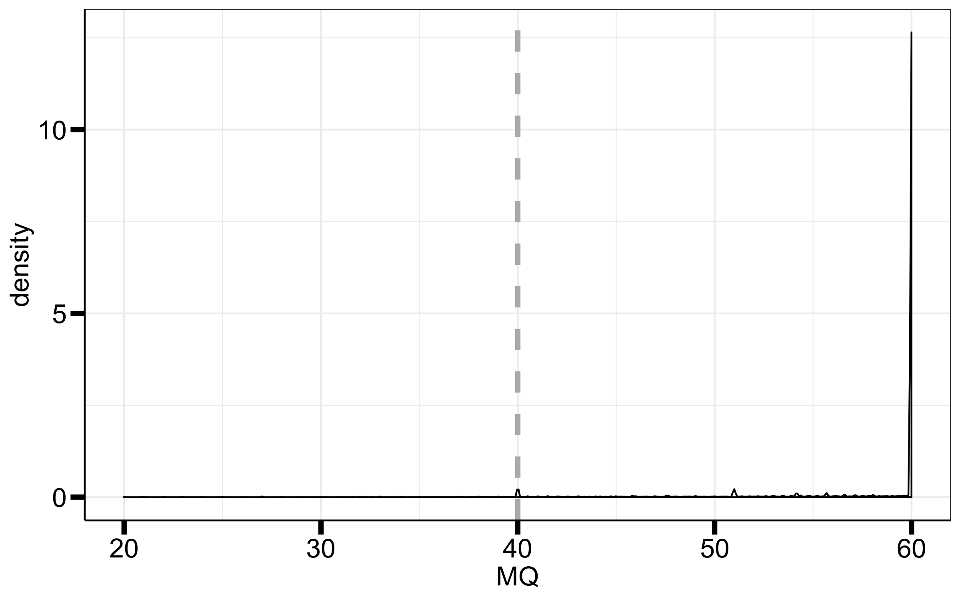
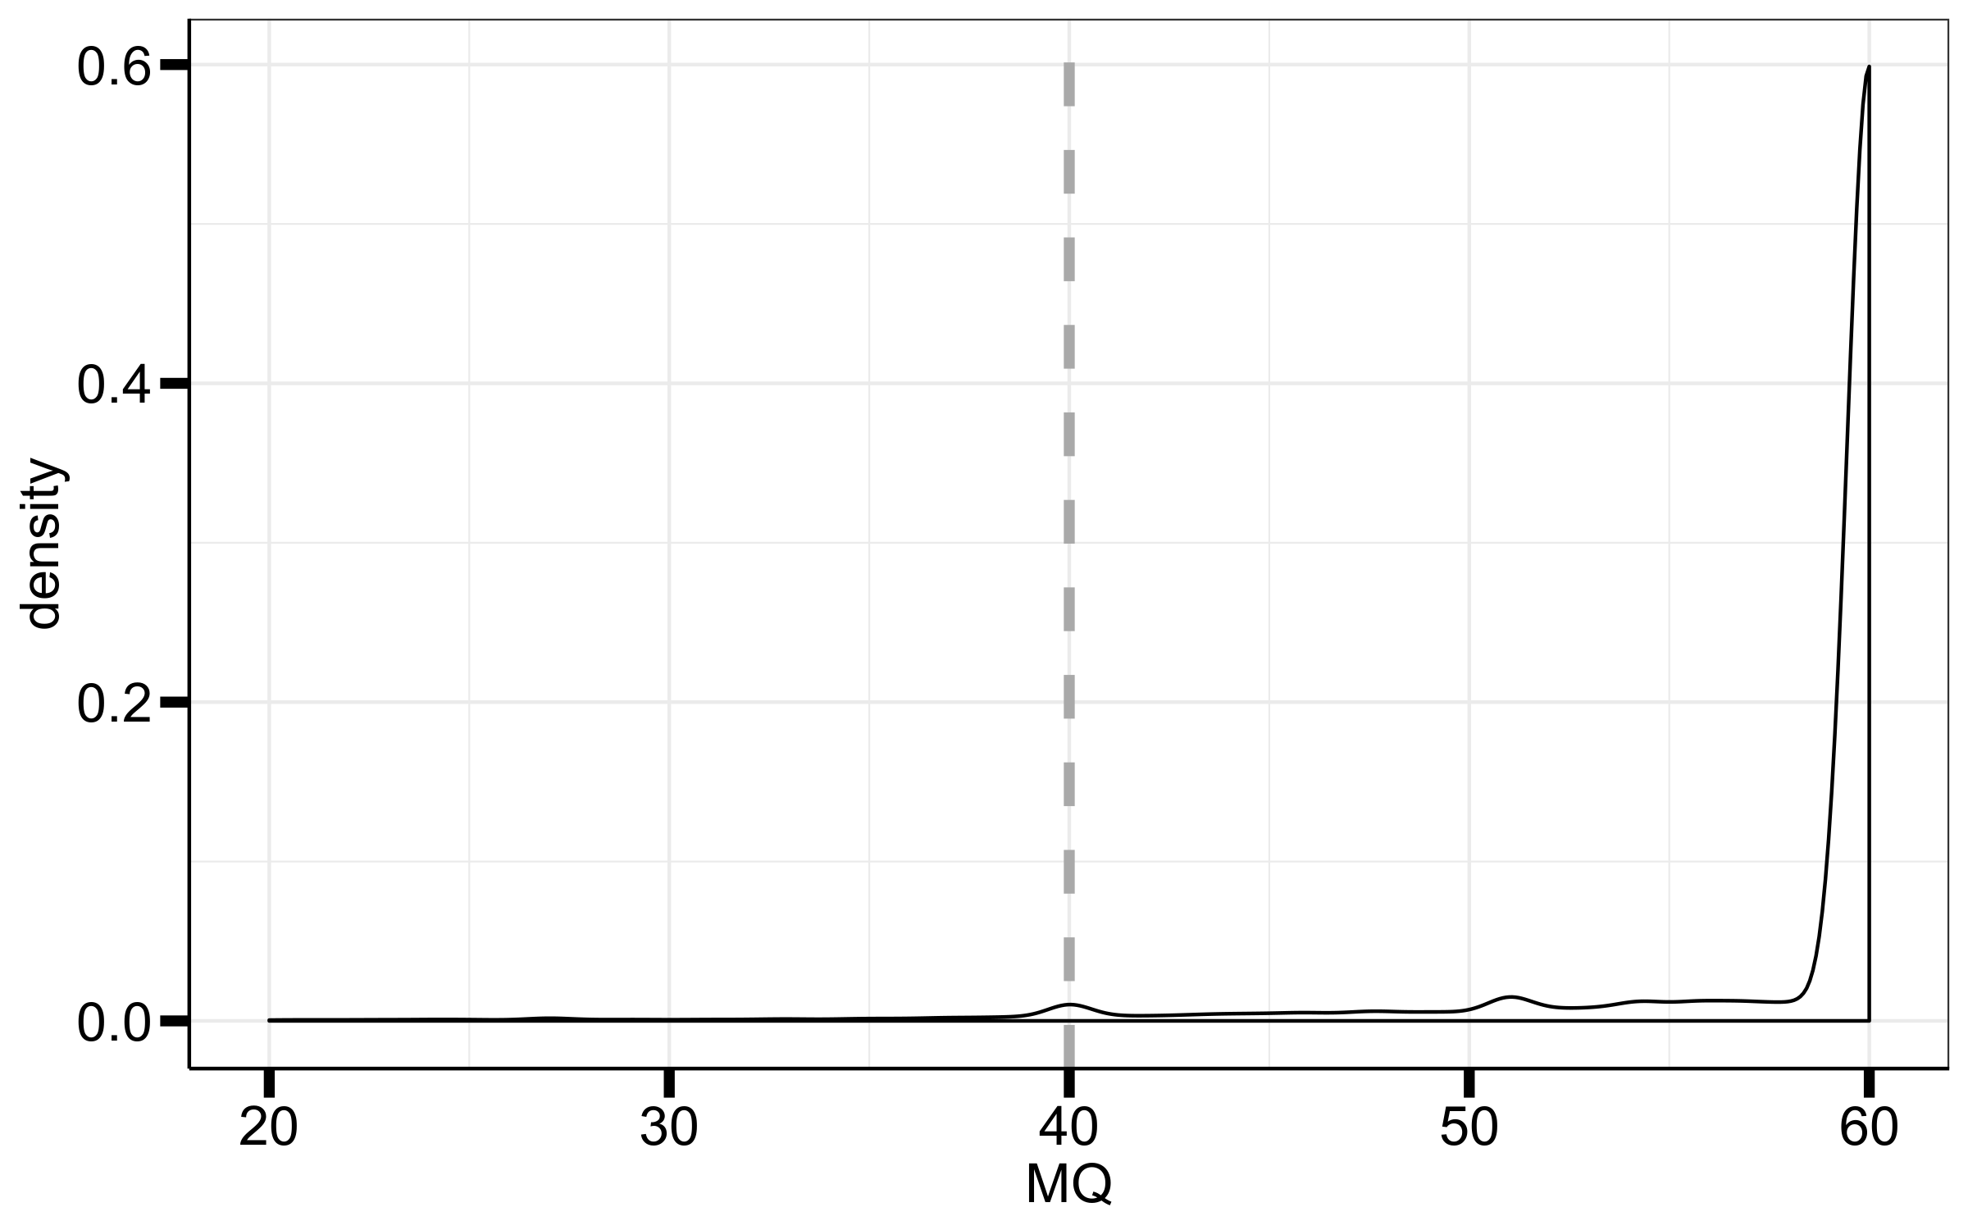
MQ
chrX
chr8
Keep variants where MQ ≥ 55

Slide 6
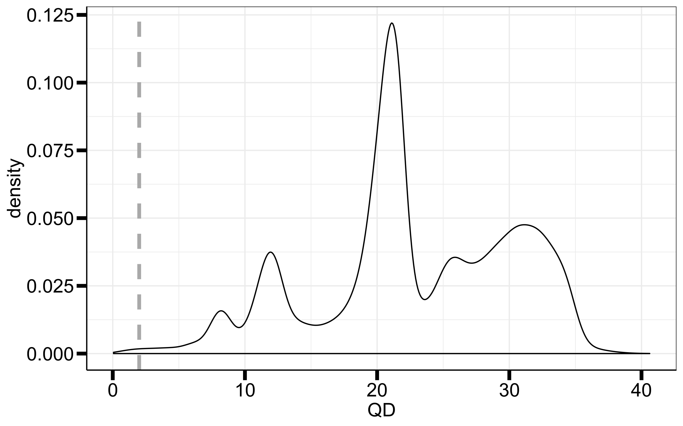
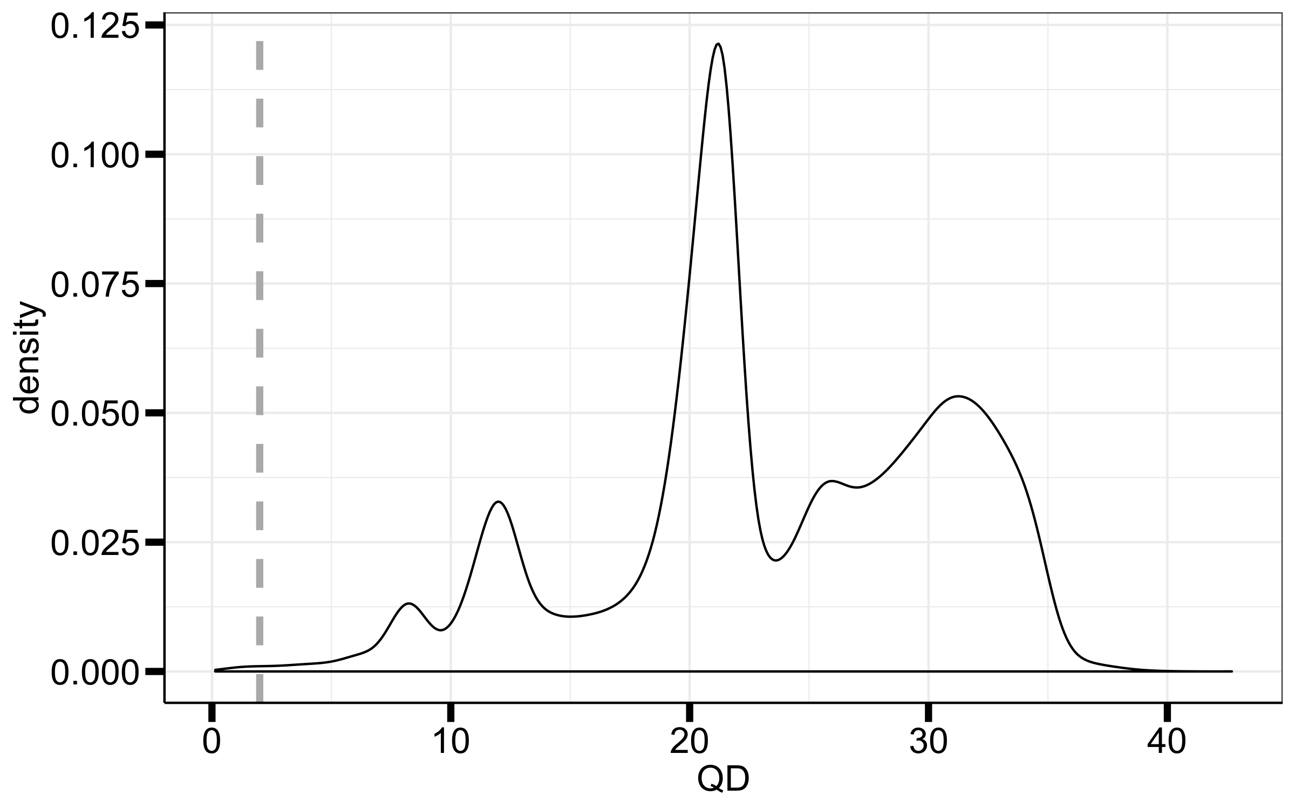
QD
chrX
chr8
I think all of this is bad quality
Keep variants where QD ≥ 15

Slide 7
Before phasing X chromosome

Slide 8
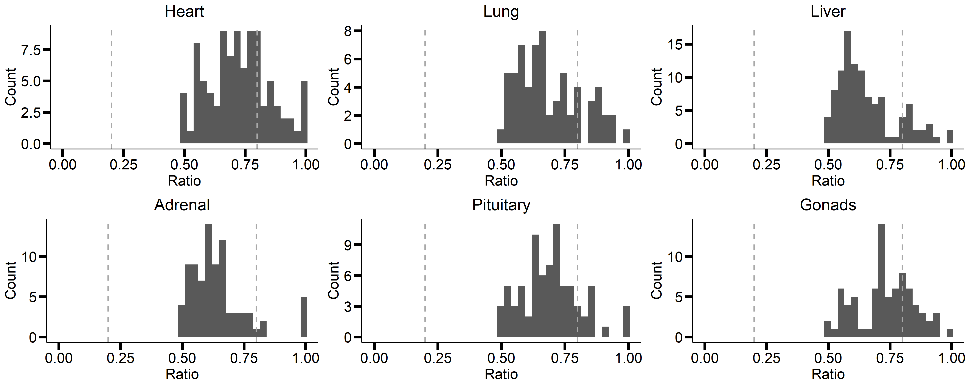
GTEX-1A8FM-0004

Slide 9
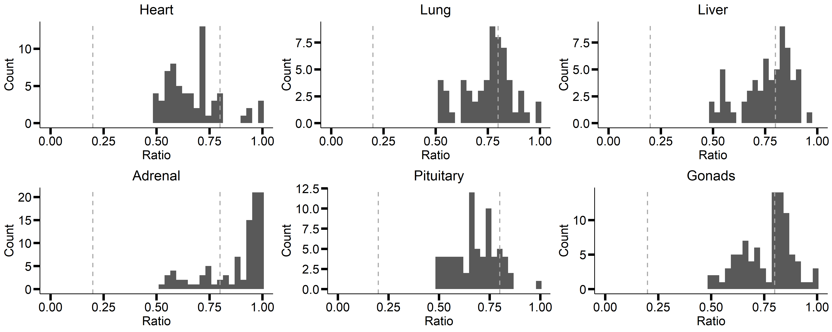
GTEX-1A32A-0001

Slide 10
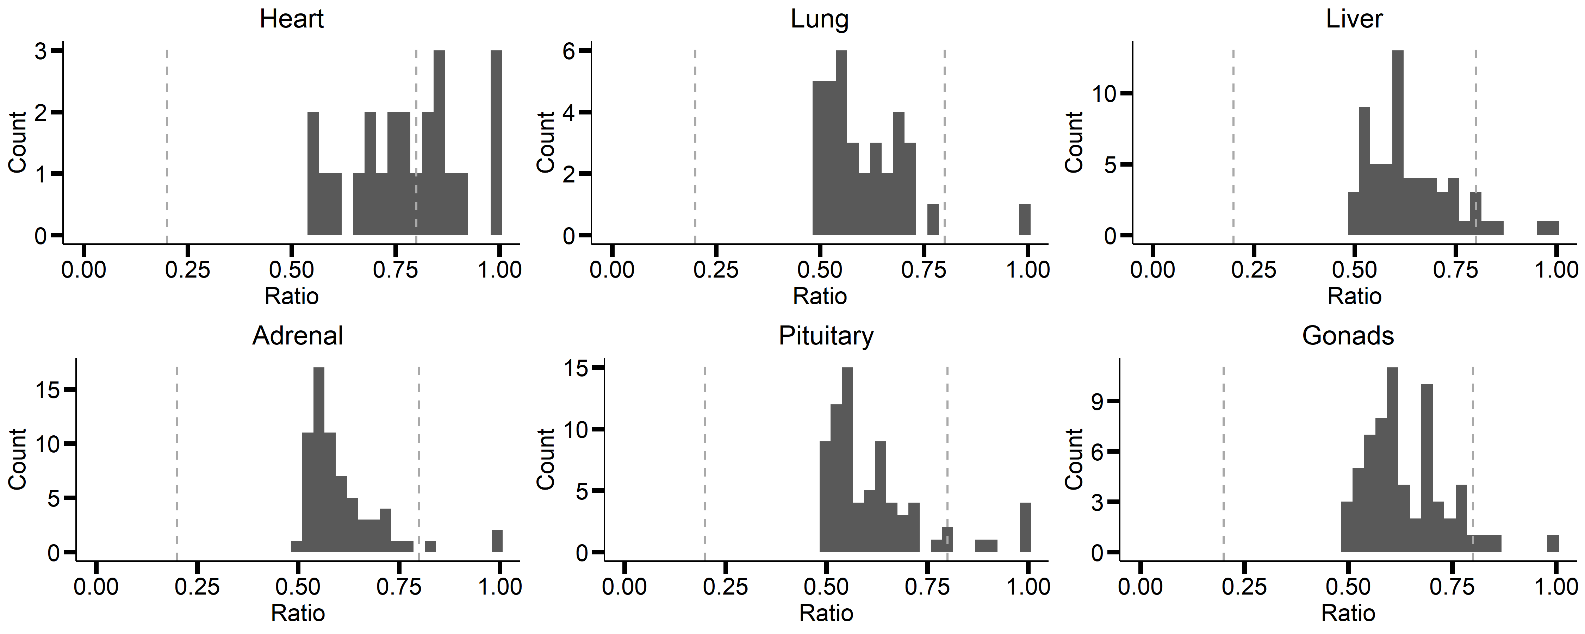
GTEX-11GSP-0004

Slide 11
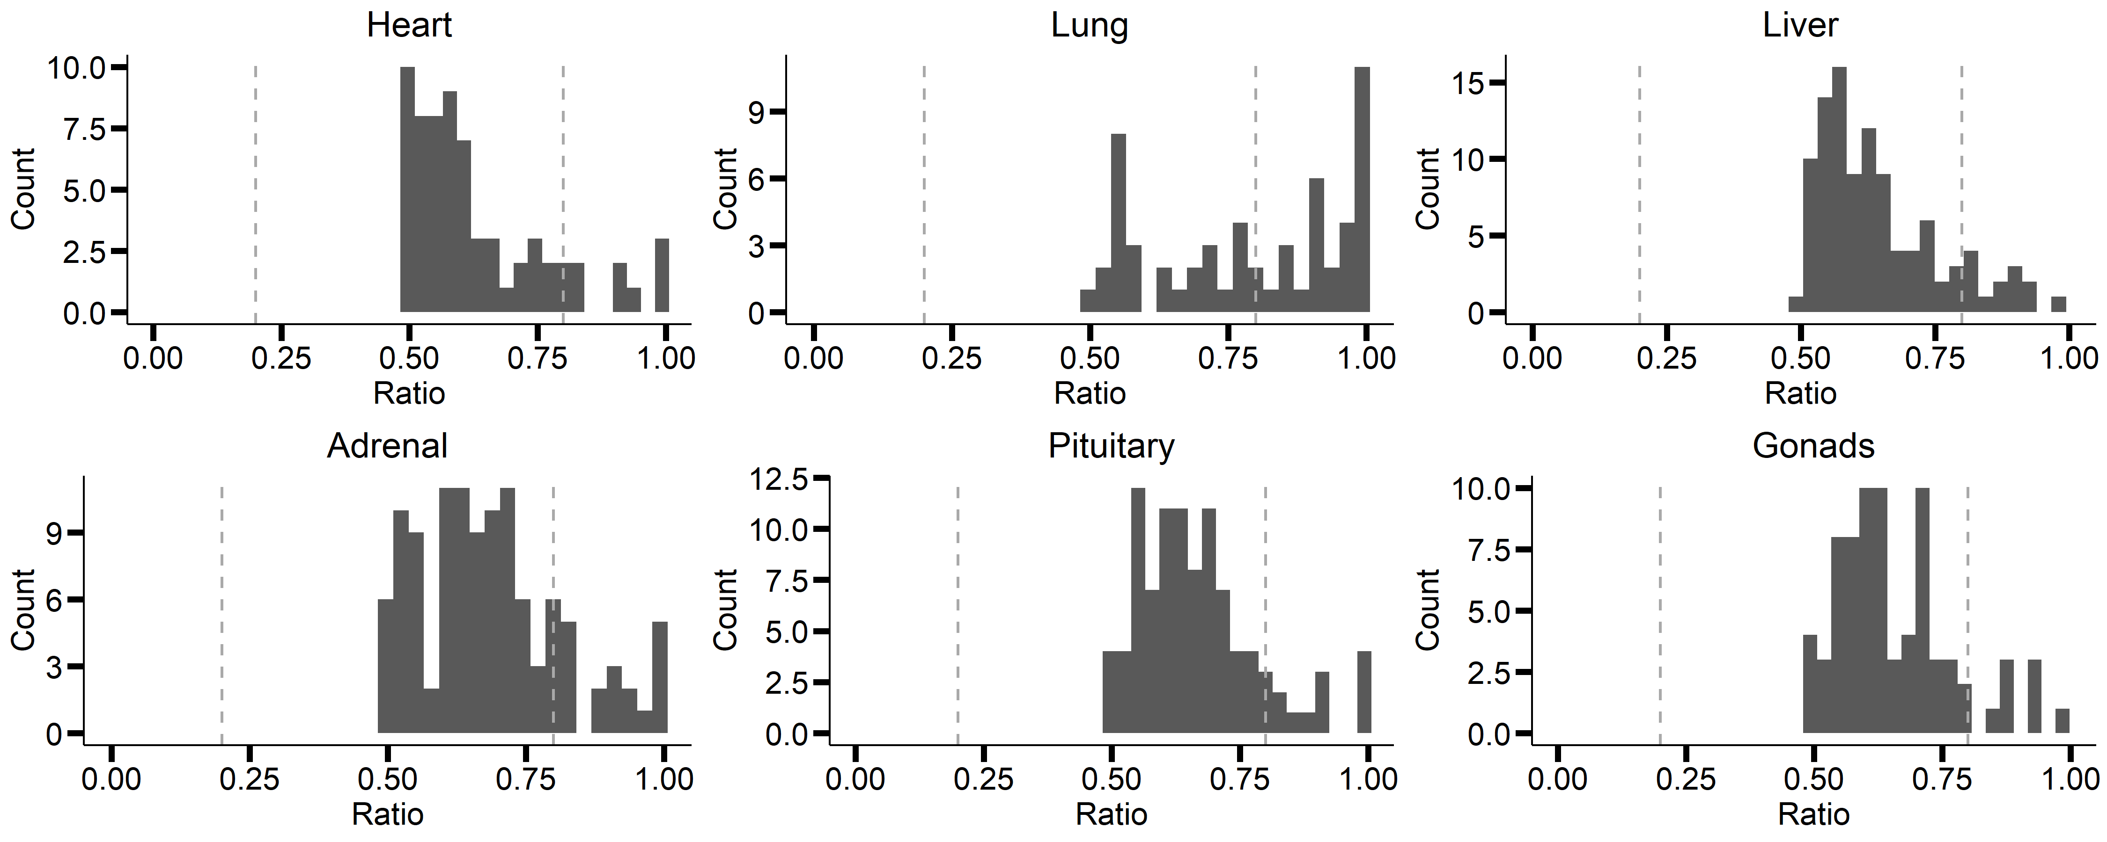
GTEX-12WSD-0002

Slide 12
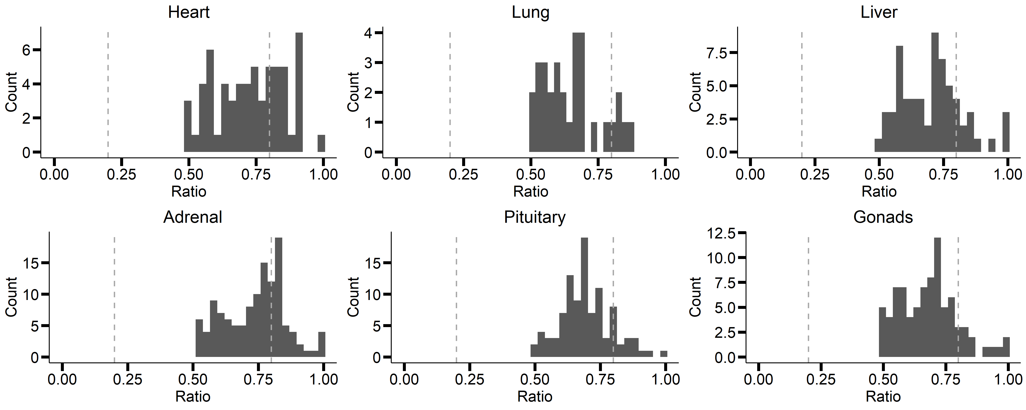
GTEX-14DAQ-0004

Slide 13
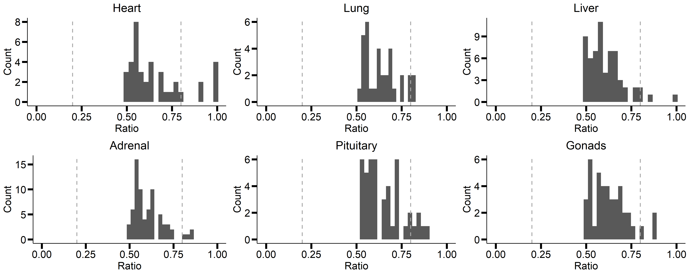
GTEX-15ER7-0002

Slide 14
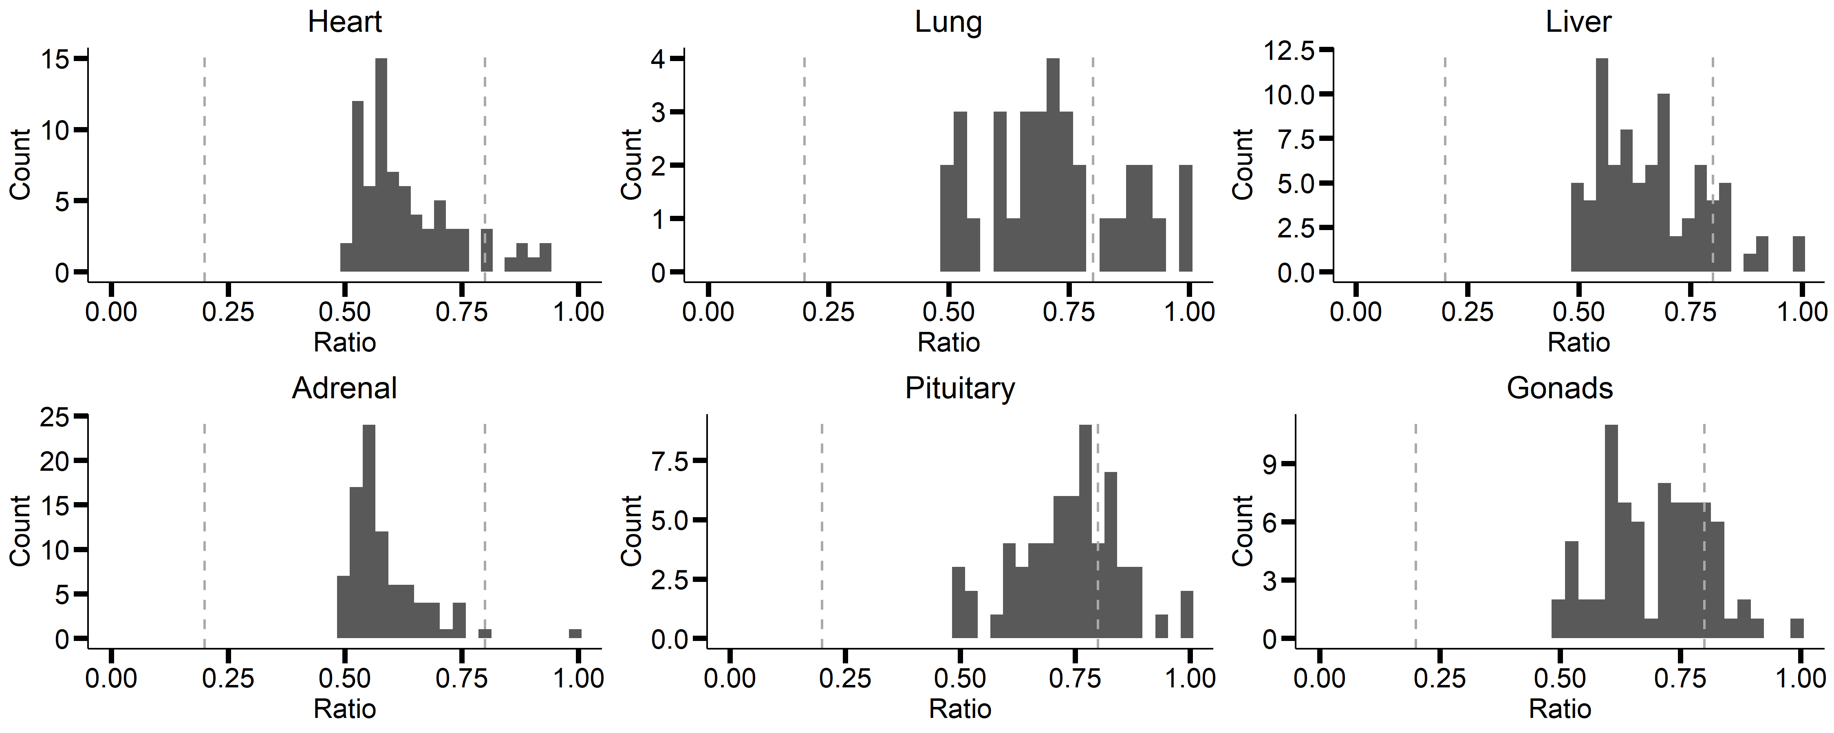
GTEX-131YS-0003

Slide 15
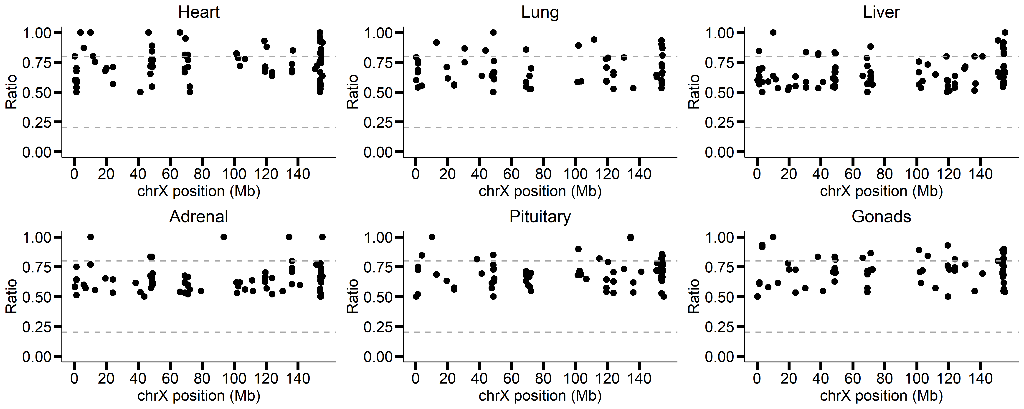
GTEX-1A8FM-0004

Slide 16
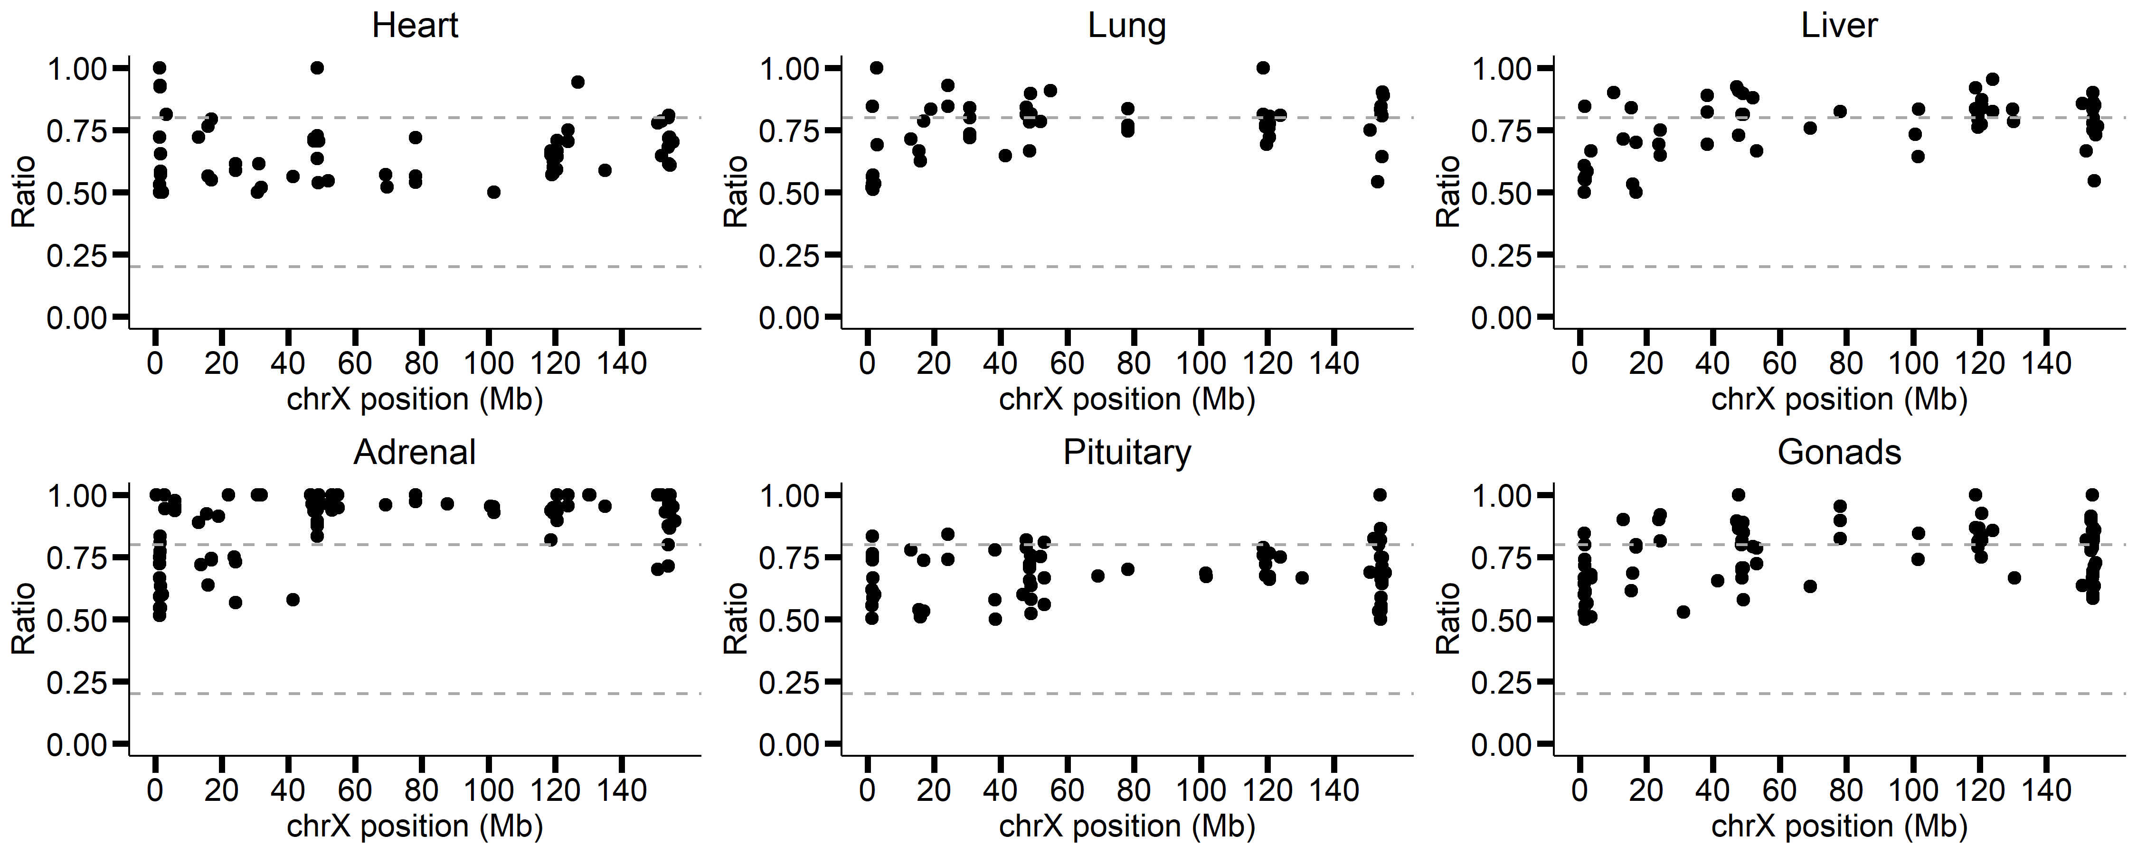
GTEX-1A32A-0001
v
v

Slide 17
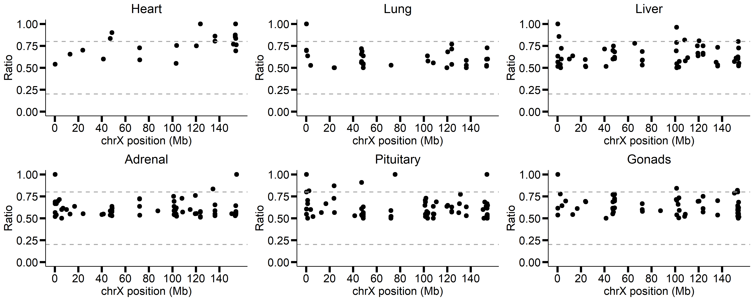
GTEX-11GSP-0004

Slide 18
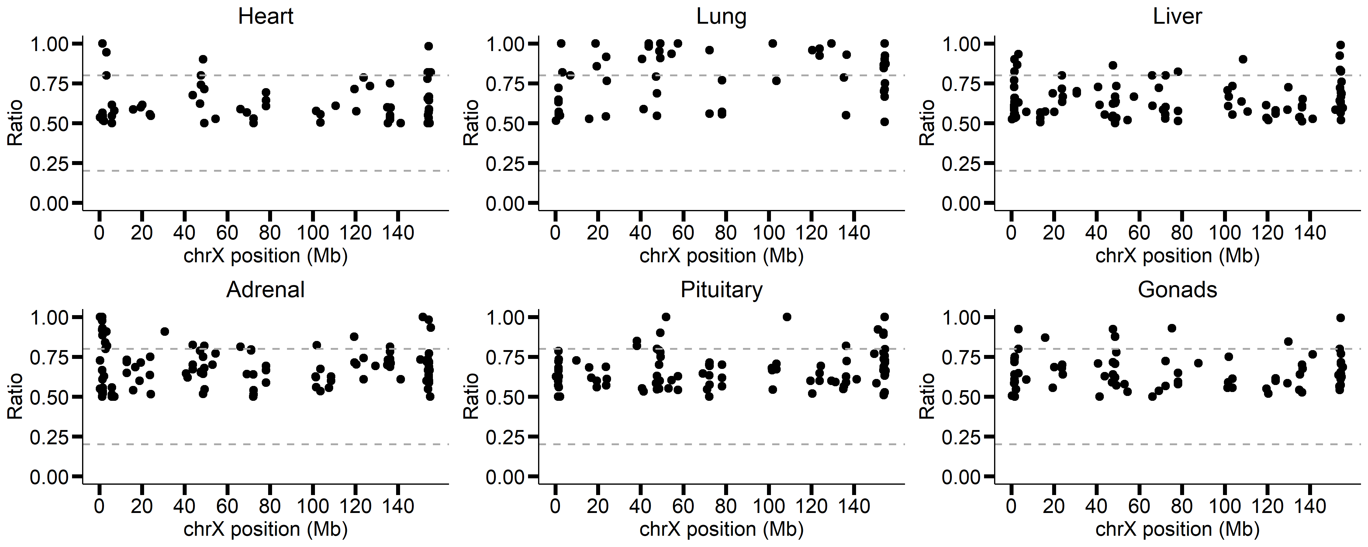
GTEX-12WSD-0002

Slide 19
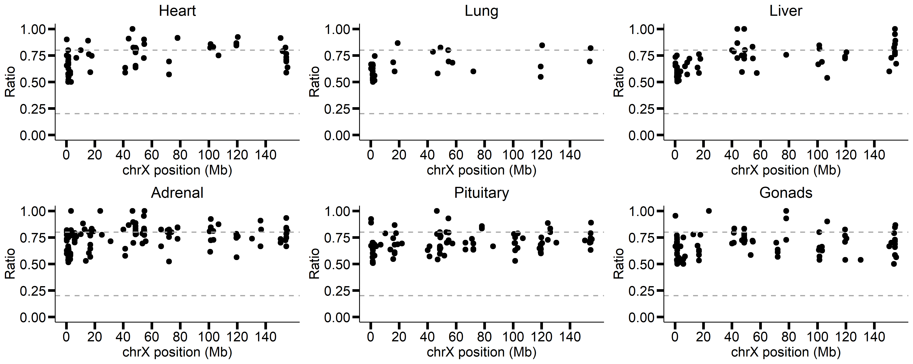
GTEX-14DAQ-0004

Slide 20
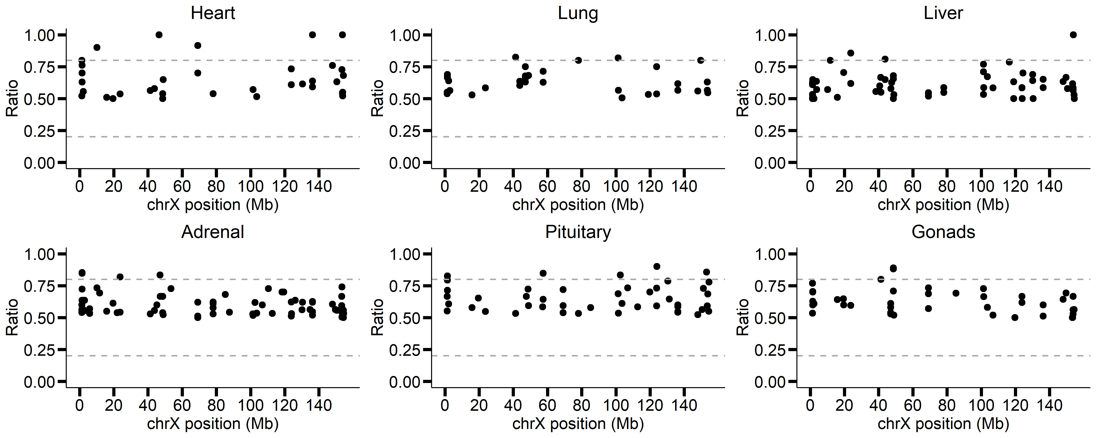
GTEX-15ER7-0002

Slide 21
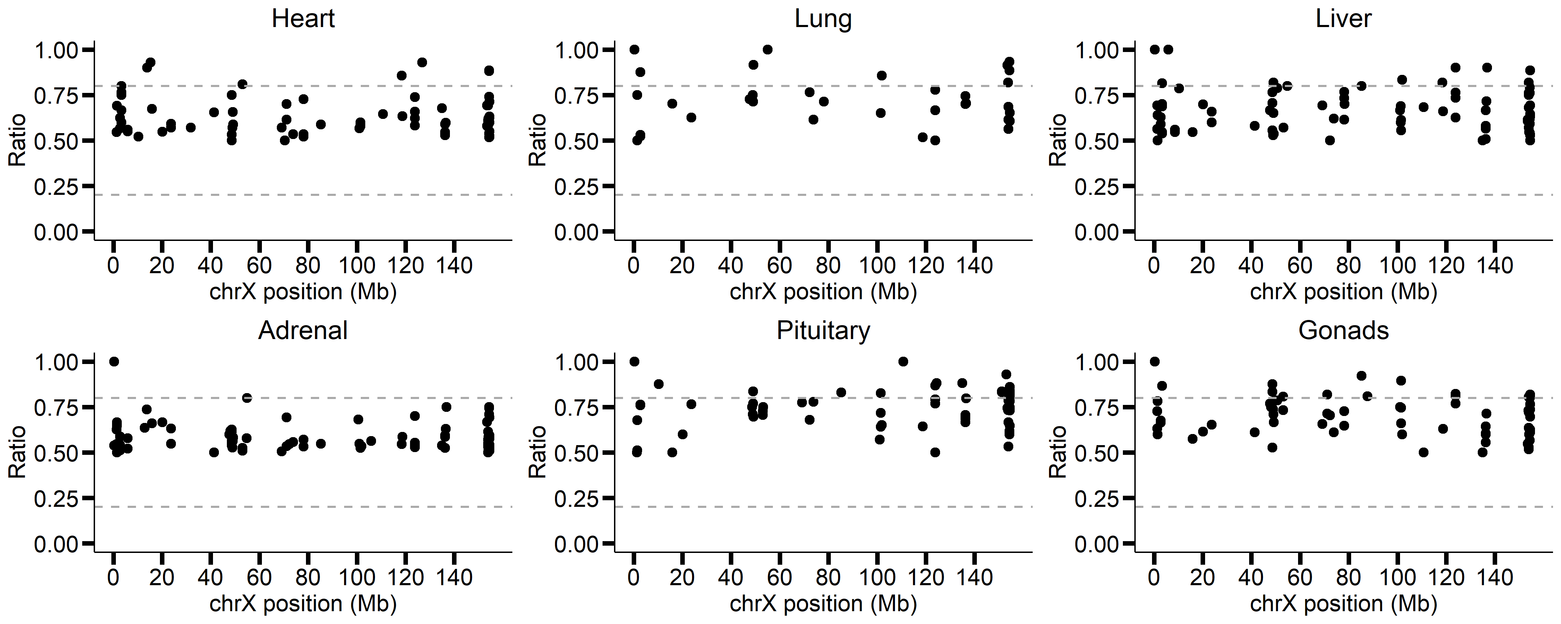
GTEX-131YS-0003

Slide 22
After phasing X chromosome

Slide 23
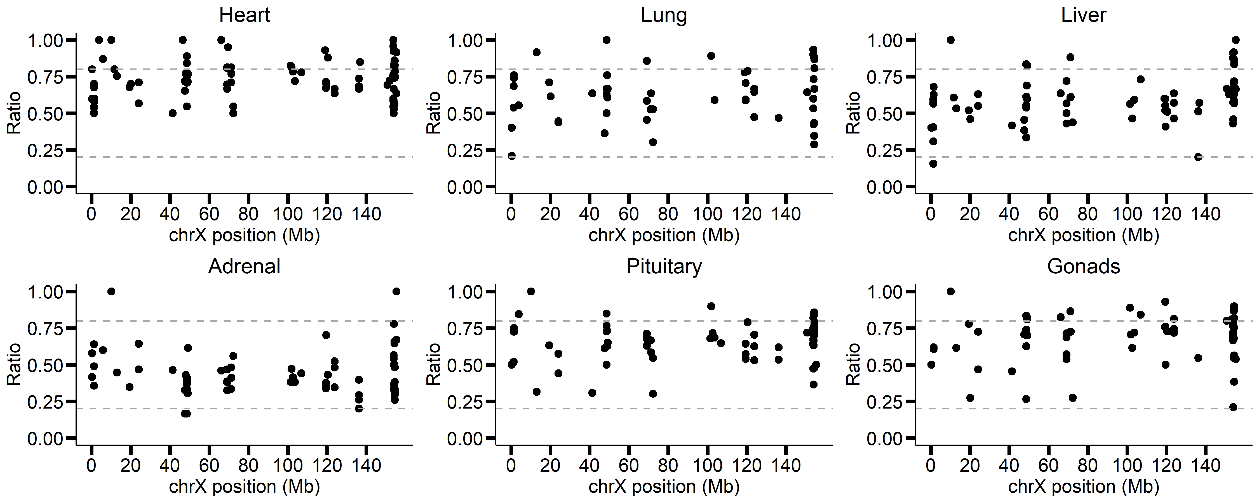
GTEX-1A8FM-0004

Slide 24
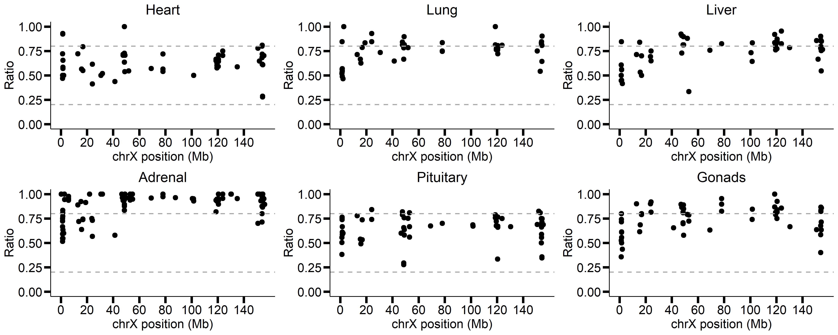
GTEX-1A32A-0001
v
v

Slide 25
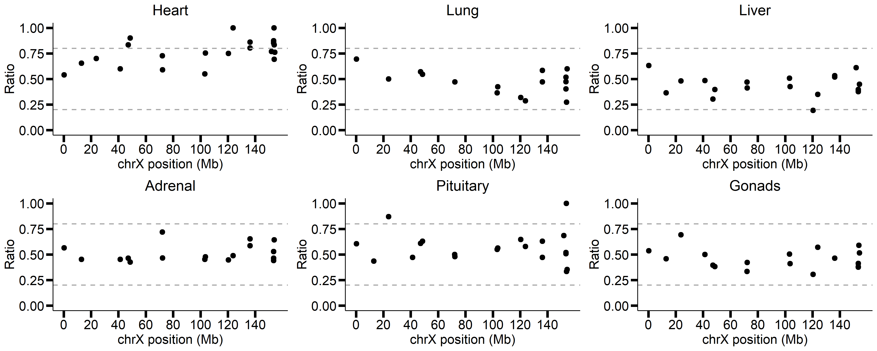
GTEX-11GSP-0004

Slide 26
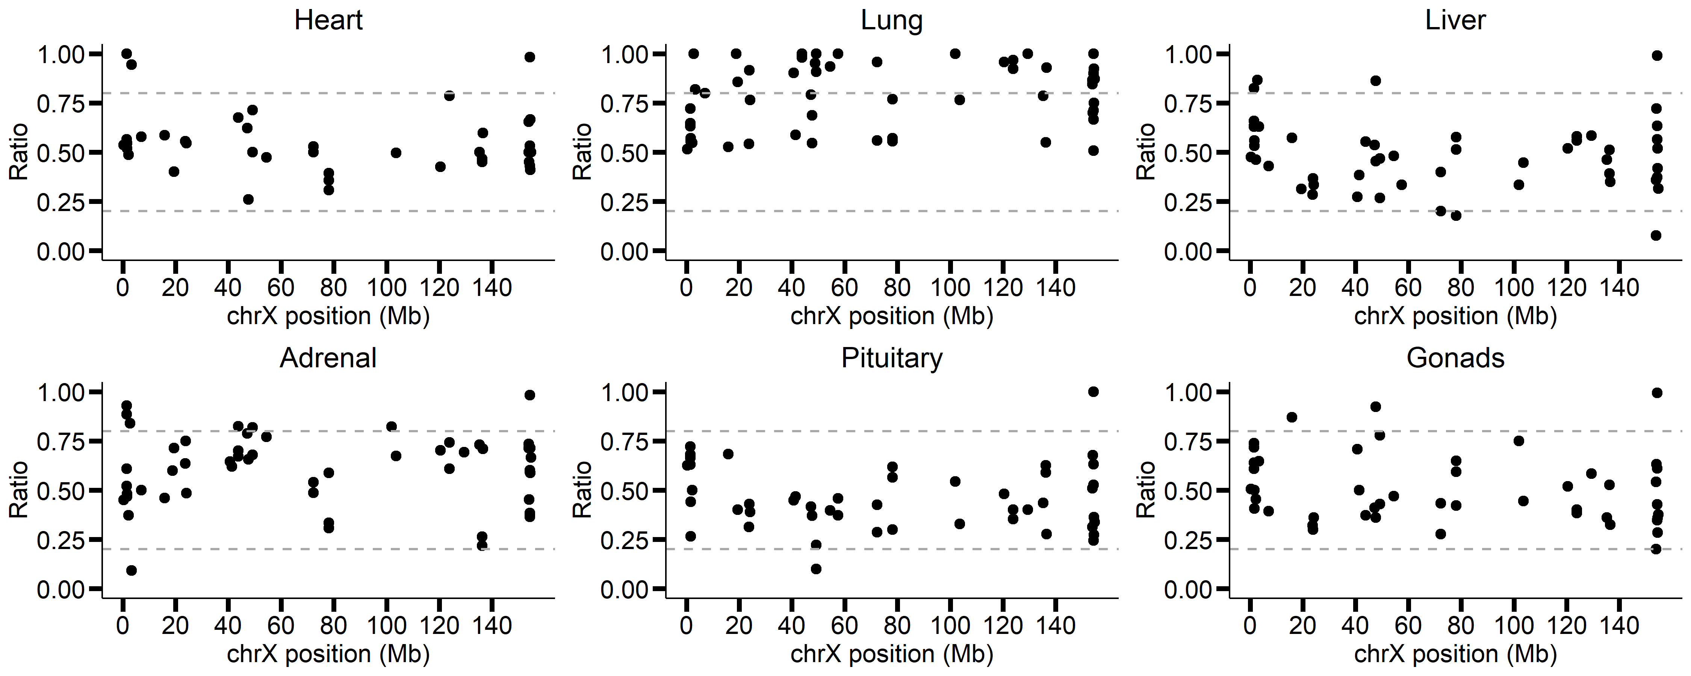
GTEX-12WSD-0002

Slide 27
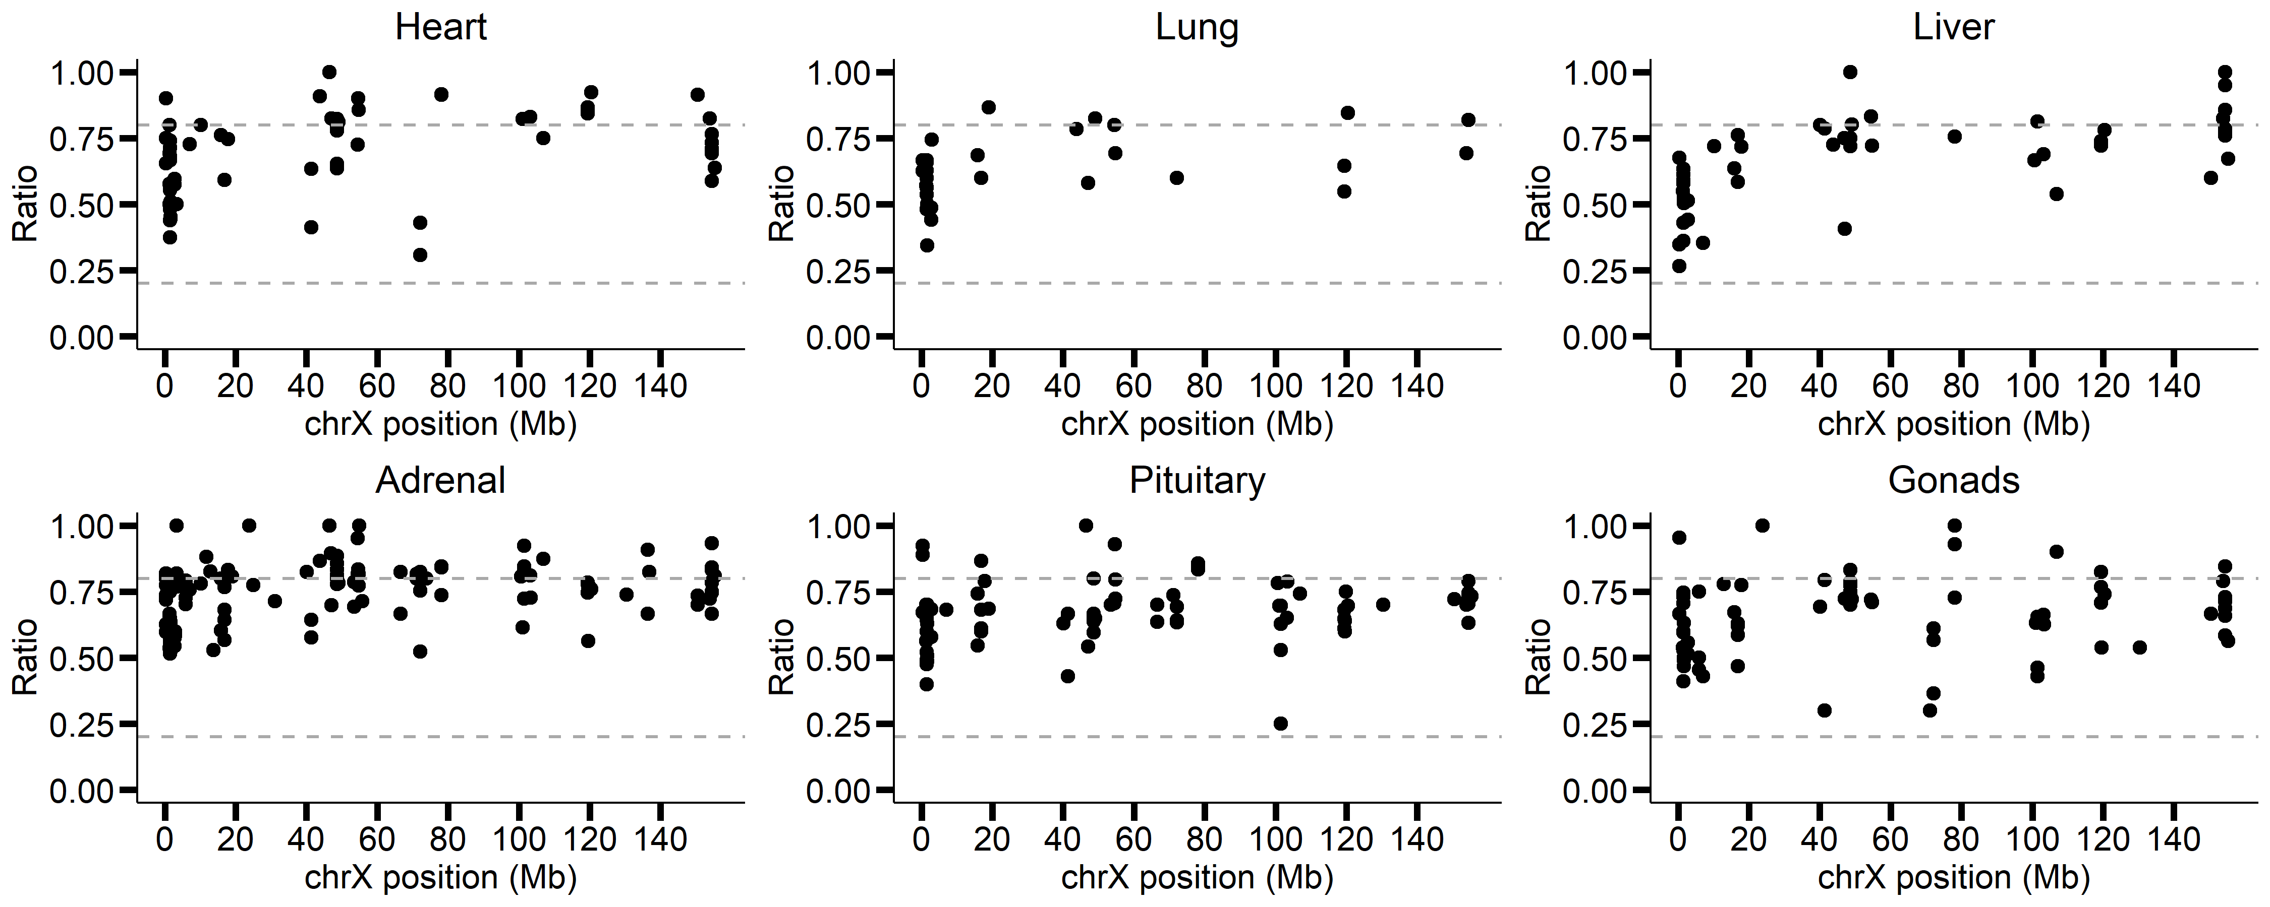
GTEX-14DAQ-0004

Slide 28
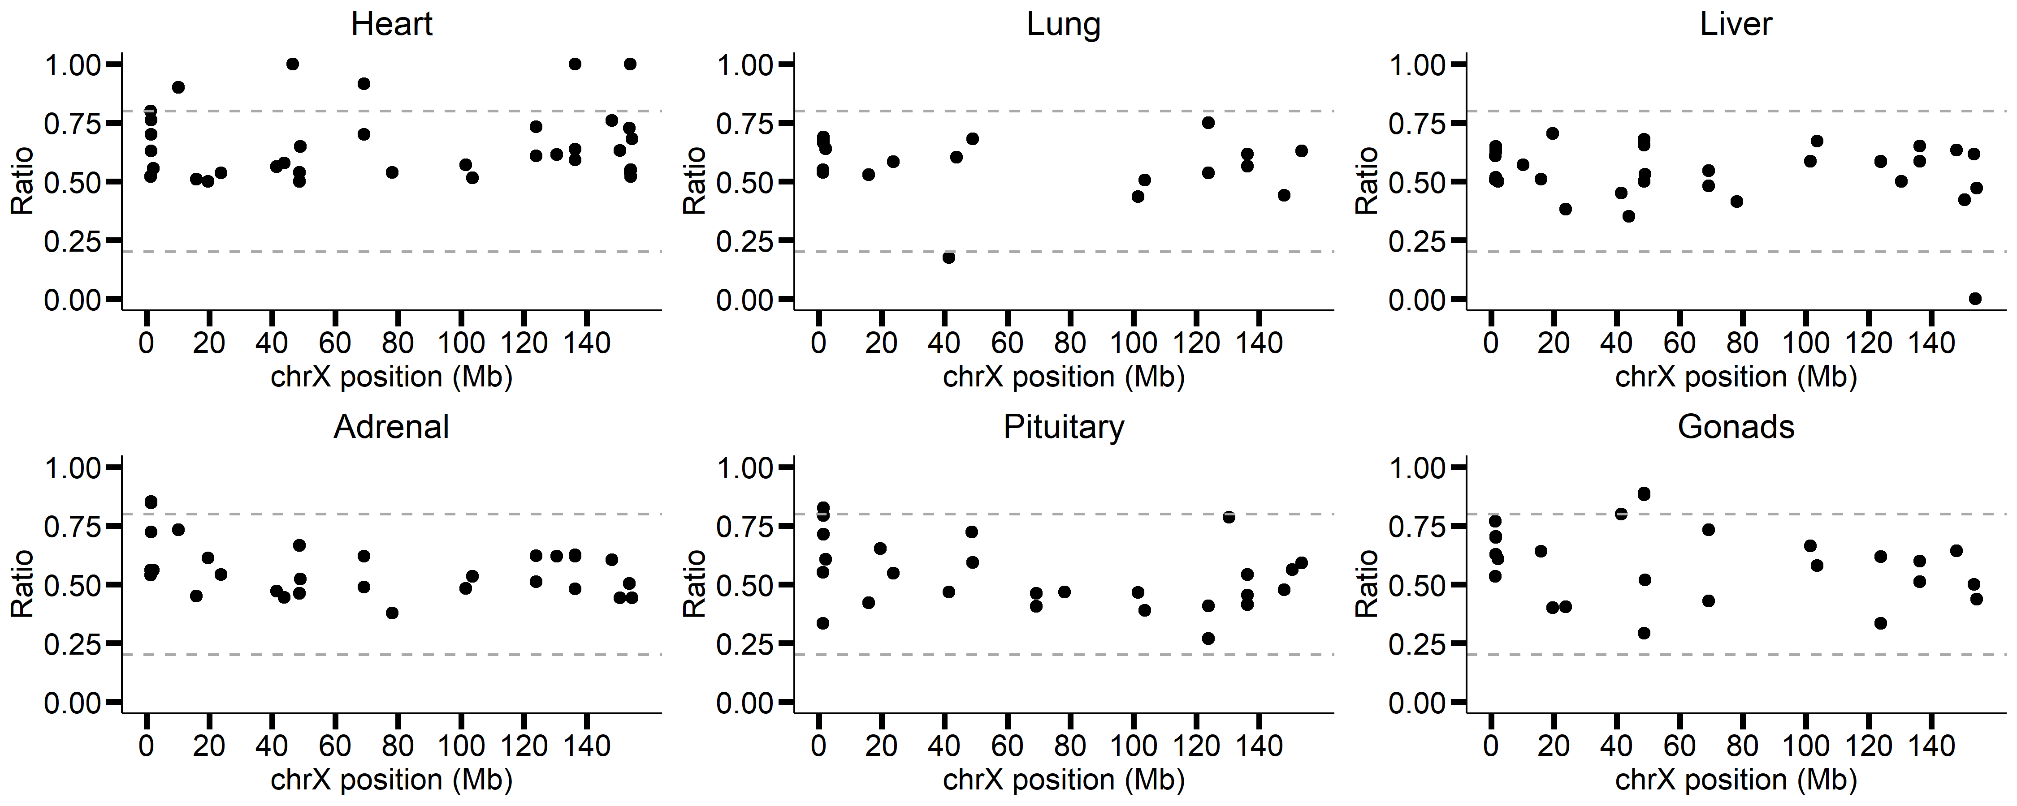
GTEX-15ER7-0002

Slide 29
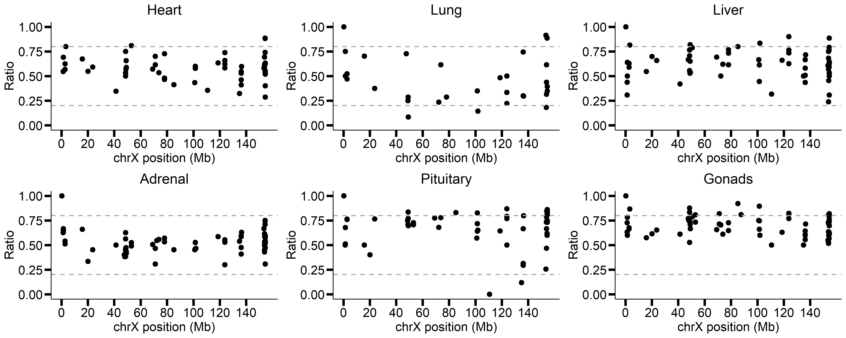
GTEX-131YS-0003

