Slide 1
For each individual:
For each tissue:
Identify positions on chrX where allele balance is equal to 1
Phase chrX

Slide 2
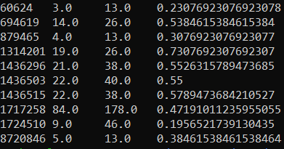
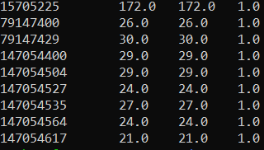
PT101159
heart
Allele balance
Obtain the positions where the allele balance is equal to 1 (completely skewed)
Total number of reads
position
Number of reads for the biased allele (biased allele is determined from phasing
Repeat for all of the tissues within an individual

Slide 3
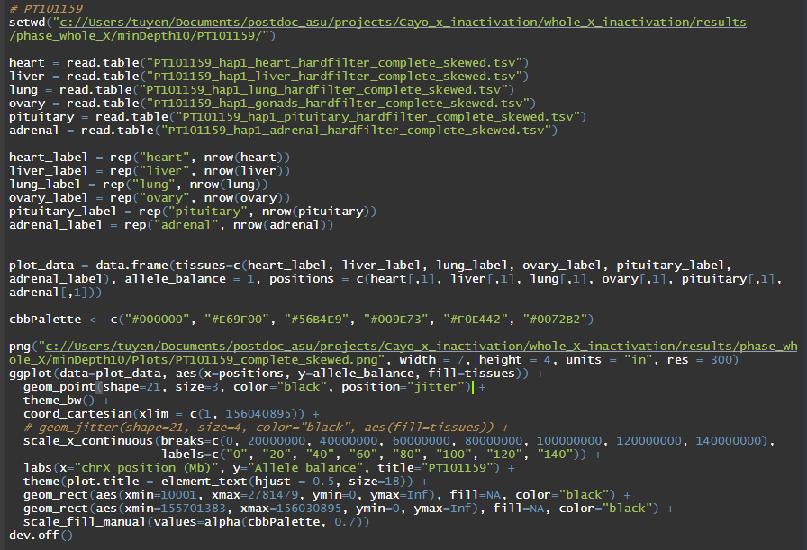

Slide 4
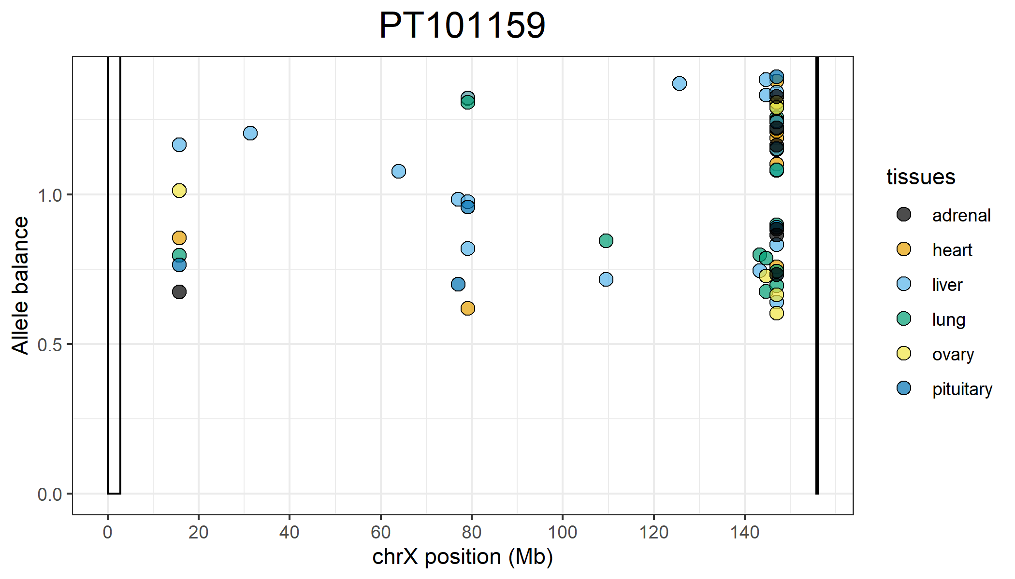
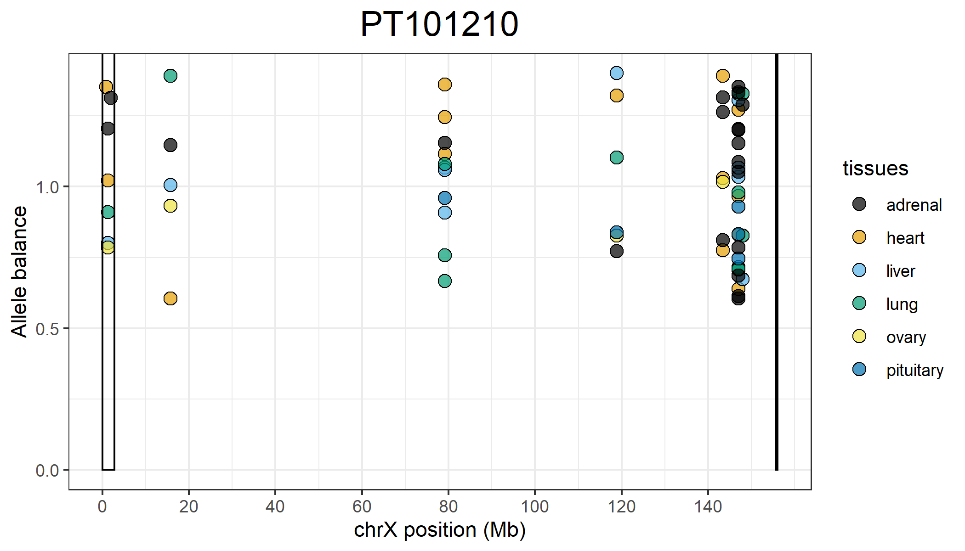
Positions on the X that are completely skewed that are shared across all 6 tissues:
15,705,225
147,054,504
147,054,527
147,054,535
147,054,564
Positions on the X that are completely skewed that are shared across all 6 tissues:
118,831,364

Slide 5
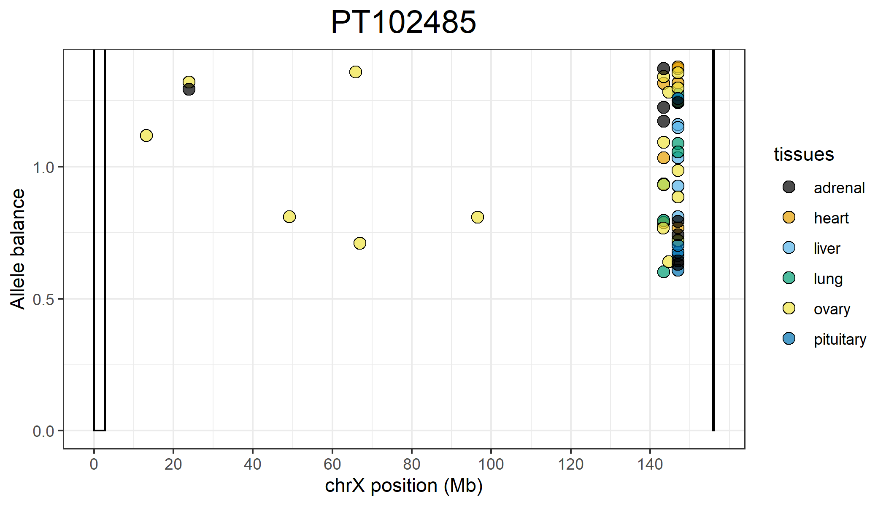
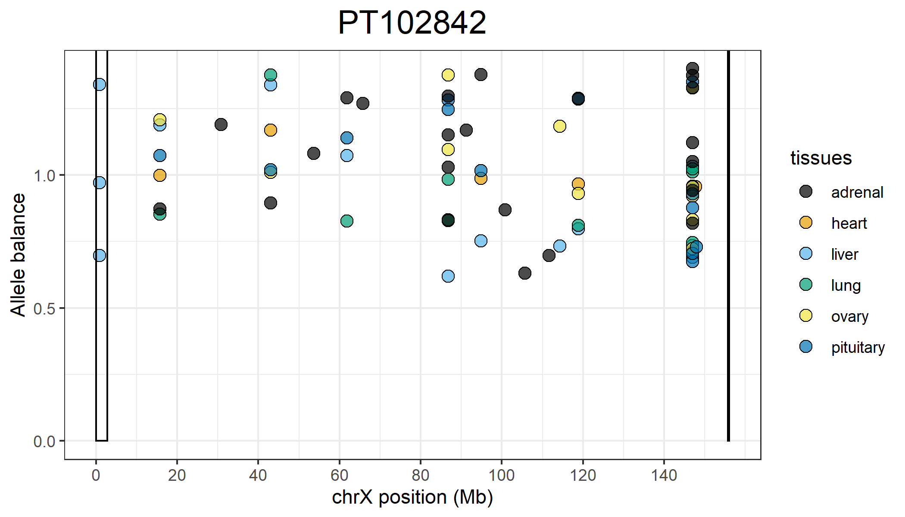
Positions on the X that are completely skewed that are shared across all 6 tissues:
147,054,504
147,054,527
147,054,535
147,054,564
147,054,617
Positions on the X that are completely skewed that are shared across all 6 tissues:
15,705,200
43,034,819
118,831,364

Slide 6
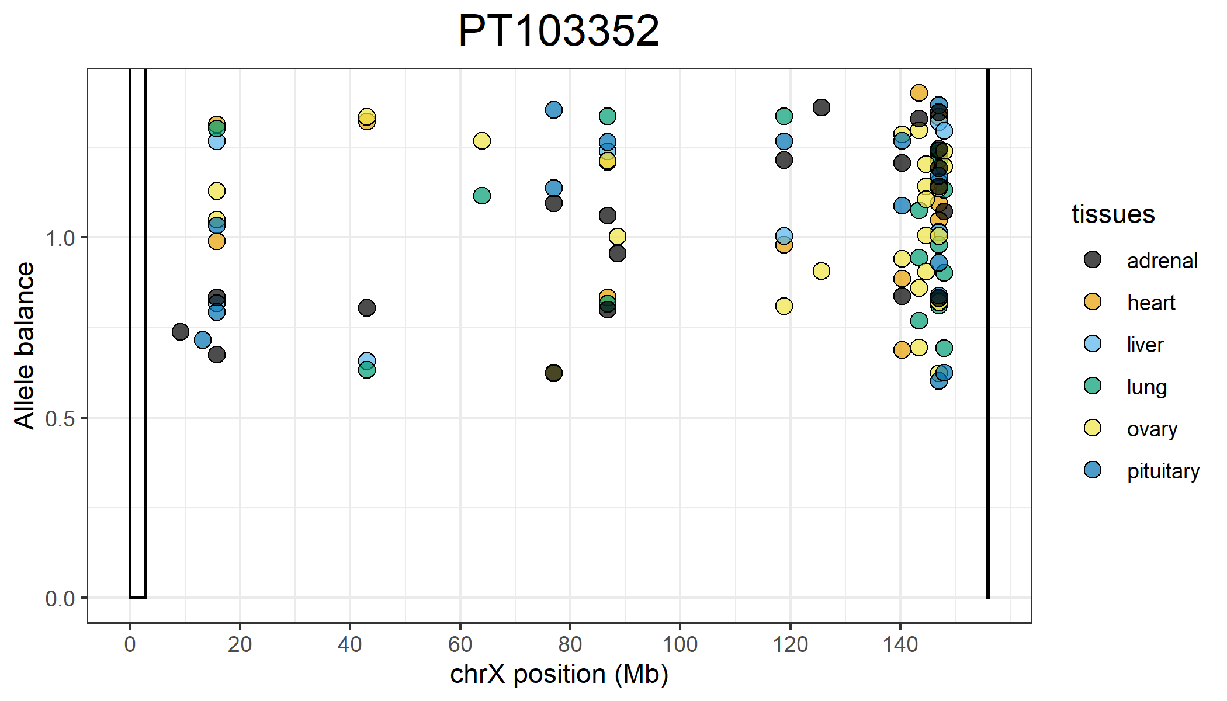
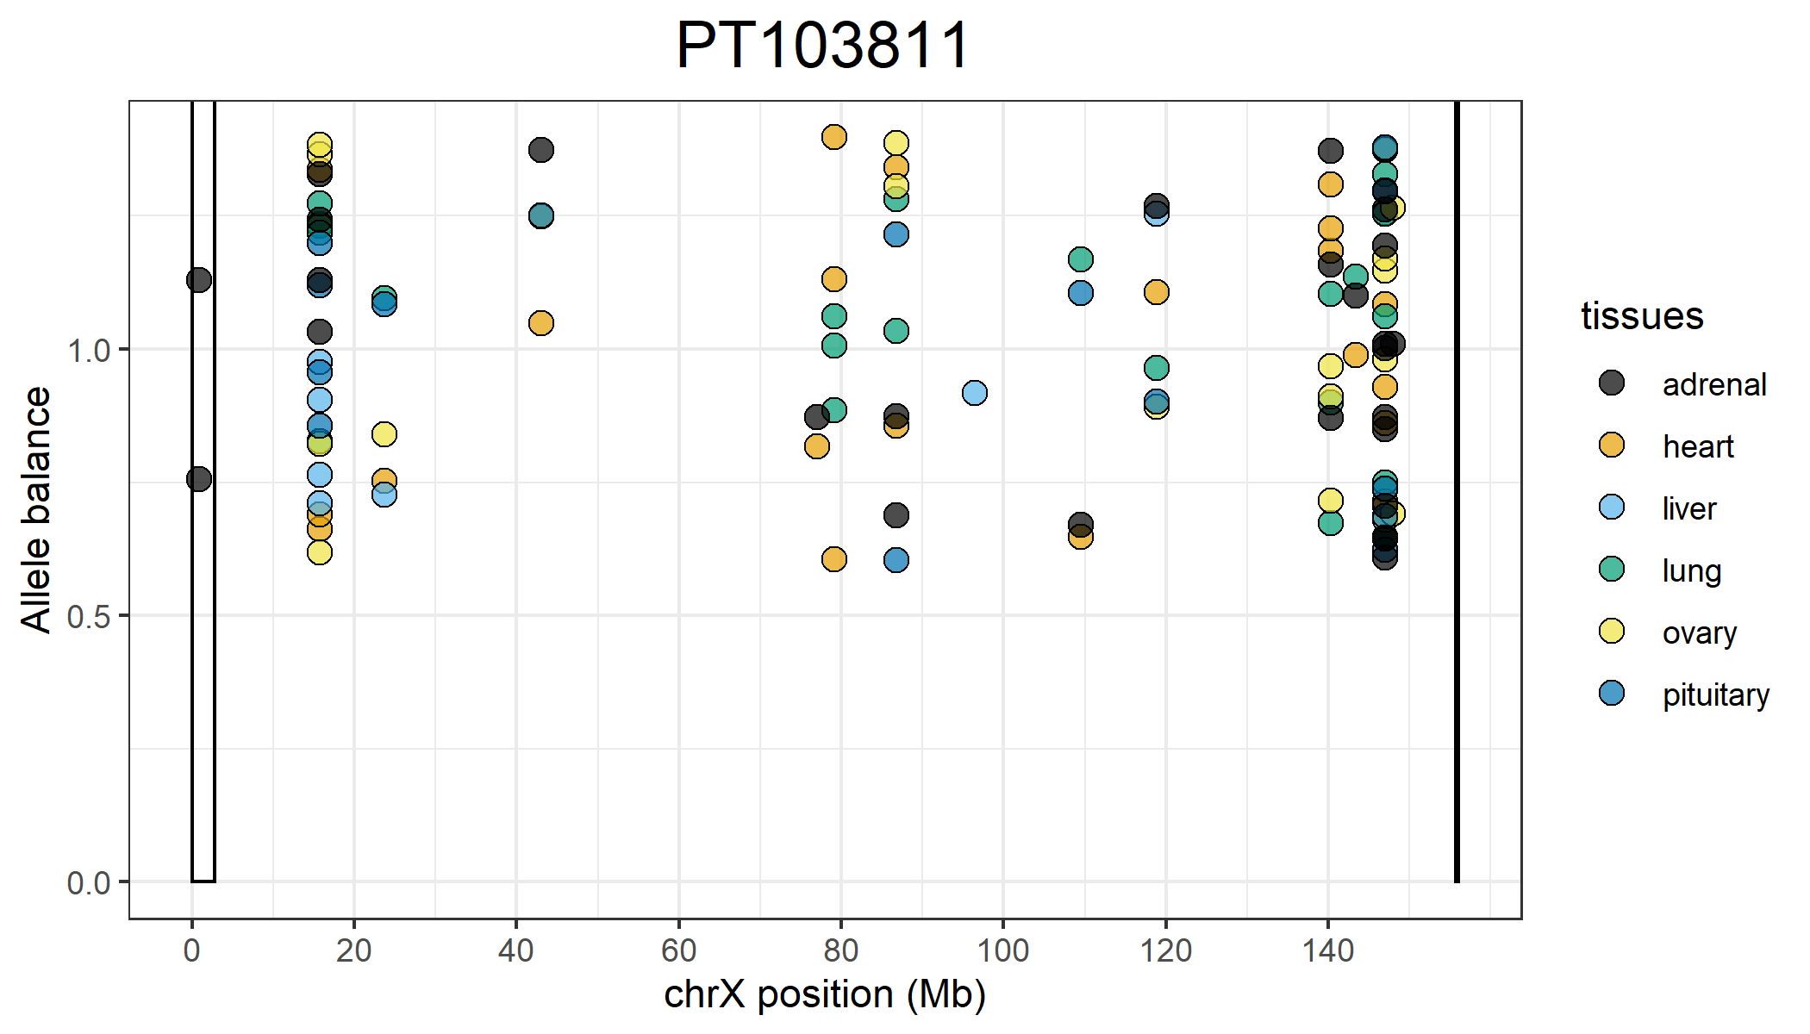
Positions on the X that are completely skewed that are shared across all 6 tissues:
15,705,233
118,831,364
147,054,400
147,054,504
147,054,527
147,054,535
147,054,564
Positions on the X that are completely skewed that are shared across all 6 tissues:
15,705,200
15,705,225
15,705,233
15,705,394
118,831,364
147,054,504
147,054,527
147,054,535

Slide 7
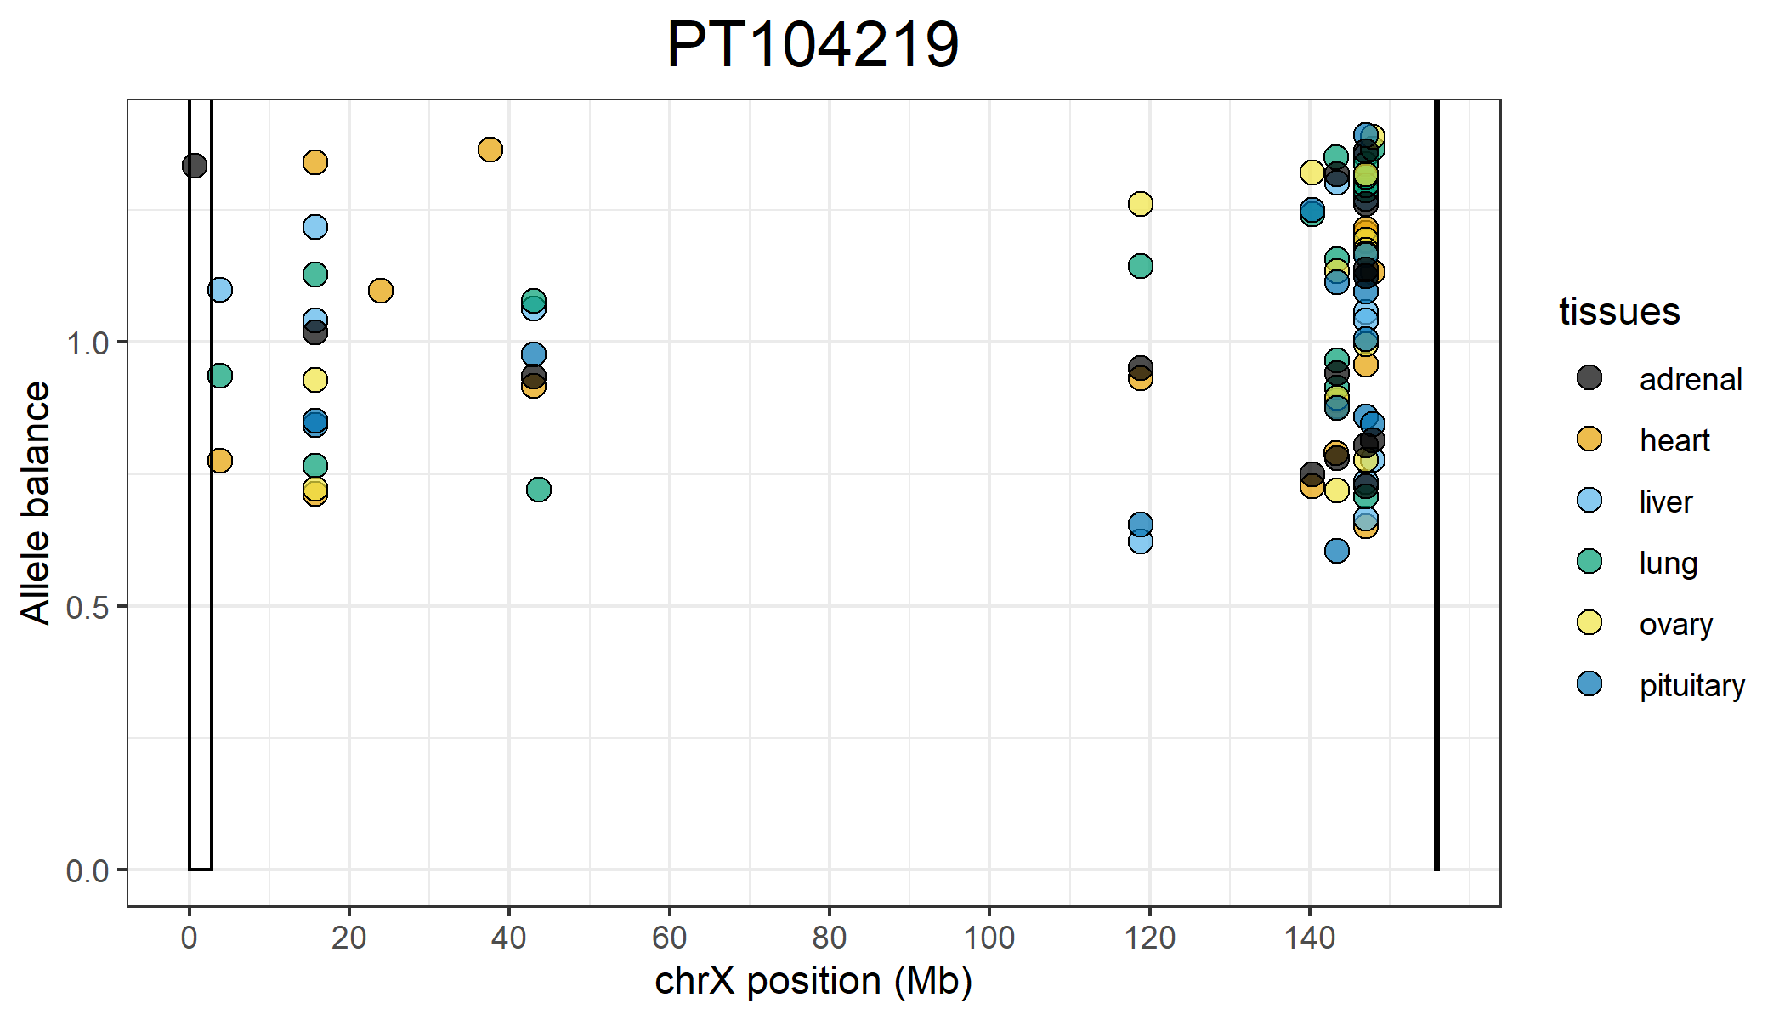
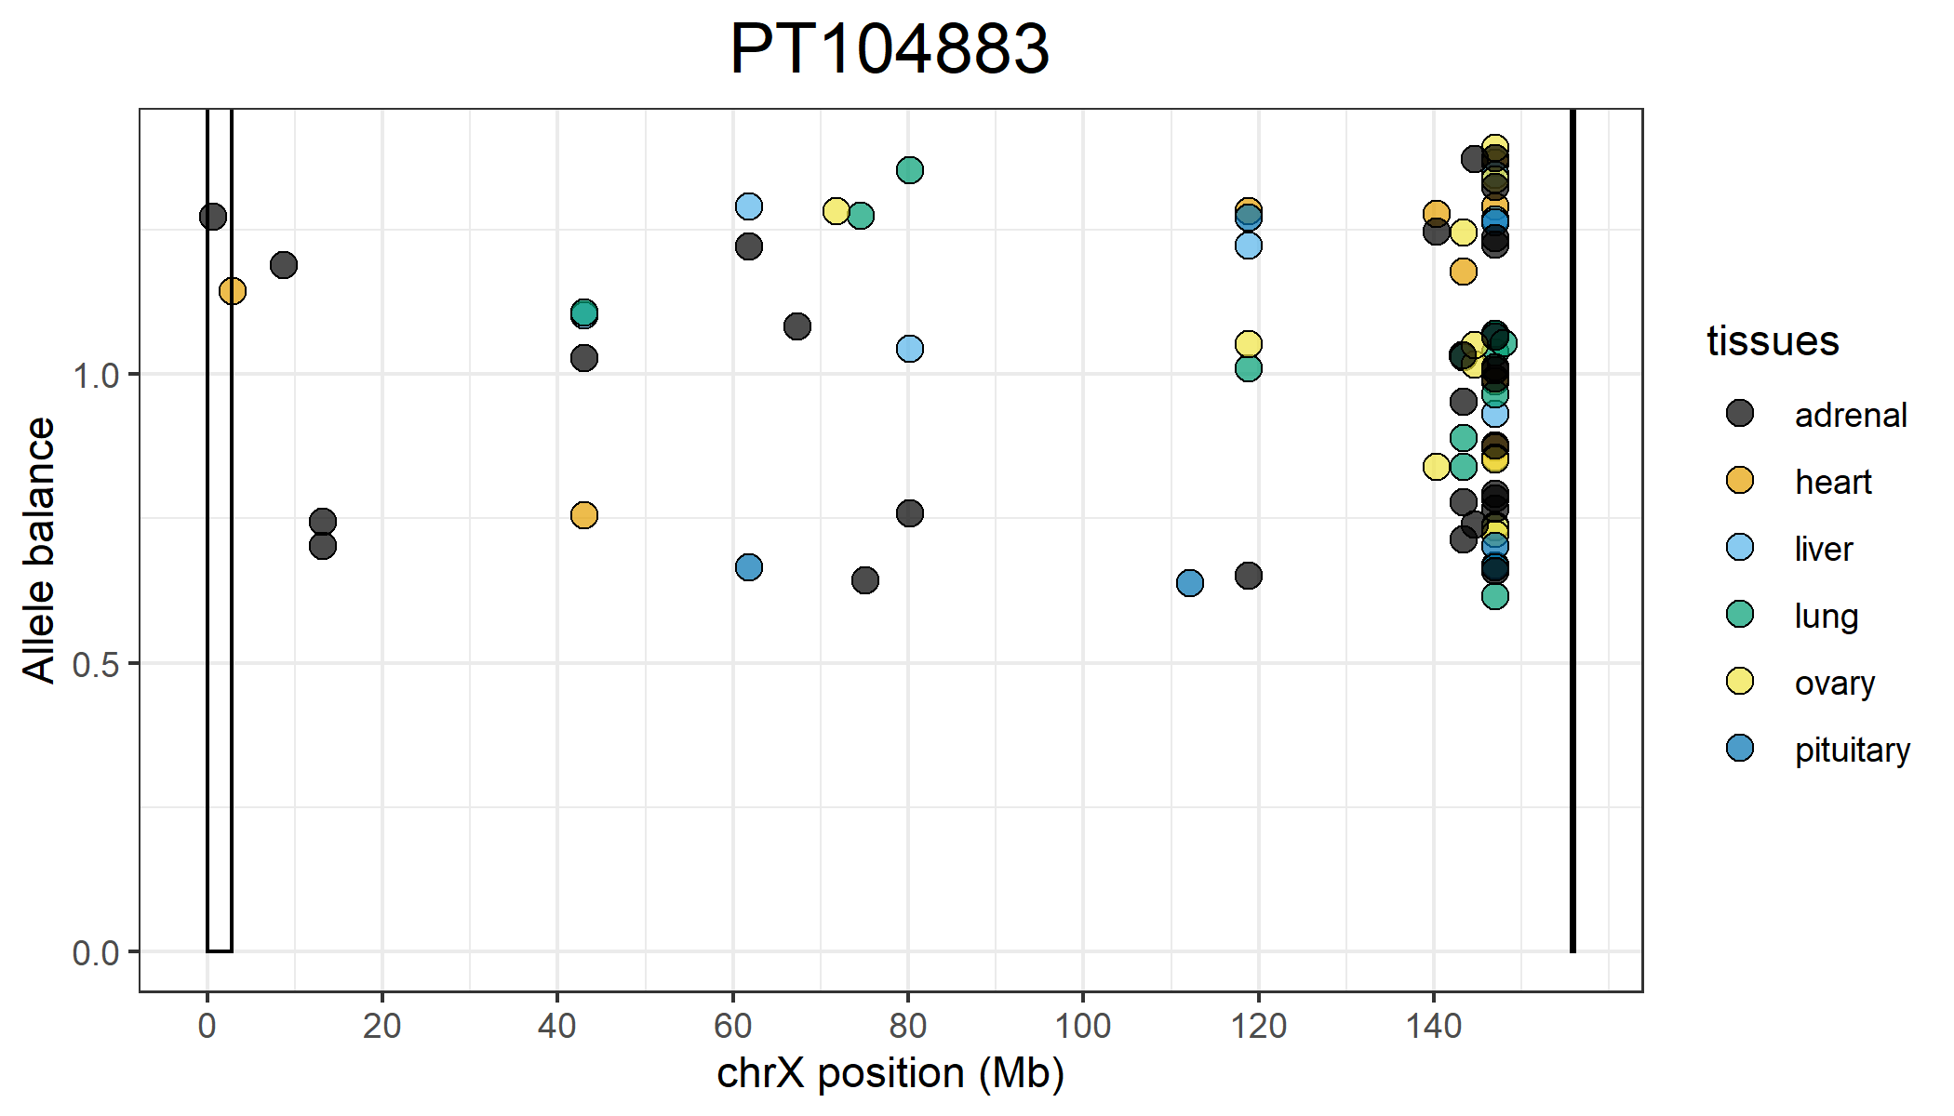
Positions on the X that are completely skewed that are shared across all 6 tissues:
15,705,225
118,831,364
143,373,439
147,054,400
147,054,504
147,054,527
147,054,535
147,054,564
147,054,617
147,823,222
Positions on the X that are completely skewed that are shared across all 6 tissues:
118,831,364
147,054,527
147,054,535
147,054,564

Slide 8
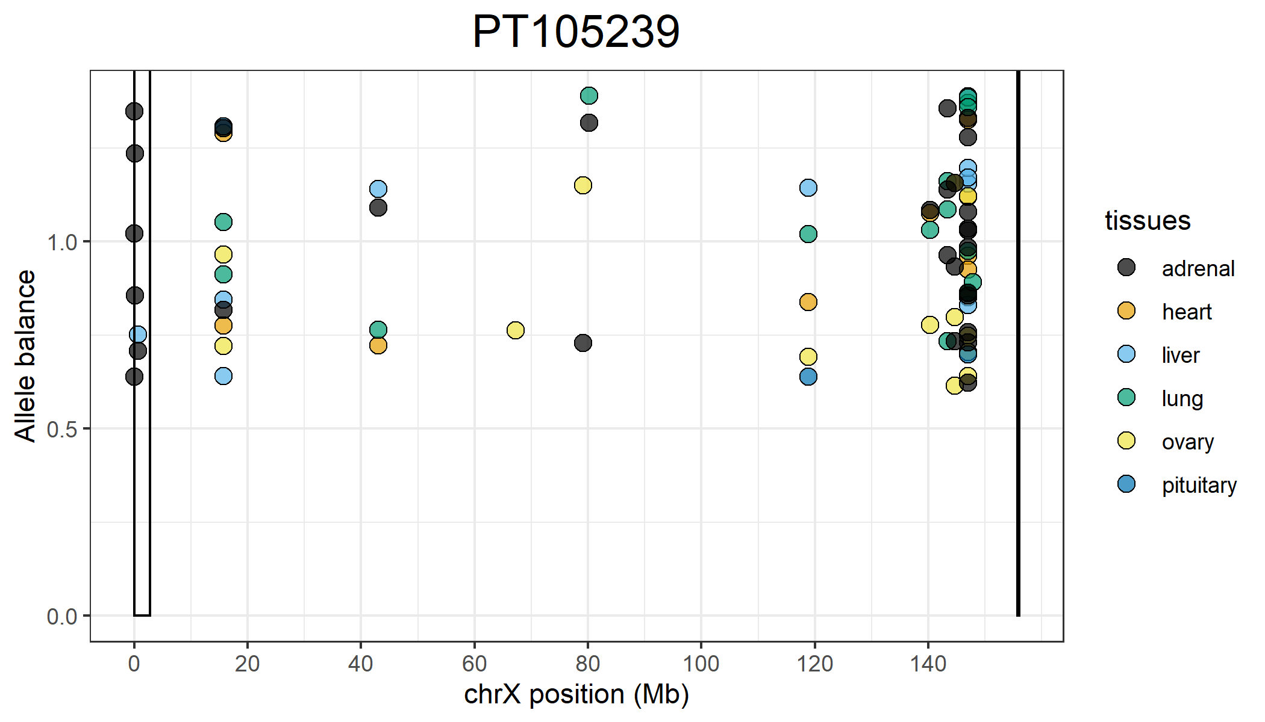
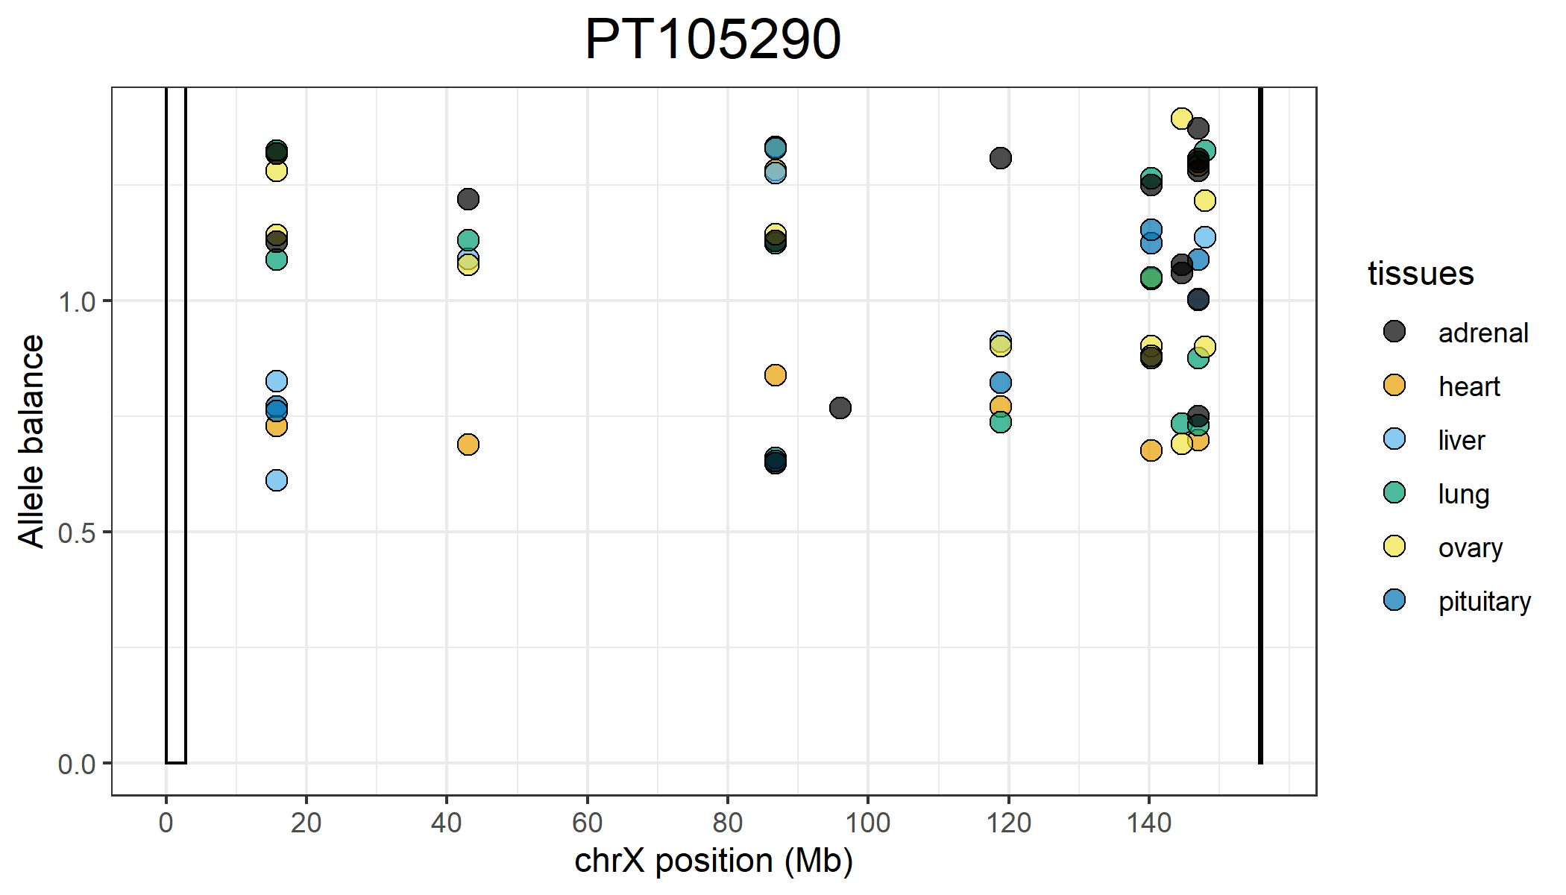
Positions on the X that are completely skewed that are shared across all 6 tissues:
15,705,225
147,054,504
Positions on the X that are completely skewed that are shared across all 6 tissues:
15,705,225
15,705,233
86,750,672
118,831,364

Slide 9
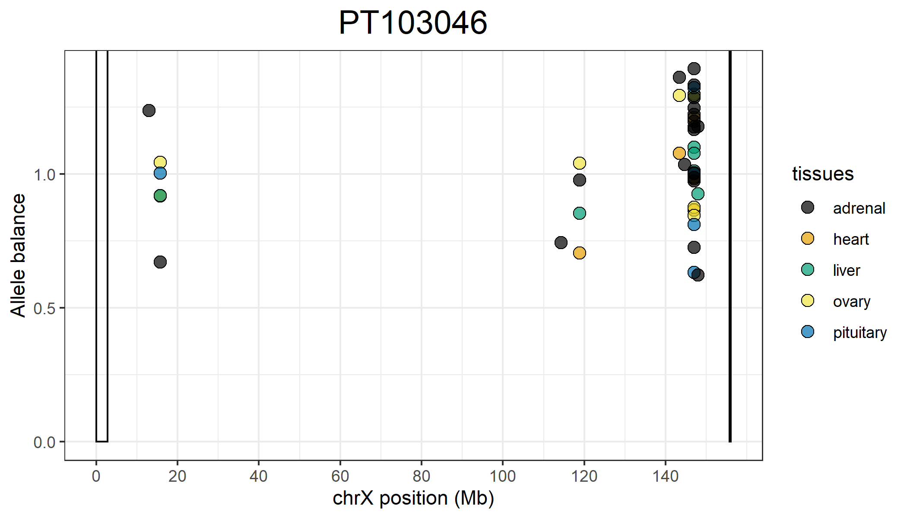
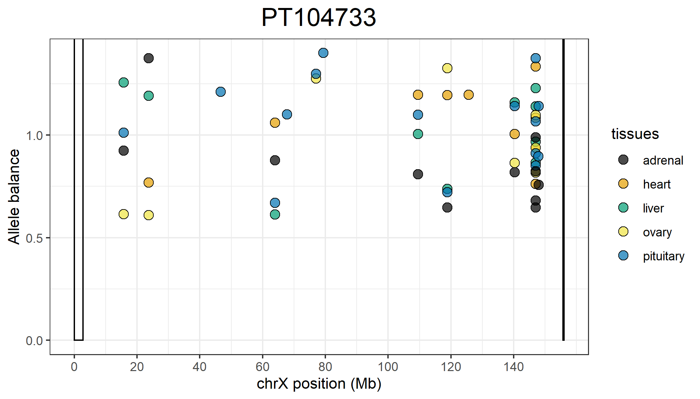
Positions on the X that are completely skewed that are shared across all 5 tissues:
15,705,394
147,054,527
147,054,564
Positions on the X that are completely skewed that are shared across all 5 tissues:
118,831,364
140,353,426
147,054,504
147,054,527
147,054,535

Slide 10
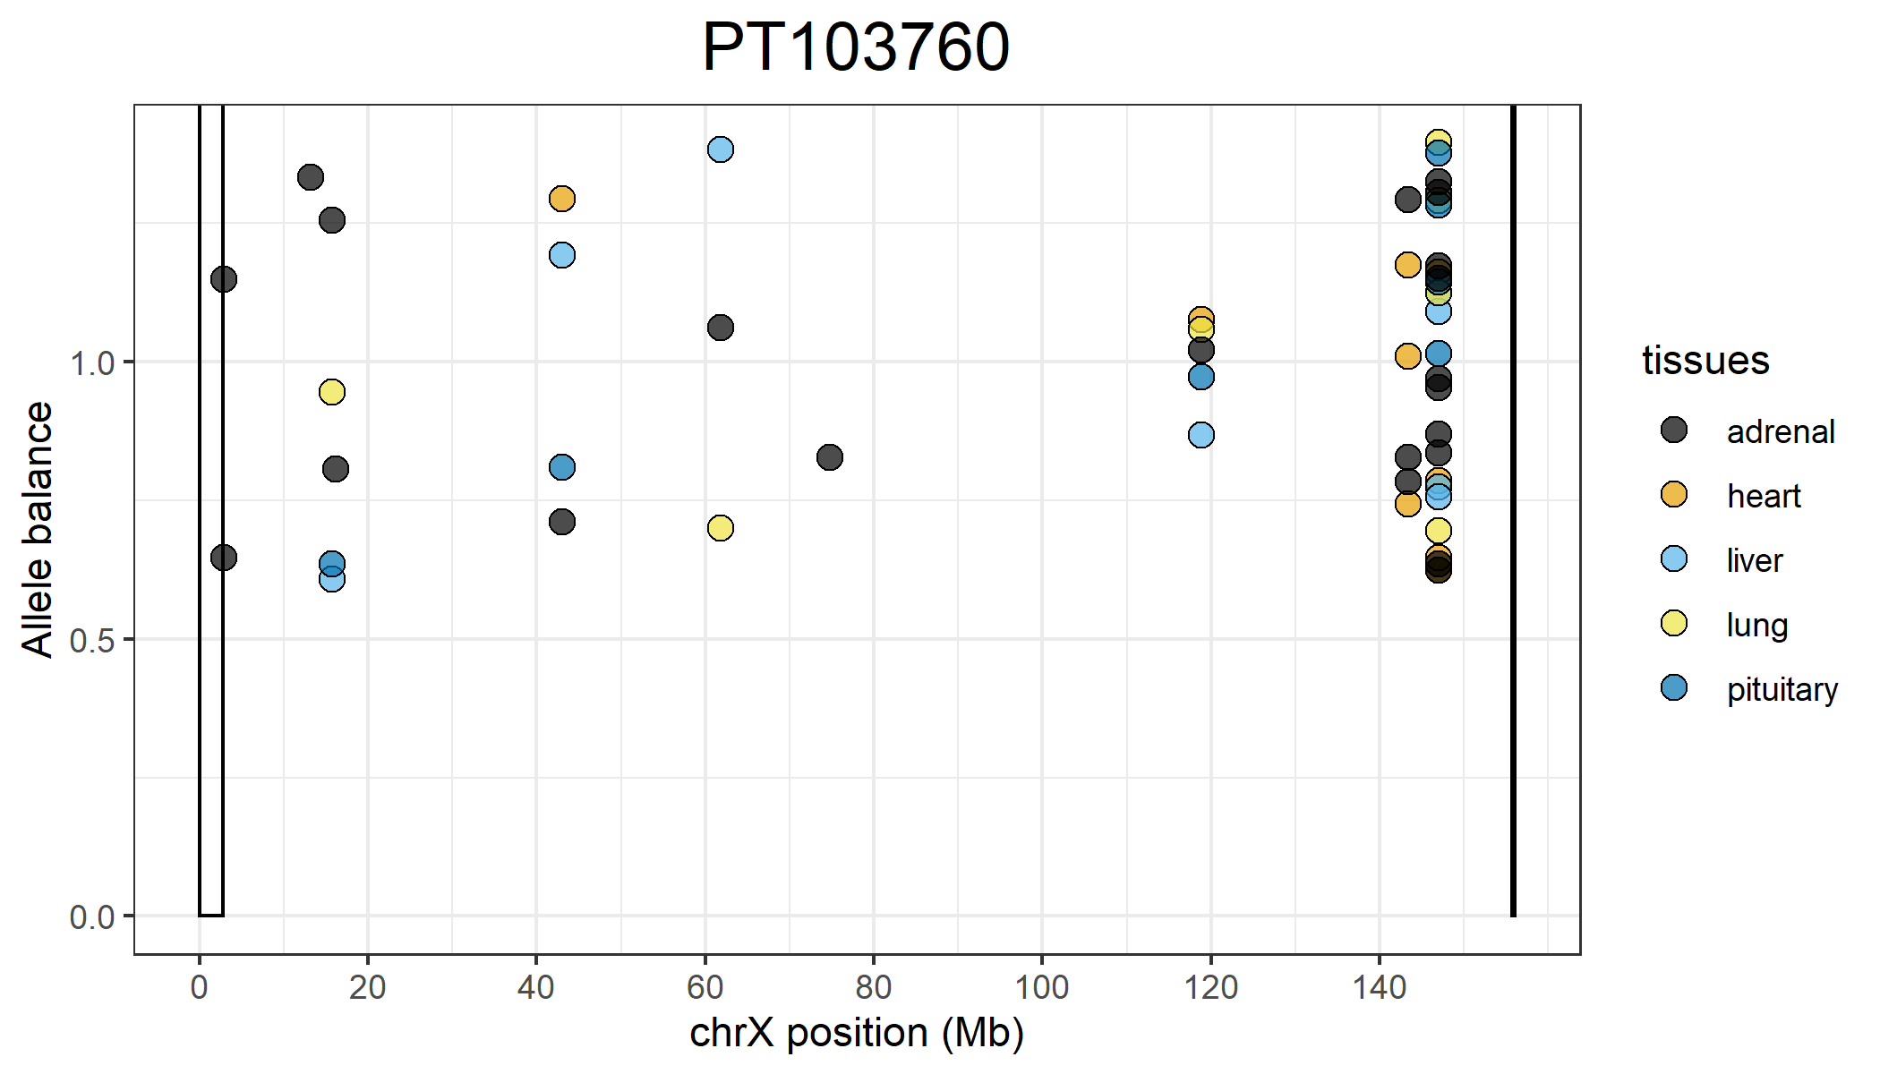
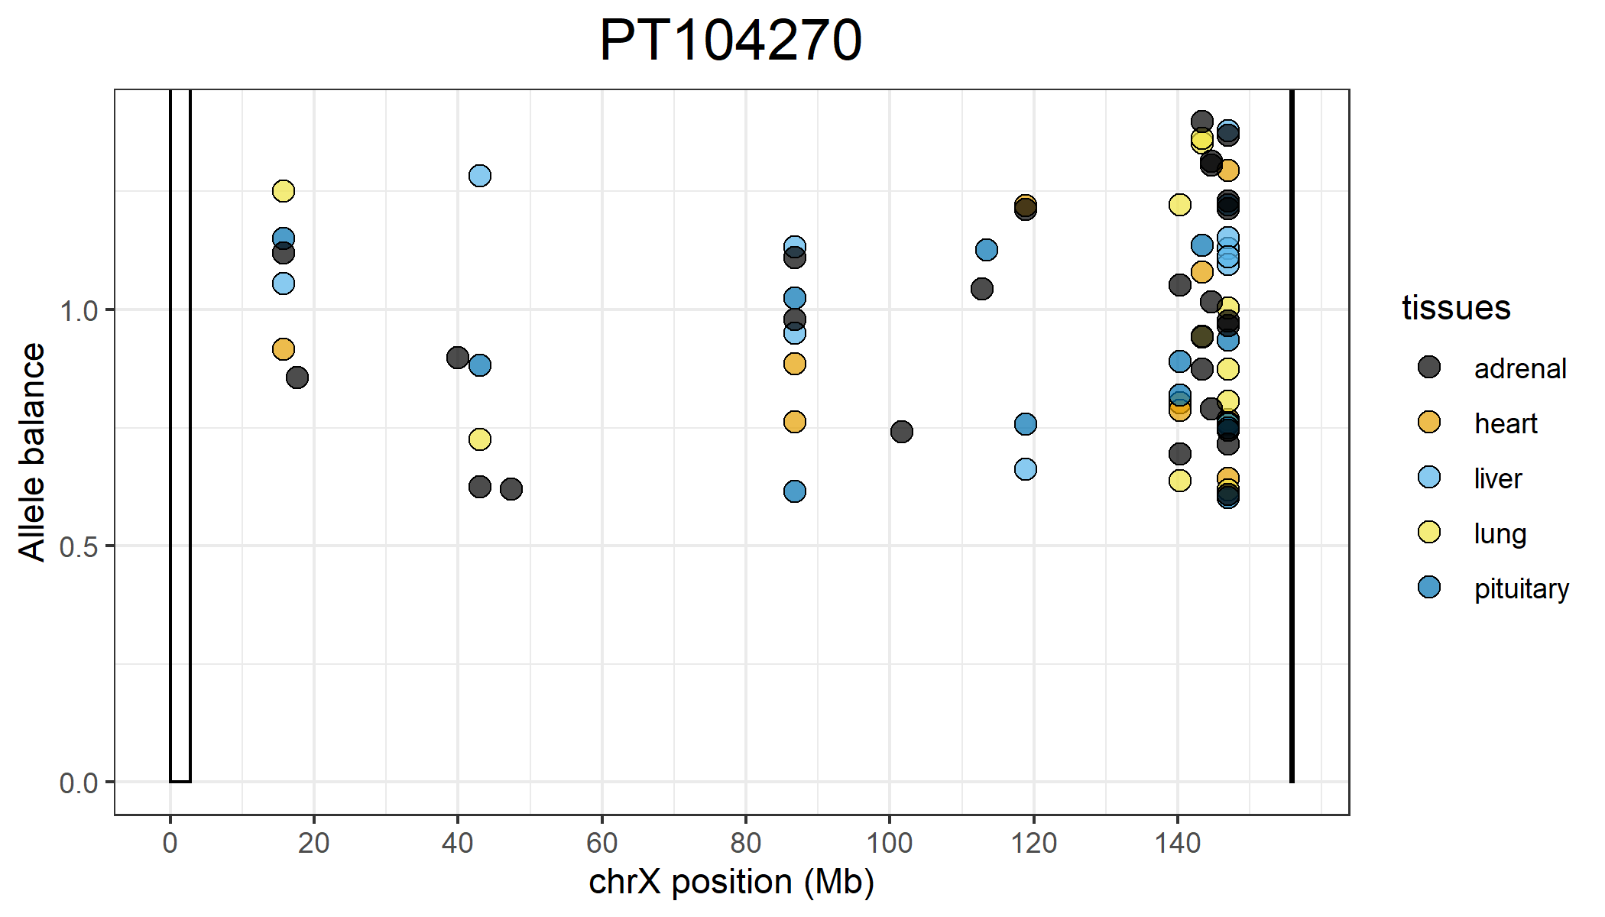
Positions on the X that are completely skewed that are shared across all 5 tissues:
118,831,364
147,054,504
147,054,527
147,054,535
147,054,564
Positions on the X that are completely skewed that are shared across all 5 tissues:
15,705,225
147,054,504
147,054,535
147,054,564

