Slide 1
For each individual:
For each tissue:
Identify positions on chrX where allele balance is equal to 1
Phase chrX

Slide 2
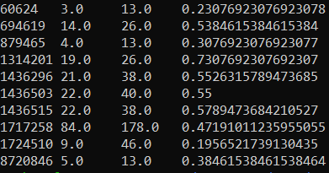
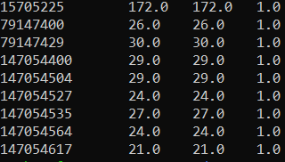
PT101159
heart
Allele balance
Obtain the positions where the allele balance is equal to 1 (completely skewed)
Total number of reads
position
Number of reads for the biased allele (biased allele is determined from phasing
Repeat for all of the tissues within an individual

Slide 3
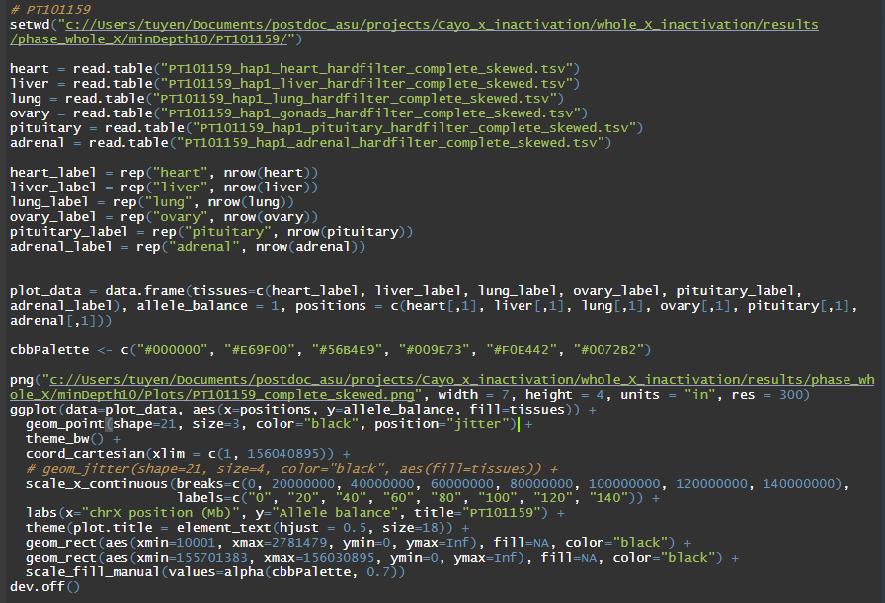

Slide 4
Phased chrX Cayo

Slide 5
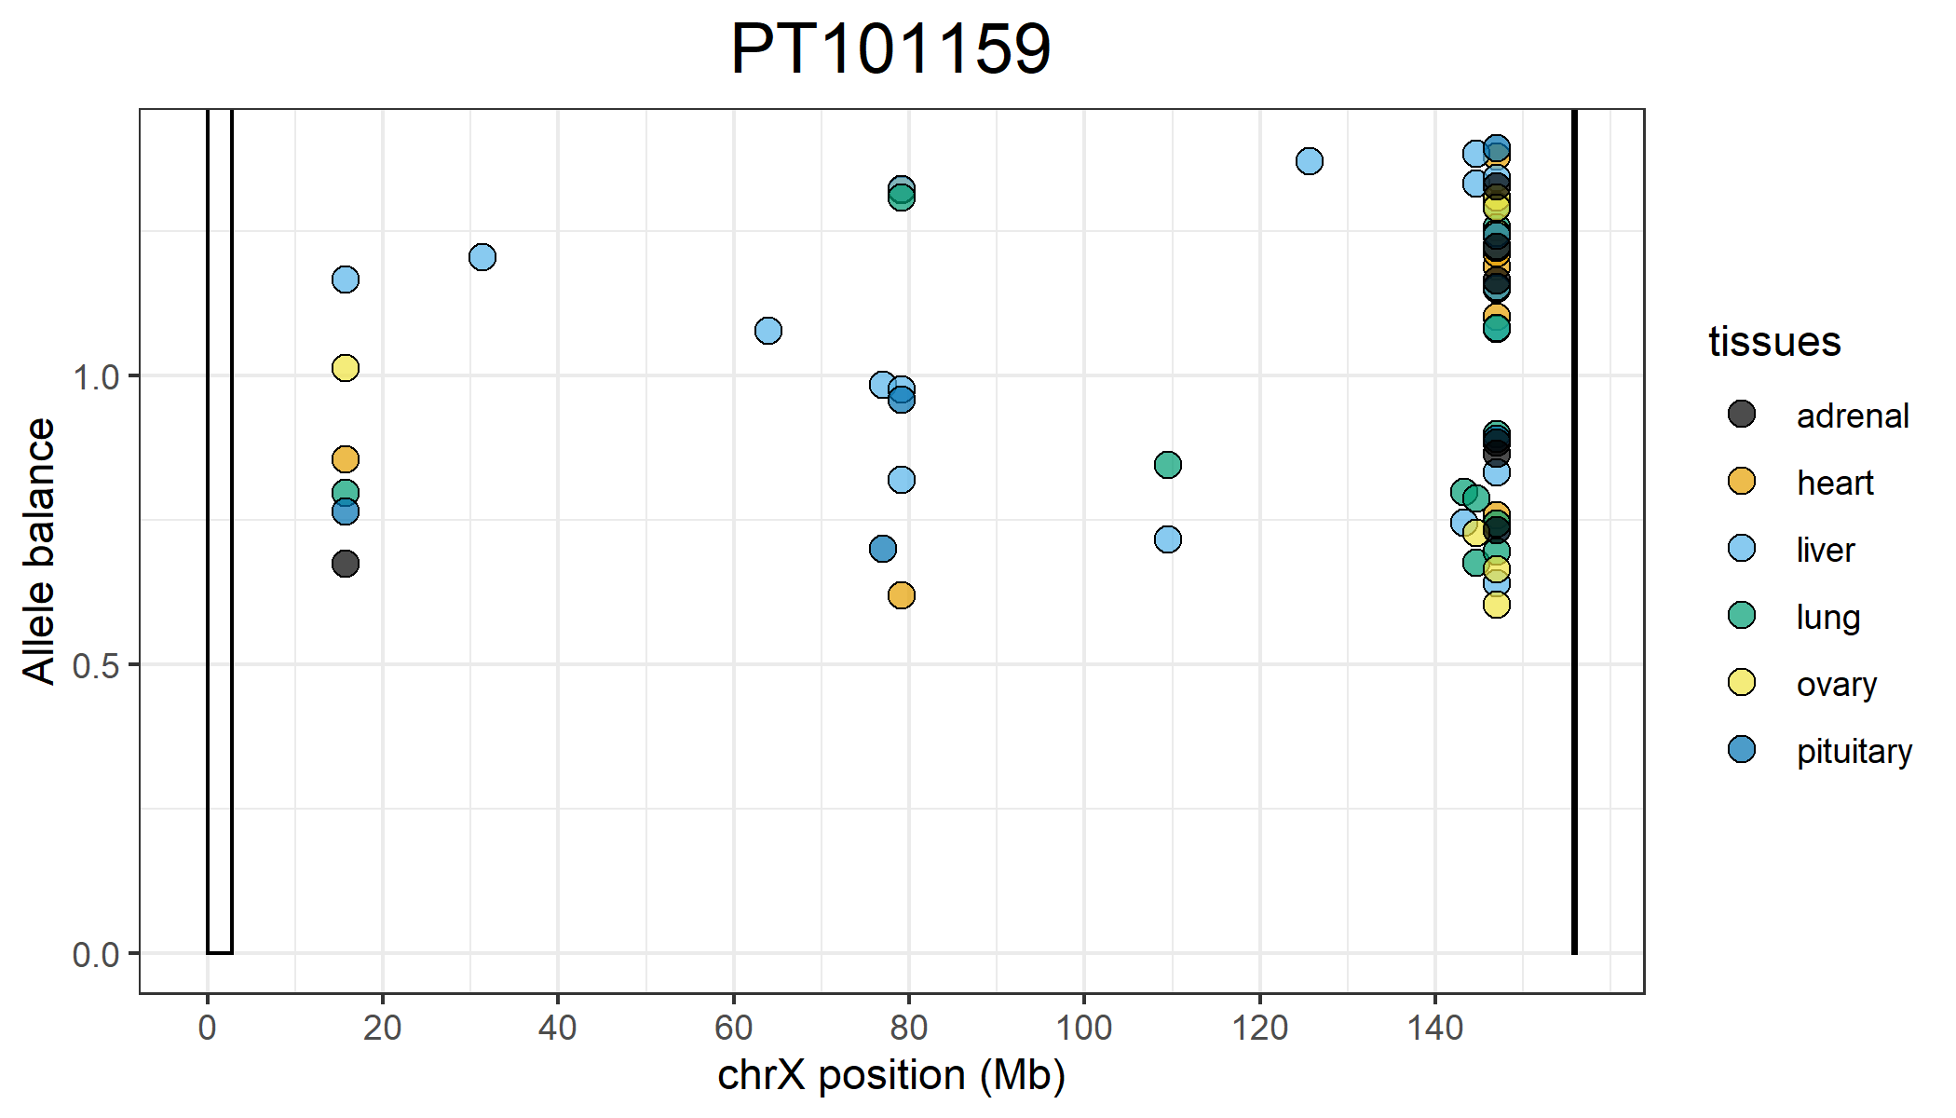
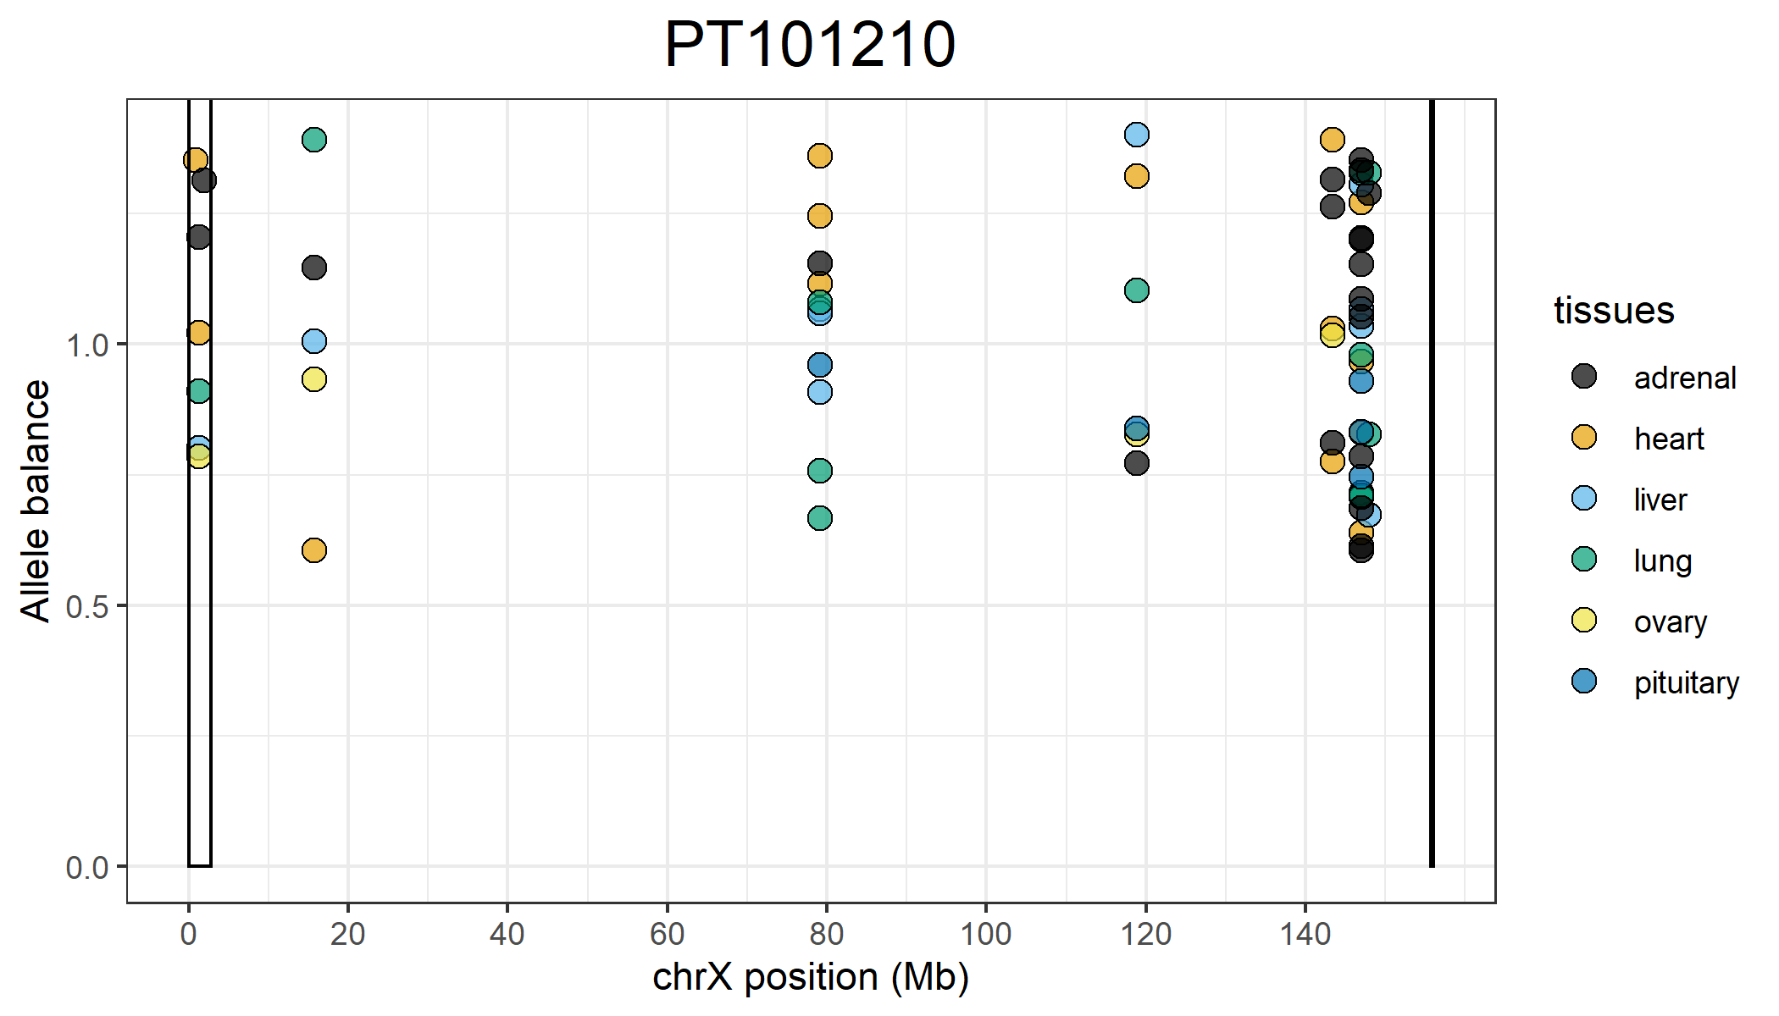
Positions on the X that are completely skewed that are shared across all 6 tissues:
15,705,225
147,054,504
147,054,527
147,054,535
147,054,564
Positions on the X that are completely skewed that are shared across all 6 tissues:
118,831,364

Slide 6
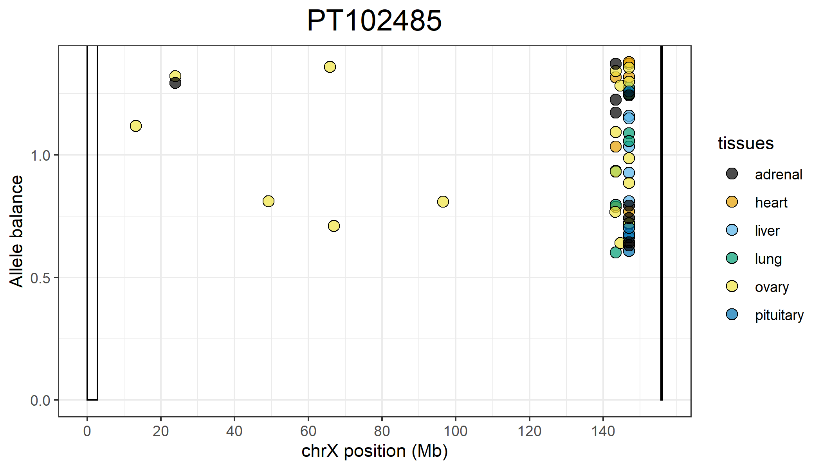
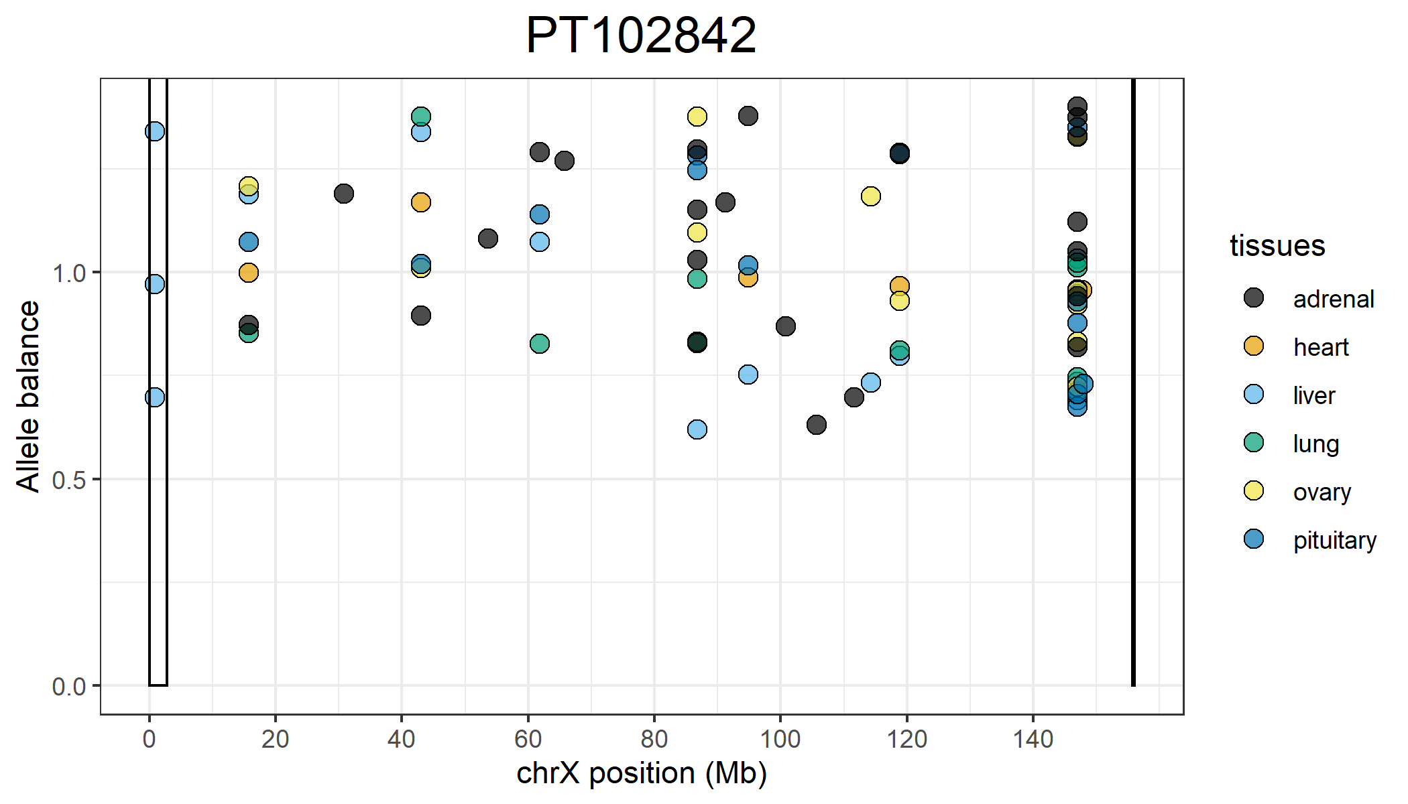
Positions on the X that are completely skewed that are shared across all 6 tissues:
147,054,504
147,054,527
147,054,535
147,054,564
147,054,617
Positions on the X that are completely skewed that are shared across all 6 tissues:
15,705,200
43,034,819
118,831,364

Slide 7
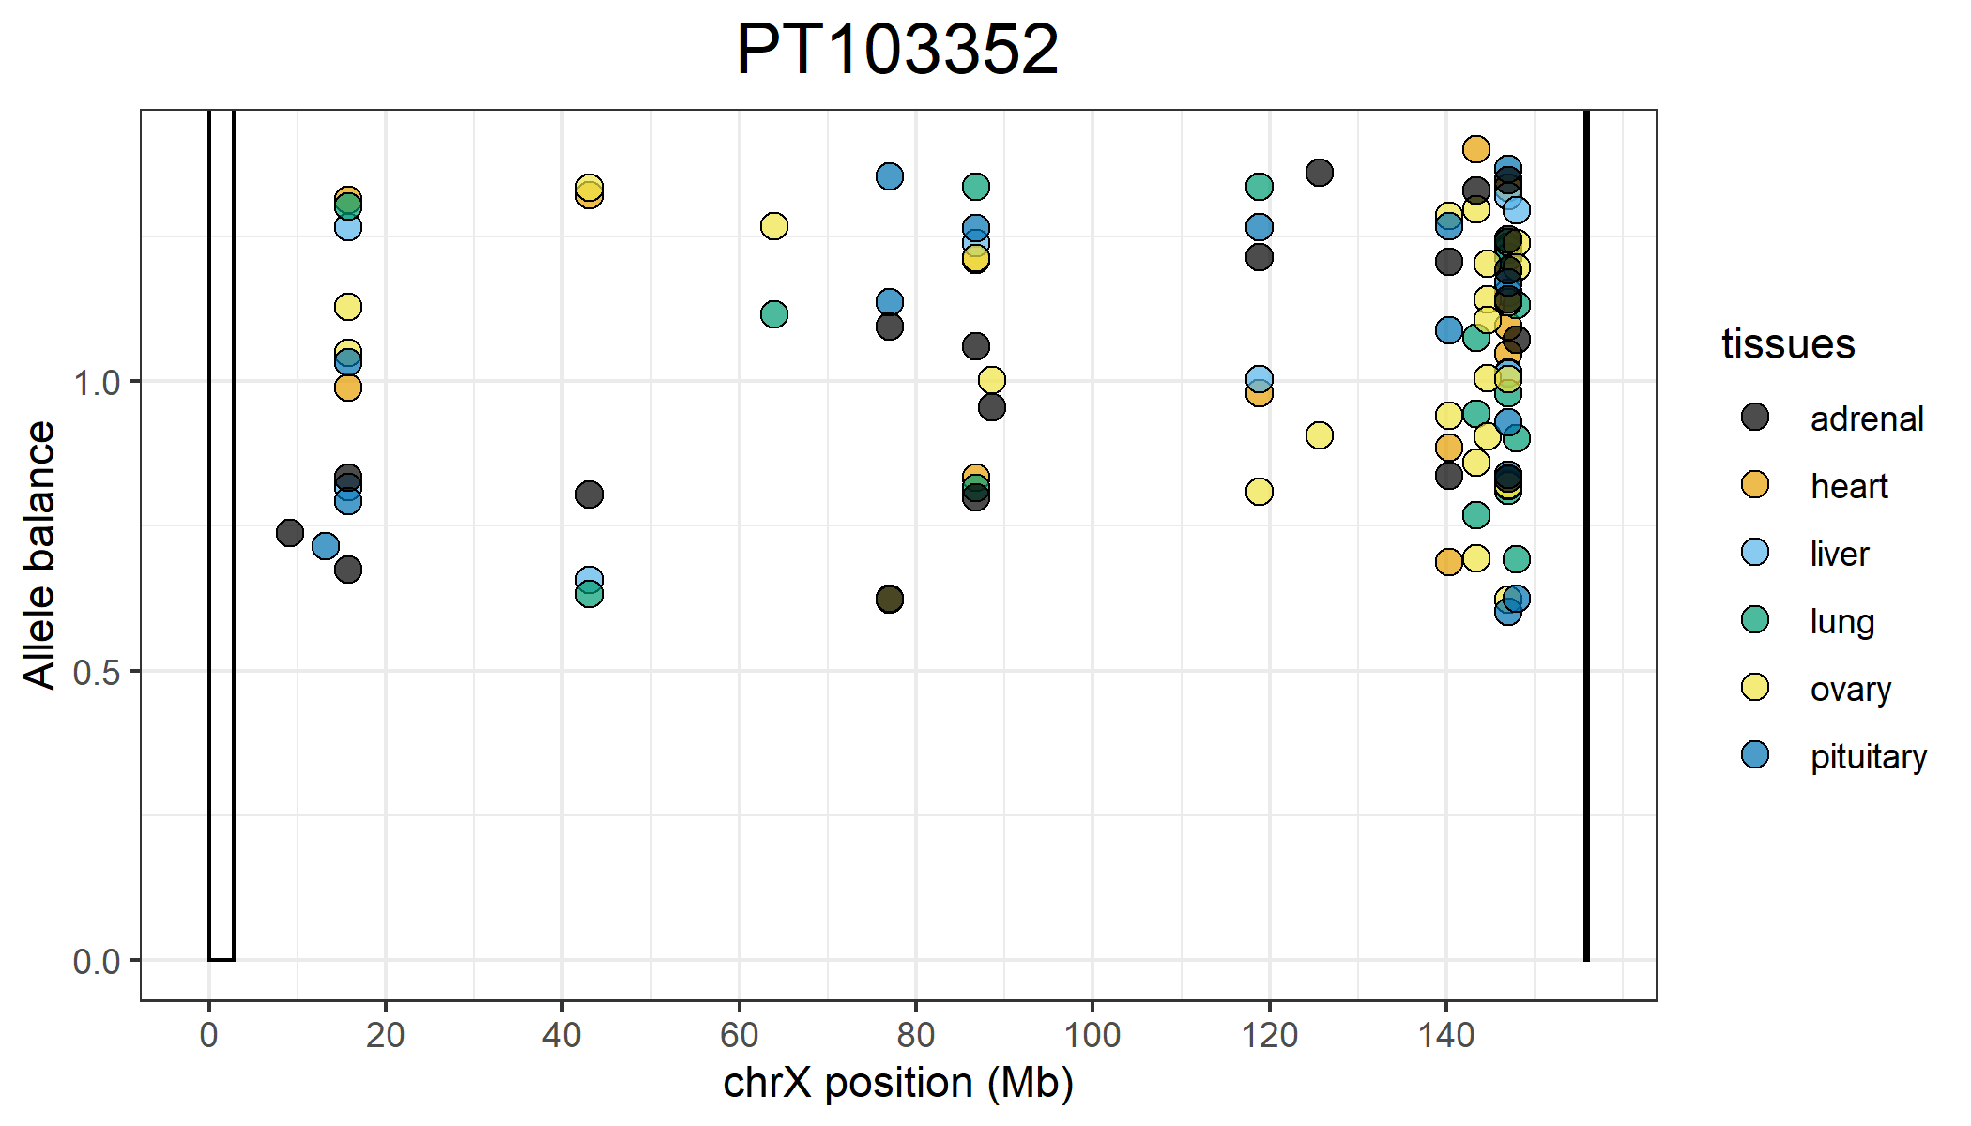
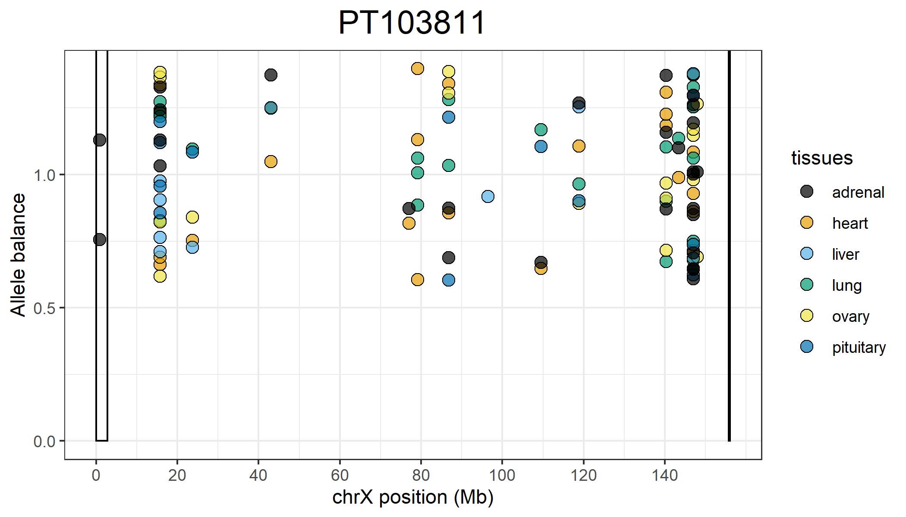
Positions on the X that are completely skewed that are shared across all 6 tissues:
15,705,233
118,831,364
147,054,400
147,054,504
147,054,527
147,054,535
147,054,564
Positions on the X that are completely skewed that are shared across all 6 tissues:
15,705,200
15,705,225
15,705,233
15,705,394
118,831,364
147,054,504
147,054,527
147,054,535

Slide 8
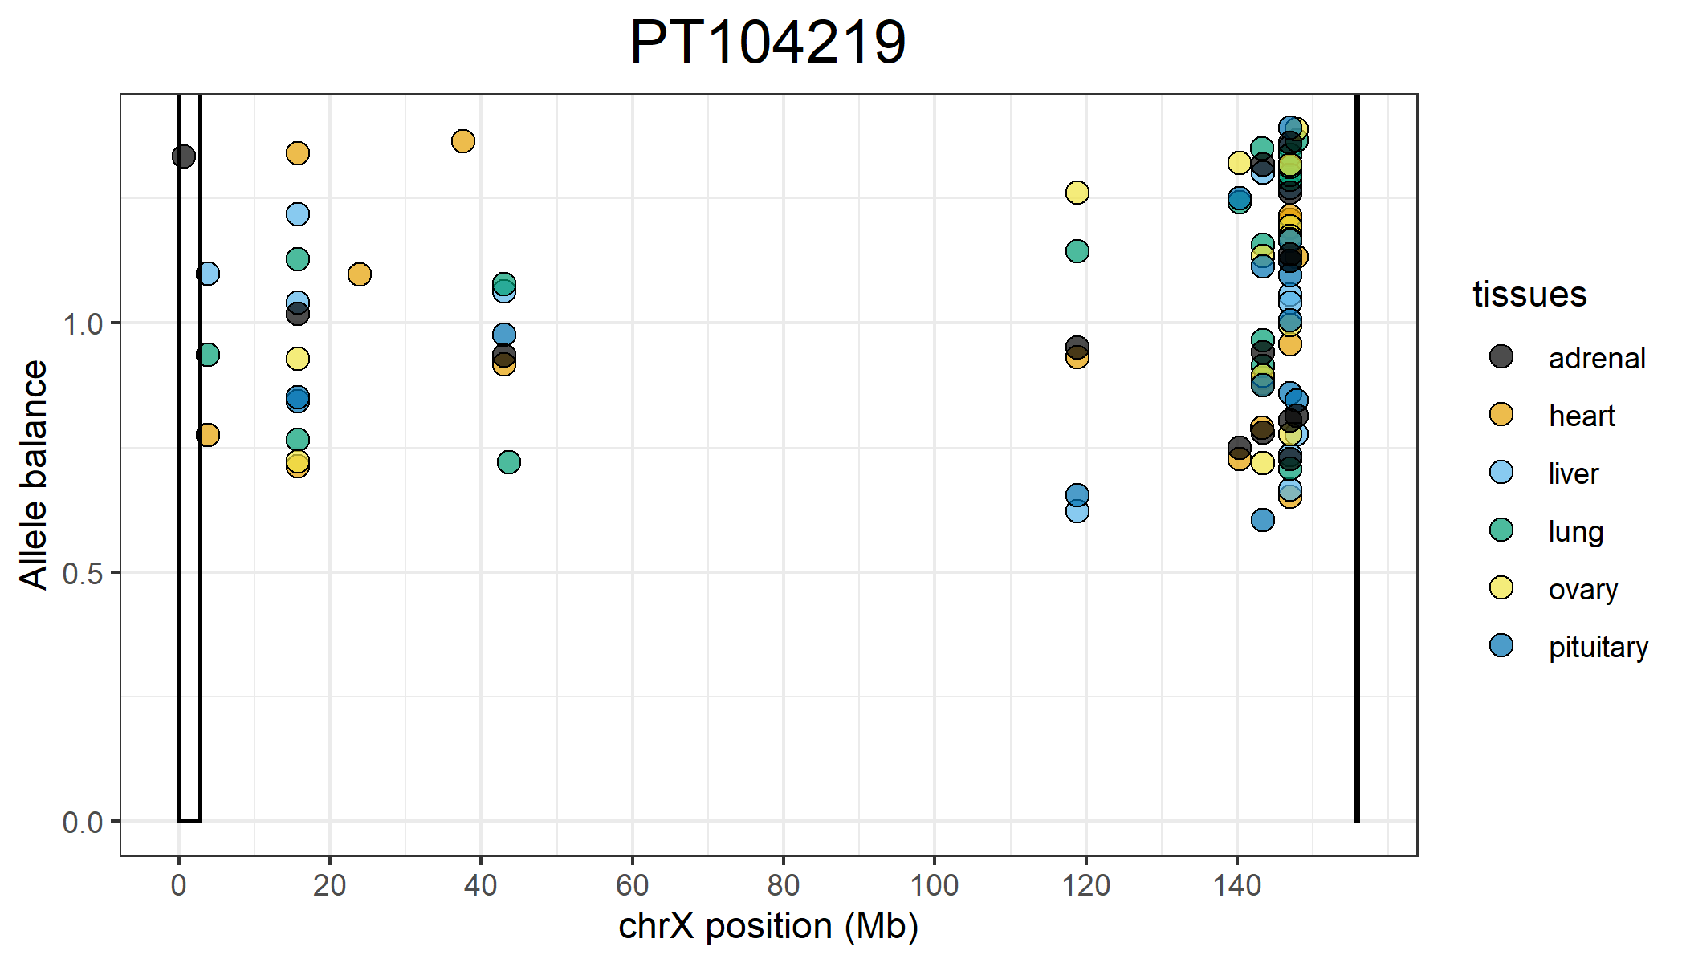
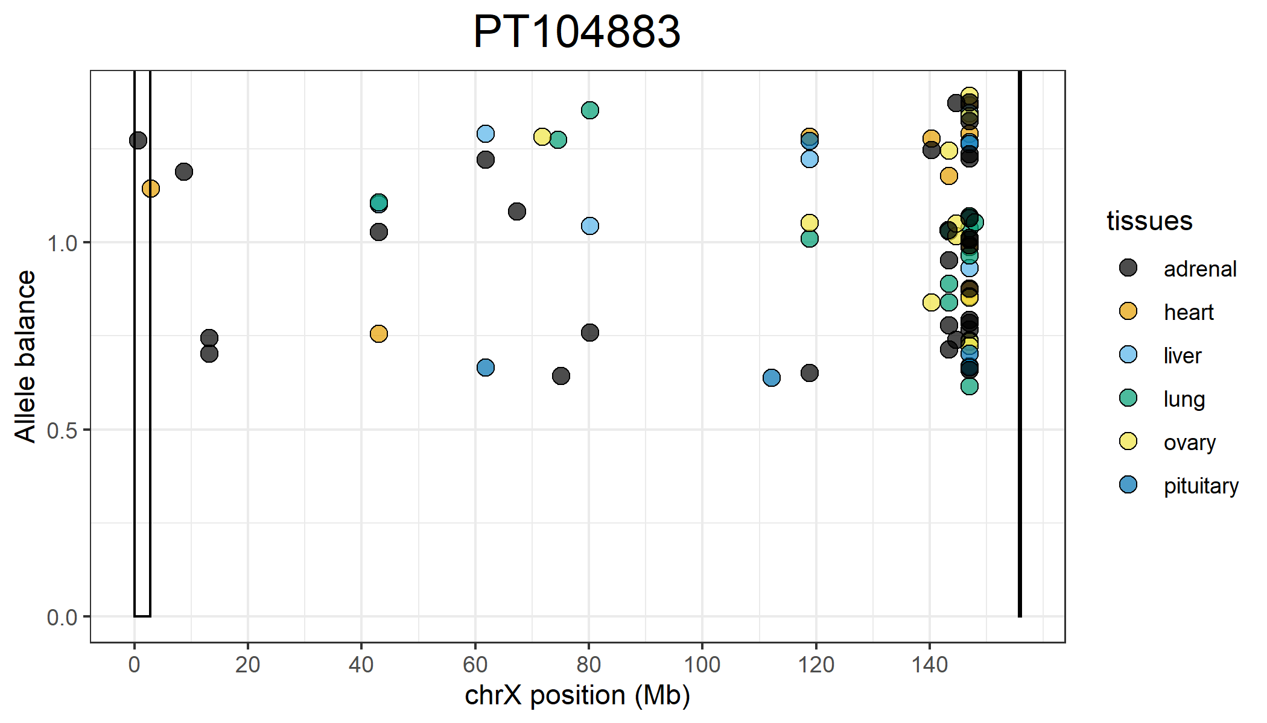
Positions on the X that are completely skewed that are shared across all 6 tissues:
15,705,225
118,831,364
143,373,439
147,054,400
147,054,504
147,054,527
147,054,535
147,054,564
147,054,617
147,823,222
Positions on the X that are completely skewed that are shared across all 6 tissues:
118,831,364
147,054,527
147,054,535
147,054,564

Slide 9
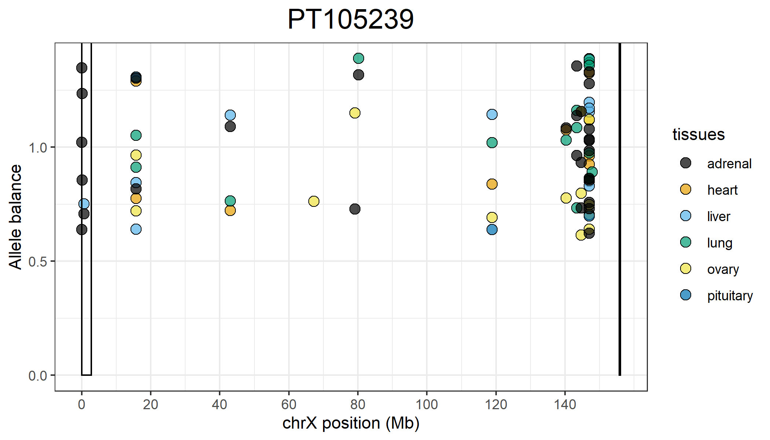
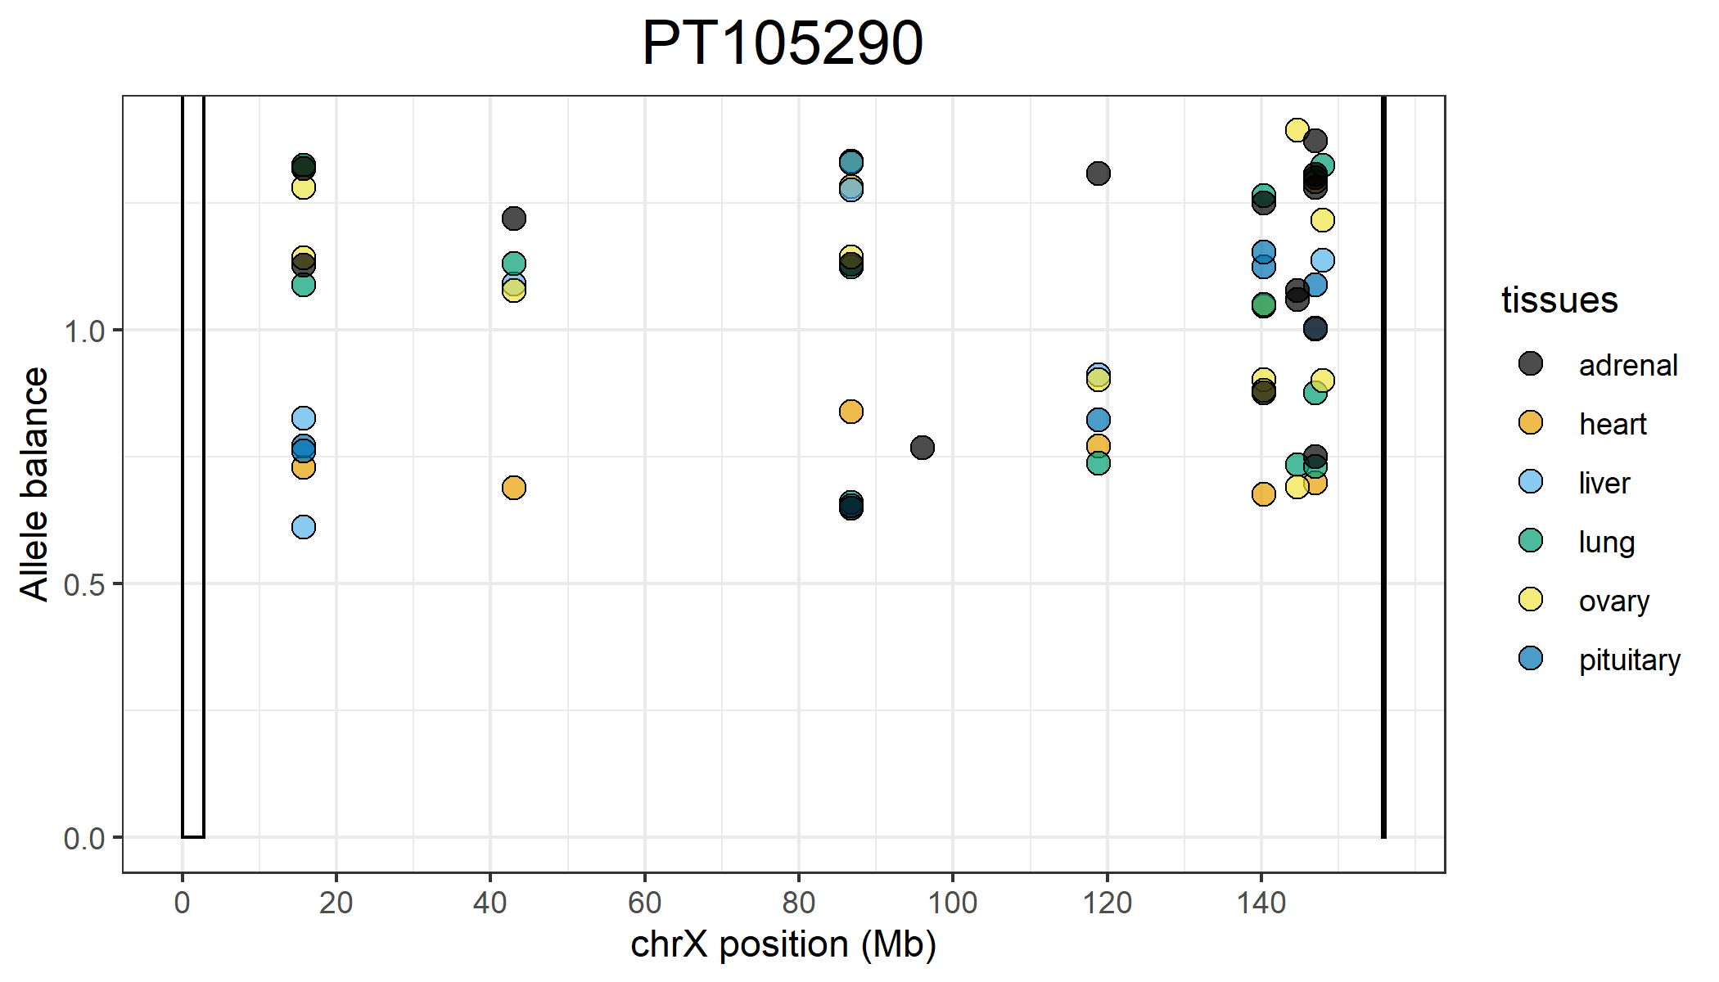
Positions on the X that are completely skewed that are shared across all 6 tissues:
15,705,225
147,054,504
Positions on the X that are completely skewed that are shared across all 6 tissues:
15,705,225
15,705,233
86,750,672
118,831,364

Slide 10
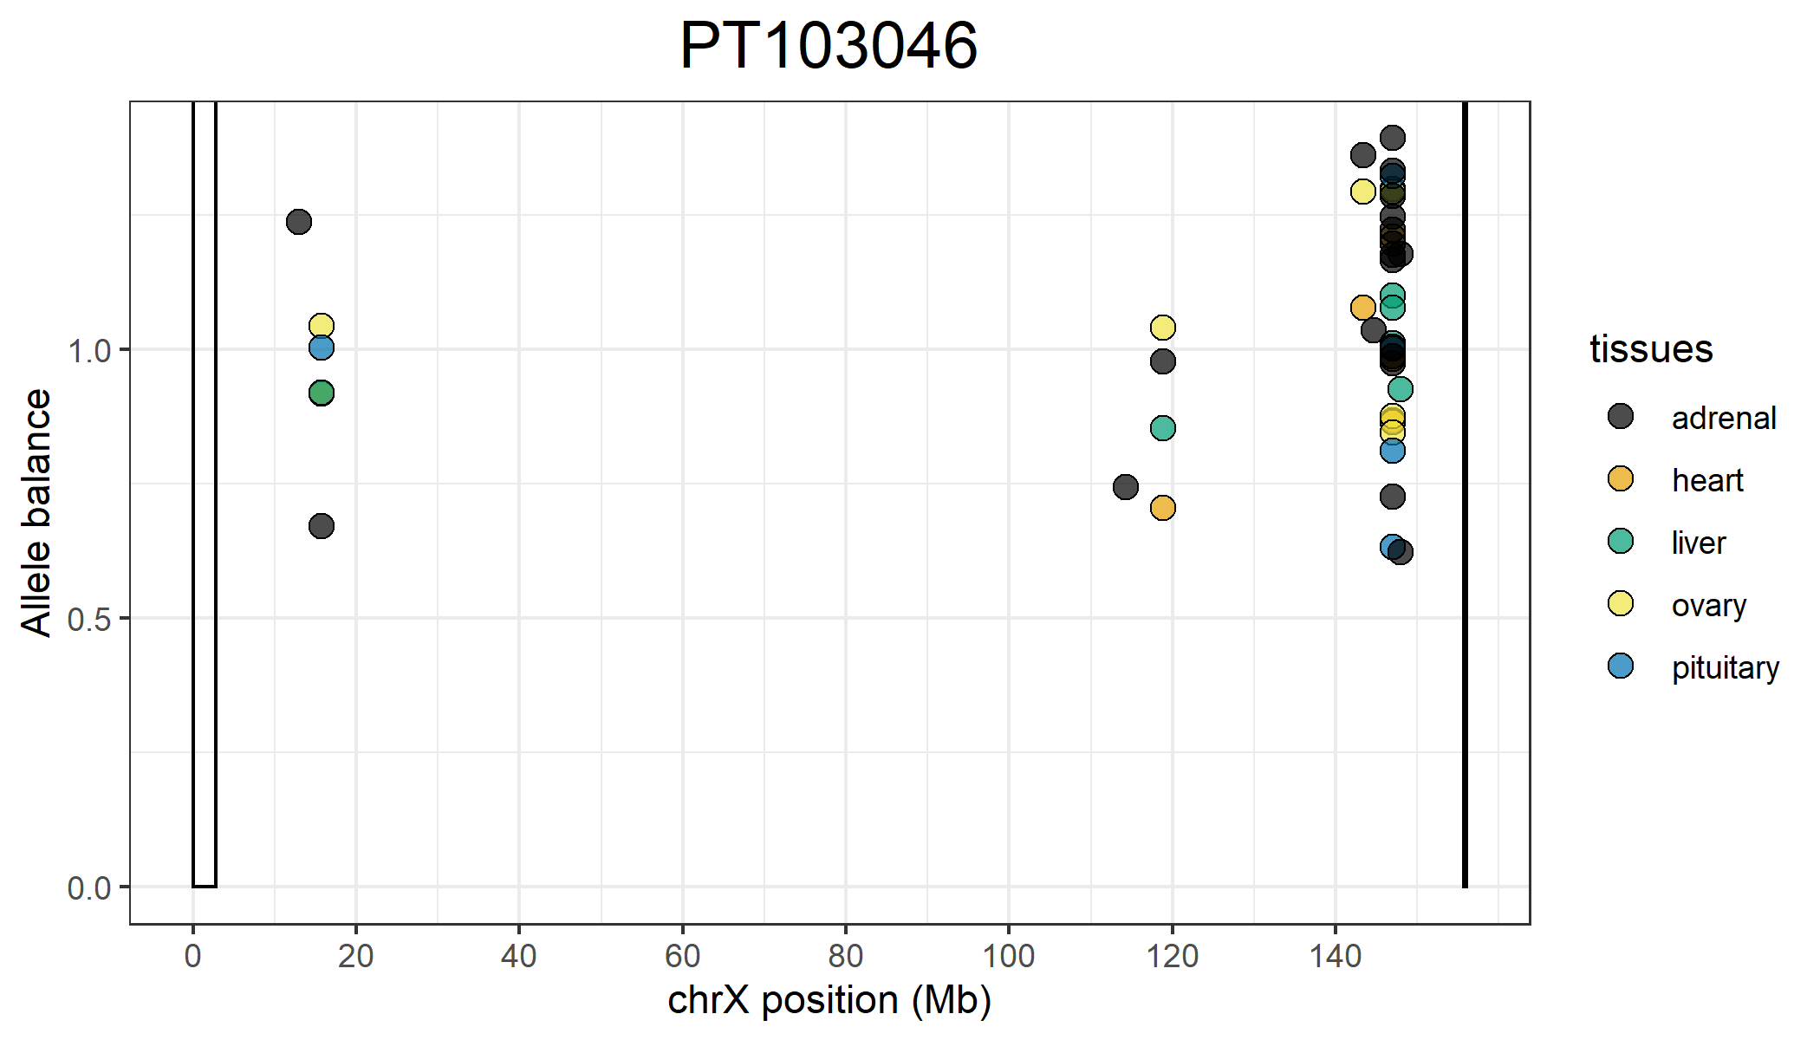
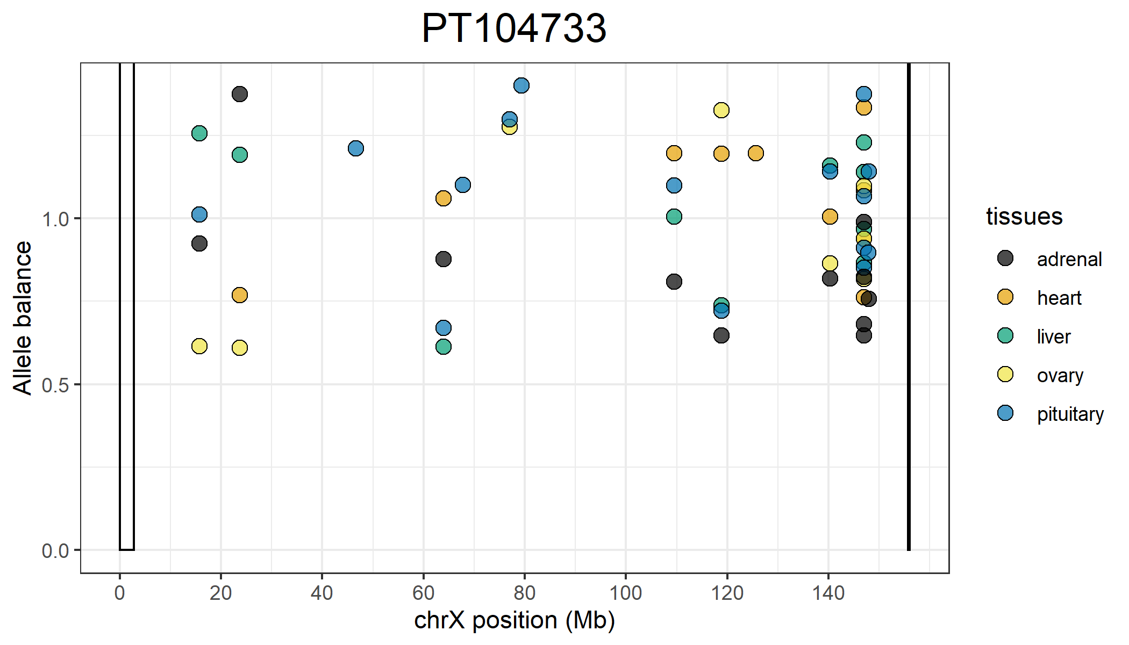
Positions on the X that are completely skewed that are shared across all 5 tissues:
15,705,394
147,054,527
147,054,564
Positions on the X that are completely skewed that are shared across all 5 tissues:
118,831,364
140,353,426
147,054,504
147,054,527
147,054,535

Slide 11
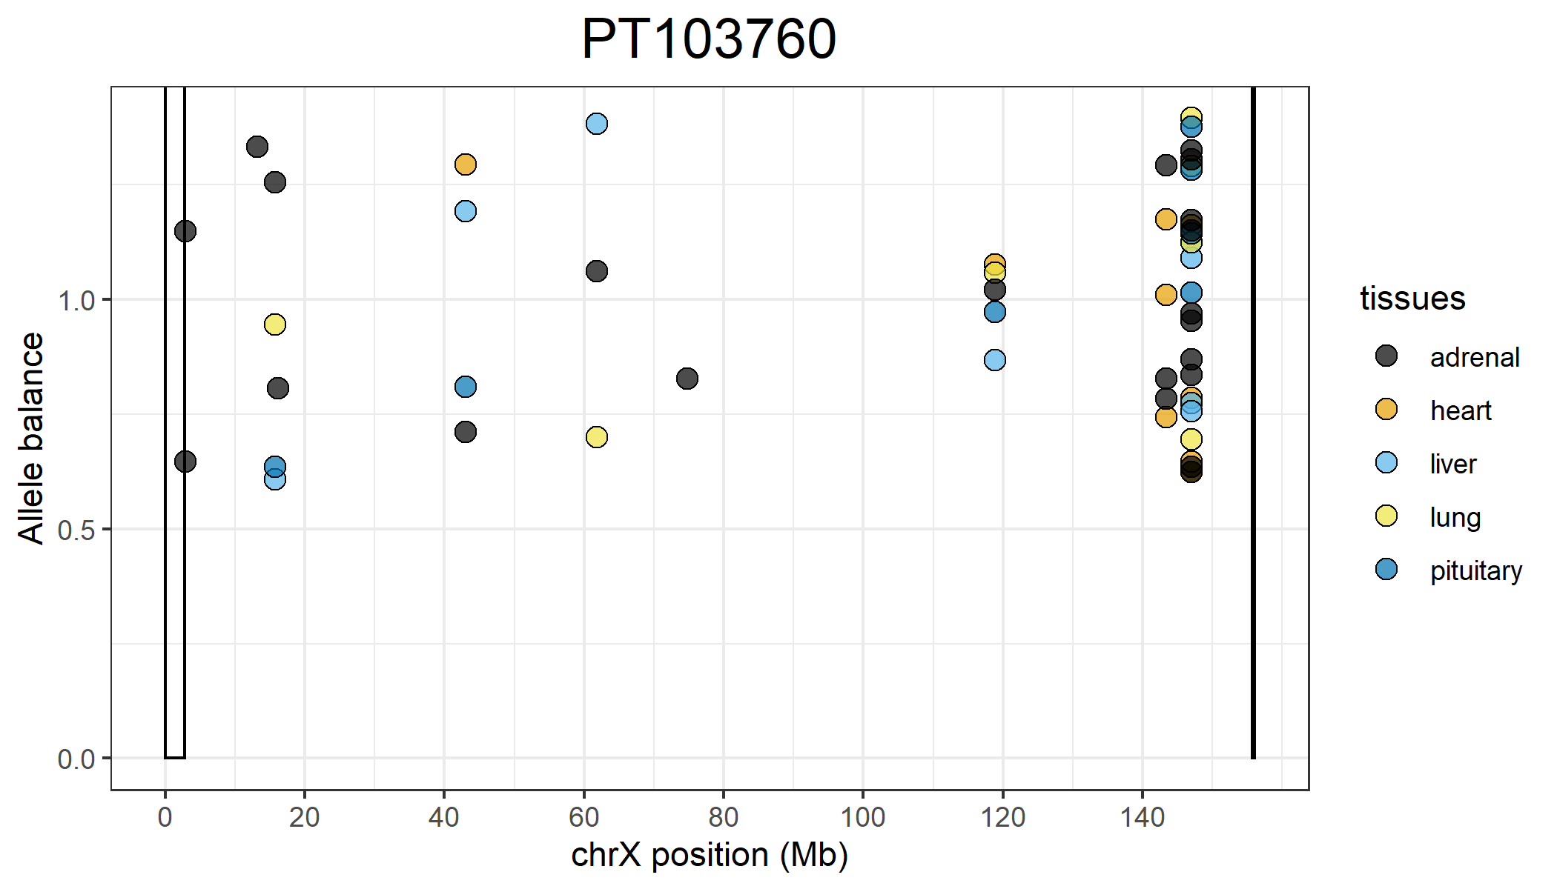
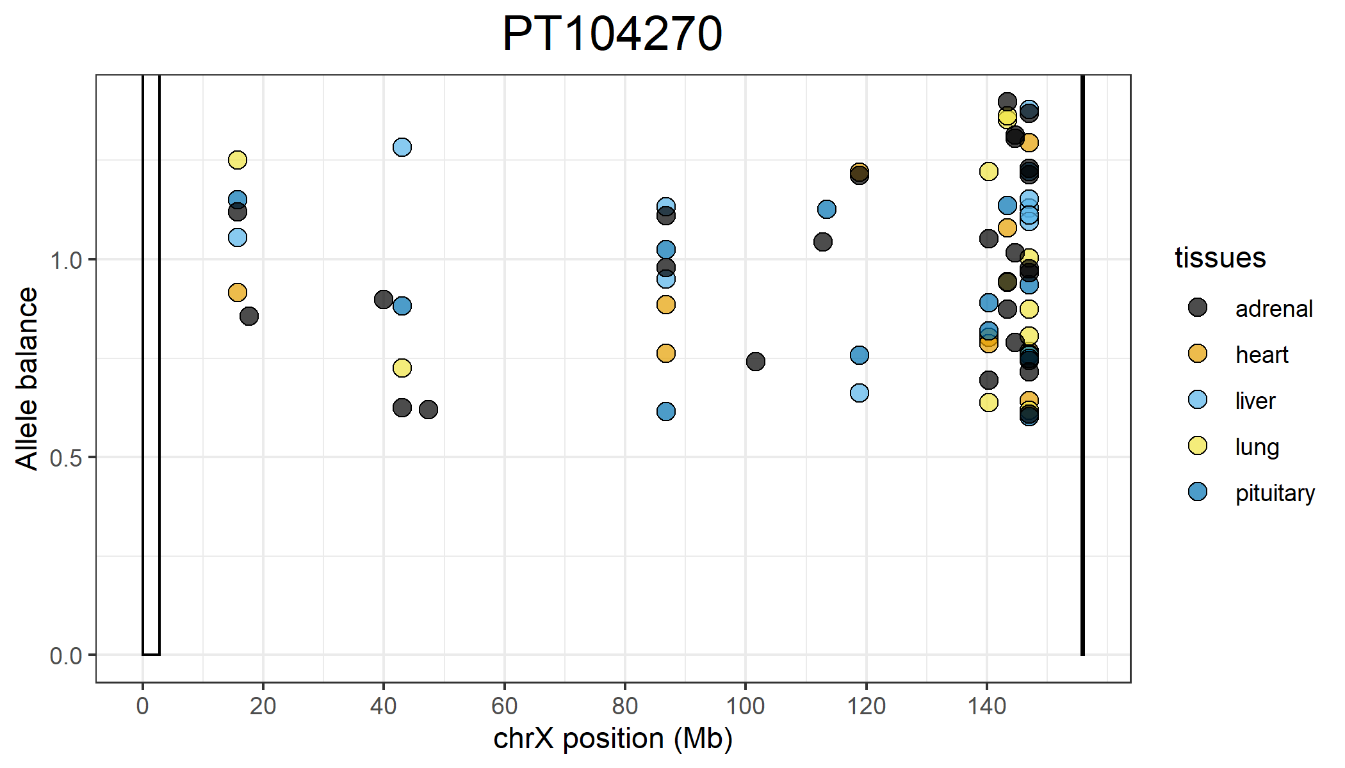
Positions on the X that are completely skewed that are shared across all 5 tissues:
118,831,364
147,054,504
147,054,527
147,054,535
147,054,564
Positions on the X that are completely skewed that are shared across all 5 tissues:
15,705,225
147,054,504
147,054,535
147,054,564

Slide 12
Phased chrX GTEx

Slide 13
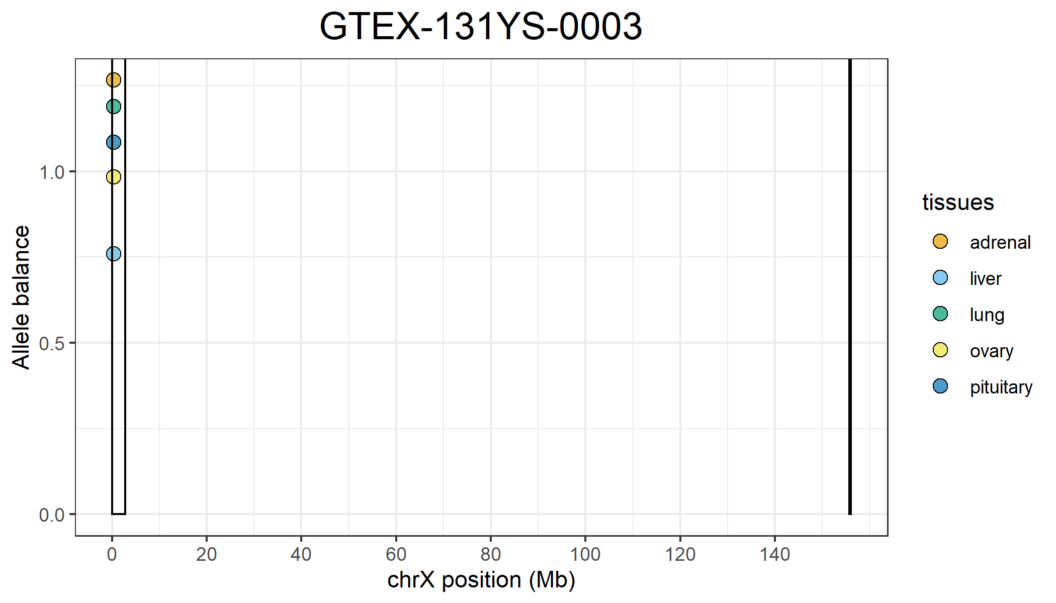
Tissue | How many variants that are completely skewed? | Positions
Heart | 0
Liver | 1 | 311858
Lung | 1 | 311858
Ovary | 1 | 311858
Pituitary | 1 | 311858
Adrenal | 1 | 311858

Slide 14
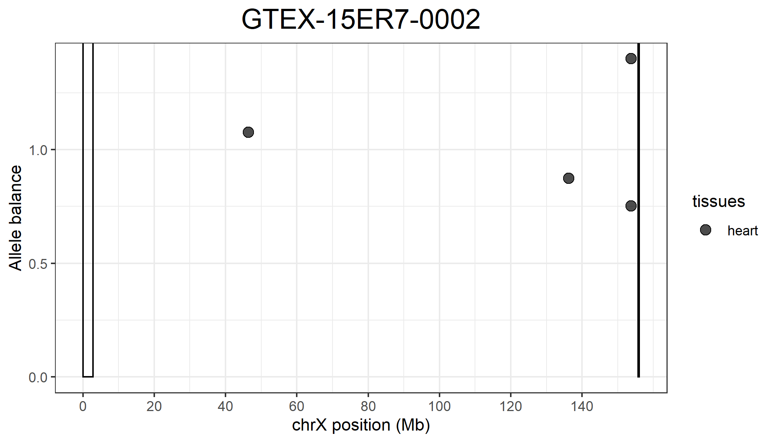
Tissue | How many variants that are completely skewed? | Positions
Heart | 4 | 46440204, 136228626, 136228626, 153784707
Liver | 0
Lung | 0
Ovary | 0
Pituitary | 0
Adrenal | 0

Slide 15
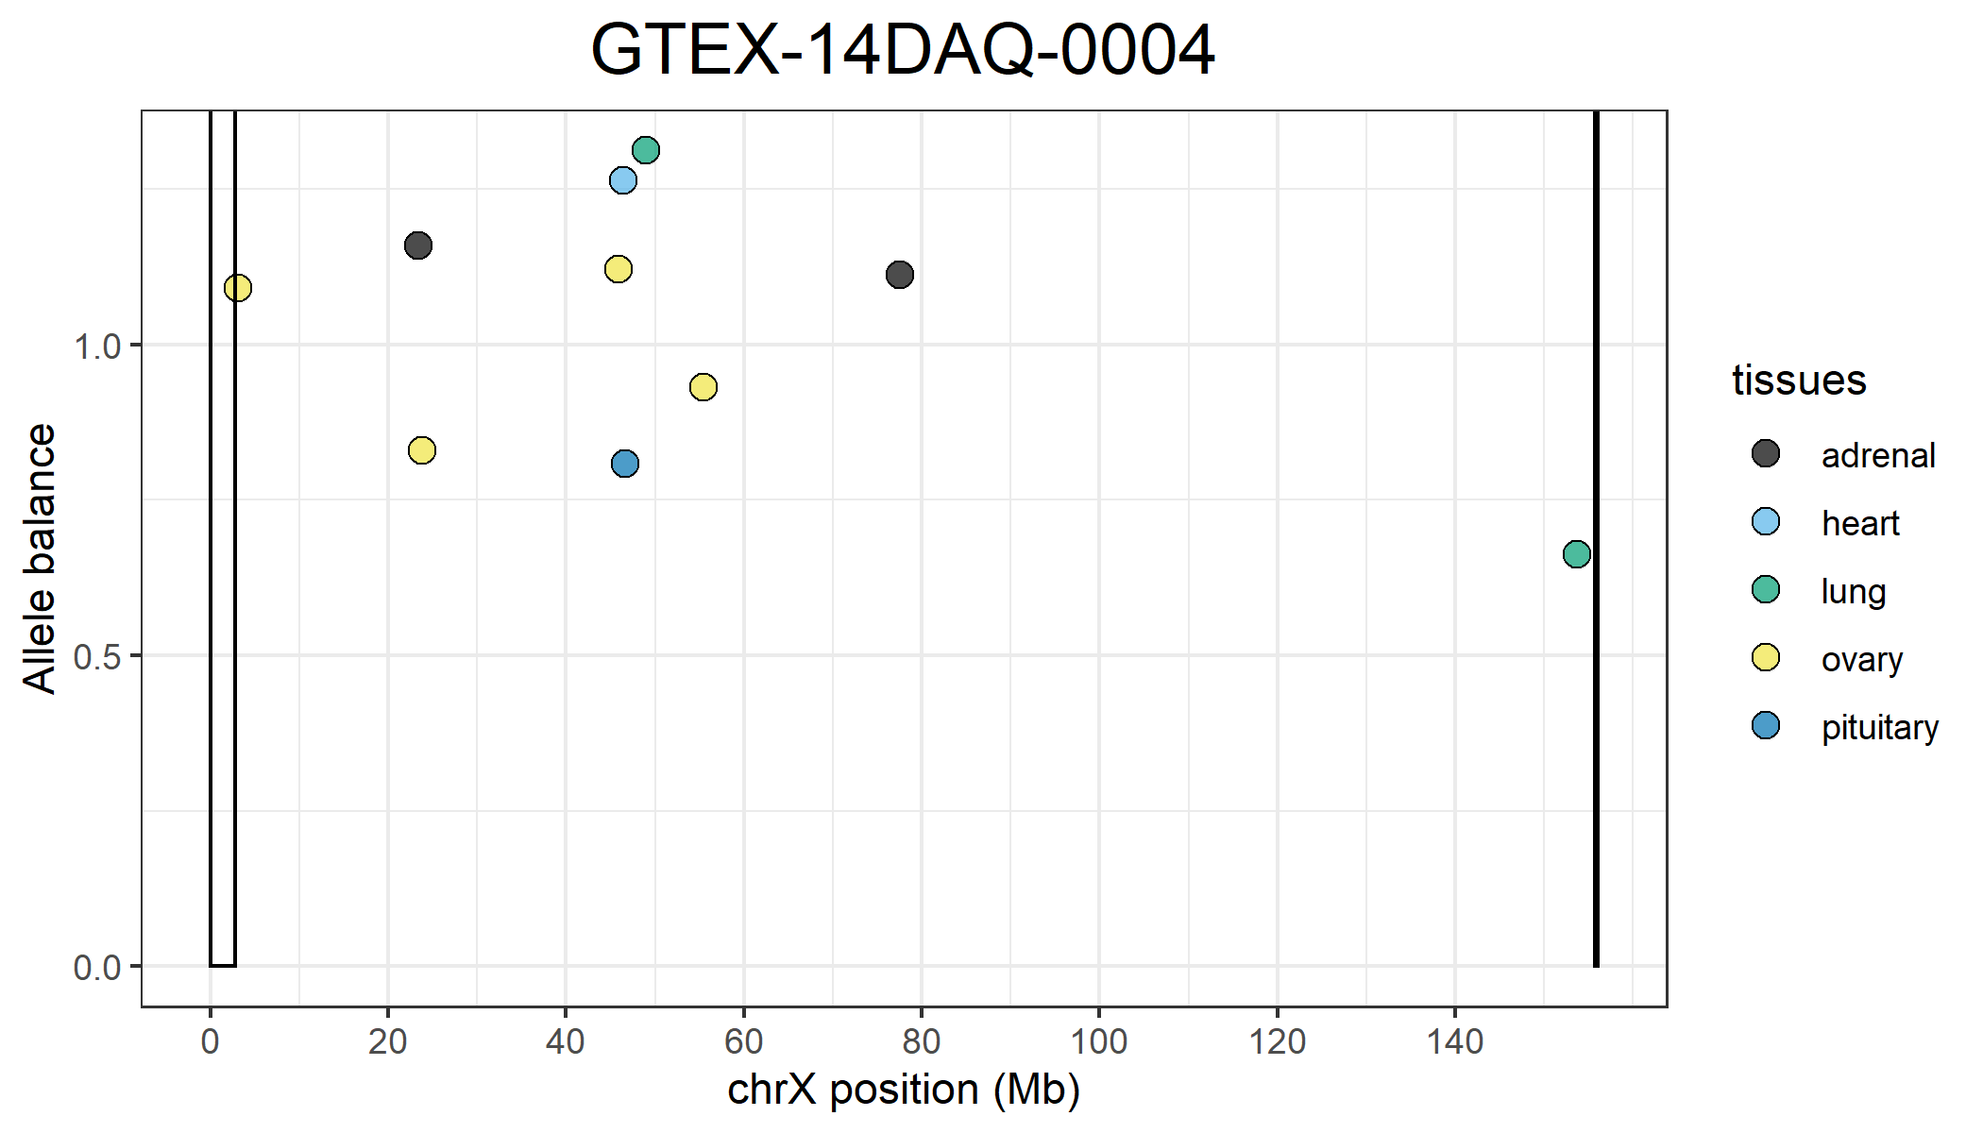
Tissue | How many variants that are completely skewed? | Positions
Heart | 1 | 46440204
Liver | 0
Lung | 2 | 48575111, 154462057
Ovary | 4 | 3321504, 23783476, 46440204, 54927214
Pituitary | 1 | 46440204
Adrenal | 2 | 23783476, 78125505

Slide 16
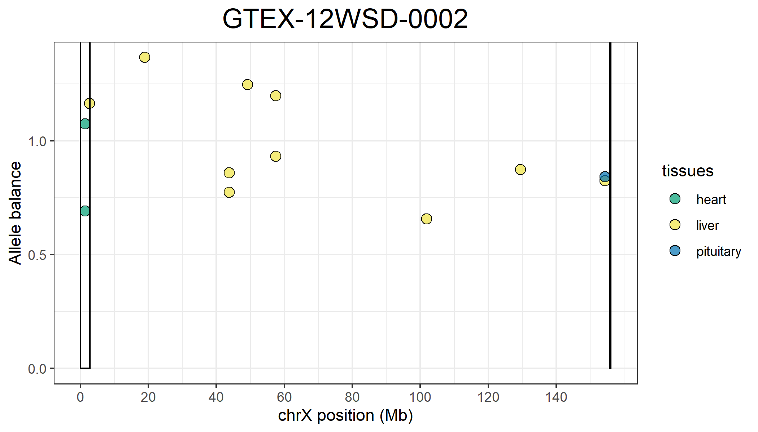
Tissue | How many variants that are completely skewed? | Positions
Heart | 2 | 1412872, 1412877
Liver | 10 | 2717448, 18893947, 43768752, 43768865, 49175859, 57448699, 57489006, 101886821, 129448500, 154348765
Lung | 0
Ovary | 0
Pituitary | 1 | 154348765
Adrenal | 0

Slide 17
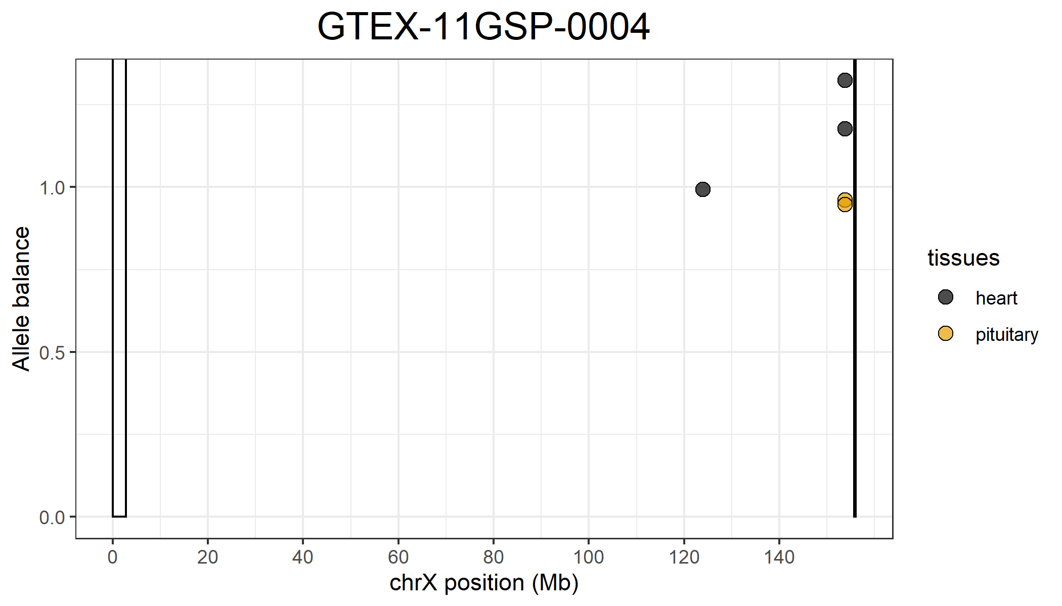
Tissue | How many variants that are completely skewed? | Positions
Heart | 3 | 123913073, 153784705, 153784707
Liver | 0
Lung | 0
Ovary | 0
Pituitary | 2 | 153784705, 153784707
Adrenal | 0

Slide 18
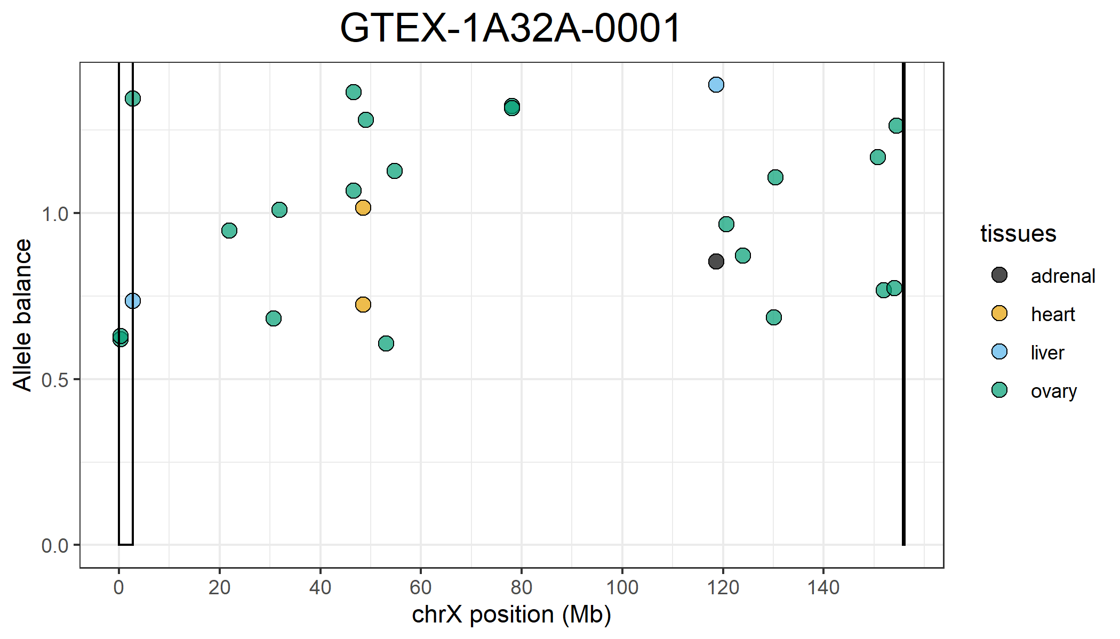
Tissue | How many variants that are completely skewed? | Positions
Heart | 2 | 48577014, 48577017
Liver | 2 | 2717448, 118685810
Lung | 0
Ovary | 21 | 284193, 290695, 2717448, 21967346, 30727673, 31875190, 46607325, 46613391, 49076231, 53087548, 54813580, 78125505, 78125517, 120626774, 123913432, 130067204, 130364862, 150762633, 151956016, 154014407, 154429242
Pituitary | 0
Adrenal | 1 | 118685810

Slide 19
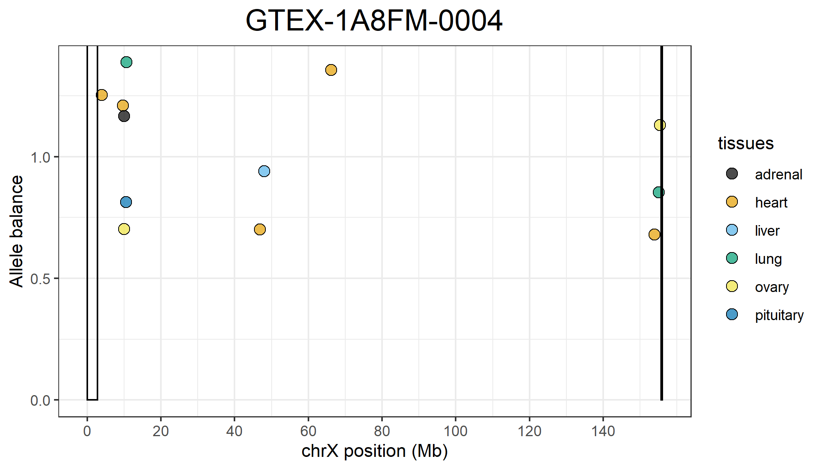
Tissue | How many variants that are completely skewed? | Positions
Heart | 5 | 3818448, 10143330, 46440204, 66207198, 153784707
Liver | 1 | 48576920
Lung | 2 | 10143330, 155309667
Ovary | 2 | 10143330, 155309667
Pituitary | 1 | 10143330
Adrenal | 1 | 10143330

Slide 20
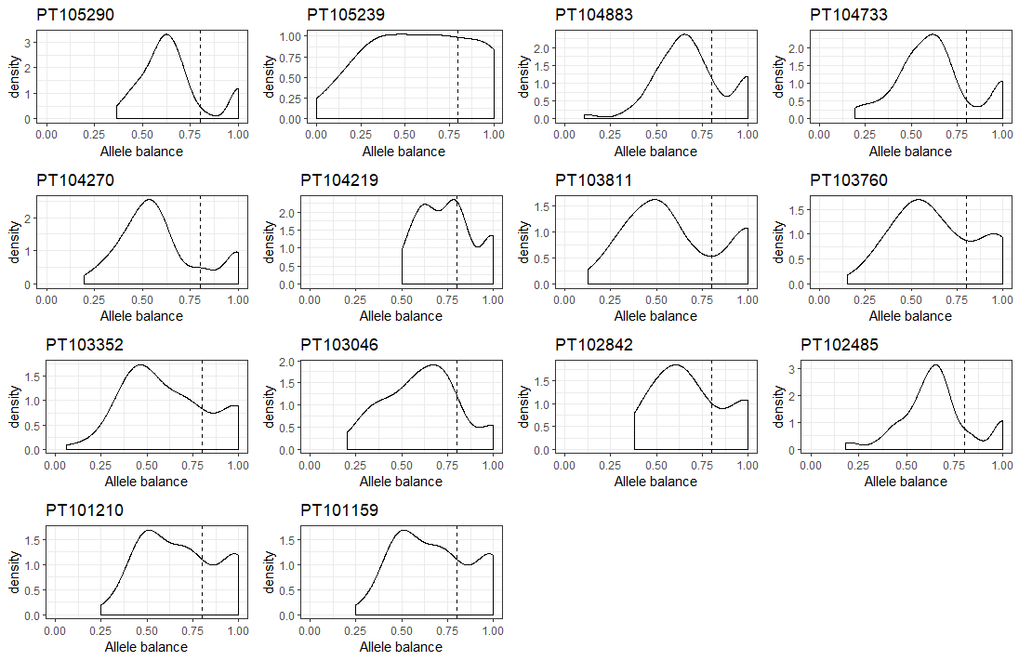
HEART TISSUE
Cayo

Slide 21
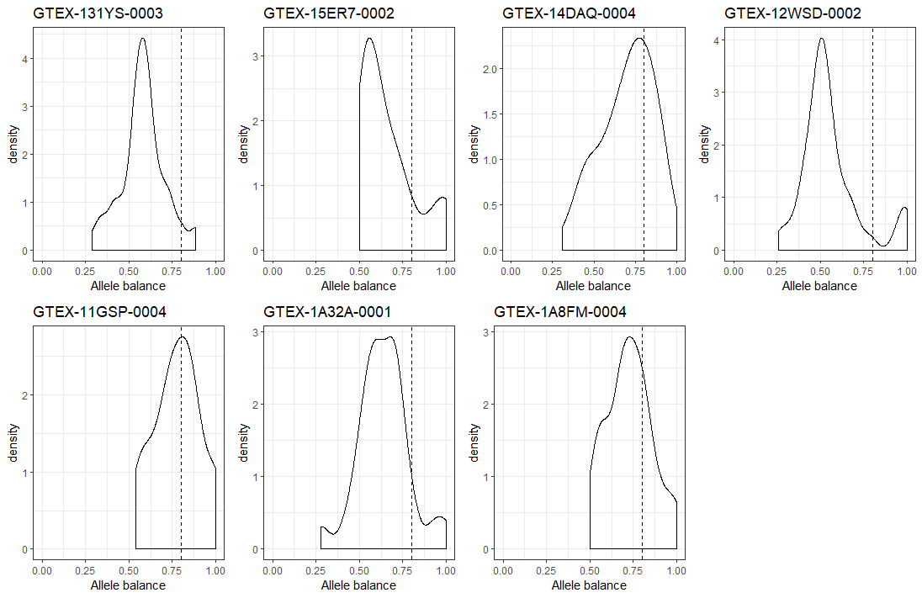
HEART TISSUE
GTEx

