Slide 1
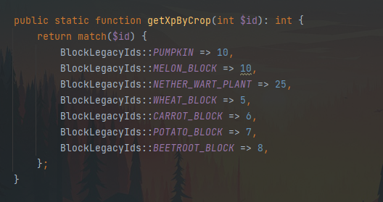
Farming Changes
Skill:
Replaces the farming levels from neptune
Shearing sheeps in the grinding world also gives farming xp
Farming in the grinding world (hypixel world) gives you farming xp
Farming at your island gives you 5x less farming xp
Skill levelup rewards (max 50 levels):
+2 pve health
Farming fortune (chance for multiple crops, crops will sell for decent $)
A few hundred to thousands of essence on levelup (depends on the level)
Rules:
- Afk farming bannable

