Slide 1
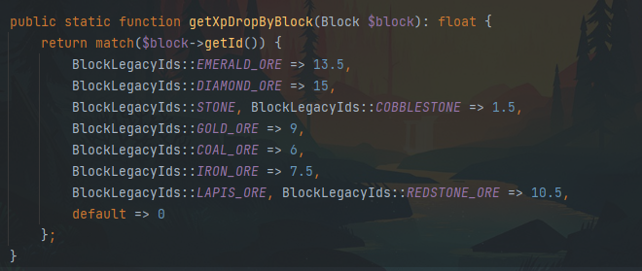
Rules:
- Afk mining bannable
Mining Changes
Skill:
There are mines (ore spreads across caves) you can mine ores at to get mining xp (maybe farming xp as well
Chance to get ess from mining these ores
There are PvE mobs in the mines that makes mining a bit difficult (those mobs are used in quest kills and drop items)
- Multiple mining caves/areas
Skill levelup rewards (max 50 levels):
+1 PVE defense
Mining fortune (chance for multiple drops, ores will sell for decent $)
A few hundred to thousands of essence on levelup (depends on the level)

