Slide 1
MINESWEEPER
Siddhartha Shering – 140110002
Pankil Nimje -140110092
Aditi Sharma -140110012
Shardul Kanvinde -140110009

Slide 2
PROBLEM STATEMENT
Minesweeper consists of a rectangular grid having multiple tiles. Some of the tiles contain mines and the rest don’t have mines.
To win, the player must uncover all the tiles that do not have mines .
If you uncover a mine, you lose.
Our goal is to create minesweeper game using C++.

Slide 3
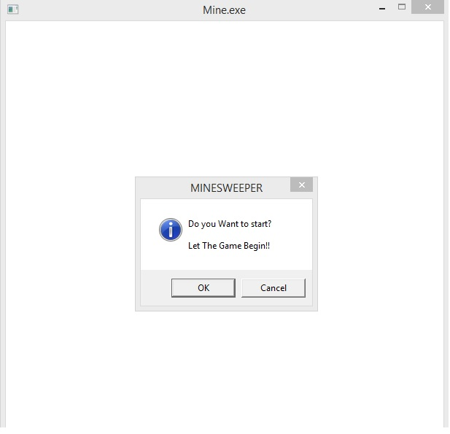
Screenshots

Slide 4
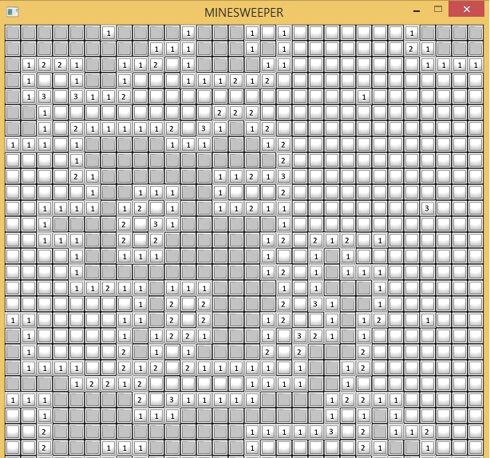
Screenshots

Slide 5
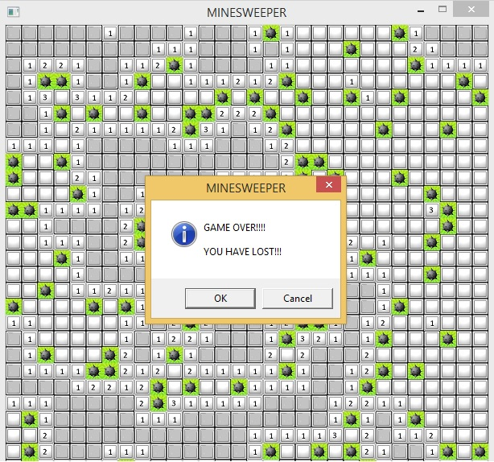
Screenshots

Slide 6
Challenges
The biggest problem we faced was to integrate graphics into the game.
Our prototype was console-based, but we wanted to include ‘Allegro 5’ graphics package.
So we had to rewrite some functions in a new format so that they could be used along with graphics

Slide 7
Future Work
As future work, one can include flags.
If you think that a location has a mine, you can place a flag there.
Also one can include sound effects.

