Slide 1

CARENOW
Family care
and local
transport
Innovation exhibition presentation
Working prototype and pilot proposal
Bangladesh · September 2026
AI-generated editorial illustration
Notes:
CareNow 1.2.1 is a working exhibition prototype. The team stated Innovator Exhibitor intent. No selection, endorsement, commercial traction or clinical effectiveness is claimed. Cover artwork is an original AI-generated editorial illustration. Public context: https://innovationfairbd.org/

Slide 2
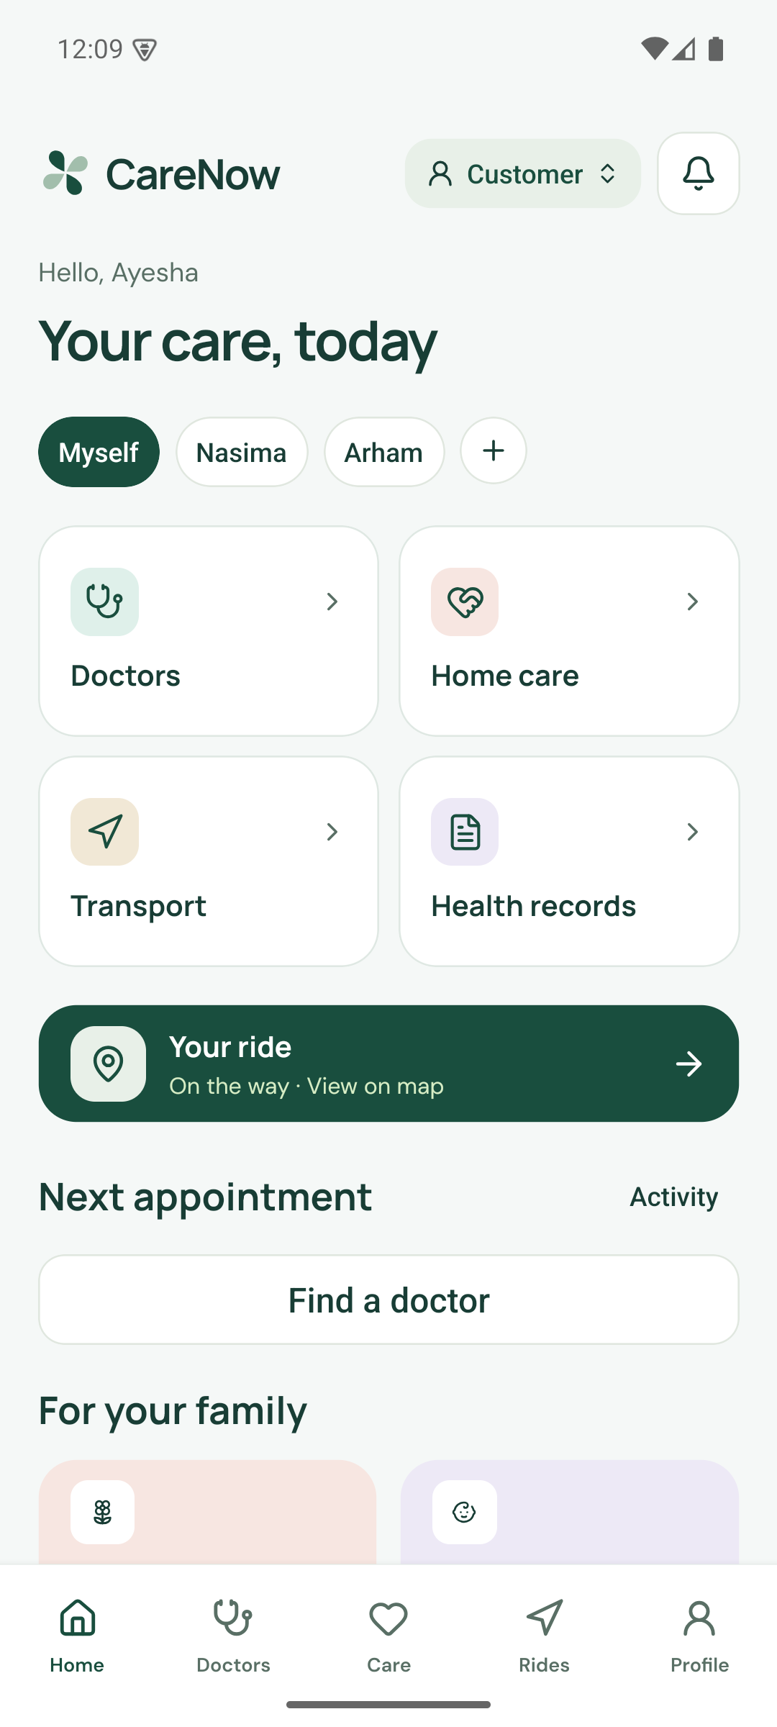
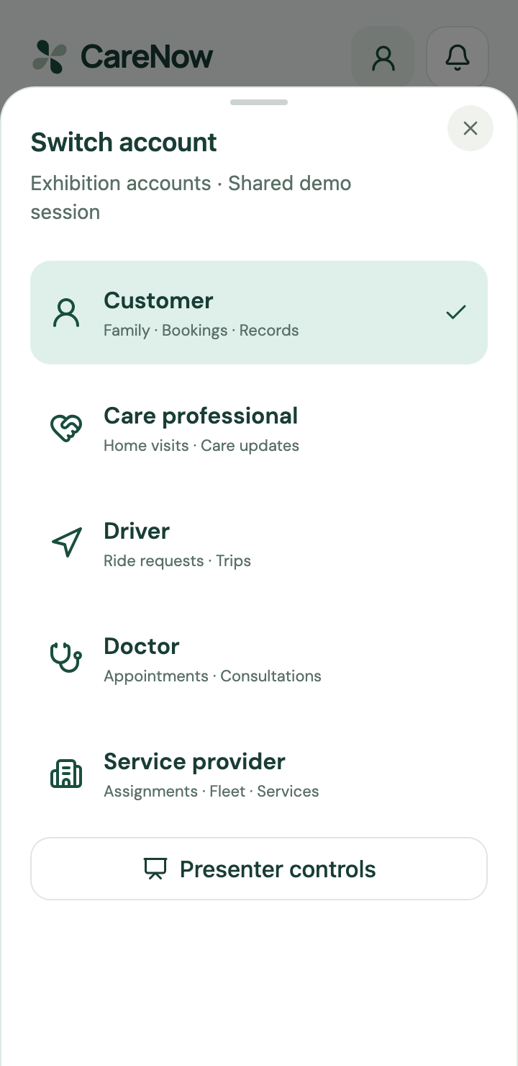
PRODUCT
One application for a family service journey
Family context
Select the person receiving care.
A complete job
Request, assignment, acceptance and status.
Five account types
Customer, care professional, driver, doctor and provider.
CareNow 1.2.1 · Exhibition prototype · September 2026
02
Notes:
Show how the household context persists across services. Roles share a demo session, not independently authenticated production accounts.
[16] CareNow repository: Product and verification evidence
https://github.com/Seyamalam/CareNow
Source, release APK, README screenshots, QA, transport, performance and visual review of the private original brief. Repository evidence is project-authored, not independent evaluation.

Slide 3
MARKET EVIDENCE
Bangladesh context
175.69m
128.99m
73%
People in 2025
Internet subscriptions
Out-of-pocket share
World Bank population estimate
BTRC, January 2026
Health expenditure, 2021
Reach, affordability and willingness to pay need separate evidence.
CareNow 1.2.1 · Exhibition prototype · September 2026
03
Notes:
These indicators have different observation years and denominators. Population and connectivity support context, not a revenue forecast. Internet subscriptions are not unique people. BSS reports a historical health-spending share.
[1] World Bank: Bangladesh country indicators
https://data.worldbank.org/country/bangladesh?lang=en
Population 175,686,899 in 2025 and individuals using the internet 53% in 2024. Different indicators have different observation years.
[2] BTRC: Internet subscribers
https://btrc.gov.bd/site/page/347df7fe-409f-451e-a415-65b109a207f5/-
January 2026: 114.22 million mobile and 14.77 million ISP/PSTN subscriptions, 128.99 million total. Subscriptions are not unique people.
[4] Bangladesh Sangbad Sangstha: Out of pocket healthcare expenditure rises to 73pc study
https://www.bssnews.net/news/200361
15 July 2024 report of Bangladesh National Health Accounts: 73% out of pocket in 2021. Historical expenditure context, not a current app market estimate.

Slide 4
PRODUCT HYPOTHESIS
The coordination problem
A family organises the visit
Recipient details, contact information and timing need to stay together.
A provider assigns the work
Someone must confirm the person, vehicle and service scope.
The family needs a status
Acceptance and arrival should be understandable without repeated follow-up.
CareNow 1.2.1 · Exhibition prototype · September 2026
04
Notes:
These are hypotheses derived from the brief and prototype, not completed user research. Compare them with the actual calls, messages and provider contacts used by each household.
[16] CareNow repository: Product and verification evidence
https://github.com/Seyamalam/CareNow
Source, release APK, README screenshots, QA, transport, performance and visual review of the private original brief. Repository evidence is project-authored, not independent evaluation.

Slide 5
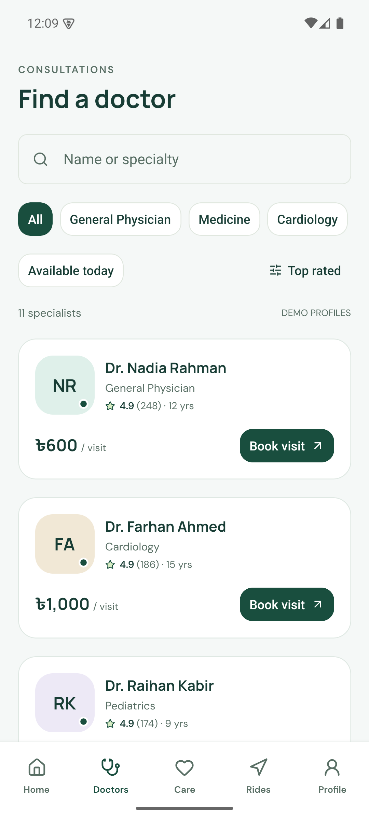
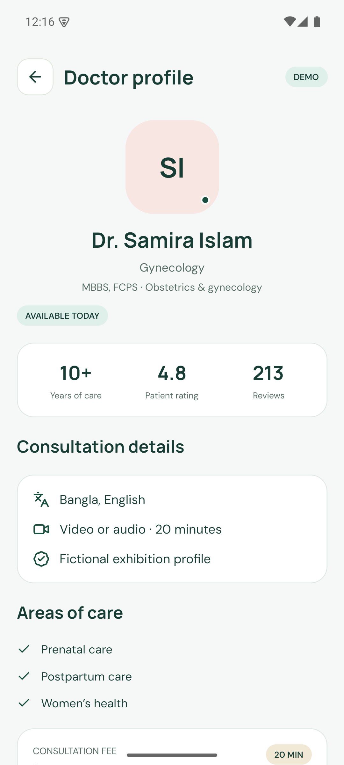
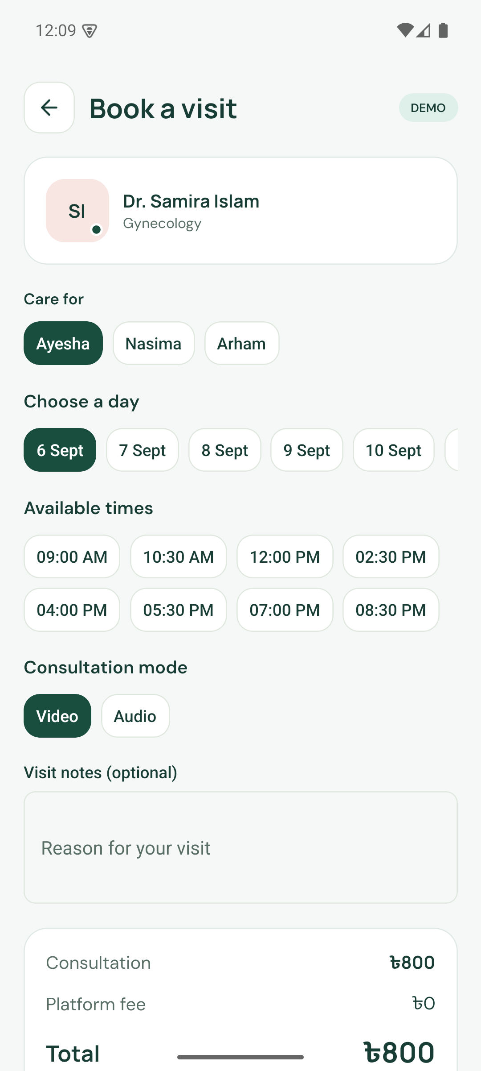
PRODUCT
Doctor discovery and booking
Find a specialist
Review a demo profile
Choose recipient and time
CareNow 1.2.1 · Exhibition prototype · September 2026
05
Notes:
Corrected Android release captures. Doctor identities, qualifications, ratings and fees are fictional. Real booking state persists, but no clinician or payment service is connected.
[16] CareNow repository: Product and verification evidence
https://github.com/Seyamalam/CareNow
Source, release APK, README screenshots, QA, transport, performance and visual review of the private original brief. Repository evidence is project-authored, not independent evaluation.

Slide 6
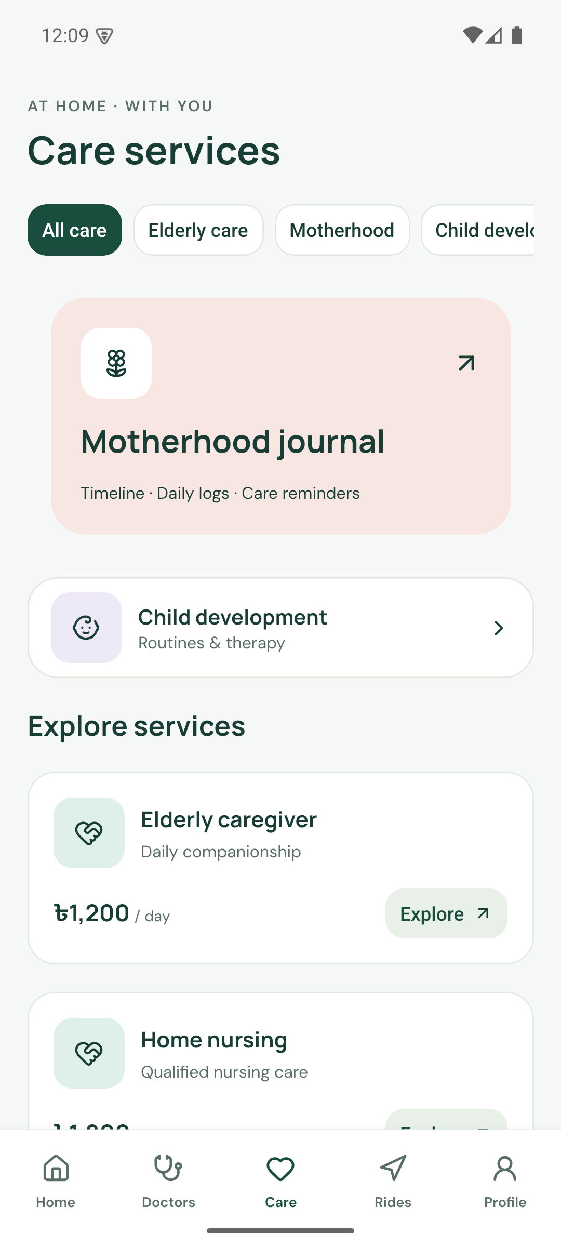
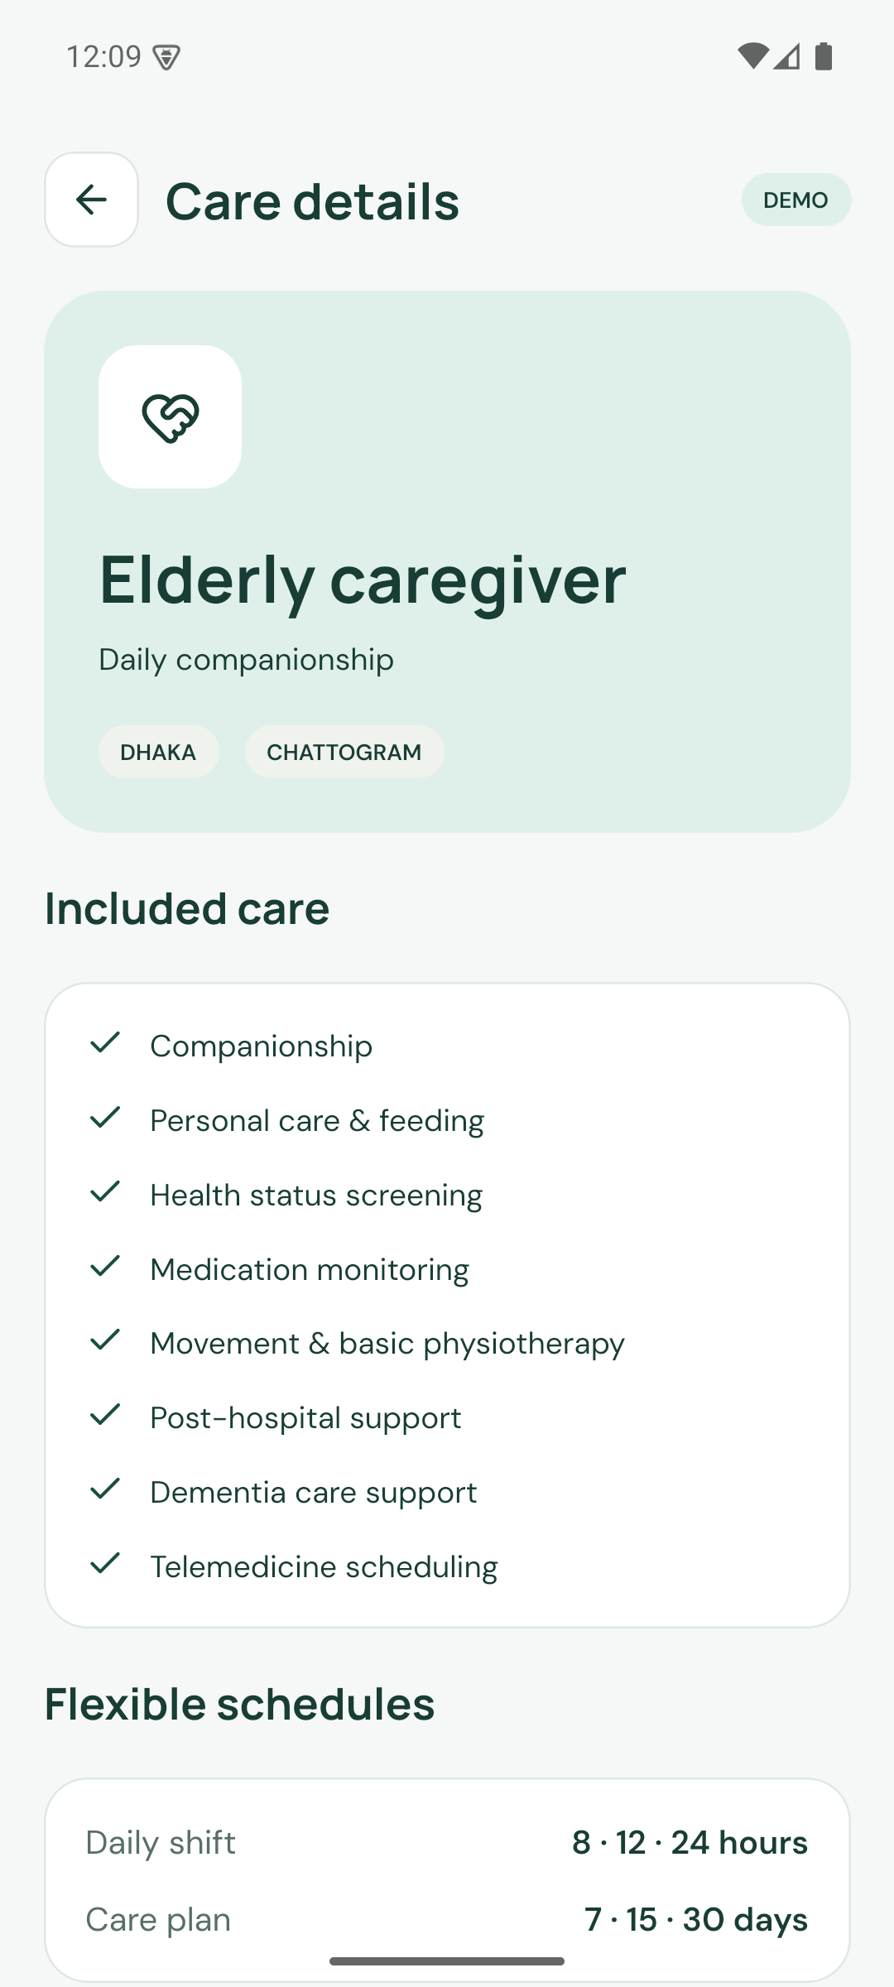
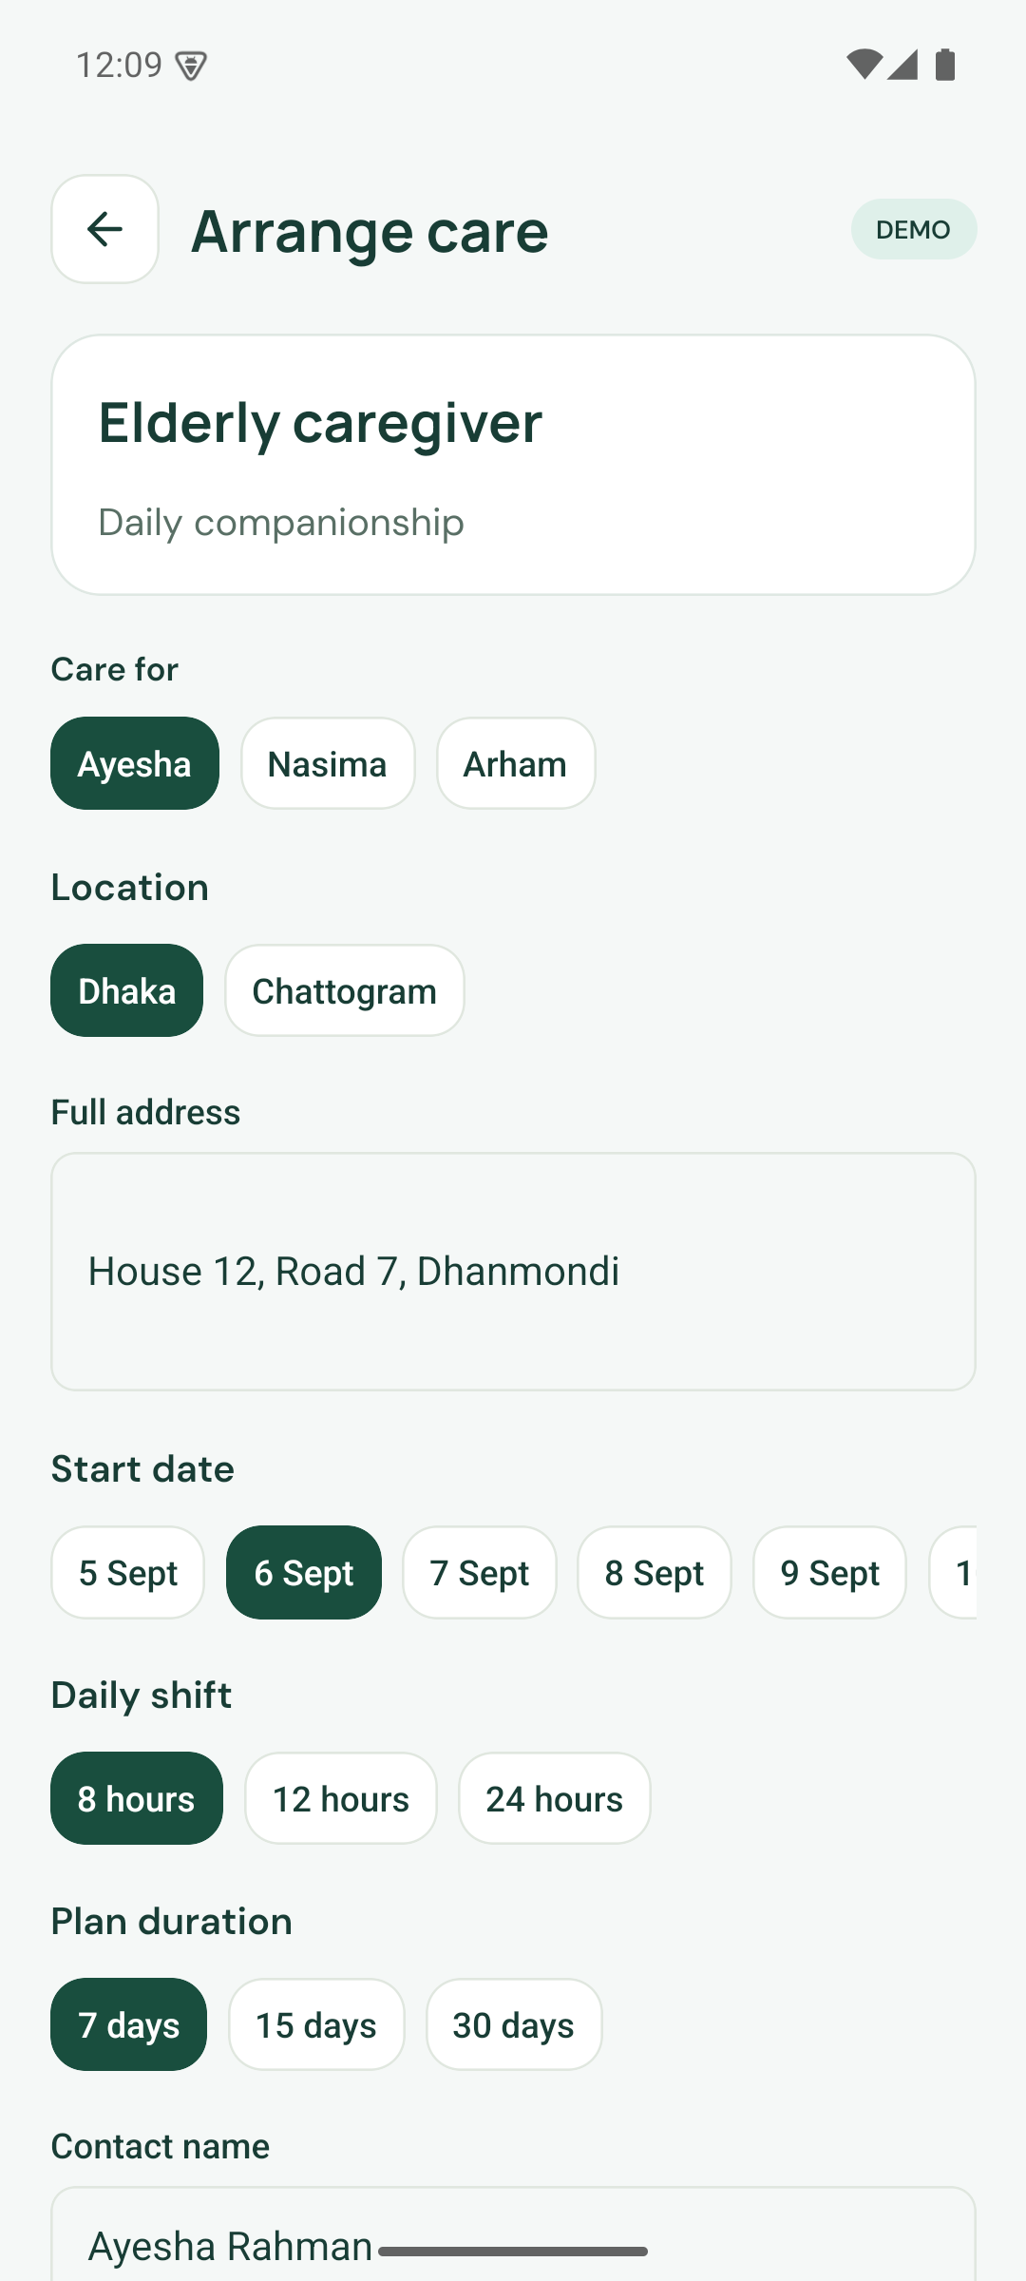
PRODUCT
Home care requests
Explore services
Inspect service scope
Arrange a visit
CareNow 1.2.1 · Exhibition prototype · September 2026
06
Notes:
The original brief includes elderly care, motherhood, child support and emergency services. Request fields include city, address, shift and plan duration. Clinical scope still requires qualified review.
[16] CareNow repository: Product and verification evidence
https://github.com/Seyamalam/CareNow
Source, release APK, README screenshots, QA, transport, performance and visual review of the private original brief. Repository evidence is project-authored, not independent evaluation.

Slide 7
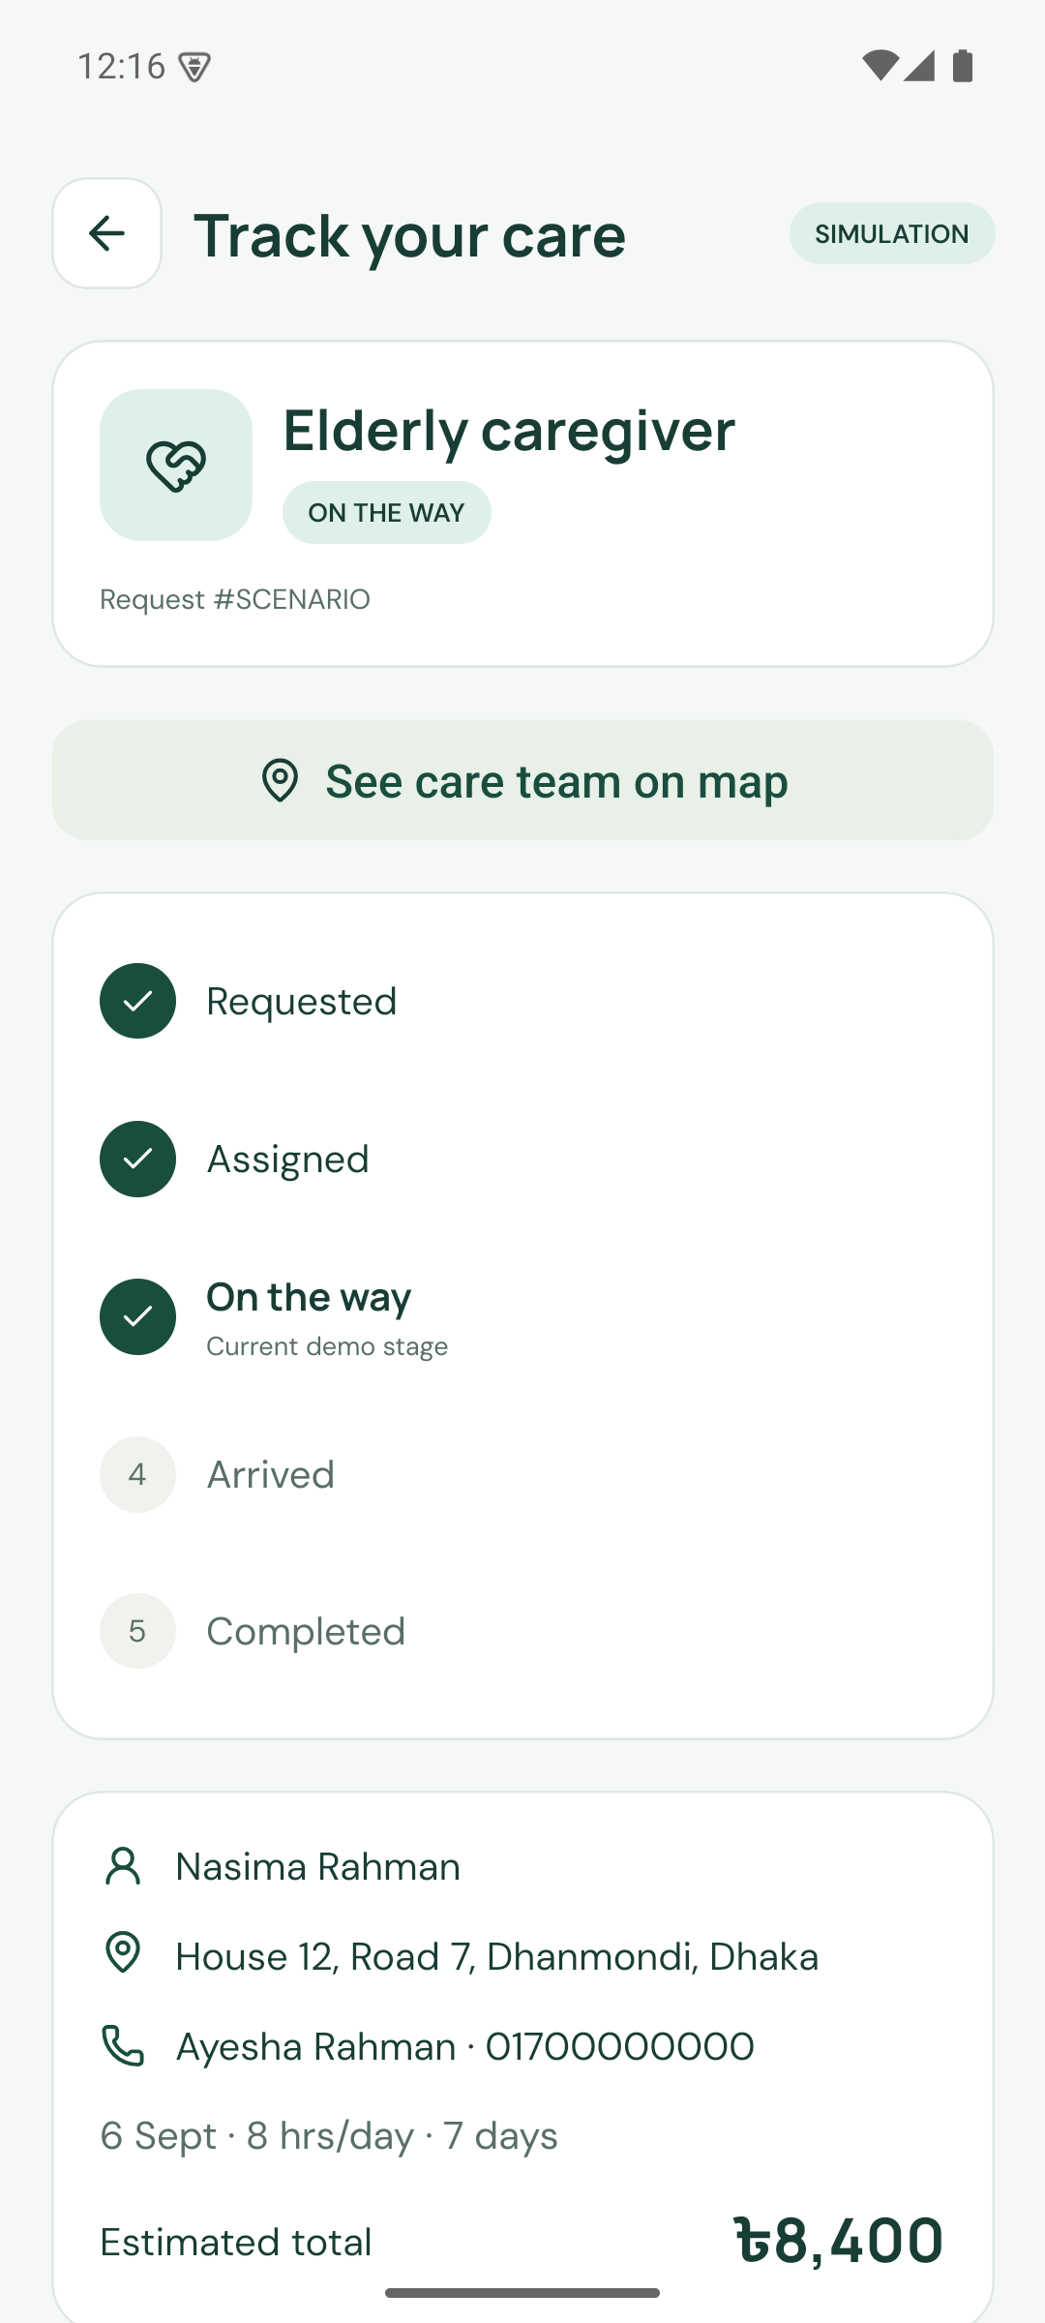
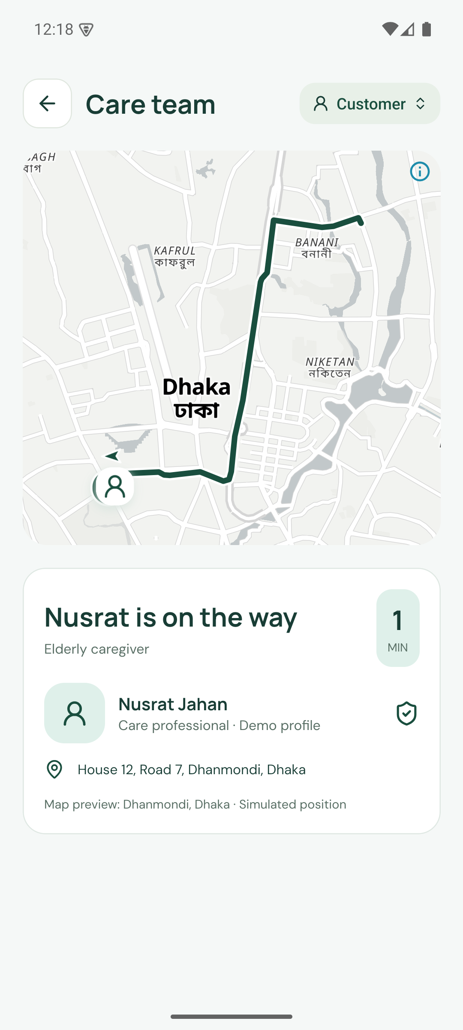
PRODUCT
Care status and arrival visibility
Ordered job status
Simulated care team location
CareNow 1.2.1 · Exhibition prototype · September 2026
07
Notes:
The care map uses saved route geometry. The marker and arrival estimate are simulated and do not represent a dispatched worker.
[16] CareNow repository: Product and verification evidence
https://github.com/Seyamalam/CareNow
Source, release APK, README screenshots, QA, transport, performance and visual review of the private original brief. Repository evidence is project-authored, not independent evaluation.

Slide 8
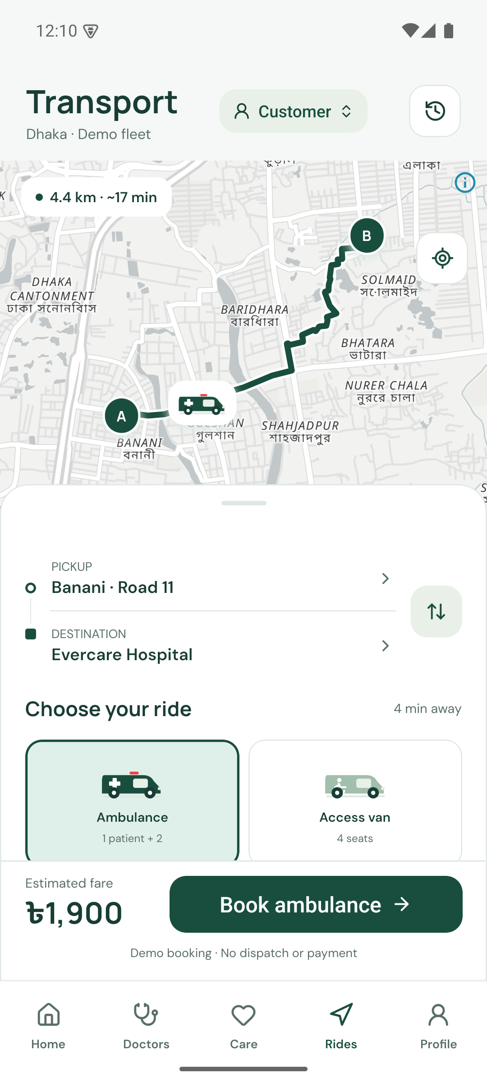
PRODUCT
Transport with street maps and road routes
Four vehicle classes
Ambulance, accessible van, truck and minibus.
Relevant booking details
Cargo, capacity, passenger count and scheduled departure.
Responsive booking controls
Scrollable compact layout and an animated drawer on taller phones.
CareNow 1.2.1 · Exhibition prototype · September 2026
08
Notes:
MapLibre renders native streets with OpenStreetMap/OpenFreeMap styling and saved OSRM road geometries. Five Dhaka landmarks and twenty directional route pairs are bundled. No actual GPS dispatch or payments.
[16] CareNow repository: Product and verification evidence
https://github.com/Seyamalam/CareNow
Source, release APK, README screenshots, QA, transport, performance and visual review of the private original brief. Repository evidence is project-authored, not independent evaluation.

Slide 9

SERVICE SCOPE
Broader transport in the same product
Assisted travel
Vehicle suitability and reliable pickup.
Household cargo
Capacity, loading details and timing.
Group journeys
Passenger count and whole-vehicle hire.
AI-generated concept illustration
CareNow 1.2.1 · Exhibition prototype · September 2026
09
Notes:
The image is an AI-generated editorial scene. No fleet exists as a result of this illustration. Broad transport is user-requested, but each category requires separate supplier verification and operational rules.

Slide 10
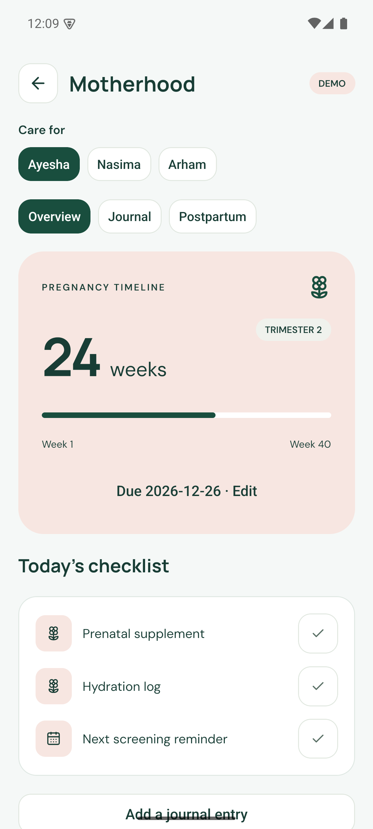
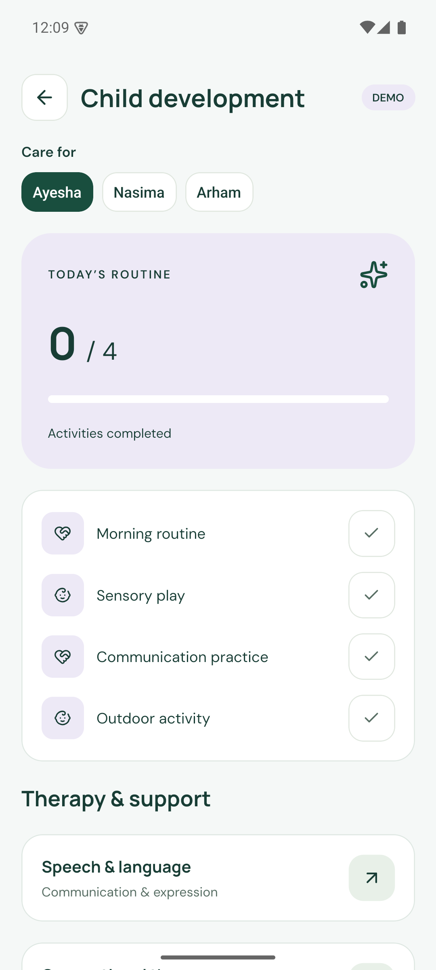
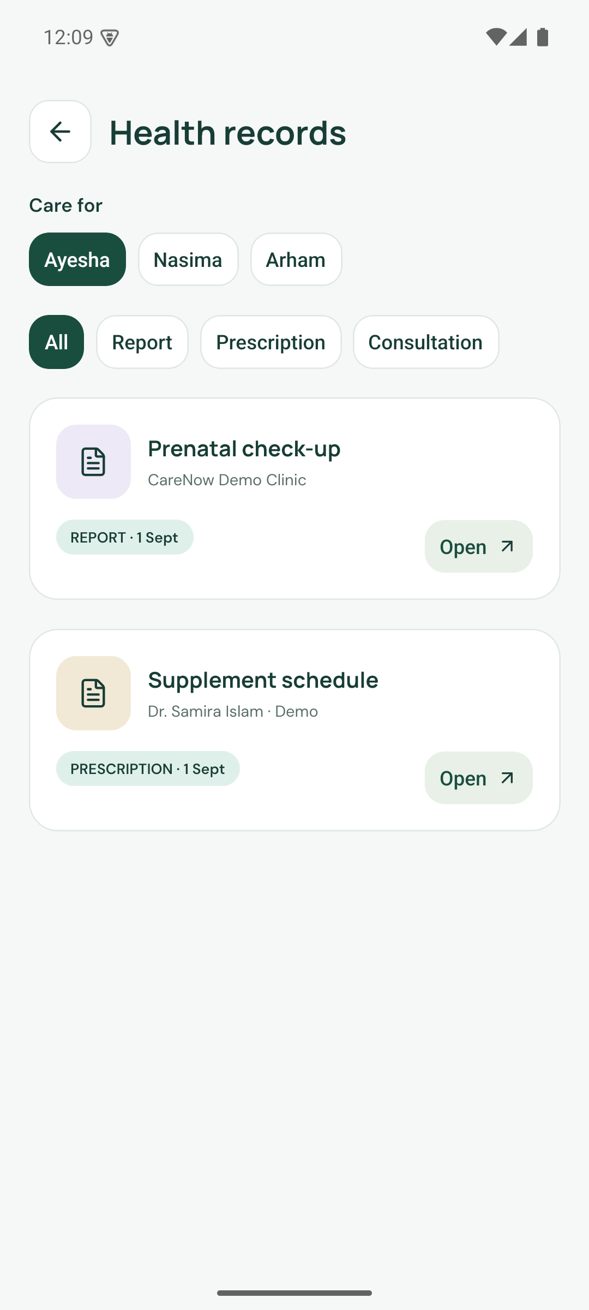
PRODUCT
Family routines and records
Motherhood timeline
Daily child routines
Family records
CareNow 1.2.1 · Exhibition prototype · September 2026
10
Notes:
These organisational tools do not diagnose, prescribe or establish therapeutic effectiveness. All visible clinical content is fictional demonstration data.
[16] CareNow repository: Product and verification evidence
https://github.com/Seyamalam/CareNow
Source, release APK, README screenshots, QA, transport, performance and visual review of the private original brief. Repository evidence is project-authored, not independent evaluation.

Slide 11
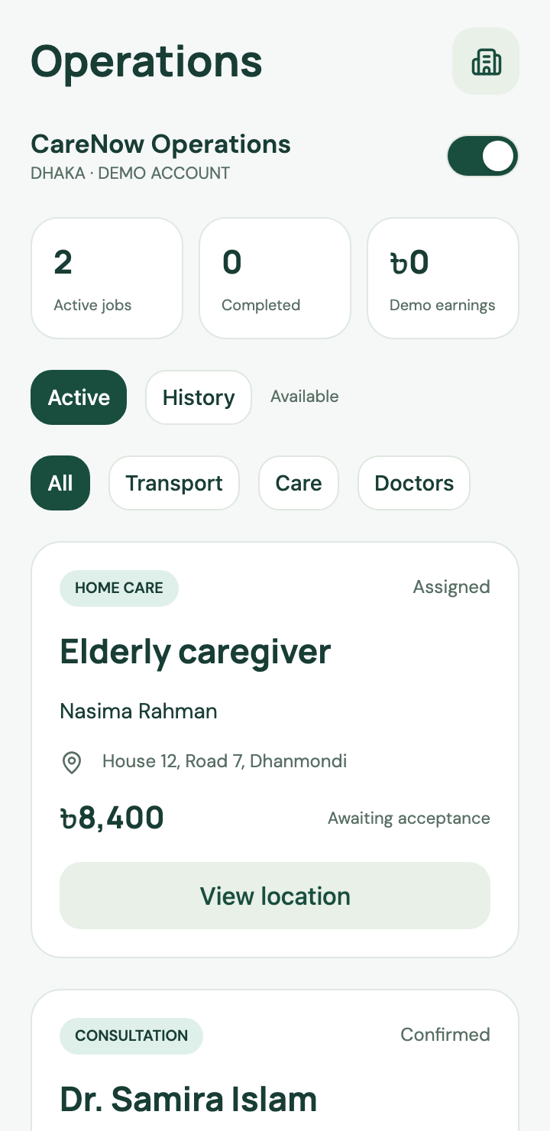
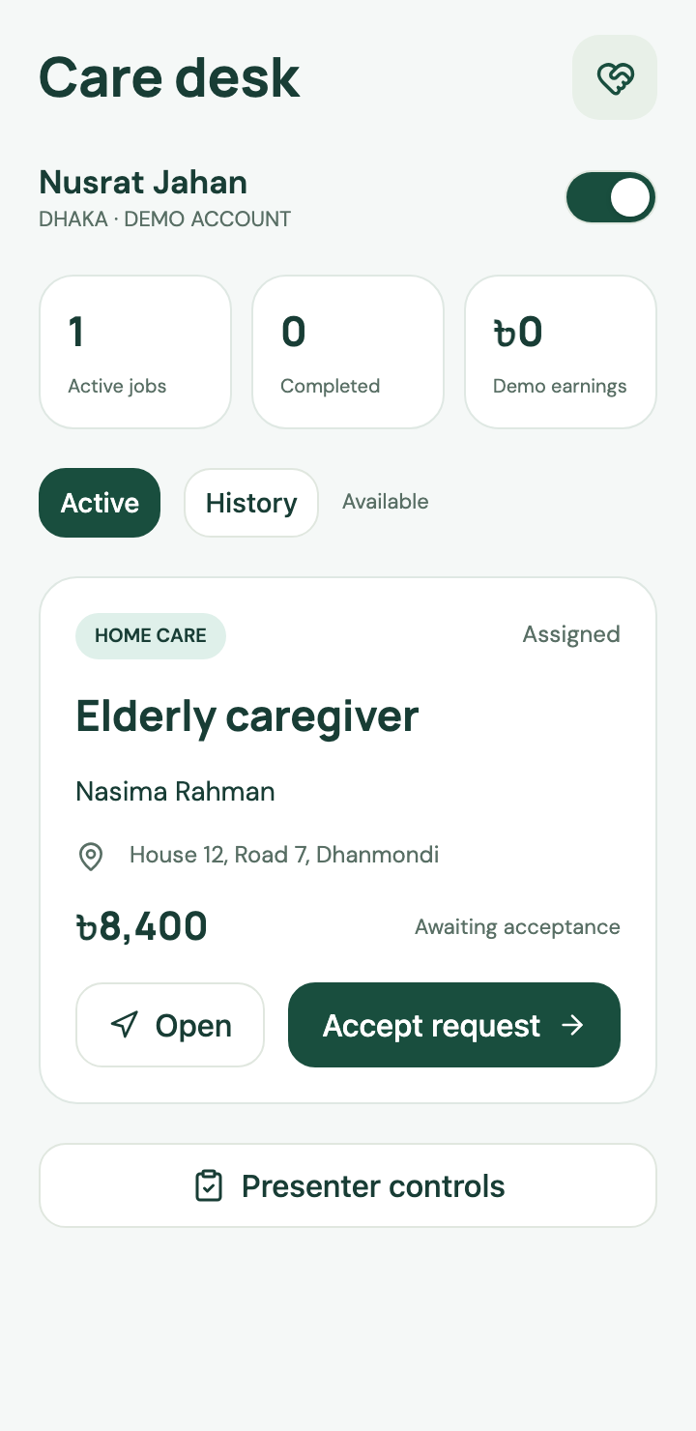
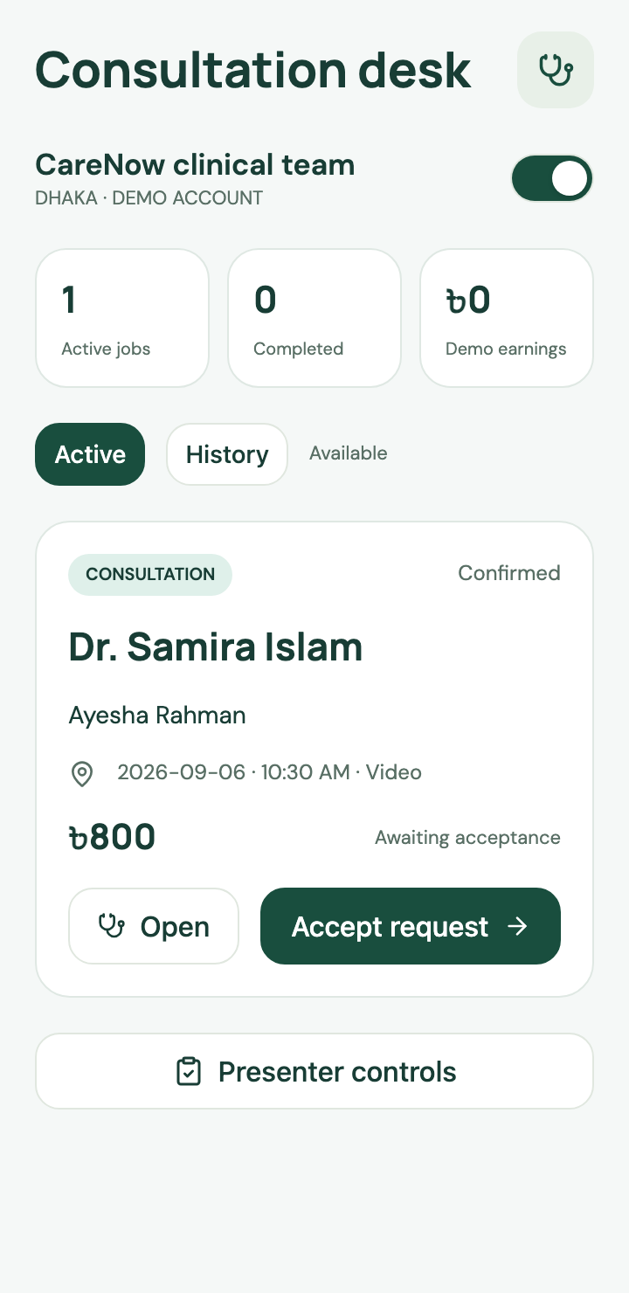
PRODUCT
Professional workspaces
Provider operations
Care professional
Doctor
CareNow 1.2.1 · Exhibition prototype · September 2026
11
Notes:
Current web captures show the same application from three professional roles. The switcher supports one isolated exhibit session. Production needs individual identity, membership and object-level access rules.
[16] CareNow repository: Product and verification evidence
https://github.com/Seyamalam/CareNow
Source, release APK, README screenshots, QA, transport, performance and visual review of the private original brief. Repository evidence is project-authored, not independent evaluation.

Slide 12
READINESS
Working demo and production requirements
Area | Working demonstration | Before real operation
Bookings | Forms, state and history | Supplier capacity and operating rules
Maps | Street tiles and route simulation | Consented GPS and dispatch
Consultation | Messages and simulated call | Verified clinicians and real communications
Accounts | Five roles in one demo session | Identity, consent and permissions
Payments | Fictional fares and earnings | Collection, settlement and refunds
CareNow 1.2.1 · Exhibition prototype · September 2026
12
Notes:
The prototype provides working application state and D1 persistence, but real service delivery requires external integrations and governance.
[16] CareNow repository: Product and verification evidence
https://github.com/Seyamalam/CareNow
Source, release APK, README screenshots, QA, transport, performance and visual review of the private original brief. Repository evidence is project-authored, not independent evaluation.

Slide 13
MARKET REVIEW
Competition and adjacent services
Organisation | Public offering | Overlap
DocTime | Video consultation | Doctor access
Praava Ghore Lab | Home sample collection | Diagnostics
HelloTask | Domestic worker service | Household assistance
Truck Lagbe | Truck hire and logistics | General transport
Shohoz | Bus, train and flight tickets | Travel booking
CareNow tests continuity across a family’s service journey.
CareNow 1.2.1 · Exhibition prototype · September 2026
13
Notes:
Official website review only. It is not an exhaustive feature audit or service-quality ranking. An unlisted feature is not evidence of absence. Familiar local providers and phone contacts are also substitutes.
[6] DocTime: Official service website
https://doctime.com.bd/
Public website advertises video consultation and an enterprise offering. This review did not test service delivery.
[7] Praava Health: Ghore Lab
https://web.praavahealth.com/ghore-lab
Public page describes home sample collection and laboratory testing with an online request form.
[8] HelloTask: Official service website
https://www.hellotask.app/
Public website identifies a domestic worker service. Domestic assistance and regulated clinical care are distinct.
[9] Truck Lagbe: Official service website
https://www.trucklagbe.com/
Truck booking, vendor bidding, cargo/loading details, shifting and business logistics. Marketing volume and savings claims are excluded.
[10] Shohoz: Official service website
https://www.shohoz.com/
Bus, train, flight and event ticket booking. Bus ticketing is distinct from whole-vehicle charter.

Slide 14
PLANNING ASSUMPTIONS
Bottom-up opportunity scenarios
BDT million
Annual service value
2.4 bookings per year
BDT 1,500 per booking
12% platform fee
Independent illustrative scenarios
No customer traction claimed
CareNow 1.2.1 · Exhibition prototype · September 2026
14
Notes:
All three customer counts are assumptions, not measured TAM, SAM or SOM. Annual GMV = households × 2.4 bookings × BDT 1,500. A 12% fee produces BDT 432k, 8.64m and 43.2m respectively. GMV is not revenue.

Slide 15
PLANNING ASSUMPTIONS
Unit economics need repeat use
BDT 100
Fee | Contribution | CAC payback
10% | BDT 70 | 9 orders
12% | BDT 100 | 6 orders
15% | BDT 145 | 5 orders
Contribution per completed booking
BDT 600 acquisition cost requires
6 completed bookings to repay.
Variable costs and demand are unmeasured.
CareNow 1.2.1 · Exhibition prototype · September 2026
15
Notes:
Base booking BDT 1,500. Platform fee BDT 180 at 12%. Variable costs: payment 30, support 35, service recovery 15. Contribution 100 before acquisition, fixed costs and tax. CAC 600 takes six completed bookings or about 30 months at 2.4 bookings per year.

Slide 16
ILLUSTRATIVE BDT BUDGET
Six-month pilot budget
23.69 lakh
BDT 2.369 million
Including 15% contingency
Budget bars show
BDT thousand
CareNow 1.2.1 · Exhibition prototype · September 2026
16
Notes:
No quotes or commitments. Base BDT 2,060,000, contingency 15% = 309,000, total BDT 2,369,000. Excludes vehicles, facilities, major insurance, broad 24/7 dispatch and provider-payout financing.

Slide 17
PUBLISHED PRICING AND ASSUMPTIONS
Cloud infrastructure cost
Monthly Worker load | CPU per request | Workers estimate
1 million requests | 5 ms | USD 5.00
15 million requests | 7 ms | USD 8.00
20 million requests | 10 ms | USD 11.40
Early infrastructure can be inexpensive. Fulfilment, support and governance still need a real budget.
CareNow 1.2.1 · Exhibition prototype · September 2026
17
Notes:
Cloudflare prices accessed 5 September 2026. Assumes the account has no other usage consuming included allowances. D1 below paid allowances. These estimates exclude maps, media, OTP, monitoring vendors, payments, support and taxes.
[11] Cloudflare: Workers pricing
https://developers.cloudflare.com/workers/platform/pricing/
Paid plan minimum USD 5 per account per month, 10 million requests and 30 million CPU milliseconds included. Additional requests USD 0.30 per million and CPU USD 0.02 per million milliseconds.
[12] Cloudflare: D1 pricing
https://developers.cloudflare.com/d1/platform/pricing/
Paid plan includes 25 billion rows read, 50 million rows written per month and 5 GB storage. Overage USD 0.001 per million reads, USD 1 per million writes, USD 0.75 per GB-month.

Slide 18
TECHNICAL
Application architecture
Expo application
PanelUI and Router
Shared contracts
TypeScript and Zod
Hono API
Cloudflare Workers
→
→
↓
MapLibre
Street maps and routes
Offline rehearsal
Separate local state
D1
Session and attachments
Client rendering
Bounded exhibition data
CareNow 1.2.1 · Exhibition prototype · September 2026
18
Notes:
Implemented demo architecture. The aggregate is deliberately bounded. Production normalization, external identity, live communications and GPS are future work. Offline rehearsal stores separate local fixtures and does not sync them into cloud.
[16] CareNow repository: Product and verification evidence
https://github.com/Seyamalam/CareNow
Source, release APK, README screenshots, QA, transport, performance and visual review of the private original brief. Repository evidence is project-authored, not independent evaluation.

Slide 19
TECHNICAL
Data and state integrity
Shared domain objects
Family members, appointments, care requests and transport jobs.
Ordered job transitions
Assignments and acceptance precede travel and completion.
Versioned persistence
Compare-and-swap updates prevent silent lost changes.
Production migration
Separate identities, organisations, consent, event history and media.
CareNow 1.2.1 · Exhibition prototype · September 2026
19
Notes:
D1 uses version checks and up to four conflict retries for the session aggregate. Prepared SQL and session-scoped access apply. The role switcher is not production authentication.
[16] CareNow repository: Product and verification evidence
https://github.com/Seyamalam/CareNow
Source, release APK, README screenshots, QA, transport, performance and visual review of the private original brief. Repository evidence is project-authored, not independent evaluation.

Slide 20
TECHNICAL READINESS
Privacy and access controls
Implemented in the demo | Required production work
Isolated session and ownership checks | Individual identity and role permissions
Validated actions and prepared SQL | Access audit and incident response
Attachment type and size checks | Secure media storage and retention
Separate offline rehearsal | Consent, delegation and device-loss controls
No clinical security certification is claimed.
CareNow 1.2.1 · Exhibition prototype · September 2026
20
Notes:
Tokens are SHA-256 hashed at rest and demo sessions expire after seven days. AsyncStorage is not a production credential vault. Attachment signature and ownership checks do not replace a clinical security review.
[16] CareNow repository: Product and verification evidence
https://github.com/Seyamalam/CareNow
Source, release APK, README screenshots, QA, transport, performance and visual review of the private original brief. Repository evidence is project-authored, not independent evaluation.

Slide 21
PILOT READINESS
Clinical and operational governance
Clinical accountability
Qualified lead, verified professionals and scoped services.
Transport readiness
Vehicle capability, capacity, operator responsibility and escalation.
Recipient and worker protection
Consent, safeguarding and an accessible complaint route.
Emergency boundaries
The demo makes no real dispatch or clinical response promise.
CareNow 1.2.1 · Exhibition prototype · September 2026
21
Notes:
DGHS lists its National Telehealth Guideline for Bangladesh on 29 March 2026. The hosted PDF discusses broad responsibilities. Confirm applicable DGHS and BMDC requirements with competent advisers. This is not a legal opinion.
[13] DGHS: National Telehealth Guideline for Bangladesh
https://dghs.portal.gov.bd/pages/miscellaneous-infos
Official publication listing dated 29 March 2026. The linked PDF discusses governance, workforce and legal and ethical responsibilities. Applicability must be confirmed with competent advisers before a pilot.
[14] DGHS: National Telehealth Guideline PDF
https://objectstorage.ap-dcc-gazipur-1.oraclecloud15.com/n/axvjbnqprylg/b/V2Ministry/o/office-dghs/2026/2/0420ffe2-8247-454a-8902-4f2cdfe85c18.pdf
Official hosted PDF, executive summary and scope. This report does not interpret it as an approval for CareNow.

Slide 22
EVALUATION PLAN
Proposed research and pilot methodology
Discovery
Operational evaluation
24 household participants
8 care professionals
6 drivers
4 provider operators
Up to 100 households
A defined Dhaka service area
Six weeks after readiness gates
Baseline coordination comparison
Observe task success, fulfilled jobs, support effort and total cost.
CareNow 1.2.1 · Exhibition prototype · September 2026
22
Notes:
Proposed recruitment targets only: 24 households, 8 care professionals, 6 drivers, 4 provider operators. Not representative or completed research. Seek appropriate ethics review. Khatun et al offers relevant service-quality constructs but cannot validate CareNow.
[5] Khatun et al: Users Perceived Service Quality of National Telemedicine Services During the COVID 19 Pandemic in Bangladesh
https://humanfactors.jmir.org/2024/1/e46566/
JMIR Human Factors 2024;11:e46566. Cross-sectional study of 2,097 Shastho Batayon users surveyed in October to December 2020. DOI 10.2196/46566.

Slide 23
PROPOSED TARGETS
Pilot decision criteria
Measure | Proposed decision rule
Core task success | At least 85% without coaching
Accepted job fulfilment | At least 90% within defined scope
Coordination burden | Lower than documented baseline
Support cost | Fits measured contribution margin
Safety and privacy | Investigate every material event
CareNow 1.2.1 · Exhibition prototype · September 2026
23
Notes:
Targets require partner agreement and meaningful denominators. Report absolute counts. Serious safety/privacy issues trigger review regardless of satisfaction averages. No outcomes have been measured yet.

Slide 24
ENGINEERING
Motion and performance evidence
About 59 fps
Next acceptance work
Controlled physical-device traces
Keyboard and sheet interaction
Startup, memory and battery
Full accessibility review
Observed route cadence in one emulator sample
This does not establish sustained 60 fps across the app.
Reduced motion, background pause and responsive layout are implemented.
CareNow 1.2.1 · Exhibition prototype · September 2026
24
Notes:
Prior 1.2 release, Android emulator, 1080×2400. Route sample: 1,497 frames in about 25.3 seconds, 0.80% deadline jank, legacy jank 97.80%, p50/p95 24/28ms. Sheet samples: 1.1 13.42% jank, 1.2 under host load 35.39%. Conditions confound the comparison. No universal 60 fps claim.
[16] CareNow repository: Product and verification evidence
https://github.com/Seyamalam/CareNow
Source, release APK, README screenshots, QA, transport, performance and visual review of the private original brief. Repository evidence is project-authored, not independent evaluation.

Slide 25
PILOT GOVERNANCE
Material risks and accountable owners
Risk | Required response | Owner
Unfilled service | Limit scope and confirm capacity | Operations
Unqualified task | Credentials and defined scope | Clinical
Data exposure | Consent, permissions and audit | Security
Poor economics | Cohorts and contribution after support | Commercial
Research bias | Protocol and negative findings | Research
CareNow 1.2.1 · Exhibition prototype · September 2026
25
Notes:
Proposed roles, not appointed staff. A named owner should be able to stop an unsafe or unserviceable activity. No partner commitments are claimed.

Slide 26
DELIVERY PLAN
Roadmap with evidence gates
Stage | Evidence needed to proceed
Exhibition release | Working build and repeatable scenarios
Pilot preparation | Partners, protocol and named owners
Production foundation | Identity, consent and access acceptance
Formative evaluation | Observed usability and resolved critical defects
Operational pilot | Fulfilment, safety and economic evidence
Selective expansion | A case for each new service or area
CareNow 1.2.1 · Exhibition prototype · September 2026
26
Notes:
Illustrative sequence, not a nationwide launch commitment. Pause or narrow scope when a gate fails. Identity and operating readiness precede real-service research.

Slide 27
NEXT INVESTMENT
The collaboration request
A bounded Dhaka pilot
Service partners
Accountable care and transport supply in a defined area.
Research partners
Independent evaluation of usability, fulfilment and cost.
Milestone-based support
A six-month planning envelope of BDT 2.369 million.
CareNow 1.2.1 · Exhibition prototype · September 2026
27
Notes:
No investment, partnership or endorsement has been secured by this report. The BDT 2.369 million is a planning envelope, not a valuation. Funding should follow scope, quotations and readiness milestones.

Slide 28
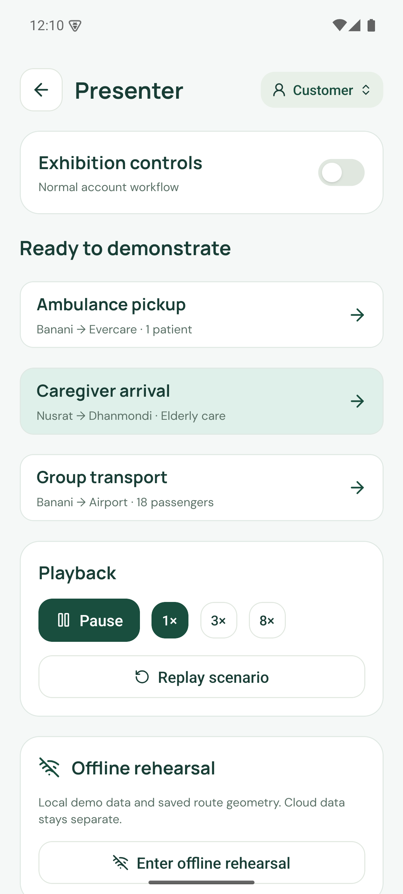
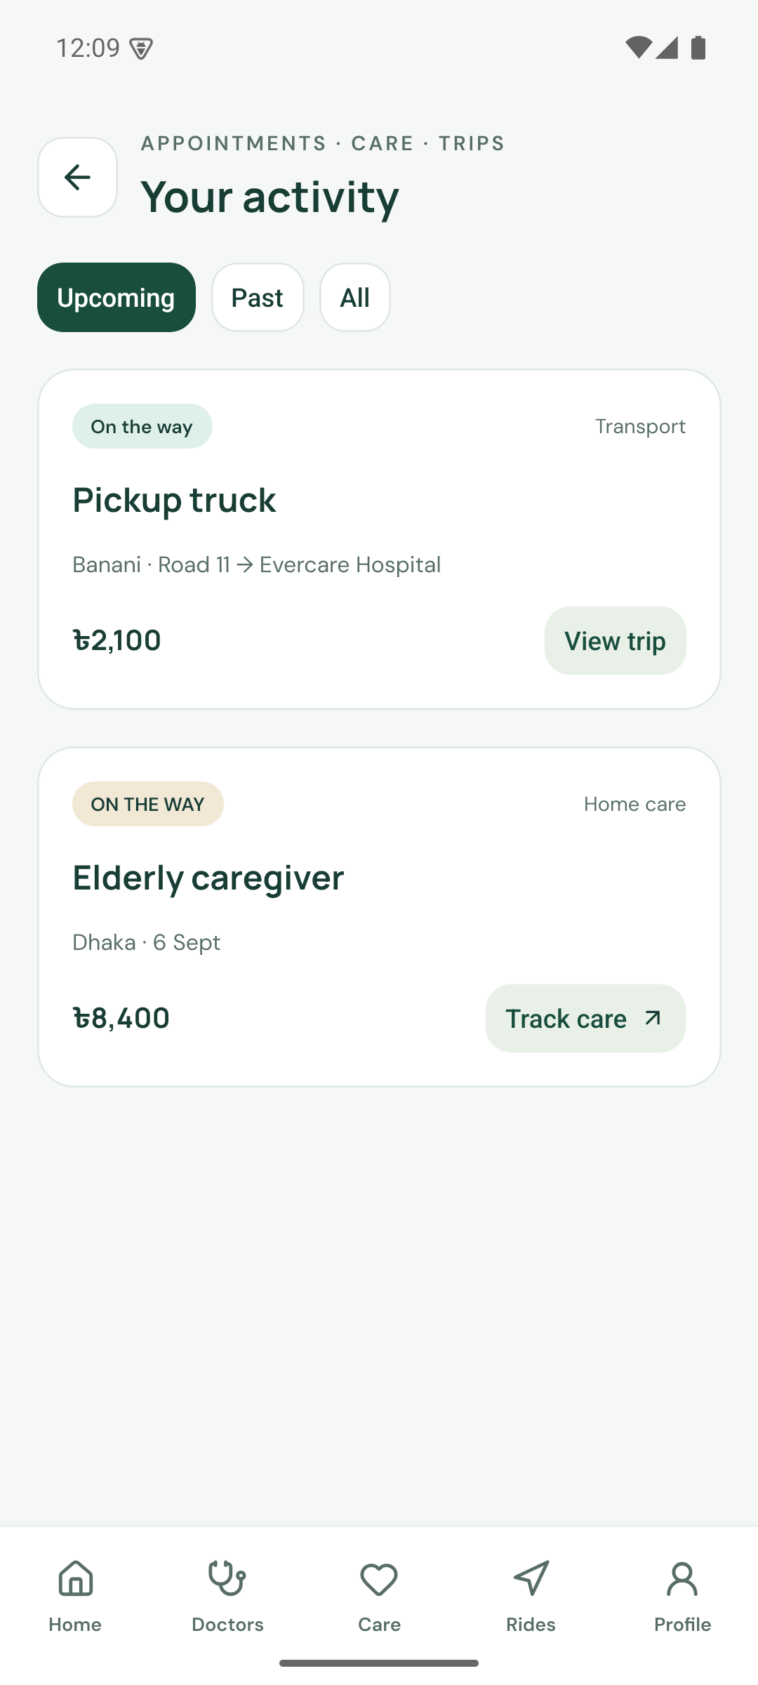
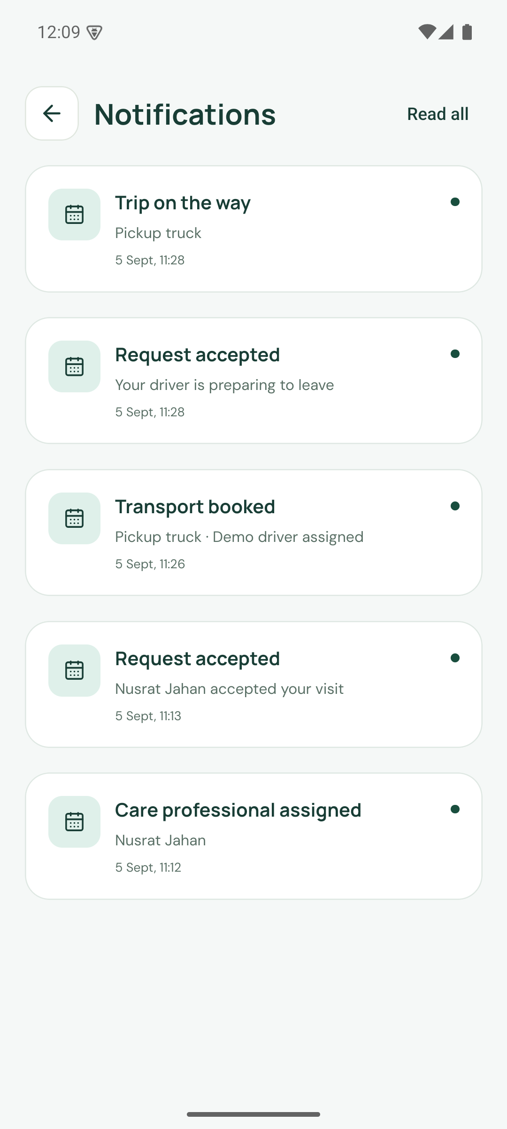
PRODUCT
A repeatable exhibition demonstration
Load and replay scenarios
Inspect the same job
Follow status changes
CareNow 1.2.1 · Exhibition prototype · September 2026
28
Notes:
Use one coherent job. Presenter scenarios include ambulance, caregiver arrival and group transport. Pause, replay and 1×/3×/8× speed are available. Offline rehearsal is separate from cloud. Prepare the Android APK and never enter real patient data.
[16] CareNow repository: Product and verification evidence
https://github.com/Seyamalam/CareNow
Source, release APK, README screenshots, QA, transport, performance and visual review of the private original brief. Repository evidence is project-authored, not independent evaluation.

Slide 29
APPENDIX
Feature inventory
Family and care | Transport and operations
Profiles, records and routine logs | Ambulance, van, truck and minibus
Doctor search and dated bookings | Capacity, cargo and departures
Messages and PDF/photo uploads | Map routes and simulated arrivals
Motherhood and child support | Five role workspaces
Notifications and activity history | Scenario replay and offline rehearsal
CareNow 1.2.1 · Exhibition prototype · September 2026
29
Notes:
See the report for detailed boundaries. Every feature here uses fictional exhibition data. Real clinical, payment and dispatch services are not connected.
[16] CareNow repository: Product and verification evidence
https://github.com/Seyamalam/CareNow
Source, release APK, README screenshots, QA, transport, performance and visual review of the private original brief. Repository evidence is project-authored, not independent evaluation.

Slide 30
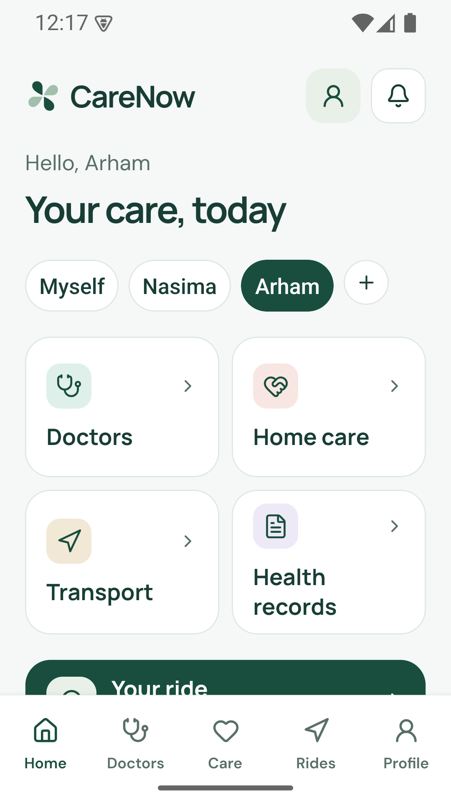
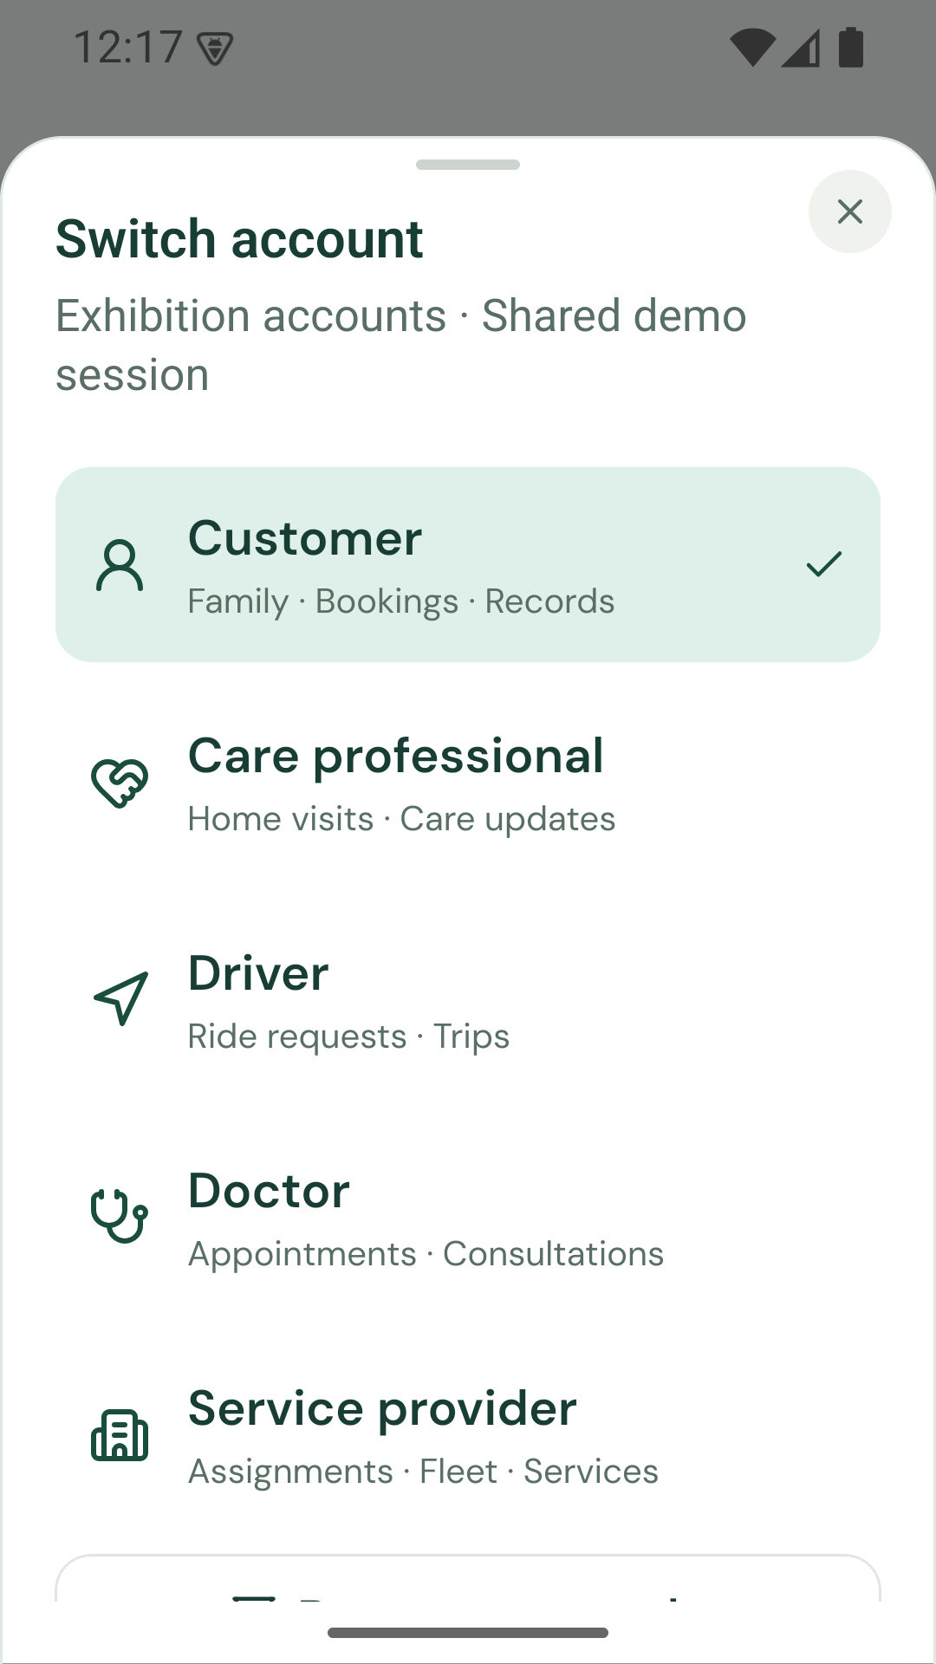
APPENDIX
Responsive layout correction
Flexible content
Tiles and labels grow with text.
Bounded sheets
Long content stays scrollable.
Measured map panel
The footer participates in layout.
CareNow 1.2.1 · Exhibition prototype · September 2026
30
Notes:
Latest Android release checked at regular size and 360×640 with 120% text. Keyboard-open sheet checked during development on the same layout implementation. 23 web routes and five roles inspected. These are selected visual checks, not complete accessibility certification.
[16] CareNow repository: Product and verification evidence
https://github.com/Seyamalam/CareNow
Source, release APK, README screenshots, QA, transport, performance and visual review of the private original brief. Repository evidence is project-authored, not independent evaluation.

Slide 31
REFERENCES
Market and research sources
National context
World Bank, BTRC, UNFPA and Bangladesh National Health Accounts reporting.
Primary research
Khatun et al, JMIR Human Factors 2024, e46566.
Competitor evidence
Official DocTime, Praava, HelloTask, Truck Lagbe and Shohoz pages.
CareNow 1.2.1 · Exhibition prototype · September 2026
31
Notes:
All sources accessed 5 September 2026. Full URLs and limits are in these notes and the companion report.
[1] World Bank: Bangladesh country indicators
https://data.worldbank.org/country/bangladesh?lang=en
Population 175,686,899 in 2025 and individuals using the internet 53% in 2024. Different indicators have different observation years.
[2] BTRC: Internet subscribers
https://btrc.gov.bd/site/page/347df7fe-409f-451e-a415-65b109a207f5/-
January 2026: 114.22 million mobile and 14.77 million ISP/PSTN subscriptions, 128.99 million total. Subscriptions are not unique people.
[3] UNFPA Bangladesh: Population trends
https://bangladesh.unfpa.org/en/topics/population-trends-0?page=1
Overview reports the share aged 60 and older as 9.3%. The overview does not identify a separate year next to that share. No population multiplication is used here.
[4] Bangladesh Sangbad Sangstha: Out of pocket healthcare expenditure rises to 73pc study
https://www.bssnews.net/news/200361
15 July 2024 report of Bangladesh National Health Accounts: 73% out of pocket in 2021. Historical expenditure context, not a current app market estimate.
[5] Khatun et al: Users Perceived Service Quality of National Telemedicine Services During the COVID 19 Pandemic in Bangladesh
https://humanfactors.jmir.org/2024/1/e46566/
JMIR Human Factors 2024;11:e46566. Cross-sectional study of 2,097 Shastho Batayon users surveyed in October to December 2020. DOI 10.2196/46566.
[6] DocTime: Official service website
https://doctime.com.bd/
Public website advertises video consultation and an enterprise offering. This review did not test service delivery.
[7] Praava Health: Ghore Lab
https://web.praavahealth.com/ghore-lab
Public page describes home sample collection and laboratory testing with an online request form.
[8] HelloTask: Official service website
https://www.hellotask.app/
Public website identifies a domestic worker service. Domestic assistance and regulated clinical care are distinct.
[9] Truck Lagbe: Official service website
https://www.trucklagbe.com/
Truck booking, vendor bidding, cargo/loading details, shifting and business logistics. Marketing volume and savings claims are excluded.
[10] Shohoz: Official service website
https://www.shohoz.com/
Bus, train, flight and event ticket booking. Bus ticketing is distinct from whole-vehicle charter.

Slide 32
REFERENCES
Technical and policy sources
Infrastructure pricing
Cloudflare Workers and D1 official pricing.
Clinical governance context
DGHS publication listing and National Telehealth Guideline.
Project evidence
Public source, release APK, QA, performance logs and screenshot gallery.
Live demo carenow-demo.pages.dev
Repository github.com/Seyamalam/CareNow
CareNow 1.2.1 · Exhibition prototype · September 2026
32
Notes:
All sources accessed 5 September 2026. Full URLs and boundaries are in notes and companion report. Artwork is original AI-generated editorial illustration. Screenshots are actual native or web captures.
[11] Cloudflare: Workers pricing
https://developers.cloudflare.com/workers/platform/pricing/
Paid plan minimum USD 5 per account per month, 10 million requests and 30 million CPU milliseconds included. Additional requests USD 0.30 per million and CPU USD 0.02 per million milliseconds.
[12] Cloudflare: D1 pricing
https://developers.cloudflare.com/d1/platform/pricing/
Paid plan includes 25 billion rows read, 50 million rows written per month and 5 GB storage. Overage USD 0.001 per million reads, USD 1 per million writes, USD 0.75 per GB-month.
[13] DGHS: National Telehealth Guideline for Bangladesh
https://dghs.portal.gov.bd/pages/miscellaneous-infos
Official publication listing dated 29 March 2026. The linked PDF discusses governance, workforce and legal and ethical responsibilities. Applicability must be confirmed with competent advisers before a pilot.
[14] DGHS: National Telehealth Guideline PDF
https://objectstorage.ap-dcc-gazipur-1.oraclecloud15.com/n/axvjbnqprylg/b/V2Ministry/o/office-dghs/2026/2/0420ffe2-8247-454a-8902-4f2cdfe85c18.pdf
Official hosted PDF, executive summary and scope. This report does not interpret it as an approval for CareNow.
[15] Bangladesh Innovation Fair: Official event website
https://innovationfairbd.org/
Innovation Exhibitor category and health, medical and life sciences sector. Team-supplied participation intent does not imply selection, an award or endorsement.
[16] CareNow repository: Product and verification evidence
https://github.com/Seyamalam/CareNow
Source, release APK, README screenshots, QA, transport, performance and visual review of the private original brief. Repository evidence is project-authored, not independent evaluation.

