Slide 1
BENGALI HALLUCINATION DETECTION
Evidence-first selective inference
for Bengali hallucination detection
A study of routing, abstention, provenance, and domain shift
Research question
When should exact evidence decide, and when should the system abstain to a language-model judge?
We trace the hypotheses, failed experiments, routing policies, regression gates, and Phase 2 shift.
Touhidul Alam Seyam | MD. Abtahee Kabir | Joyeta Barua Moni | Noore Tamanna Orny
BGC Trust University Bangladesh | Chittagong University of Engineering & Technology
[1] Competition task [3,4] Bengali hallucination and idiom studies [7] Experiment ledger
01
Notes:
Presenter: Touhidul Alam Seyam
Target time: 30 seconds
Script:
Good morning. We are Team Huntrix. Our question was simple: when is a Bengali hallucination decision exact enough for a deterministic method, and when should the system abstain to a language-model judge? We will show the architecture that emerged, the experiments that changed it, and what the organizer-run Phase 2 evaluation revealed about generalization and runtime.

Slide 2
TEAM HUNTRIX
One binary label hid many different reasoning tasks
The same label had to cover context faithfulness, language knowledge, and outside facts.
Context
MCQ
Idioms
entailment
option parsing
literal vs figurative
Numbers
Language
Facts
dates and ranges
morphology
history and law
A single judge prompt treated all six as the same problem.
That worked as a baseline, but it was prompt-sensitive and weak on culturally specific relations.
[1] Competition task definition [3] BenHalluEval task taxonomy [4] Bengali idiom benchmark
02
Notes:
Presenter: Touhidul Alam Seyam
Target time: 35 seconds
Script:
The output was binary, but the reasoning was not. Some rows required context entailment; others required arithmetic, option parsing, morphology, idioms, law, history, or literature. A single generic prompt applied one evidence policy to every task. It produced a useful baseline, but it also confused a related fact with an answer to the requested relation. That observation led us from uniform judging to task routing.

Slide 3
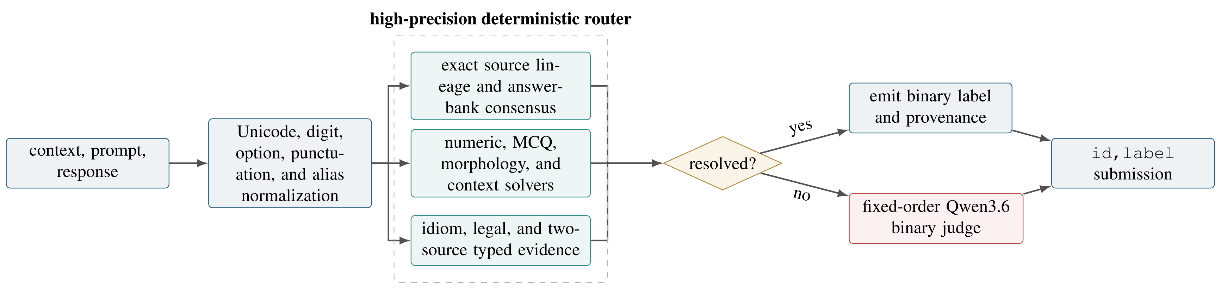
TEAM HUNTRIX
The working hypothesis became a selective cascade
Every stage could answer, or abstain. Abstention was a normal outcome, not a failure.
[3] BenHalluEval [4] Bengali idiom benchmark [7] Frozen v91 architecture
03
Notes:
Presenter: Touhidul Alam Seyam
Target time: 40 seconds
Clock checkpoint: 1:45
Script:
This is the final selective cascade, matching Figure 1 in our paper. We normalize the row, then try exact lineage, structured solvers, context verification, and typed evidence. Each deterministic branch may return zero, one, or abstain. A label is emitted only when the source and requested relation align. Unresolved rows reach the fixed Qwen judge. The important design choice is that abstention is a valid outcome, not a failure.

Slide 4
TEAM HUNTRIX
Routing made abstention an explicit state
A branch could return 0, 1, or abstain. Only abstentions moved to the next branch.
Context
present?
no
Structured
task?
no
Exact source
lineage?
no
Fallback
LLM judge
Row
input
unresolved
unresolved tail
only
yes
yes
yes
Context
verifier
Structured
solver
Typed
evidence
support or contradict
extra-claim check
numeric / MCQ
morphology
entity + predicate
value + provenance
Decision contract
branch(row) -> {0, 1, null}; null means abstain, never a guessed label
[3] Task decomposition [7] v91 router implementation and trace schema
04
Notes:
Presenter: Touhidul Alam Seyam
Target time: 40 seconds
Script:
The router first separates answer-bearing context from no-context tasks. Context rows go to claim verification. No-context rows may enter numeric, multiple-choice, morphology, lineage, or typed-evidence paths. Every route uses the same contract: return a label with provenance, or return null. Approximate retrieval can propose a candidate, but it cannot force a verdict. Ambiguity or equal-trust conflict therefore moves forward instead of contaminating deterministic decisions.

Slide 5
TEAM HUNTRIX
Structured solvers shared one decision contract
Each solver parsed a task-specific representation, verified the requested relation, then answered or abstained.
Numbers
MCQ
Morphology
Idiom & lexical
normalize Bengali digits
extract option set
identify requested form
select literal or figurative
units / dates / ranges
map aliases to options
parse root / suffix / class
retrieve exact sense
compare requested relation
validate selected option
compare analysis
compare requested meaning
Common output
{entity, predicate, parsed value, source, verdict} — incomplete or conflicting fields return null
[7] v91 structured solvers, relation schema, and regression cases
05
Notes:
Presenter: Touhidul Alam Seyam
Target time: 35 seconds
Script:
The deterministic layer was a set of small task-specific parsers, not one keyword system. Numeric rules normalized Bengali digits, units, dates, and ranges. Multiple-choice rules mapped answer aliases. Morphology rules checked the requested grammatical form, while idiom rules separated literal and figurative meaning. Despite different parsing logic, every solver returned the same fields: entity, predicate, value, source, and verdict. Missing or conflicting fields produced abstention.

Slide 6
TEAM HUNTRIX
A correct fact can still answer the wrong relation
Released sample 4 contains both the film title and year; the prompt asks specifically for the year.
Released labeled example
Relation check
Context (English)
Entity
Runway
matches
Runway, Tareque Masud's latest feature film, was released in 2010.
Requested predicate
release_year
expected
Prompt
Response type
film_title
observed
In which year was the film released?
Response
Runway
predicate mismatch → label 0
Released label: 0
Similarity finds a related answer. The relation gate rejects it.
[1] Competition-released labeled sample 4 [7] v91 predicate gate
06
Notes:
Presenter: Touhidul Alam Seyam
Target time: 35 seconds
Script:
This example explains the predicate guard. The passage says that *Runway* was released in 2010. The prompt asks for the release year, but the response gives the film title. The response is related to the correct entity, yet its semantic type is wrong: a title is not a year. Similarity-based retrieval may accept it; our relation check emits label zero.

Slide 7
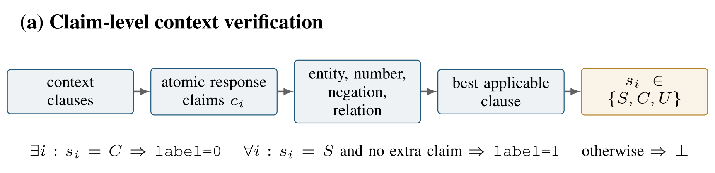
TEAM HUNTRIX
Context rows were reduced to claim-level entailment tests
The verifier compared atomic response claims against the relevant context clause, not against global word overlap.
Report Fig. 2a | [3] Context-faithfulness design [7] v91 clause and claim verifier
07
Notes:
Presenter: Touhidul Alam Seyam
Target time: 40 seconds
Clock checkpoint: 4:15
Script:
For context rows, we split the passage into clauses and the response into atomic claims. Entity, number, negation, and predicate anchors select the applicable clause. Each claim becomes supported, contradicted, or unknown. One contradiction is enough for label zero. Label one requires every factual claim to be supported with no unsupported addition. Everything between those cases abstains. This catches responses that copy most of the passage but alter one decisive fact.
Handoff: Abtahee will cover the fallback judge, evidence gates, experiment history, and Phase 2 result.

Slide 8
TEAM HUNTRIX
Qwen judged 158 rows, not the whole test set
The fallback was short, deterministic, and biased toward catching hallucinations.
Context row
No-context row
1 entailment view
Up to 3 short views
Compare the response against the supplied passage.
Fact check | exam grading | zero-bias check
Any contradiction returns 0.
Label 1 requires unanimous positive votes.
Qwen3.6-27B Q4_K_P | one-token grammar | fixed seeds and batches
[5] Qwen3.6 model card [6] llama.cpp b9637 [7] Frozen judge configuration
08
Notes:
Presenter: MD. Abtahee Kabir
Target time: 35 seconds
Script:
The Phase 1 fallback used quantized Qwen3.6-27B across two T4 GPUs. Context rows received one entailment view. No-context rows received up to three short checks and required unanimous positive votes for label one. Thinking was disabled and generation was constrained to one binary token. Fixed row order, prompt order, seeds, and batches made the judge deterministic. In Phase 1, only 158 unresolved rows reached it.

Slide 9
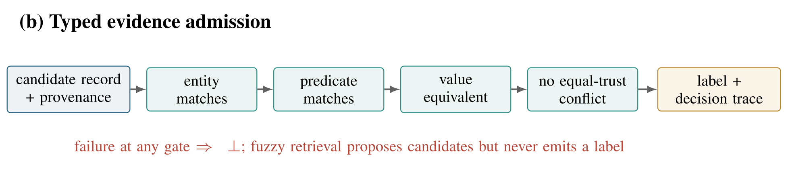
TEAM HUNTRIX
A source record was accepted only after four fields aligned
The trace records why a row was resolved, its source, and the relation that was tested.
Report Fig. 2b | [7] v91 evidence schema, provenance ledger and decision trace
09
Notes:
Presenter: MD. Abtahee Kabir
Target time: 40 seconds
Script:
This is Figure 2b from the paper. A candidate fact carried its provenance, entity, predicate, and value. It could decide a row only if four gates passed: the entity matched, the requested predicate matched, the value was equivalent, and no equal-trust source contradicted it. Any failed gate returned abstention. This prevented a relevant source from answering a neighboring question and gave every deterministic verdict an inspectable decision trace.

Slide 10
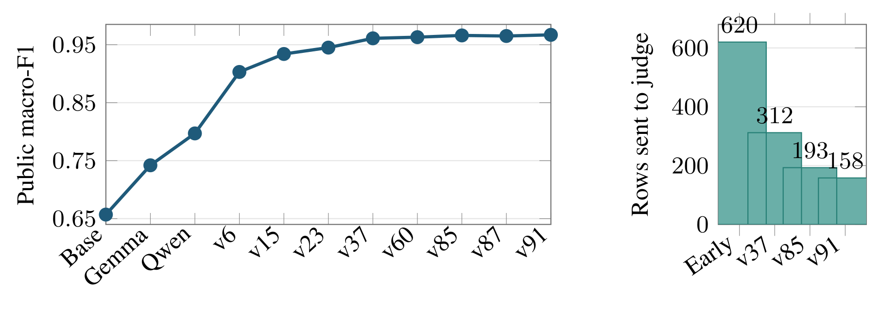
TEAM HUNTRIX
Versioned comparisons locate the main design pivots
These are cumulative versions, not controlled single-factor ablations.
The largest observed step coincided with routing: 0.797 → 0.903.
[7] Scored Phase 1 experiment ledger and Kaggle public leaderboard
10
Notes:
Presenter: MD. Abtahee Kabir
Target time: 40 seconds
Clock checkpoint: 6:10
Script:
The left curve shows public macro-F1 across selected versions; the right chart shows the shrinking judge queue. A uniform Qwen judge reached 0.797. The largest jump came with source and structured routing in v6, which reached 0.903. Later provenance and relation guards raised the score more gradually while reducing the Phase 1 judge queue from 620 early rows to 158 in v91. These are cumulative versions, not controlled single-factor ablations.

Slide 11
TEAM HUNTRIX
Decision logs turned failed runs into routing rules
Each negative result changed what later versions were allowed to decide.
Experiment
Observed result
Decision recorded
Prompt voting
0.851 local, 0.783 public
Stop prompt churn; require new evidence
TF-IDF verifier
0.826 out of fold
Keep as a portable fallback, not a scorer
Raw QA retrieval
Relevant passage, wrong relation
Retrieval proposes; it never decides
v87 fact edits
0.966 to 0.965 public
Require source + predicate; revert
Admission rule: a change must add an evidence trace and preserve the regression suite.
[7] Rejected and scored experiment records in EXPERIMENT.log
11
Notes:
Presenter: MD. Abtahee Kabir
Target time: 35 seconds
Script:
Failed runs changed the next hypothesis. Prompt voting was unstable, so prompt variation was not treated as independent evidence. TF-IDF missed cultural facts, so it remained only a fallback. Raw retrieval repeatedly found the correct entity but the wrong predicate, so it was restricted to candidate generation. When v87 changed plausible facts and reduced the public score, we reverted it and added the source-plus-predicate admission rule.

Slide 12
TEAM HUNTRIX
Reproducibility was treated as an evaluation result
Correctness, deterministic execution, output integrity, and runtime were checked separately.
249
3
225
0
automated regression tests
byte-identical inference runs
deterministic controls
schema or ID-order failures
Literal path
Pinned assets
Fixed schedule
T4×2 inference
Validated CSV
organizer test path
model + runtime + evidence
rows + prompts + batches
one tensor-split server
ordered id,label
3 runs matched byte-for-byte • scored CSV hash matched • 5,000 Phase 2 rows validated in 3:52:02
[7] Regression suite, freeze manifest, evaluation ledger [8] Phase 2 runtime evidence
12
Notes:
Presenter: MD. Abtahee Kabir
Target time: 40 seconds
Script:
The final notebook used pinned model, runtime, and evidence assets with a fixed schedule. The codebase had 249 automated tests, including 225 deterministic controls. Three full Phase 1 runs produced byte-identical CSVs, and the frozen output matched the scored submission. The notebook preserved incoming IDs and wrote only `id,label`. The organizer then ran the same pipeline on 5,000 Phase 2 rows without schema, ordering, or runtime failure.

Slide 13
TEAM HUNTRIX
Phase 2 ranked 7/32 with an official score of 0.90144
Official 5,000-row evaluation on Kaggle Tesla T4 x2; runtime 3 h 52 min.
0.90144
7 / 32
4,793
3:52:02
official score
official rank
Qwen judge (95.86%)
end-to-end runtime
Measured milestones
Elapsed
Observation
Router complete
1:13.18
207 resolved; 4,793 abstained
Model ready
2:51.25
16.332 GiB Qwen across two T4 GPUs
Judge complete
3:52:01.91
13,747.50 s; 0.349 rows/s
42.97% of the 9-hour budget used
5:07:58 headroom
[8] Organizer-run notebook and runtime [9] Official Phase 2 results
13
Notes:
Presenter: MD. Abtahee Kabir
Target time: 40 seconds
Clock checkpoint: 8:05
Script:
On the organizer-run 5,000-row set, the router resolved 207 rows and sent 4,793 to Qwen. End-to-end inference took 3 hours, 52 minutes, and 1.91 seconds on two T4 GPUs, using about 43 percent of the nine-hour budget. Output validation passed for all 5,000 ordered IDs. The official Phase 2 score was 0.90144, ranking seventh among 32 teams.

Slide 14
TEAM HUNTRIX
Phase 2 source shift collapsed deterministic coverage
Exact Phase 1 lineage will cover less. The fallback must remain safe when coverage drops.
Web and news
Common Crawl, recent newspapers
Try exact routing
If uncertain
Knowledge
context clauses
structured solvers
entity-relation checks
skip lineage
use the fixed judge
keep the same vote rule
Wikipedia and Banglapedia
Civic and legal
government services and bdlaws
Education and culture
NCTB textbooks and literature
Deterministic coverage: 93.72% in Phase 1 -> 4.14% in Phase 2
Official score 0.90144; rank 7/32; completed in 3:52:02.
[2] Source preview [8] Held-out runtime [9] Official Phase 2 results
14
Notes:
Presenter: MD. Abtahee Kabir
Target time: 35 seconds
Script:
The broader Phase 2 sources changed system behavior sharply. Deterministic coverage fell from 93.72 percent in Phase 1 to 4.14 percent. The router did not compensate by forcing approximate evidence; it abstained, so 95.86 percent of rows reached Qwen. Runtime increased but remained comfortably compliant. Because only the aggregate score was released, we cannot yet attribute the remaining errors to individual sources or branches.

Slide 15
TEAM HUNTRIX
What the experiments support—
and what remains open
Supported
Limitations
Next analyses
Task families need separate policies.
Predicate alignment prevents relation swaps.
Abstention protected runtime under shift.
Only 299 released labels.
Phase 2 result is aggregate only.
No Phase 2 row-level errors.
If labels are released, inspect Phase 2 errors.
Calibrate the judged tail.
Expand licensed civic and news evidence.
Questions
Held-out result: 0.90144, rank 7/32; runtime: 3 h 52 min.
[7] Final system [8] Runtime evidence [9] Official Phase 2 results
15
Notes:
Presenter: MD. Abtahee Kabir
Target time: 35 seconds
Clock checkpoint: 9:15
Script:
Our experiments support three conclusions. Different task families benefit from different evidence policies. Predicate alignment prevents relation swaps. Explicit abstention protects the pipeline under source shift. The limitations are 299 released labels and no row-level Phase 2 feedback. With those labels, our next step would be to analyse the judged tail and expand licensed civic and news evidence. Thank you. We are ready for your questions.

Slide 16
TECHNICAL APPENDIX
Evidence standards changed with the row type
The binary label stayed fixed; the support test changed with the task and available evidence.
Context
Closed form
Language
Knowledge
split response claims
parse number / option
identify requested form
match source lineage
check passage support
apply requested operation
resolve idiom sense
align entity + predicate
reject extra claims
verify exact result
compare requested meaning
verify typed value
Common contract
{label 0, label 1, abstain, route, evidence} — uncertainty never becomes a guessed label
[1] Label definition [3,4] task families [7] v91 trace contract
16
Notes:
Appendix / Q&A
Use when judges ask how one binary label can cover very different task families.
The label semantics never changed: zero means hallucinated and one means faithful. What changed was the support test. Context rows require claim-level support from the supplied passage. Closed-form rows require the exact requested calculation or option. Language rows require the requested grammatical form or idiom sense. Knowledge rows require source lineage plus aligned entity, predicate, and typed value. Every branch returns the same typed trace or abstains.
Sources:
[1] Competition label definition. [3,4] Task-family references. [7] Frozen v91 trace contract.

Slide 17
TECHNICAL APPENDIX
Decision precedence kept uncertainty out of labels
Contradiction can decide zero; complete support can decide one; every ambiguous case abstains.
Conflict?
no
Complete
support?
no
Evidence
complete?
no
Abstain
LLM judge
Row
input
uncertain
unresolved
yes
yes
yes
Label 0
Label 1
Typed
verdict
wrong value /
relation / claim
all factual claims
supported
entity + predicate
value + provenance
Precedence contract
contradiction → 0; complete support → 1; exact typed evidence may decide; otherwise null → judge
[7] v91 router, conflict audit, and decision trace
17
Notes:
Appendix / Q&A
Use when judges ask which decision wins when evidence disagrees.
A direct contradiction is sufficient for label zero. Label one is stricter: every factual claim must be supported and no unsupported addition may remain. Exact typed evidence can decide only when entity, requested predicate, value, and provenance all align. Missing fields, ambiguity, or equal-trust conflict produce null, which is abstention rather than an error. Only that unresolved tail reaches the fixed LLM judge.
Source:
[7] Frozen v91 router, conflict audit, and decision trace.

Slide 18
TECHNICAL APPENDIX
TECHNICAL APPENDIX
One trace exposes the exact reason behind a verdict
Released example: the response names the film when the prompt asks for its release year.
Admission gate
Released row
trace
Decision trace
example
sample 4
1
Entity
2
Predicate
route
context_verifier
family
context row
same film identity
expected: year
source
supplied_context
entity
Tareque Masud
predicate
release_year
predicate
release year
3
Value type
4
Conflict
verdict
0
observed
Runway (title)
observed: title
predicate / type mismatch
context
supplied passage
Gate 2/3 fail: film title ≠ release year → label 0
accept = entity AND predicate AND value_type AND no_conflict
[1] Released competition sample [7] predicate-alignment trace
18
Notes:
Appendix / Q&A
Use when judges ask for a concrete trace.
The released passage identifies Runway as Tareque Masud's latest feature film and gives 2010 as the release year. The prompt asks for the year, but the response says Runway. The entity is related, yet the requested predicate and observed value type do not align: a title is not a year. The trace therefore records context_verifier, supplied_context, release_year, and verdict zero. This is why semantic similarity alone was unsafe.
Sources:
[1] Released competition sample. [7] Predicate-alignment trace.

Slide 19
TECHNICAL APPENDIX
Five evidence layers answer five different questions
Only labeled rows measure classification quality; software and runtime checks establish other properties.
299
249
3
0
released labeled rows
automated regression tests
byte-identical inference runs
schema or ID-order failures
Released labels
Regression suite
Hash equality
T4×2 runtime
Leaderboard
macro-F1 + label 0
behavior preserved
same predictions
5,000 rows in 3:52:02
0.90144; rank 7/32
Accuracy ≠ reproducibility ≠ output integrity ≠ runtime; each claim needs its own evidence.
[1] Released labels [7] regressions [8] runtime [9] Phase 2 results
19
Notes:
Appendix / Q&A
Use when judges ask what each reported number proves.
The 299 released labels can measure classification performance. The 249 automated tests show whether documented behavior was preserved. Three byte-identical runs show deterministic execution. Zero schema or ID-order failures show output integrity. The 5,000-row run establishes runtime compliance. The official Phase 2 result, 0.90144 at rank 7 of 32, measures aggregate held-out performance but still provides no row-level errors. These are complementary evidence layers, not substitutes for one another.
Sources:
[1] Released labels and leaderboard. [7] Regression ledger. [8] Phase 2 runtime evidence. [9] Official Phase 2 results sheet.

Slide 20
TECHNICAL APPENDIX
Phase 2 defines a focused
next-experiment queue
Observed shift
Next experiments
Rejected shortcuts
Deterministic coverage: 93.72% → 4.14%.
Judge handled 4,793 / 5,000 rows.
Official score: 0.90144; rank 7/32.
If labels are released, cluster judged-tail errors.
Calibrate abstention and judge votes.
Add licensed civic and news evidence.
Do not force fuzzy matches.
Do not fine-tune on only 299 labels.
Do not call runtime an accuracy result.
Decision
Keep the conservative admission contract; optimize the judge tail only after Phase 2 error labels exist.
[7] Frozen v91 [8] Runtime report [9] Official Phase 2 results
20
Notes:
Appendix / Q&A
Use when judges ask what changes after the official Phase 2 result.
The source shift reduced deterministic coverage from 93.72 percent to 4.14 percent, so 4,793 of 5,000 rows reached the fixed judge. The official score of 0.90144 and rank 7 of 32 show that the system transferred reasonably well, but the aggregate result does not identify its remaining errors. That does not justify forcing approximate evidence. If row-level labels are released, the next work should cluster the judged tail, recalibrate abstention and vote rules, then add licensed civic and recent-news evidence. We would reject three shortcuts: fuzzy matches that bypass predicate checks, fine-tuning on only 299 released labels, and treating runtime success as accuracy.
Sources:
[7] Frozen v91 system. [8] Organizer-run Phase 2 runtime report. [9] Official Phase 2 results sheet.

