Slide 1
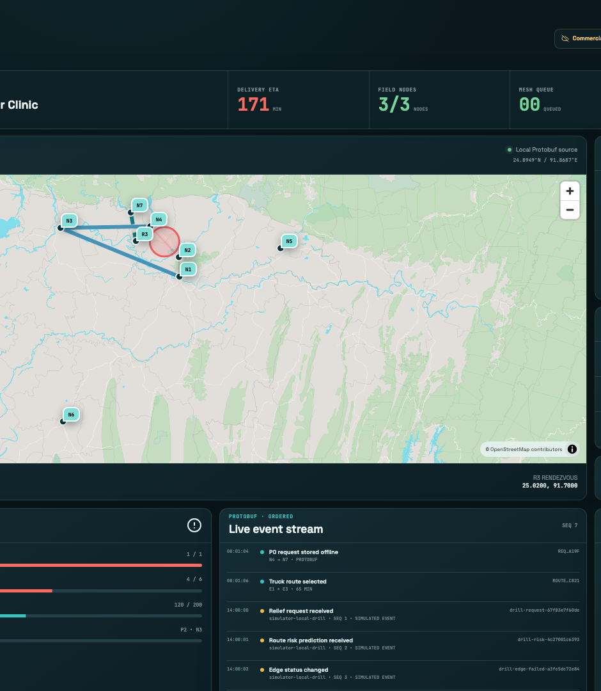
BANGLADESH INNOVATION FAIR 2026 • INNOVATION EXHIBITOR
Digital Delta
Relief logistics that keep working when the internet and power do not
FIELD FIRST Bangla + English • Android • Protobuf • Signed custody
Touhidul Alam Seyam • BGC Trust University Bangladesh
DIGITAL DELTA
1
Notes:
Opening: This is not another cloud dashboard. The field mission lives on the phones. The projector only observes it.

Slide 2
02
One flood can break every dependency at once
The continuity gap is local, not abstract
7.2M
3.74M
1.4M
THE GAP
people affected in the 2022 northeast floods
people affected across six districts in 2024
needed urgent assistance in the 2024 plan
Central systems can be excellent and still be unreachable.
When the flood arrives
• Electricity may be shut down for safety.
• Mobile communication becomes difficult.
• Roads, storage, and airport access can fail together.
• The request, route, and handoff record still have to move.
Field teams need continuity beside existing radio, phone, and paper procedures, not a replacement for them.
Problem evidence from DDM and UN Bangladesh
DIGITAL DELTA
2
Notes:
Sources: https://rapid.ddm.gov.bd/risk/riskinfo ; https://bangladesh.un.org/en/188010-flash-floods-humanitarian-response-plan-2022-united-nations-bangladesh-coordinated-appeal ; https://bangladesh.un.org/sites/default/files/2024-10/Bangladesh-HCTT-Humanitarian%20Response%20Plan-Cyclone%20and%20Monsoon%20Floods%202024-29-09-2024%20%28June%202024%20to%20March%202025%29.pdf

Slide 3
03
The mission lives on the phones
The observer can disappear without stopping field work
CLINIC
RELAY
HOSPITAL
OPTIONAL OBSERVER PATH
Create P0 request
Store before ack
Decrypt + decide
Go observer
ordered, sanitized events
AES-256-GCM payload • RSA-OAEP key wrap • Protobuf envelope
Next.js headquarters
local SSE + offline map
DISCONNECT THE LAPTOP Requests, relay, routing, triage, and custody continue on Android.
Vercel + D1
reviewer convenience only
Field transport
Nearby framed Protobuf
Supported IP link
gRPC + Protobuf
Browser boundary
Sanitized SSE JSON
DIGITAL DELTA
3
Notes:
Architecture evidence: README.md and docs/ARCHITECTURE.md. JSON is used only at the browser observer boundary, never on the mesh.

Slide 4
04
Eight modules, one continuous mission
Each module changes the same signed and replayable field state
M1
Identity
M2
CRDT sync
M3
Mesh relay
M4
Routing
Offline role credential + audit
Vector clocks + human conflict
Authenticated store and forward
Road + water + simulated air
M5
Custody
M6
Triage
M7
Route risk
M8
Hybrid fleet
Signed QR + replay rejection
SLA warning + safe preemption
On-device ONNX advisory
Rendezvous + signed handoff
REAL LOGIC
Simulated weather and vehicles are labelled. Cryptography, storage, routing, and decisions are real code paths.
DIGITAL DELTA
4
Notes:
Technical capability: all eight module paths are implemented. Simulation labels remain visible for environmental inputs and vehicle movement.

Slide 5
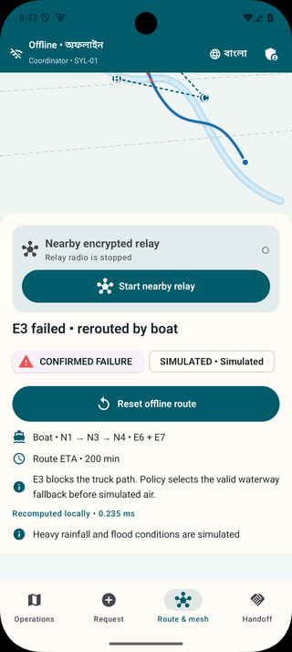
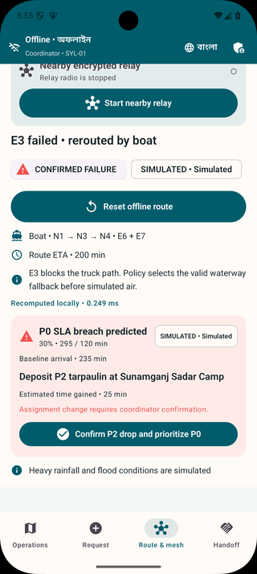
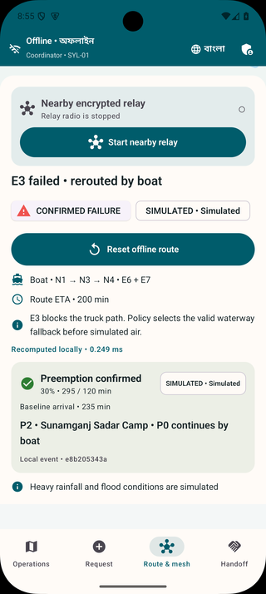
05
One failure changes route and priority
A deterministic offline drill that judges can follow in seconds
01
E3 fails
Truck path becomes invalid
02
Boat selected
E6 + E7, ETA 200 min
03
P0 warning
30% slowdown breaches SLA
04
Human confirms
P2 deposit at N3
SIMULATED FAILURE • REAL ROUTE + TRIAGE
DIGITAL DELTA
5
Notes:
Demo sequence: show the seeded truck route, inject simulated E3 failure, show boat E6 and E7, show P0 slowdown breach, then require coordinator confirmation before changing the P2 assignment.

Slide 6
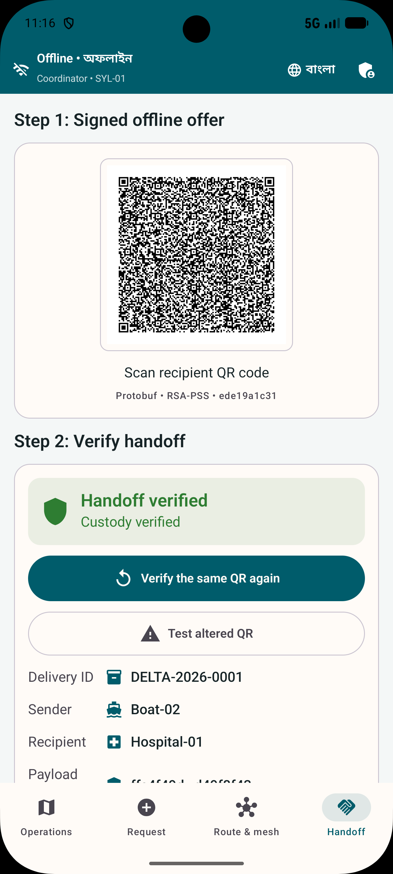
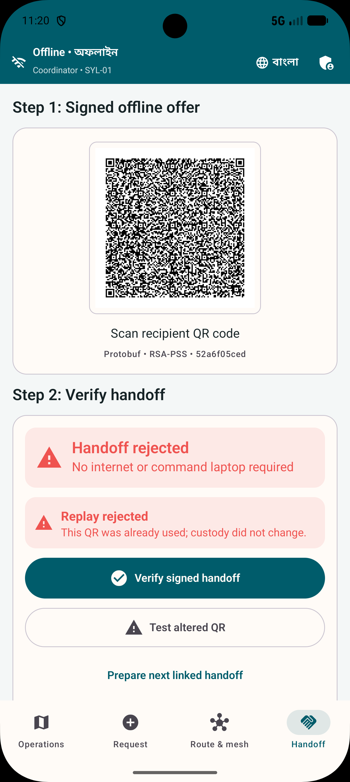
06
Trust is verified at every handoff
The relay can carry the envelope but cannot read its contents
Security path
60
• Administrator-signed role credentials
• Fresh peer challenge + RSA-PSS proof
• RSA-OAEP wrapped AES-256-GCM payload
• Atomic nonce claim + linked receipt hash
• Signed durable acknowledgements
connected Android journeys in the current suite
10,000
gRPC streams durably acknowledged in the load run
17
headquarters tests plus production build
HONEST LIMIT
Physical three-phone and camera-in-airplane-mode proof remains a release gate.
DIGITAL DELTA
6
Notes:
Evidence: docs/TESTING.md and artifacts/reports/load/2026-09-04-go-10000.md. The 10,000-stream run proves connection capacity under recorded laptop conditions, not district radio throughput. QR camera and three-phone evidence remain open.

Slide 7
07
Start with one district exercise
Public-interest deployment, not a consumer subscription
Alternative | Strong at | Remaining continuity gap
Sahana Eden | Relief logistics | Server reachability in the field
KoboCollect | Offline forms | Routing, relay, signed custody
Briar | Nearby secure messaging | Operational logistics workflow
Meshtastic | Off-grid radio mesh | Requires additional hardware
Beachhead
Six northeastern districts
about 64 upazilas • 360 unions
First obtainable deployment
One district • one health referral path • one relief partner
1
Map the workflow
2
Controlled exercise
3
Shadow pilot
Authority + data owner
Range + recovery + usability
Compare with official log
DIGITAL DELTA
7
Notes:
Sources: https://sahanafoundation.org/products/eden/ ; https://support.kobotoolbox.org/data_collection_kobocollect.html ; https://briarproject.org/manual/ ; https://meshtastic.org/docs/ ; Bangladesh 2024 to 2025 humanitarian response plan. Commercialization is deployment preparation, integration, training, offline map packaging, exercise support, and maintained releases.

Slide 8
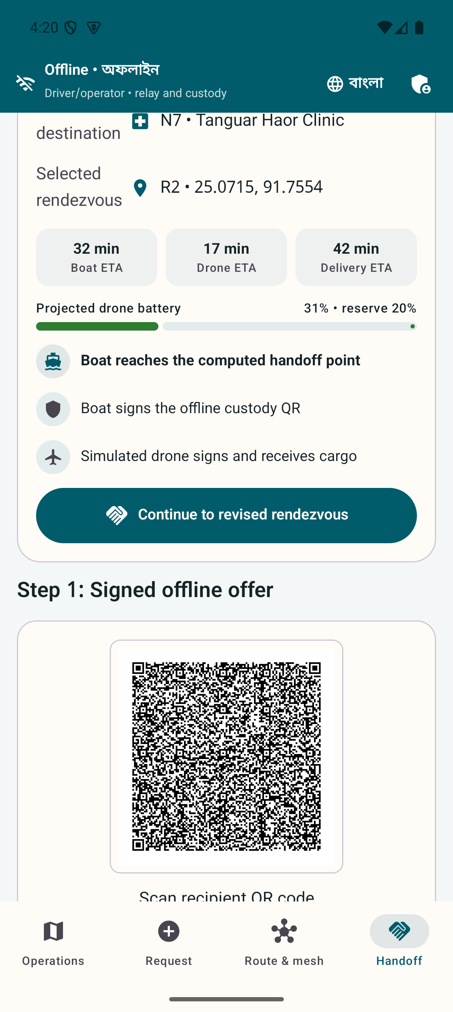
08
The next milestone is a real field exercise
Software is ready to be challenged by phones, radios, people, and procedure
THE ASK
Run one controlled three-phone exercise with a district authority, health facility, and relief partner
Built solo by
Touhidul Alam Seyam
Success gates
BGC Trust University Bangladesh
• A to B to C relay with the middle phone restarted
• Camera provisioning and custody in airplane mode
• Target-phone memory, route latency, and battery
• Bangla, English, TalkBack, and operator task review
Product • Android • Go Security • Routing • ML Next.js • Testing • Evidence
SDG 3 • 9 • 11 • 13 • 16
digital-delta-headquarters.vercel.app
github.com/Seyamalam/digital-delta
Thank you
DIGITAL DELTA
8
Notes:
Close: The fair build proves the hard software boundary. The ask is not national deployment. It is one controlled exercise that can turn emulator evidence into measured field evidence. Inclusion and ethics gates are explicit in docs/PHYSICAL_DEVICE_TEST.md and docs/FINAL_REPORT.md.

