Slide 1


Digital Delta
Offline relief coordination
for Bangladesh
Innovate to Market
Touhidul Alam Seyam
BGC Trust University Bangladesh
Innovation Fair 2026
Concept illustration
01
Notes:
Main pitch, slides 1–14. Suggested speaking time 7–9 minutes, subject to organizer rules. For 5 minutes, use slides 1, 2, 3, 5, 6, 8, 9, 13 and 14. Introduce Touhidul Alam Seyam, BGC Trust University Bangladesh. An offline disaster logistics demonstration for Innovate to Market. The river illustration is AI-generated concept art.

Slide 2
Flood outages disrupt the delivery record
Transport, power and communications can fail together.
7.2 million
3.74 million
People affected
June 2022, nine districts
People affected
June 2024, six districts
A request still needs to reach the next responsible person
when the network is unavailable.
UN Bangladesh 2022 response plan and NAWG June 2024 assessment. Different events and geographic coverage.
02
Notes:
Event estimates are not a time series. UN Bangladesh 2022 response plan: 7.2 million affected in nine northeastern districts. NAWG June 2024: 3.74 million in six districts. Different coverage, do not sum. Sources: https://bangladesh.un.org/en/188010-flash-floods-humanitarian-response-plan-2022-united-nations-bangladesh-coordinated-appeal
https://bangladesh.un.org/sites/default/files/2022-06/situation_overview_flash_flood_final_draft_.pdf
https://bangladesh.un.org/bn/download/163651/272834

Slide 3
One delivery journey connects the modules
Clinic request, relay, rerouting, human review and signed receipt.
01 CLINIC
02 RELAY
03 ROUTE
04 DECISION
05 RECIPIENT
Save request
Carry record
Reroute
Review
Sign receipt
Save the request
on the phone.
Persist encrypted
bytes. Forward
when peers meet.
A simulated road
failure selects
a boat path.
A coordinator
reviews the
proposed change.
Verify once.
Reject replay
and tampering.
A conceptual walkthrough across demonstrated modules
Screenshots come from separate seeded captures. Physical end-to-end acceptance remains open.
03
Notes:
Sources: README.md, docs/ARCHITECTURE.md and docs/TESTING.md. Evidence reviewed 4 September 2026. All environmental and vehicle inputs are simulated. Physical multi-phone acceptance is still open. This is a conceptual cross-module story. Screenshots are separate seeded captures, not an assertion that a physical end-to-end mission was completed.

Slide 4
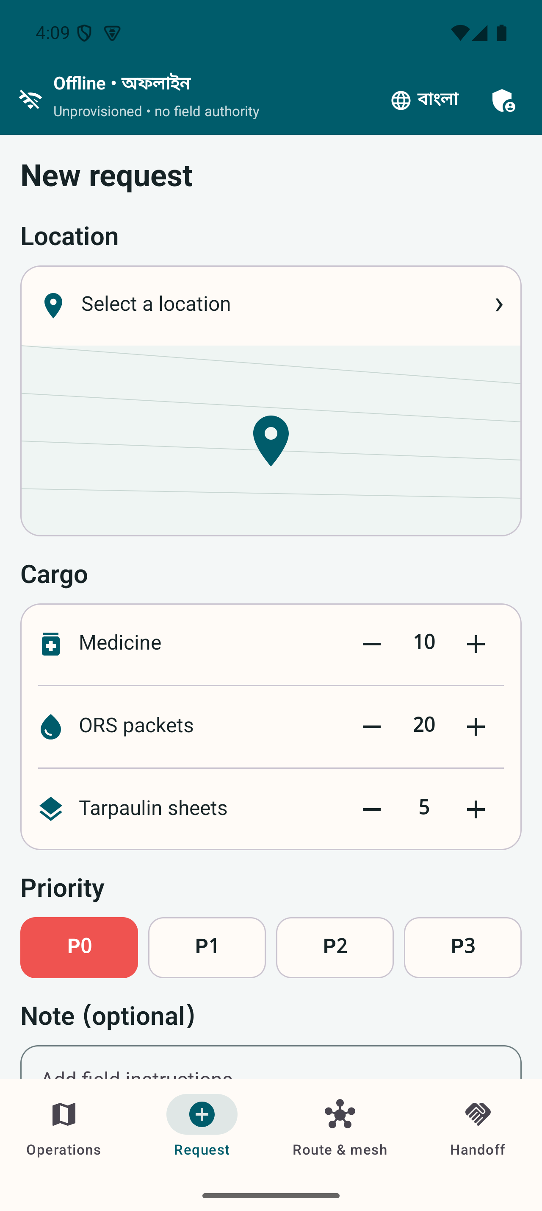
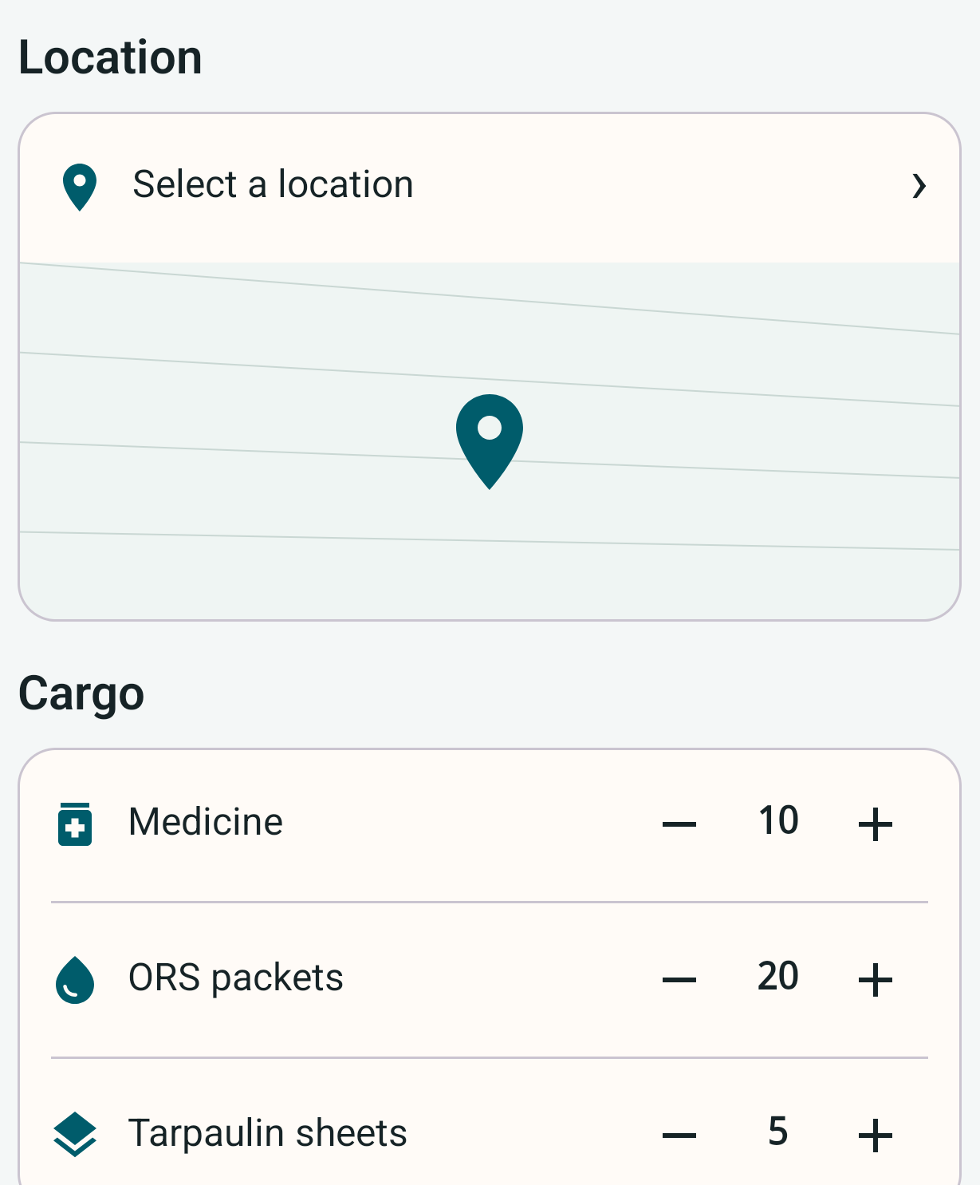
The clinic can record a request offline
The phone owns the local record before any transfer.
01 Structured request
Location, supplies and urgency belong to a record the phone can retain.
02 Honest transfer state
Queued, forwarded and accepted remain separate states.
Left: full source capture. Center: enlarged detail crop. Both show the actual application.
04
Notes:
Sources: README.md, docs/ARCHITECTURE.md and docs/TESTING.md. Evidence reviewed 4 September 2026. All environmental and vehicle inputs are simulated. Physical multi-phone acceptance is still open. The displayed English request form shows cargo fields. An enlarged source crop is shown beside a full capture. A saved or queued state must not be described as delivery acceptance. Source: /Users/seyam/Work/Innovation_fair/artifacts/screenshots/field-en/03-field-en-p0-request-1280x2856.png

Slide 5
The relay forwards encrypted contents
Only the intended recipient opens the protected delivery payload.
RELAY CAN CHECK
Forwarding metadata
SENDER
IDs and destination
Expiry and hop limits
Envelope integrity
RECIPIENT
Seal the event
Open and verify
Protobuf bytes
Recipient encryption
Signed envelope
Decrypt with own key
Verify trusted fields
Apply accepted event
RELAY CANNOT OPEN
Delivery payload
AES-256-GCM payload encryption
Recipient encryption
protects the contents.
Persist before acknowledgement
RSA-OAEP recipient key wrapping
Receipt ≠ domain acceptance
Metadata remains available for forwarding. Payload encryption does not hide every communication pattern.
05
Notes:
Sources: README.md, docs/ARCHITECTURE.md and docs/TESTING.md. Evidence reviewed 4 September 2026. All environmental and vehicle inputs are simulated. Physical multi-phone acceptance is still open. AES-256-GCM encrypts payload. RSA-OAEP wraps recipient key. RSA-2048-PSS signatures and signed credentials bind authority. Relays validate forwarding and integrity fields, persist ciphertext and acknowledge storage. Receipt is not final domain acceptance. See docs/SECURITY.md.

Slide 6
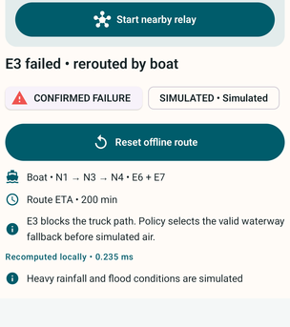
A failed road changes the phone’s route
The seeded E3 failure selects the boat alternative E6 and E7.
Truck
E1 and E3
Boat after failure
E6 and E7
Enlarged source detail. Route failure and vehicles are simulated. Target-phone performance requires measurement.
06
Notes:
Sources: README.md, docs/ARCHITECTURE.md and docs/TESTING.md. Evidence reviewed 4 September 2026. All environmental and vehicle inputs are simulated. Physical multi-phone acceptance is still open. Initial truck edges E1 and E3. Confirmed simulated failure excludes E3. Strict mode constraints and deterministic search select the boat alternative. Real route safety and target-phone latency remain open.

Slide 7
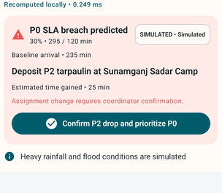
A coordinator confirms the priority change
The proposal explains the deadline pressure and safe drop.
01 Explain the tradeoff
The longer boat route threatens the urgent delivery deadline.
02 Retain the decision
A person confirms the assignment change and its reason.
Enlarged source detail. Simulated cargo and environmental inputs remain labelled in the application.
07
Notes:
Sources: README.md, docs/ARCHITECTURE.md and docs/TESTING.md. Evidence reviewed 4 September 2026. All environmental and vehicle inputs are simulated. Physical multi-phone acceptance is still open. The M6 policy uses route ETA, 30 percent slowdown, safe waypoint and a five minute staleness guard. It records the confirmer, reason, cargo and policy version. Logistics priority is not clinical diagnosis.

Slide 8
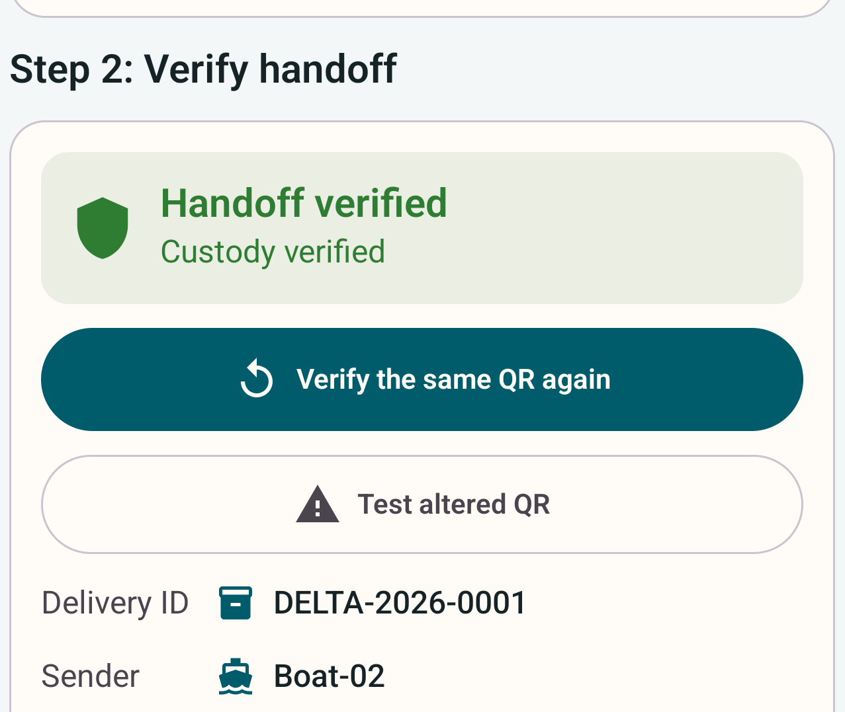
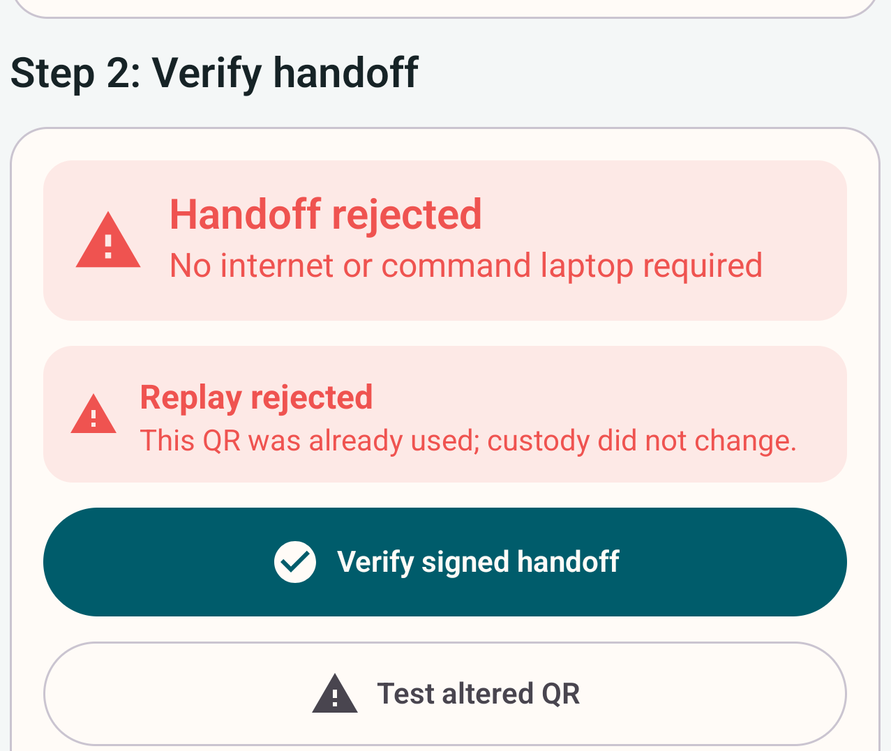
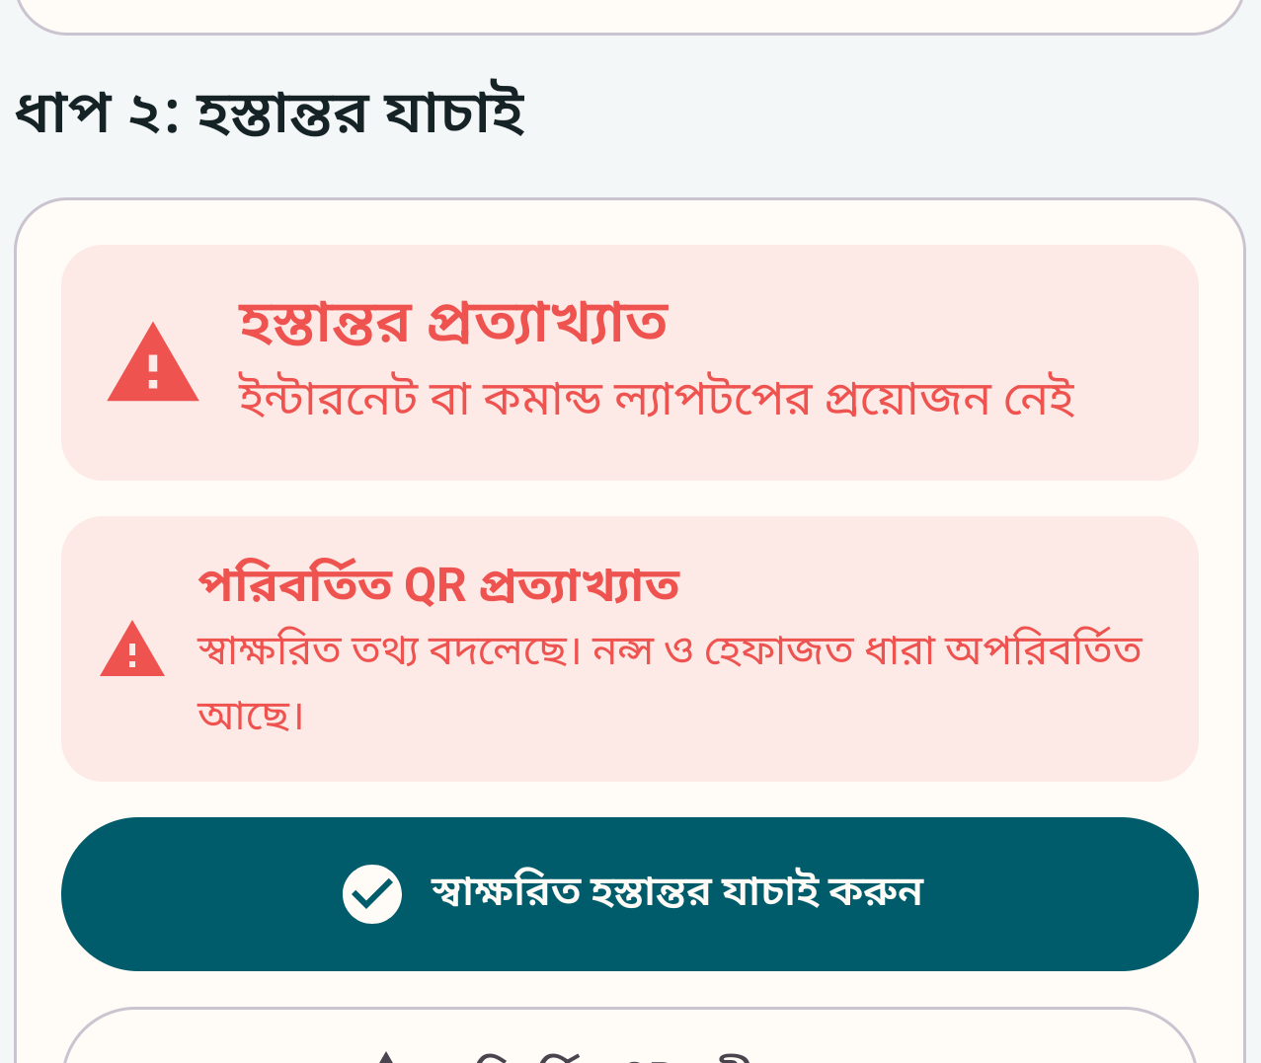
A signed handoff accepts custody once
Replay and altered offers must leave custody unchanged.
Accepted
Replay rejected
Tamper rejected
Enlarged source details. Full captures appear in the report. Physical camera acceptance remains open.
08
Notes:
Sources: README.md, docs/ARCHITECTURE.md and docs/TESTING.md. Evidence reviewed 4 September 2026. All environmental and vehicle inputs are simulated. Physical multi-phone acceptance is still open. Native Android Keystore signatures and local verification are implemented. Nonce consumption and linked two-party receipts have automated evidence. These app captures show simulated cargo. Physical camera scanning between phones in airplane mode remains open.

Slide 9
The first buyer owns preparedness
An institutional sponsor needs a named operational owner.
Buyer hypothesis. Interviews and willingness to pay remain unvalidated.
USES THE PRODUCT
APPROVES ADOPTION
RECEIVES THE BENEFIT
Field operator
Institutional sponsor
Community
Records requests
Carries encrypted messages
Verifies a handoff
Government or NGO team
Budget and procurement
Named operational owner
Continuity of supply records
Accountable delivery
Outcomes to be measured
DEPLOYMENT RESPONSIBILITY
Keep the system ready between events
Training, devices, maps, credentials and support
Proposed roles. Field users, budget owners and community beneficiaries are different groups.
09
Notes:
Commercial hypothesis. Government and NGO preparedness or health logistics teams are potential sponsors, not confirmed customers. No interviews or willingness-to-pay study have been completed for this report. https://bangladesh.un.org/bn/download/163651/272834

Slide 10
The integrated workflow must earn adoption
The comparison starts with each alternative’s documented strength.
Alternative | Documented strength | Digital Delta adoption question
Sahana Eden | Relief inventory and logistics | Does phone continuity add value?
KoboCollect | Offline assessment collection | Does custody need a separate workflow?
Ushahidi | Reports and incident mapping | Can verified events complement reporting?
Briar | Encrypted nearby messaging | Are structured logistics rules worth training?
Meshtastic | LoRa mesh messaging | Can existing phones meet the relay need?
Positioning hypothesis. A missing feature in reviewed documentation is not proof that a competitor cannot provide it.
10
Notes:
First-party public materials reviewed 4 September 2026. These are adjacent alternatives, not a universal feature audit. Sahana source is the Eden legacy archive. Sources:
https://sahanafoundation.org/products/eden/
https://support.kobotoolbox.org/data_collection_kobocollect.html
https://www.ushahidi.com/features/
https://briarproject.org/how-it-works/
https://meshtastic.org/docs/introduction/

Slide 11
The offer is a preparedness service
Configuration, measured exercises and agreed support surround the software.
INITIAL ENGAGEMENT
ACCEPTANCE
ONGOING AGREEMENT
Prepare the exercise
Produce evidence
Maintain readiness
Workflow configuration
Devices and identities
Bundled maps
Bilingual training
Supervised scenario
Baseline comparison
Failure and recovery log
Sponsor review
Release maintenance
Map refreshes
Credential administration
Seasonal rehearsals
The proposed commercial unit is an institutional service engagement.
Pricing and repeat demand require validation. Sensitive data is not a revenue product.
Initial engagement and recurring support are commercial hypotheses to test with buyers.
11
Notes:
Proposed service model, not current revenue or validated pricing. Setup includes workflow mapping, devices, signed identities, offline maps and training. Acceptance produces evidence. Seasonal readiness support requires an agreed owner and budget.

Slide 12
The illustrative pilot totals BDT 517,500
A 12-week planning model with six exercise phones and 15% contingency.
Illustrative BDT assumptions, not market quotations. The report contains quantities, rates and exclusions.
12
Notes:
Planning assumptions only. Engineering BDT 200,000; facilitation 48,000; security 40,000; phones 108,000; power accessories 24,000; travel 30,000. Subtotal: BDT 450,000. Contingency: BDT 67,500. Total: BDT 517,500. The chart aggregates workflow and facilitation as BDT 248,000, and devices and power as BDT 132,000. No supplier quotes, contract or actual spend. Excludes taxes, emergency transport and ongoing production support.

Slide 13
Software evidence supports a physical pilot
The next gate is a supervised test on real phones.
Recorded evidence | Next acceptance evidence
60 journeys on each of two Android emulators | Three-phone relay and recovery
Signed receipt acceptance and rejection | Camera verification in airplane mode
Bundled bilingual and model workflows | Human task completion and accessibility
Local observer replay after disconnection | Phone continuity with the laptop off
Reproducible local verification scripts | Target-phone battery, memory and latency
Existing dated evidence. The 10,000-stream laptop test measures connection capacity, not physical mesh readiness.
13
Notes:
Sources: README.md, docs/ARCHITECTURE.md and docs/TESTING.md. Evidence reviewed 4 September 2026. All environmental and vehicle inputs are simulated. Physical multi-phone acceptance is still open. Existing final local gate 2026-09-04 reports the same 60 journeys passed on each Android 15 and Android 16 emulator. There were 17 dashboard tests and 3 archive tests. At 10,000 Go loopback streams, p95 acknowledgement was 57.645 seconds and RSS was 1.19 GiB. This is server capacity evidence, not phone mesh latency. No new verification run performed for the presentation.

Slide 14

The next step is one controlled exercise
A sponsor, an operational owner and a measured delivery scenario.
One referral chain.
A clear acceptance decision.
Touhidul Alam Seyam
BGC Trust University Bangladesh
Concept illustration
14
Notes:
Close the main pitch here. Ask for a discovery meeting and a nominated operational owner. Agree a supervised three-phone test and baseline, then review whether a 12-week pilot is justified. No current institutional endorsement, customer, award or funding is claimed. Project lead Touhidul Alam Seyam, BGC Trust University Bangladesh. https://github.com/Seyamalam/digital-delta. AI-generated handoff concept illustration.

Slide 15
The phone owns its operational stack
Technical appendix
INTERFACE
Compose and ViewModels
Bundled Bangla and English read the same local mission.
DOMAIN
Policies and repositories
Identity, conflicts, routing, priority and custody.
PERSISTENCE
LOCAL CAPABILITY
TRANSPORT
Room and DataStore
Keystore and ONNX
Nearby service
Events, queues and profile
Protected keys and inference
Active foreground relay
Original editable diagram derived from repository architecture and documented acceptance boundaries.
15
Notes:
Sources: README.md, docs/ARCHITECTURE.md and docs/TESTING.md. Evidence reviewed 4 September 2026. All environmental and vehicle inputs are simulated. Physical multi-phone acceptance is still open. Compose, ViewModels and repositories coordinate Room, DataStore, Keystore, ONNX and Nearby. Foreground service owns active radio; WorkManager handles bounded maintenance.

Slide 16
Optional observation stays outside field authority
Technical appendix
FIELD AUTHORITY / Bundled Bangla and English
CLINIC
RELAY
RECIPIENT
Create and retain
Store and forward
Verify and accept
Identity checks
Local request and outbox
Authenticated nearby peers
Recipient-encrypted queue
Local route and policy
Signed custody receipt
Observation may disconnect
OPTIONAL
OPTIONAL
Local observer
Public presentation
Go log and dashboard
Sanitized archive and web view
Original editable diagram derived from repository architecture and documented acceptance boundaries.
16
Notes:
Sources: README.md, docs/ARCHITECTURE.md and docs/TESTING.md. Evidence reviewed 4 September 2026. All environmental and vehicle inputs are simulated. Physical multi-phone acceptance is still open. Each phone performs local identity checks, routing, priority and custody. Optional local and public views have no authority over field actions.

Slide 17
Acknowledgement precedes domain acceptance
Technical appendix
01 SENDER
02 RELAY
03 RECIPIENT
04 LOCAL STATE
Write outbox
Persist bytes
Verify and apply
Rebuild view
Encrypted envelope
Stable message ID
Durable queue
Signed storage
acknowledgement
Decrypt and deduplicate
Check domain rules
Accepted event
Updated projection
A stored envelope may still fail recipient or domain verification.
ON INTERRUPTION
ON DUPLICATION
Retry within limits
Preserve one effect
Expiry and hop count bound retries.
IDs and nonces prevent repetition.
Original editable diagram derived from repository architecture and documented acceptance boundaries.
17
Notes:
Sources: README.md, docs/ARCHITECTURE.md and docs/TESTING.md. Evidence reviewed 4 September 2026. All environmental and vehicle inputs are simulated. Physical multi-phone acceptance is still open. Store before acknowledge. The recipient may still reject a stored envelope. Stable IDs, nonce checks, TTL and hop limits bound duplicate effects and retries.

Slide 18
Unsafe concurrent edits need an authorized decision
Technical appendix
PHONE A
PHONE B
Destination edit
Concurrent edit
Vector clock and event ID
Independent offline record
MERGE POLICY
Compare causality
Safe data types merge
Unsafe fields enter review
AUTHORIZED COORDINATOR
ACCEPTED PROJECTION
Select the resolution
Retain the decision
Destination, priority or quantity
Selected value, policy version and hash
Original editable diagram derived from repository architecture and documented acceptance boundaries.
18
Notes:
Sources: README.md, docs/ARCHITECTURE.md and docs/TESTING.md. Evidence reviewed 4 September 2026. All environmental and vehicle inputs are simulated. Physical multi-phone acceptance is still open. Vector clocks expose concurrent edits. Safe types merge by deterministic rules. Safety-sensitive destination, priority and quantity conflicts require review. Physical convergence remains open.

Slide 19
Route failures and risk have different effects
Technical appendix
CONFIRMED FAILURE
SIMULATED RISK
Exclude the edge
Add advisory cost
Vehicle mode constraints
remain mandatory.
The model does not
confirm a closure.
LOCAL SEARCH
Calculate a route
Deterministic path and ETA
PRIORITY PROPOSAL
HUMAN CONFIRMATION
Check time and safe waypoint
Record the assignment change
Fresh estimate and slowdown scenario
Confirmer, cargo, reason and policy
Original editable diagram derived from repository architecture and documented acceptance boundaries.
19
Notes:
Sources: README.md, docs/ARCHITECTURE.md and docs/TESTING.md. Evidence reviewed 4 September 2026. All environmental and vehicle inputs are simulated. Physical multi-phone acceptance is still open. Confirmed failed edges are excluded. Synthetic risk adds cost. Local ETA feeds a fresh safe-waypoint priority proposal, followed by human confirmation.

Slide 20
The model improves recall on synthetic labels
The result demonstrates integration and an explicit error tradeoff.
Recall 0.837
The model finds more synthetic positives, with more false alarms.
900 held-out synthetic examples
Actual model-card metrics. Real observations, calibration and geographic/time holdouts remain future research.
20
Notes:
The dataset has 6,000 deterministic synthetic rows: 4,200 training, 900 validation and 900 test. The threshold of 0.285 was selected on validation data. Model precision is 0.612766, recall 0.837209 and F1 0.707617. Baseline precision is 0.954545, recall 0.061047 and F1 0.114754. The confusion matrix contains 374 true negatives, 182 false positives, 56 false negatives and 288 true positives. Maximum ONNX parity error is 8.94e-8. Source models/route-decay/MODEL_CARD.md. These are not real flood prediction results.

Slide 21
Pilot milestones support an adoption decision
Proposed twelve-week exercise
WEEKS 1–2
WEEKS 3–5
WEEKS 6–8
WEEKS 9–12
Agree ownership
Test real phones
Observe the users
Review adoption
Sponsor and workflow
Phone selection
Acceptance criteria
Relay and recovery
Camera QR verification
Battery and latency
Bangla and English
Accessibility review
Rehearsal and baseline
Shadow exercise
Incident and cost review
Go, revise or stop
Technical acceptance
Human acceptance
Governance acceptance
Proposed schedule. No customer commitment or organizer requirement is implied.
Technical, human and governance acceptance determine whether expansion is justified.
21
Notes:
Proposed schedule, not a customer commitment or organizer requirement. Agree stop conditions. Retain approved procedures during the shadow exercise.

Slide 22
Market sizing starts with verified institutions
Geographic need provides context rather than a revenue total.
NEED CONTEXT
REACHABLE SEGMENT
FIRST EXERCISE
3.74 million people
Institutions with a role
One referral chain
June 2024 assessment
6 districts
64 upazilas
360 unions
Relief logistics
Health supply coordination
Preparedness operations
Budget authority to verify
One sponsor
Experienced relief partner
Named operational owner
Bounded device cohort
Bottom-up sizing follows verified organizations, budgets and purchase cycles.
S03: NAWG June 2024 assessment. Revenue market size is not yet established.
22
Notes:
The June 2024 NAWG assessment covers 3.74 million people, 6 districts, 64 upazilas and 360 unions. These units overlap and are not purchasing accounts. Verify institution lists, authority, preparedness budgets, procurement and realistic annual contract assumptions before estimating revenue TAM/SAM/SOM. https://bangladesh.un.org/bn/download/163651/272834

Slide 23
Discovery tests the buying hypothesis
Twelve proposed interviews across operational and institutional roles.
Participants | What to learn | Decision it informs
4 field users | Last outage, current workaround, critical errors | Workflow and interface fit
4 coordinators | Decision authority, custody and handoff exceptions | Operating procedures
4 budget or IT owners | Budget timing, procurement, support and data rules | Buyer and service model
Recruit across Bangla and English use, device experience
and accessibility needs.
Illustrative discovery design. Demand, willingness to pay and sponsor ownership remain unvalidated.
23
Notes:
Proposed research, not completed interviews. Suggested sample: 4 field users, 4 coordinators and 4 budget, IT or procurement owners. Small qualitative study tests workflows and buying hypotheses, not statistical market prevalence. Obtain consent and avoid sensitive beneficiary data.

Slide 24
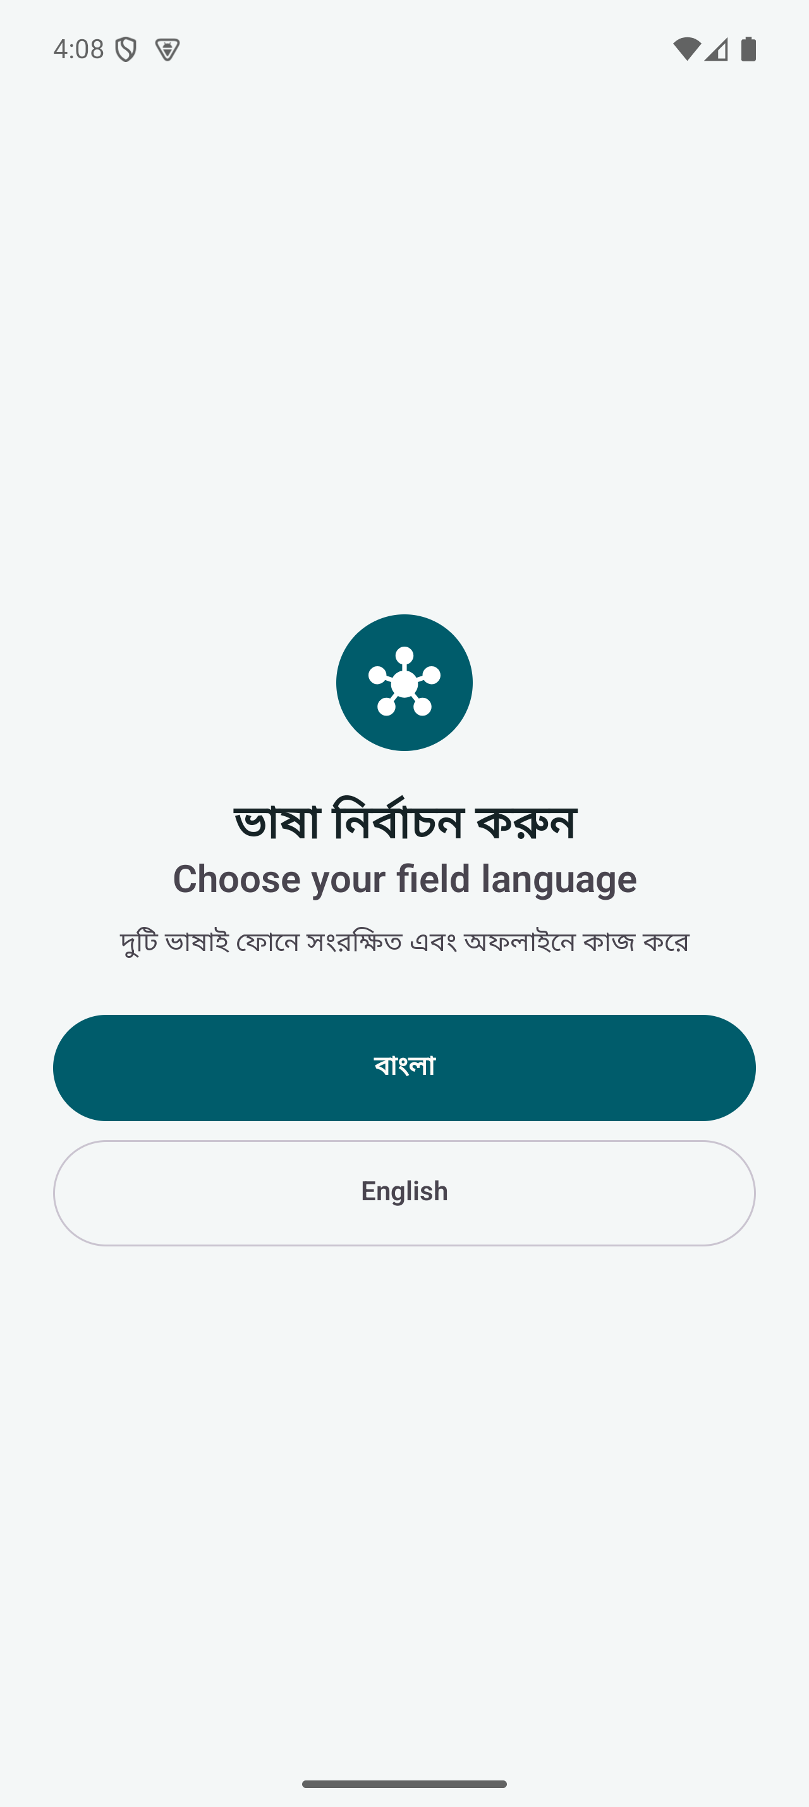
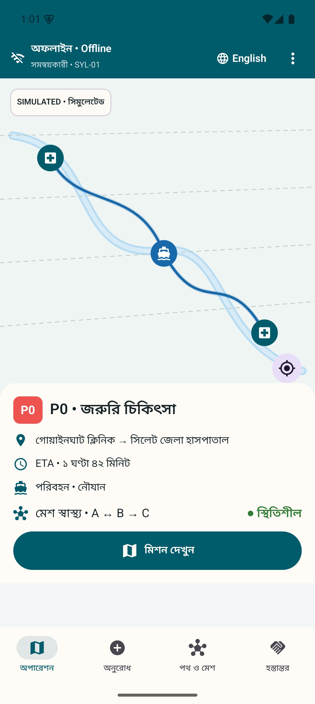
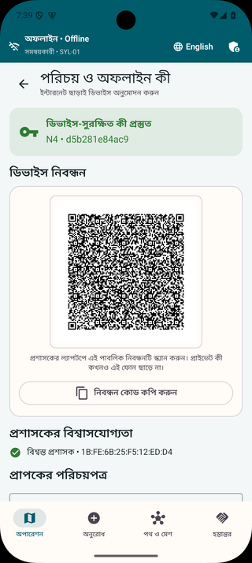
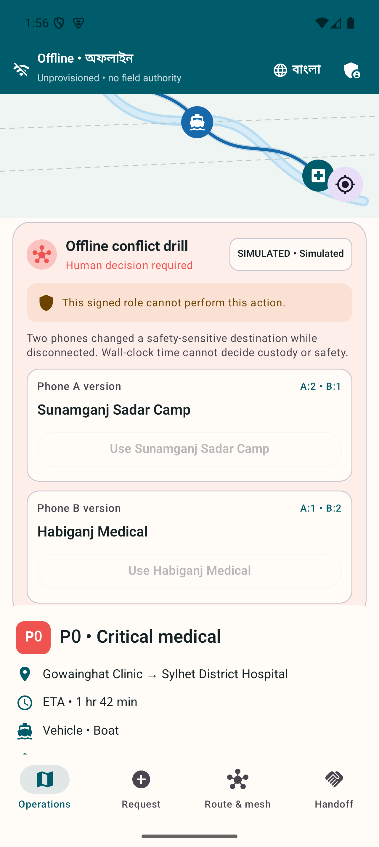
Both languages share the same mission
Product appendix: language choice and authority.
Language choice
Bangla home
Trusted identity
Role denial
Original full captures. Language parity alone does not establish human accessibility.
24
Notes:
Sources: README.md, docs/ARCHITECTURE.md and docs/TESTING.md. Evidence reviewed 4 September 2026. All environmental and vehicle inputs are simulated. Physical multi-phone acceptance is still open. Full original captures demonstrate bundled language choice, Bangla home, trusted provisioning and English role denial. Human accessibility review remains open.

Slide 25
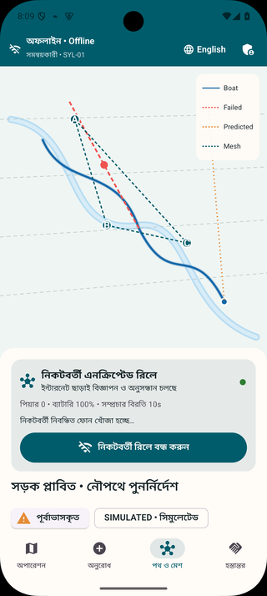
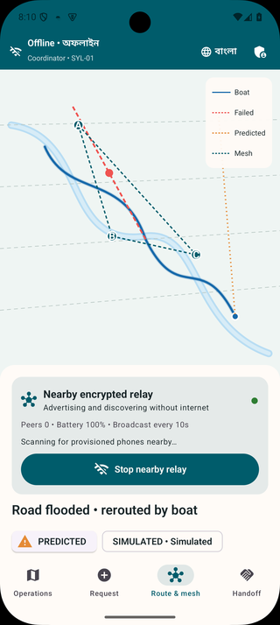
The active relay has a visible lifecycle
Product appendix: Bangla and English Nearby sessions.
Authenticated peers
Nearby connection acceptance is followed by independent signed challenge verification.
Durable transfer
Queues persist before acknowledgement. Interruption and retry require physical validation.
Full source captures. Three physical phones must demonstrate relay interruption and recovery.
25
Notes:
Sources: README.md, docs/ARCHITECTURE.md and docs/TESTING.md. Evidence reviewed 4 September 2026. All environmental and vehicle inputs are simulated. Physical multi-phone acceptance is still open. Single-emulator live lifecycle proves start, advertise/discover and stop, not completed A-B-C transmission or range.

Slide 26
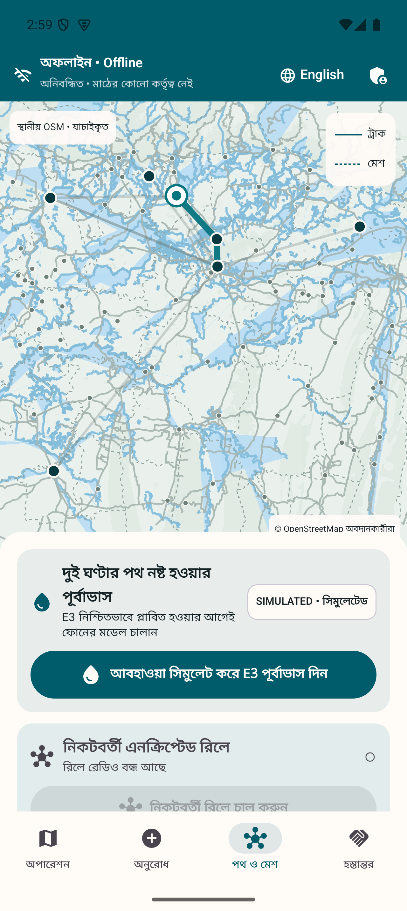
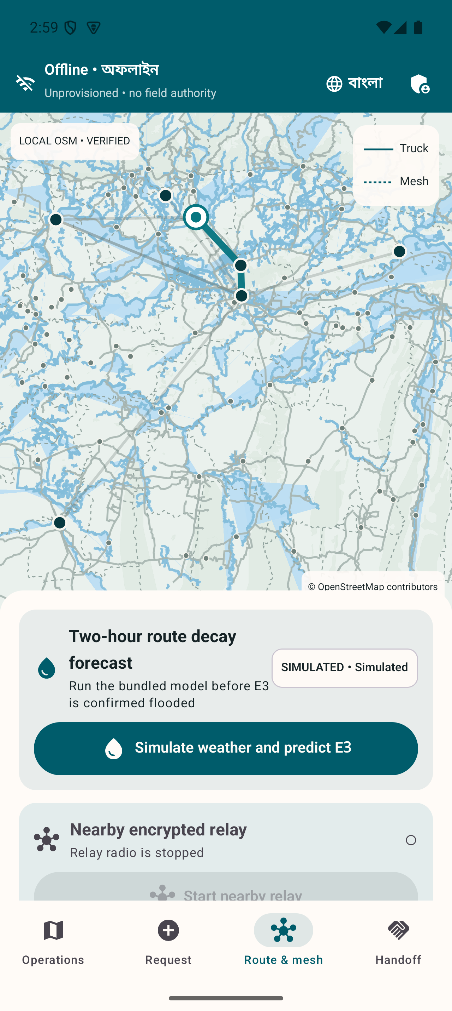
Maps remain available on the phone
Product appendix: geographic provenance and simulated overlays.
Local geography
Reviewed extract and checksum verification support offline rendering.
Separate sources
OSM attribution identifies the basemap. The mission overlay remains simulated.
OpenStreetMap contributors. Full source captures. Deployment requires maintained maps and closure procedures.
26
Notes:
Sources: README.md, docs/ARCHITECTURE.md and docs/TESTING.md. Evidence reviewed 4 September 2026. All environmental and vehicle inputs are simulated. Physical multi-phone acceptance is still open. Reviewed OSM-based PMTiles archive with checksum-pinned mobile extract. Geographic map does not guarantee current route safety.

Slide 27
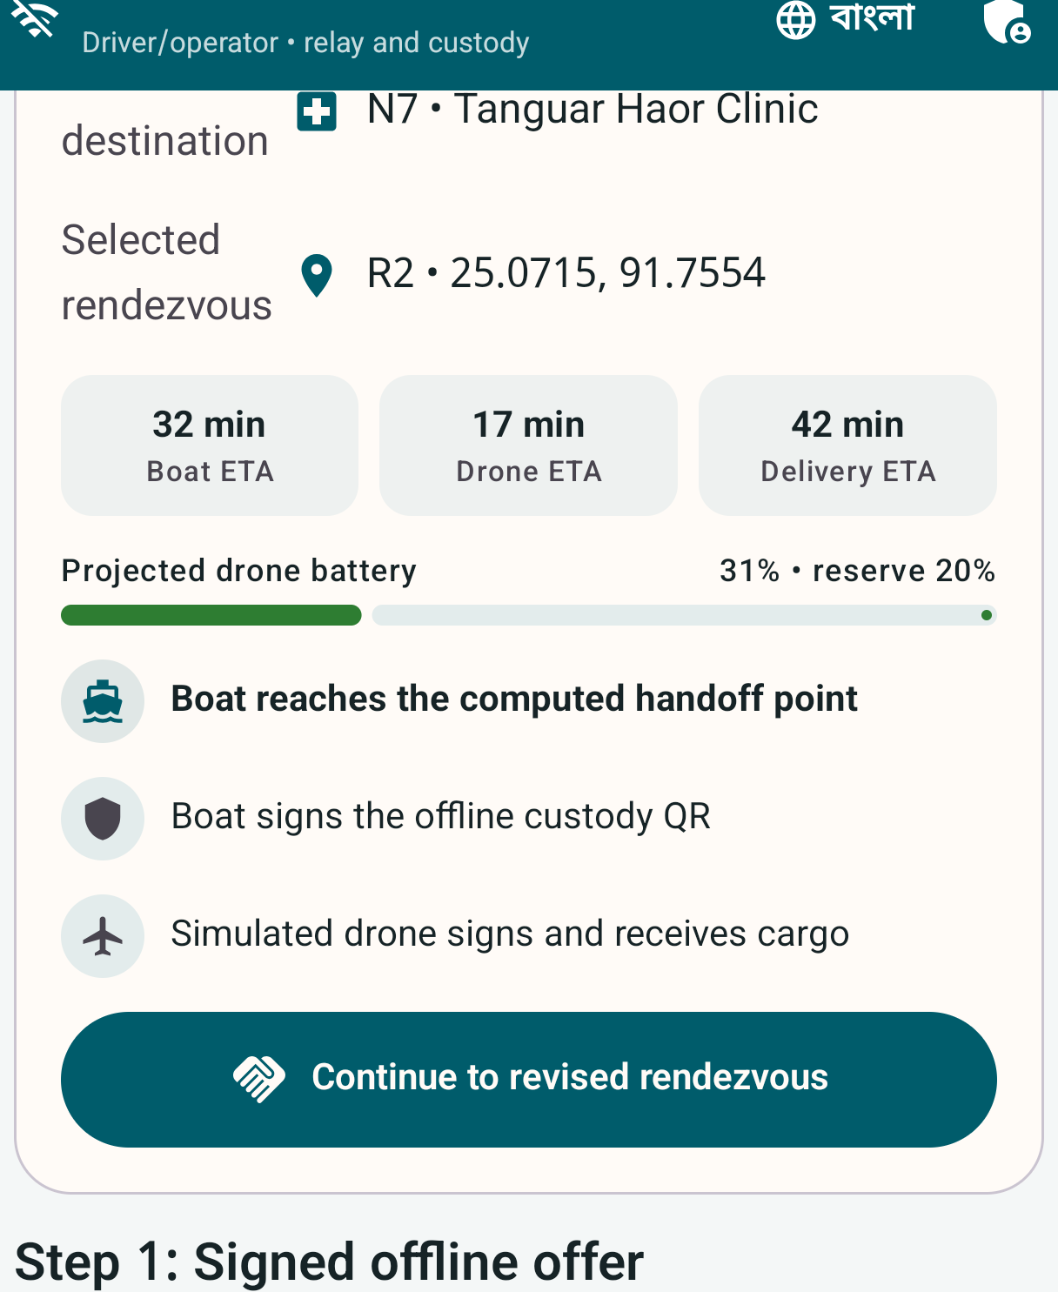
A simulated delay moves the rendezvous
Product appendix: the hybrid fleet calculation.
18-minute delay
The seeded calculation moves the meeting point from R3 to R2.
20% battery reserve
Candidate selection retains the configured reserve before handoff.
Enlarged source crop. All vehicles and telemetry are simulated. No drone hardware or control is included.
27
Notes:
Sources: README.md, docs/ARCHITECTURE.md and docs/TESTING.md. Evidence reviewed 4 September 2026. All environmental and vehicle inputs are simulated. Physical multi-phone acceptance is still open. M8 classifies air-only destination as drone-required. An 18-minute simulated boat delay replans the rendezvous from R3 to R2, with a 20 percent reserve. Linked signatures record boat-to-simulated-drone custody. No physical drone control.

Slide 28
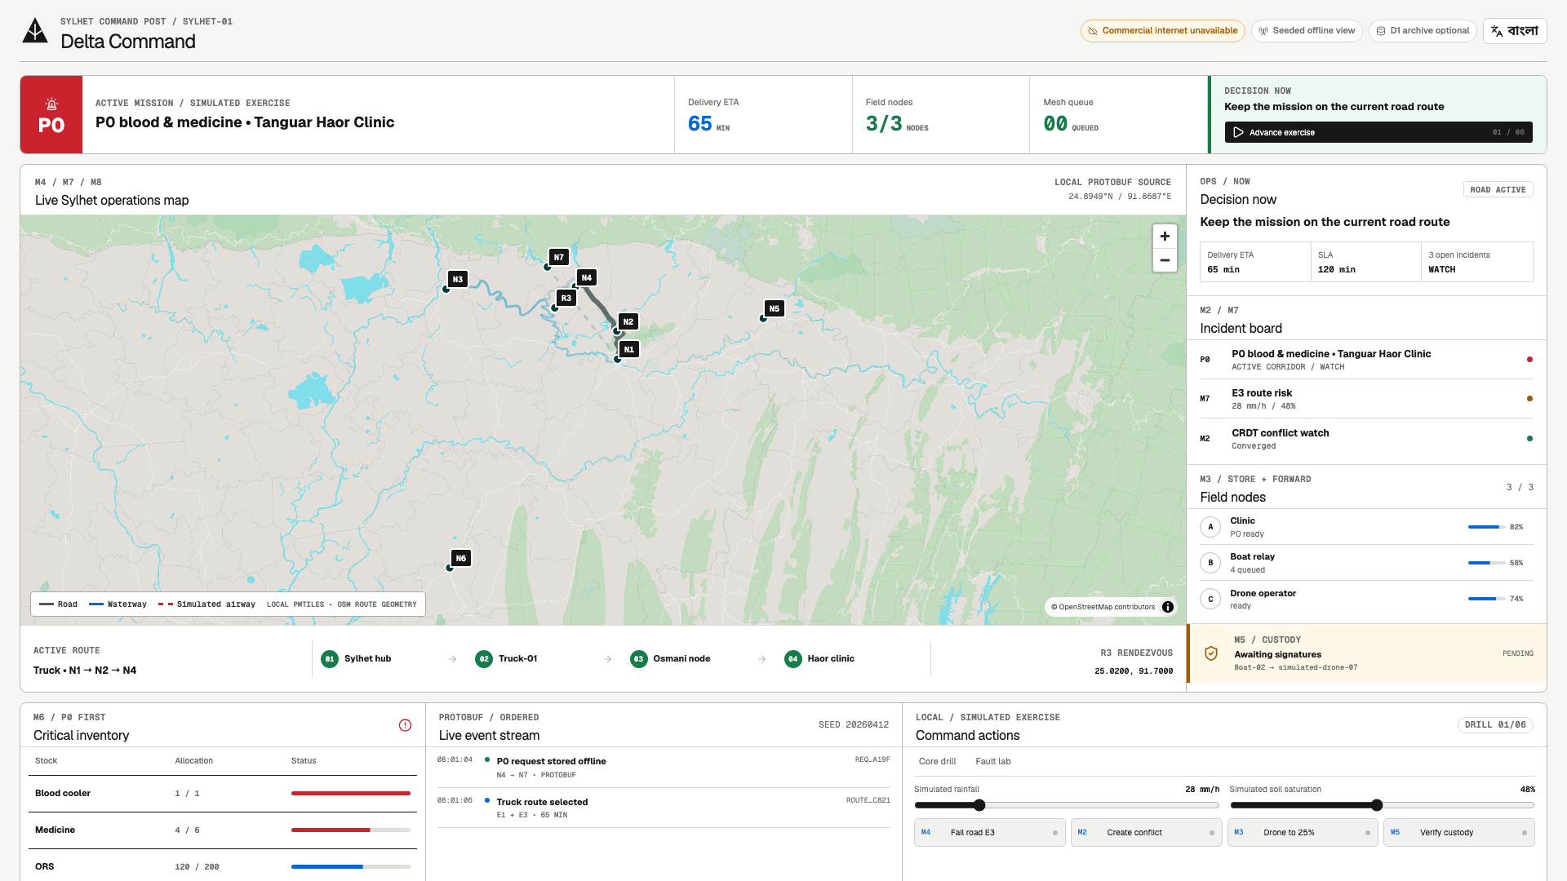
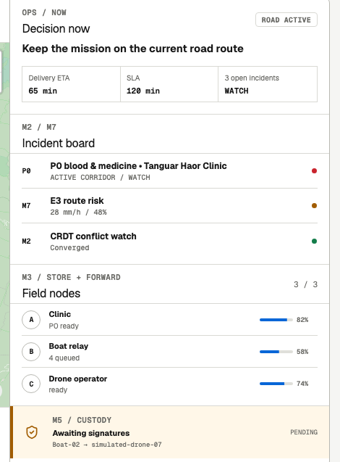
The observer makes the mission readable
Product appendix: overview and enlarged decision detail.
Full capture plus enlarged detail. OpenStreetMap contributors. Field actions do not depend on this screen.
28
Notes:
Sources: README.md, docs/ARCHITECTURE.md and docs/TESTING.md. Evidence reviewed 4 September 2026. All environmental and vehicle inputs are simulated. Physical multi-phone acceptance is still open. Local Next.js projection with Go ordered events and optional sanitized archive. The observer is disposable and cannot authorize custody.

Slide 29
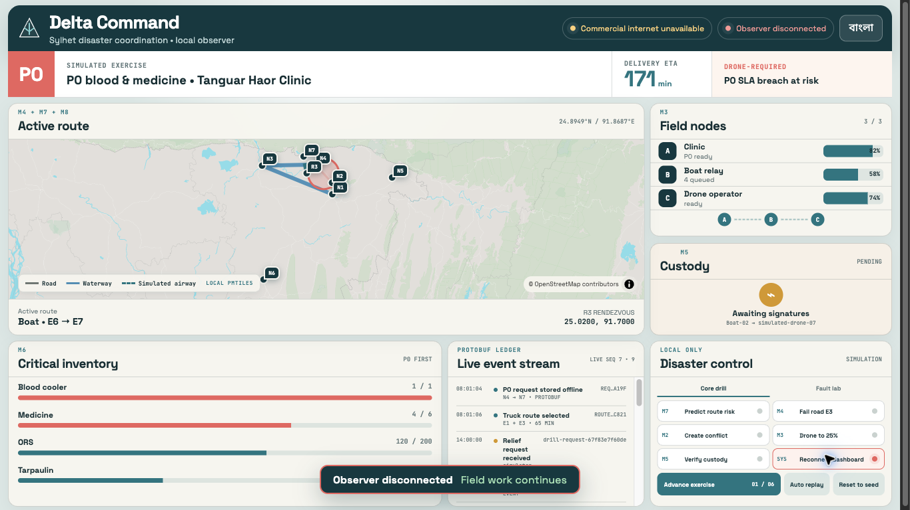
The observer can replay a missed interval
Product appendix: disconnect at sequence 7, then recover events 8–14.
Sequence 7
Observer disconnects
Events 8–14
Replay after reconnect
Actual local observer evidence. This does not establish the physical laptop-off phone journey.
29
Notes:
Sources: README.md, docs/ARCHITECTURE.md and docs/TESTING.md. Evidence reviewed 4 September 2026. All environmental and vehicle inputs are simulated. Physical multi-phone acceptance is still open. Recorded local observer experiment. Source artifacts/reports/fault-injection/2026-09-04-dashboard-disconnect.md. Physical phone continuity with laptop off remains separate proof.

Slide 30
Sources and evidence
The report contains the complete register and implementation boundaries.
Problem and market
Comparison
UN Bangladesh 2022 response plan
NAWG June 2024 assessment
World Bank May 2025 financing
Sahana, KoboToolbox, Ushahidi,
Briar and Meshtastic official sources
Implementation
Traceability
Architecture and testing documents
Dated local gate and model card
Slide notes include sources.
Report pages 39–40 contain the register.
30
Notes:
External sources reviewed 4 September 2026:
S01 Flash Floods Humanitarian Response Plan 2022 https://bangladesh.un.org/en/188010-flash-floods-humanitarian-response-plan-2022-united-nations-bangladesh-coordinated-appeal
S02 Severe Flash Floods Situation Update 1 https://bangladesh.un.org/sites/default/files/2022-06/situation_overview_flash_flood_final_draft_.pdf
S03 Rapid Assessment of Northeastern Flood 2024 https://bangladesh.un.org/bn/download/163651/272834
S04 Bangladesh flood risk reduction and recovery financing https://www.worldbank.org/en/news/press-release/2025/05/14/world-bank-supports-bangladesh-in-flood-risk-reduction-and-recovery
S05 Innovate to Market and exhibitor information https://www.innovationfairbd.org/
S06 Eden Legacy Archive and documented capabilities https://sahanafoundation.org/products/eden/
S07 Collecting data using KoboCollect https://support.kobotoolbox.org/data_collection_kobocollect.html
S08 Platform features and enterprise deployments https://www.ushahidi.com/features/
S09 How it works https://briarproject.org/how-it-works/
S10 Introduction to off grid mesh communication https://meshtastic.org/docs/introduction/
R01 README and technical architecture https://github.com/Seyamalam/digital-delta
Repository evidence:
R02 artifacts/reports/verification/2026-09-04-final-local-gate.md
R03 artifacts/reports/load/2026-09-04-go-10000.md
R04 models/route-decay/MODEL_CARD.md
R05 docs/TESTING.md and docs/PHYSICAL_DEVICE_TEST.md
R06 artifacts/screenshots/field-bn, field-en, command-bn, command-en
R07 docs/SECURITY.md and artifacts/reports/claim-audit/2026-09-04.md
R08 docs/PRD.md and research/innovation-fair-fit.md
Original screenshots from artifacts/screenshots; crops retain source context in the report. Three AI illustrations are concept art. Original vector diagrams are supplied in editable .drawio format and as SVG. No physical deployment or customer research is fabricated.

