Slide 1

Digital Delta
Offline relief coordination
for Bangladesh
Innovate to Market
Touhidul Alam Seyam
BGC Trust University Bangladesh
Innovation Fair 2026
4 September 2026
AI-generated concept illustration
01
Notes:
Core pitch. Introduce Touhidul Alam Seyam, BGC Trust University Bangladesh. Theme: Innovate to Market. Digital Delta is an offline disaster logistics demonstration. All cover artwork is an AI-generated concept illustration, not documentary evidence. Suggested short pitch route: slides 1, 2, 3, 6, 8, 9, 11, 15 and 17. The remaining slides support a longer presentation and questions.

Slide 2
Relief coordination during outages
Transport, power and communications can fail together.
7.2 million
3.74 million
Affected people
June 2022, nine districts
Affected people
June 2024, six districts
The product question is how field teams preserve requests,
decisions and delivery records through disconnected periods.
Sources: UN Bangladesh 2022 response plan and NAWG June 2024 assessment. Event-specific estimates.
02
Notes:
The UN Bangladesh 2022 response plan estimated 7.2 million affected people across nine northeastern districts. The June 2024 NAWG rapid assessment reported 3.74 million across six districts. These counts cover different events and areas and should not be added or compared as a growth trend. The 19 June 2022 situation update documents simultaneous power, road and communication disruption. Sources: https://bangladesh.un.org/en/188010-flash-floods-humanitarian-response-plan-2022-united-nations-bangladesh-coordinated-appeal
https://bangladesh.un.org/sites/default/files/2022-06/situation_overview_flash_flood_final_draft_.pdf
https://bangladesh.un.org/bn/download/163651/272834

Slide 3
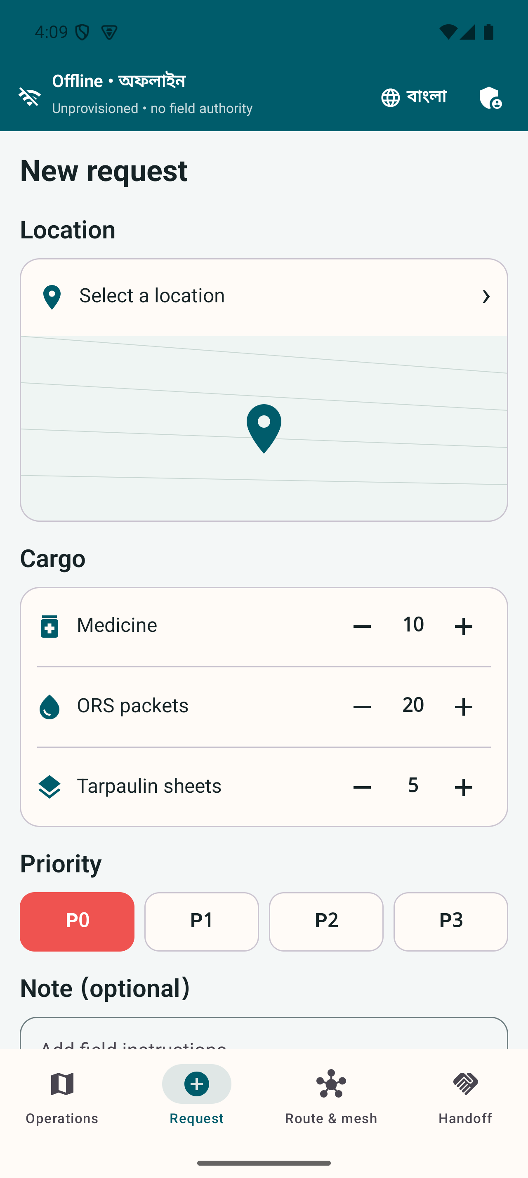
One urgent supply request
A field phone saves the mission before it attempts transfer.
Clinic
Records the need and urgency in a bundled bilingual interface.
Local record
Keeps the request and encrypted envelope through disconnection.
Actual app capture. Mission data is simulated. A queued request is not a confirmed delivery.
03
Notes:
Explain the clinic request, locally stored Protobuf event and recipient-encrypted outbox. Queued means persisted, not delivered or accepted. The screenshot is actual application evidence from the repository. Physical end-to-end radio verification remains open. Sources: README.md, docs/ARCHITECTURE.md, docs/TESTING.md and /Users/seyam/Work/Innovation_fair/artifacts/screenshots/field-en/03-field-en-p0-request-1280x2856.png

Slide 4
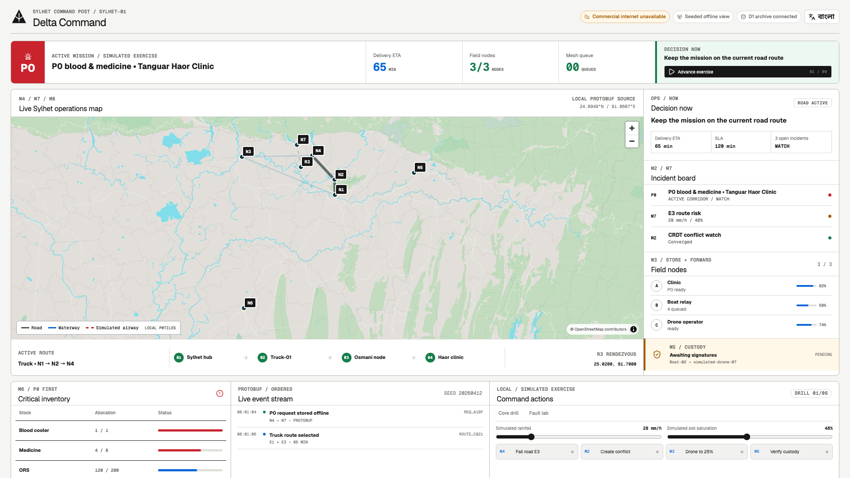
Delta Command
A local observer makes the mission visible on the projector.
Actual 1920 × 1080 capture. OpenStreetMap contributors. Field operations do not depend on this view.
04
Notes:
The Next.js headquarters application runs on the local laptop. It uses the bundled OpenStreetMap-derived PMTiles archive and an optional Go observer stream. This is a seeded simulated mission, not real vehicles or weather. The field phones retain authority. Sources: docs/ARCHITECTURE.md and /Users/seyam/Work/Innovation_fair/artifacts/screenshots/command-en/02-command-en-live-overview-1920x1080.png

Slide 5
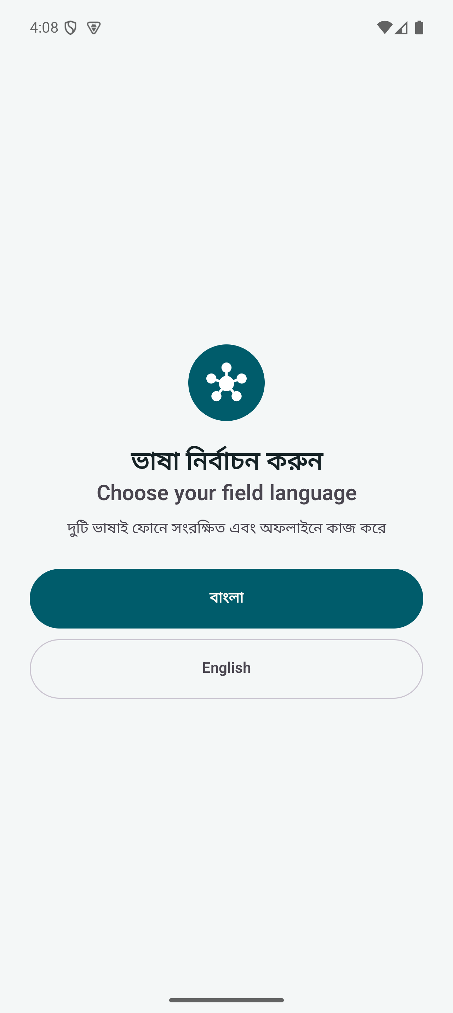
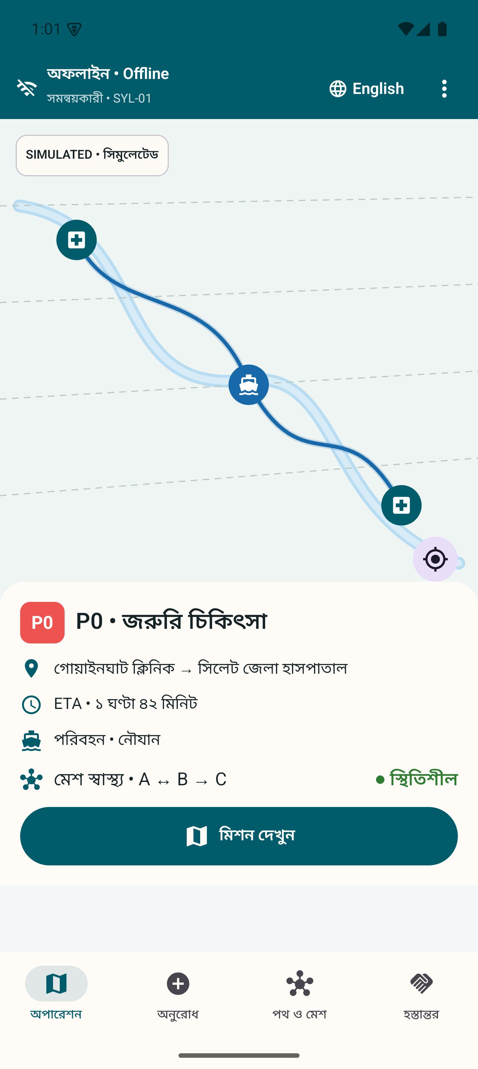
Bangla and English together
Language changes the display while the mission state remains the same.
Bundled language choice
No language-pack download.
No mission reset when switching.
Equivalent field responsibilities.
Actual app captures. Human accessibility review remains an open gate.
05
Notes:
Both languages ship in the APK. Protocol state uses language-neutral codes. Automated parity and emulator journeys support implementation. Human comprehension, accessibility and target-phone testing remain required. Sources: docs/LOCALIZATION.md, docs/TESTING.md and screenshot evidence.

Slide 6
Field phones own the workflow
Encrypted Protobuf moves between peers. Observation is optional.
Nearby framed Protobuf
Clinic phone
Relay phone
Recipient phone
Room record
Identity and local rules
Durable encrypted queue
No payload decryption
Verification and local routes
Signed custody
Optional observation only
Local observer
Public presentation
Go event log and Next.js
Optional laptop projection
Vercel and sanitized D1
Optional non-authoritative view
Solid links: field message path. Dashed links: optional observation. Vercel and D1 never own field authority.
06
Notes:
Editable architecture diagram derived from docs/ARCHITECTURE.md. Nearby carries framed Protobuf, not gRPC. gRPC applies to IP-capable node and observer links. Browser SSE uses a sanitized JSON presentation object, which is not a mesh domain payload. Each phone owns local storage, identity, routing, triage and custody. Dashed arrows indicate optional observation.

Slide 7
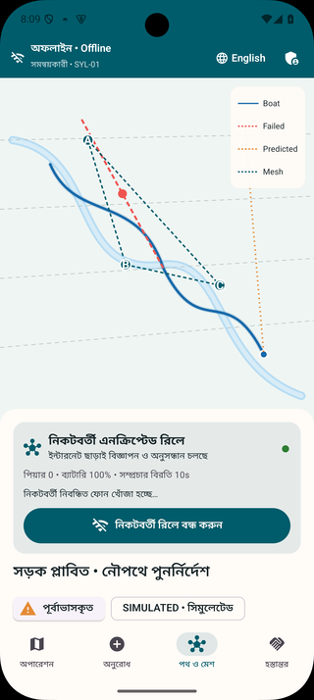
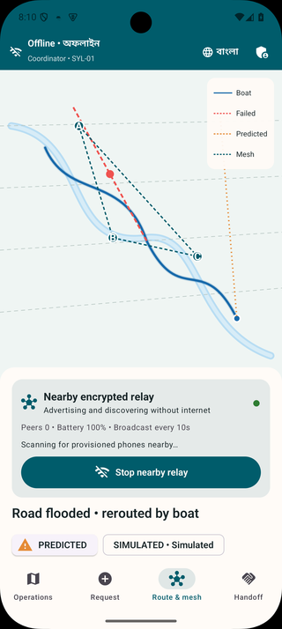
Store carry and forward
An active nearby relay persists encrypted envelopes before acknowledgement.
Trusted peers
Durable queues
Expiry and hop limits
Duplicate rejection
Physical radio transfer, range and recovery measurements remain open.
07
Notes:
The screenshots establish a real Nearby foreground-service lifecycle on an emulator. They do not establish multi-phone range or completed physical A-to-B-to-C relay. Durable queues and duplicate rejection have automated evidence. Sources: docs/ARCHITECTURE.md, docs/TESTING.md and field relay captures.

Slide 8
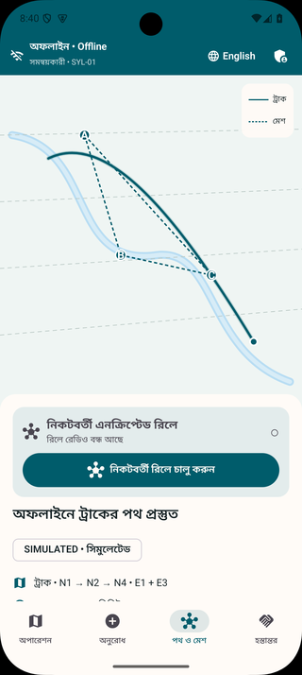
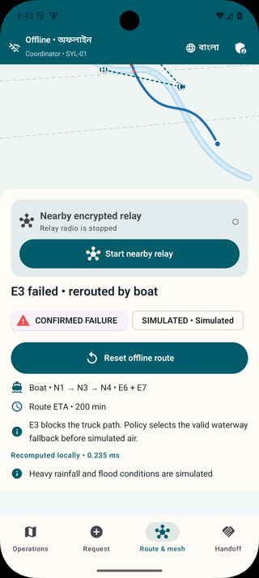
A failed road changes the route
The phone selects a mode-valid boat alternative in the seeded drill.
Initial truck path
E1 and E3
After the simulated failure
Boat path E6 and E7
Vehicles, route failure and movement are simulated. Target-phone latency remains to be measured.
08
Notes:
The initial truck path uses E1 and E3. A simulated E3 failure excludes the truck path and chooses boat edges E6 and E7. Deterministic graph search and strict transport constraints run locally. A valid graph path does not prove actual navigation safety. Source: docs/ROUTING.md, docs/TESTING.md and route screenshots.

Slide 9
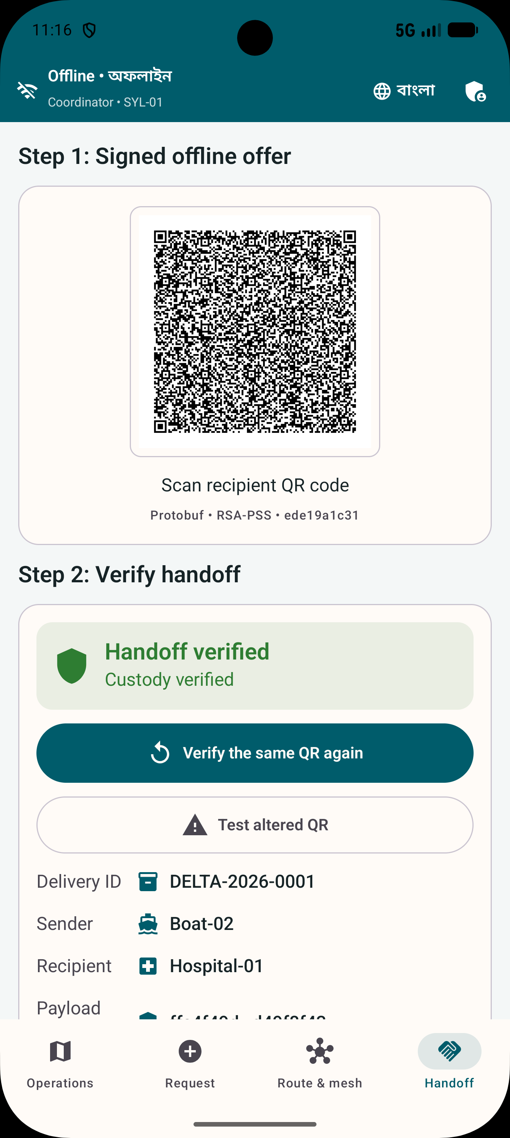
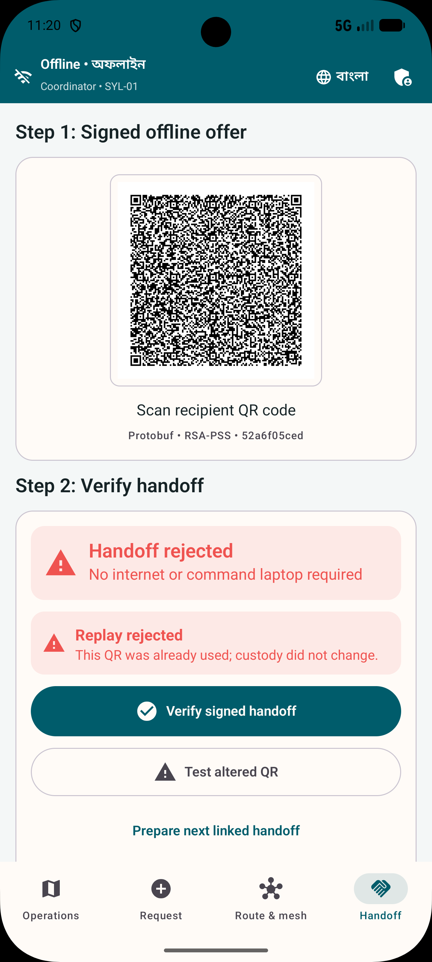
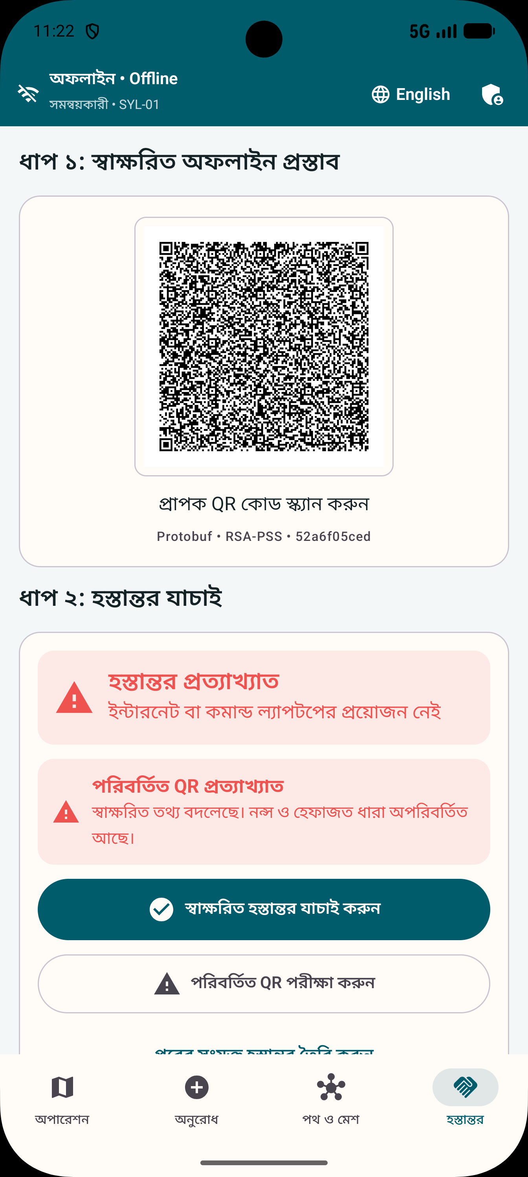
A delivery can be accepted only once
Signatures and nonce checks protect the custody transition.
Accepted
Replay rejected
Tamper rejected
Actual cryptographic workflow. Simulated cargo. Real-camera airplane-mode trial remains open.
09
Notes:
The software signs a Protobuf offer with Android Keystore RSA-PSS, verifies trusted fields and atomically records a two-party receipt. A replay or tampered offer must not create a second custody event. The screenshots are actual application states of simulated cargo. Physical camera scanning between phones is still required. Sources: docs/PROOF_OF_DELIVERY.md, docs/TESTING.md.

Slide 10
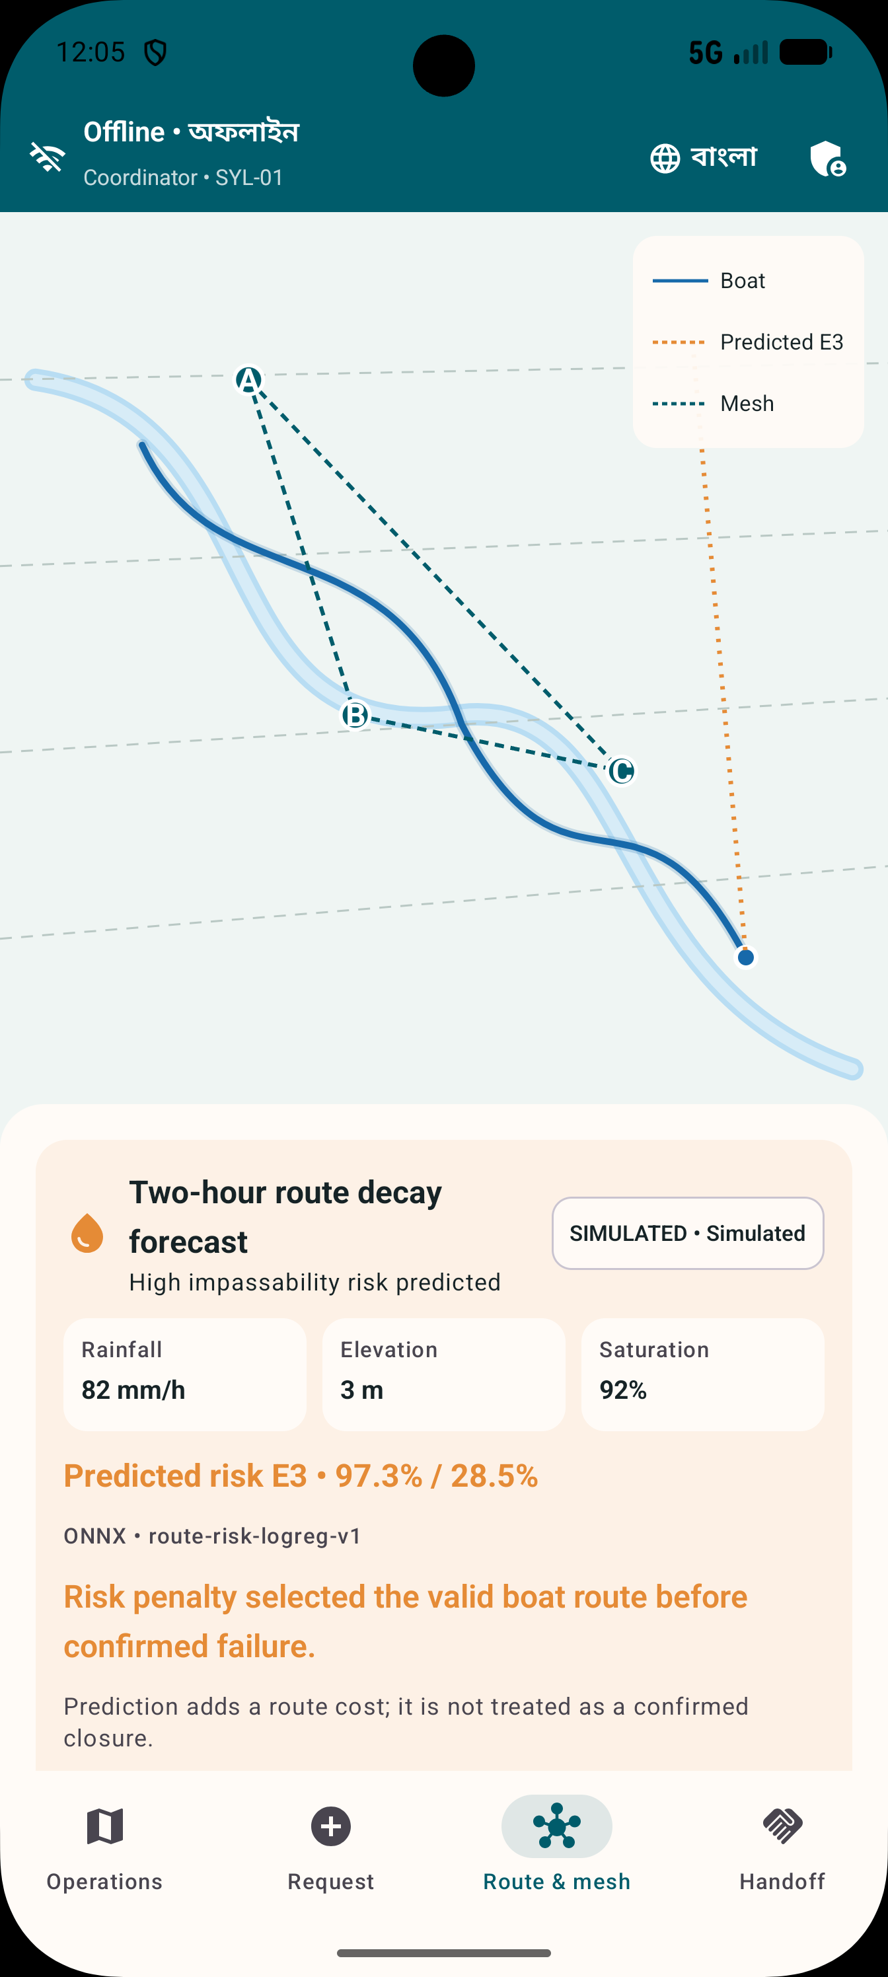
Route risk runs on the phone
The current model measures synthetic labels only.
Held-out F1 on 900 synthetic examples
Risk adds an advisory edge cost. It does not declare a confirmed closure. No sensors or live weather feed.
10
Notes:
The model uses 6,000 deterministic synthetic examples with 4,200 train, 900 validation and 900 test. Threshold 0.285 selected on validation data. Held-out model precision 0.612766, recall 0.837209, F1 0.707617. Baseline F1 0.114754. The editable chart displays the F1 comparison only. These are not real flood forecast results. Source: models/route-decay/MODEL_CARD.md.

Slide 11
The customer is a deployment owner
Government and NGO teams are the buyer hypothesis. Households are beneficiaries.
Deployment owner
Field user
Approves procedures, provisions identities and keeps the tool ready between emergencies.
Creates requests, carries encrypted messages or signs a delivery receipt.
First segment: one sponsor, one health referral chain
and one experienced relief partner.
Customer demand and willingness to pay require primary research. No institutional endorsement is claimed.
11
Notes:
This is a commercial hypothesis, not validated demand or partnership. The proposed sponsor is a district, health logistics institution or NGO with an operational owner. Discovery must establish budget authority, current procedures and capacity to maintain devices. The 2024 assessment frame contains 6 districts, 64 upazilas and 360 unions, but those counts are not paying accounts. Source: https://bangladesh.un.org/bn/download/163651/272834

Slide 12
Existing tools and the proposed position
The integration must justify adoption against familiar alternatives.
Platform | Documented strength | Potential relationship
Sahana Eden | Relief inventory and logistics | Domain analogue
KoboCollect | Offline assessment forms | Assessment input
Ushahidi | Crowdsourced reports and maps | Reporting partner
Briar | Encrypted nearby communication | Adjacent transport concept
Meshtastic | LoRa mesh messaging | Extra radio hardware
Digital Delta tests one integrated path across relay, routing, priority review and signed custody.
12
Notes:
First-party comparison as of 4 September 2026. Sahana page is a legacy archive. Kobo supports offline collection after setup, followed by server upload. Ushahidi documents reporting and mapping. Briar documents encrypted Bluetooth/Wi-Fi sync. Meshtastic uses LoRa radio hardware. Absence of an integrated Digital Delta workflow in these reviewed pages does not prove a competitor cannot add it. Sources:
https://sahanafoundation.org/products/eden/
https://support.kobotoolbox.org/data_collection_kobocollect.html
https://www.ushahidi.com/features/
https://briarproject.org/how-it-works/
https://meshtastic.org/docs/introduction/

Slide 13
A readiness service around the product
The first commercial offer is a bounded preparedness exercise.
First engagement
Ongoing support
A supervised exercise with configuration, bilingual training and a measured evidence report.
Seasonal readiness, map updates, credential administration and maintained releases.
Pricing follows delivery cost and institutional procurement.
Sensitive data and emergency requests are not the revenue unit.
Commercial proposal. No price, contract or revenue has been validated.
13
Notes:
Proposed business model, not current revenue. Offer includes workflow mapping, configured devices, identities, maps, training, supervised exercise and evidence review. Recurring support could cover seasonal readiness, release maintenance and credential administration. Approved integrations are separately scoped. Pricing and willingness to pay remain unvalidated.

Slide 14
Illustrative pilot budget
One sponsor, 12 weeks and six exercise phones. All figures are planning assumptions.
Work package | Illustrative BDT
Workflow, engineering and facilitation | 248,000
Independent security review | 40,000
Phones and power accessories | 132,000
Travel and exercise logistics | 30,000
Subtotal | 450,000
Contingency at 15% | 67,500
Total | 517,500
Planning arithmetic only. Existing devices may reduce costs. This is not a funding commitment or supplier quote.
14
Notes:
BDT planning model, not market quotations or actual expenditure. Engineering 40 days×5,000=200,000; facilitation 12×4,000=48,000; security review 5×8,000=40,000; phones 6×18,000=108,000; accessories 6×4,000=24,000; logistics allowance 30,000. Subtotal 450,000. 15 percent contingency 67,500. Total 517,500. Excludes taxes, emergency transport, long-term salaries and ongoing production support. Replace inputs with quotations and agreed staffing before procurement.

Slide 15
Evidence today and the next gate
Software implementation is supported. Physical field verification is still ahead.
Recorded software evidence | What remains open
60 journeys on each of two Android emulators | Three physical-phone relay and restart
Signed receipt acceptance and rejection | Real-camera scanning in airplane mode
On-device route and synthetic model paths | Target-phone battery, memory and latency
10,000 local streams with durable receipts | Physical range and lossy-radio throughput
Bilingual resources and emulator flows | Human accessibility and repeated rehearsal
10,000-stream result: loopback p95 acknowledgement 57.645 seconds. Capacity evidence, not deployment latency.
15
Notes:
Cited from existing dated evidence. Final local gate 2026-09-04 passed scripts/verify-local.sh --connected. Same 60 journeys pass on Android 15 and 16 emulators. Go load test held 10,000 independent acknowledged streams on loopback, p95 57.645 seconds, peak RSS about 1.19 GiB. It does not include wireless contention or recipient encryption load. Sources: artifacts/reports/verification/2026-09-04-final-local-gate.md and artifacts/reports/load/2026-09-04-go-10000.md. No new test run is claimed by this presentation.

Slide 16
A proposed twelve week pilot
A supervised exercise should earn the next deployment decision.
Period | Work | Evidence
Weeks 1–2 | Sponsor and workflow mapping | Owner and agreed acceptance criteria
Weeks 3–5 | Physical device testing | Relay, QR, recovery and power records
Weeks 6–8 | Bilingual participant tasks | Task success and critical errors
Weeks 9–12 | Supervised shadow exercise | Baseline comparison and go or stop review
Proposed schedule. Scale only after device, human and governance gates pass.
16
Notes:
This is an illustrative proposed pilot schedule, not an organizer requirement or customer commitment. Existing approved procedures remain authoritative in shadow mode. Agree technical, human, governance and support gates before conducting the exercise. Stop if no owner exists, critical errors persist, or devices fail acceptance.

Slide 17
The partnership request
One operational owner and one controlled exercise.
Validate the radios.
Observe the operators.
Compare the delivery record.
Touhidul Alam Seyam
BGC Trust University Bangladesh
17
Notes:
Close the pitch. Ask for a discovery meeting, a nominated operational owner and agreement on a supervised three-phone scenario. Do not claim a current partnership, award, customer or field deployment. Project lead: Touhidul Alam Seyam, BGC Trust University Bangladesh. Repository: https://github.com/Seyamalam/digital-delta. Optional public presentation: https://digital-delta-headquarters.vercel.app. The following slides are technical and product detail for questions.

Slide 18
Inside a field phone
Technical appendix
Compose UI and ViewModels
Bundled Bangla and English state
Domain rules and repositories
Authorization Conflicts Routing Triage Custody
Room and DataStore
Keystore and ONNX
Nearby service
Events and durable queues
Profile and language
Protected private keys
Bundled risk inference
Foreground active relay
Deferred maintenance separately
Editable explanatory diagram derived from the repository. Simulated inputs remain distinct from confirmed facts.
18
Notes:
Compose and ViewModels read local state. Domain rules and repositories coordinate Room, Keystore, ONNX and Nearby. Active radio runs in the foreground service. WorkManager handles bounded deferred work. Source: docs/ARCHITECTURE.md.

Slide 19
Encrypted message lifecycle
Technical appendix
Sender
Trusted relay
Recipient
Protobuf event
Recipient encryption
Atomic outbox write
Validate envelope
Store before acknowledgement
Forward later
Decrypt and verify
Deduplicate and apply
Rebuild local state
Expiry, hop limits and message IDs bound retries and duplicate effects
Signed acknowledgements
Durable receipt confirms storage Domain acceptance remains separate
Editable explanatory diagram derived from the repository. Simulated inputs remain distinct from confirmed facts.
19
Notes:
Sender stores a recipient-encrypted Protobuf envelope. The relay persists ciphertext before acknowledging. The recipient decrypts, verifies, deduplicates and applies. A durable receipt is not final domain acceptance. Source: docs/ARCHITECTURE.md and docs/SECURITY.md.

Slide 20
Conflict-aware event records
Technical appendix
Device A event
Device B event
Vector clock and stable ID
Offline local edit
Concurrent local edit
May arrive in either order
Merge policy
Safe types merge
Unsafe fields need review
Accepted projection
Policy version and hash
Editable explanatory diagram derived from the repository. Simulated inputs remain distinct from confirmed facts.
20
Notes:
Vector clocks expose concurrent edits. Safe sets and counters use deterministic merges. Safety-sensitive fields require authorized human review. Equal accepted events and policy versions should yield the same convergence hash. Physical multi-phone convergence remains open. Source: docs/CONFLICTS.md and docs/TESTING.md.

Slide 21
Routing risk and human confirmation
Technical appendix
Confirmed edge failure
Simulated model risk
Remove unavailable edge
Respect vehicle mode
Add advisory cost
Do not claim closure
On-phone route search
Deterministic path and ETA
Priority proposal
Human confirmation
SLA and slowdown
Safe drop and fresh estimate
Record reason and identity
Commit assignment event
Editable explanatory diagram derived from the repository. Simulated inputs remain distinct from confirmed facts.
21
Notes:
Confirmed closures exclude edges. Synthetic model risk adds cost. Route ETA feeds the priority engine with a 30 percent slowdown, stale-estimate checks and safe-waypoint constraints. A person confirms changes. Source: docs/ARCHITECTURE.md, docs/TRIAGE.md and models/route-decay/MODEL_CARD.md.

Slide 22
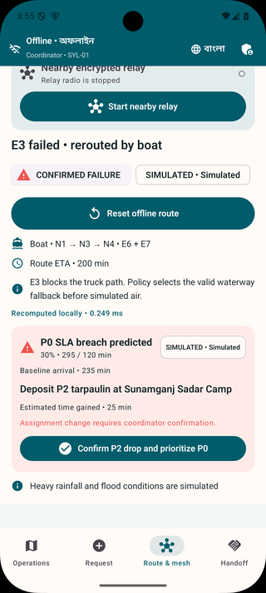
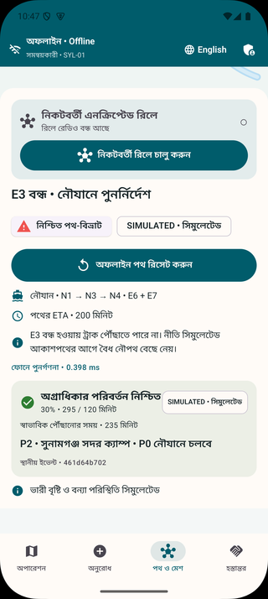
Priority preemption
Product appendix. A coordinator confirms a proposal based on a fresh estimate.
Decision inputs
SLA, route ETA, slowdown scenario, safe waypoint and estimate age.
Audit output
Confirmer, policy, affected cargo, waypoint and reason.
Cargo and vehicle states are simulated. Authorization remains a human responsibility.
22
Notes:
The seeded fallback predicts a P0 SLA breach and proposes a safe P2 deposit. The policy rejects estimates older than five minutes, orders concurrent urgent cargo and records a confirmed assignment atomically. This is logistics priority, not clinical triage. Sources: docs/TRIAGE.md, docs/TESTING.md and actual app screenshots.

Slide 23
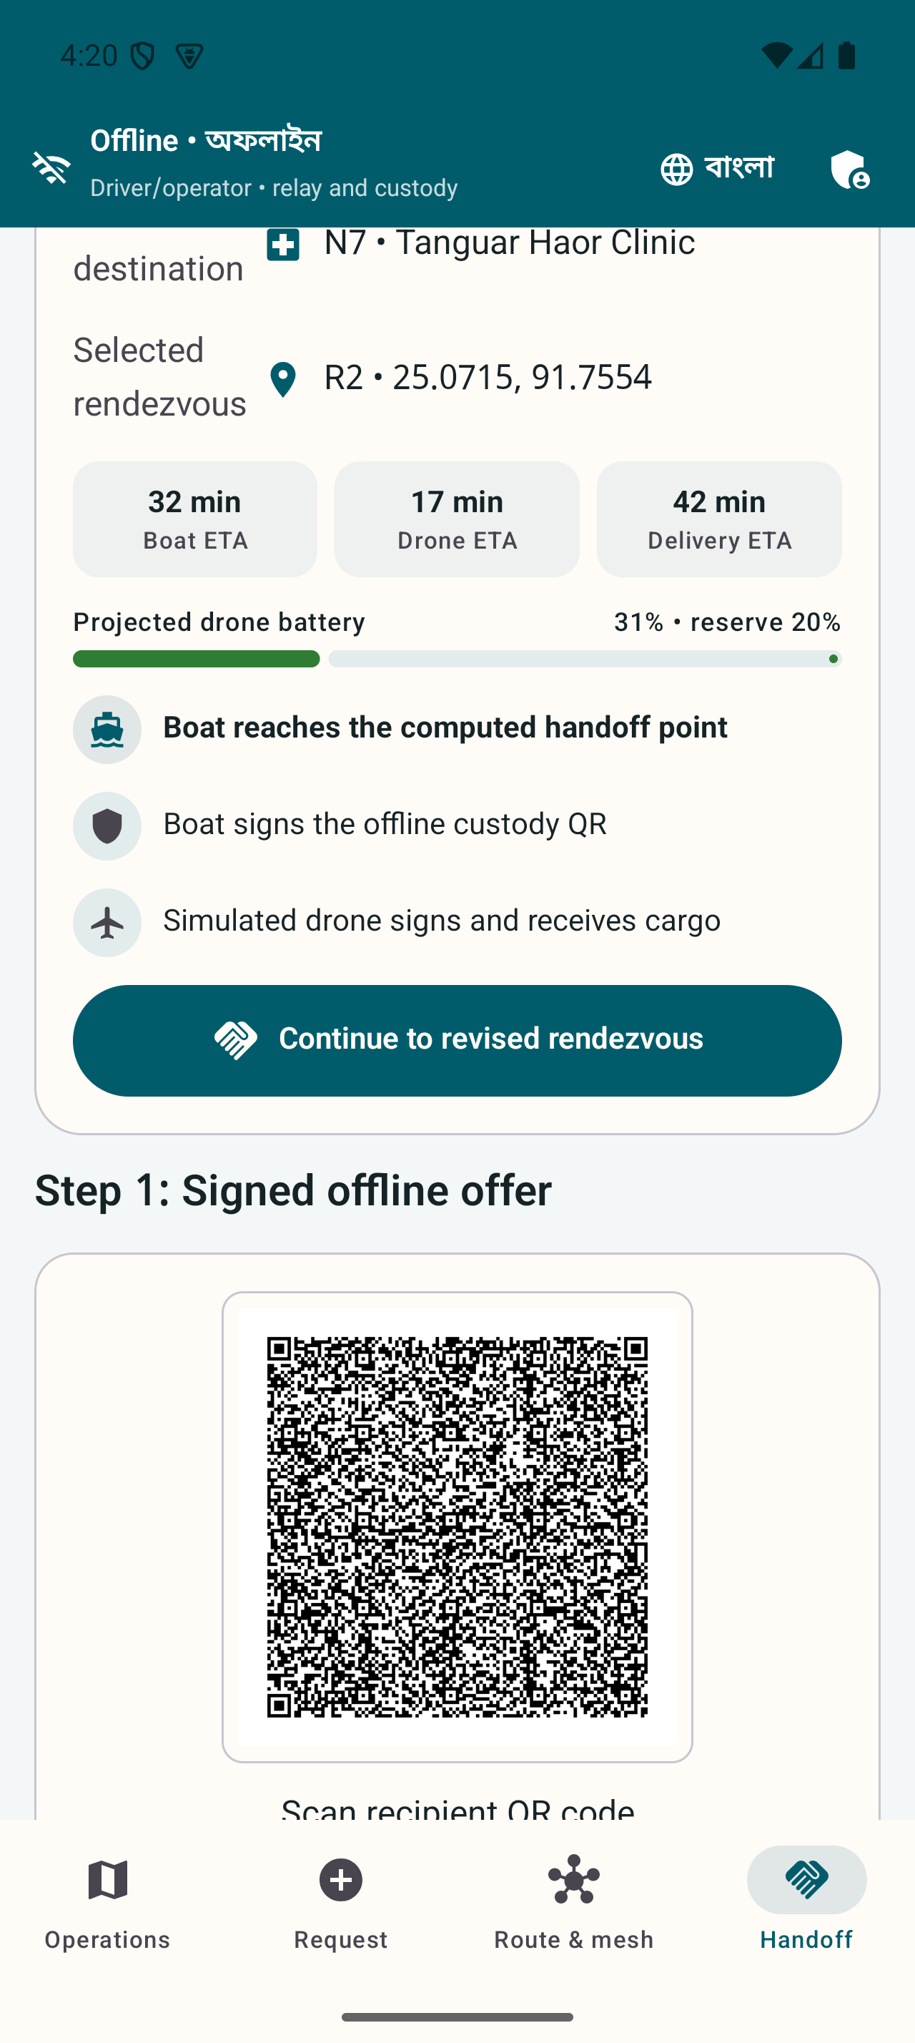
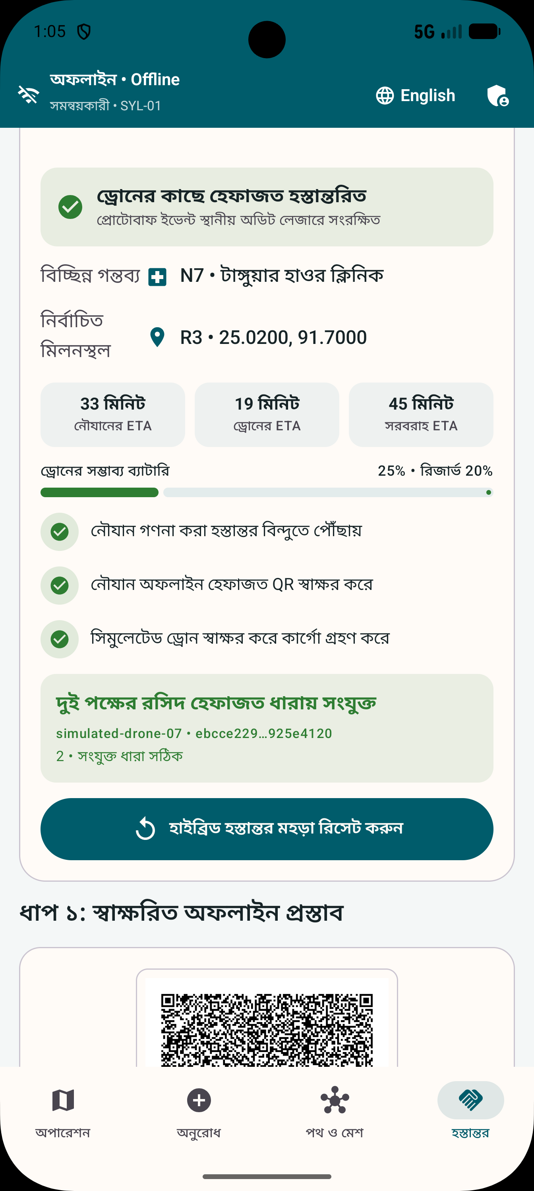
Hybrid fleet handoff
Product appendix. A simulated delay changes the rendezvous.
18 minute delay
R3 replans to R2
Battery reserve and signed custody
remain part of the plan.
All vehicles and telemetry are simulated. No physical drone is controlled.
23
Notes:
The air-only destination is classified drone-required in the graph. The seeded engine selects R3 then switches to R2 after an 18-minute simulated boat delay. Plans require a 20 percent battery reserve. A signed receipt records boat-to-simulated-drone custody. No drone hardware or control is part of the build. Sources: README.md, docs/TESTING.md and M8 screenshots.

Slide 24
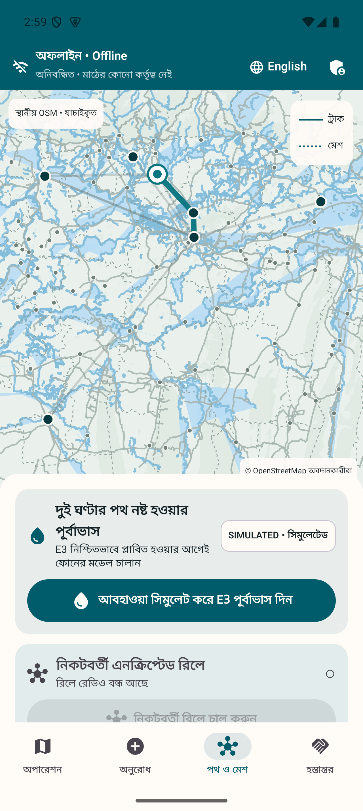
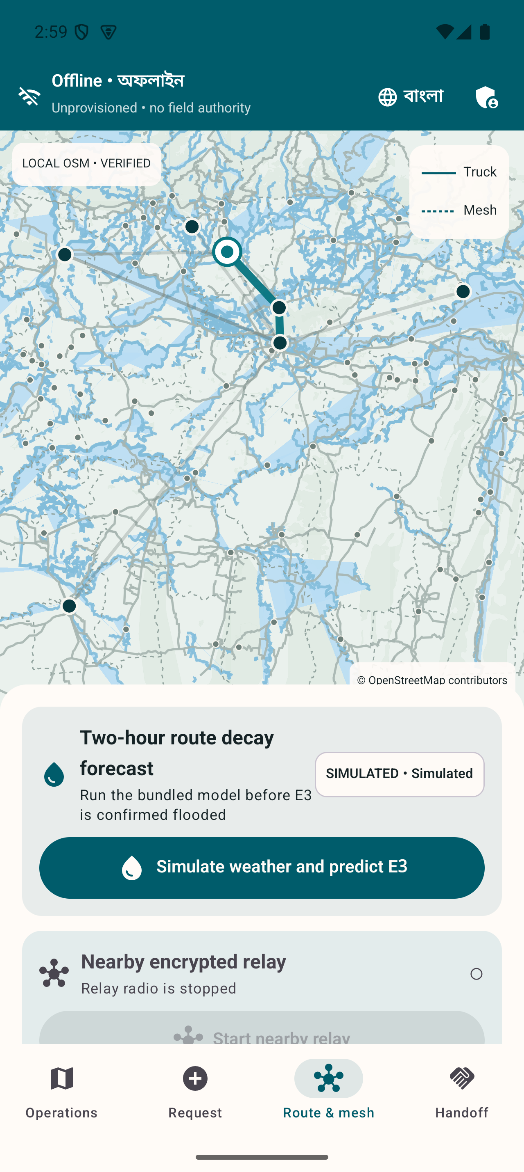
Offline geographic maps
Product appendix. Geography and mission overlays have separate provenance.
Reviewed local extract
Checksum verification
Visible OSM attribution
Separate simulated overlays
OpenStreetMap contributors. Bundled geography does not guarantee current route safety.
24
Notes:
Android uses a checksum-pinned extract derived from the reviewed OpenStreetMap PMTiles archive. MapLibre Native has local sources, with separate simulated mission overlay. Deployment needs maintained maps and official closure procedures. Sources: docs/ARCHITECTURE.md, offline map README files and screenshots.

Slide 25
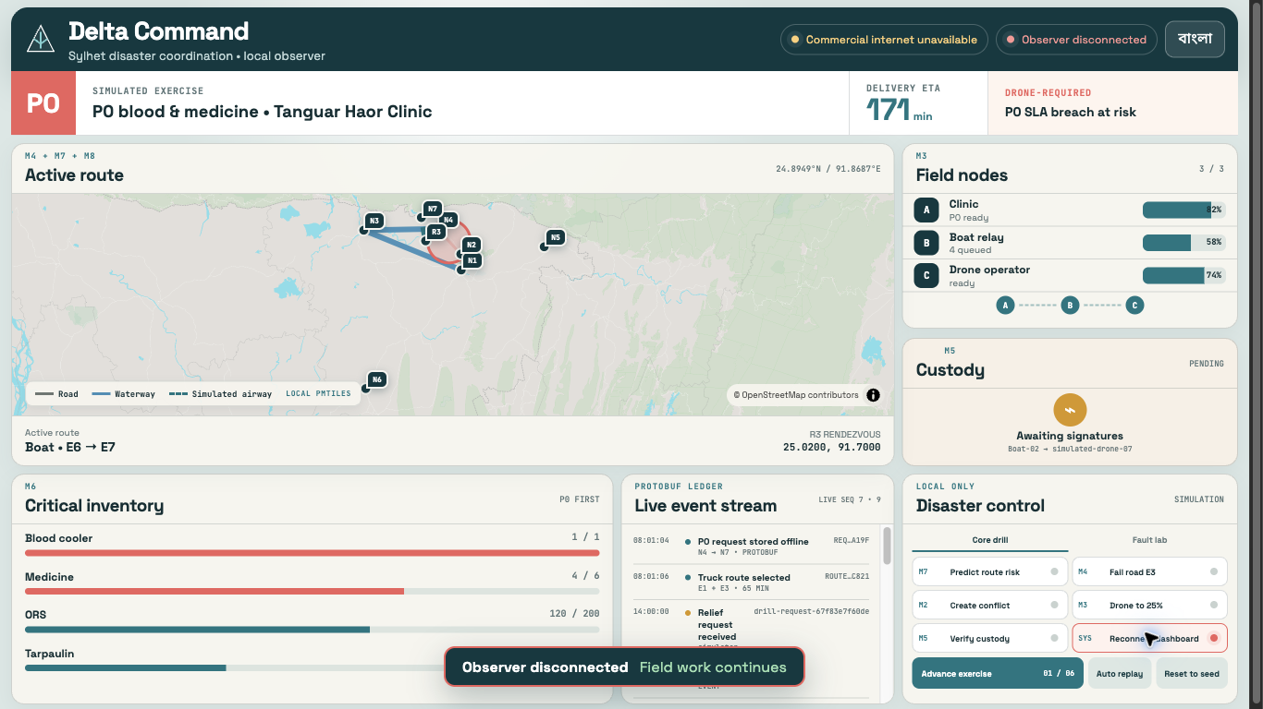
Observer disconnect recovery
Product appendix. The local event log can replay a missed interval.
Sequence 7
Projector disconnects
Events 8 to 14
Replay after reconnection
Actual local observer test. Physical field continuity with the laptop off remains a separate gate.
25
Notes:
The recorded local disconnect experiment closed the projector at sequence 7, published sequences 8–14 while absent and replayed the gap after reconnection. This is laptop observer evidence. It does not replace a physical phone action with the laptop off. Source: artifacts/reports/fault-injection/2026-09-04-dashboard-disconnect.md and screenshot evidence.

Slide 26
Sources and evidence
The full report includes the reference register and implementation boundaries.
Problem and market
Platform comparison
UN Bangladesh 2022 response plan
NAWG June 2024 assessment
World Bank May 2025 financing
Bangladesh Innovation Fair
Sahana Eden, KoboToolbox, Ushahidi,
Briar and Meshtastic official materials
Implementation evidence
Source links
Repository architecture and testing docs
Final local gate dated 4 September 2026
Route model card and load report
Relevant links and evidence paths are
in each slide’s speaker notes.
26
Notes:
All external sources were reviewed 4 September 2026. External source links:
S01 Flash Floods Humanitarian Response Plan 2022 https://bangladesh.un.org/en/188010-flash-floods-humanitarian-response-plan-2022-united-nations-bangladesh-coordinated-appeal
S02 Severe Flash Floods Situation Update 1 https://bangladesh.un.org/sites/default/files/2022-06/situation_overview_flash_flood_final_draft_.pdf
S03 Rapid Assessment of Northeastern Flood 2024 https://bangladesh.un.org/bn/download/163651/272834
S04 Bangladesh flood risk reduction and recovery financing https://www.worldbank.org/en/news/press-release/2025/05/14/world-bank-supports-bangladesh-in-flood-risk-reduction-and-recovery
S05 Innovate to Market and exhibitor information https://www.innovationfairbd.org/
S06 Eden Legacy Archive and documented capabilities https://sahanafoundation.org/products/eden/
S07 Collecting data using KoboCollect https://support.kobotoolbox.org/data_collection_kobocollect.html
S08 Platform features and enterprise deployments https://www.ushahidi.com/features/
S09 How it works https://briarproject.org/how-it-works/
S10 Introduction to off grid mesh communication https://meshtastic.org/docs/introduction/
R01 README and technical architecture https://github.com/Seyamalam/digital-delta
Repository evidence:
R02 artifacts/reports/verification/2026-09-04-final-local-gate.md
R03 artifacts/reports/load/2026-09-04-go-10000.md
R04 models/route-decay/MODEL_CARD.md
R05 docs/TESTING.md and docs/PHYSICAL_DEVICE_TEST.md
R06 artifacts/screenshots/field-bn, field-en, command-bn, command-en
R07 docs/SECURITY.md and artifacts/reports/claim-audit/2026-09-04.md
R08 docs/PRD.md and research/innovation-fair-fit.md
Original app screenshots are from artifacts/screenshots. Cover is an AI-generated concept illustration. Diagrams are editable original summaries derived from architecture documentation. Market proposals and budget inputs are assumptions. No field deployment or customer research is fabricated.

