Slide 1
Introduction
Machine Learning
Instructor: Polichshuk Yekaterina

Slide 2
Logistics
Instructor: Polichshuk Yekaterina
  Email: polichshuk.y.v@gmail.com
  Office: 262
TA: Aidos Askhatuly
Email: aidos.askhatuly@gmail.com

Slide 3
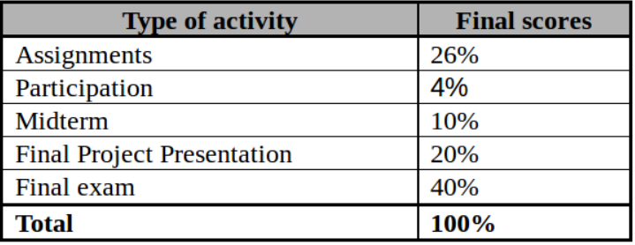
Evaluation

Slide 4
Source Materials
P. Harrington, Machine learning in Action(Recommended)
T. Mitchell, Machine Learning,
McGraw-Hill
Online courses:
udacity.com - Introduction to machine learning
https://www.udacity.com/course/viewer#!/c-ud120/l-2254358555/e-3012748573/m-3035918544
coursera.org - Machine learning - Andrew Ng
https://www.coursera.org/learn/machine-learning/home/welcome

Slide 5
A Few Quotes
“A breakthrough in machine learning would be worth
ten Microsofts” (Bill Gates, Chairman, Microsoft)
“Machine learning is the next Internet”
(Tony Tether, Director, DARPA)
Machine learning is the hot new thing”
(John Hennessy, President, Stanford)
“Web rankings today are mostly a matter of machine learning” (Prabhakar Raghavan, Dir. Research, Yahoo)
“Machine learning is going to result in a real revolution” (Greg Papadopoulos, CTO, Sun)
“Machine learning is today’s discontinuity”
(Jerry Yang, CEO, Yahoo)

Slide 6
So What Is Machine Learning?
Automating automation
Getting computers to program themselves
Writing software is the bottleneck
Let the data do the work instead!

Slide 7
Traditional Programming
Machine Learning
Data
Computer
Output
Program
Data
Computer
Program
Output

Slide 8

Magic?
No, more like gardening
Seeds = Algorithms
Nutrients = Data
Gardener = You
Plants = Programs

Slide 9
Sample Applications
Web search
Computational biology
Finance
E-commerce
Space exploration
Robotics
Information extraction
Social networks
Debugging
[Your favorite area]

Slide 10
ML in a Nutshell
Tens of thousands of machine learning algorithms
Hundreds new every year
Every machine learning algorithm has three components:
  Representation
  Evaluation
  Optimization

Slide 11
Representation
Decision trees
Sets of rules / Logic programs
Instances
Graphical models (Bayes/Markov nets)
Neural networks
Support vector machines
Model ensembles
Etc.

Slide 12
Evaluation
Accuracy
Precision and recall
Squared error
Likelihood
Posterior probability
Cost / Utility
Margin
Entropy
K-L divergence
Etc.

Slide 13
Optimization
Combinatorial optimization
  E.g.: Greedy search
Convex optimization
  E.g.: Gradient descent
Constrained optimization
  E.g.: Linear programming

Slide 14
Types of Learning
Supervised (inductive) learning
  Training data includes desired outputs
Unsupervised learning
  Training data does not include desired outputs
Semi-supervised learning
  Training data includes a few desired outputs
Reinforcement learning
  Rewards from sequence of actions

Slide 15
Inductive Learning
Given examples of a function (X, F(X))
Predict function F(X) for new examples X
  Discrete F(X): Classification
  Continuous F(X): Regression
  F(X) = Probability(X): Probability estimation

Slide 16
What We’ll Cover
Supervised learning
  Decision tree induction
  Rule induction
  Instance-based learning
  Bayesian learning
  Neural networks
  Support vector machines
  Model ensembles
  Learning theory
Unsupervised learning
  Clustering
  Dimensionality reduction

Slide 17
Steps in developing a machine learning application
Collect data.
Prepare the input data.
Analyze the input data.
Filter garbage
Train the algorithm.
Test the algorithm.
Use it.

Slide 18
Programming languages
Why Python?
Python is a great language for machine learning for a large number of reasons.
Python has clear syntax.
it makes text manipulation extremely easy.
A large number of people and organizations use Python, so there’s ample development and documentation.

Slide 19
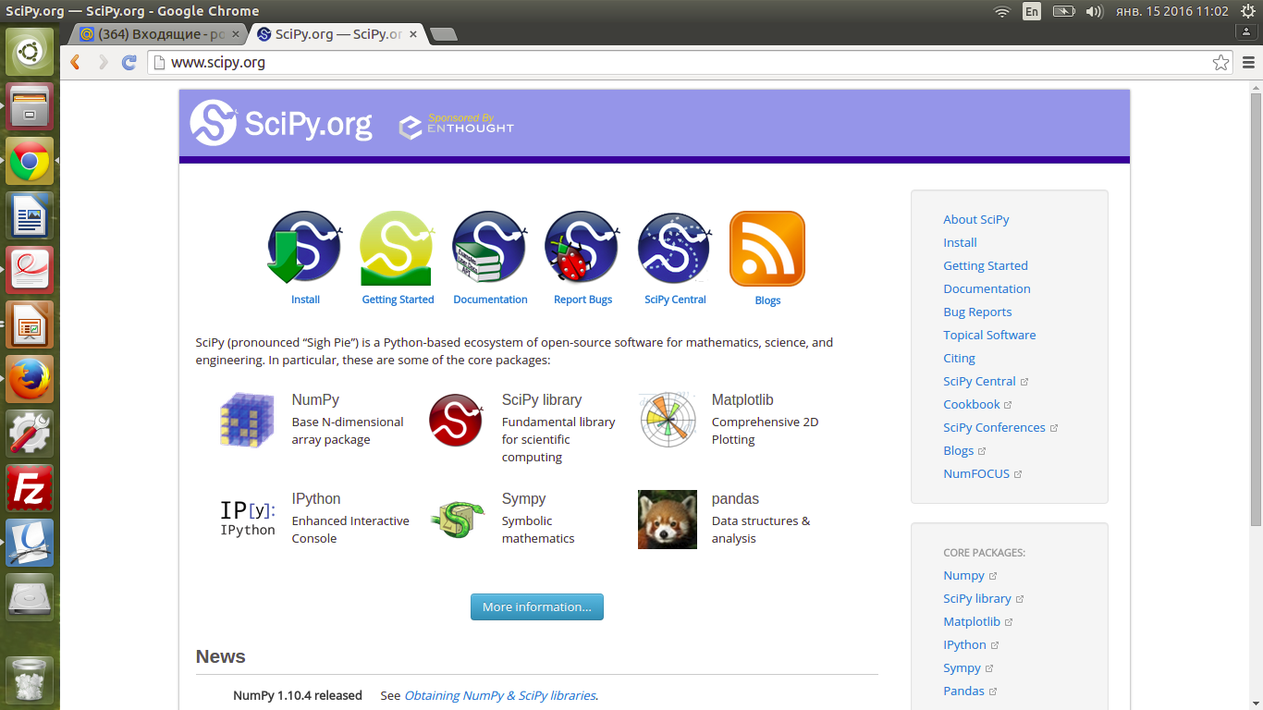
Libraries: SciPy

Slide 20
Homework
Read 1st chapter in “Machine learning in Action”
Find any interesting material connect to ML

