Slide 1
WEEK 3 — NETWORK SECURITY ASSESSMENT
Advanced Cybersecurity Practical • Nmap + Wireshark + Hardening
DISCOVER
23 ports
CYBERSECURITY INTERN
Seyed Ismai Bilal S
INVESTIGATE
PCAP + filters
Student ID: 016
HARDEN
5 ports closed
Authorized target: Metasploitable 2 • 192.168.56.101
Evidence-driven workflow: Discover → Analyze → Assess Risk → Harden → Verify
Authorized lab environment • 192.168.56.0/24

Slide 2
Project Objective & Scope
ASSESSMENT OVERVIEW
What this practical demonstrates
• Discover authorized hosts and exposed services on the isolated lab network.
• Perform basic and advanced Nmap assessment: service/version, OS, SYN, UDP and NSE vulnerability checks.
• Capture and investigate traffic with Wireshark using protocol and TCP flag filters.
• Correlate scan observations with packet-level evidence and identify security risks.
• Apply practical hardening and verify the reduction in exposed attack surface.
LAB SCOPE
Kali
192.168.56.1
Target
192.168.56.101
Network
192.168.56.0/24
Target OS
Metasploitable 2 / Linux
Capture interface
vboxnet0
Authorization
Own isolated virtual lab
Authorized lab environment • 192.168.56.0/24
2

Slide 3
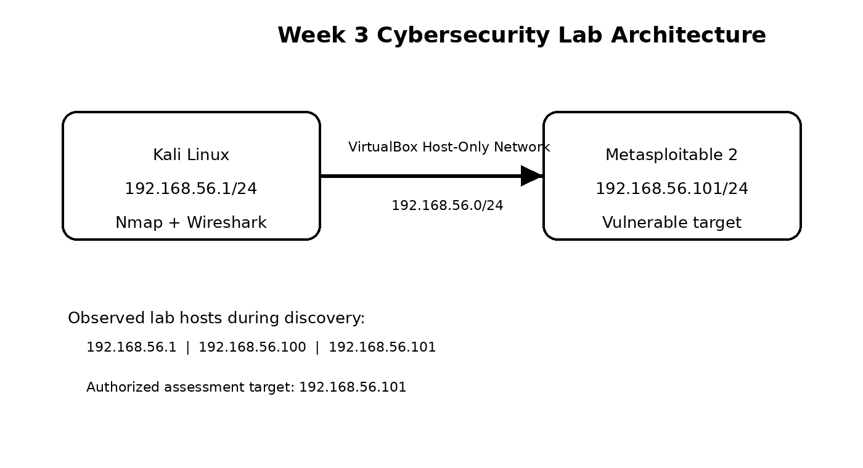
Lab Architecture
NETWORK TOPOLOGY
TRAFFIC PATH
• Kali initiates discovery and assessment traffic.
• vboxnet0 provides the isolated host-only network.
• Metasploitable 2 exposes intentionally vulnerable services.
• Wireshark observes traffic on vboxnet0.
• Hardening changes are verified from Kali with repeat scans.
Authorized lab environment • 192.168.56.0/24
3

Slide 4
Tools & Assessment Methodology
WORKFLOW
Nmap
Discovery, ports, versions, OS, NSE
Wireshark
Packet capture, protocol analysis, filters
VirtualBox
Isolated lab virtualization
Kali Linux
Assessment workstation
Metasploitable 2
Authorized vulnerable target
Method: Discover → Enumerate → Capture → Analyze → Harden → Re-scan
Authorized lab environment • 192.168.56.0/24
4

Slide 5
Nmap Assessment — Discovery & Enumeration
TASKS 7–8
HOSTS DISCOVERED
TCP PORTS BEFORE
UDP TOP PORTS
FINAL OPEN TCP
3
23
20
17
.1 Kali • .100 • .101 target
Target 192.168.56.101
10 open/open|filtered
After hardening
KEY ENUMERATION RESULTS
HIGH-VALUE EXPOSED SERVICES
• Host discovery: 192.168.56.1, .100 and .101 were up.
• Basic scan identified 23 open TCP services.
• Service detection exposed legacy versions including vsftpd 2.3.4, Apache 2.2.8 and MySQL 5.0.51a.
• OS detection indicated Linux 2.6.x.
• UDP top-20 scan identified DNS/NetBIOS and several open|filtered services.
21/tcp
vsftpd 2.3.4
22/tcp
OpenSSH 4.7p1
80/tcp
Apache 2.2.8
139/445
Samba 3.X–4.X
3306/tcp
MySQL 5.0.51a
5900/tcp
VNC 3.3
Authorized lab environment • 192.168.56.0/24
5

Slide 6
Advanced Nmap Security Assessment
TASK 8
SCAN TECHNIQUES EXECUTED
SELECTED FINDINGS
nmap -sV
Service/version detection
vsftpd 2.3.4
CVE-2011-2523 backdoor reported vulnerable
nmap -O
OS fingerprinting
SSL/TLS
POODLE, Logjam, weak DH and CCS findings
nmap -sS
TCP SYN scan
HTTP
Slowloris indication; TRACE enabled; weak cookie flags
nmap -sU --top-ports 20
Limited UDP assessment
Java RMI
RMI classloader / remote code execution risk
nmap --script vuln
NSE vulnerability checks
UnrealIRCd
Backdoor/trojaned version indication
nmap -sC
Default NSE scripts / enumeration
Web surface
DVWA, Mutillidae, phpMyAdmin and test paths discovered
Authorized lab environment • 192.168.56.0/24
6

Slide 7
Wireshark Traffic Capture & Packet Analysis
TASKS 9–11
CAPTURE OBSERVATIONS
USEFUL DISPLAY FILTERS
• Capture interface: vboxnet0; traffic remained inside the authorized host-only lab.
• Observed protocols: ARP, ICMP, TCP, HTTP, DNS and broadcast/BROWSER traffic.
• Normal traffic capture contained 38 packets with 0 dropped.
• Nmap-only capture contained roughly 2,027 packets with 0 dropped.
• HTTP flow showed SYN → SYN/ACK → GET → 200 OK → connection termination.
• DNS filter isolated a query for metasploitable.local and a server-failure response.
dns
DNS request/response
tcp
TCP conversation
tcp.flags.syn == 1
SYN/SYN-ACK traffic
tcp.flags.reset == 1
RST detection
http
HTTP requests/responses
arp
ARP resolution
Authorized lab environment • 192.168.56.0/24
7

Slide 8
Nmap + Wireshark Correlation
TASK 10
Nmap SYN probes were visible at packet level, allowing scan behavior to be correlated with TCP responses.
1
SYN
2
SYN/ACK
3
RST / close
4
HTTP
Kali → target
target :80 → Kali
observed in Nmap capture
GET + 200 OK in normal capture
Investigation outcome
• Port 80 produced a complete TCP handshake followed by HTTP application traffic.
• The dedicated Nmap PCAP contained SYN and reset behavior; the normal traffic PCAP did not show RST packets, so no RST finding was invented for that capture.
• Packet-level evidence confirmed that scan results represent observable network activity, not just Nmap output.
Authorized lab environment • 192.168.56.0/24
8

Slide 9
Vulnerability Assessment & Risk Prioritization
TASK 12
CRITICAL / HIGH
vsftpd 2.3.4 backdoor • RMI classloader RCE • OpenSSL CCS
HIGH
POODLE • Logjam • weak DH • UnrealIRCd backdoor indication
MEDIUM / HIGH
Slowloris indication • TRACE • weak session cookie flags
EXPOSURE
Legacy FTP/SMB/VNC/DB/Tomcat services increase attack surface
Risk logic: prioritize remotely reachable services with known exploitable weaknesses, legacy cryptography, or unnecessary exposure.
Authorized lab environment • 192.168.56.0/24
9

Slide 10
Security Hardening Performed
TASK 13
BEFORE
AFTER
FTP 21/tcp
OPEN
FTP 21/tcp
CLOSED
vsftpd 2.3.4
disabled via xinetd
Telnet 23/tcp
OPEN
Telnet 23/tcp
CLOSED
telnetd
commented in /etc/inetd.conf
R-services 512/513/514
OPEN
R-services
CLOSED
rexec / login / shell
shell/login/exec entries disabled
Configuration backups were created before editing; changes were verified with repeat Nmap scans.
Authorized lab environment • 192.168.56.0/24
10

Slide 11
Before vs After — Attack Surface Reduction
VERIFICATION
OPEN TCP PORTS BEFORE
OPEN TCP PORTS AFTER
REDUCTION
23
17
6
Initial Nmap enumeration
Final -sS -sV scan
~26% fewer open ports
INITIAL
FINAL
Closed during hardening: 21/tcp FTP • 23/tcp Telnet • 512/513/514 tcp R-services
Final scan still found legacy services such as ProFTPD 2121, SMB, databases, VNC, Tomcat and RMI.
Authorized lab environment • 192.168.56.0/24
11

Slide 12
Recommendations & Conclusion
FINAL ASSESSMENT
5 PROFESSIONAL RECOMMENDATIONS
FINAL TAKEAWAY
• Remove or isolate unnecessary legacy services; keep only business-required ports reachable.
• Replace vulnerable legacy software and cryptographic configurations with supported versions.
• Restrict administrative interfaces (SSH, databases, RMI, VNC) to trusted management hosts.
• Continue packet monitoring and retain PCAP/evidence for incident investigation and validation.
• Repeat vulnerability scans after every hardening change and document measurable before/after results.
The lab moved from broad exposure to a measurably smaller attack surface.
Evidence from Nmap and Wireshark was used to identify risk, implement hardening, and verify the result rather than relying on assumptions.
Assessment completed in an authorized isolated lab.
Authorized lab environment • 192.168.56.0/24
12

