Slide 1

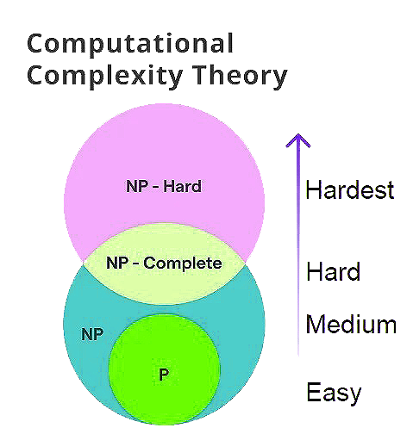
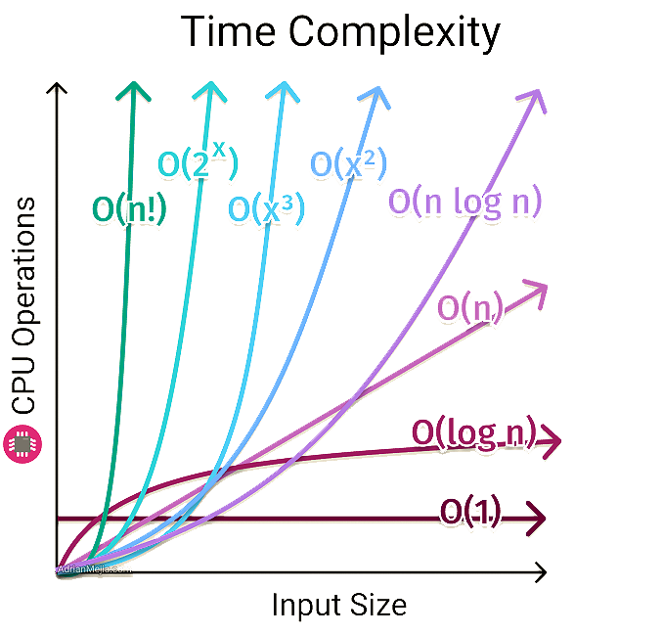

Complexity
S. M. Hossein Mousavi
Lugano, Switzerland
December 2024

Slide 2

Outline:
Complexity
Definition
Importance
Applications
Big O – Notation Classes

Slide 3


Definition
The complexity of an algorithm is the amount of resources required to run the algorithm.
Particular focus is given to computation time (generally measured by the number of needed operations) and memory storage requirements.
The complexity of a problem is the complexity of the best algorithms that allow solving the problem.
The complexity refers to the study of how computational resources (like time, memory, or energy) are consumed by algorithms or systems.
Complexity helps us evaluate and compare the efficiency and feasibility of solutions for computational problems.
Importance
The calculation of algorithmic complexity is crucial as it helps evaluate the efficiency and feasibility of solutions to computational problems.
By analyzing complexity, we can determine how an algorithm scales with input size, predict its performance, and identify resource requirements such as time, memory, or energy.
This allows for informed decisions when choosing or designing algorithms, ensuring optimal performance and cost-effectiveness, especially for large-scale or resource-constrained applications.
Understanding complexity is essential for balancing trade-offs and developing robust, scalable systems.

Slide 4

Applications
Algorithm Optimization: Identifying inefficiencies in algorithms to improve runtime and memory usage.
Scalability Assessment: Ensuring that solutions remain effective as input sizes grow, critical in fields like big data, machine learning, and cloud computing.
System Design: Choosing the most suitable algorithms for hardware or software systems based on available resources.
Real-Time Applications: Ensuring algorithms meet strict time constraints in systems like robotics, autonomous vehicles, or real-time monitoring.
Gaming and Graphics: Optimizing algorithms for rendering, physics simulation, and AI behavior in real-time environments.
Network Design: Optimizing routing protocols and resource allocation for efficient communication.
Energy Efficiency: Designing algorithms with lower energy consumption for battery-operated or energy-constrained devices.
Scientific Simulations: Ensuring computational models in physics, biology, or climate science are efficient and scalable.
Artificial Intelligence: Optimizing machine learning algorithms for faster training and inference in AI applications.

Slide 5

Big O – Notation Classes
It describes how algorithms grow in terms of resource use (like time or memory) as input size increases.
It goes from the fastest/less complex of O(1) to the slowest/most complex of O(n!).
The number of samples, iterations, epochs, data size, and layers affects the complexity.
Constant Time (𝑂(1)) class:
Definition: Takes the same time regardless of input size.
Example: Accessing an element in an array by index.
Graph Shape: Flatline.
Logarithmic Time (O(log n))class:
Definition: Time grows slowly as the input size increases.
Example: Binary search on a sorted list.
Graph Shape: Slowly increasing curve.
Linear Time (O(n))class:
Definition: Time grows directly proportional to the input size.
Example: Searching for an element in an unsorted list.
Graph Shape: Straight diagonal line.
Linearithmic Time (O(n log n))class:
Definition: Combination of linear and logarithmic growth.
Example: Merge sort or heap sort.
Graph Shape: Curves faster than linear but slower than quadratic.

Slide 6
Big O – Notation Classes
Quadratic Time (𝑂(n²)) class:
Definition: Takes the same time regardless of input size.
Example: Accessing an element in an array by index.
Graph Shape: Flatline.
Quadratic Time (𝑂(n²)) class:
Definition: Time grows as the square of input size.
Example: Comparing all pairs in a list (e.g., bubble sort).
Graph Shape: Parabolic curve.
Cubic Time (𝑂(n³)) class:
Definition: Time grows as the cube of input size.
Example: Matrix multiplication with brute force.
Graph Shape: Steep parabolic curve.
Exponential Time (𝑂(2^{X})) class:
Definition: Time doubles with each additional input.
Example: Solving the traveling salesman problem (brute force).
Graph Shape: Exponentially steep curve.
Factorial Time (𝑂(n!)) class:
Definition: Time grows faster than exponential.
Example: Generating all permutations of 𝑛 elements.
Graph Shape: Extremely steep curve.

