Slide 1
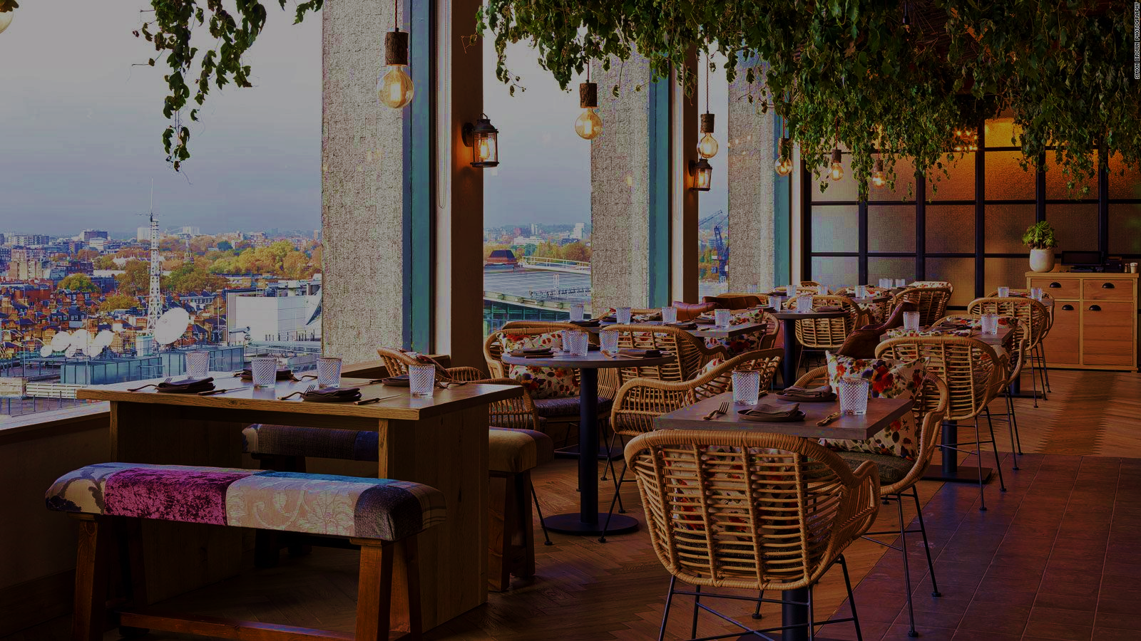
UML CLASS
DIAGRAM

Slide 2
GLOBAL
Restuarant
KitchenManager
- kitchen
# name : string
1
# address : string
- hunan
HumanManager
1
- tables
TablesManager
1
OrdersManager
- orders
1

Slide 3
KITCHEN
<abstract>
Meal
<Enum>
1
MealCategory
KitchenManager
# id : number
*
# name : string
# category
FOOD
- menu
# price : string
DRINK
- meal
1
*
<Enum>
FoodStock
Food
FoodType
1
DESERT
- quantity : number
MEAT
- type
VEGETABLE
Drink
<Enum>
DrinkType
1
JUICE
- type
TEA
FRESH_DRINK
COFFEE

Slide 4
HUMAN
HumanManager
Address
<Enum>
VehicleCategory
# street : string
# district : string
TUCTUC
# city : string
Customer
MOTORCYCLE
DeliveryPerson
1
BICYCLE
# address
1/0
- vehicle
CAR
*
<Abstract>
Chef
0/1
<Enum>
Person
Staff
FoodType
- speciality
# id : number
# salary: number
# name : string
*
# age : number
Waiter
# phone? : number
- category
1
<Enum>
Cleaner
StaffCategory
# gender
1
<Enum>
WAITER
Gender
CLEANER
Cashier
CHEF
MALE
CASHIER
FEMALE
DELIVERYPERSON

Slide 5
TABLES
TablesManager
- maxTables? : number
*
<Enum>
Table
MaterialStatus
1
*
Customer
NEW
- id : number
TO_FIX
# status
- maxCustomers? : number
- customers
OLD

Slide 6
ORDERS
Date
Customer
# day : number
# month : number
# year : number
<Enum>
# time : number
OrderCategory
1
# customer
1
# orderDate
1
- deliverDate
ONLINE
# category
IN_RESTAURANT
1
DeliveryPerson
<abstract>
OnlineOrder
- deliveryPerson
Order
1
OrdersManager
# id : number
- deliveryService : number
*
# totalPrice : number
# isPaid : boolean
- table
InRestaurantOrder
Table
+
# foods
1
FoodOrder
Meal
1
- quantity : number
- waiter
Waiter
- meal
1

