Slide 1
FINAL PROJECT — DEEP LEARNING
Khmer Automatic Speech Recognition
Two trained architectures, with a transparent review of the saved evaluation evidence
Department of Engineering | Bachelor of Software Engineering
Lecturer: Mr. Soklong HIM
Student: Khemrak Pasey

Slide 2
1
Dataset Description & Preprocessing Pipeline
1,675
326
771
Google FLEURS Khmer (km_kh)
Hugging Face Datasets (google/fleurs), CC-BY 4.0. Audio processed at 16 kHz mono across multiple speakers.
train examples
validation examples
test examples
Unified audio & text preprocessing pipeline
1. Audio standardization
Resampled to 16,000 Hz, single-channel.
2. Unicode normalization
NFC normalization applied to all transcripts.
3. Text sanitization
Strips zero-width / non-breaking spaces (U+200B, U+FEFF) and compacts whitespace.
4. Scoring convention
CER removes whitespace before scoring — Khmer spaces do not reliably mark words.
Whisper: 80-channel log-mel spectrograms, 25 ms Hann windows, 10 ms hop length.
MMS: normalized 1D temporal representations, extracted directly by a 7-layer convolutional feature encoder.
Diagnostic caveat All three saved checkpoints were scored on the first 200 FLEURS test rows. Saved training selections and filters differ across runs, so these results are diagnostic, not a controlled comparison.
Khmer Automatic Speech Recognition — Final Project
2 / 9

Slide 3
2
Two Trained Deep Learning Approaches
APPROACH 1 — PRIMARY
APPROACH 2 — COMPARISON
OPTIONAL ABLATION — NOT REPORTED
OpenAI Whisper-Tiny
(Seq2Seq Transformer)
Meta MMS-1B Khmer
(Acoustic CTC Model)
Whisper-Tiny
(Frozen Encoder)
Strategy: Full fine-tuning
Parameters: 37.8M (100% trainable)
Strategy: Top-4-layer partial fine-tuning
Parameters: 79.1M trainable
Status: No saved run — no checkpoint or metrics
Autoregressive cross-attention. Encoder maps 80-channel log-mel frames; decoder predicts subwords conditioned on preceding tokens. Implicit internal language model.
Wav2Vec 2.0 with CTC. The saved run unfroze the top four encoder layers plus the CTC head / adapter.
Excluded from this report: no trained checkpoint, predictions, or run logs were available for this configuration.
Khmer Automatic Speech Recognition — Final Project
3 / 9

Slide 4
3
Saved Training Setup & Tuning Evidence
Training infrastructure & hardware
Saved run settings (not a complete sweep)
Original runs: Google Colab T4 GPU. Whisper warmup rerun: RTX 4050 Laptop GPU.
Framework: PyTorch, Transformers, Hugging Face Datasets, and Accelerate.
Mixed precision: FP16 used in the saved training configurations.
Seed 42 set for Python, NumPy, PyTorch, and Transformers.
Setting | Whisper | MMS
Epochs | 3 | 15
Learning rate | 1e-5 | 5e-5
Warmup steps | 500 | 50
Batch size | 8 | 1
Grad. accumulation | 1 | 8
MMS unfroze the top four encoder layers and CTC head/adapter; SpecAugment was enabled.
Diagnostic caveat No complete tuning sweep is saved. Original run times were not recorded; the Whisper warmup rerun took about 11 minutes.
Khmer Automatic Speech Recognition — Final Project
4 / 9

Slide 5
4
Saved Checkpoints: Shared-Test Diagnostic
83.89%
83.67%
15.96%
Whisper — original (CER, n = 200)
Whisper — rerun (warmup 35) (CER, n = 200)
MMS — CTC (CER, n = 200)
Approach | Model | Training | Params | Train / val | Epochs | CER | Test n
Whisper original | Whisper-Tiny | Full tuning | 37.8M | ~941 / ~189 | 3 | 83.89% | 200
MMS | MMS-1B CTC | Top 4 + head | 79.1M | ≤1000 / ≤200 | 15 | 15.96% | 200
Whisper rerun | Whisper-Tiny | Full; warmup 35 | 37.8M | 941 / 189 | 3 | 83.67% | 200
All three checkpoints were scored on the first 200 FLEURS test rows. The Whisper rerun saved 59 character edits relative to the original run.
Diagnostic caveat Training selections and filters differed across architecture runs, so these scores are diagnostic, not a controlled ranking of architectures.
CER values are rounded to two decimals. Scoring uses NFC normalization and removes whitespace.
Khmer Automatic Speech Recognition — Final Project
5 / 9

Slide 6
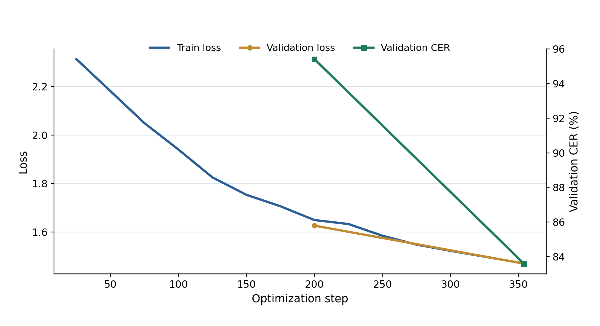
5
Learning Curves & Error Rate Comparison
Saved checkpoints on the first 200 FLEURS test rows
Saved Whisper loss and validation-CER history
Left: historical validation CER retained spaces; current test CER removes them, so the two are not directly comparable. MMS trainer history was not retained.
Right: both checkpoints are scored on the same 200 test rows, but different training subsets limit interpretation.
Khmer Automatic Speech Recognition — Final Project
6 / 9

Slide 7
6
Error Analysis: FLEURS and Live Voices
Whisper errors on 200 FLEURS test clips
13,424
8,741
286
Substitutions
Deletions
Insertions
MMS on student recordings
Names and numbers appear in several high-error clips. A separate eleventh recording lacks a reference and was not scored.
Live audio experiment
Full clips: 24.17% CER on 10 recordings.
Pause-based split: 25.83% CER; not adopted.
Diagnostic caveat Live references came from student-provided text and still need audio verification. One extra clip has no reference.
Khmer Automatic Speech Recognition — Final Project
7 / 9

Slide 8
7
Limitations & Prioritized Future Work
Limitations of the saved study
Next steps
Original Whisper row counts are inferred; MMS retained counts were not logged.
MMS training history was not retained; only selected FLEURS predictions were saved.
The frozen-encoder run has no saved checkpoint or metrics.
Rerun both models on matched, seeded train / validation / test subsets.
For reruns, save both trainer states and full predictions.
Document learning-rate and regularization experiments.
Make the Whisper download accessible and record training runtimes.
Khmer Automatic Speech Recognition — Final Project
8 / 9

Slide 9
8
Progress Review & Teacher Feedback
Current demo and evidence
Advice requested from teacher
Gradio accepts microphone input or uploaded audio.
MMS: 15.96% CER on 200 FLEURS clips; 24.17% provisional CER on 10 new recordings.
Training selections differed, so the architecture comparison remains diagnostic.
Is current real-speech quality acceptable with honest limitations?
Prioritize a general decoder / new labeled speech, or matched reruns, tuning, and MMS curves?
Khmer Automatic Speech Recognition — Final Project
9 / 9

