Slide 1
FINAL PROJECT — DEEP LEARNING
Khmer Automatic Speech Recognition
Two trained architectures, with a transparent review of the saved evaluation evidence
Department of Engineering | Bachelor of Software Engineering
Lecturer: Mr. Soklong HIM
Student: Khemrak Pasey

Slide 2
1
Problem Definition & Practical Motivation
Formal formulation Given a 16 kHz raw audio waveform X = (x1, x2, ..., xT), the model optimizes the posterior P(Y | X) to output the correct Khmer Unicode orthographic sequence Y = (y1, y2, ..., yU).
The linguistic challenge of Khmer
Real-world impact in Cambodia
1
Scriptio continua
Written without consistent spaces between words; context helps identify word boundaries.
Can improve speech-based access for Khmer speakers.
Potential uses include dictation, transcription, and voice interfaces.
2
Intricate orthography
Consonant series, dependent vowels, and stacked subscript consonants (Cheung).
3
Acoustic ambiguity
The same vowel sign can be pronounced differently with first- and second-series consonants.
Khmer Automatic Speech Recognition — Final Project
2 / 13
Notes:
Khmer writing and consonant-series references: https://seasite.niu.edu/khmer/writingsystem/vowhtm/vowels.htm ; https://unstats.un.org/unsd/geoinfo/ungegn/docs/3rd-gegn-docs/3rd_gegn_inf12.pdf. The slide describes potential applications, not deployed outcomes.

Slide 3
2
Dataset Description & Preprocessing Pipeline
1,675
326
771
Google FLEURS Khmer (km_kh)
Hugging Face Datasets (google/fleurs), CC-BY 4.0. Audio processed at 16 kHz mono across multiple speakers.
train examples
validation examples
test examples
Unified audio & text preprocessing pipeline
1. Audio standardization
Resampled to 16,000 Hz, single-channel.
2. Unicode normalization
NFC normalization applied to all transcripts.
3. Text sanitization
Strips zero-width / non-breaking spaces (U+200B, U+FEFF) and compacts whitespace.
4. Scoring convention
CER removes whitespace before scoring — Khmer spaces do not reliably mark words.
Whisper: 80-channel log-mel spectrograms, 25 ms Hann windows, 10 ms hop length.
MMS: normalized 1D temporal representations, extracted directly by a 7-layer convolutional feature encoder.
Diagnostic caveat All three saved checkpoints were scored on the first 200 FLEURS test rows. Saved training selections and filters differ across runs, so these results are diagnostic, not a controlled comparison.
Khmer Automatic Speech Recognition — Final Project
3 / 13

Slide 4
3
Two Trained Deep Learning Approaches
APPROACH 1 — PRIMARY
APPROACH 2 — COMPARISON
OPTIONAL ABLATION — NOT REPORTED
OpenAI Whisper-Tiny
(Seq2Seq Transformer)
Meta MMS-1B Khmer
(Acoustic CTC Model)
Whisper-Tiny
(Frozen Encoder)
Strategy: Full fine-tuning
Parameters: 37.8M (100% trainable)
Strategy: Top-4-layer partial fine-tuning
Parameters: 79.1M trainable
Status: No saved run — no checkpoint or metrics
Autoregressive cross-attention. Encoder maps 80-channel log-mel frames; decoder predicts subwords conditioned on preceding tokens. Implicit internal language model.
Wav2Vec 2.0 with CTC. The saved run unfroze the top four encoder layers plus the CTC head / adapter.
Excluded from this report: no trained checkpoint, predictions, or run logs were available for this configuration.
Khmer Automatic Speech Recognition — Final Project
4 / 13

Slide 5
4
Theoretical Justification: Why Compare Seq2Seq vs. CTC?
Seq2Seq Transformers
CTC Models
Autoregressive decoders that learn semantic dependencies.
With limited fine-tuning data, outputs may repeat or contain unsupported text.
Predicts tokens autoregressively, using prior output tokens as context.
Use monotonic frame-to-token alignment without autoregressive decoding.
Greedy CTC decoding avoids a token-by-token text decoder.
Output tokens are decoded from acoustic frames using CTC.
What the models illustrate: Seq2Seq uses prior output tokens; CTC decodes aligned acoustic frames without that text loop.
Diagnostic caveat The saved runs differ in training data size, so the observed score gap does not isolate architecture alone.
Khmer Automatic Speech Recognition — Final Project
5 / 13

Slide 6
5
Saved Training Setup & Tuning Evidence
Training infrastructure & hardware
Saved run settings (not a complete sweep)
Original runs: Google Colab T4 GPU. Whisper warmup rerun: RTX 4050 Laptop GPU.
Framework: PyTorch, Transformers, Hugging Face Datasets, and Accelerate.
Mixed precision: FP16 used in the saved training configurations.
Seed 42 set for Python, NumPy, PyTorch, and Transformers.
Setting | Whisper | MMS
Epochs | 3 | 15
Learning rate | 1e-5 | 5e-5
Warmup steps | 500 | 50
Batch size | 8 | 1
Grad. accumulation | 1 | 8
MMS unfroze the top four encoder layers and CTC head/adapter; SpecAugment was enabled.
Diagnostic caveat No complete tuning sweep is saved. Original run times were not recorded; the Whisper warmup rerun took about 11 minutes.
Khmer Automatic Speech Recognition — Final Project
6 / 13

Slide 7
6
Evaluation Metrics: CER vs. WER
Primary evaluation metric — Character Error Rate (CER)
CER = (S + D + I) ⁄ N × 100%
S = substitutions, D = deletions, I = insertions, N = total reference Unicode characters.
Computed after NFC normalization and whitespace removal.
WER limitation
Standard WER uses whitespace as a word tokenizer — unsuitable for Khmer, which does not use spaces as word boundaries.
Interpretable word-level WER needs a consistent Khmer word-segmentation method.
CER is therefore the primary metric in this project; unsegmented WER is omitted from the comparison.
Khmer Automatic Speech Recognition — Final Project
7 / 13

Slide 8
7
Saved Checkpoints: Shared-Test Diagnostic
83.89%
83.67%
15.96%
Whisper — original (CER, n = 200)
Whisper — rerun (warmup 35) (CER, n = 200)
MMS — CTC (CER, n = 200)
Approach | Model | Training | Params | Train / val | Epochs | CER | Test n
Whisper original | Whisper-Tiny | Full tuning | 37.8M | ~941 / ~189 | 3 | 83.89% | 200
MMS | MMS-1B CTC | Top 4 + head | 79.1M | ≤1000 / ≤200 | 15 | 15.96% | 200
Whisper rerun | Whisper-Tiny | Full; warmup 35 | 37.8M | 941 / 189 | 3 | 83.67% | 200
All three checkpoints were scored on the first 200 FLEURS test rows. The Whisper rerun saved 59 character edits relative to the original run.
Diagnostic caveat Training selections and filters differed across architecture runs, so these scores are diagnostic, not a controlled ranking of architectures.
CER values are rounded to two decimals. Scoring uses NFC normalization and removes whitespace.
Khmer Automatic Speech Recognition — Final Project
8 / 13

Slide 9
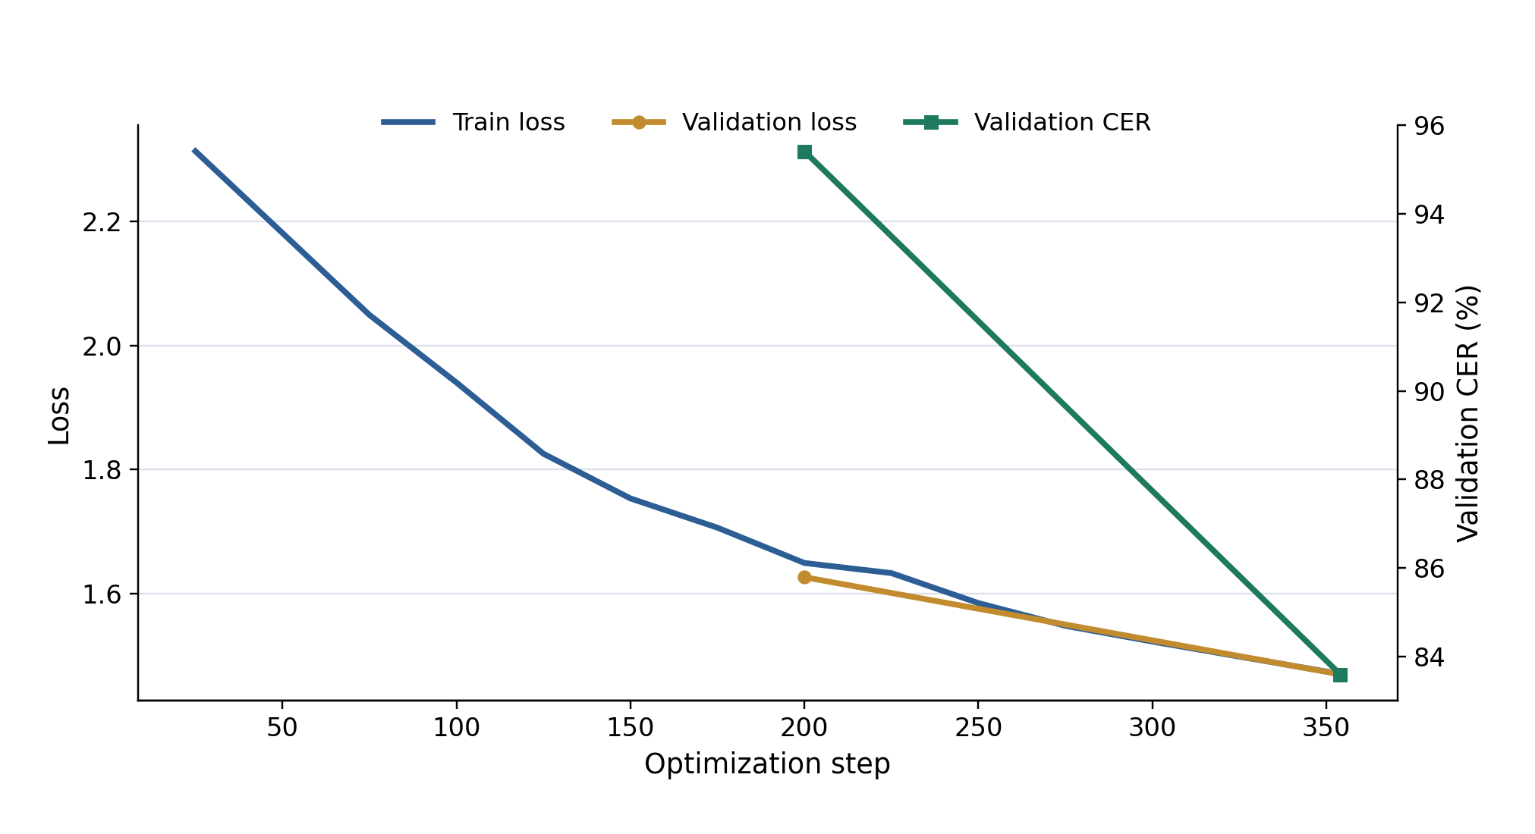
8
Learning Curves & Error Rate Comparison
Saved checkpoints on the first 200 FLEURS test rows
Saved Whisper loss and validation-CER history
Left: historical validation CER retained spaces; current test CER removes them, so the two are not directly comparable. MMS trainer history was not retained.
Right: both checkpoints are scored on the same 200 test rows, but different training subsets limit interpretation.
Khmer Automatic Speech Recognition — Final Project
9 / 13

Slide 10
9
Error Analysis & Failure Case Inspection
Whisper character errors across 200 test examples
13,424
8,741
286
Substitutions
Deletions
Insertions
Observed pattern in high-error outputs
Several examples contain repeated Khmer token strings, suggesting decoding collapse in the observed transcripts.
Example — FLEURS test row 66
Reference: contains “802.11n … 5.0ghz”
Output: repeats “បាន” until decoding stops.
Diagnostic caveat Text scores alone do not establish an acoustic cause. MMS per-example predictions were not retained.
Khmer Automatic Speech Recognition — Final Project
10 / 13

Slide 11
10
Limitations & Prioritized Future Work
Limitations of the saved study
Next steps
Original Whisper row counts are inferred; MMS retained counts were not logged.
MMS training history and per-example outputs were not retained.
The frozen-encoder run has no saved checkpoint or metrics.
Rerun both models on matched, seeded train / validation / test subsets.
Save both trainer states and per-example predictions.
Document learning-rate and regularization experiments.
Make the Whisper download accessible and record training runtimes.
Khmer Automatic Speech Recognition — Final Project
11 / 13

Slide 12
11
Live Demonstration & Q&A Preparation
Demo — Gradio web app
Q&A topics to be ready for
Accepts microphone input or an uploaded audio file.
Use a sample clip to show the resulting Khmer transcript.
For Q&A: explain the FLEURS subset mismatch and the whitespace-insensitive CER convention.
Explain the observed Whisper repetition errors and CTC decoding.
Describe why the saved scores are diagnostic, not a controlled ranking.
Khmer Automatic Speech Recognition — Final Project
12 / 13

Slide 13
Q&A BACKUP SLIDE
Appendix: Hyperparameters and References
Saved run parameters
Whisper: 3 epochs; lr 1e-5; warmup 500; batch 8; accumulation 1.
Warmup rerun: 941 train / 189 validation rows retained.
MMS: 15 epochs; lr 5e-5; warmup 50; batch 1; accumulation 8.
MMS: top four layers unfrozen; trainable parameter count 79.08M.
All three checkpoints scored post hoc on the first 200 FLEURS test rows.
References
Radford et al. (2023), Robust Speech Recognition via Large-Scale Weak Supervision
Pratap et al. (2023), Scaling Speech Technology to 1,000+ Languages
Conneau et al. (2023)
Graves et al. (2006)
Khmer Automatic Speech Recognition — Final Project
13 / 13

