Slide 1
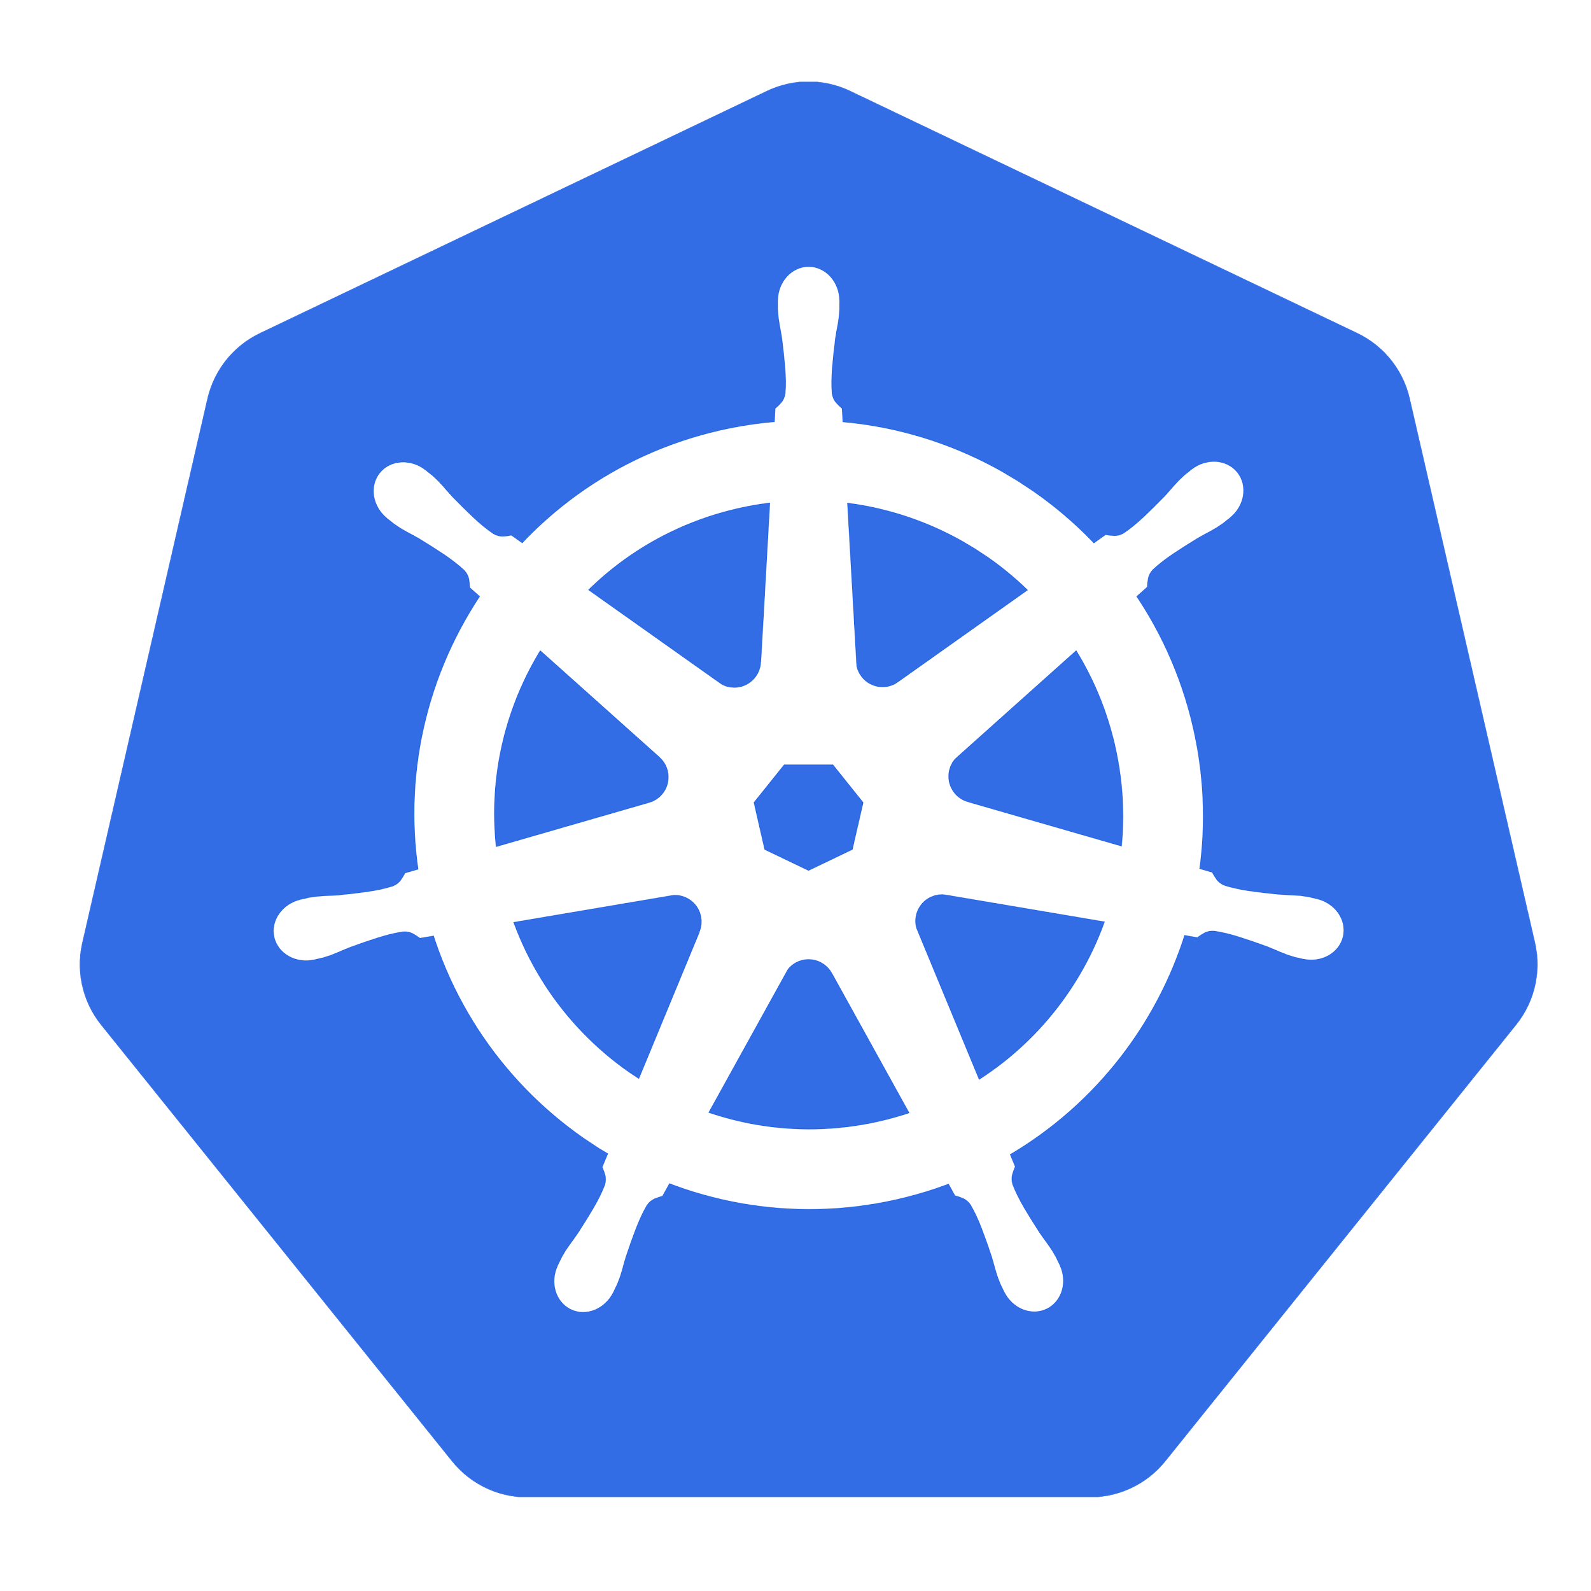
Introduction to Kubernetes
Basic concepts
Mohamed Abdennebi
twitter.com/abdennebi
github.com/abdennebi
Sfeir Quarters Back : May 2, 2017

Slide 2
Big Internet Companies Secrets
Scalability and availability
Fully automated data centers :
Auto-placement for applications
Auto-replication
Auto-updating
Auto-healing

Slide 3
Microservices with cloud practices
Easily deploy an application to multiple machines at the same time
Update applications with zero downtime
Scale out or down at demand and even better scale automatically
Recover gracefully from application crash or hardware failure
Optimize usage of computers resources and infrastructure to save money

Slide 4
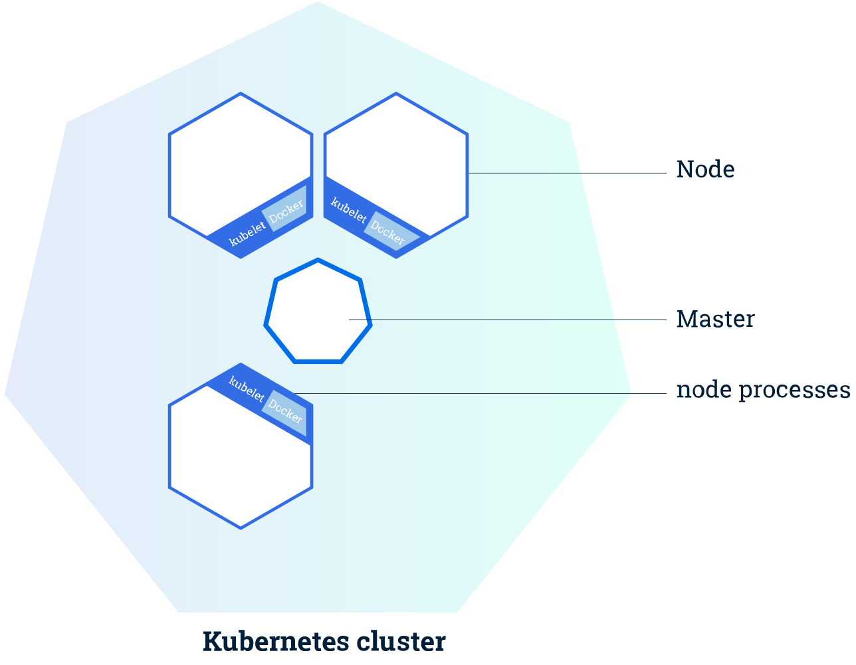
Kubernetes Cluster
The Master coordinates the cluster
From one to several Nodes the execute the workload

Slide 5
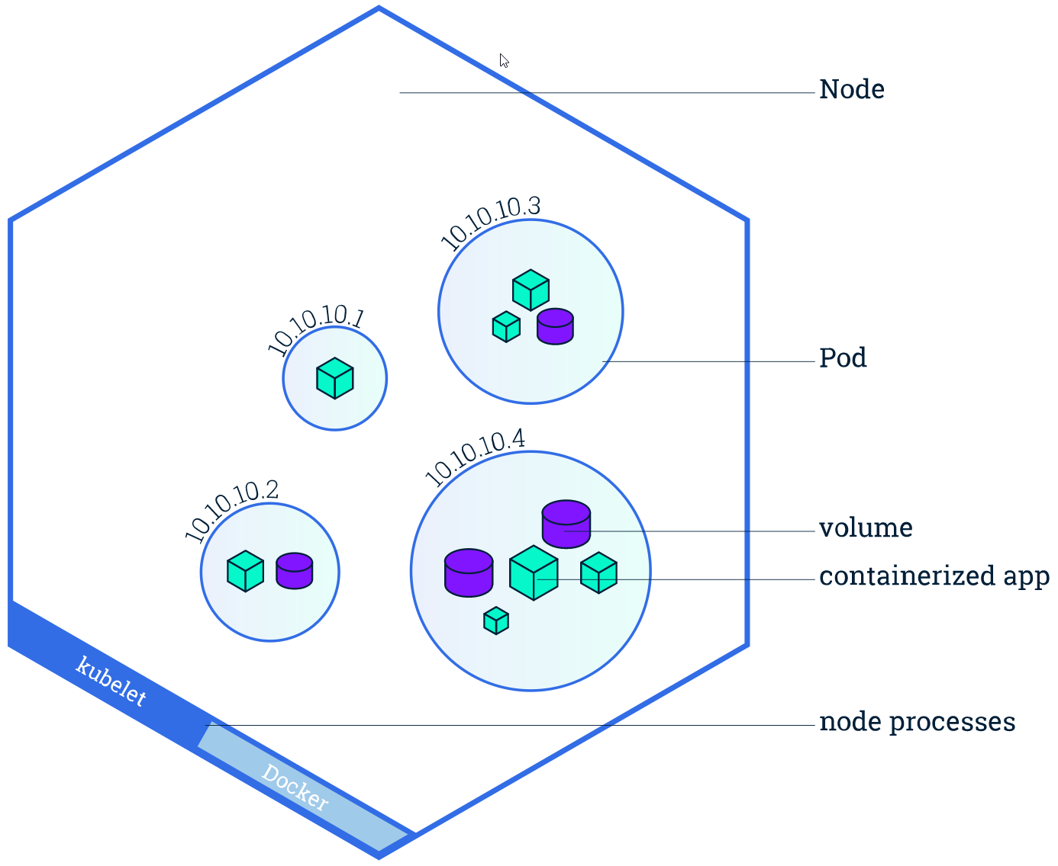
Concept 1 : Node
Machines (physical or virtual) that run the actual workloads assigned to them.
Docker installed
Kublet agent : The main contact point for each node with the cluster

Slide 6
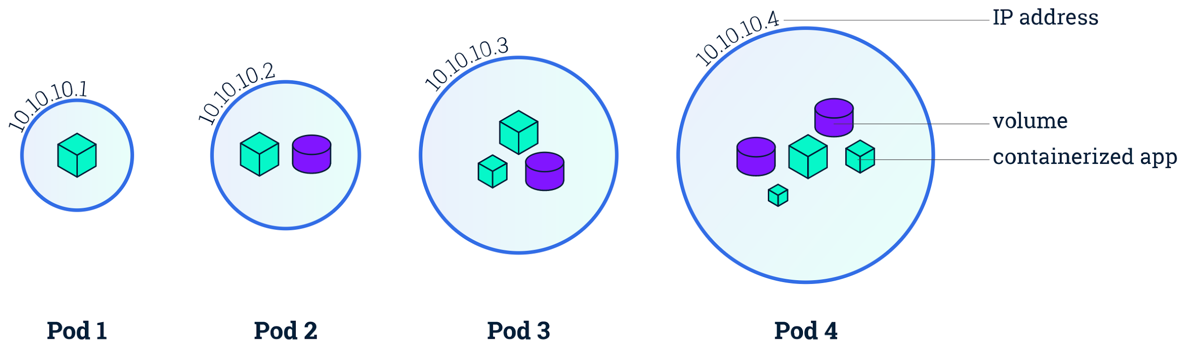
Concept 2 : Pod
Atomic unit of deployment
Attached resources to it : unique IP address, data volumes, etc.
A group of one or more application containers tightly coupled
Supported containers : Docker and rkt

Slide 7
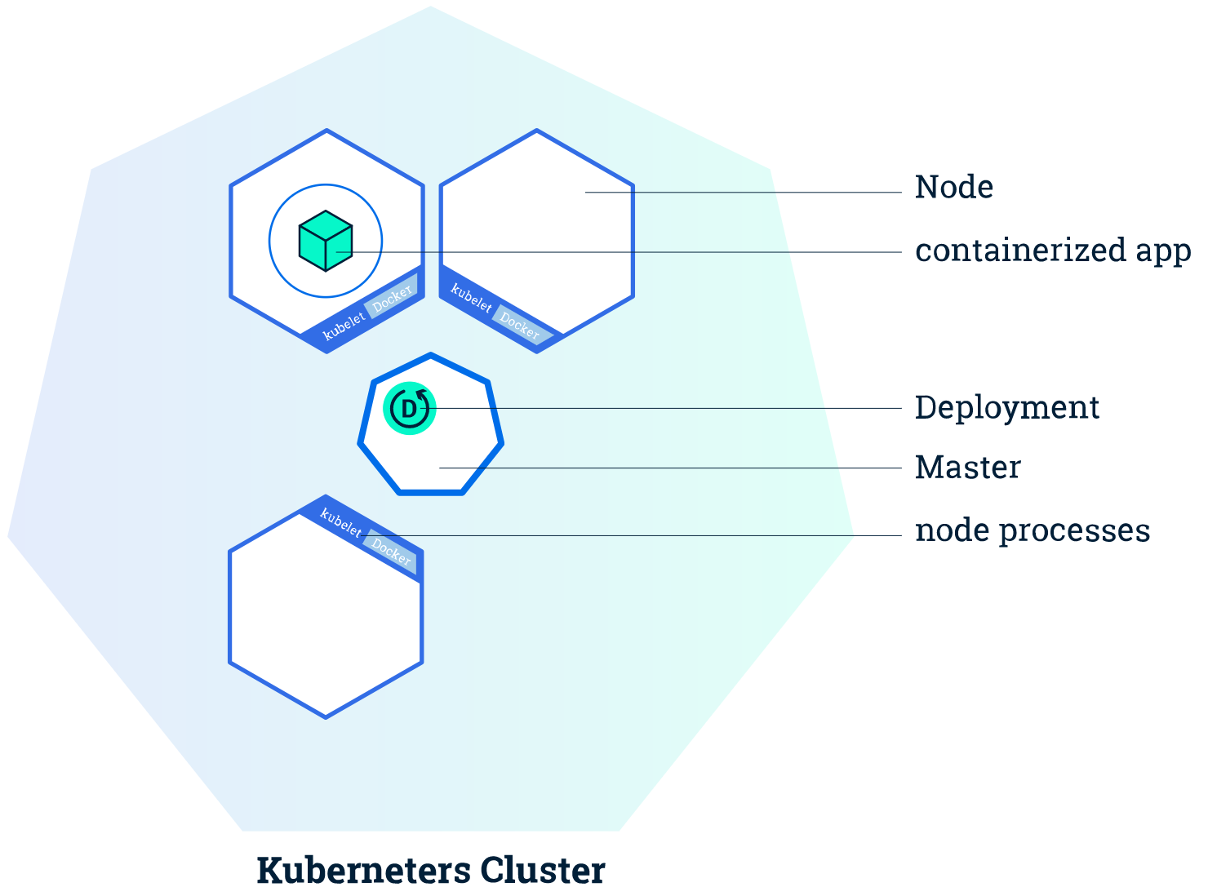
Concept 3 : Deployment
Deployment provides a declarative mecanisme to create, update and scale applications
apiVersion: apps/v1 kind: Deployment metadata: name: hello-deployment spec: replicas: 3 spec: containers: - name: hello image: hello:1.0.0 ports: - containerPort: 80

Slide 8
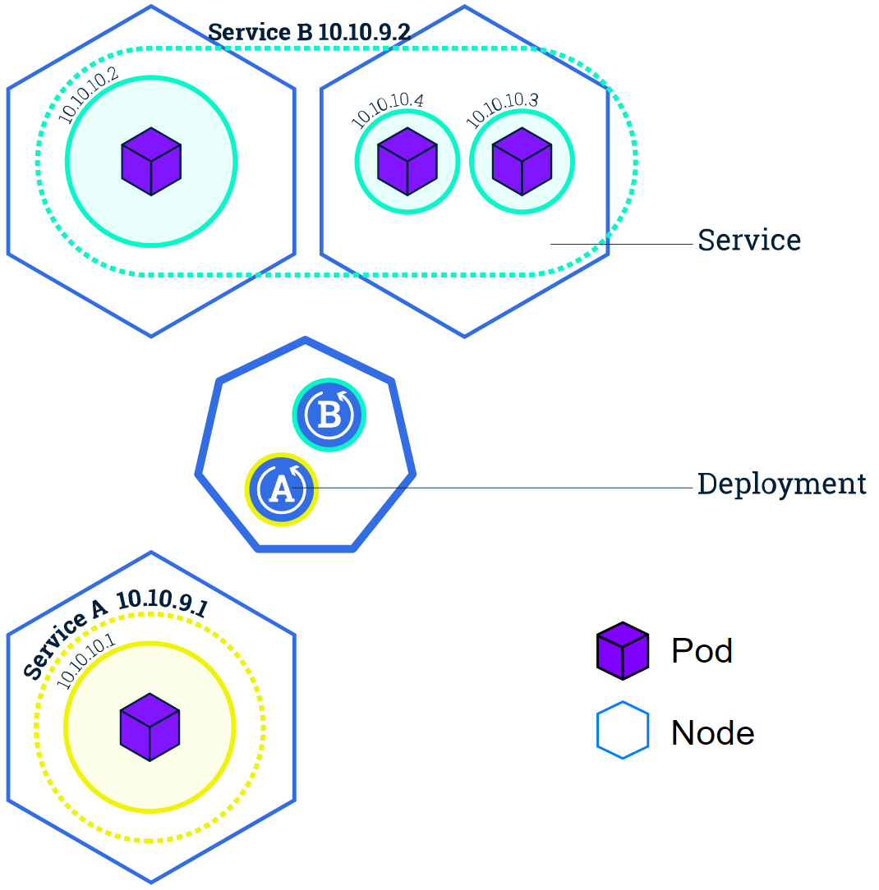
Concept 4 : Services
Service acts like gateway to a group of Pods
It allows decoupling between apps by implementing service discovery.
It acts as load balancer for Pods it covers
kubectl expose deployment hello-world --type="NodePort"
--port 80 service "hello-world"
curl http://hello-world

Slide 9
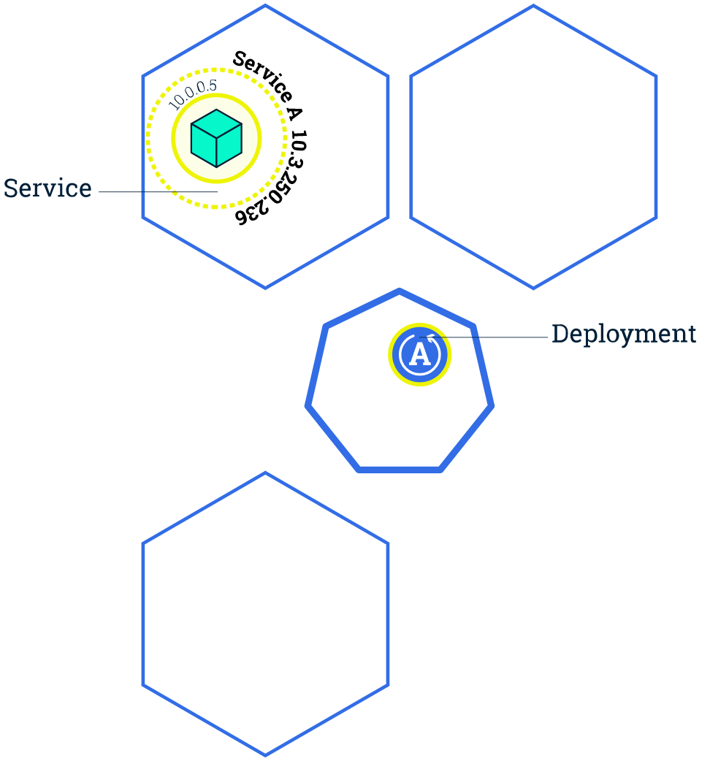
Scaling
Scaling is accomplished by changing the number of replicas in a Deployment
apiVersion: apps/v1 kind: Deployment metadata: name: nginx-deployment spec: replicas: 4 spec: containers: - name: nginx image: nginx:1.7.9 ports: - containerPort: 80

Slide 10
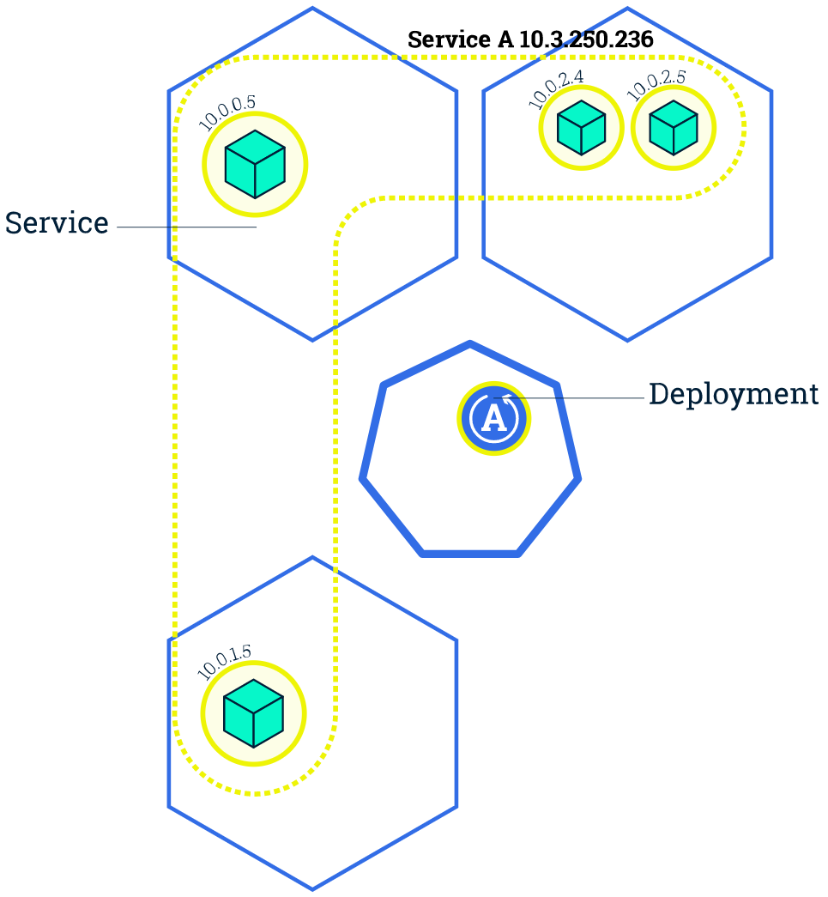
Scaling
Scaling is accomplished by changing the number of replicas in a Deployment
apiVersion: apps/v1 kind: Deployment metadata: name: nginx-deployment spec: replicas: 4 spec: containers: - name: nginx image: nginx:1.7.9 ports: - containerPort: 80

Slide 11
Scaling
Kubernetes supports : Scale out, Scale down and Autoscale
Scale out
kubectl scale deployment hello --replicas=4
Scale down
kubectl scale deployment hello --replicas=2
Autoscale
kubectl autoscale deployment hello --cpu-percent=50 --min=1 --max=10
Notes:
maintain an average CPU utilization across all Pods of 50%

Slide 12
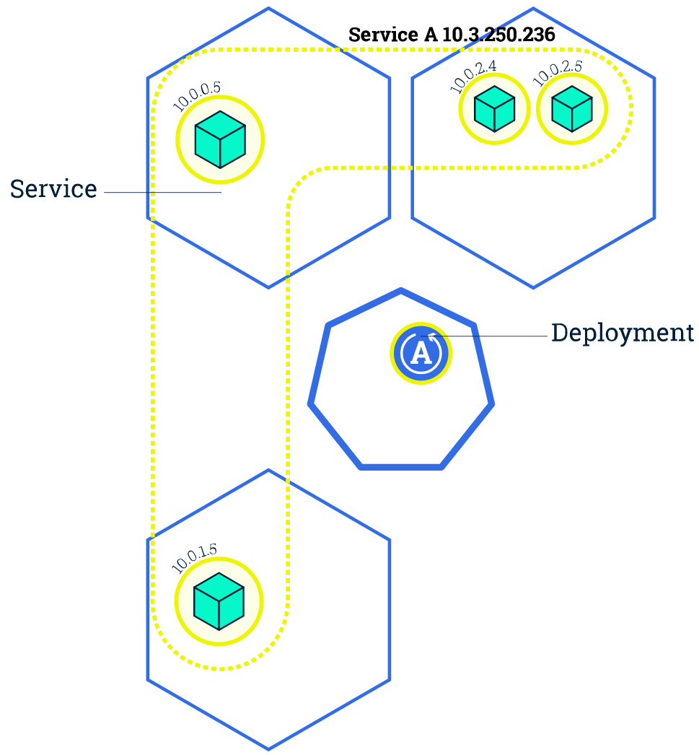
Rolling update
Rolling updates allow Deployments' update to take place with zero downtime
Updates are versioned and any Deployment update can be reverted to previous (stable) version.
While updating, traffic is routed to both versions

Slide 13
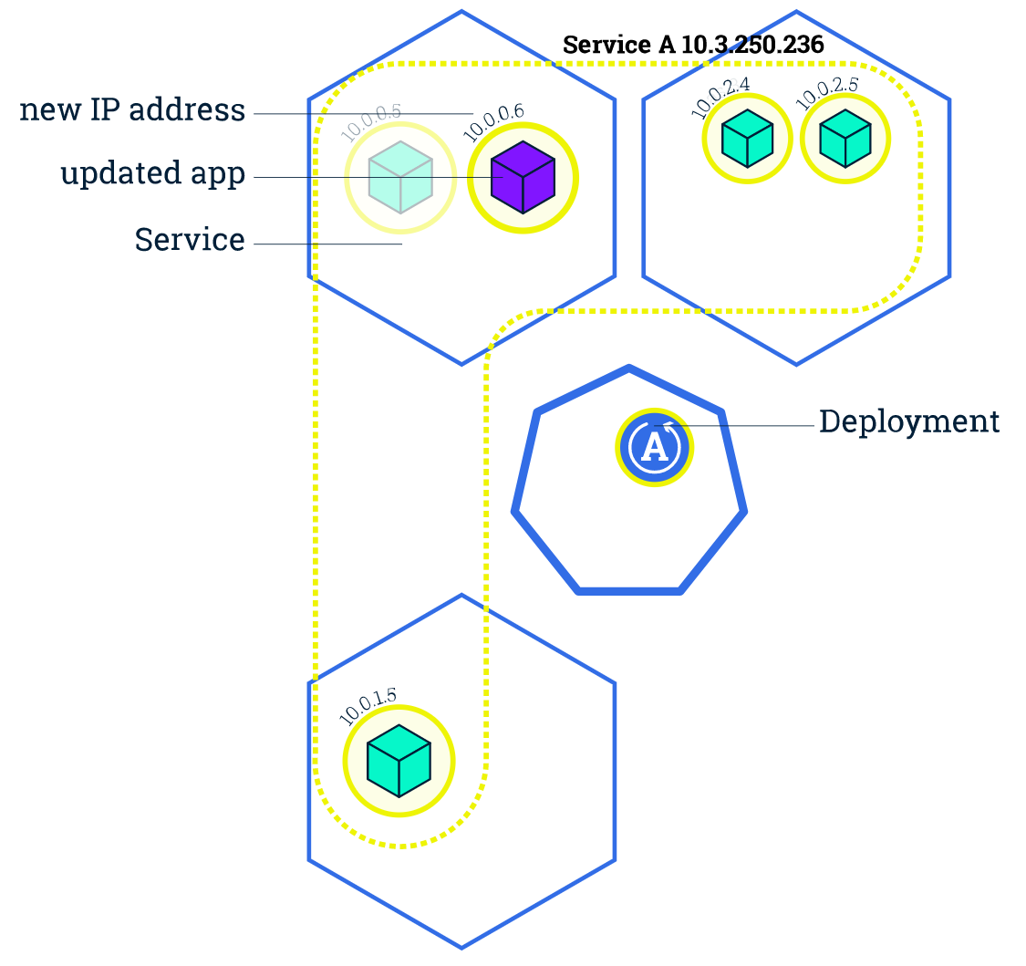
Rolling update
Rolling updates allow Deployments' update to take place with zero downtime
Updates are versioned and any Deployment update can be reverted to previous (stable) version.
While updating, traffic is routed to both versions

Slide 14
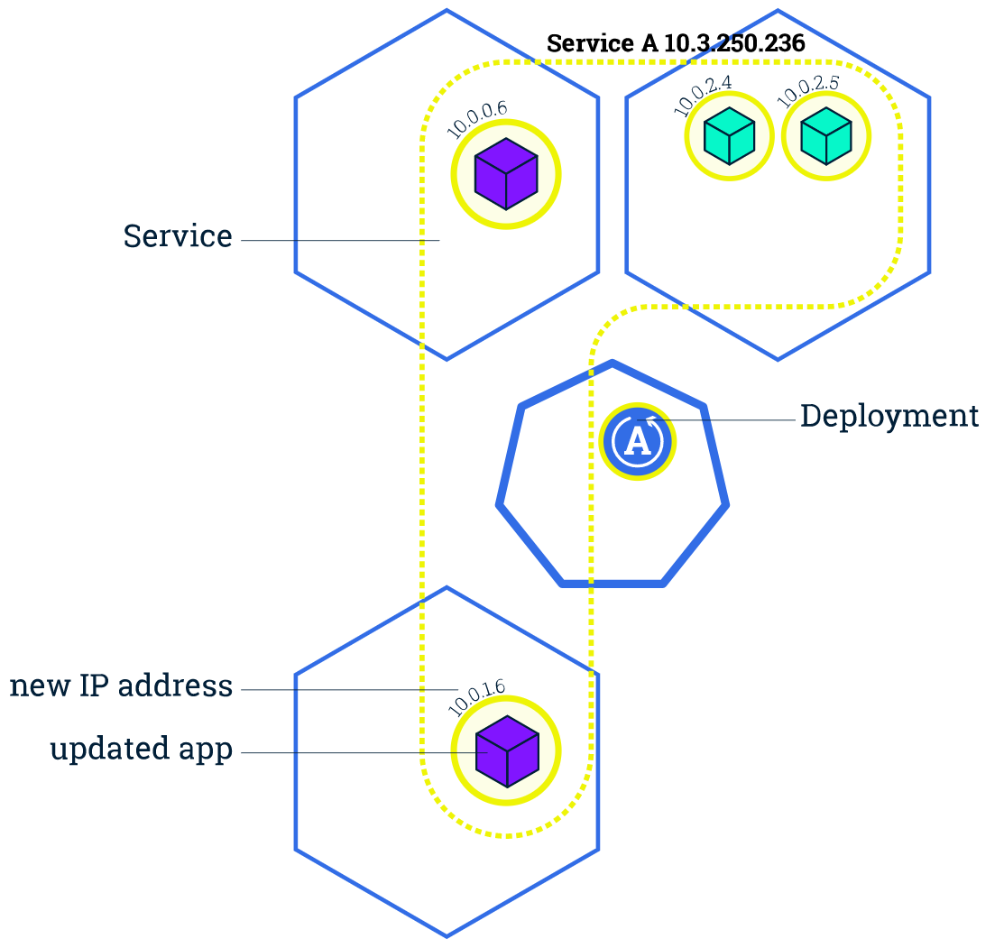
Rolling update
Rolling updates allow Deployments' update to take place with zero downtime
Updates are versioned and any Deployment update can be reverted to previous (stable) version.
While updating, traffic is routed to both versions

Slide 15
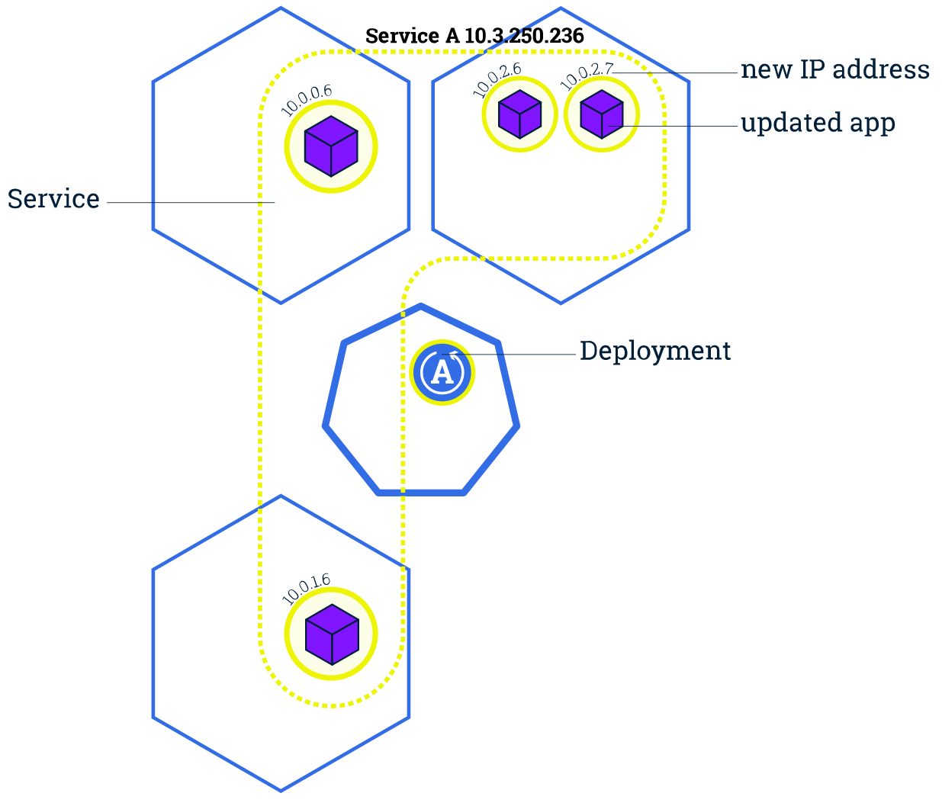
Rolling update
Rolling updates allow Deployments' update to take place with zero downtime
Updates are versioned and any Deployment update can be reverted to previous (stable) version.
While updating, traffic is routed to both versions

Slide 16
To go further
Kubernetes interactive tutorial who inspired this presentation : https://kubernetes.io/docs/tutorials/kubernetes-basics/
Scalable Microservices with Kubernetes (free course on Udacity by Google) https://www.udacity.com/course/scalable-microservices-with-kubernetes--ud615
Compagnon project to this presentation : https://github.com/Abdennebi/hello-kubernetes

