Slide 1
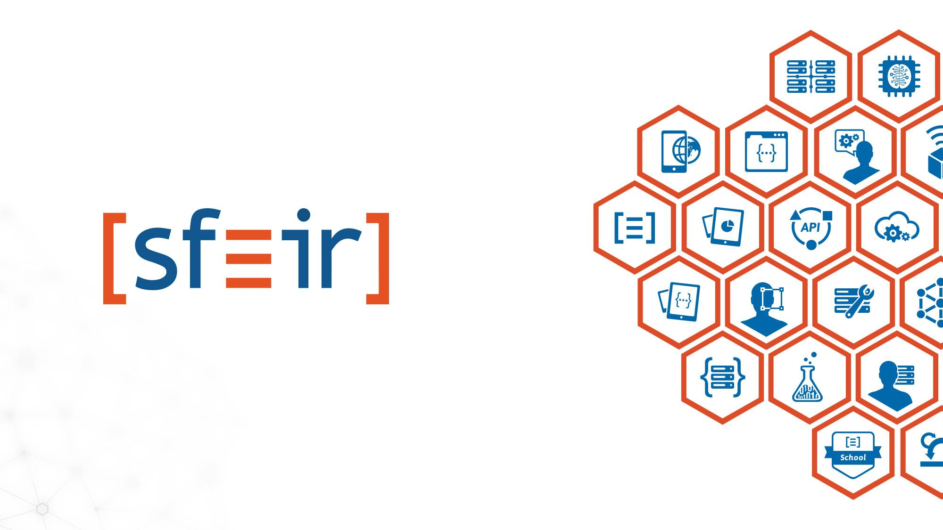
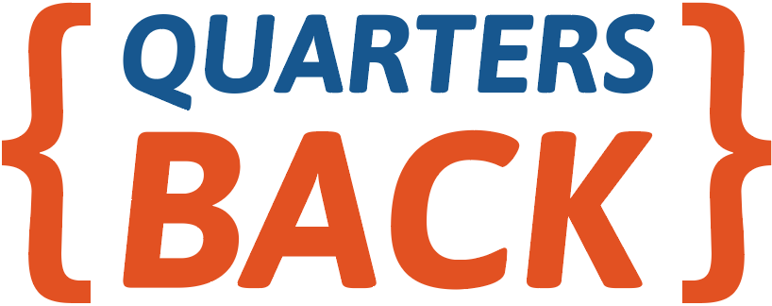
OK Google ! How to deal with Big Data?
Amel HAFSA 02/05/2017

Slide 2
Plan
1
What’s Big Data ?
2
Data Platform
3
Google Cloud Platform
4
OK Google ! How to?
5
IoT example
6
Next ?

Slide 3
What’s Big Data?
Volume
Terabytes
Transactions
Tables
Files
Variety
Structured
Unstructured
Semi structured
All
Velocity
Batch
Real time
Near time
Streams

Slide 4





Data Platform : 5 axes
Ingest/Capture
Process
Store
Analyze
Expose
Source 1
Source 2
Source n
Files
Batch Transformation
Real-time or Batch Analysis
API
Report DataViz
IoT 1
IoT 2
IoT n
Gateway
Streams
Real-time Transformation
MQTT 1
MQTT 2
MQTT n
Mobile device 1
Mobile device 2
Mobile device 3

Slide 5


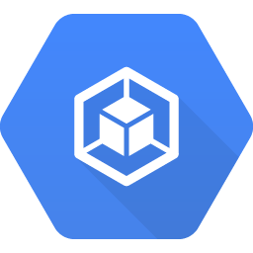

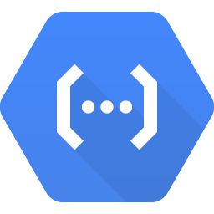





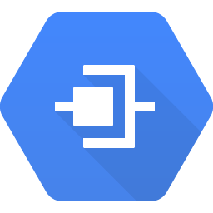
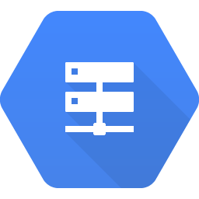
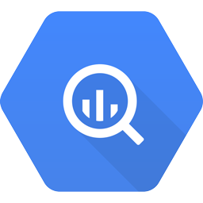
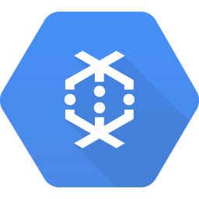



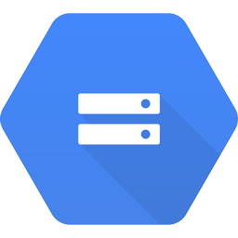

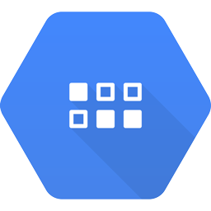




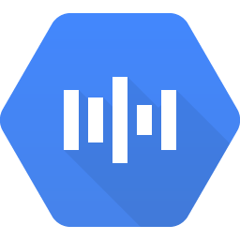
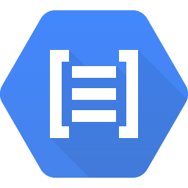
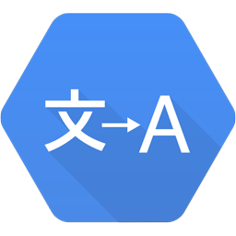
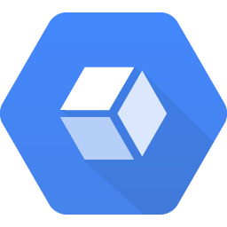





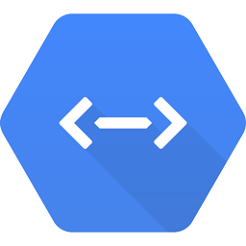

Google Cloud Platform
Compute
Identity & Security
Compute Engine
App Engine
Container Engine
Container Registry
Cloud Functions
Cloud IAM
Cloud Resource Manager
Cloud Security Scanner
Cloud Platform Security
Networking
Big Data
Cloud Virtual Network
Cloud Load Balancing
Cloud CDN
Cloud Interconnect
Cloud DNS
BigQuery
Cloud Dataflow
Cloud Dataproc
Cloud Datalab
Cloud Pub/Sub
Storage and Databases
Machine Learning
Cloud Storage
Cloud Bigtable
Cloud Datastore
Cloud SQL
Persistent Disk
Cloud Machine Learning
Vision API
Speech API
Natural Language API
Translation API
Management Tools
Stackdriver
Monitoring
Logging
Error Reporting
Trace
Debugger
Deployment Manager
Cloud Endpoints
Cloud Console
Cloud Shell
Cloud Mobile App
Billing App
Cloud APIs
Developer Tools
Cloud SDK
Deployment Manager
Cloud Source Repositories
Cloud Tools for Android Studio
Cloud Tools for IntelliJ
Cloud Tools for PowerShell
Cloud Tools for Visual Studio
Google Plug-in for Eclipse
Cloud Test Lab

Slide 6
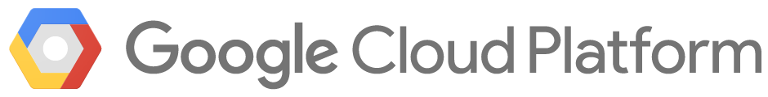
IoT platform
Ingest/Capture
Process
Store
Analyze
Expose
Storage
Cloud Storage
Iot devices
Cloud Datastore
Ingest
Pipelines
Application & Presentation
Cloud Pub/Sub
Cloud Dataflow
Cloud Bigtable
App Engine
Gateway
Analytics
Monitoring
Container Engine
Cloud Dataflow
Logging
Compute Engine
BigQuery
Cloud Dataproc
Cloud Datalab

Slide 7
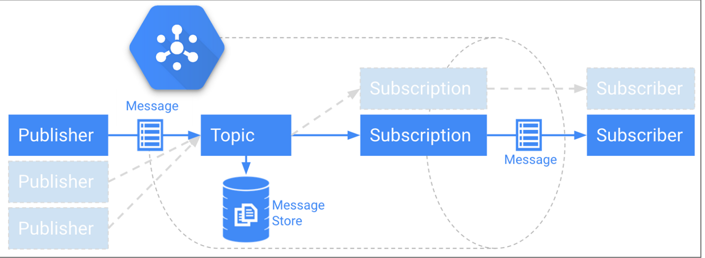
Cloud Pub/Sub
Service de messaging:
Design pattern : Publish / Subscribe
Asynchrone
Millions d'événements / seconde

Slide 8
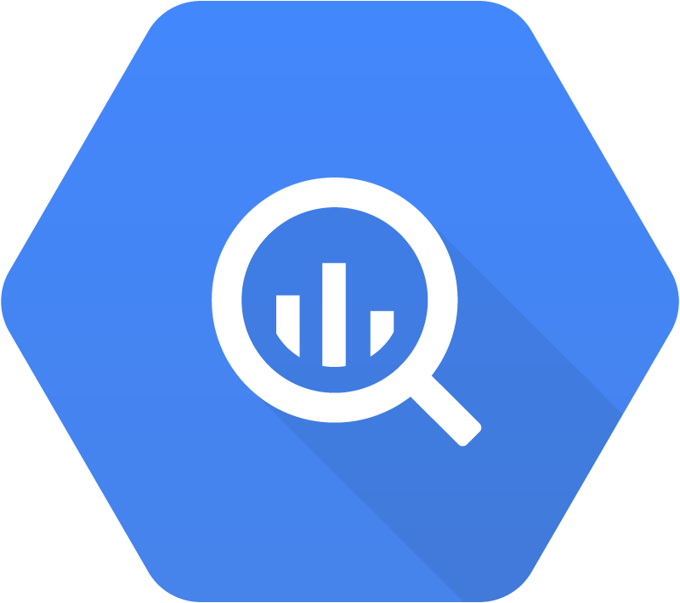

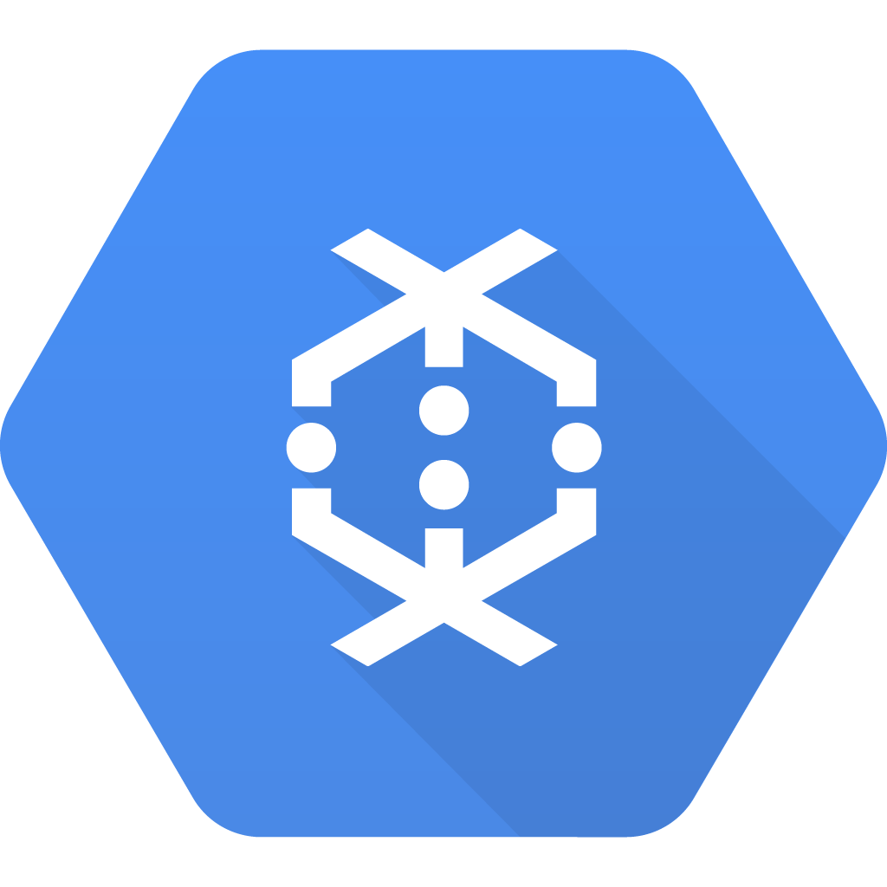

Cloud Dataflow
Pipeline d’ingestion et de transformation de données
Exécution de pipelines en parallèle
Apache Beam : Cloud Dataflow SDK
Streaming ou Batch : même code
BigQuery
Cloud Pub/Sub
Cloud Dataflow
Cloud Pub/Sub
Cloud Storage
Cloud Storage

Slide 9
BigQuery
Datawarehouse de 1Mo à 1Po
Base orientée colonne
SQL like queries
User Defined Functions (javascript)
ETL : CSV et JSON dans Cloud Storage

Slide 10
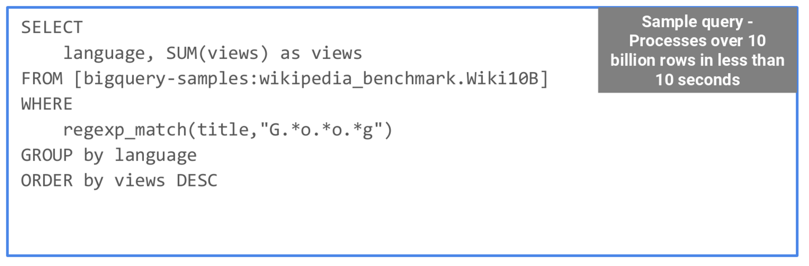
BigQuery

Slide 11
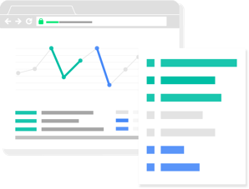



IoT platform
SOURCE 1 : MQTT devices
Storage Layer
Unprocessed data Storage Cloud Storage
Autoscaled IoT Application
Transformed data Storage Cloud Storage
Data collector
App Engine
Ingest
Autoscaled Web Application
IoT Topic Cloud Pub/Sub
Stream Analytics Cloud Dataflow
Dashboard
App Engine
Analyse
IoT Warehouse BigQuery
Data Studio
Live Database Cloud Datastore
Cloud Pub/Sub
Autoscaled Broker Tier Custom MQTT <-> Cloud Pub/Sub broker
Scheduled Tasks
IoT Topic Cloud Pub/Sub
Stream Analytics Cloud Dataflow
Storage Layer
MQTT Broker Compute Engine
Unprocessed data Storage Cloud Storage
Logs API
RabbitMQ™
Transformed data Storage Cloud Storage
Task Queues
SOURCE 2 : MQTT devices

Slide 12
Next?
Big Data
BigQuery
Cloud Dataflow
Cloud Dataproc
Cloud Datalab
Cloud Pub/Sub
Machine Learning
Cloud Machine Learning
Vision API
Speech API
Natural Language API
Translation API

Slide 13
Questions ?

Slide 14
Merci de votre attention!

