Slide 1

Service Discovery

Slide 2
1 Genesis

Slide 3
service A trying to find service B
A
B
<<invokes>>

Slide 4
Monolith
A
B
language level call

Slide 5
Classical Distributed Application 1/2
A
B
RPC/TCP
VM
VM

Slide 6
Classic Distributed Application 2/2
A
B
HTTP
VM
VM

Slide 7
The problem is service A must know where B is
A
B
192.168.xx.xx
HTTP
VM
VM

Slide 8
What if there’s we scale service B ?
192.168.xx.x3
B
B
A
B
HTTP/TCP
192.168.xx.x2
192.168.xx.x1
VM
VM

Slide 9
What if B has to scale ?
192.168.xx.x3
192.168.xx.x3
192.168.xx.x3
B
B
B
B
B
B
A
B
B
B
HTTP/TCP
192.168.xx.x2
192.168.xx.x2
192.168.xx.x2
192.168.xx.x1
192.168.xx.x1
192.168.xx.x1
VM
VM
VM
VM

Slide 10
What if B has to scale more ?
DC
DC
DC
192.168.xx.x3
192.168.xx.x3
192.168.xx.x3
B
B
B
B
B
B
B
B
B
192.168.xx.x2
192.168.xx.x2
192.168.xx.x2
A
192.168.xx.x1
192.168.xx.x1
192.168.xx.x1
HTTP/TCP
VM
VM
VM
192.168.xx.x3
192.168.xx.x3
192.168.xx.x3
B
B
B
VM
B
B
B
B
B
B
192.168.xx.x2
192.168.xx.x2
192.168.xx.x2
192.168.xx.x1
192.168.xx.x1
192.168.xx.x1
VM
VM
VM

Slide 11
What if we scale service A ?
DC
DC
DC
192.168.xx.x3
192.168.xx.x3
192.168.xx.x3
B
B
B
B
B
B
B
B
B
192.168.xx.x2
192.168.xx.x2
192.168.xx.x2
A
192.168.xx.x1
192.168.xx.x1
192.168.xx.x1
A
HTTP/TCP
A
VM
VM
VM
192.168.xx.x3
192.168.xx.x3
192.168.xx.x3
B
B
B
VM
B
B
B
B
B
B
192.168.xx.x2
192.168.xx.x2
192.168.xx.x2
192.168.xx.x1
192.168.xx.x1
192.168.xx.x1
VM
VM
VM

Slide 12
What if we really scale service A ?
DC
DC
DC
192.168.xx.x3
192.168.xx.x3
192.168.xx.x3
B
B
B
B
B
B
B
B
B
B
B
B
B
A
A
192.168.xx.x2
192.168.xx.x2
192.168.xx.x2
192.168.xx.x1
192.168.xx.x1
192.168.xx.x1
VM
VM
VM
VM
VM
HTTP/TCP
B
B
192.168.xx.x3
192.168.xx.x3
192.168.xx.x3
B
B
A
A
B
B
B
B
B
B
B
B
B
192.168.xx.x2
192.168.xx.x2
192.168.xx.x2
VM
VM
192.168.xx.x1
192.168.xx.x1
192.168.xx.x1
VM
VM
VM

Slide 13
What if we have some fails ?
DC
DC
DC
192.168.xx.x3
192.168.xx.x3
192.168.xx.x3
B
B
B
B
B
B
B
B
B
B
B
B
B
A
A
192.168.xx.x2
192.168.xx.x2
192.168.xx.x2
192.168.xx.x1
192.168.xx.x1
192.168.xx.x1
VM
VM
VM
VM
VM
HTTP/TCP
B
B
192.168.xx.x3
192.168.xx.x3
192.168.xx.x3
B
B
A
A
B
B
B
B
B
B
B
B
B
192.168.xx.x2
192.168.xx.x2
192.168.xx.x2
VM
VM
192.168.xx.x1
192.168.xx.x1
192.168.xx.x1
X
VM
VM
VM

Slide 14
do you remember the original story ?
A
B
discover location ?

Slide 15
Introducing the Service Registry
B
B
B
B
B
A
B
B
B
B
A
B
B
A
B
B
LB
LB
LB
C
C
C
SERVICE REGISTRY
LB

Slide 16
2 Service Registry Pattern

Slide 17



Slide 18
Service Registry
Is a database of services, their instances and their locations.
Service instances are registered with the service registry on startup and deregistered on shutdown.
Client of the service and/or routers query the service registry to find the available instances of a service.

Slide 19
Self Registration
A service instance is responsible for registering itself with the service registry.
On startup the service instance registers itself (host and IP address) with the service registry and makes itself available for discovery. The client must typically periodically renew its registration so that the registry knows it is still alive. On shutdown, the service instance unregisters itself from the service registry.

Slide 20
3 Quick overview of Hashicorp Consul

Slide 21







Slide 22

Service Discovery with Consul
B
B
B
B
B
A
B
B
B
B
A
B
B
A
B
B
stateless agent
C
stateless agent
stateless agent
C
C
Consul Server
stateless agent

Slide 23
HashiCorp Consul
Service Registry (Discovery)
Health Checking
KV Store
Multi Data centers out of the box (Gossip/WAN)
Developer Friendly (one agent binary for both server/client)
written in Go
it has an API

Slide 24
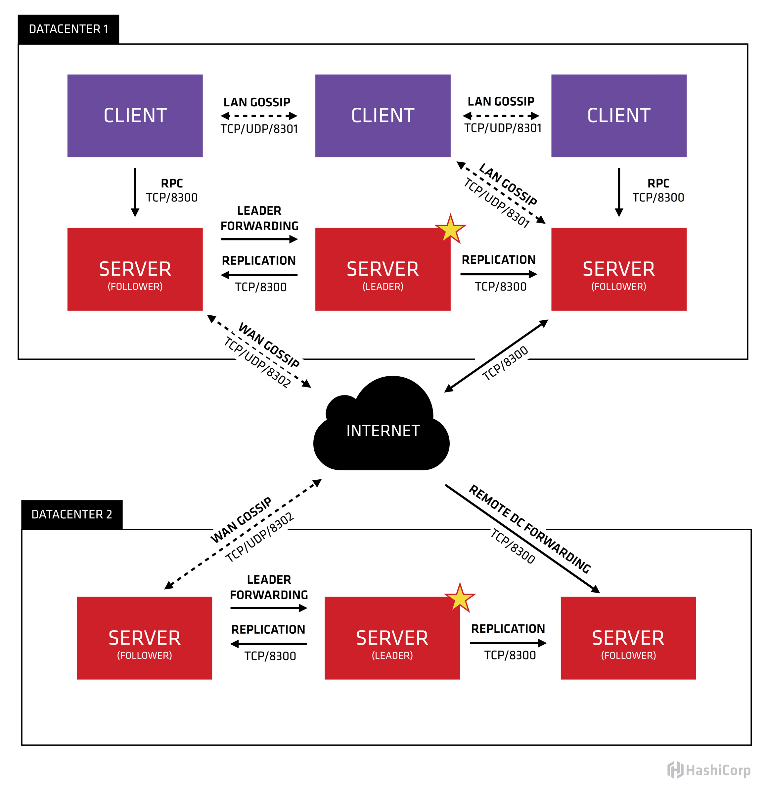
Consul Server Architecture

Slide 25
Consul Server
Consensus Protocol (Implemented with the Raft Algorithm)
Provides Consistency as defined by the CAP theorem
uses GOSSIP protocol based on the Serf Library for both internal GOSSIP/LAN and external GOSSIP/WAN exchange.
Sessions, Robust Security Model, Jepsen Testing
Notes:
Sessions : distributed locks
Security Model : The gossip protocol is powered by Serf, which uses a symmetric key, or shared secret, cryptosystem. There are more details on the security of Serf here. For details on how to enable Serf's gossip encryption in Consul, see the encryption doc here.
Jepsen Testing : Jepsen is a tool, written by Kyle Kingsbury, designed to test the partition tolerance of distributed systems. It creates network partitions while fuzzing the system with random operations. The results are analyzed to see if the system violates any of the consistency properties it claims to have.

Slide 26
How does it work ?
B
B
B
B
B
A
B
B
4
2
B
B
A
B
B
A
B
1
B
C
3
C
C
Notes:
service A asks for a healthy instance of service B
Consul server maintains a mapping of healthy running service B instances
Consul returns the ip+port of an instance B
service A makes its call

Slide 27
How does it work ?
service A asks for a healthy instance of service B
Consul server maintains a mapping of healthy running service B instances
Consul returns the ip+port of an instance B
service A makes its call

Slide 28
How to register a service
Consul cluster
DB
B
B
B
GOSSIP/WAN
GOSSIP/WAN

Slide 29
“Manually” register a service
$ sudo mkdir /etc/consul.d
$ echo '{"service": {"name": "product-service", "tags": ["java"], "port": 52001}}' \ | sudo tee /etc/consul.d/web.json
$ consul agent -dev -config-dir=/etc/consul.d ==> Starting Consul agent... ... [INFO] agent: Synced service 'web' ...

Slide 30
“Automatically” register a service with spring-boot
Demo

Slide 31
4 Demo
Notes:
start consul
start apps
show product controller
show application.yml and bootstrap.yml
show FeignClient
show consul/ui
start 2nd product-service

Slide 32
References
https://start.spring.io
https://consul.io
https://raft.github.io/
https://www.serf.io/
http://microservices.io/
https://github.com/unicorndz/qb-20170502

