Slide 1


Slide 2


Slide 3
1 Concept

Slide 4

Notes:
It is not about superbowl :)

Slide 5
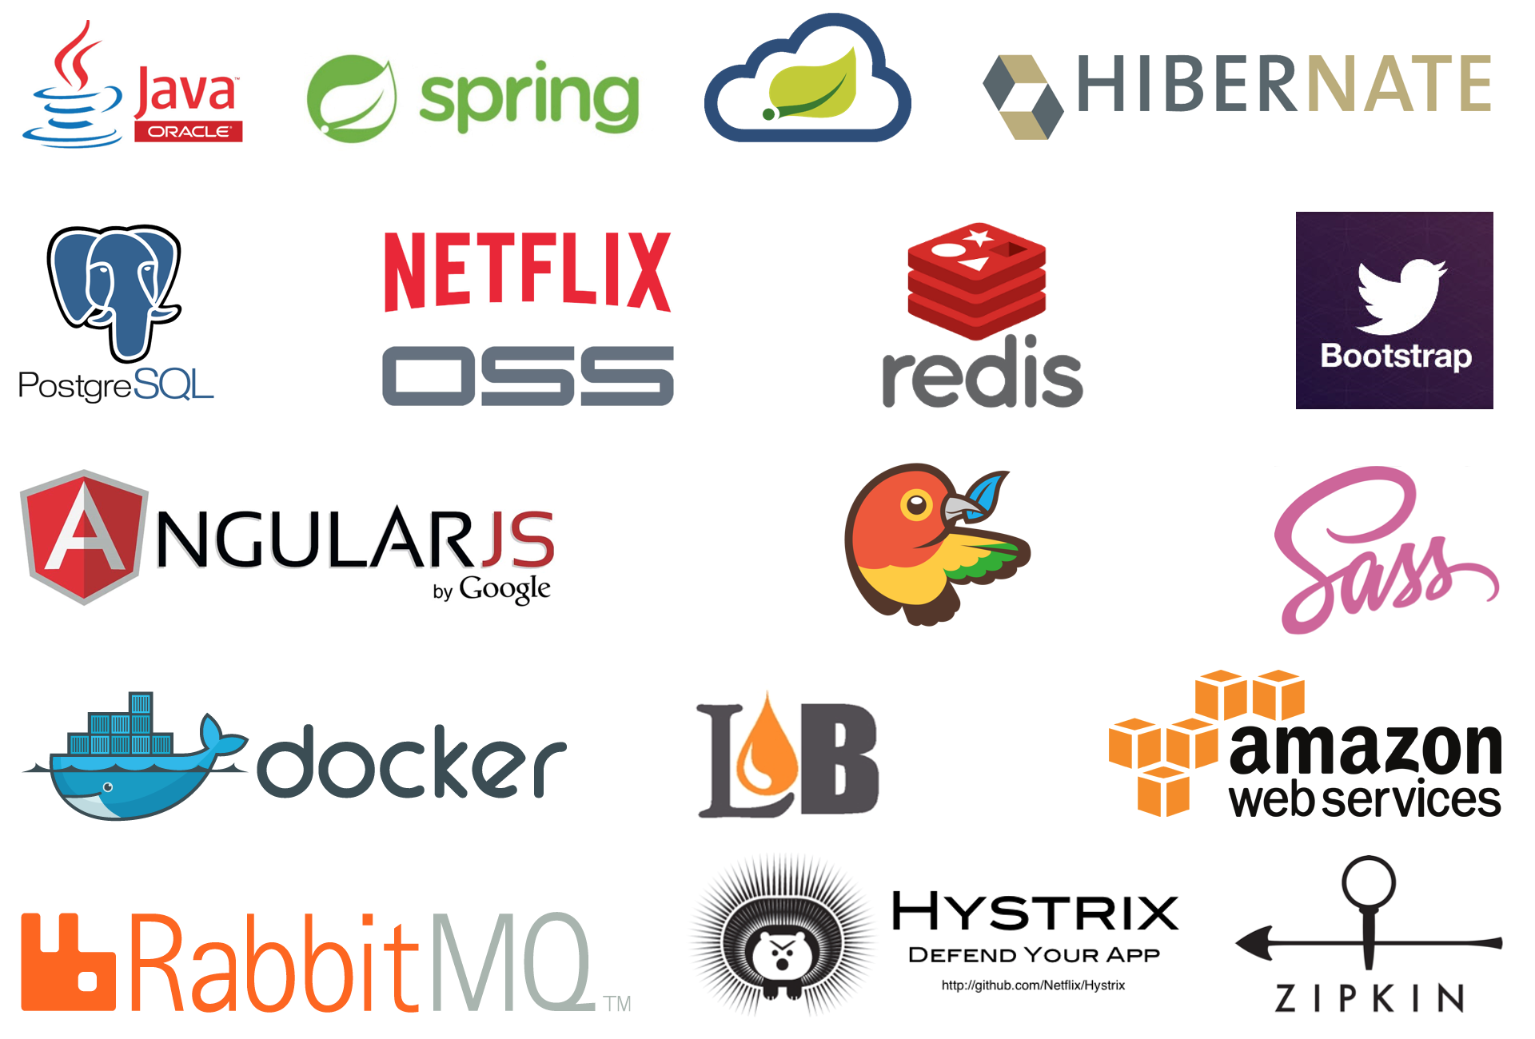
X
X
X
X

Slide 6
Concept
1
Backend technologies only
2
5’ 10’ or 15’ time slot
3
Building a strong community by sharing knowledge
4
No stress
5
It’s woman friendly

Slide 7
2 How to be an active actor ?

Slide 8
How to be an active actor ?
1
Make talk’s proposal (Demo)
2
Showoff and help organize high quality meetups
3
Be awesome
Notes:
1 demoying the github repository make talk proposal process
2 cfp opens in the early beginning of the month and last until 1 week before the meetup
3 you can choose/propose dates

Slide 9

Action
Notes:
1 demoying the github repository make talk proposal process
2 cfp opens in the early beginning of the month and last until 1 week before the meetup
3 you can choose/propose dates

