Slide 1

KrishiSathi
कृषि साथी — Voice-first, offline-ready AI for smallholder farmers
AI for Sustainable Agriculture · SFHS C.O.D.E Hack 7.0 · 2026
Vardaan Sharma · Ved Vishal · Aditi Sharda · Bhavik Katal · Himank

Slide 2



WHY THIS APP EXISTS
Three hard constraints, not features
Can't always read
Signal drops in the field
A wrong answer costs a season
Many farmers read with difficulty. A screen full of text that nobody speaks aloud is a screen half the app cannot use.
2G, or nothing, is the daily reality. An app that needs a network round-trip just to open has already failed the farmer.
Bad dosage advice or a missed counterfeit isn't a bug — it's a lost harvest and a year of income.
02

Slide 3
THE CORE INSIGHT
It's not that farmers lack advice.
It is that the advice isn’t voice-first, isn’t offline-proof, and isn’t honest about what it doesn’t know.
Every design decision in KrishiSathi follows from closing that gap — not from adding AI for its own sake.
01
03

Slide 4
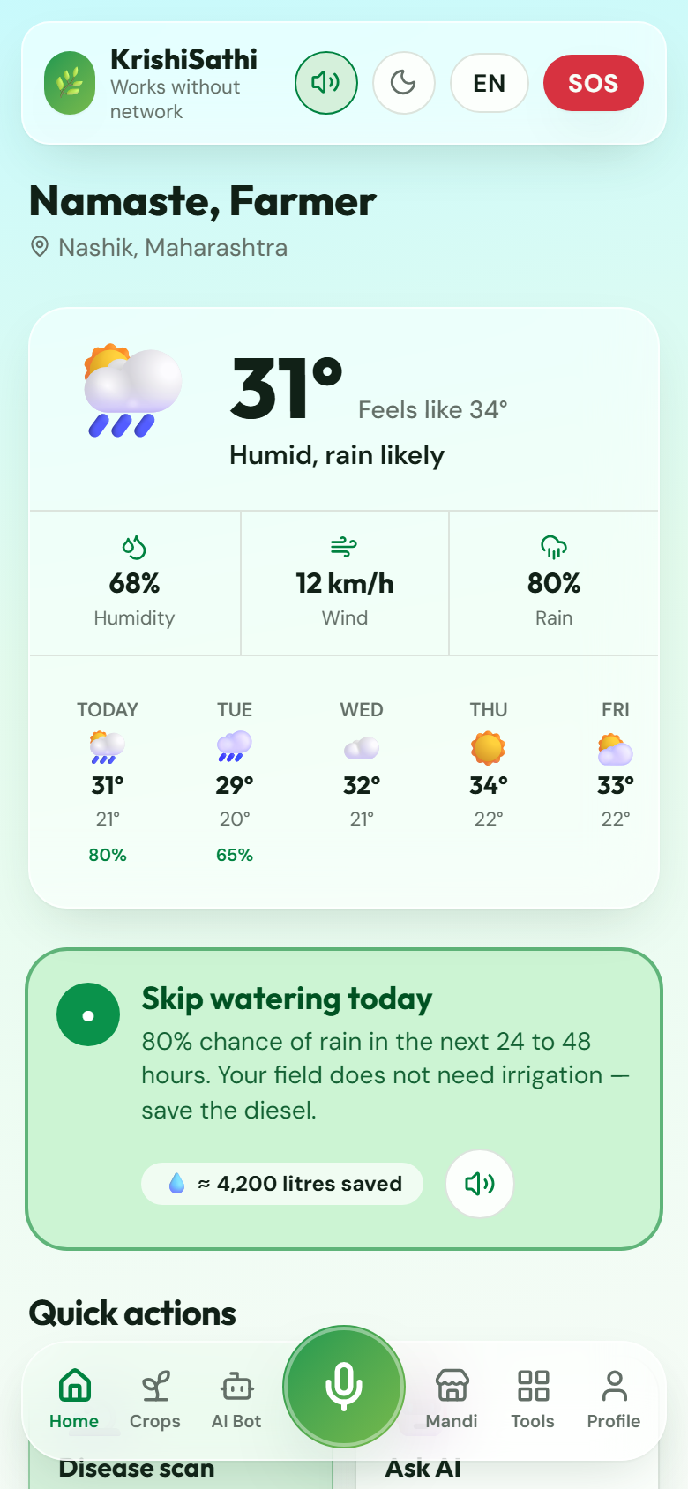
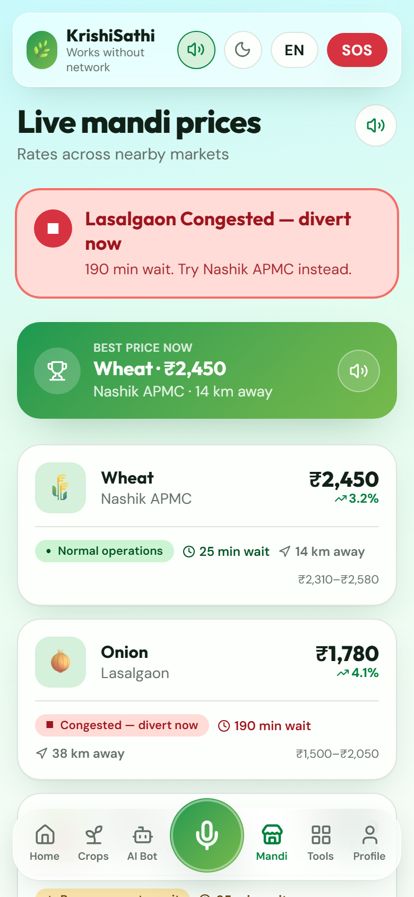
THE SOLUTION
One app. Six languages. Zero assumptions.
Hold-to-speak mic docked on every screen, in 6 languages
Colour + shape + text label — never colour alone
Works fully offline: cached data, outbox, on-device rules
Built for a farmer who may not read, on a phone that drops to 2G
Home — irrigation call, spoken aloud
Mandi — GREEN / YELLOW / RED, everywhere
04

Slide 5











EVERYTHING IN ONE HUB
11 tools, all voice-reachable
Disease Scan
Counterfeit Check
Yield Prediction
Govt Schemes
Photo → diagnosis + treatment
Barcode + label verify
Baseline + AI estimate
8 schemes, rule-matched
Soil Health
Crop Rotation
Land Diversification
Expense Tracker
NPK, pH, exact dosing
2-season rotation plan
4 costed income options
Voice entry + P&L chart
Organic Advisor
Residue Manager
Emergency SOS
On-farm input doses
Stop burning, sell straw
One-tap helplines, offline
05

Slide 6


HOW IT WORKS
Voice-first and offline-first, by construction
Voice, routed on-device
Offline, by default
1
Hold-to-speak mic Docked on every screen, all 6 languages
1
Every fetch is cached IndexedDB, stale-while-offline fallback
2
Keyword intent match Runs on-device, zero network, instant
2
Offline → serve cache Any age of cached data beats a blank screen
3
Match → navigate/act "मंडी भाव" opens Mandi with no round-trip
3
Actions queue in an outbox Replayed automatically once back online
4
No match → ask Gemini Falls through to a full AI answer
4
No key/network → 503 Client shows demo data, never an error page
06

Slide 7



THE DIFFERENTIATOR
Honest about uncertainty, by design
Schemes are rule-code, not LLM output
A hallucinated ₹ figure or fake portal link is a real harm — Gemini only translates the human-written reason.
Counterfeit check defaults to YELLOW
It only ever returns GREEN on positive evidence. An honest "unverified" beats a confident wrong answer.
Missing key → 503 → cached data
The client treats a down service as "show cached data," never as a blank, broken screen.
Soil readings are labelled "modelled"
India has no free point-API for real soil data — the UI says so and links to the free government test.
Safety rules live in the AI prompt itself
Never a banned pesticide; PPE and pre-harvest interval always stated; defers to 1800-180-1551 / 108.
07

Slide 8






UNDER THE HOOD
Technology stack
Frontend
Backend
React 19 + TypeScript + Vite + Tailwind — installable PWA
Firebase Cloud Functions, Node 20, TypeScript, Express
AI
Weather
Google Gemini — chat, vision, structured JSON generation
OpenWeather — current conditions + 5-day forecast
Market data
Platform
data.gov.in Agmarknet — live mandi commodity prices
Firebase Hosting, Auth, Firestore
Offline layer
Barcode
IndexedDB (idb-keyval), Service Worker, outbox queue
Native BarcodeDetector API + ZXing WASM fallback
08

Slide 9
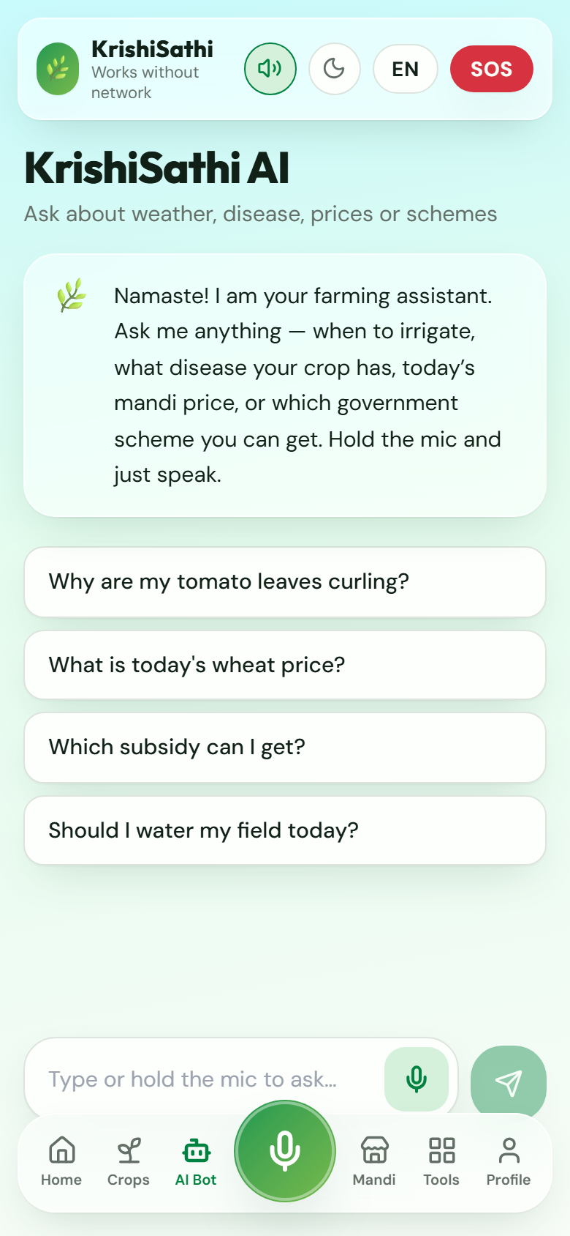
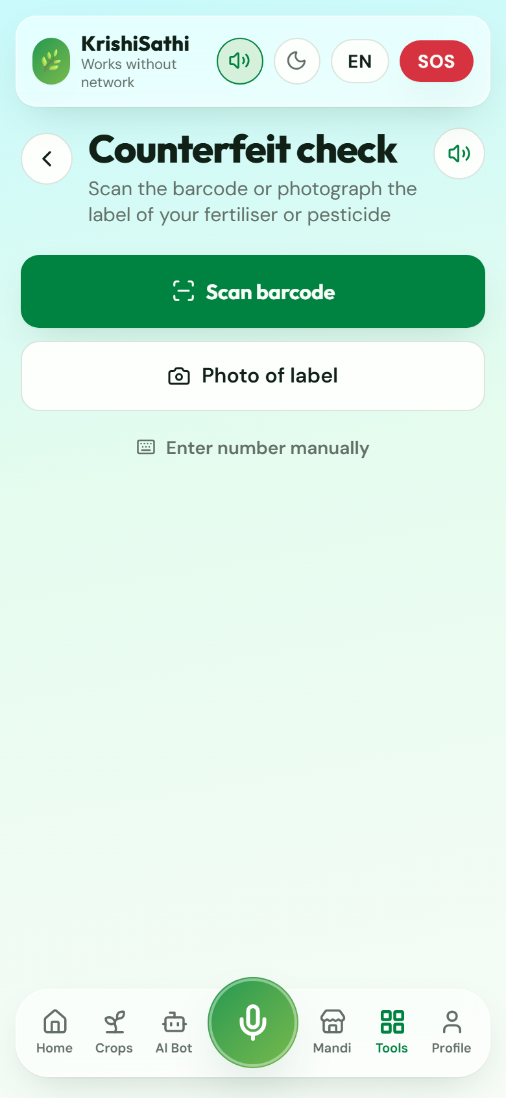
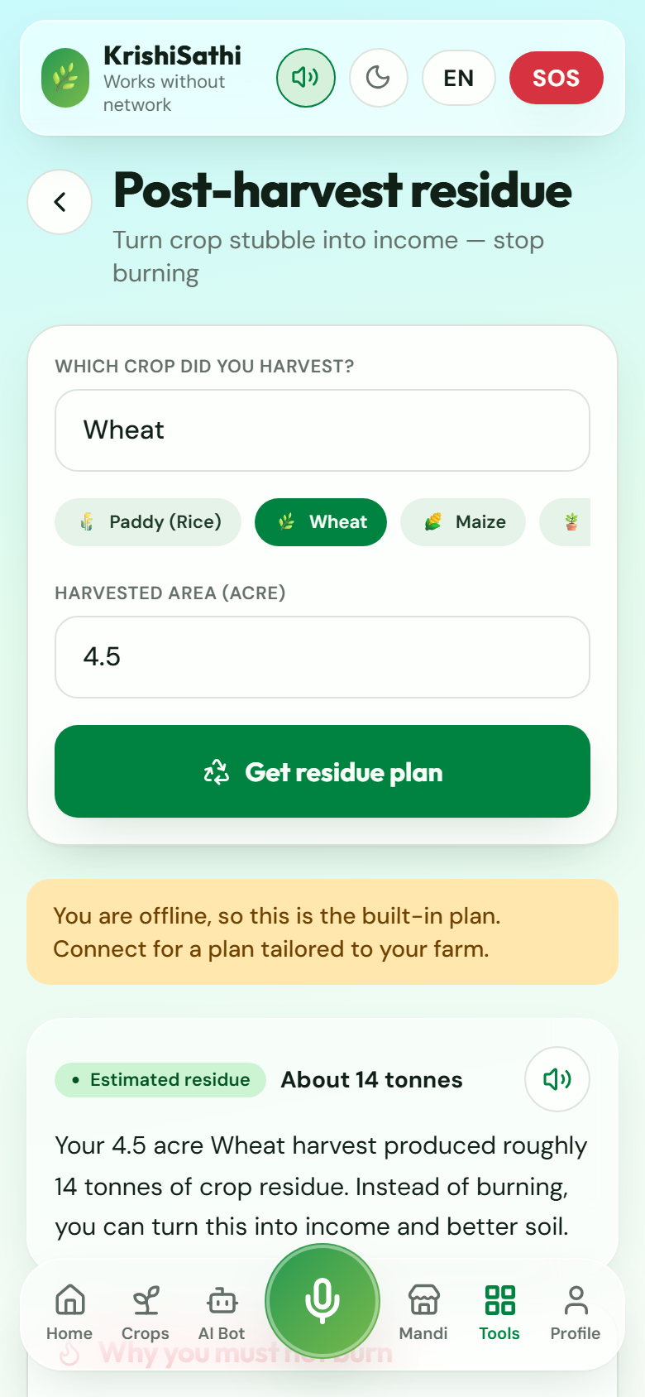
NOT A MOCKUP
Real screens, running tonight
Gemini agronomist — voice in & out
Counterfeit check — offline & honest
Residue manager — built tonight
09

Slide 10
BY THE NUMBERS
What ships tonight
6
11
8
0
languages, fully translated UI
tools + 6 main screens
real government schemes, rule-matched
API keys needed to demo it live
Sub-theme fit
AI for Sustainable Agriculture — precision fertiliser dosing, disease monitoring, resilient production via rotation, organic and residue tools. Also touches AI for a Greener Future — the Residue Manager targets crop burning, a major seasonal air-pollution driver, and turns it into income instead.
10

Slide 11
MAPPED TO THE BRIEF
Why this scores
Innovation & Originality
Voice-first is on-device intent routing, not a bolt-on mic; honesty-by-design AI (rule-based schemes, YELLOW-default verification).
Practicality & Viability
Full-stack, typechecked, builds clean; graceful 503→cached-data degradation; usable with zero API keys.
User Experience (UI/UX)
One traffic-light language everywhere; read-aloud on every block; colour never the only signal.
Business Value
Scheme discovery, counterfeit-loss prevention, idle-land monetisation — all with costed, concrete numbers.
Societal Impact
Literacy-independent, 6 Indian languages, offline-first for rural connectivity, SOS that works at zero signal.
11

Slide 12
Thank you
धन्यवाद · Questions?
github.com/Sfhs-code/krishiai
Vardaan Sharma · Ved Vishal · Aditi Sharda · Bhavik Katal · Himank

