Slide 1
DSC40B: Theoretical Foundations of Data Science II
Lecture 7: The Median, order statistics, QuickSelect and QuickSort
Instructor: Yusu Wang

Slide 2

Previously
Sorting an array
(Binary) search in a sorted array
Today:
What if, without sorting, we would like to select a specific number with a certain rank in the array
For example, how to find the median of an unsorted array of numbers quickly?
Before we start: how fast do you think you can find the median of $n$ numbers?

Slide 3
Part A: Order statistics and simple examples

Slide 4
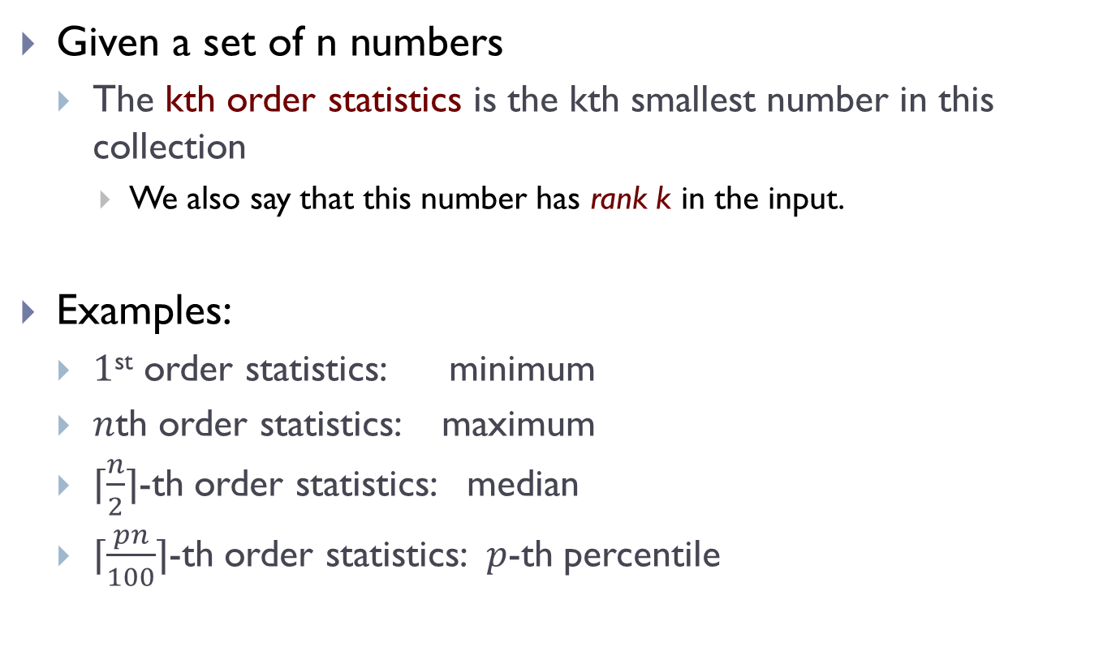
Order statistics
Given a set of n numbers
The kth order statistics is the kth smallest number in this collection
We also say that this number has rank k in the input.
Examples:
$1$^{st} order statistics: minimum
$n$th order statistics: maximum
$⌈\frac{n}{2}⌉$-th order statistics: median
$⌈\frac{pn}{100}⌉$-th order statistics: $p$-th percentile

Slide 5
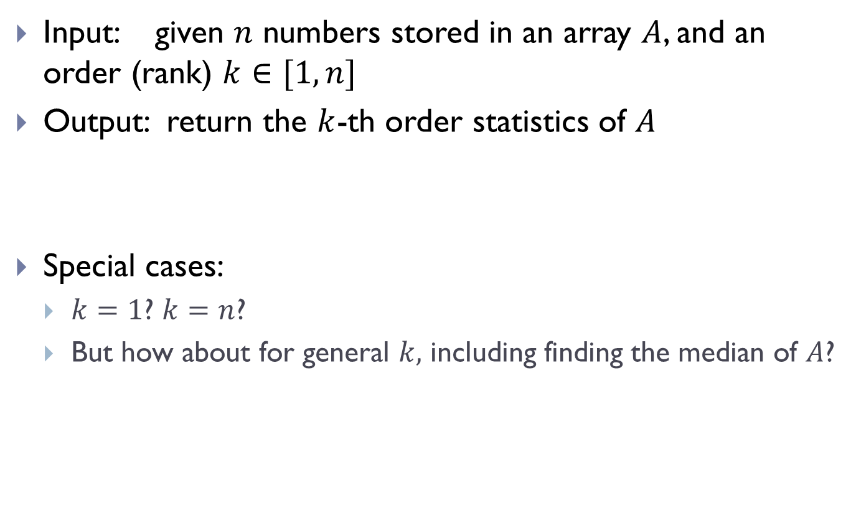
Select problem
Input: given $n$ numbers stored in an array $A$, and an order (rank) $k∈[1, n]$
Output: return the $k$-th order statistics of $A$
Special cases:
$k=1$? $k=n$?
But how about for general $k,$ including finding the median of $A$?

Slide 6
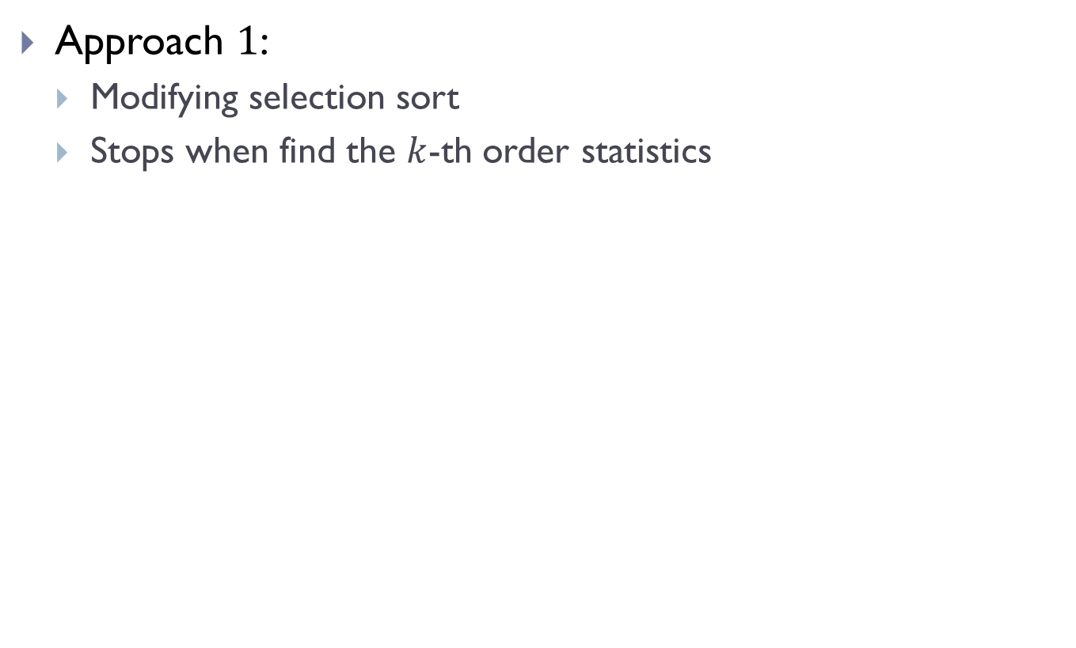
Simple approaches
Approach $1$:
Modifying selection sort
Stops when find the $k$-th order statistics

Slide 7
Algorithm selection_sort
def selection_sort(A):
n = len(A)
if n <= 1:
return
for barrier_id in range(n-1):
# find index of min in A[start:]
min_id = find_minimum(A, start=barrier_id)
#swap
A[barrier_id], A[min_id] = (
A[min_id], A[barrier_id]
)

Slide 8
Algorithm selection_kthOS
def selection_kthOS(A, k):
n = len(A)
if n < k:
return Error
for barrier_id in range(k):
# find index of min in A[start:]
min_id = find_minimum(A, start=barrier_id)
#swap
A[barrier_id], A[min_id] = (
A[min_id], A[barrier_id]
)
return A[k-1]

Slide 9
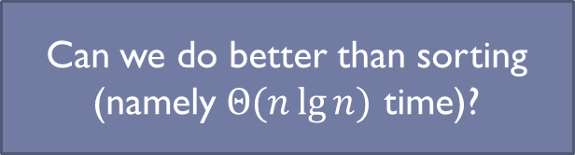
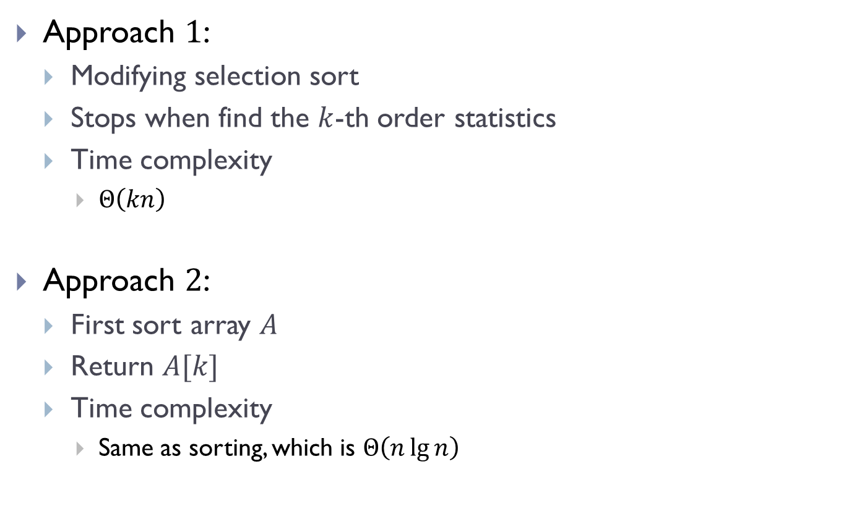
Simple approaches
Approach $1$:
Modifying selection sort
Stops when find the $k$-th order statistics
Time complexity
$Θ\left(kn\right)$
Approach $2$:
First sort array $A$
Return $A[k]$
Time complexity
Same as sorting, which is $Θ\left(n\lg{n}\right)$
Can we do better than sorting (namely $Θ(n\lg{n})$ time)?

Slide 10
Part B: Can we do better than sorting? First try of QuickSelect
I will use pseudo-code in what follows.
As convention: array index starts from 0.

Slide 11
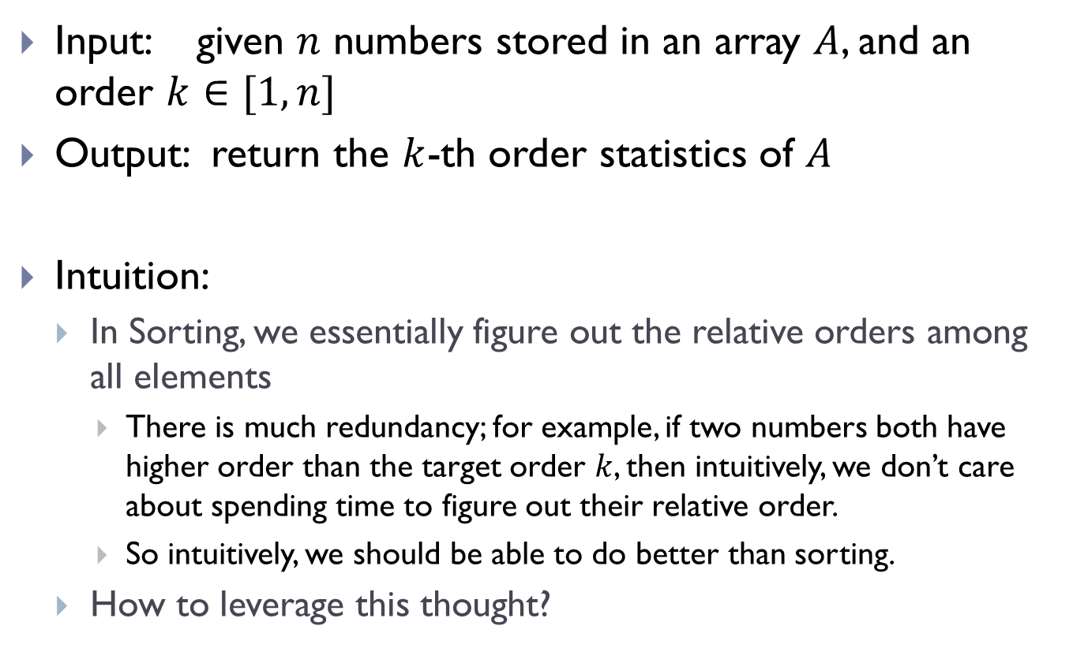
Select problem
Input: given $n$ numbers stored in an array $A$, and an order $k∈[1, n]$
Output: return the $k$-th order statistics of $A$
Intuition:
In Sorting, we essentially figure out the relative orders among all elements
There is much redundancy; for example, if two numbers both have higher order than the target order $k$, then intuitively, we don’t care about spending time to figure out their relative order.
So intuitively, we should be able to do better than sorting.
How to leverage this thought?

Slide 12
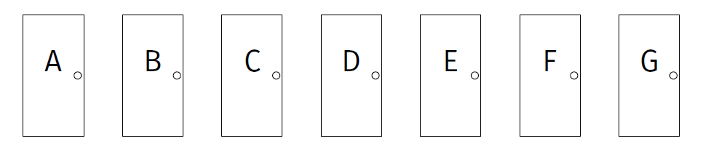

An example
Given $n$ doors, need to find the largest number behind the door
Each time we open a door, we have an oracle to tell us
which doors are smaller, and
which doors are bigger
Call this a partition operation

Slide 13
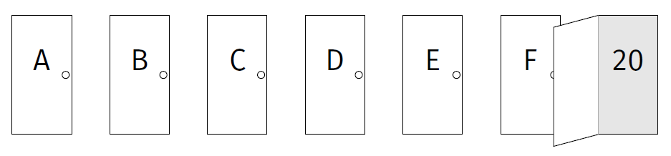
we open the last door

Slide 14
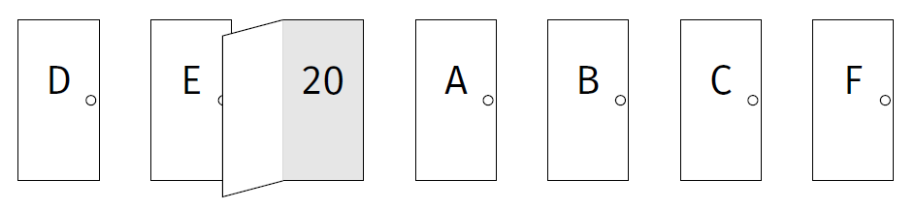
after partition

Slide 15
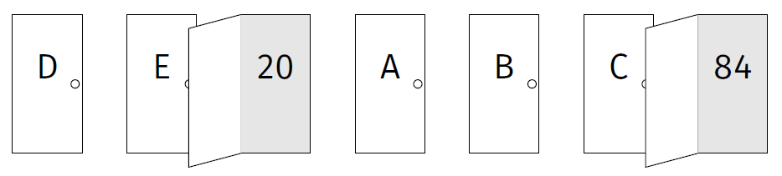
repeat in the right portion:
open the last door of this subarry

Slide 16
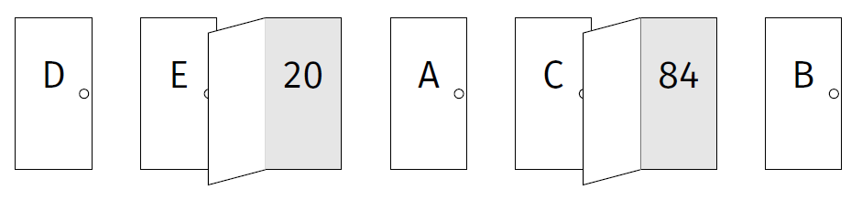
repeat in the right portion:
after partition in this subarray

Slide 17
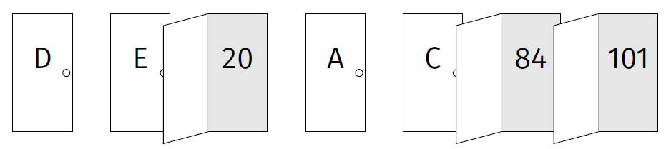
again, go to the right portion:
only 1 entry left: must be the largest, and we return

Slide 18

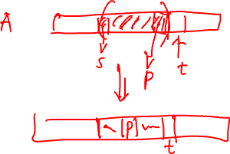
Generalizing the idea?
Assume that we are given the Partition procedure:
Partition ($A, s, t$)
Input:
Given an array $A$and consider sub-array $A[s, … t−1]$
$A[t−1]$ will be used as the pivot $p= A[t−1]$
Output:
Rearrange elements in $A$ where $p$ is now in $A[m]$ such that
all elements $≤p$ are to its left
all elements $>p$ are to its right
Return the new position $m$ of the pivot $p$

Slide 19

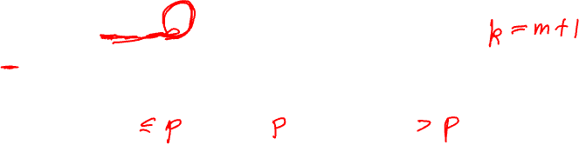
Intuition of QuickSelect
Suppose we are already given the Partition procedure.
QuickSelect($A, 0, n, k$)
$m$ = Partition($A, 0, n$)
Note: the order of the pivot = $m+1$
p = A[m]: pivot
Case 1: k = m+1
return A[m]

Slide 20

Intuition of QuickSelect
Imagine we are given Partition procedure.
QuickSelect($A, 0, n, k$)
$m$ = Partition($A, 0, n$)
Note: the order of the pivot = $m+1$
p = A[m]: pivot
Case 2: k < m+1
return QuickSelect ( A, 0, m, k )

Slide 21
Intuition of QuickSelect
Imagine we are given Partition procedure.
QuickSelect($A, 0, n, k$)
$m$ = Partition($A, 0, n$)
Note: the order of the pivot = $m+1$
p = A[m]: pivot
Case 3: k > m+1
return QuickSelect ( A, m+1, n, k )

Slide 22
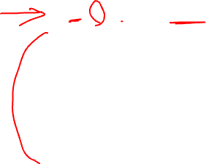
Pseudo-code for QuickSelect
QuickSelect ( A, s, t, k )
/* select the order k element in A from subarray A[s,..t-1] */
if (k < s or k ≥ t or s ≥ t) return None;
m = Partition ( A, s, t );
pivot_order = m+1 ;
if ( pivot_order = k) return A[m];
if ( pivot_order > k )
return QuickSelect ( A, s, m, k );
else return QuickSelect ( A, m+1, t, k );
At the top level, we call QuickSelect(A, 0, n, k)

Slide 23
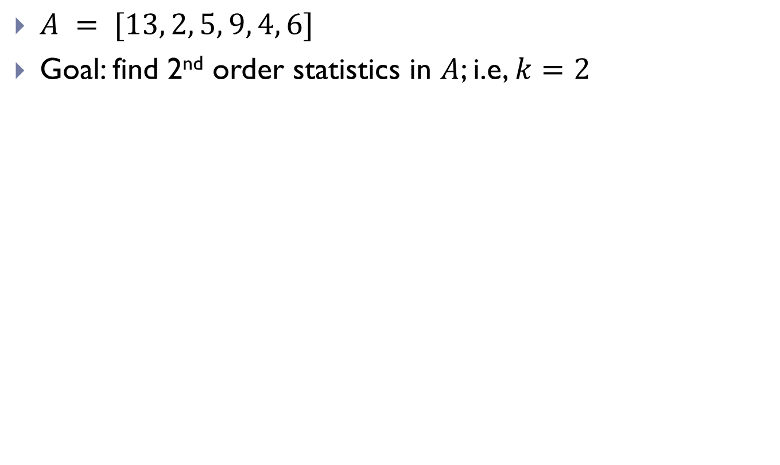
Example
$A = [13, 2, 5, 9, 4, 6]$
Goal: find 2nd order statistics in $A$; i.e, $k=2$

Slide 24
Part C: Partition procedure

Slide 25
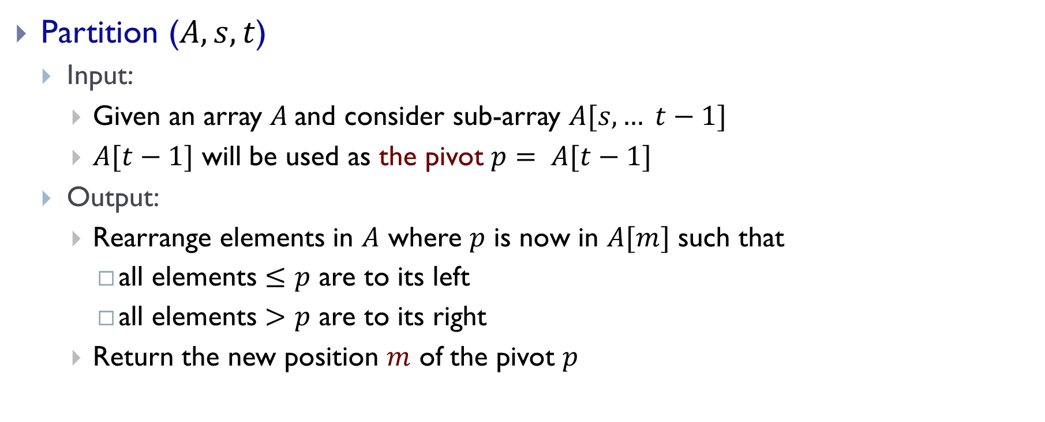
Partition procedure
Partition ($A, s, t$)
Input:
Given an array $A$and consider sub-array $A[s, … t−1]$
$A[t−1]$ will be used as the pivot $p= A[t−1]$
Output:
Rearrange elements in $A$ where $p$ is now in $A[m]$ such that
all elements $≤p$ are to its left
all elements $>p$ are to its right
Return the new position $m$ of the pivot $p$

Slide 26


Partition($A, s, t$)
Plan: take A[t-1] as pivot
p
p
return m
In-place partition !
i.e, we use the same input array,
and only need constant number of auxiliary memory
y
x
p

Slide 27
Partition($A, s, t$)
y
x
p
Case 1: x > p
y x
p

Slide 28
Partition($A, s, t$)
y
x
p
Case 2: otherwise
x
y
p

Slide 29
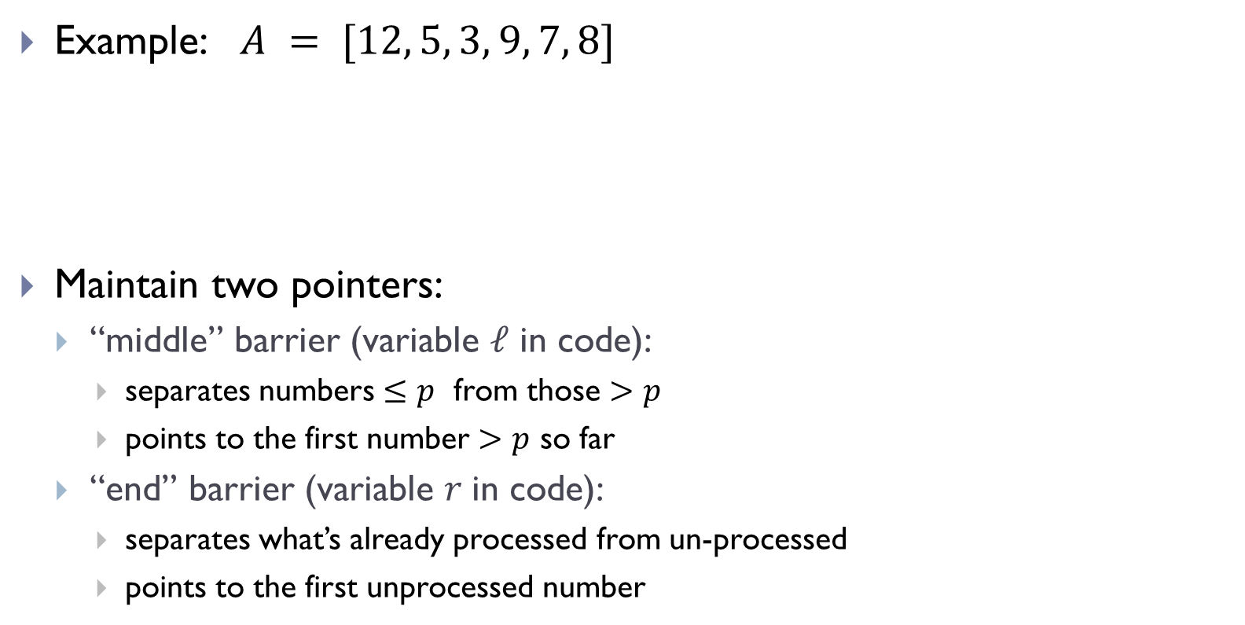
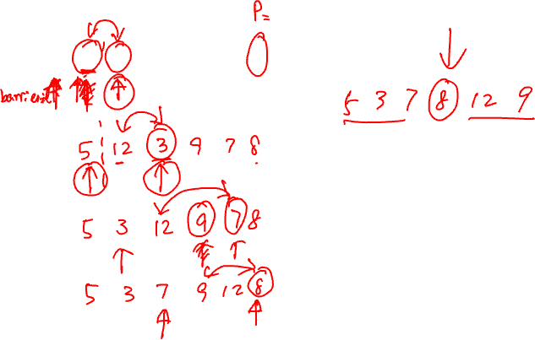
Example: $A = [12, 5, 3, 9, 7, 8]$
Maintain two pointers:
“middle” barrier (variable $ℓ$ in code):
separates numbers $≤p$ from those $>p$
points to the first number $>p$ so far
“end” barrier (variable $r$in code):
separates what’s already processed from un-processed
points to the first unprocessed number
[ 12, 5, 3, 9, 7, 8]

Slide 30
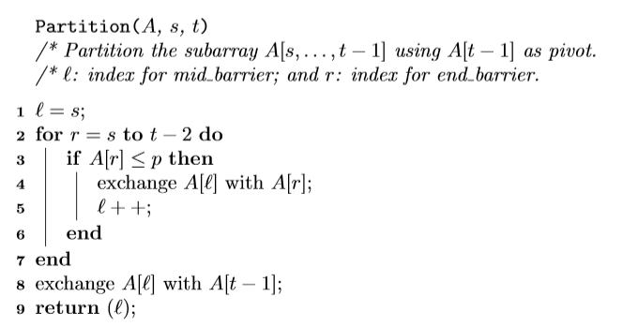

Pseudo-code for Partition
In-place!
Time complexity:
$$Θ(t−s)$$

Slide 31
Part D: Time complexity for QuickSelect and Randomized QuickSelect

Slide 32
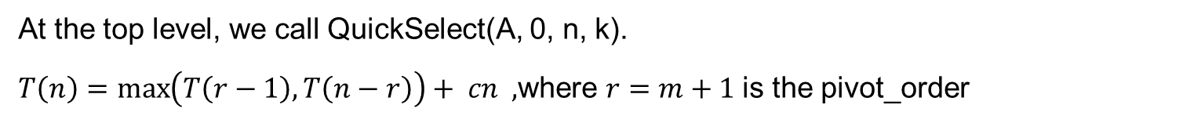
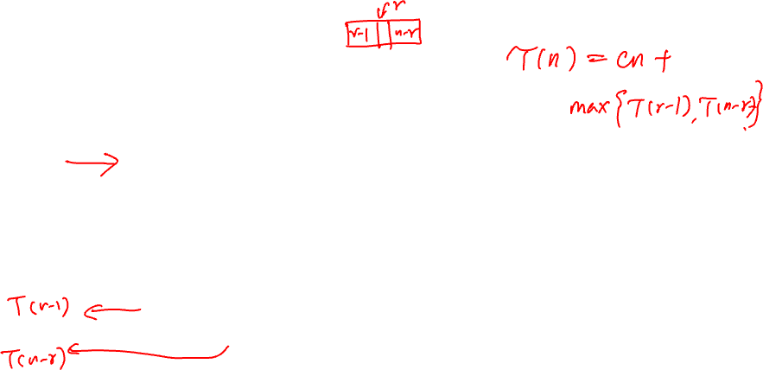
Worst case complexity
QuickSelect ( A, s, t, k )
/* select the order k element in A from subarray A[s,..t-1] */
if (k < s or k ≥ t or s ≥ t) return None;
m = Partition ( A, s, t );
pivot_order = m+1 ;
if ( pivot_order = k) return A[m];
if ( pivot_order > k )
return QuickSelect ( A, s, m, k );
else return QuickSelect ( A, m+1, t, k );
At the top level, we call QuickSelect(A, 0, n, k).
$T\left(n\right)=\max\left(T\left(r−1\right), T\left(n−r\right)\right)+ cn ,$where $r=m+1$is the pivot_order

Slide 33

$T\left(n\right)=\max\left(T\left(r−1\right), T\left(n−r\right)\right)+ cn$
Depending on value of $r$, recursively.
A lucky case:
Each time we remove half of the numbers
we cannot do better, why?
$T\left(n\right)=T\left(\frac{n}{2}\right)+cn$
$=Θ\left(n\right)$

Slide 34

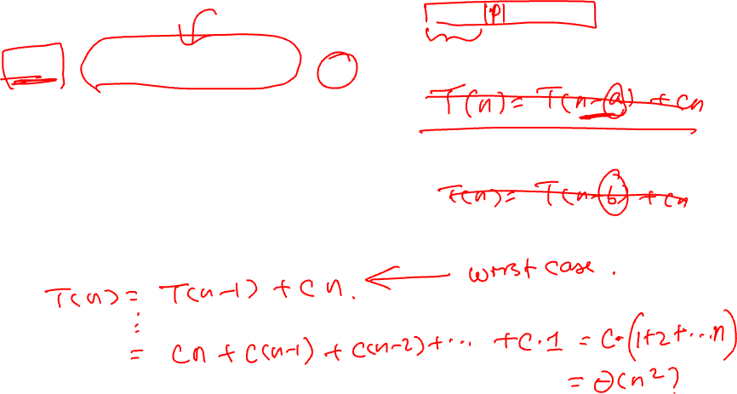
$T\left(n\right)=\max\left(T\left(r−1\right), T\left(n−r\right)\right)+ cn$
Depending on value of $m$, recursively.
Worst case:
Each time we can only remove one number
say, the target order $k=n$ , while $r−1$ each time
$T\left(n\right)=T\left(n−1\right)+cn$
$=Θ\left(n^{2}\right)$

Slide 35
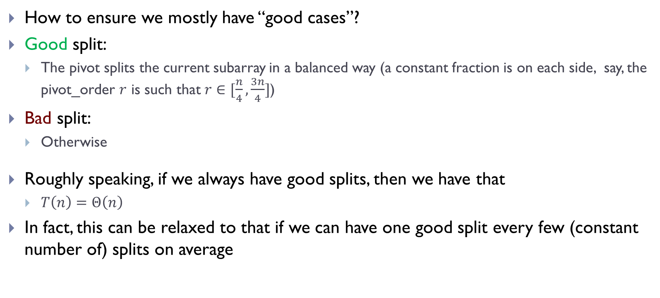
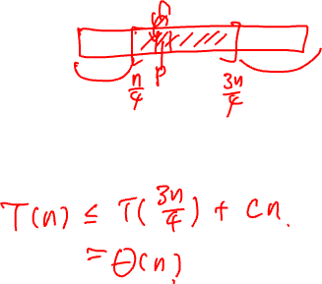
How to ensure we mostly have “good cases”?
Good split:
The pivot splits the current subarray in a balanced way (a constant fraction is on each side, say, the pivot_order $r$ is such that $r∈[\frac{n}{4},\frac{3n}{4}]$)
Bad split:
Otherwise
Roughly speaking, if we always have good splits, then we have that
$T\left(n\right)=Θ\left(n\right)$
In fact, this can be relaxed to that if we can have one good split every few (constant number of) splits on average
How to ensure that this happens?

Slide 36
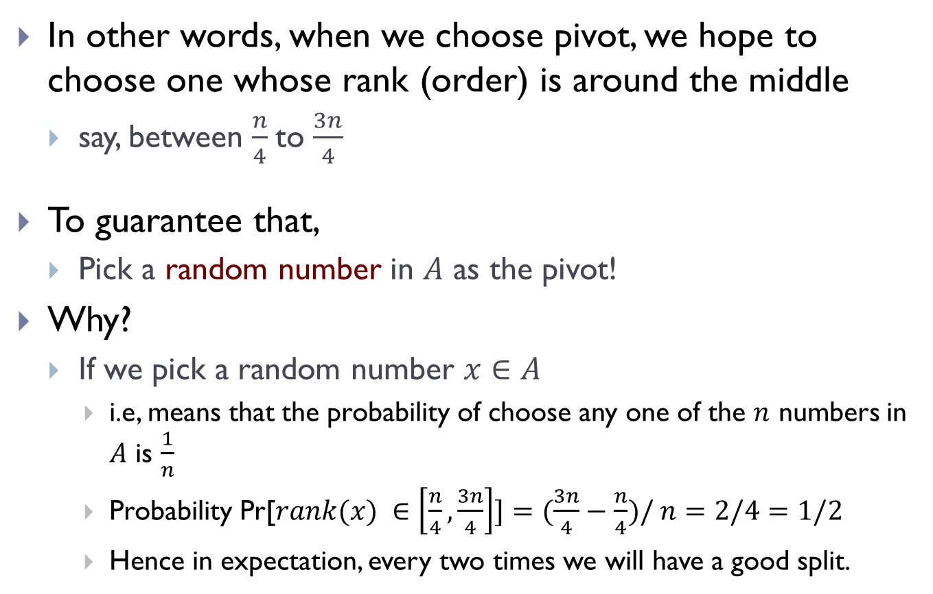
In other words, when we choose pivot, we hope to choose one whose rank (order) is around the middle
say, between $\frac{n}{4}$to $\frac{3n}{4}$
To guarantee that,
Pick a random number in $A$ as the pivot!
Why?
If we pick a random number $x∈A$
i.e, means that the probability of choose any one of the $n$ numbers in $A$ is $\frac{1}{n}$
Probability Pr[$rank(x) ∈\left[\frac{n}{4},\frac{3n}{4}\right]]=(\frac{3n}{4}−\frac{n}{4})/ n=2/4=1/2$
Hence in expectation, every two times we will have a good split.

Slide 37
Rand-Select
Rand-Select ( A, s, t, k )
/* select the order k element in A from subarray A[s,..t-1] */
if (k < s or k ≥ t or s ≥ t) return None;
m = Rand-Partition ( A, s, t );
pivot_order = m+1 ;
if ( pivot_order = k) return A[m];
if ( pivot_order > k )
return Rand-Select ( A, s, m, k );
else return Rand-Select ( A, m+1, t, k );
Rand-Partition(A, s, t) uses a random element from A[s, … t-1] as pivot, instead of using A[t-1] as pivot like in Partition(A, s, t).

Slide 38
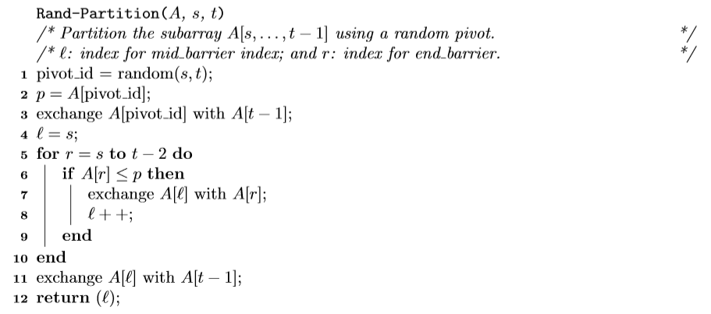
Rand-Partition pseudo-code

Slide 39
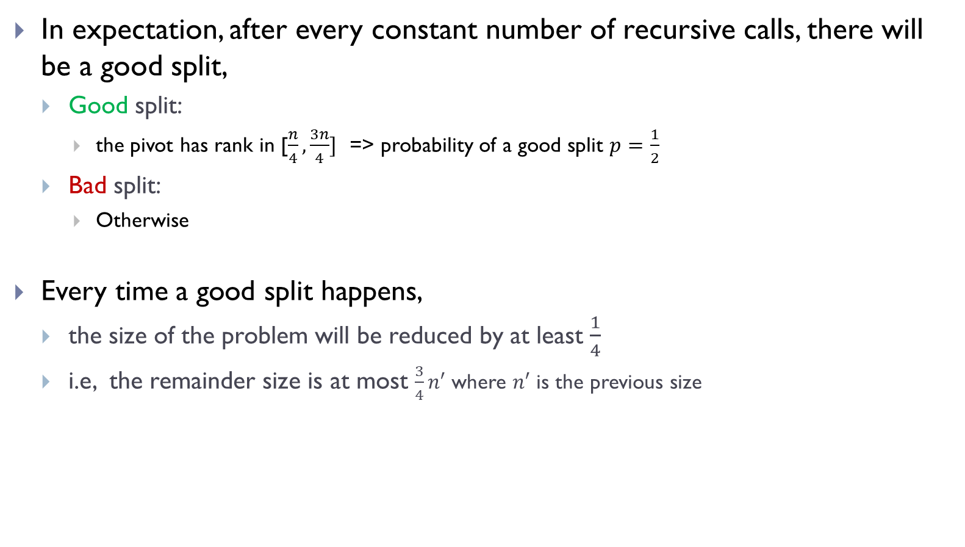
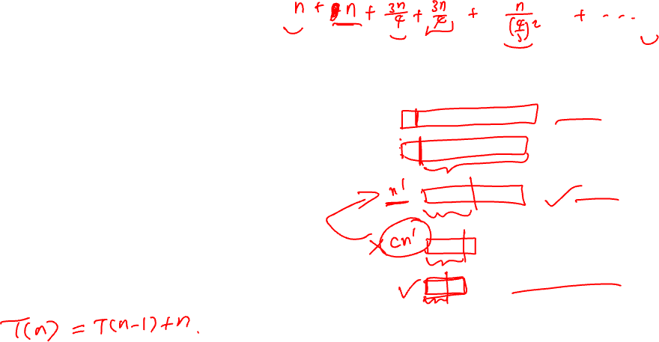
Expected time analysis -- intuition
In expectation, after every constant number of recursive calls, there will be a good split,
Good split:
the pivot has rank in [$\frac{n}{4},\frac{3n}{4}]$ => probability of a good split $p=\frac{1}{2}$
Bad split:
Otherwise
Every time a good split happens,
the size of the problem will be reduced by at least $\frac{1}{4}$
i.e, the remainder size is at most $\frac{3}{4}n′$ where $n′$ is the previous size

Slide 40
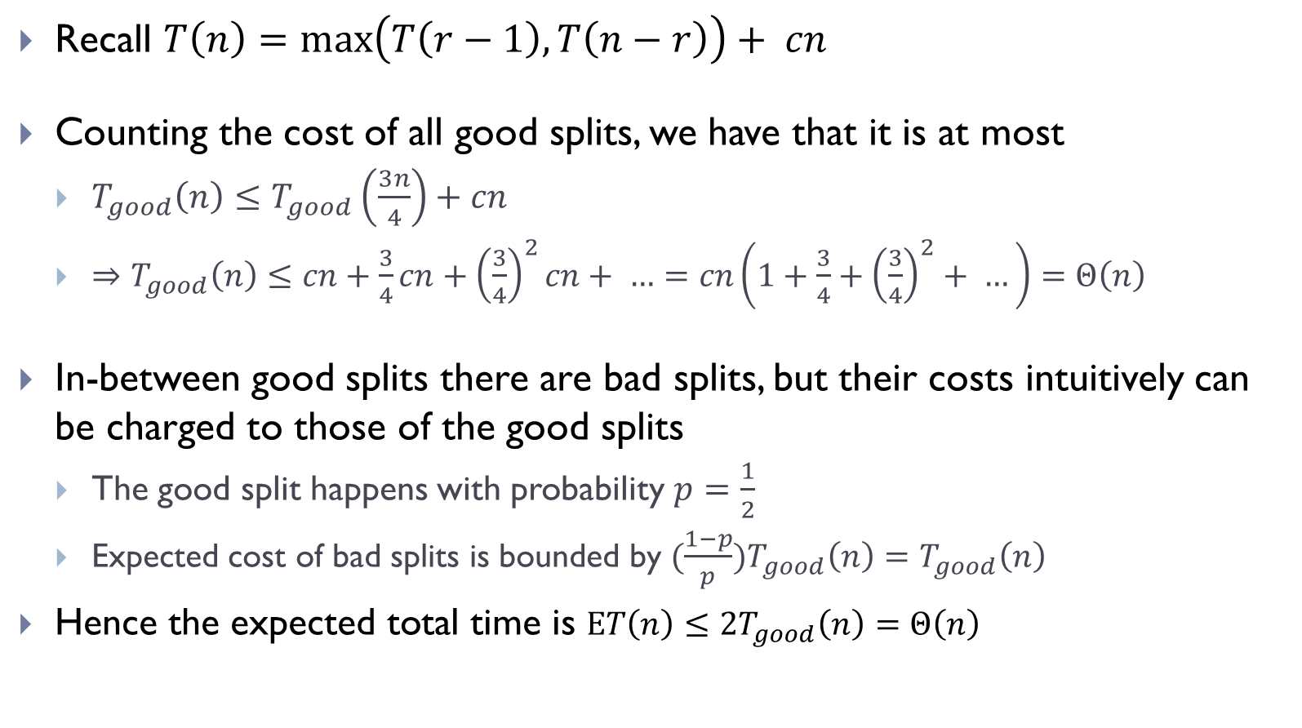

Expected time analysis -- intuition
Recall $T\left(n\right)=\max\left(T\left(r−1\right), T\left(n−r\right)\right)+ cn$
Counting the cost of all good splits, we have that it is at most
$T_{good}\left(n\right)≤T_{good}\left(\frac{3n}{4}\right)+cn$
$⇒T_{good}\left(n\right)≤cn+\frac{3}{4}cn+{\left(\frac{3}{4}\right)}^{2}cn+ …=cn\left(1+\frac{3}{4}+{\left(\frac{3}{4}\right)}^{2}+ …\right)=Θ\left(n\right)$
In-between good splits there are bad splits, but their costs intuitively can be charged to those of the good splits
The good split happens with probability $p=\frac{1}{2}$
Expected cost of bad splits is bounded by ${(\frac{1−p}{p})T}_{good}\left(n\right)=T_{good}\left(n\right)$
Hence the expected total time is $ET\left(n\right)≤2T_{good}\left(n\right)=Θ\left(n\right)$
This is NOT a precise argument, just intuition.
This can be made more precise.

Slide 41
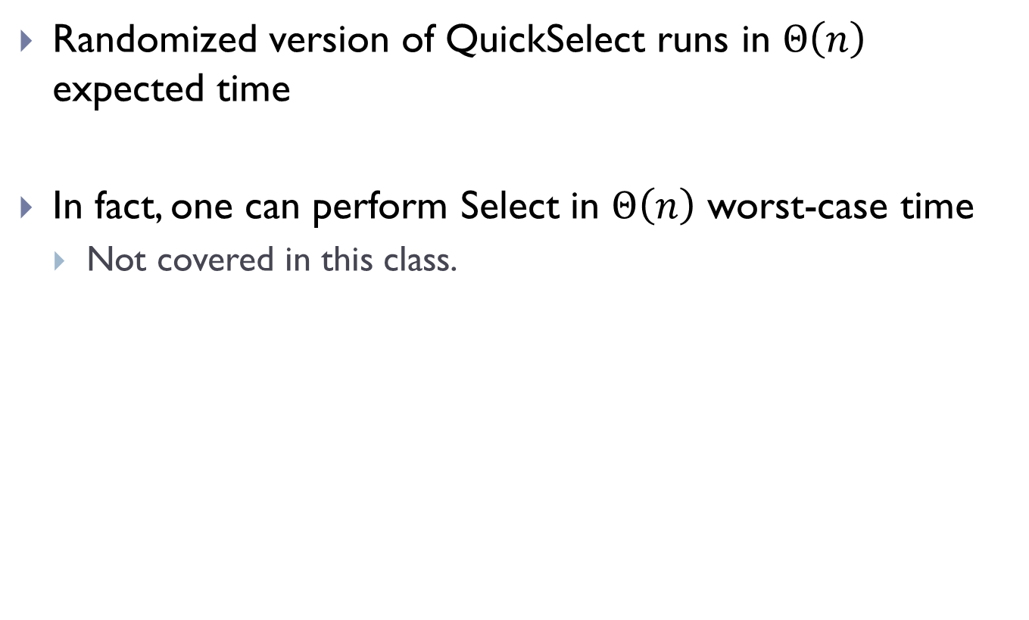
Summary
Randomized version of QuickSelect runs in $Θ\left(n\right)$ expected time
In fact, one can perform Select in $Θ\left(n\right)$ worst-case time
Not covered in this class.

Slide 42
Part E: Randomized QuickSort

Slide 43
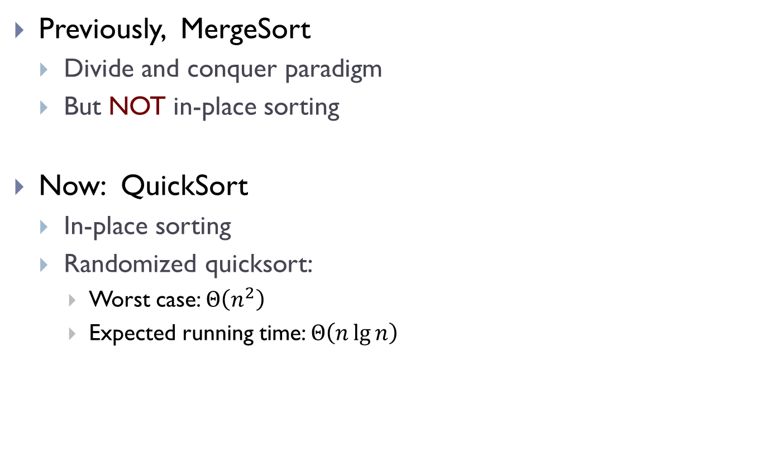
Sorting revisited!
Previously, MergeSort
Divide and conquer paradigm
But NOT in-place sorting
Now: QuickSort
In-place sorting
Randomized quicksort:
Worst case: $Θ\left(n^{2}\right)$
Expected running time: $Θ\left(n\lg{n}\right)$

Slide 44
Recall MergeSort
MergeSort ( A, r, s ) // sorting subarray A[r,s]
if ( r ≥ s) return;
m = (r+s) / 2;
A1 = MergeSort ( A, r, m );
A2 = MergeSort ( A, m+1, s );
Merge (A1, A2);
Much work has to be done in Merge(), but the “divide” step is easy (simply split the array into two equal parts).

Slide 45
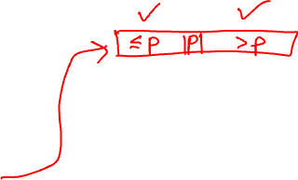
QuickSort
QuickSort ( A, r, s )
if ( r ≥ s) return;
m = Partition ( A, r, s );
A1 = QuickSort ( A, r, m );
A2 = QuickSort ( A, m+1, s );
Merge (A1, A2);
A[m]: pivot

Slide 46
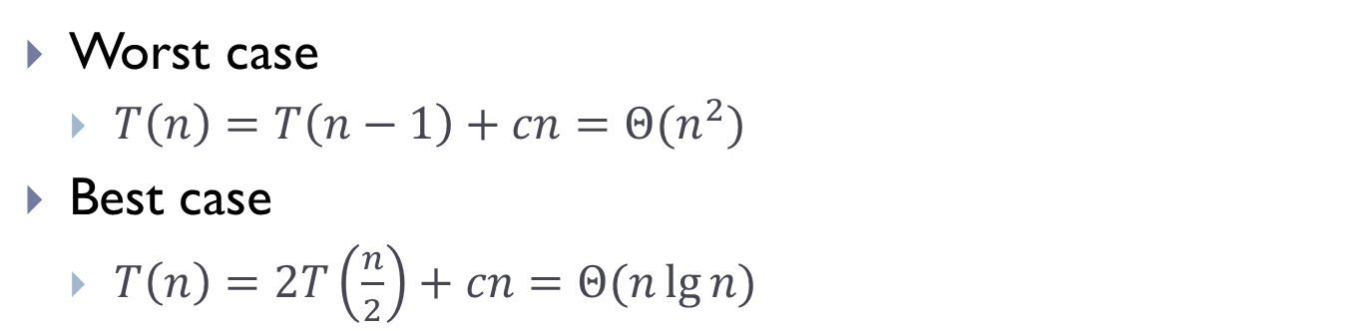
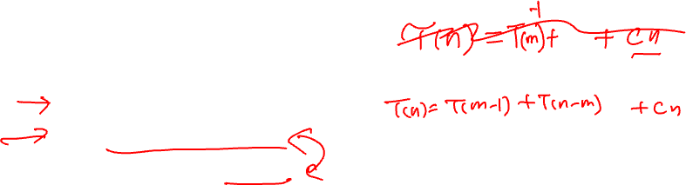
QuickSort
QuickSort ( A, r, s )
if ( r ≥ s) return;
m = Partition ( A, r, s );
A1 = QuickSort ( A, r, m-1 );
A2 = QuickSort ( A, m+1, s );
Worst case
$T\left(n\right)=T\left(n−1\right)+cn=Θ(n^{2})$
Best case
$T\left(n\right)=2T\left(\frac{n}{2}\right)+cn=Θ(n\lg{n)}$

Slide 47
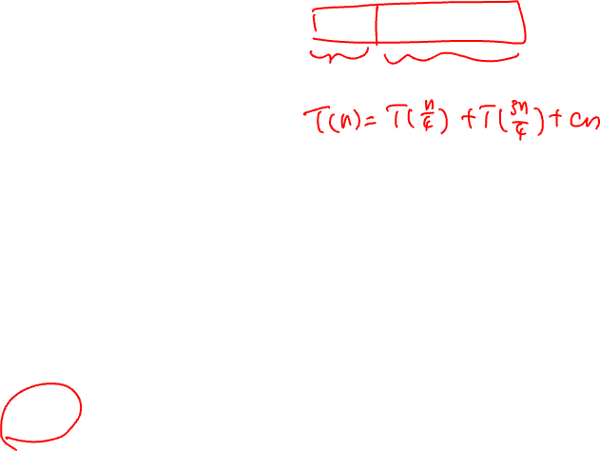
rand-QuickSort
rand-QuickSort ( A, r, s )
if ( r ≥ s) return;
m = rand-Partition ( A, r, s );
A1 = rand-QuickSort ( A, r, m-1 );
A2 = rand-QuickSort ( A, m+1, s );
Worst case
$T\left(n\right)=T\left(n−1\right)+cn=Θ(n^{2})$
Best case
$T\left(n\right)=2T\left(\frac{n}{2}\right)+cn=Θ(n\lg{n)}$

Slide 48
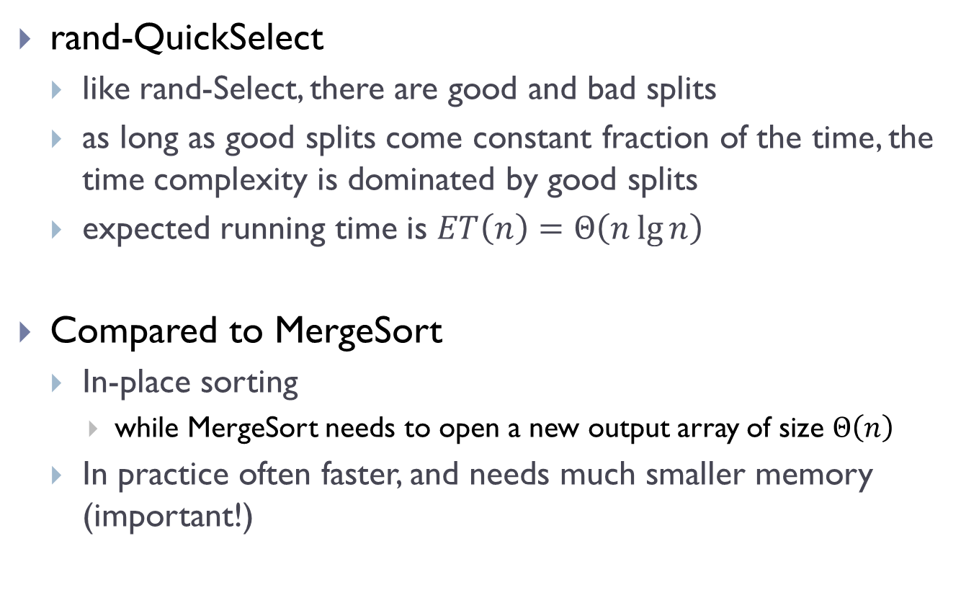
rand-QuickSelect
like rand-Select, there are good and bad splits
as long as good splits come constant fraction of the time, the time complexity is dominated by good splits
expected running time is $ET\left(n\right)=Θ\left(n\lg{n}\right)$
Compared to MergeSort
In-place sorting
while MergeSort needs to open a new output array of size $Θ\left(n\right)$
In practice often faster, and needs much smaller memory (important!)

Slide 49
FIN

