Slide 1
DSC40B: Theoretical Foundations of Data Science II
Lecture 1: Welcome, introduction and examples
Instructor: Yusu Wang

Slide 2
Prelude

Slide 3
Course Information
Course webpage:
http://dsc40b.com
Office hours:
Tue@ 9:00am – 10:00am
always feel free to send me emails with questions / concerns
yusuwang@ucsd.edu
using Campuswire message board may be faster to get an answer
Discussion sessions are very important!

Slide 4
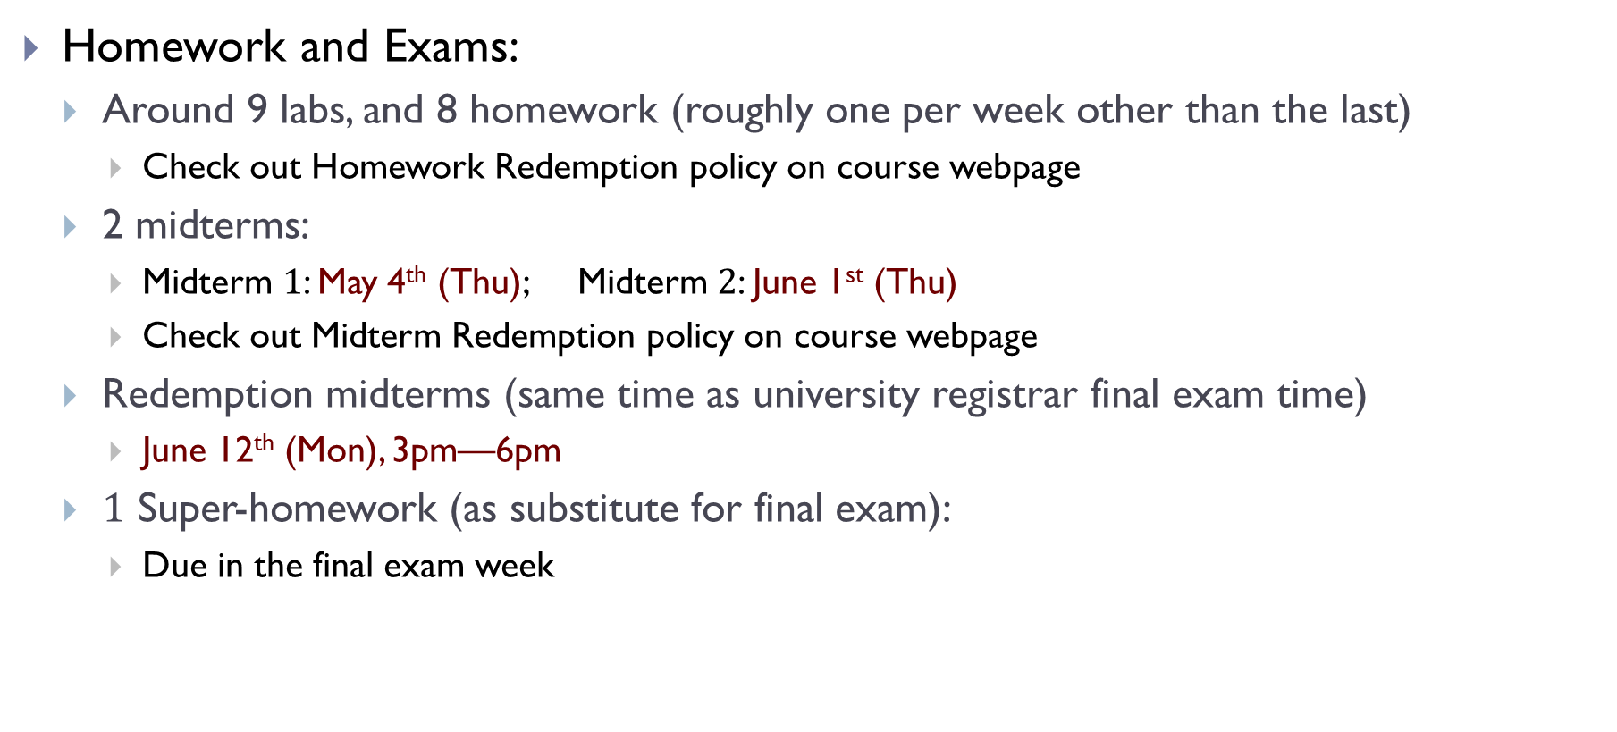
Course Information
Homework and Exams:
Around 9 labs, and 8 homework (roughly one per week other than the last)
Check out Homework Redemption policy on course webpage
2 midterms:
Midterm $1$: May 4th (Thu); Midterm $2$: June 1st (Thu)
Check out Midterm Redemption policy on course webpage
Redemption midterms (same time as university registrar final exam time)
June 12th (Mon), 3pm—6pm
$1$ Super-homework (as substitute for final exam):
Due in the final exam week

Slide 5
Course Information
Grading:
12.5%: Labs
30%: Homework Assignments
7.5%: Final super-homework
25%: Midterm 01
(or Redemption Midterm 01, whichever is larger)
25%: Midterm 02
(or Redemption Midterm 02, whichever is larger)
Passing threshold: ≥60% average in two midterm in order to pass!

Slide 6
Course Information
Slip Days
You have 5 "slip days" to use throughout the quarter. A slip day extends the deadline of any one homework by 24 hours. Slip days can't be "stacked“. Slip days are applied automatically at the end of the quarter, but it's your responsibility to keep track of how many you have left.
Slips days cannot be used for the homework prior to the two midterms, nor for the final Super homework.
Homework collaboration
You may discuss homework with your classmates – in fact, it is sometimes encouraged. It is very important that you write up your solutions individually.

Slide 7
Course Materials
Couse note by Justin Eldridge (JE)
https://ucsd-ets.github.io/dsc40b-2021-wi-public/published/default/notes/book.pdf
Other optional textbooks:
Cormen, Leiserson, Rivest, Stein (CLRS), Intruction to Algorithms
Dasgupta, Papadimitriou, Vazirani, Algorithms

Slide 8
Introduction to the course

Slide 9
Recall in DSC 40 A
How do we formalize learning from data
How do we model it in a precise way so that a computer could potentially tackle it

Slide 10
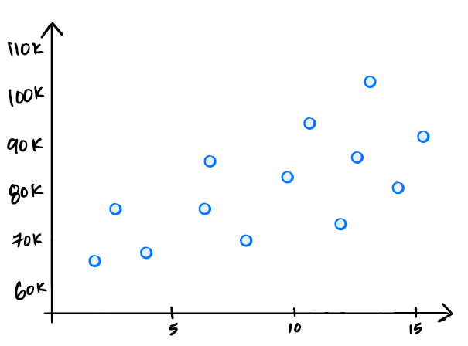
A simple example
Salary prediction from existing data
salary
years of experience

Slide 11
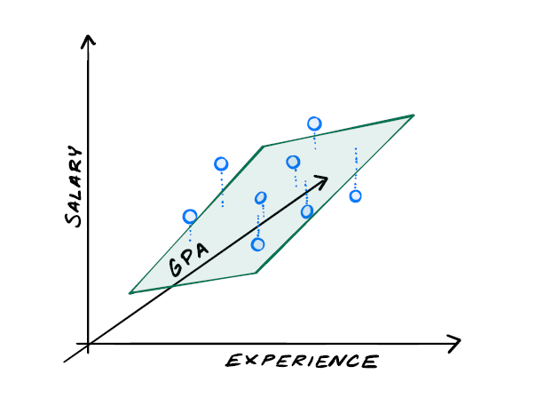

A simple example
Salary prediction from existing data
Formulation (linear regression):
Find the best (hyper-)plane fitting these points with least total error (sum-square distances)
$X^{T}X \vec{ω}=X^{T} \vec{b}$

Slide 12
Is that the end?

Slide 13
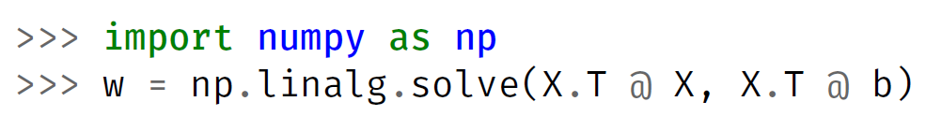
But ….
How do we really compute it?
How do we ask the computer to compute it for us?
This is an algorithm
a sequence of steps / operations to achieve a goal
How do we know this is a “good” algorithm?
How fast does it run on 1,000 points?
How does it scale to 1,000,000 points?
Can we come up with better algorithms for this?

Slide 14
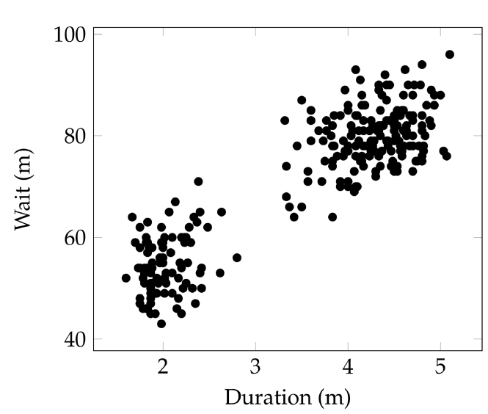
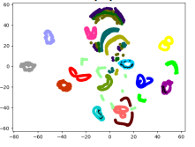
A second example
Clustering
Given a set of data, identify “groups” (clusters) such that “similar” data points are grouped together
Ubiquitous across science and engineering
Notes:
How many different types of specific cancer cells – targeting with different treatments?
How many groups of opinions are there within a population?
For different type of problems, the measurement of “similarity” is different, and the objective could be different.

Slide 15
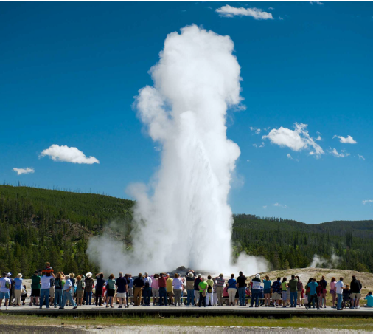
Old Faithful Geyser
What’s the pattern behind its eruption?
How to define as well as find the two clusters?

Slide 16
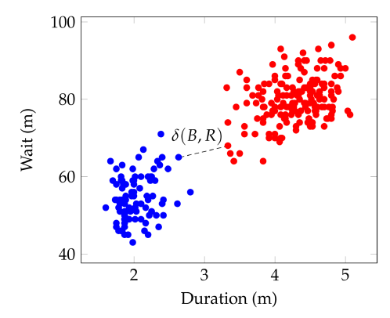


DSC40A says
Let’s model this as an optimization problem
first develop a way to measure / quantify the “goodness” of different grouping
then compute the best grouping with highest goodness score
A grouping candidate:
assign each point to be either blue or red
Quality (goodness):
min separation distance $δ(B, R)$
smallest distance between a red or blue point
Goal:
given points $X=\left\{x_{1},…, x_{n}\right\}$
return the assignment of $X=B∪R$ with largest separation distance $δ(B, R)$

Slide 17
Are we done?
But… how do we really solve this optimization problem?
What is an algorithm to achieve this?
The algorithm needs to be correct
If we develop a correct algorithm, is this algorithm good?
How do we know? (aka: how to analyze our algorithm?)
How do we design better algorithms?

Slide 18
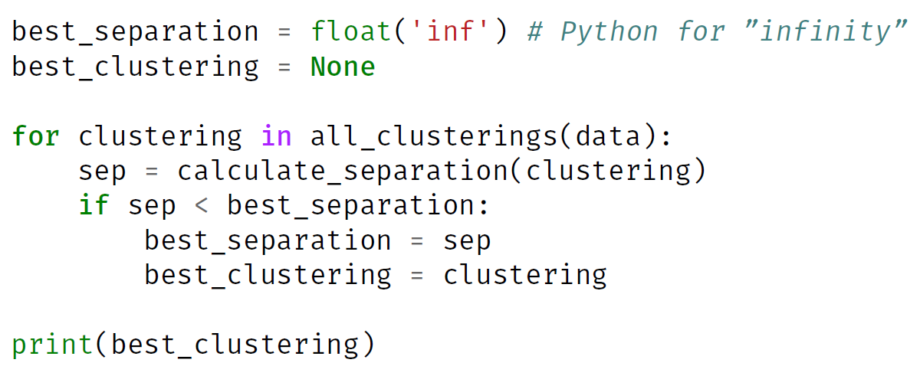
A first algorithm for clustering
Intuition: to compute min-separation grouping
try all possible assignment of all input data points
compute separation distance for each assignment (grouping)
return the one with largest separation distance (the best)
>

Slide 19
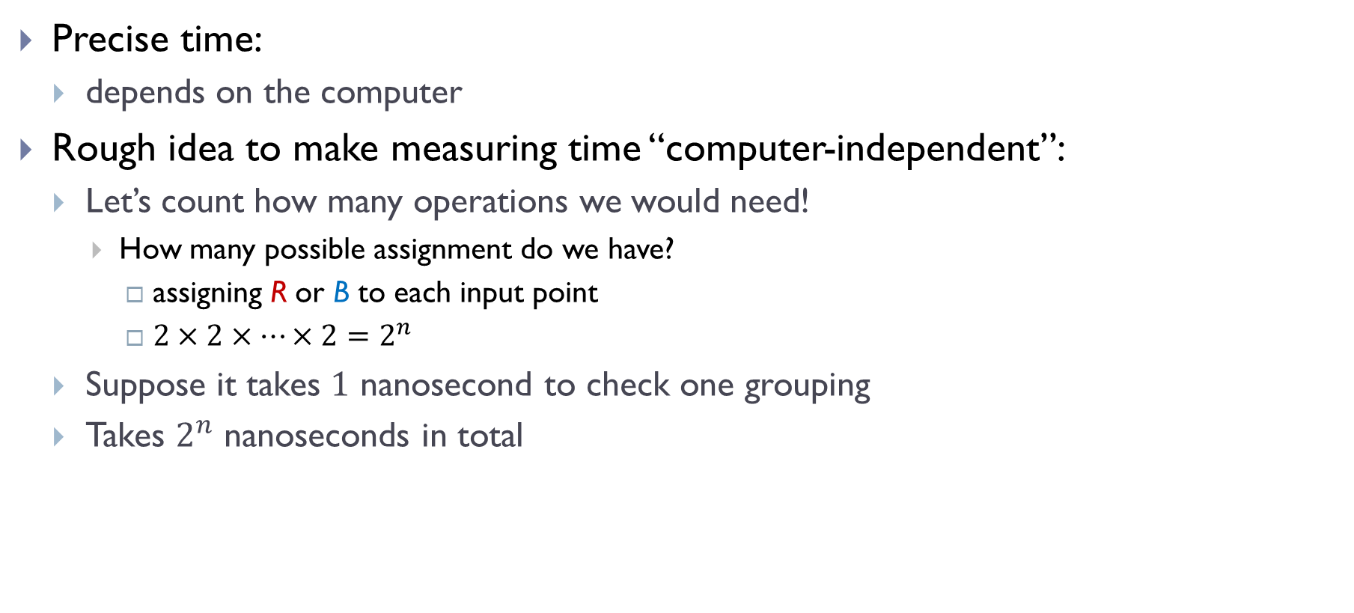
Running time?
Precise time:
depends on the computer
Rough idea to make measuring time “computer-independent”:
Let’s count how many operations we would need!
How many possible assignment do we have?
assigning R or B to each input point
$2×2×⋯×2=2^{n}$
Suppose it takes $1$ nanosecond to check one grouping
Takes $2^{n}$ nanoseconds in total

Slide 20
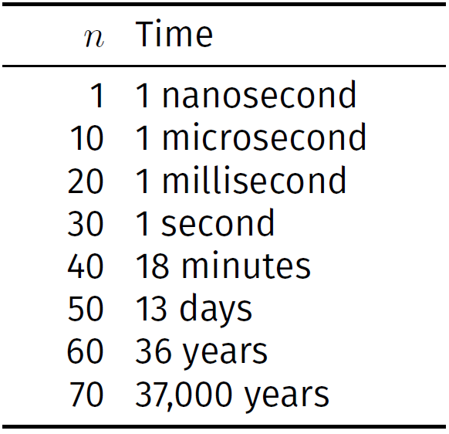
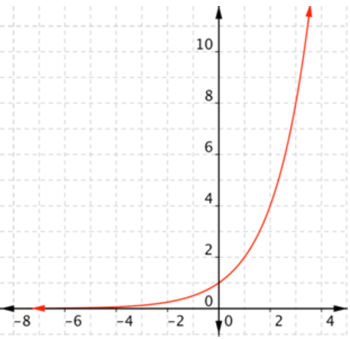
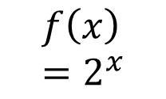
Time needed
Clearly not efficient. Can we do better? How to design better algorithms?
$$f\left(x\right)=2^{x}$$

Slide 21
This course: DSC40B
DSC40A how to model / formulate a problem to tackle an input task
DSC40B: how we then solve it efficiently!
Focus on “algorithms”
What is an algorithm?
step by step strategy to solve problems
should terminate and return correct answer for any input instance
Notes:
After DSC40A of how to model problems

Slide 22
This course: DSC40B
Often, obvious algorithms might not be “efficient”
Doesn’t mean that the problem at hand is hard!
Various issues involved in designing good algorithms
What do we mean by “good”?
algorithm analysis, asymptotic language used to measure performance
How to design good algorithms
data structures, algorithm paradigms
Fundamental problems
graph traversal, shortest path etc.
Notes:
After DSC40A of how to model problems

Slide 23
How to measure efficiency? Time complexity

Slide 24
Efficiency
An algorithm takes an input and performs a task (which could produce an output)
Efficiency matters!
Running time?
How much memory it needs?
An algorithm is only useful when it is efficient enough
How do we measure time efficiency?
Note: running time
Depends on computing environments
depends on size of input
depends on specific input too
Notes:
Just having a correct algorithm is not enough
We will focus on running time in the remainder of this course. Space efficiency will also matter, in fact, in many setting, you may also want to look at communication cost, although often running time is more prominent and serves as a bigger bottleneck. The principles often apply to other costs / efficiency measurements.

Slide 25
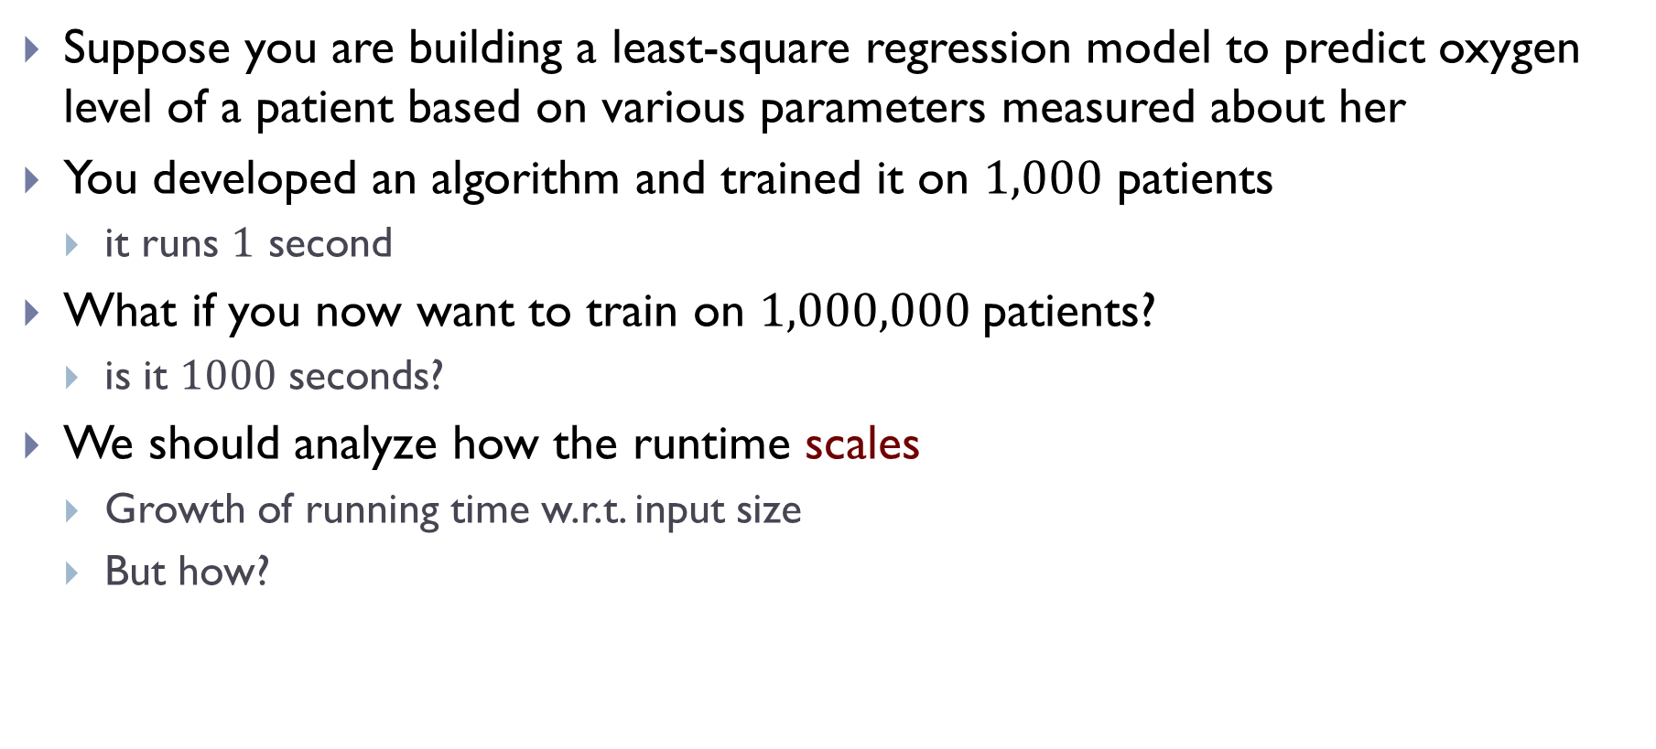
Scenario
Suppose you are building a least-square regression model to predict oxygen level of a patient based on various parameters measured about her
You developed an algorithm and trained it on $1,000$ patients
it runs $1$ second
What if you now want to train on $1,000,000$patients?
is it $1000$ seconds?
We should analyze how the runtime scales
Growth of running time w.r.t. input size
But how?

Slide 26
We will answer the question of “time complexity” in coming lectures
Today:
Some simple examples to provide intuition

Slide 27
Approach #1: just time it!
How about we time it
e.g, using Jupyter tools: time and timeit
Disadvantages:
depending on the machine
to get the growth, need to perform multiple runs and plot the time to obtain the pattern
one timing doesn’t tell how the algorithm scales
even then, the time may depend on specific input
input of the same size could incur different running time

Slide 28
Approach 2: Time complexity analysis
Count intuitively just operations
eliminate the precise running time of a specific computer
Determine it by analyzing the code without running it
Obtain a function (a formula) on how the ``count” changes with input size (i.e, growth w.r.t input size)
instead of timing or plotting to find how time scales

Slide 29

An example
Consider the following code
input is an array $A$
def Func(A):
total = 0
n = len(A)
for i in range(n):
total += A[i]
return total / n

Slide 30


An example
Consider the following code
input is an array $A$ of numbers
def Mean(A):
total = 0
n = len(A)
for i in range(n):
total += A[i]
return total / n

Slide 31
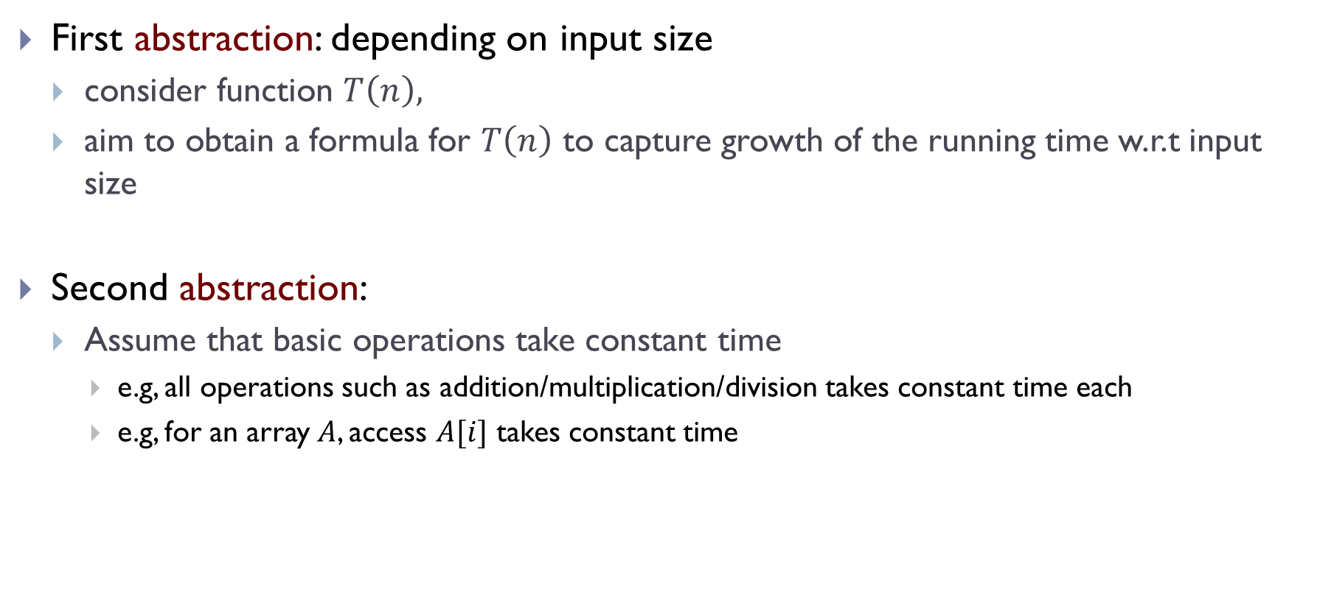
Time complexity
First abstraction: depending on input size
consider function $T\left(n\right),$
aim to obtain a formula for $T\left(n\right)$ to capture growth of the running time w.r.t input size
Second abstraction:
Assume that basic operations take constant time
e.g, all operations such as addition/multiplication/division takes constant time each
e.g, for an array $A$, access $A[i]$ takes constant time

Slide 32

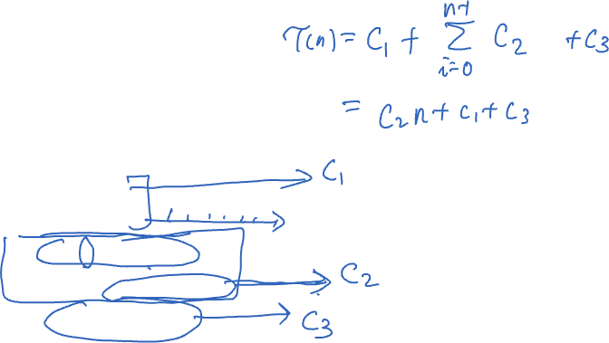
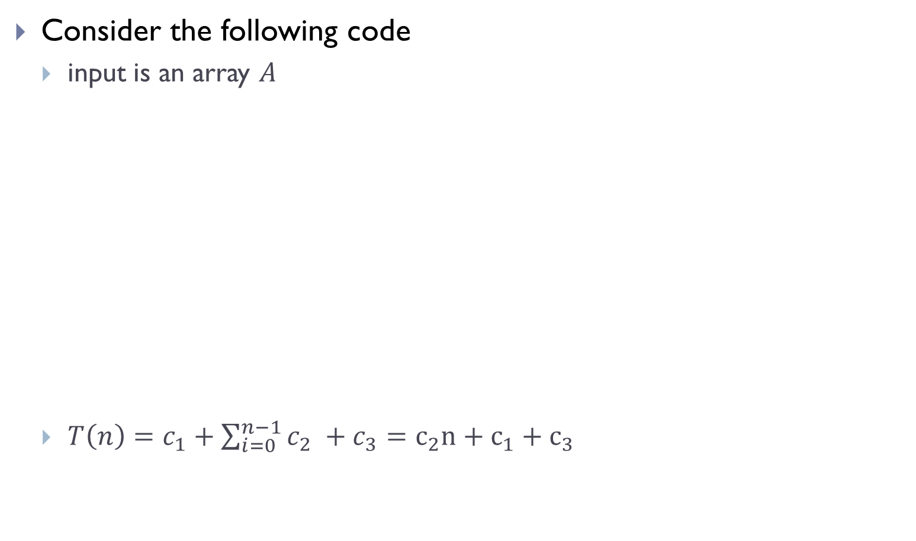


Back to our example
Consider the following code
input is an array $A$
$T\left(n\right)=c_{1}+\sum_{i=0}^{n−1}{c_{2} }+c_{3}=c_{2}n+c_{1}+c_{3}$
def mean(A):
total = 0
n = len(A)
for i in [0,n-1]:
total += A[i]
return total / n
$$c_{1}$$
$$c_{2}$$
$$c_{3}$$

Slide 33
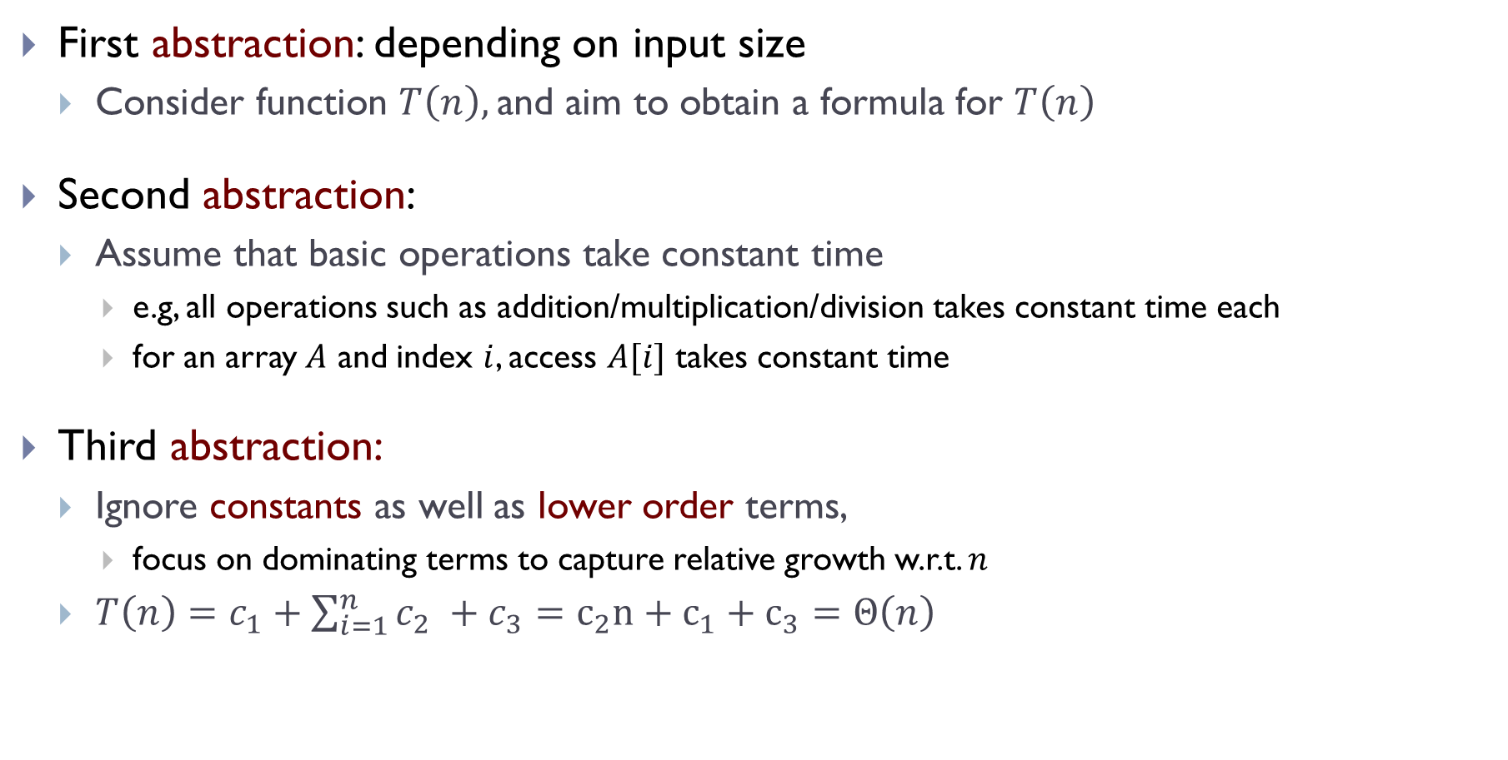

Time complexity
First abstraction: depending on input size
Consider function $T\left(n\right),$and aim to obtain a formula for $T\left(n\right)$
Second abstraction:
Assume that basic operations take constant time
e.g, all operations such as addition/multiplication/division takes constant time each
for an array $A$ and index $i$, access $A[i]$ takes constant time
Third abstraction:
Ignore constants as well as lower order terms,
focus on dominating terms to capture relative growth w.r.t. $n$
$T\left(n\right)=c_{1}+\sum_{i=1}^{n}{c_{2} }+c_{3}=c_{2}n+c_{1}+c_{3}=Θ\left(n\right)$
Notes:
Intuitively, whether it is 2n or 3n, it grows in the same scale.
Mention the lower order terms means that T(n) = n + \sqrt{n} = \Theta(n)

Slide 34
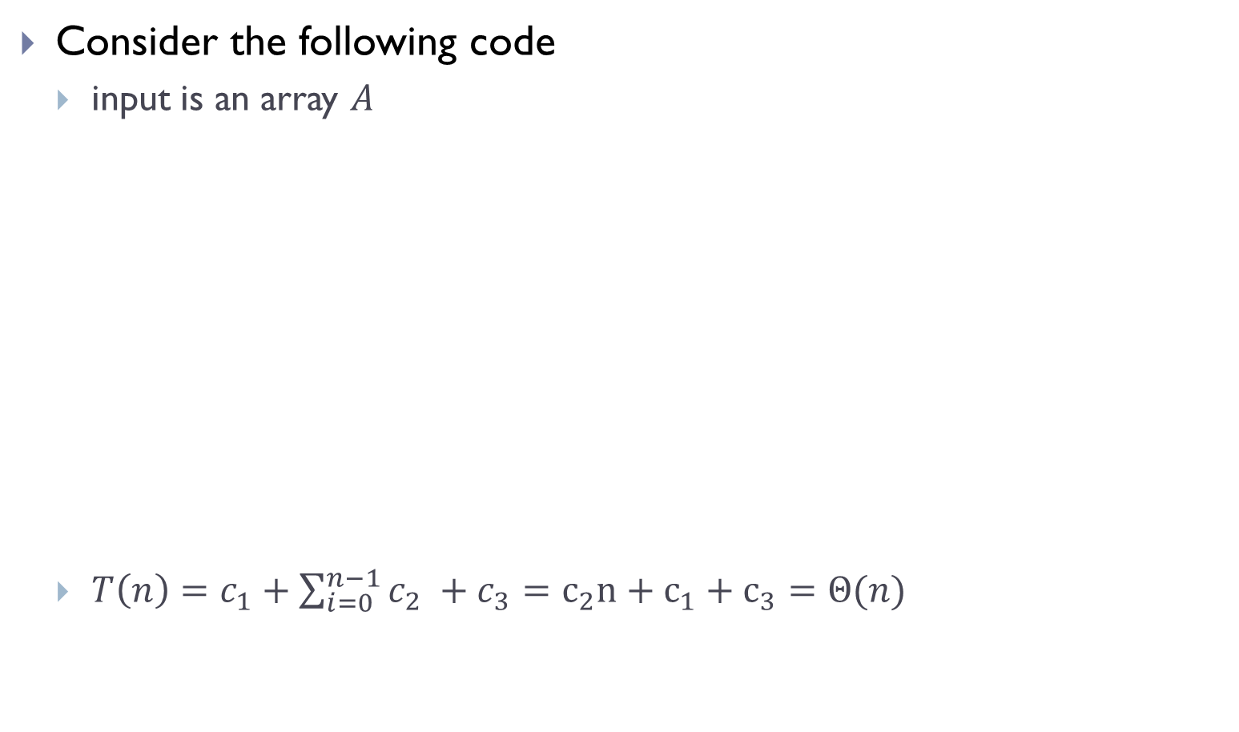

Putting everything together
Consider the following code
input is an array $A$
$T\left(n\right)=c_{1}+\sum_{i=0}^{n−1}{c_{2} }+c_{3}=c_{2}n+c_{1}+c_{3}=Θ(n)$
def mean(A):
total = 0
n = len(A)
for i in [0,n-1]:
total += A[i]
return total / n
$$c_{1}$$
Algorithm mean($A$) has time complexity $T\left(n\right)=Θ\left(n\right)$
$$c_{2}$$
$$c_{3}$$

Slide 35
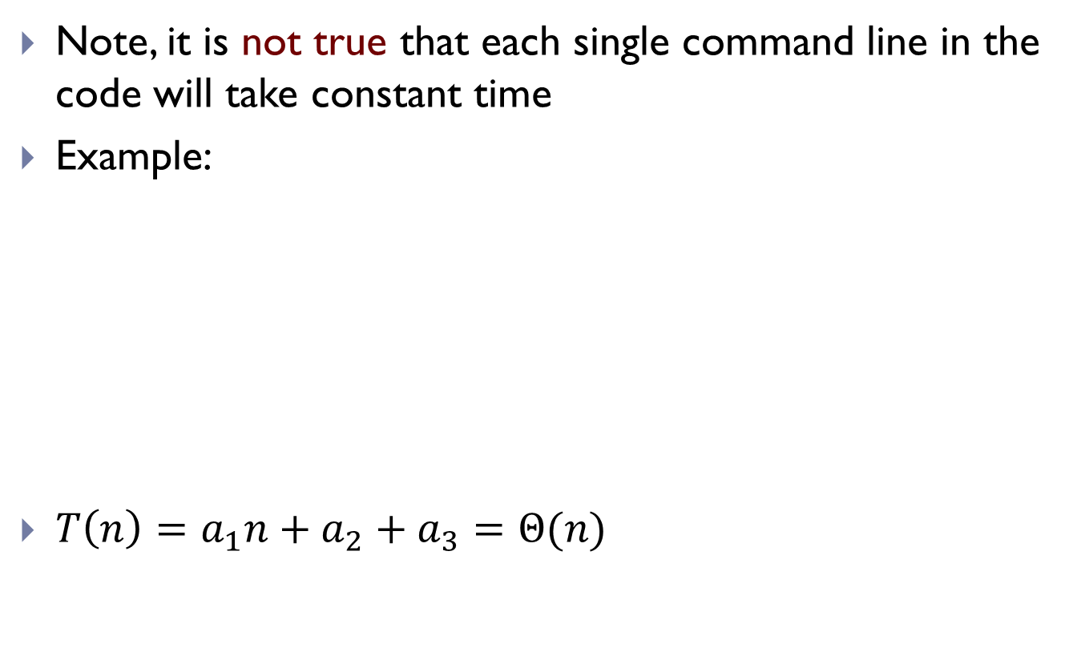
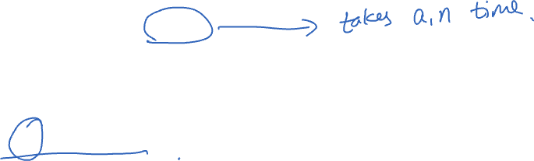
Caution
Note, it is not true that each single command line in the code will take constant time
Example:
$T\left(n\right)=a_{1}n+a_{2}+a_{3}=Θ(n)$
def mean_2(A):
total = sum(A)
n = len(A)
return total / n

Slide 36
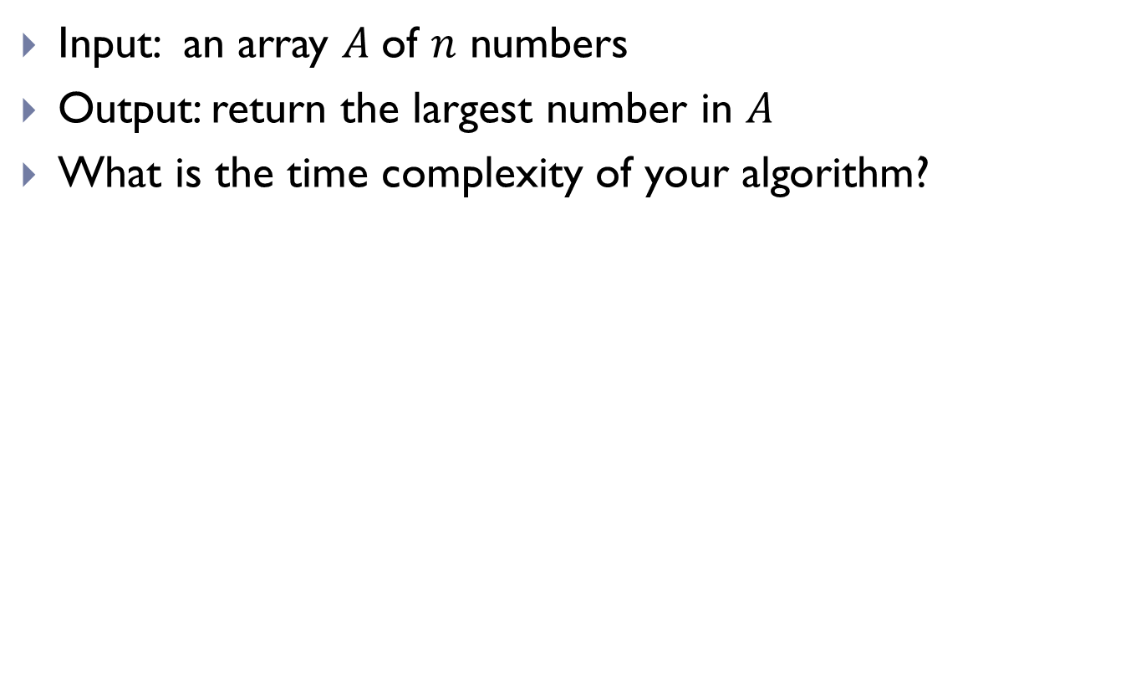
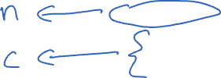
A simple exercise
Input: an array $A$of $n$ numbers
Output: return the largest number in $A$
What is the time complexity of your algorithm?
def maximum(A):
current_max = -float('inf')
for x in A:
if x > current_max:
current_max = x
return current_max

Slide 37
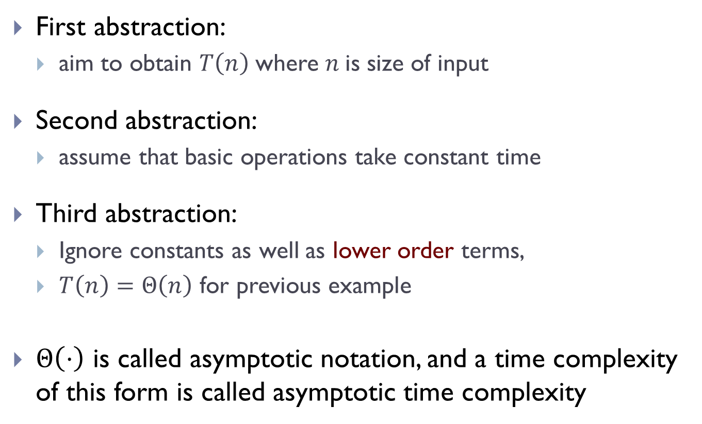
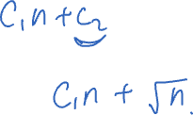
Time complexity
First abstraction:
aim to obtain $T\left(n\right)$where $n$is size of input
Second abstraction:
assume that basic operations take constant time
Third abstraction:
Ignore constants as well as lower order terms,
$T\left(n\right)=Θ\left(n\right)$ for previous example
$Θ\left(⋅\right)$ is called asymptotic notation, and a time complexity of this form is called asymptotic time complexity
Next time
We will learn what exactly are asymptotic time complexity and go through more examples
Notes:
Intuitively, whether it is 2n or 3n, it grows in the same scale.
Mention the lower order terms means that T(n) = n + \sqrt{n} = \Theta(n)

Slide 38
FIN

