Slide 1
DSC40B: Theoretical Foundations of Data Science II
Lecture 5: Binary search and recurrence
Instructor: Yusu Wang

Slide 2
Previously
Different types of time complexity analysis
Equipping us with ways to analyze performance of algorithms
Today and onwards
Algorithm design
Start with the Search problem in sorted array
Solving recurrence to obtain time complexity
Often arise from recursive algorithms

Slide 3
Part A: Motivation of binary search in sorted array

Slide 4
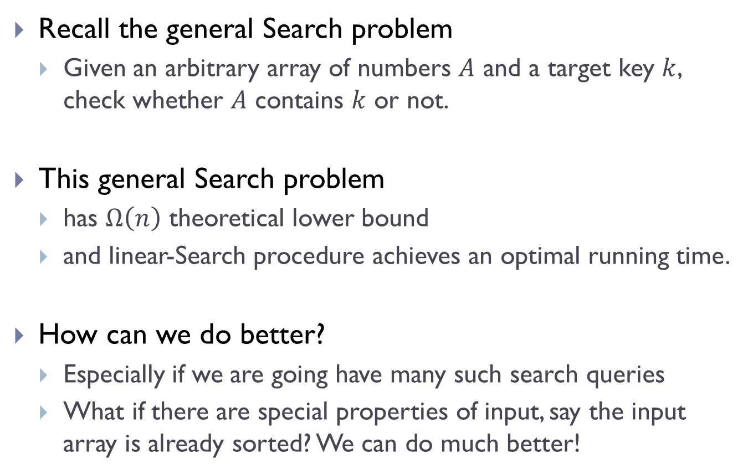
Recall the general Search problem
Given an arbitrary array of numbers $A$ and a target key $k$, check whether $A$ contains $k$ or not.
This general Search problem
has $Ω\left(n\right)$ theoretical lower bound
and linear-Search procedure achieves an optimal running time.
How can we do better?
Especially if we are going have many such search queries
What if there are special properties of input, say the input array is already sorted? We can do much better!

Slide 5
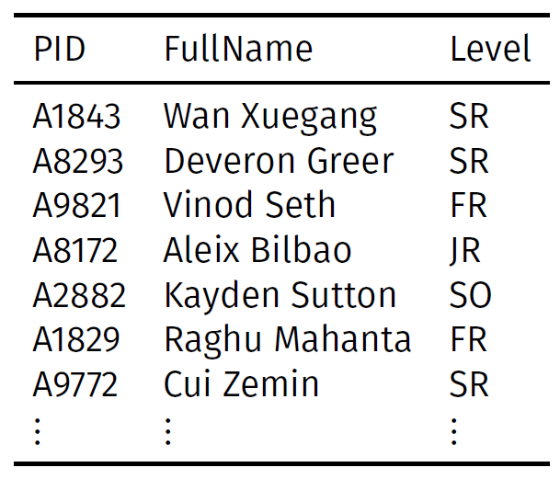
Search in Database
Large data sets are often stored in databases
Given the same database, one can make multiple queries
e.g, Search for a specific entity, find Maximum in salary, or Range queries
Query:
What is the name of the student with PID A8172?

Slide 6
Preprocessing + Queries
In general
We would like to organize data so that they can support many such queries efficiently.
Time taken to prepare / organize data into a form that is easier for later queries is call pre-processing time.
Time taken to answer queries is called query time.
Often it is worthwhile to spend pre-processing time if the query time is significantly reduced and there are many queries to be performed.

Slide 7
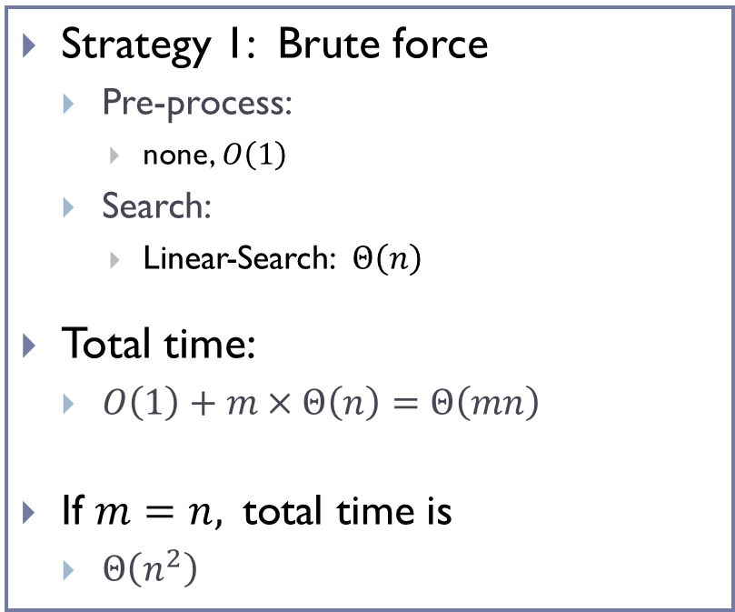

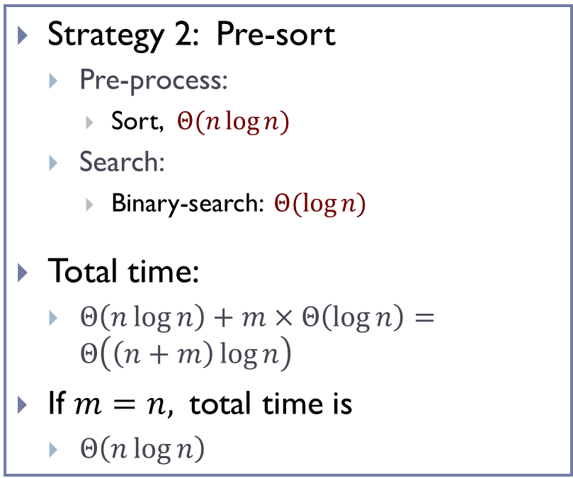
An example
Suppose we have a database of size $n$, and we wish to perform $m$ Search queries.
Strategy 1: Brute force
Pre-process:
none, $O\left(1\right)$
Search:
Linear-Search: $Θ\left(n\right)$
Total time:
$O\left(1\right)+m×Θ\left(n\right)=Θ\left(mn\right)$
If $m=n,$total time is
$Θ\left(n^{2}\right)$
Strategy 2: Pre-sort
Pre-process:
Sort, $Θ(n\log{n})$
Search:
Binary-search: $Θ(\log{n)}$
Total time:
$Θ\left(n\log{n}\right)+m×Θ\left(\log{n}\right)=Θ\left(\left(n+m\right)\log{n}\right)$
If $m=n,$total time is
$Θ\left(n\log{n}\right)$

Slide 8
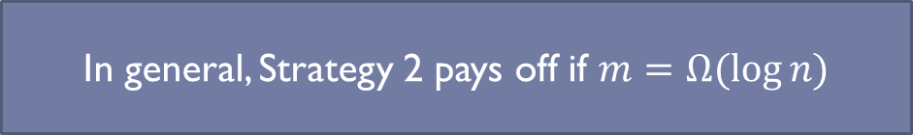
An example
Suppose we have a database of size $n$, and we wish to perform $m$ Search queries.
Strategy 1: Brute force
Pre-process:
none, $O\left(1\right)$
Search:
Linear-Search: $Θ\left(n\right)$
Total time:
$O\left(1\right)+m×Θ\left(n\right)=Θ\left(mn\right)$
If $m=n,$total time is
$Θ\left(n^{2}\right)$
Strategy 2: Pre-sort
Pre-process:
Sort, $Θ(n\log{n})$
Search:
Binary-search: $Θ(\log{n)}$
Total time:
$Θ\left(n\log{n}\right)+m×Θ\left(\log{n}\right)=Θ\left(\left(n+m\right)\log{n}\right)$
If $m=n,$total time is
$Θ\left(n\log{n}\right)$
In general, Strategy 2 pays off if $m=Ω(\log{n)}$

Slide 9
Preprocessing + Queries
If there are many queries, then often, performing a preprocessing pays off if that makes answering the queries more efficient.
Furthermore, often queries have to be done online, while preprocessing can be done offline
Hence sometimes, even if we don’t have many queries, it still pays off to do preprocessing to support fast online queries for users.

Slide 10
Part B: Binary search in sorted array

Slide 11
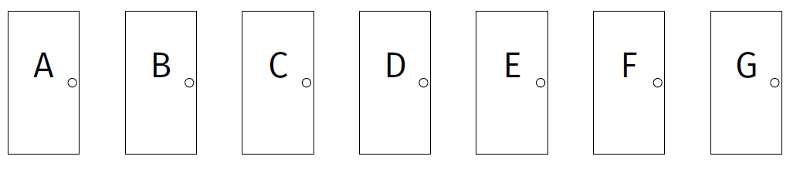
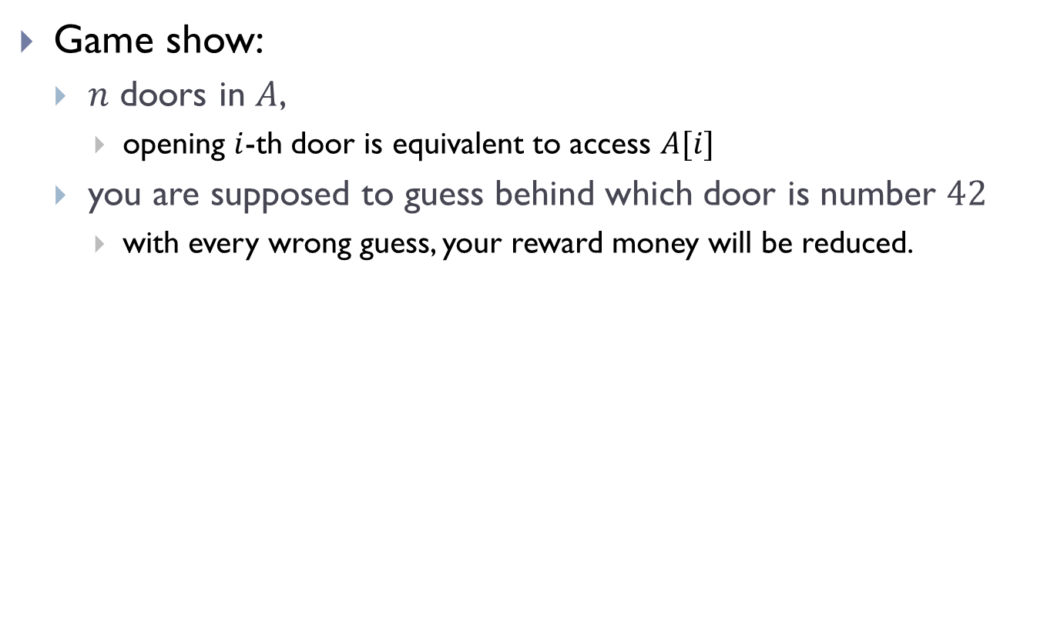
Game show:
$n$ doors in $A$,
opening $i$-th door is equivalent to access $A[i]$
you are supposed to guess behind which door is number $42$
with every wrong guess, your reward money will be reduced.

Slide 12
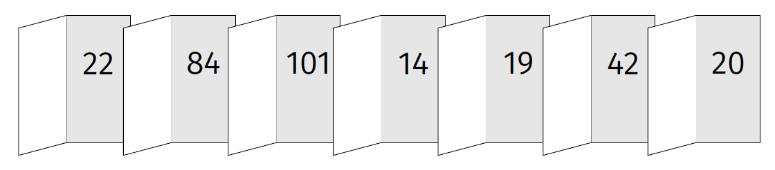
If the numbers can be arbitrarily placed behind these doors
cannot do better than linear search
after opening each door, 42 can be in any of the remainder doors

Slide 13
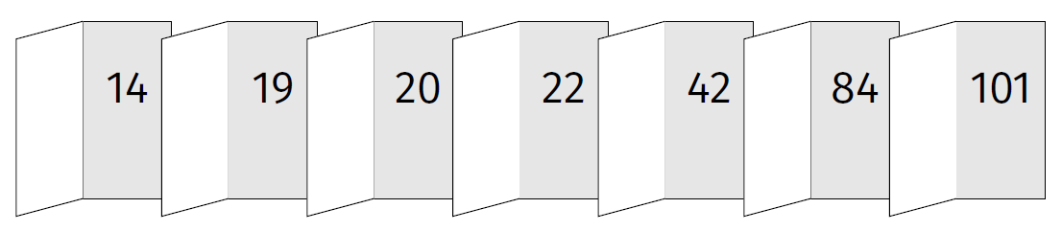
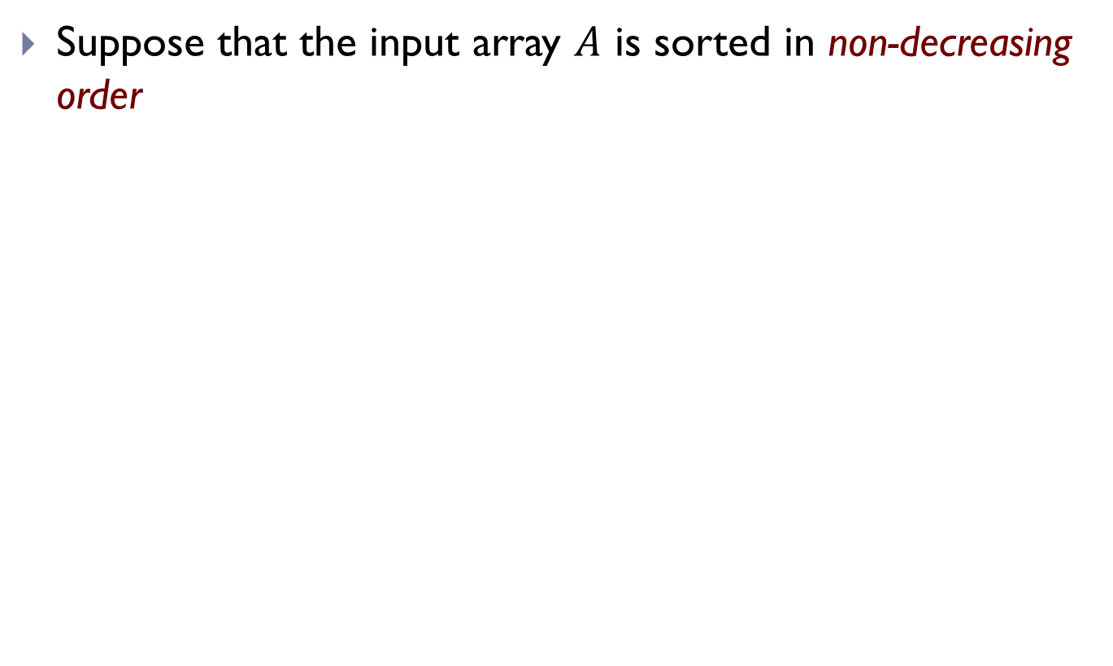
If the list of numbers are sorted
Suppose that the input array $A$ is sorted in non-decreasing order

Slide 14

If the list of numbers are sorted
Equivalently, the input array $A$ is sorted in non-decreasing order
Which door to open first?

Slide 15
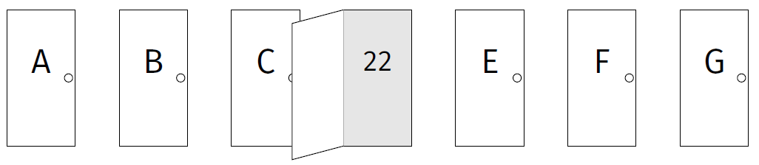

If the list of numbers are sorted
Equivalently, the input array $A$ is sorted in non-decreasing order
Which door to open first?
Door $D$ – the middle one

Slide 16
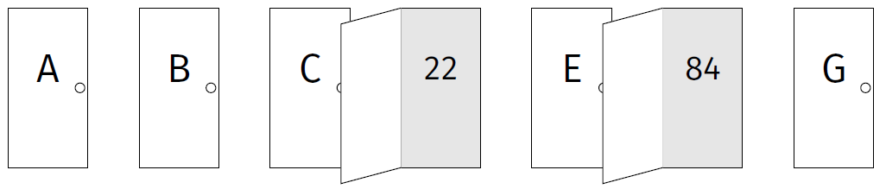
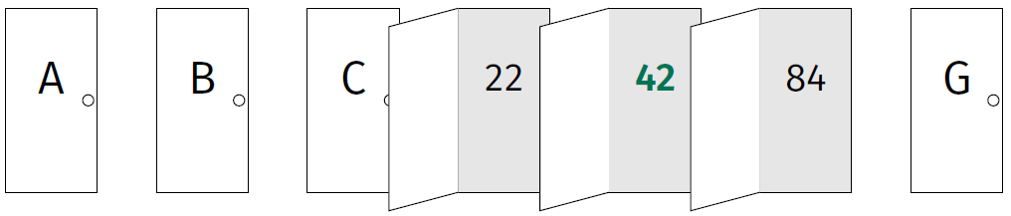
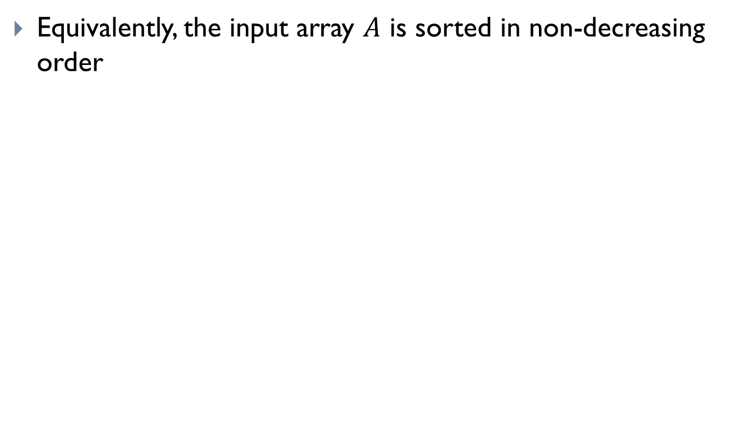
If the list of numbers are sorted
Equivalently, the input array $A$ is sorted in non-decreasing order

Slide 17
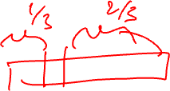
Strategy
First pick the middle door
Allows you to rule out half of the other doors.
Pick door in the middle of what remains.
Repeat, recursively.
How to convert this strategy to a piece of code (an algorithm)?

Slide 18

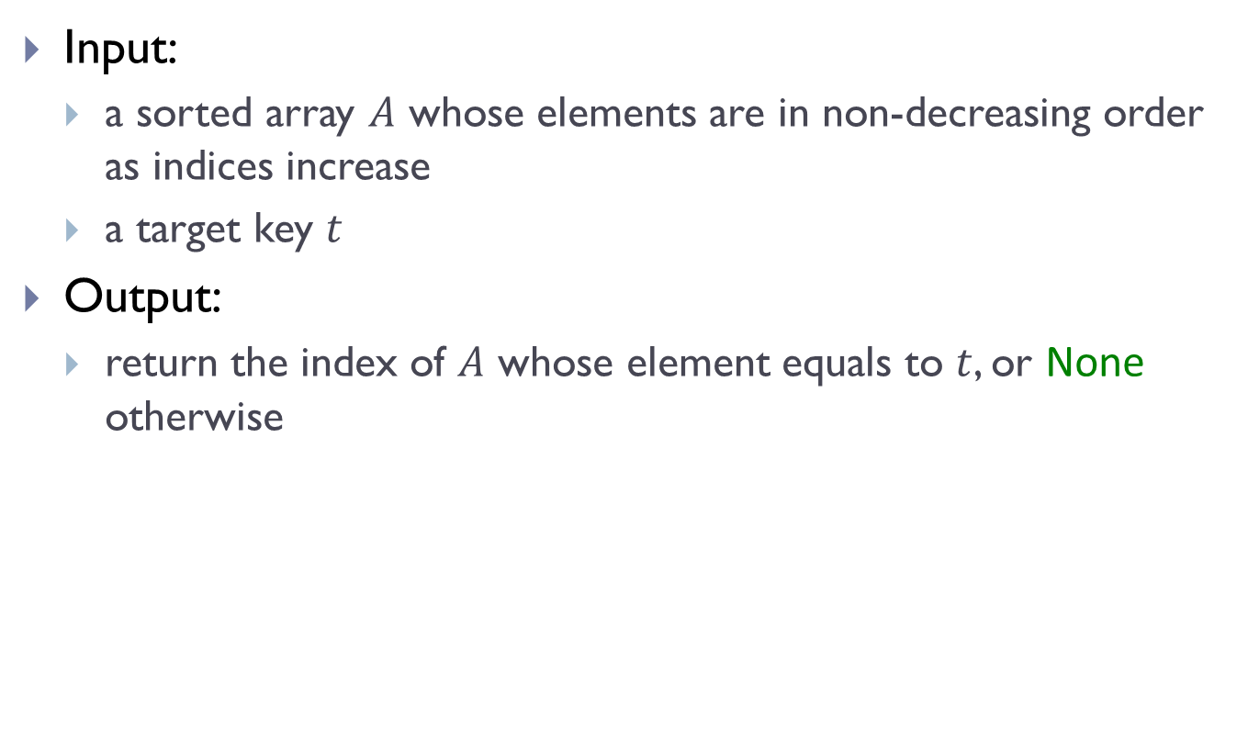
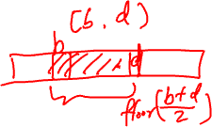
Search Problem in sorted array
Input:
a sorted array $A$ whose elements are in non-decreasing order as indices increase
a target key $t$
Output:
return the index of $A$ whose element equals to $t$, or None otherwise
Exercise: Given a sorted array $A$, and two indices $b≤d$, and we want to search $t$ in $A[b:d]$.
Which element will you check first?

Slide 19
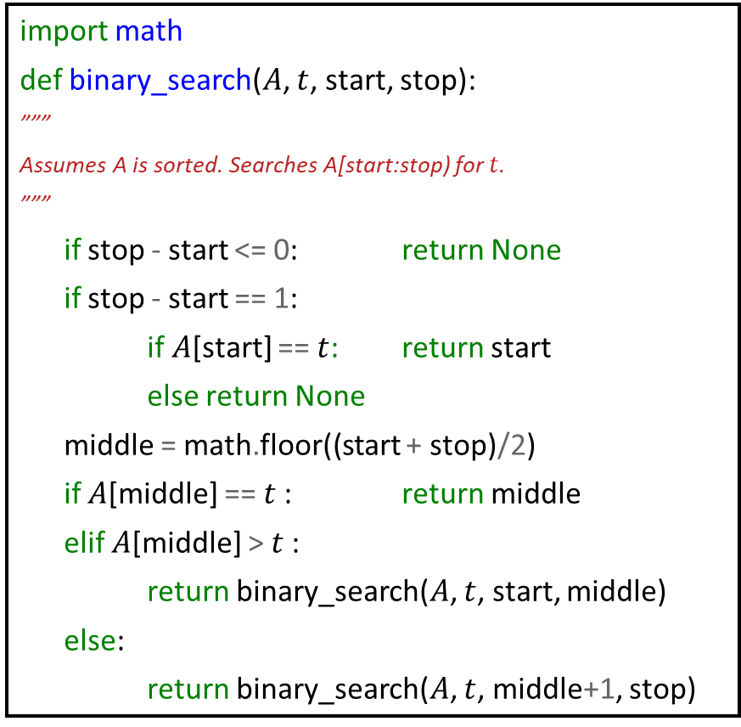
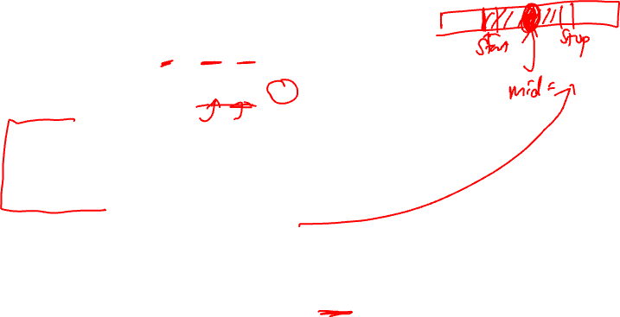
Binary Search Algorithm
import math
def binary_search($A$, $t$, start, stop):
”””
Assumes A is sorted. Searches A[start:stop) for $t$.
”””
if stop - start <= 0: return None
if stop - start == 1:
if $A$[start] == $t$: return start
else return None
middle = math.floor((start + stop)/2)
if $A$[middle] == $t$: return middle
elif $A$[middle] > $t$:
return binary_search($A$, $t$, start, middle)
else:
return binary_search($A$, $t$, middle+1, stop)

Slide 20
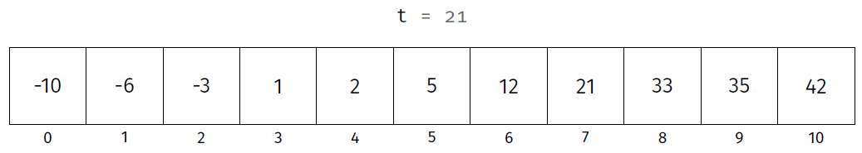
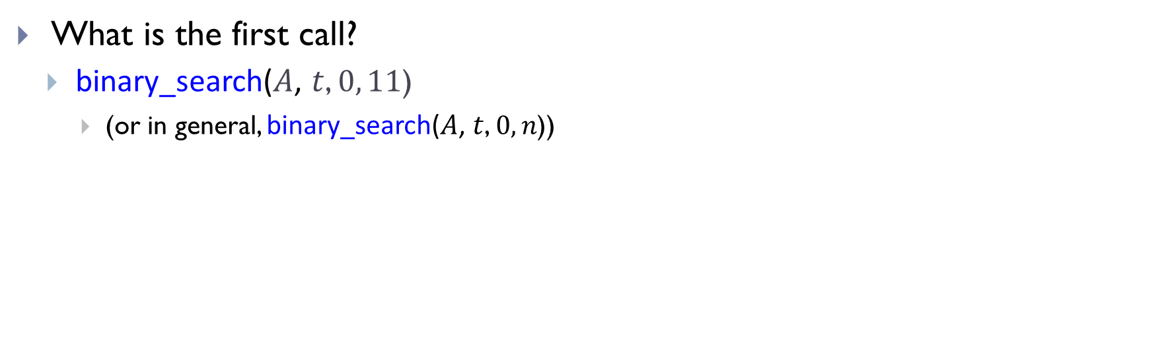
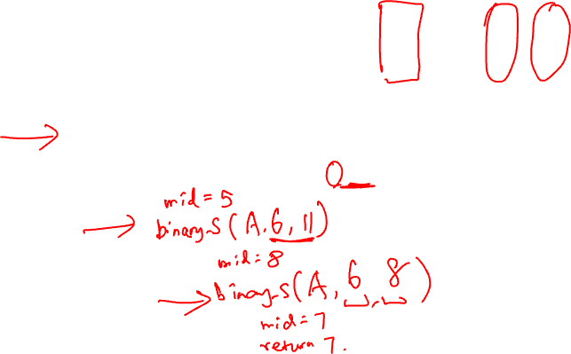
Example
What is the first call?
binary_search($A$, $t$, $0, 11$)
(or in general, binary_search($A$, $t$, $0, n$))

Slide 21
Part C: Correctness of binary-search

Slide 22
Correctness
How do we convince ourselves that such a recursive algorithm is correct?
Often by inductive thinking (bottom-up):
(1) Make sure algorithm works in the base case.
(2) Check that all recursive calls are on smaller problems, and that it terminates
(3) Assuming that the recursive calls work, does the whole algorithm work?

Slide 23
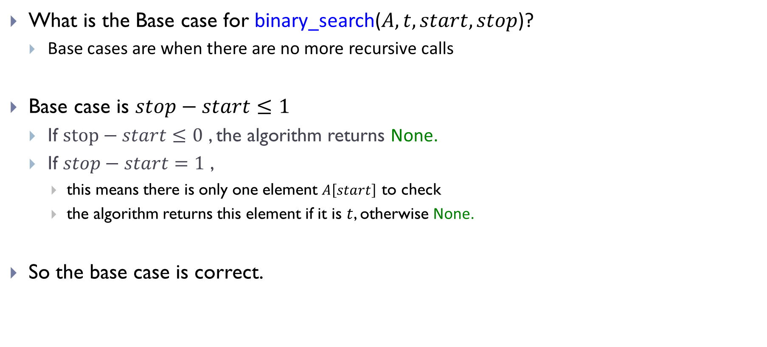

(1) Base case
What is the Base case for binary_search($A, t, start, stop$)?
Base cases are when there are no more recursive calls
Base case is $stop−start≤1$
If $stop−start≤0$ , the algorithm returns None.
If $stop−start=1$ ,
this means there is only one element $A\left[start\right]$ to check
the algorithm returns this element if it is $t$, otherwise None.
So the base case is correct.

Slide 24

(2) Recursive steps -- termination
Does the procedure terminate?
Or could it get into infinite loop?
Yes, as each time, the size of the subproblem we consider is strictly smaller till we reach the base case

Slide 25
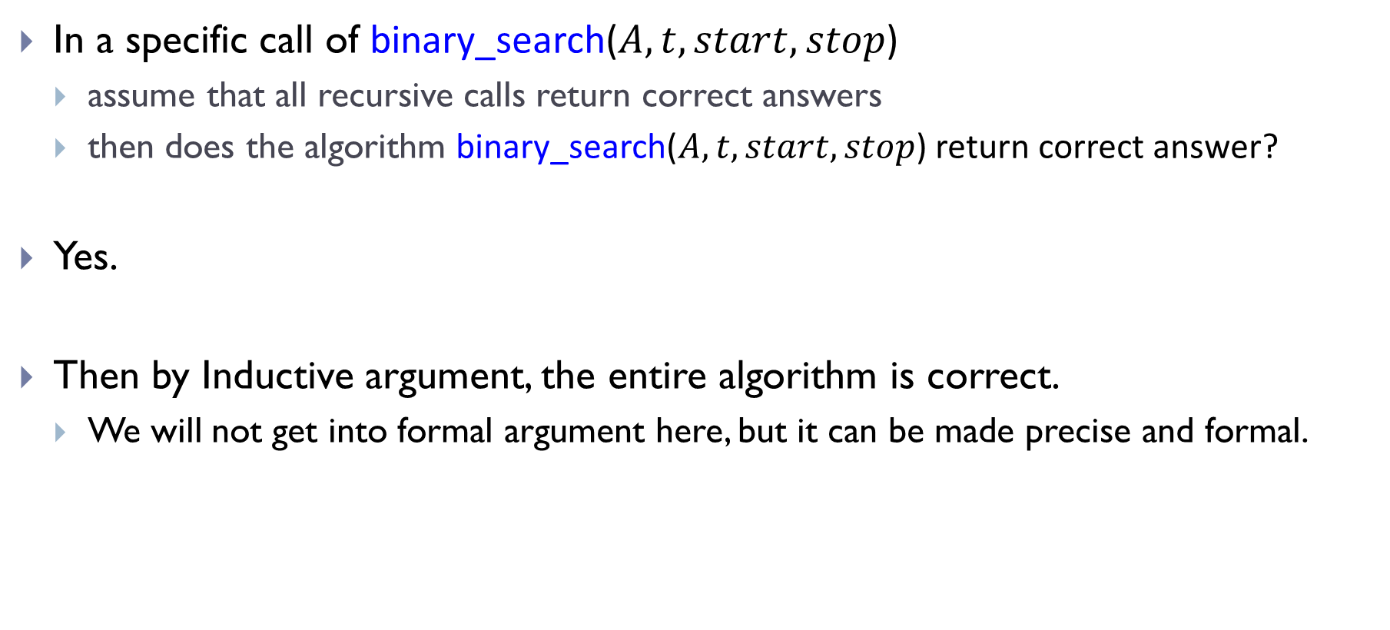
(3) Recursive steps -- correctness
In a specific call of binary_search($A, t, start, stop$)
assume that all recursive calls return correct answers
then does the algorithm binary_search($A, t, start, stop$) return correct answer?
Yes.
Then by Inductive argument, the entire algorithm is correct.
We will not get into formal argument here, but it can be made precise and formal.

Slide 26
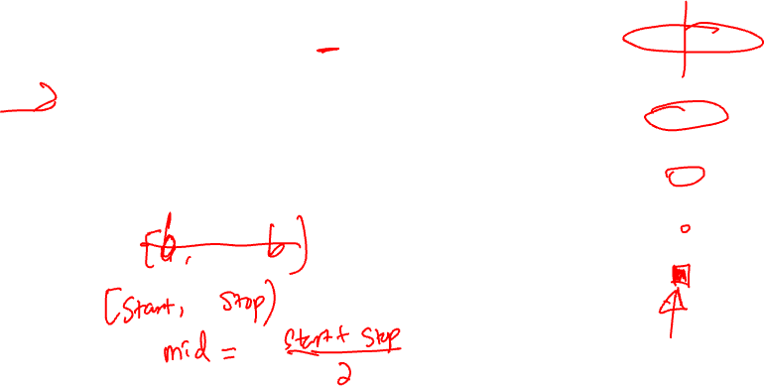
Intuitively, why it works:
Show that it works for size 1 (base case).
⟹ will work for size 2 (inductive step).
⟹ will work for sizes 3, 4 (inductive step).
⟹ will work for sizes 5, 6, 7, 8 (inductive step) ..

Slide 27
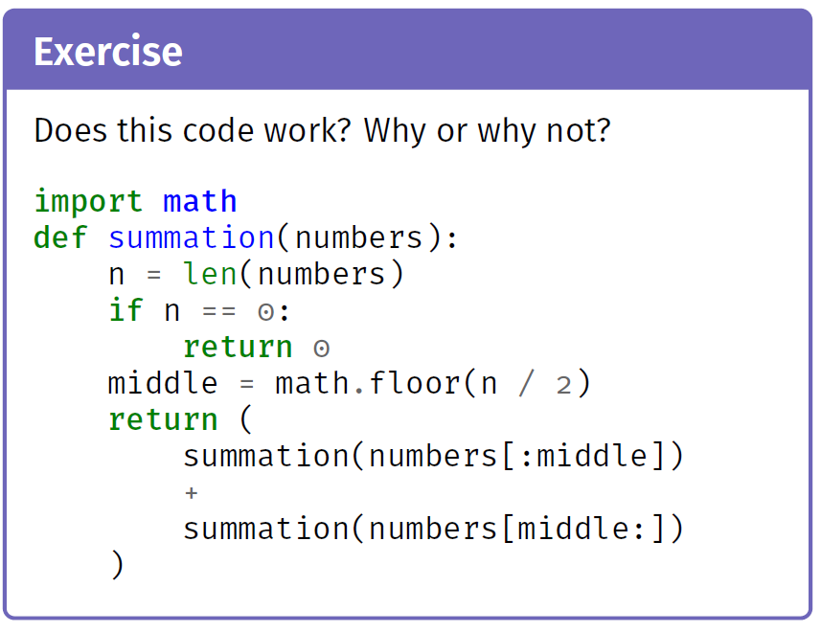

Slide 28
Part D: Time complexity analysis: Recurrence relations

Slide 29
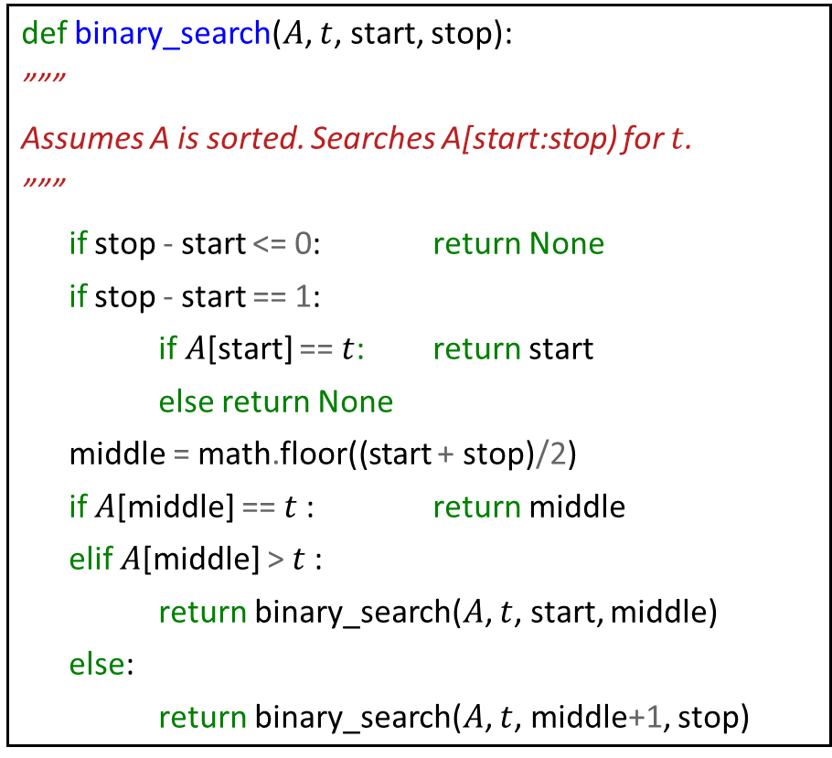

Best Case?
def binary_search($A$, $t$, start, stop):
”””
Assumes A is sorted. Searches A[start:stop) for $t$.
”””
if stop - start <= 0: return None
if stop - start == 1:
if $A$[start] == $t$: return start
else return None
middle = math.floor((start + stop)/2)
if $A$[middle] == $t$: return middle
elif $A$[middle] > $t$:
return binary_search($A$, $t$, start, middle)
else:
return binary_search($A$, $t$, middle+1, stop)

Slide 30
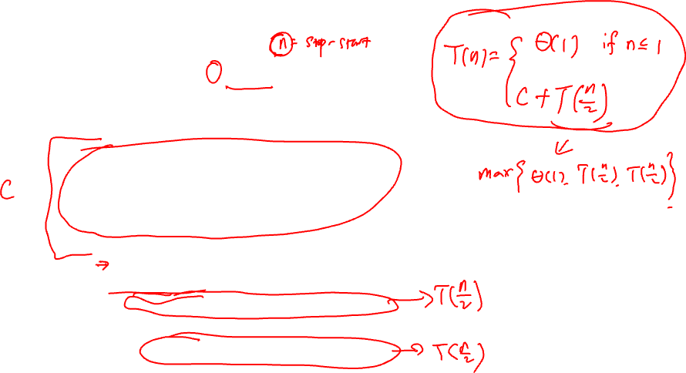
Worst Case?
def binary_search($A$, $t$, start, stop):
”””
Assumes A is sorted. Searches A[start:stop) for $t$.
”””
if stop - start <= 0: return None
if stop - start == 1:
if $A$[start] == $t$: return start
else return None
middle = math.floor((start + stop)/2)
if $A$[middle] == $t$: return middle
elif $A$[middle] > $t$:
return binary_search($A$, $t$, start, middle)
else:
return binary_search($A$, $t$, middle+1, stop)

Slide 31
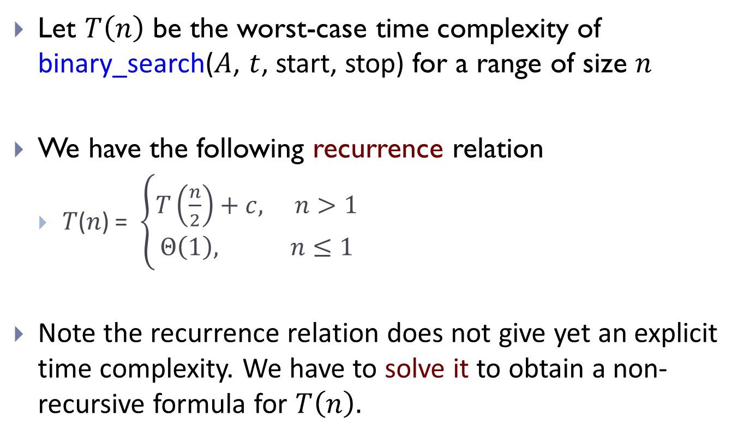
Let $T\left(n\right)$ be the worst-case time complexity of binary_search($A$, $t$, start, stop) for a range of size $n$
We have the following recurrence relation
𝑇(𝑛) = $\left\{\begin{aligned}T\left(\frac{n}{2}\right)+c, n>1 \\ Θ\left(1\right), n≤1\end{aligned}\right.$
Note the recurrence relation does not give yet an explicit time complexity. We have to solve it to obtain a non-recursive formula for $T\left(n\right).$

Slide 32
Solving Recurrence
One way is via the following strategy:
1. “Unroll” several times to find a pattern.
2. Write general formula for 𝑘th unroll.
3. Solve for # of unrolls needed to reach base case.
4. Plug this number into general formula.

Slide 33

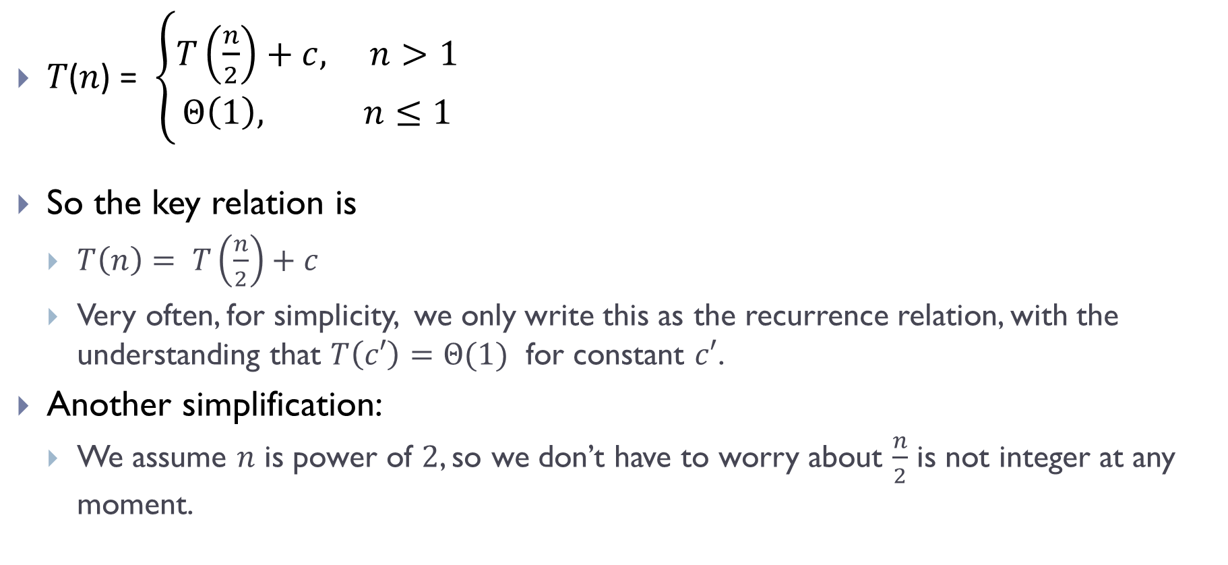
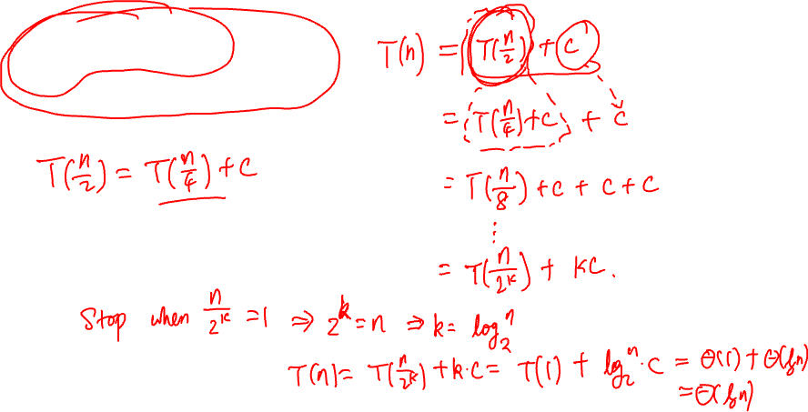
Recurrence for binary-search
𝑇(𝑛) = $\left\{\begin{aligned}T\left(\frac{n}{2}\right)+c, n>1 \\ Θ\left(1\right), n≤1\end{aligned}\right.$
So the key relation is
$T\left(n\right)= T\left(\frac{n}{2}\right)+c$
Very often, for simplicity, we only write this as the recurrence relation, with the understanding that $T\left(c′\right)=Θ(1)$ for constant $c′$.
Another simplification:
We assume $n$ is power of $2$, so we don’t have to worry about $\frac{n}{2}$ is not integer at any moment.
Termination condition.
In fact, for recurrence relations for time complexity $T(n)$, we can always assume that $T\left(c′\right)=Θ(1)$ when $c′$ is a constant, e.g, $c′=1, 2,3,4.$

Slide 34
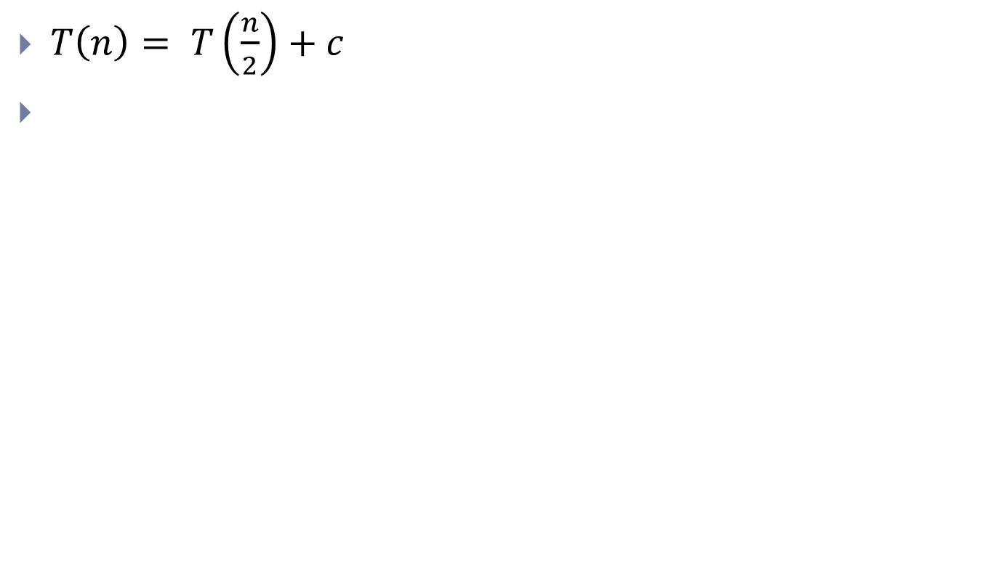

Step ($1$): unroll several times to find a pattern
$T\left(n\right)= T\left(\frac{n}{2}\right)+c$

Slide 35
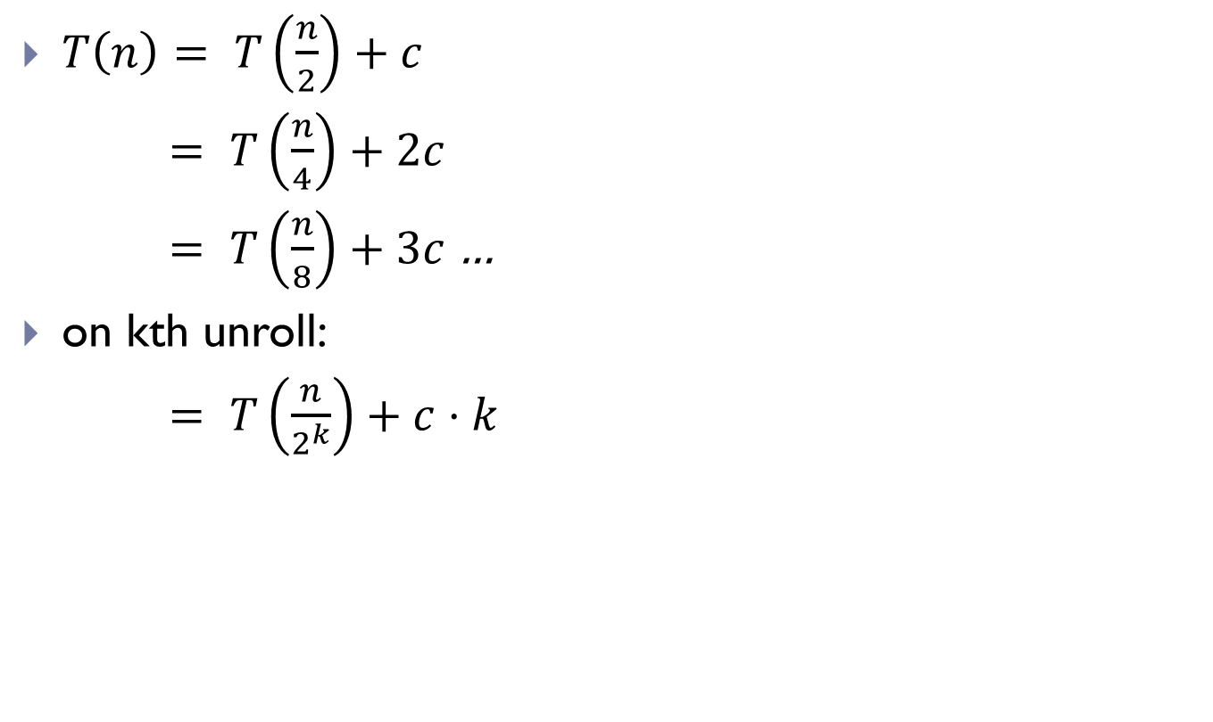

Step ($2$): find general formula for kth unroll
$T\left(n\right)= T\left(\frac{n}{2}\right)+c$
$= T\left(\frac{n}{4}\right)+2c$
$= T\left(\frac{n}{8}\right)+3c$…
on kth unroll:
$= T\left(\frac{n}{2^{k}}\right)+c⋅k$

Slide 36
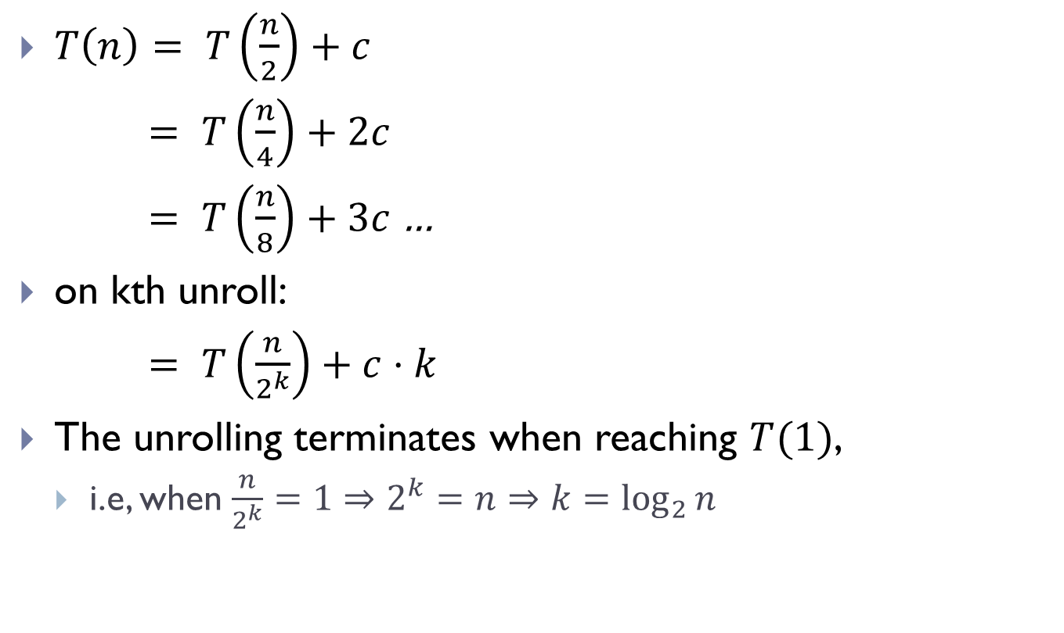
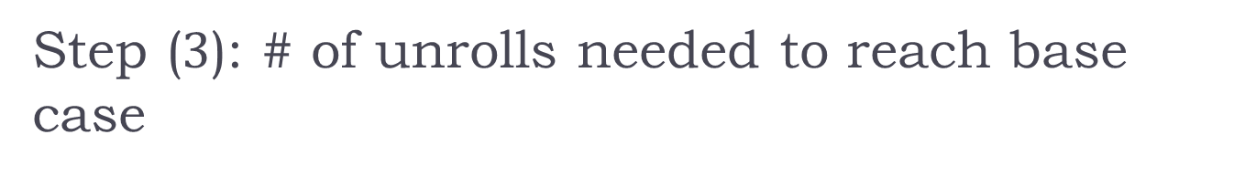
Step ($3$): # of unrolls needed to reach base case
$T\left(n\right)= T\left(\frac{n}{2}\right)+c$
$= T\left(\frac{n}{4}\right)+2c$
$= T\left(\frac{n}{8}\right)+3c$…
on kth unroll:
$= T\left(\frac{n}{2^{k}}\right)+c⋅k$
The unrolling terminates when reaching $T(1)$,
i.e, when $\frac{n}{2^{k}}=1⇒2^{k}=n⇒k=\log_{2}{n}$

Slide 37
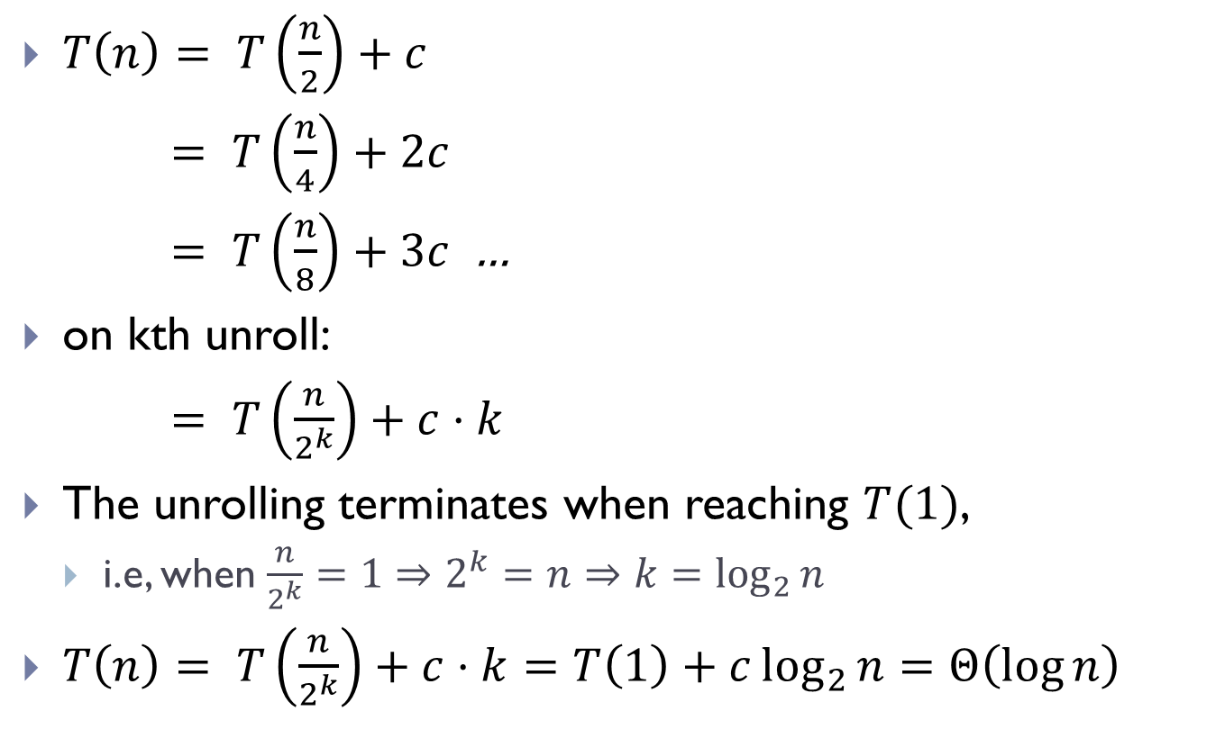

Step ($4$): Plug into general formula
$T\left(n\right)= T\left(\frac{n}{2}\right)+c$
$= T\left(\frac{n}{4}\right)+2c$
$= T\left(\frac{n}{8}\right)+3c$ …
on kth unroll:
$= T\left(\frac{n}{2^{k}}\right)+c⋅k$
The unrolling terminates when reaching $T(1)$,
i.e, when $\frac{n}{2^{k}}=1⇒2^{k}=n⇒k=\log_{2}{n}$
$T\left(n\right)= T\left(\frac{n}{2^{k}}\right)+c⋅k=T\left(1\right)+c\log_{2}{n}=Θ\left(\log{n}\right)$

Slide 38
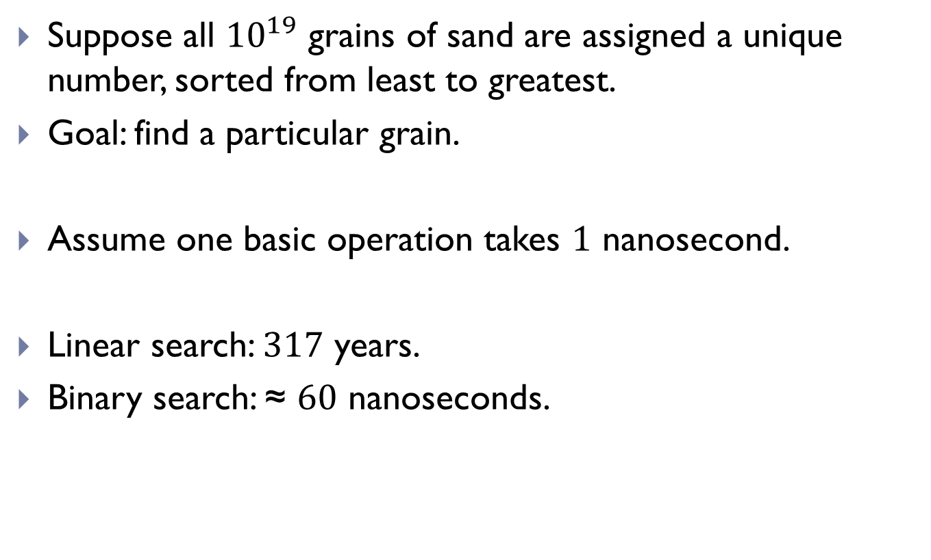
How fast is this compared to linear-search?
Suppose all ${10}^{19}$ grains of sand are assigned a unique number, sorted from least to greatest.
Goal: find a particular grain.
Assume one basic operation takes $1$ nanosecond.
Linear search: $317$ years.
Binary search: ≈ $60$ nanoseconds.

Slide 39
Remarks
Note that binary-search requires a sorted input array!
So needs a preprocessing
Worthwhile when there are many queries
Or when we need to perform quick online queries
In practice,
Databases are often indexed (sorted) by certain keys
Most commonly, B-Trees are used for organizing databases.

Slide 40

Theoretical lower bounds
It turns out that a theoretical lower bound for searching in a sorted list is $Ω(\log{n})$
Hence the binary search procedure we just talked about has optimal worst case time complexity

Slide 41
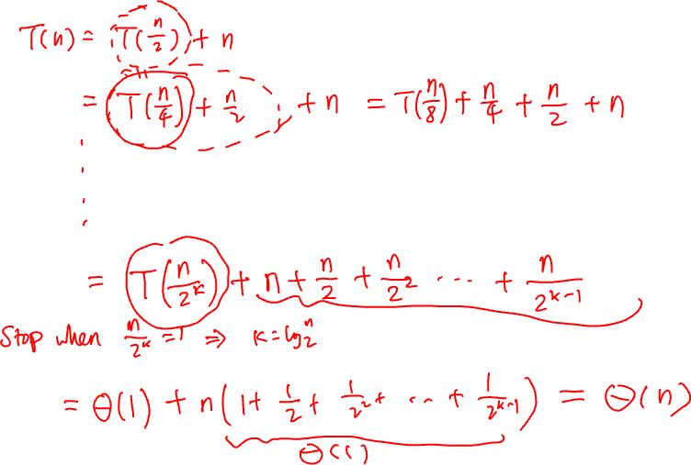
Part E: More Recurrence examples

Slide 42
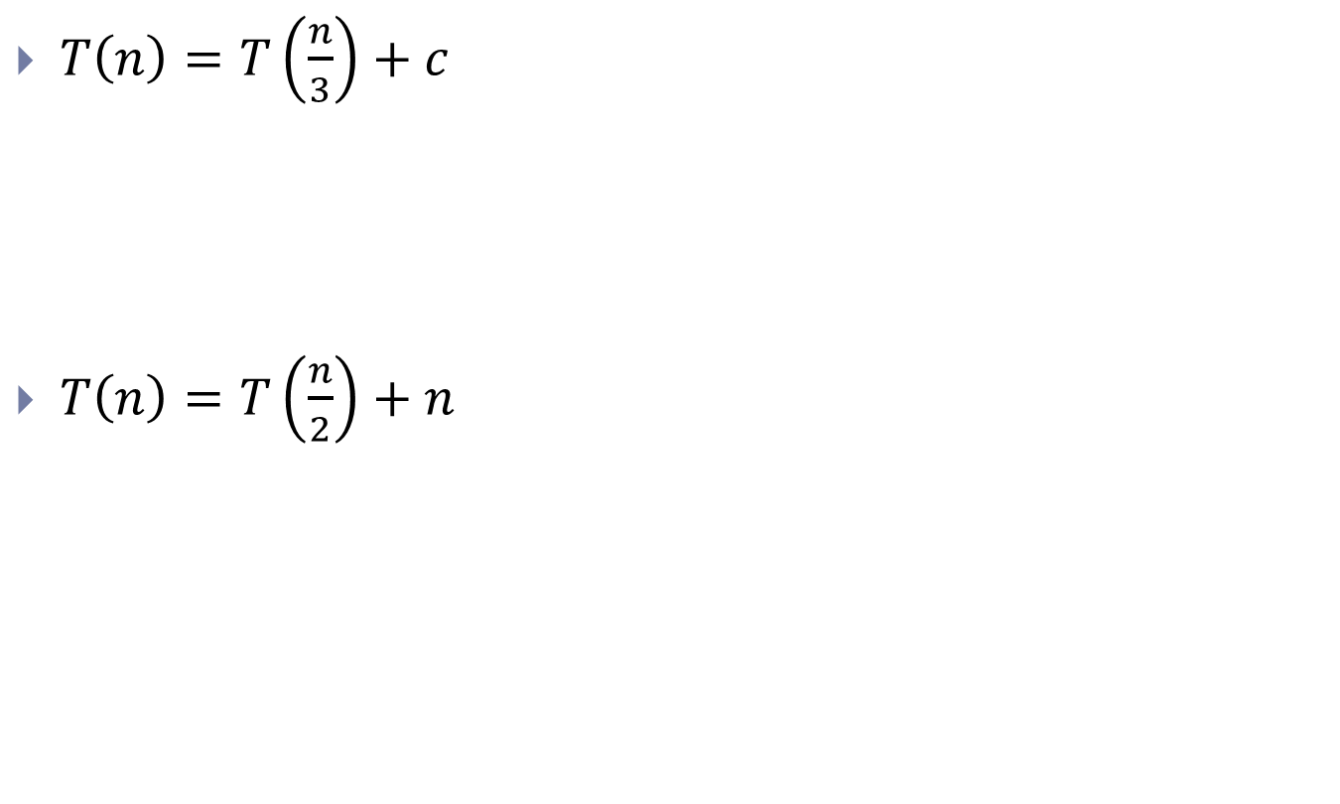
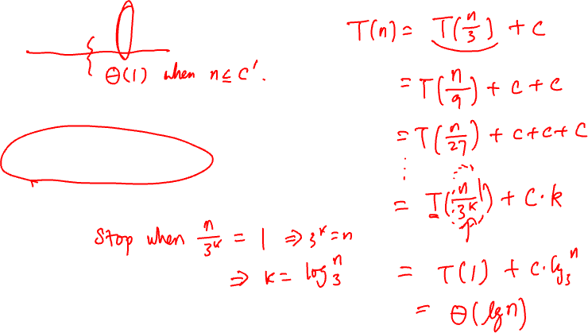
Examples
$T\left(n\right)=T\left(\frac{n}{3}\right)+c$
$T\left(n\right)=T\left(\frac{n}{2}\right)+n$

Slide 43
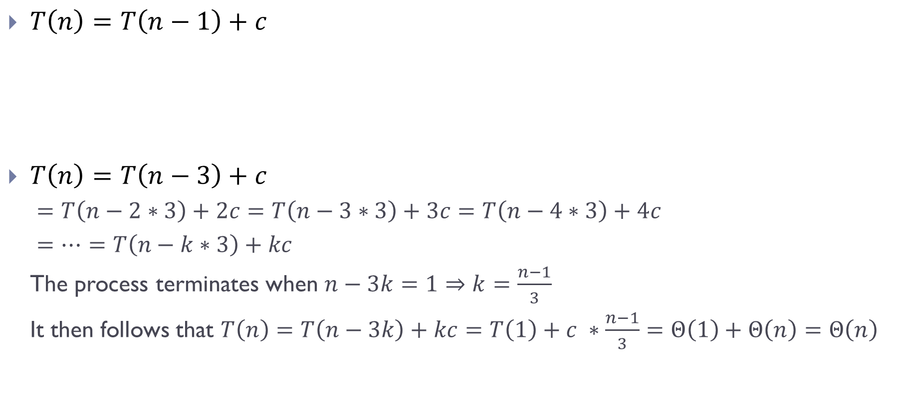
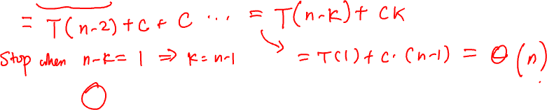
Examples/3
$T\left(n\right)=T\left(n−1\right)+c$
$T\left(n\right)=T\left(n−3\right)+c$
$=T\left(n−2∗3\right)+2c=T\left(n−3∗3\right)+3c=T\left(n−4∗3\right)+4c$
$=⋯=T\left(n−k∗3\right)+kc$
The process terminates when $n−3k=1⇒k=\frac{n−1}{3}$
It then follows that $T\left(n\right)=T\left(n−3k\right)+kc=T\left(1\right)+c ∗\frac{n−1}{3}=Θ\left(1\right)+Θ\left(n\right)=Θ\left(n\right)$

Slide 44
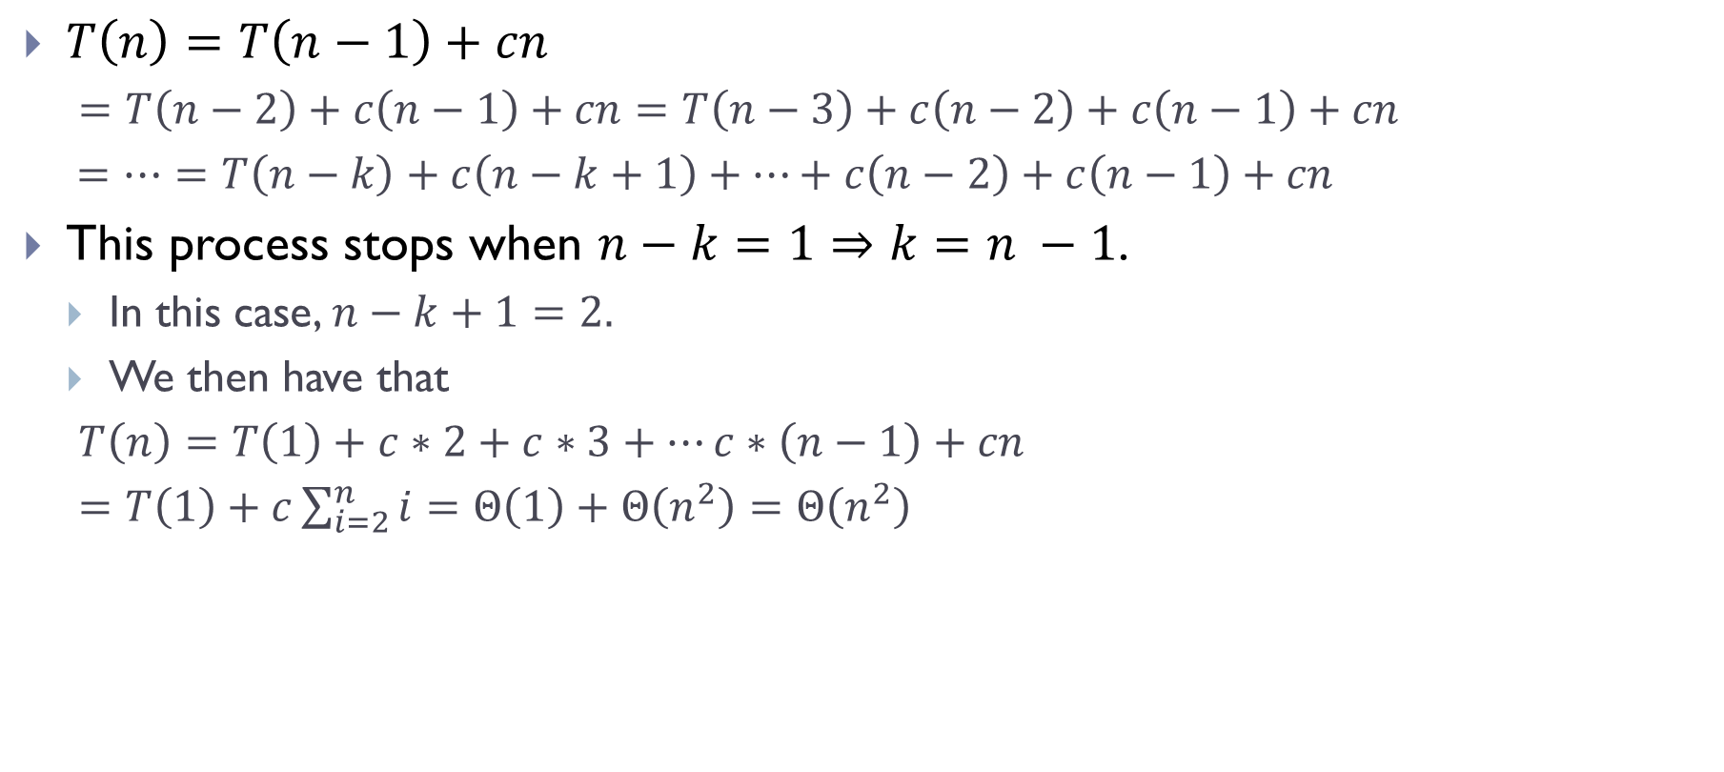
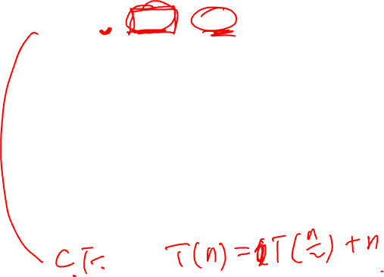
Examples
$T\left(n\right)=T\left(n−1\right)+cn$
$=T\left(n−2\right)+c\left(n−1\right)+cn=T\left(n−3\right)+c\left(n−2\right)+c\left(n−1\right)+cn$
$=⋯=T\left(n−k\right)+c\left(n−k+1\right)+⋯+c\left(n−2\right)+c\left(n−1\right)+cn$
This process stops when $n−k=1⇒k=n −1$.
In this case, $n−k+1=2.$
We then have that
$T\left(n\right)=T\left(1\right)+c∗2+c∗3+⋯c∗\left(n−1\right)+cn$
$=T\left(1\right)+c\sum_{i=2}^{n}{i}=Θ\left(1\right)+Θ\left(n^{2}\right)=Θ\left(n^{2}\right)$

Slide 45
FIN

