Slide 1
DSC40B: Theoretical Foundations of Data Science II
Lecture 15: Shortest Path in Weighted Graphs – part II
Instructor: Yusu Wang

Slide 2
Prelude
Previously
SSSP in weighted graphs
Properties of shortest paths in weighted graphs
Edge update
Bellman-Ford algorithm to solve SSSP for any weighted graphs
Today: Dijkstra algorithm
A much more efficient algorithm for SSSP for positively weighted graphs

Slide 3
Dijkstra shortest path algorithm

Slide 4
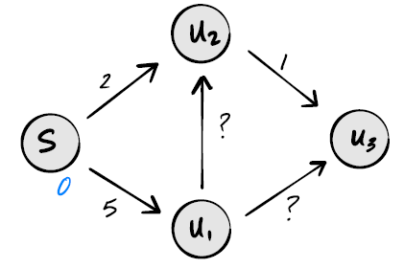
Dijkstra Algorithm
Dijkstra has some similarity to Bellman-Ford
In the sense that both will repeatedly perform update(edge) operations to improve shortest path estimates
different in the order of these update operations, where Dijkstra does so more intelligently for positively weighted graphs to reduce redundancy.
In particular,
Bellman-Ford updates all edges in each iteration – many of them don’t need to be updated
If we assume all edge weights are positive, then we can rule out some paths immediately:

Slide 5
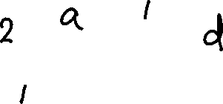
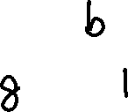
Dijkstra Algorithm
High level idea also similar to BFS
for each node, we will maintain an estimate of shortest distance to the source
this estimate will be iteratively updated
the algorithm will explore the nodes in a greedy manner, in increasing distance to the source
by the time we start to explore a node, the algorithm will be guaranteed to have already computed correct shortest path distance from the source to this node
6

Slide 6

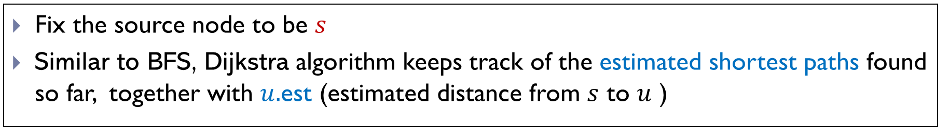
Estimated shortest path
Fix the source node to be $s$
Similar to BFS, Dijkstra algorithm keeps track of the estimated shortest paths found so far, together with $u.$est (estimated distance from $s$ to $u$ )
At the beginning, $u.$est = $∞$ for all nodes other than the source $s$
Keep track of a set $C$ of correct nodes
At every step, add node outside of $C$ with smallest estimated distance to $C;$ update estimated distances to its neighbors.

Slide 7
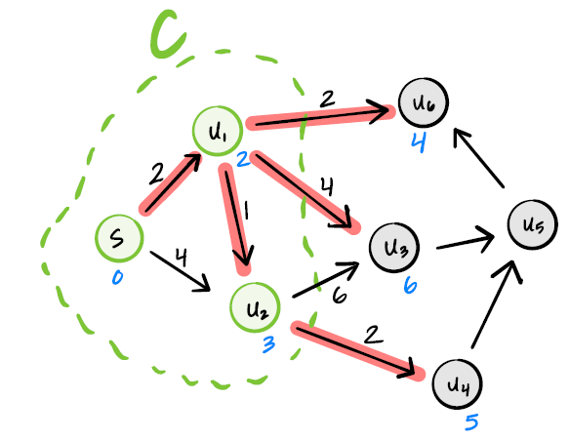

Slide 8
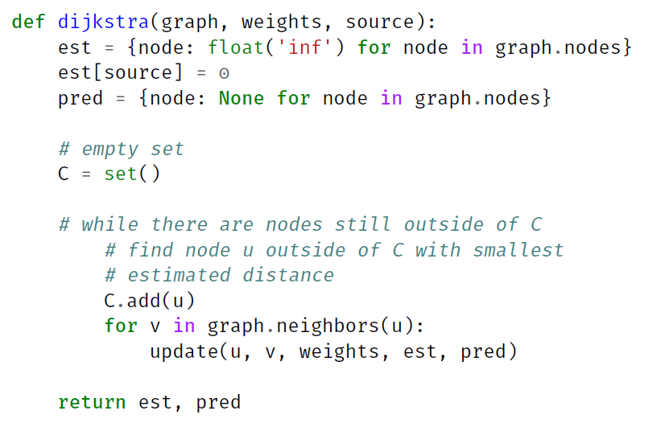
Outline of Dijkstra Alg (not code)

Slide 9
Example
Outside
Set C
6

Slide 10
Correctness of Dijkstra

Slide 11

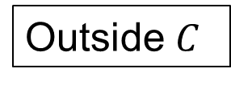
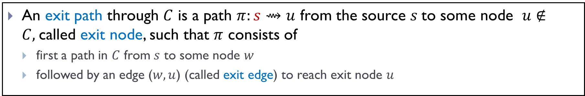



Exit paths
An exit path through $C$ is a path $π:s⇝u$ from the source $s$to some node $u∉C,$called exit node, such that $π$ consists of
first a path in $C$ from $s$ to some node $w$
followed by an edge ($w,u$) (called exit edge) to reach exit node $u$
$$u$$
$$s$$
$$w$$
$$C$$
Outside $C$

Slide 12
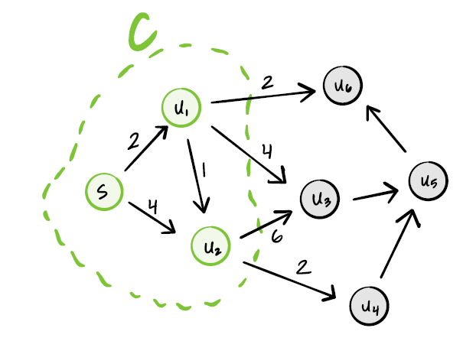
Examples

Slide 13
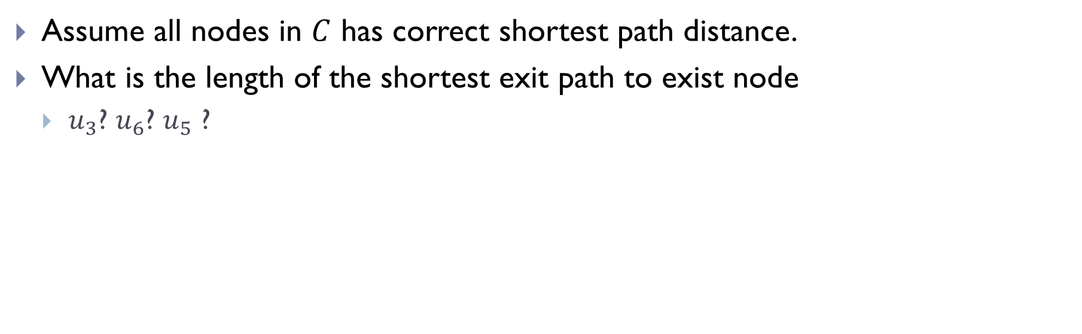
Shortest Exist-paths
Assume all nodes in $C$ has correct shortest path distance.
What is the length of the shortest exit path to exist node
$u_{3}$? $u_{6}$? $u_{5}$ ?

Slide 14
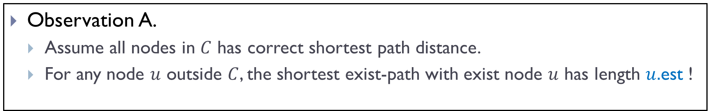
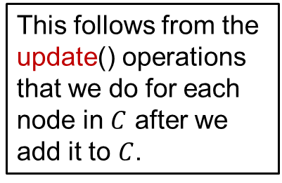
Shortest Exist-paths
Observation A.
Assume all nodes in $C$ has correct shortest path distance.
For any node $u$ outside $C$, the shortest exist-path with exist node $u$ has length $u.$est !
This follows from the update() operations that we do for each node in $C$ after we add it to $C$.

Slide 15


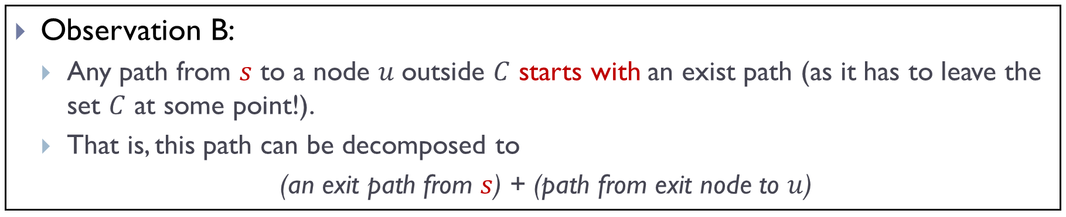





Exit-path Decomposition
Observation B:
Any path from $s$ to a node $u$outside $C$ starts with an exist path (as it has to leave the set $C$ at some point!).
That is, this path can be decomposed to
(an exit path from $s$) + (path from exit node to $u$)
$$u$$
$$s$$
$$C$$

Slide 16
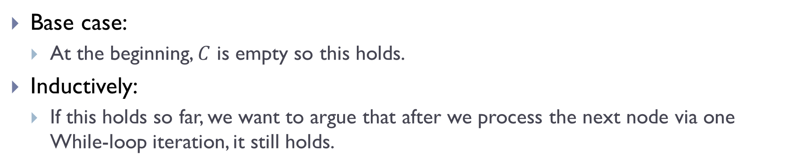
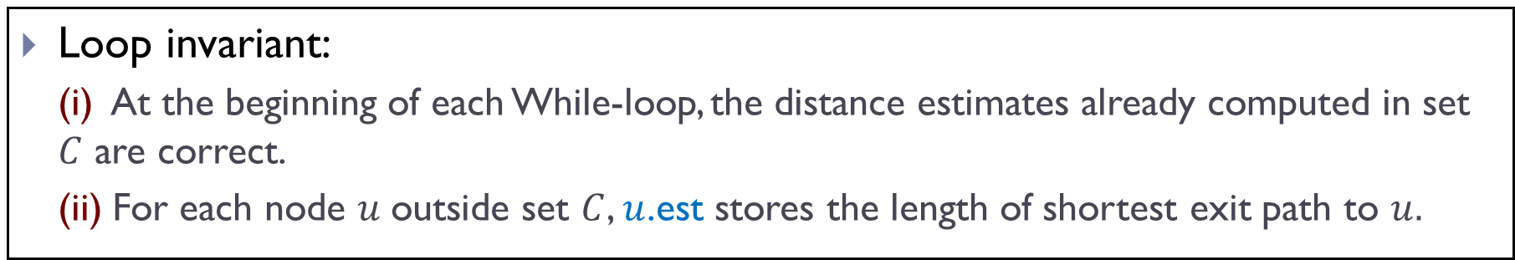
Correctness of Dijkstra
Loop invariant:
(i) At the beginning of each While-loop, the distance estimates already computed in set $C$ are correct.
(ii) For each node $u$outside set $C$, $u$.est stores the length of shortest exit path to $u.$
Base case:
At the beginning, $C$ is empty so this holds.
Inductively:
If this holds so far, we want to argue that after we process the next node via one While-loop iteration, it still holds.

Slide 17
Outline of Dijkstra Alg (not code)

Slide 18
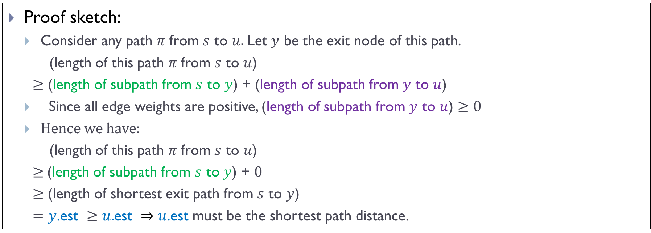
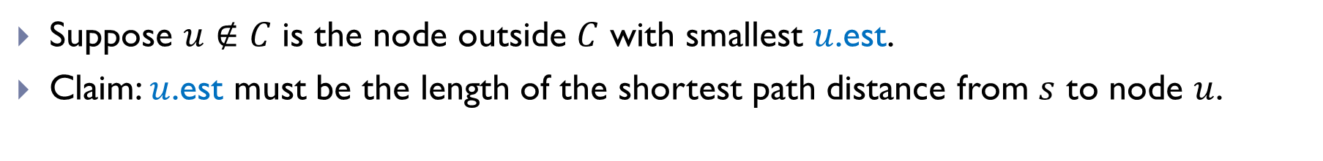
Proof of Loop Invariant (i)
Suppose $u∉C$ is the node outside $C$ with smallest $u$.est.
Claim: $u$.est must be the length of the shortest path distance from $s$ to node $u$.
Proof sketch:
Consider any path $π$from $s$ to $u.$Let $y$ be the exit node of this path.
(length of this path $π$from $s$ to $u$)
$≥$ (length of subpath from $s$ to $y$) + (length of subpath from $y$ to $u$)
Since all edge weights are positive, (length of subpath from $y$ to $u$) $≥0$
Hence we have:
(length of this path $π$from $s$ to $u$)
$≥$(length of subpath from $s$ to $y$) + $0$
$≥$ (length of shortest exit path from $s$ to $y$)
$=y$.est $≥u.$est $⇒u$.est must be the shortest path distance.

Slide 19



Illustration
$$u$$
$$s$$
$$w$$
$$C$$

Slide 20
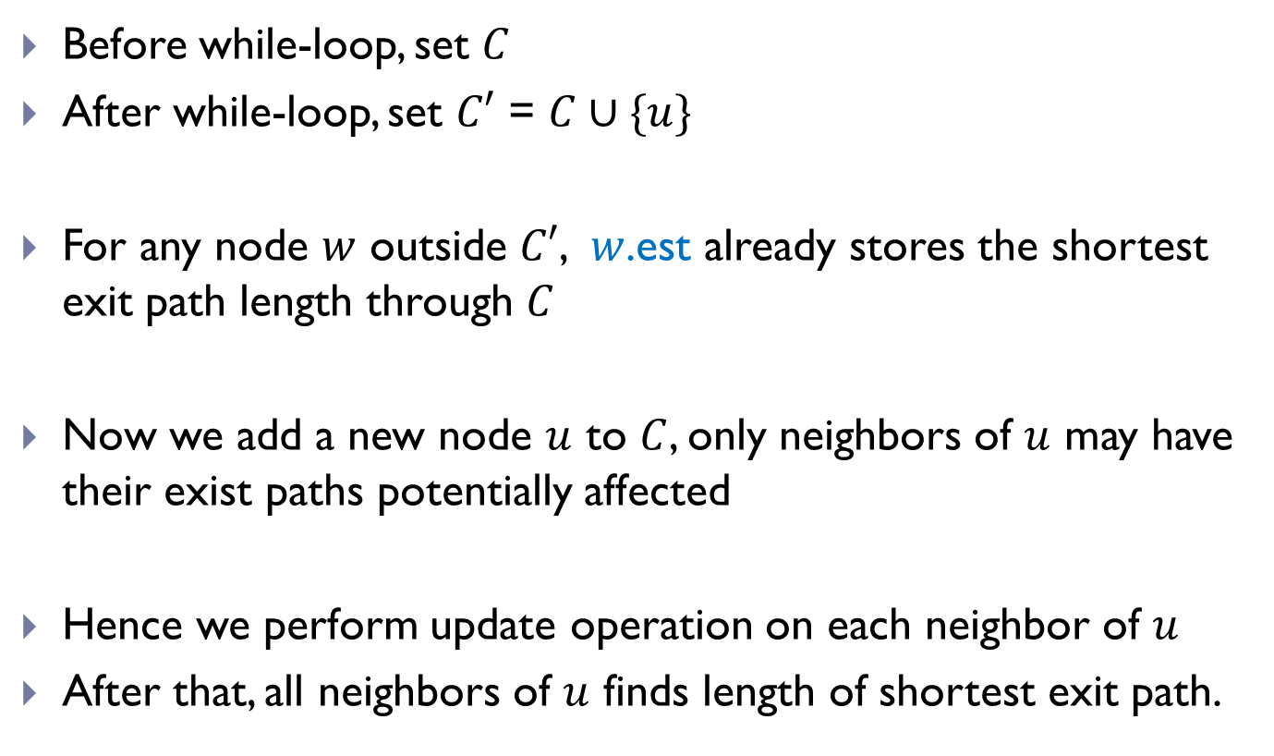
Proof of Loop invariant (ii)
Before while-loop, set $C$
After while-loop, set $C′$ = $C∪\{u\}$
For any node $w$ outside $C′$, $w$.est already stores the shortest exit path length through $C$
Now we add a new node $u$ to $C$, only neighbors of $u$ may have their exist paths potentially affected
Hence we perform update operation on each neighbor of $u$
After that, all neighbors of $u$ finds length of shortest exit path.

Slide 21
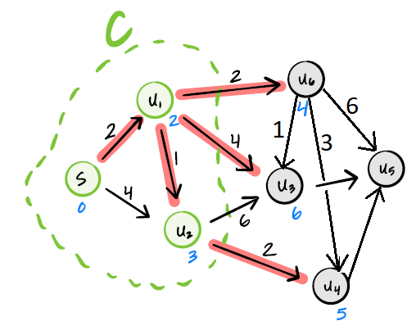
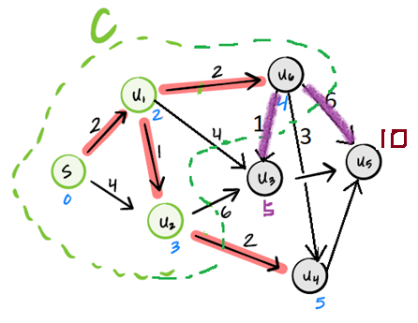
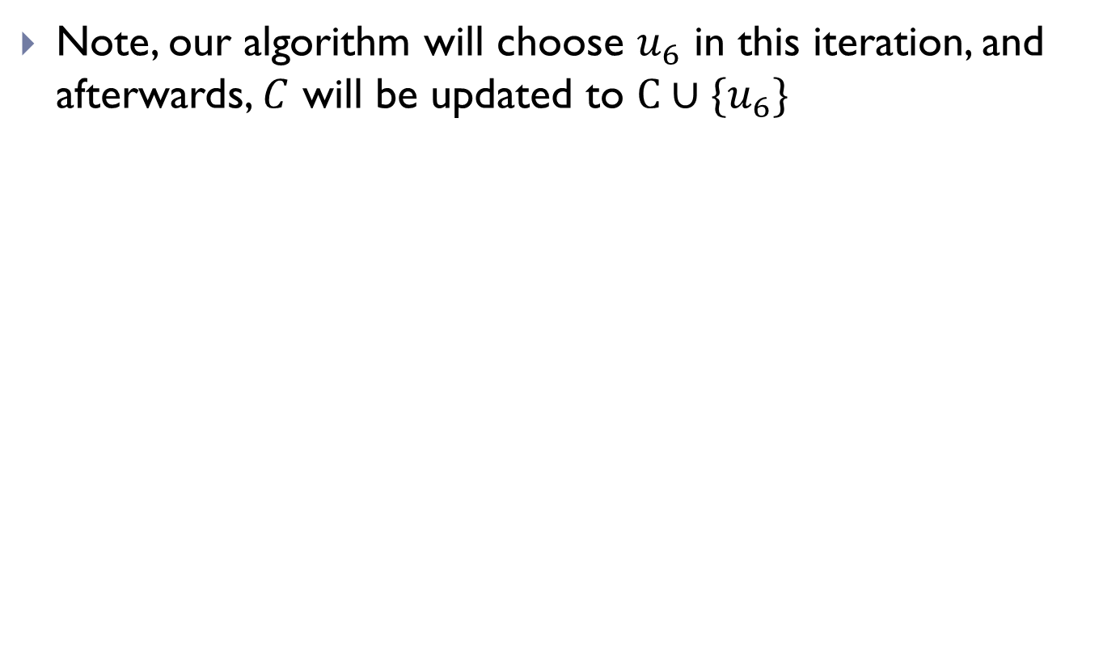
Illustrations
Note, our algorithm will choose $u_{6}$ in this iteration, and afterwards, $C$ will be updated to $C∪\{u_{6}\}$

Slide 22
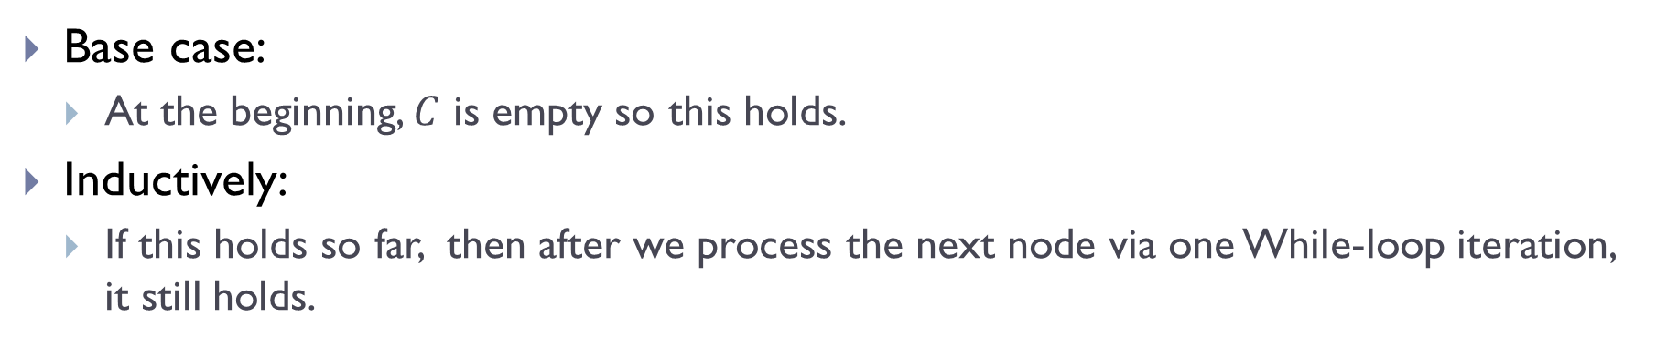
Correctness of Dijkstra
Loop invariant:
(i) At the beginning of each While-loop, the distance estimates already computed in set $C$ are correct.
(ii) For each node $u$outside set $C$, $u$.est stores the length of shortest exit path to $u.$
Base case:
At the beginning, $C$ is empty so this holds.
Inductively:
If this holds so far, then after we process the next node via one While-loop iteration, it still holds.

Slide 23
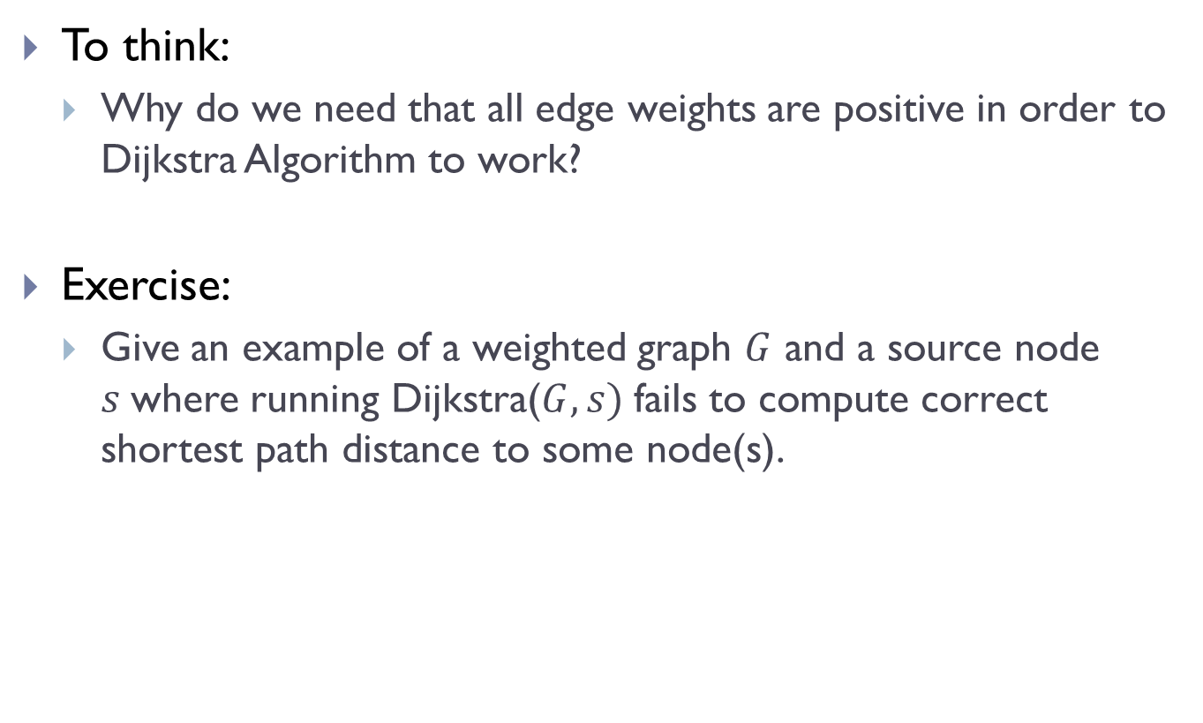
To think:
Why do we need that all edge weights are positive in order to Dijkstra Algorithm to work?
Exercise:
Give an example of a weighted graph $G$ and a source node $s$where running Dijkstra($G, s)$ fails to compute correct shortest path distance to some node(s).

Slide 24
Implementation of Dijkstra

Slide 25
Outline of Dijkstra Alg (not code)

Slide 26
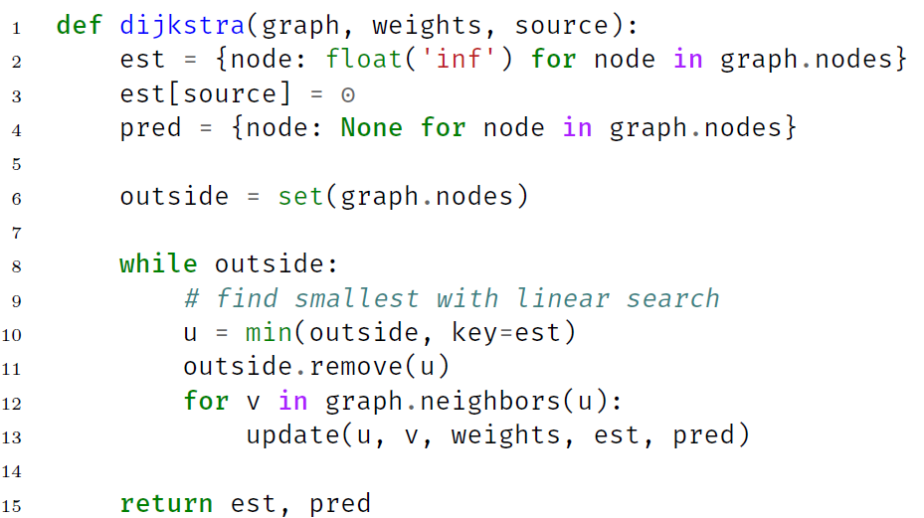
Naïve implementation of Dijkstra

Slide 27
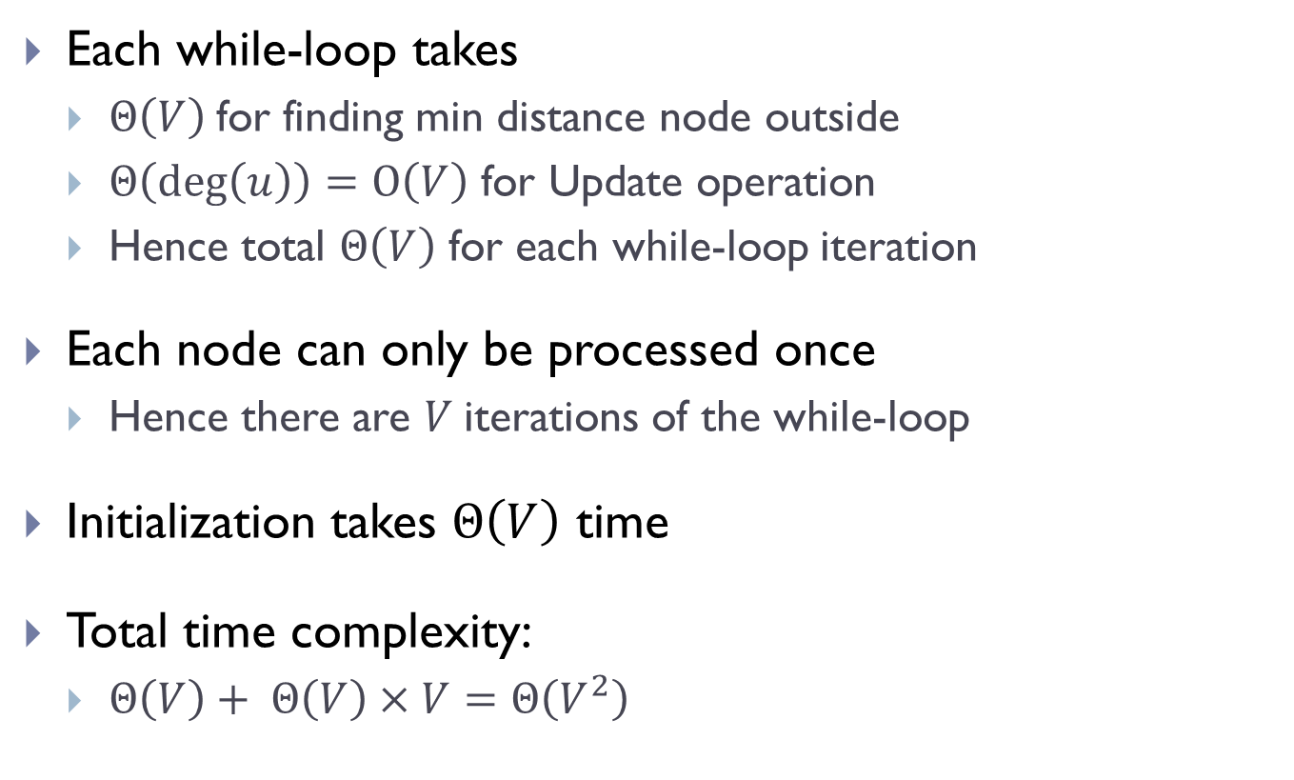
Time complexity of Naïve implementation
Each while-loop takes
$Θ\left(V\right)$for finding min distance node outside
$Θ\left(\deg\left(u\right)\right)=O\left(V\right)$ for Update operation
Hence total $Θ\left(V\right)$ for each while-loop iteration
Each node can only be processed once
Hence there are $V$iterations of the while-loop
Initialization takes $Θ\left(V\right)$ time
Total time complexity:
$Θ\left(V\right)+ Θ\left(V\right)×V=Θ\left(V^{2}\right)$

Slide 28
Can we do better?

Slide 29
Bottleneck is that we have to repeatedly perform linear-scan to find the node outside with smallest distance estimate
We need a data structure to do the following:
For each outside node, maintain estimated distance
Extract (i.e., identify and delete) the node with smallest estimated distance
Update the estimated distance for a given node (in fact, decrease the estimated distance)
We need a priority-queue data structure!

Slide 30
Priority queues
A priority queue is a data structure that allows us to store (key, value) pairs, extract the key with lowest value, and to decrease the value
These are exactly what we need!
Suppose we have a priority queue class:
PriorityQueue(priorities) will create a priority queue from a dictionary whose values are priorities
The .extract_min() method removes and returns (i.e., extract) key with smallest value
The .change_priority(key, value) method changes key’s value

Slide 31
Example
>>> pq = PriorityQueue({
'w': 5,
'x': 4,
'y': 1,
'z': 3
})
>>> pq.extract_min()
'y'
>>> pq.change_priority('w', 2)
>>> pq.extract_min()
________________?

Slide 32

Heap implementation of priority queue
A priority queue can be implemented using a (min) heap
min-heap implementation of priority queue:
PriorityQueue(priorities): takes $Θ\left(n\right)$ time for $n=|$priorities|
.extract_min() : takes $Θ\left(\log{n}\right)$ time where $n$ is the size of priority queue
.change_priority(key, value) : takes $Θ\left(\log{n}\right)$ time where $n$ is the size of priority queue

Slide 33
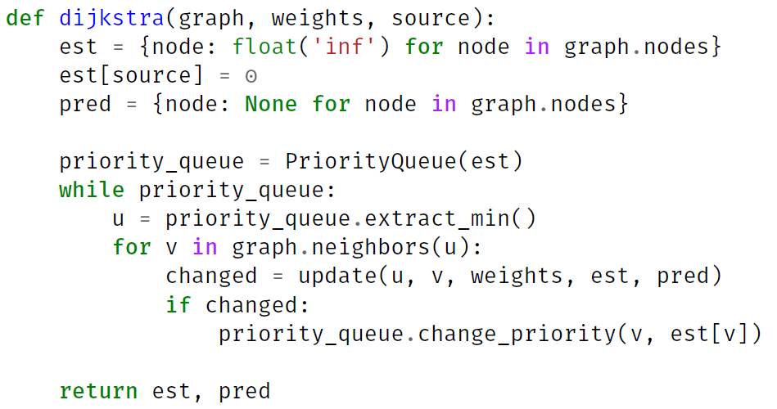
Dijkstra using priority queue

Slide 34
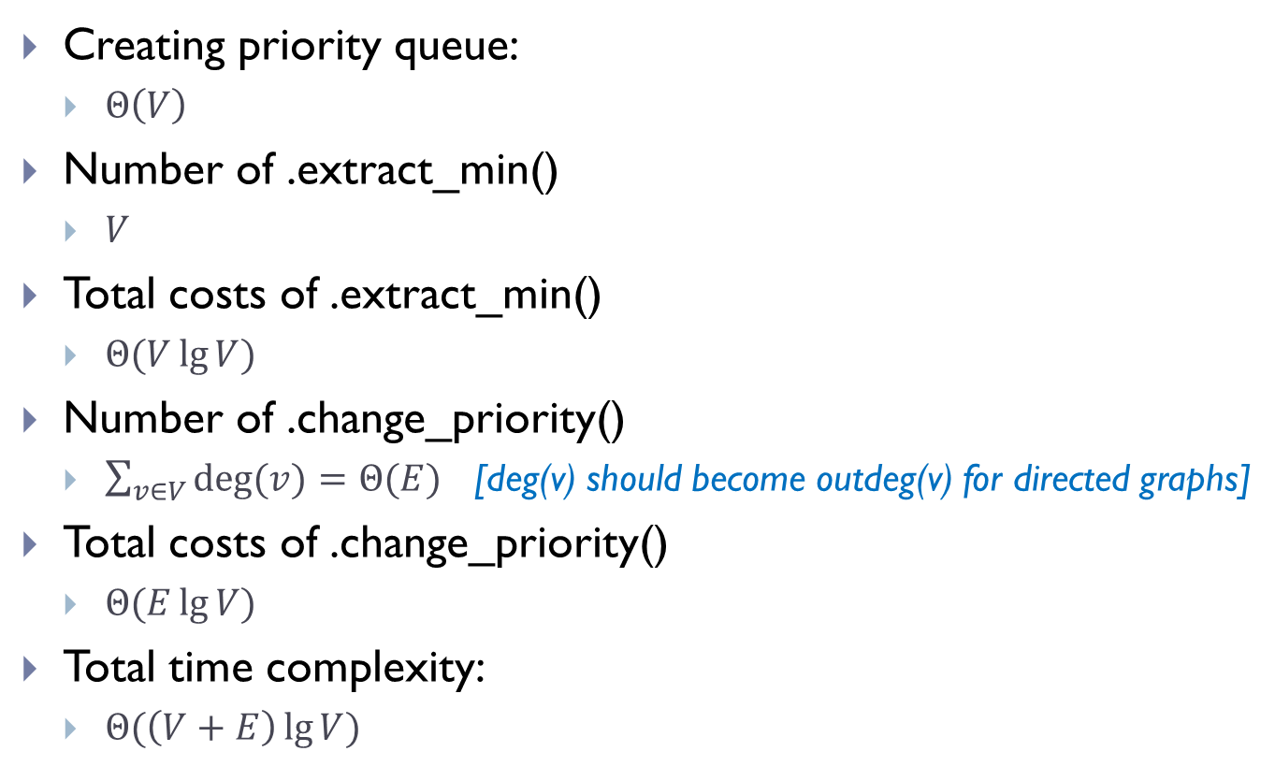
Time Complexity using heap implementation of priority queue
Creating priority queue:
$Θ\left(V\right)$
Number of .extract_min()
$V$
Total costs of .extract_min()
$Θ(V\lg{V})$
Number of .change_priority()
$\sum_{v∈V}{deg⁡(v)}=Θ(E)$ [deg(v) should become outdeg(v) for directed graphs]
Total costs of .change_priority()
$Θ(E\lg{V})$
Total time complexity:
$Θ(\left(V+E\right)\lg{V})$

Slide 35
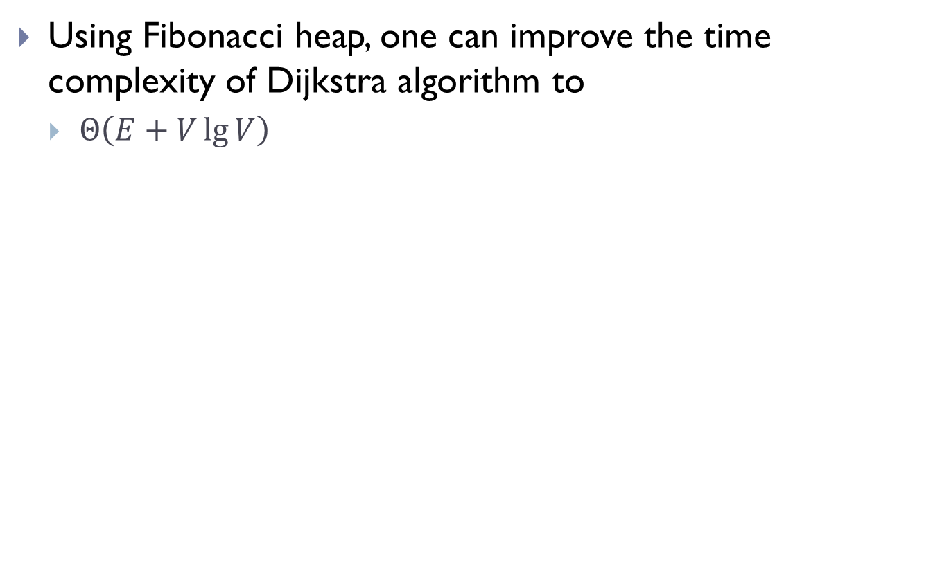
Using Fibonacci heap, one can improve the time complexity of Dijkstra algorithm to
$Θ\left(E+V\lg{V}\right)$

Slide 36
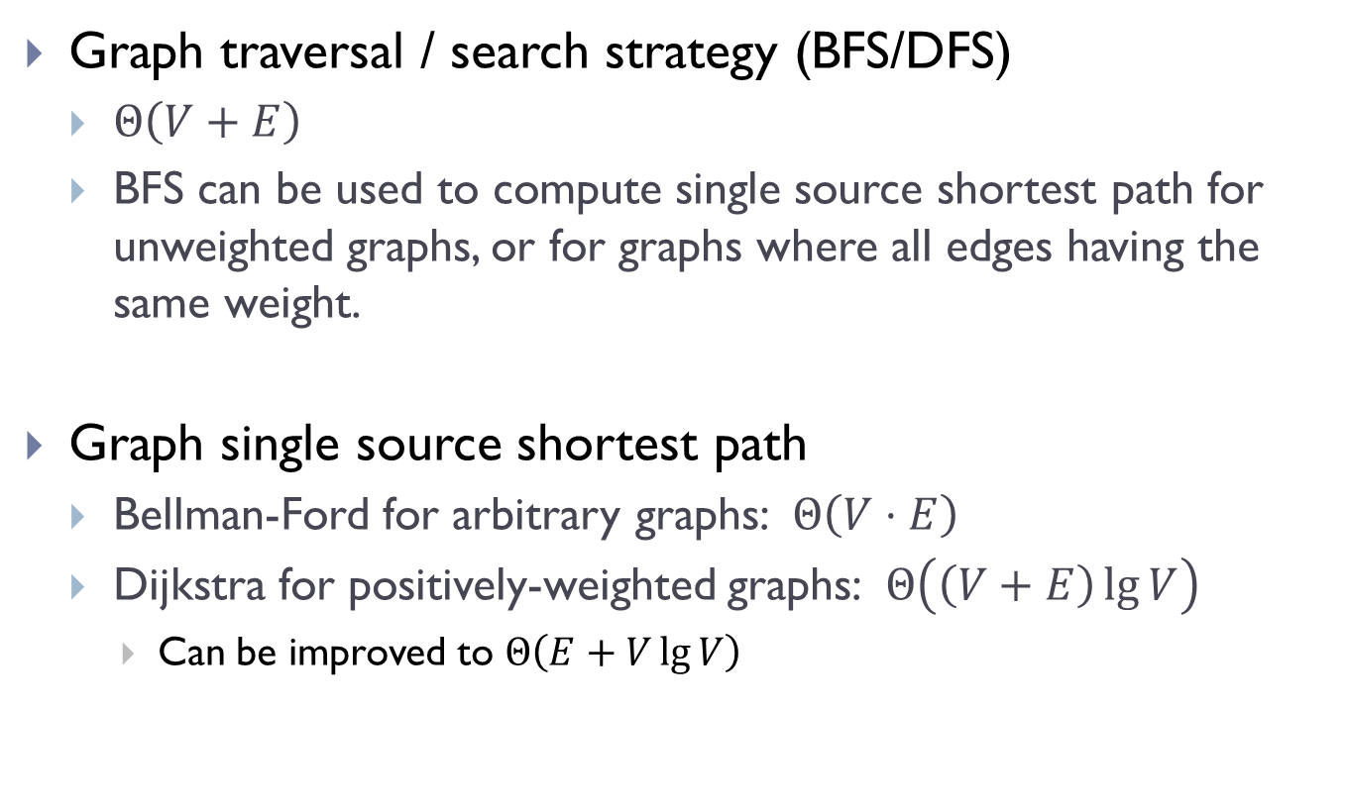
Summary
Graph traversal / search strategy (BFS/DFS)
$Θ\left(V+E\right)$
BFS can be used to compute single source shortest path for unweighted graphs, or for graphs where all edges having the same weight.
Graph single source shortest path
Bellman-Ford for arbitrary graphs: $Θ\left(V⋅E\right)$
Dijkstra for positively-weighted graphs: $Θ\left(\left(V+E\right)\lg{V}\right)$
Can be improved to $Θ\left(E+V\lg{V}\right)$

Slide 37
FIN

