Slide 1
DSC40B: Theoretical Foundations of Data Science II
Lecture 12: BFS Part II : shortest path in (unweighted) graphs
Instructor: Yusu Wang

Slide 2
First, first midterm grades are released.
Go over some exam problems.

Slide 3
Previously:
Introduced Breadth-first search (BFS) graph search algorithm
Can be used to check for connectivity etc
Today:
Properties of BFS:
Computing shortest path from a source node
BFS tree

Slide 4
Shortest path in (unweighted) graphs

Slide 5
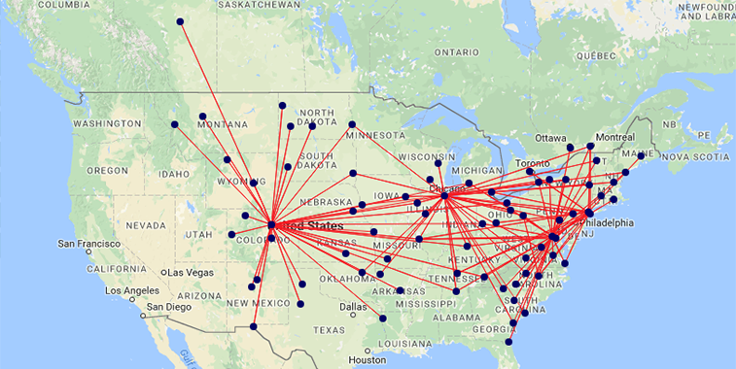
How to fly to Denver from Columbus using fewest number of connections

Slide 6
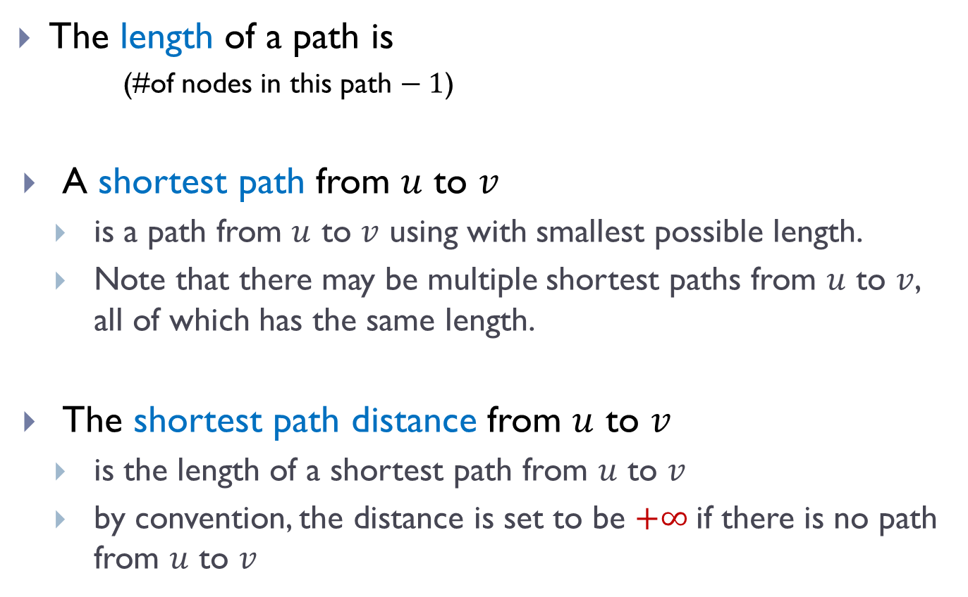
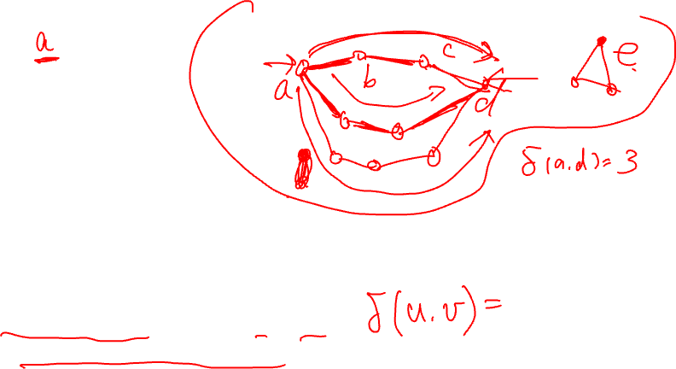
The length of a path is
(#of nodes in this path $− 1$)
A shortest path from $u$ to $v$
is a path from $u$ to $v$ using with smallest possible length.
Note that there may be multiple shortest paths from $u$ to $v$, all of which has the same length.
The shortest path distance from $u$ to $v$
is the length of a shortest path from $u$ to $v$
by convention, the distance is set to be $+∞$if there is no path from $u$ to $v$

Slide 7
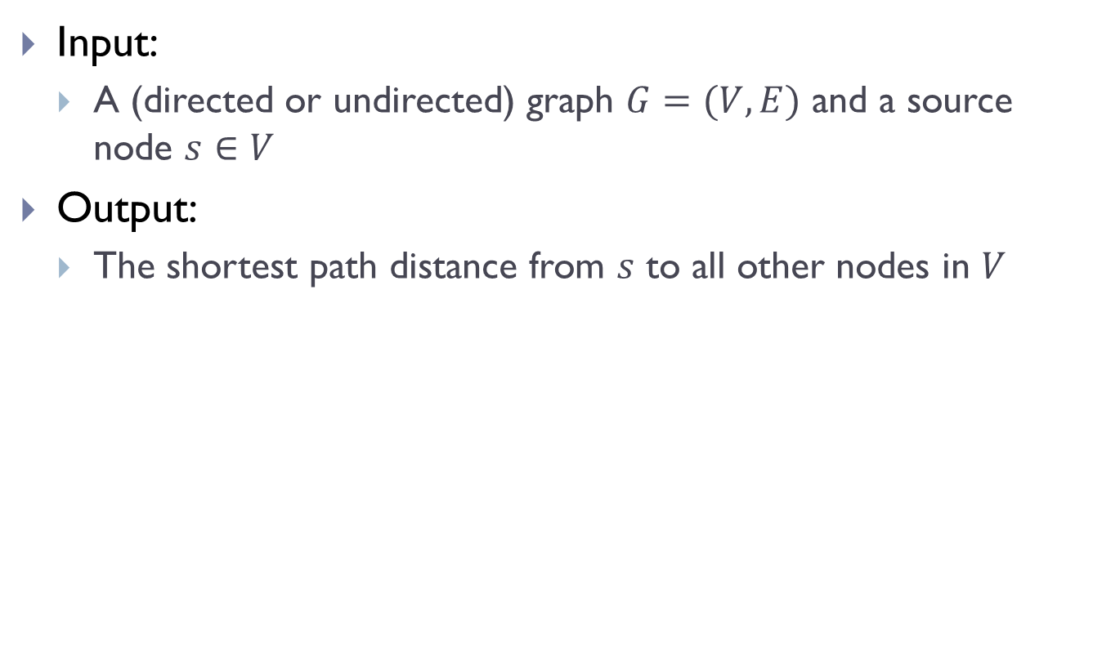
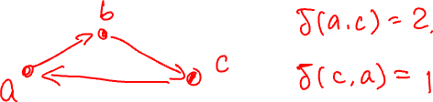
Input:
A (directed or undirected) graph $G=(V, E)$ and a source node $s∈V$
Output:
The shortest path distance from $s$ to all other nodes in $V$

Slide 8
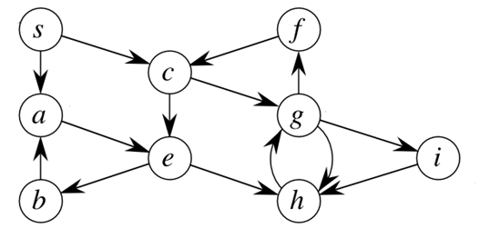
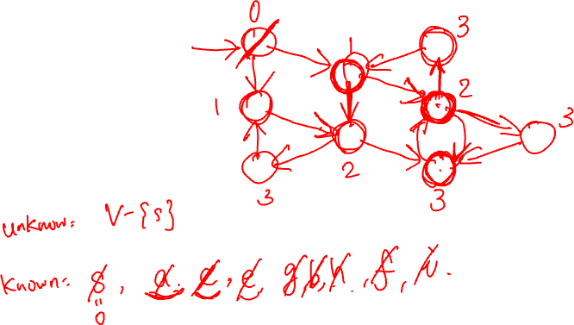
Example

Slide 9
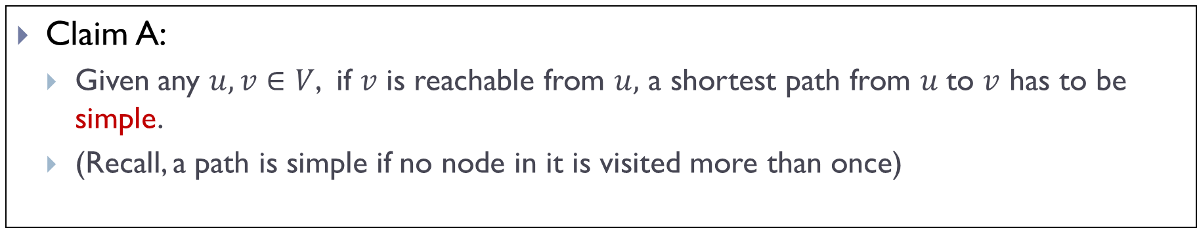

Property of shortest paths (i)
Claim A:
Given any $u, v∈V$, if $v$ is reachable from $u,$ a shortest path from $u$to $v$ has to be simple.
(Recall, a path is simple if no node in it is visited more than once)

Slide 10
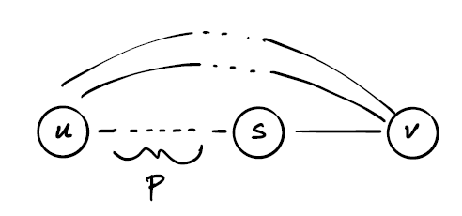
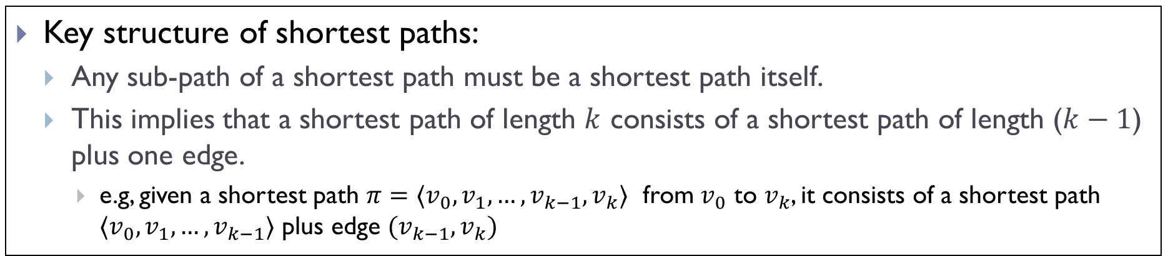
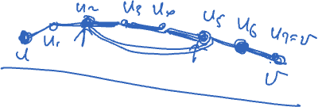
Property of shortest paths (ii)
Key structure of shortest paths:
Any sub-path of a shortest path must be a shortest path itself.
This implies that a shortest path of length $k$ consists of a shortest path of length ($k−1$) plus one edge.
e.g, given a shortest path $π=⟨v_{0},v_{1},…, v_{k−1}, v_{k}⟩$ from $v_{0}$ to $v_{k}$, it consists of a shortest path $⟨v_{0},v_{1},…, v_{k−1}⟩$ plus edge $(v_{k−1},v_{k})$

Slide 11
Shortest path and BFS

Slide 12
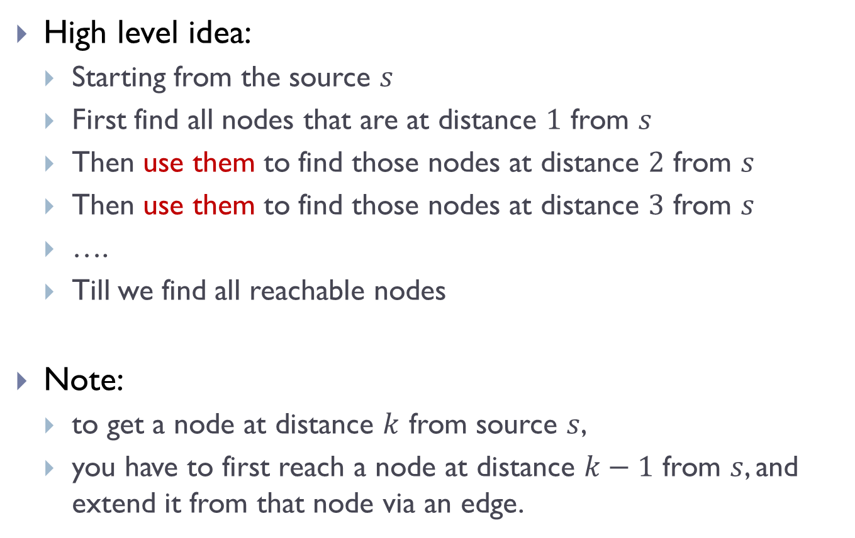

How do we find shortest paths?
High level idea:
Starting from the source $s$
First find all nodes that are at distance $1$ from $s$
Then use them to find those nodes at distance $2$ from $s$
Then use them to find those nodes at distance $3$ from $s$
….
Till we find all reachable nodes
Note:
to get a node at distance $k$ from source $s$,
you have to first reach a node at distance $k−1$ from $s$, and extend it from that node via an edge.

Slide 13
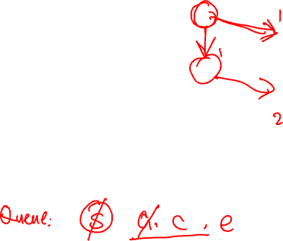
Example

Slide 14
It turns out that this idea is exactly what BFS is doing!
Intuitively,
the first time that we discover a node turns out to encode the fastest way to reach it
that is also when we first change the status of a node from undiscovered to pending
the time this node is discovered relates to the distance to the source nodes
by visiting and exploring the oldest pending nodes (those with smallest distance to the source first), we find fastest way to reach a new node

Slide 15
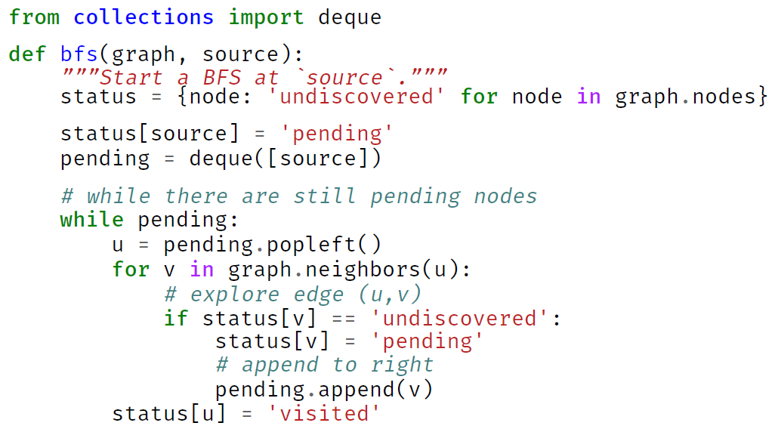
Recall BFS

Slide 16
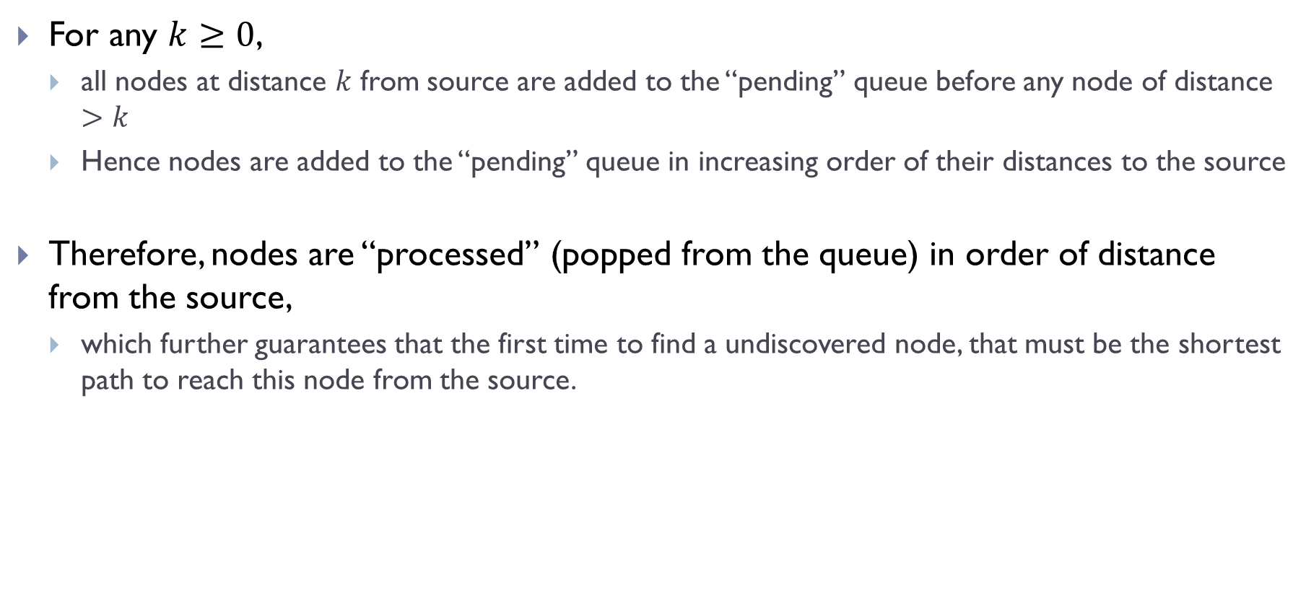
Property of BFS
For any $k≥0$,
all nodes at distance $k$ from source are added to the “pending” queue before any node of distance $>k$
Hence nodes are added to the “pending” queue in increasing order of their distances to the source
Therefore, nodes are “processed” (popped from the queue) in order of distance from the source,
which further guarantees that the first time to find a undiscovered node, that must be the shortest path to reach this node from the source.

Slide 17
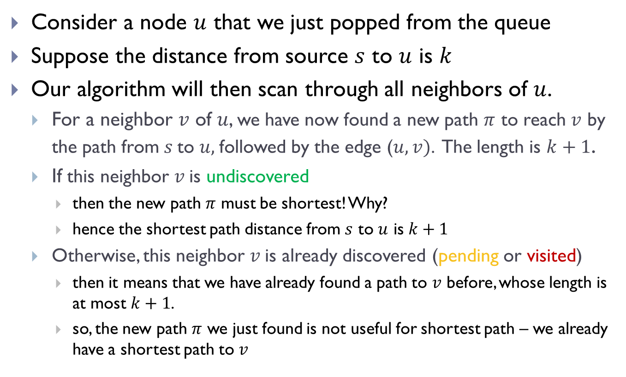

Consider a node $u$ that we just popped from the queue
Suppose the distance from source $s$ to $u$ is $k$
Our algorithm will then scan through all neighbors of $u$.
For a neighbor $v$ of $u$, we have now found a new path $π$ to reach $v$ by the path from $s$to $u,$followed by the edge ($u,v)$. The length is $k+1$.
If this neighbor $v$is undiscovered
then the new path $π$ must be shortest! Why?
hence the shortest path distance from $s$ to $u$ is $k+1$
Otherwise, this neighbor $v$is already discovered (pending or visited)
then it means that we have already found a path to $v$ before, whose length is at most $k+1$.
so, the new path $π$ we just found is not useful for shortest path – we already have a shortest path to $v$

Slide 18
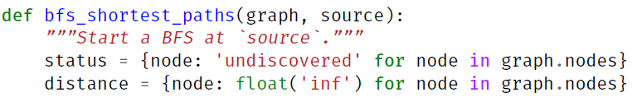

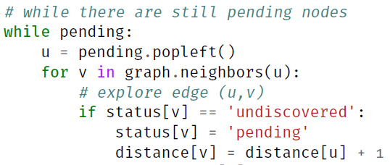
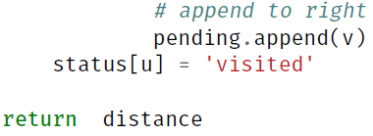
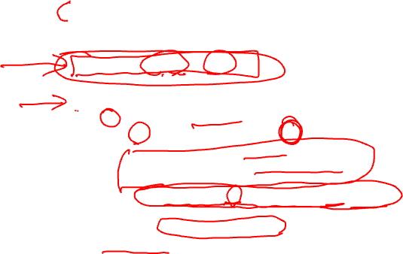
Modified BFS – distance computation

Slide 19
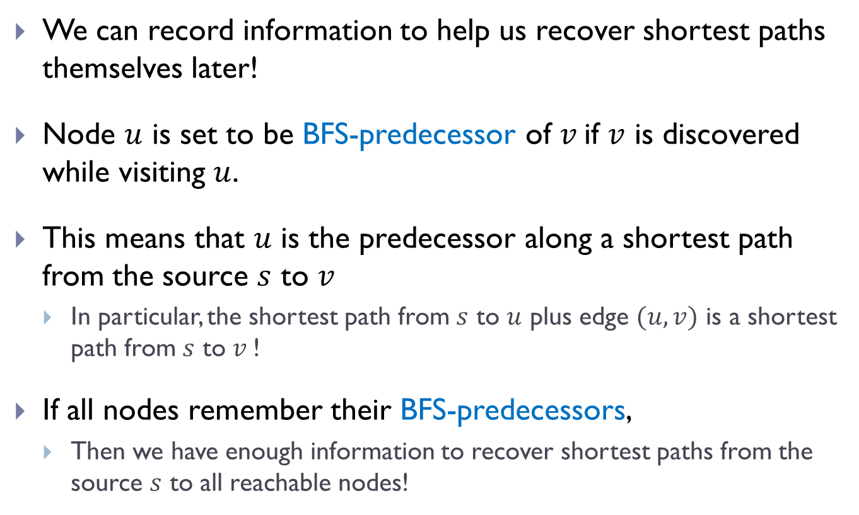
But we can do more!
We can record information to help us recover shortest paths themselves later!
Node $u$ is set to be BFS-predecessor of $v$if $v$ is discovered while visiting $u$.
This means that $u$ is the predecessor along a shortest path from the source $s$ to $v$
In particular, the shortest path from $s$ to $u$ plus edge $(u, v)$ is a shortest path from $s$ to $v$!
If all nodes remember their BFS-predecessors,
Then we have enough information to recover shortest paths from the source $s$ to all reachable nodes!

Slide 20
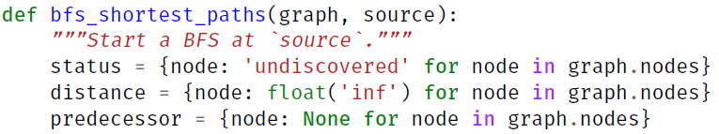

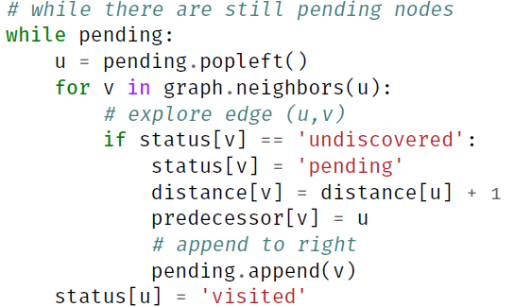

Shortest-Path algorithm

Slide 21
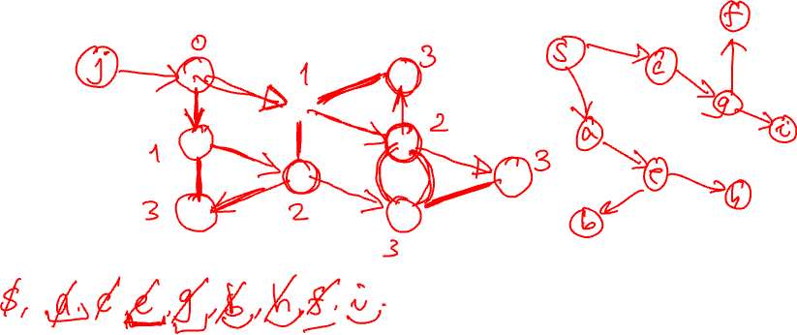
Example

Slide 22
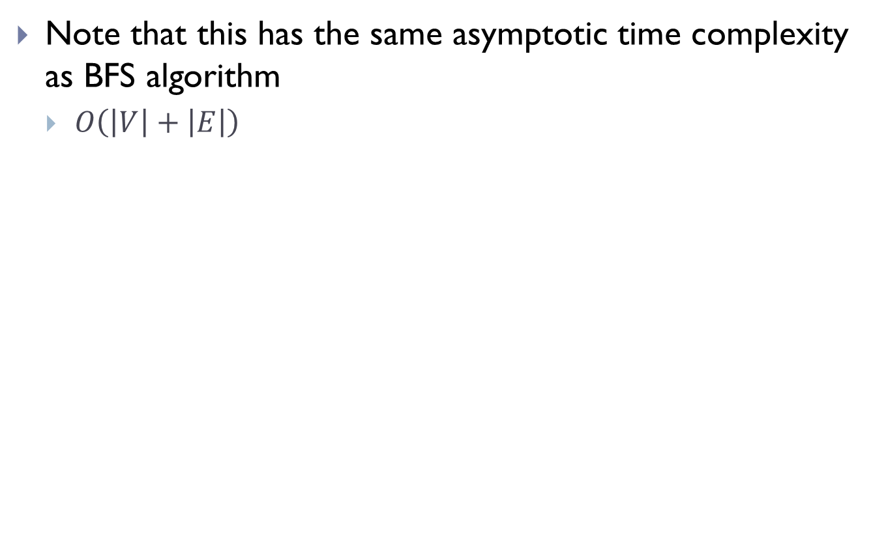
Time complexity
Note that this has the same asymptotic time complexity as BFS algorithm
$O\left(\left|V\right|+\left|E\right|\right)$

Slide 23
BFS Trees and recovering shortest paths

Slide 24
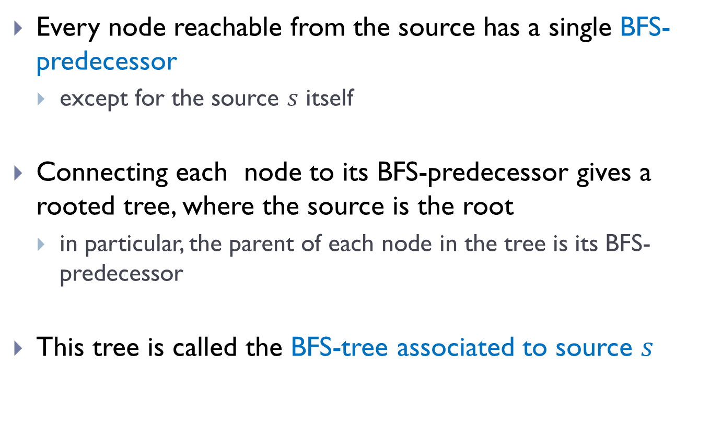
Results of BFS_shortest_path
Every node reachable from the source has a single BFS-predecessor
except for the source $s$ itself
Connecting each node to its BFS-predecessor gives a rooted tree, where the source is the root
in particular, the parent of each node in the tree is its BFS-predecessor
This tree is called the BFS-tree associated to source $s$

Slide 25
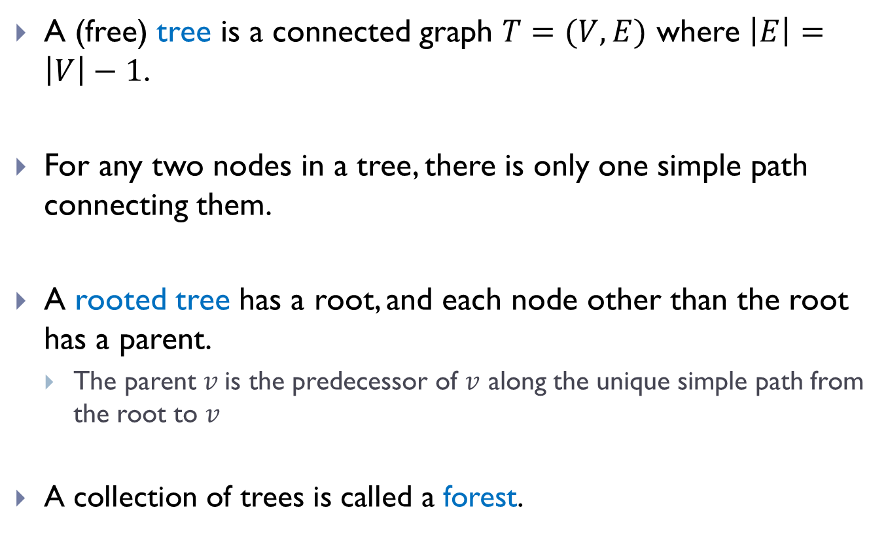
Trees
A (free) tree is a connected graph $T=(V, E)$ where $\left|E\right|=\left|V\right|−1$.
For any two nodes in a tree, there is only one simple path connecting them.
A rooted tree has a root, and each node other than the root has a parent.
The parent $v$is the predecessor of $v$ along the unique simple path from the root to $v$
A collection of trees is called a forest.

Slide 26
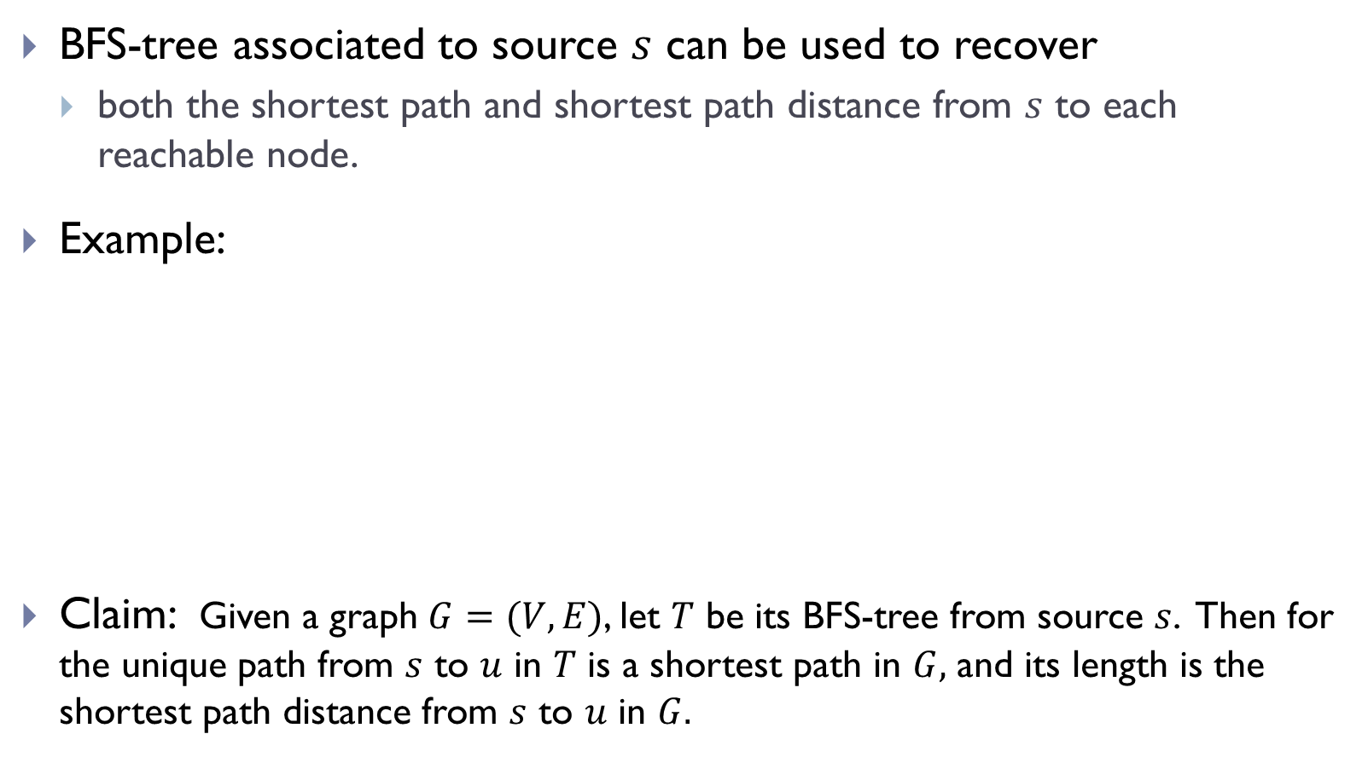
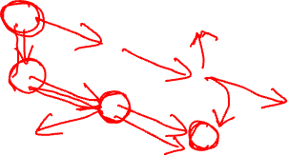
BFS-tree
BFS-tree associated to source $s$ can be used to recover
both the shortest path and shortest path distance from $s$ to each reachable node.
Example:
Claim: Given a graph $G=(V,E)$, let $T$ be its BFS-tree from source $s$. Then for the unique path from $s$ to $u$ in $T$ is a shortest path in $G,$ and its length is the shortest path distance from $s$ to $u$ in $G.$

Slide 27
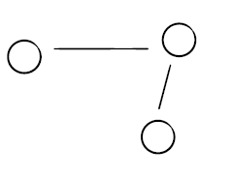
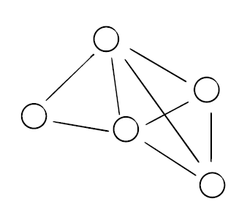
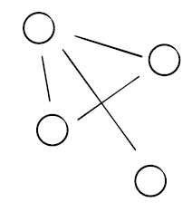

In general, if we run the full-BFS algorithm (with augmentation of computing also predecessors and distances), then we will obtain a collection of BFS-trees, called a BFS-forest.
Example:

Slide 28
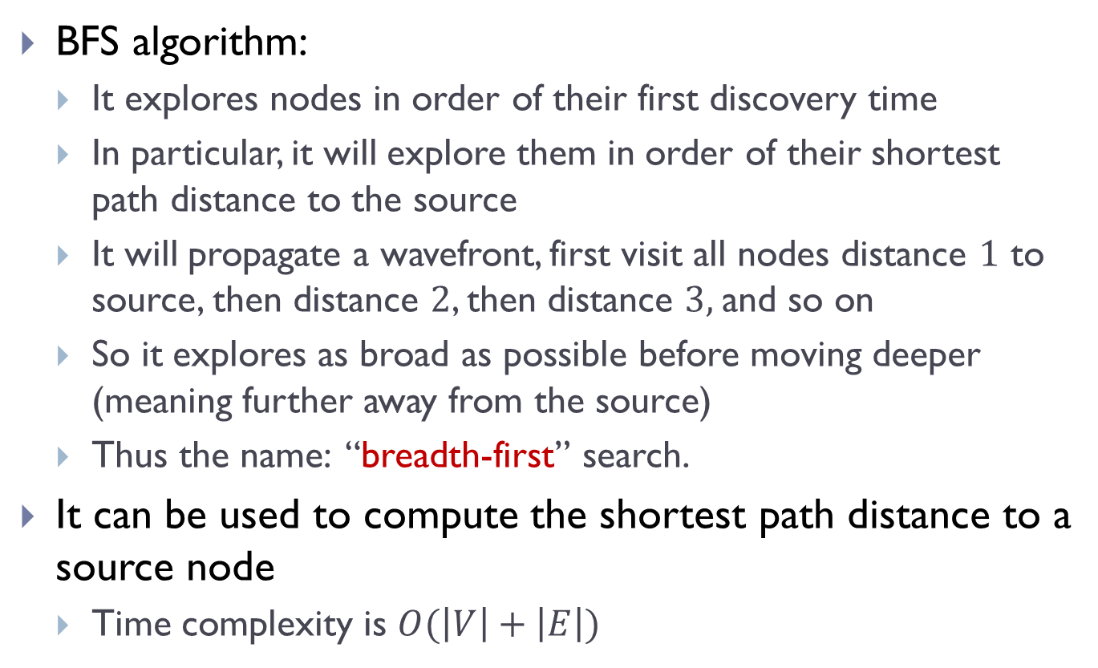

Summary
BFS algorithm:
It explores nodes in order of their first discovery time
In particular, it will explore them in order of their shortest path distance to the source
It will propagate a wavefront, first visit all nodes distance $1$ to source, then distance $2$, then distance $3,$and so on
So it explores as broad as possible before moving deeper (meaning further away from the source)
Thus the name: “breadth-first” search.
It can be used to compute the shortest path distance to a source node
Time complexity is $O(\left|V\right|+\left|E\right|)$

Slide 29
FIN

