Slide 1
DSC40B: Theoretical Foundations of Data Science II
Lecture 4: Expected time complexity
Instructor: Yusu Wang

Slide 2
Part A: Probabilistic analysis vs randomized algorithms

Slide 3
Previously
Worst-case and best-case time complexity analysis
Worst-case time complexity analysis
Most commonly used. Guarantees performance even in the worst case
However, both worst- and best-case time can be caused by just some specific input
How about average time complexity
Intuitively measures how the algorithm works on a typical input?

Slide 4
Expected Analysis
Probabilistic method:
Given a distribution for all possible inputs
Derive expected time based on distribution
Randomized algorithm:
Add randomness in the algorithm
Analyze the expected behavior of the algorithm

Slide 5
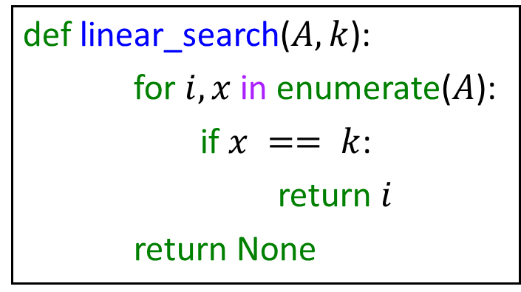
A simple example
def linear_search($A, k$):
for $i, x$in enumerate($A$):
if $x == k$:
return $i$
return None
What is worst case time complexity?
What is expected / average time complexity?

Slide 6
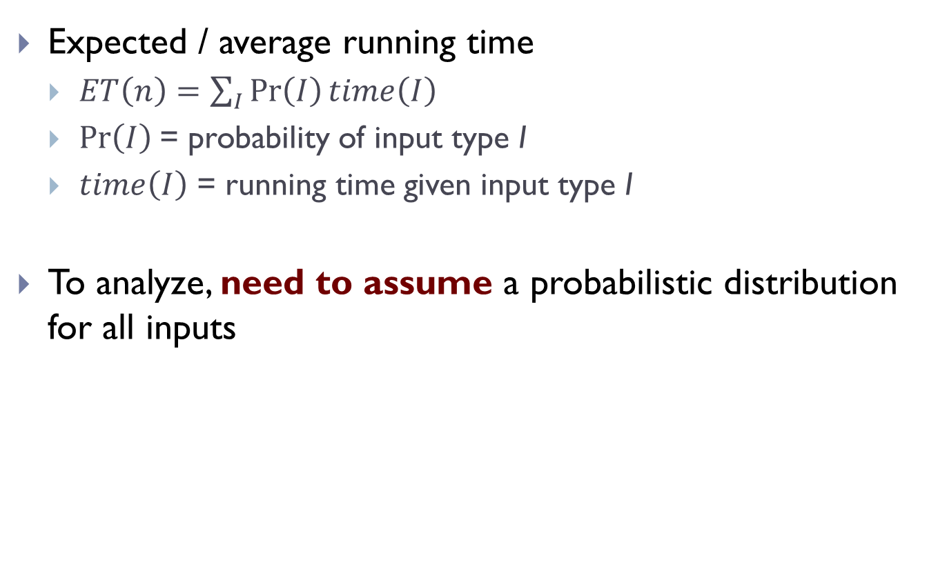
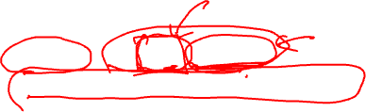
Expected Running Time
Expected / average running time
$ET\left(n\right)=\sum_{I}{\operatorname{Pr}\left(I\right)time\left(I\right)}$
$\operatorname{Pr}\left(I\right)$= probability of input type I
$time\left(I\right)$ = running time given input type I
To analyze, need to assume a probabilistic distribution for all inputs

Slide 7
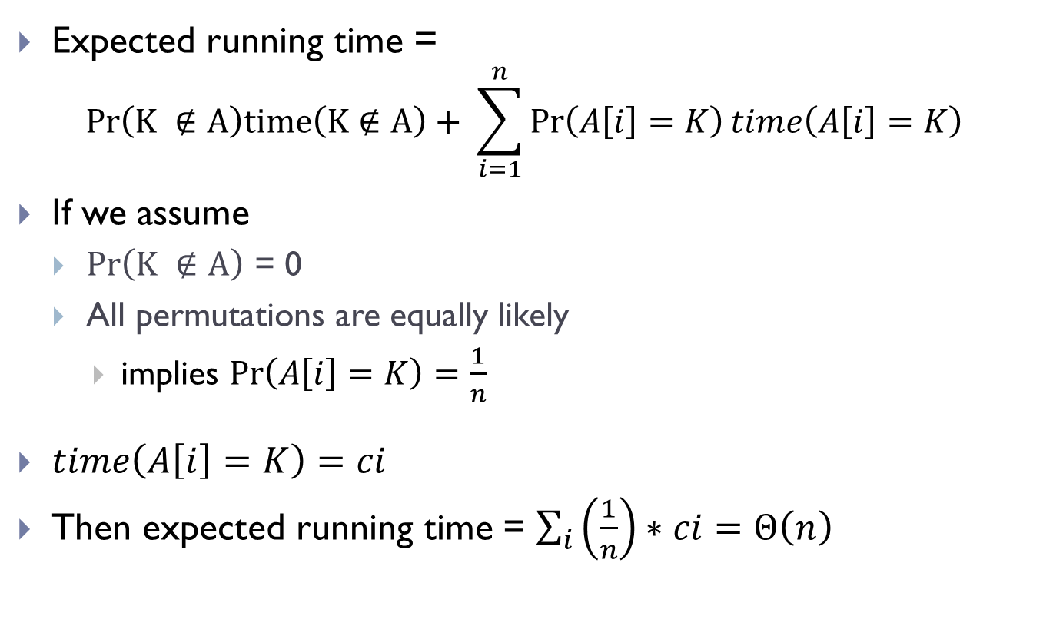
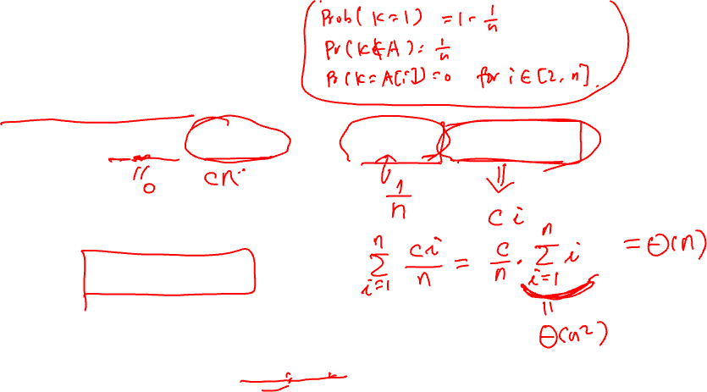
Linear-search algorithm
Expected running time =
$$Pr\left(K ∉A\right)time\left(K∉A\right)+ \sum_{i=1}^{n}{\operatorname{Pr}\left(A\left[i\right]=K\right)time\left(A\left[i\right]=K\right)}$$
If we assume
$Pr\left(K ∉A\right)$ = 0
All permutations are equally likely
implies $\operatorname{Pr}\left(A\left[i\right]=K\right)=\frac{1}{n}$
$time\left(A\left[i\right]=K\right)=ci$
Then expected running time = $\sum_{i}{\left(\frac{1}{n}\right)∗ci}=Θ\left(n\right)$

Slide 8

Remark
For probabilistic analysis
An input probabilistic distribution input model has to be assumed!
For a fixed input, the running time is fixed.
The average / expected time complexity is for if we consider running it for a range of inputs, what the average behavior is.
Randomized algorithm
No assumption in input distribution!
Randomness is added in the algorithm
For a fixed input, the running time is NOT fixed.
The expected time is what we can expect when we run the algorithm on any single input.

Slide 9
Part B: Analyzing randomized algorithms

Slide 10
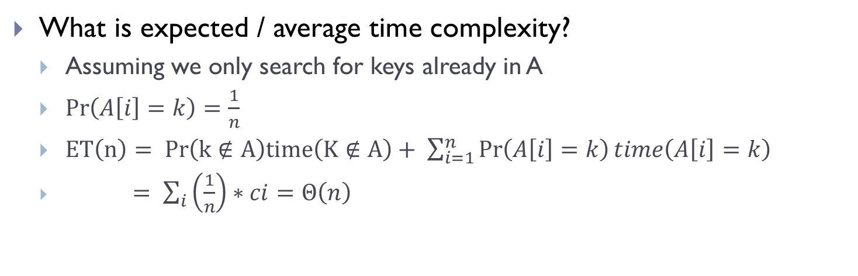
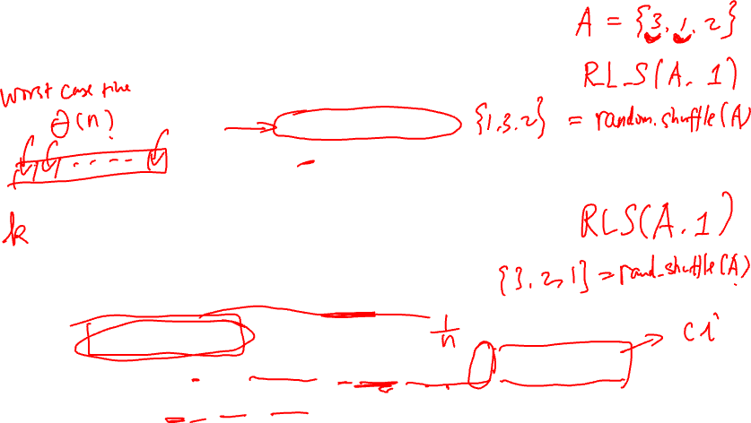
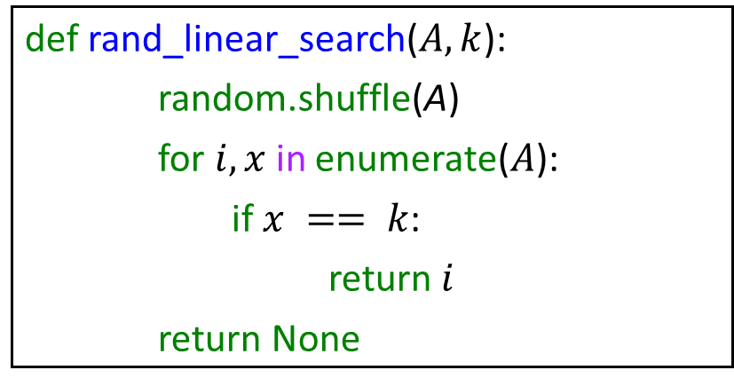
Randomized linear search example
def rand_linear_search($A, k$):
random.shuffle(A)
for $i, x$in enumerate($A$):
if $x == k$:
return $i$
return None
What is expected / average time complexity?
Assuming we only search for keys already in A
$\operatorname{Pr}\left(A\left[i\right]=k\right)=\frac{1}{n}$
$ET\left(n\right)= Pr\left(k∉A\right)time\left(K∉A\right)+ \sum_{i=1}^{n}{\operatorname{Pr}\left(A\left[i\right]=k\right)time\left(A\left[i\right]=k\right)}$
$= \sum_{i}{\left(\frac{1}{n}\right)∗ci}=Θ\left(n\right)$

Slide 11
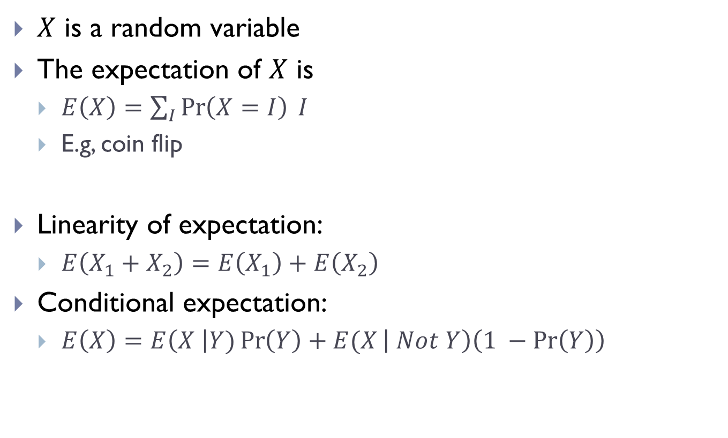
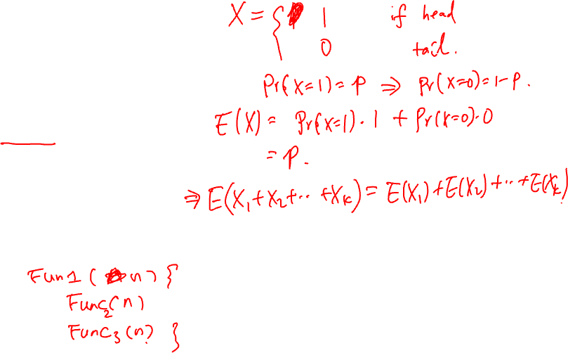
Review of Expectation
$X$ is a random variable
The expectation of $X$ is
$E\left(X\right)=\sum_{I}{\operatorname{Pr}\left(X=I\right) I}$
E.g, coin flip
Linearity of expectation:
$E\left(X_{1}+X_{2}\right)=E\left(X_{1}\right)+E\left(X_{2}\right)$
Conditional expectation:
$E\left(X\right)=E\left(X \right|Y)\operatorname{Pr}\left(Y\right)+E(X\left| Not Y\right)\left(1 −\operatorname{Pr}\left(Y\right)\right)$
Notes:
They’ve seen in 40A

Slide 12
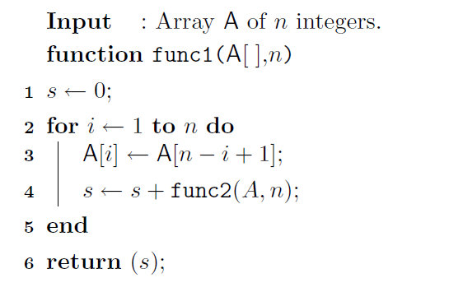
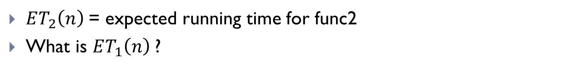
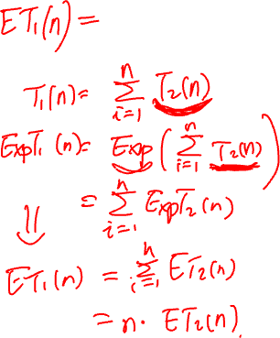
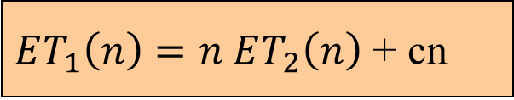
Use of linearity of expectation
$ET_{1}\left(n\right)=n ET_{2}\left(n\right)$ + cn
$ET_{2}\left(n\right)$= expected running time for func2
What is $ET_{1}\left(n\right)$?

Slide 13
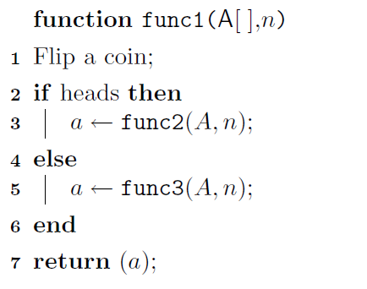
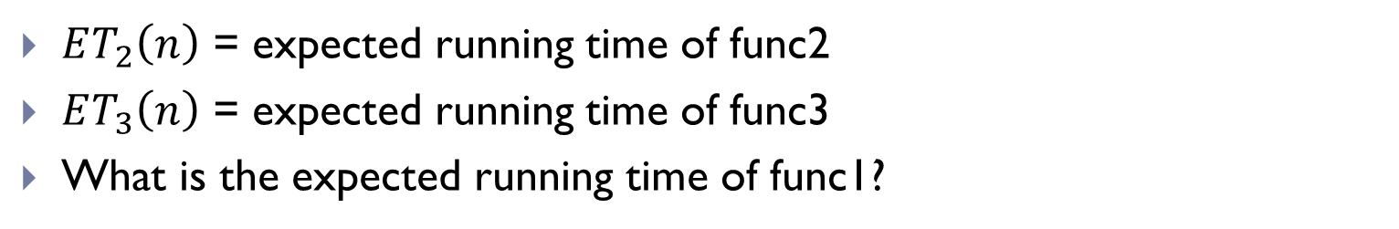
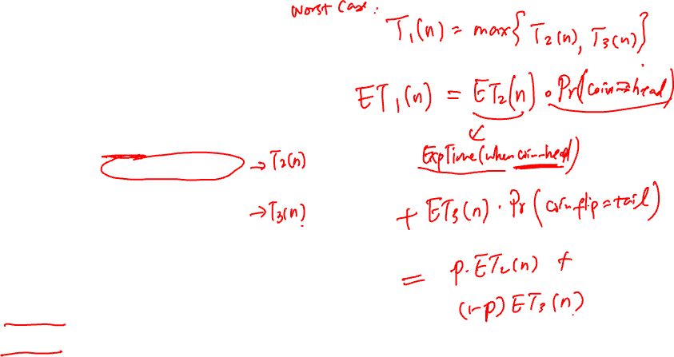
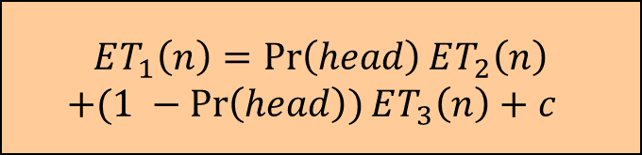
Use of Conditional expectation
$$ET_{1}\left(n\right)=\operatorname{Pr}\left(head\right)ET_{2}\left(n\right)$$
$+(1 −\operatorname{Pr}\left(head\right))ET_{3}\left(n\right)+c$
$ET_{2}\left(n\right)$ = expected running time of func2
$ET_{3}\left(n\right)$ = expected running time of func3
What is the expected running time of func1?

Slide 14
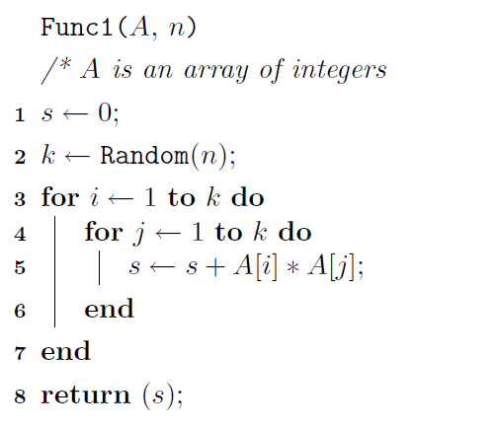
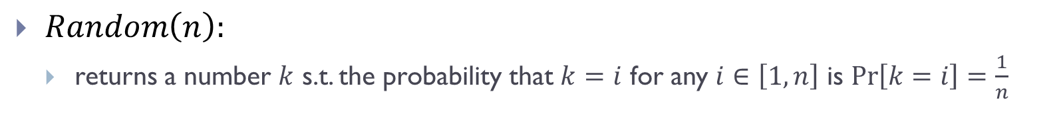
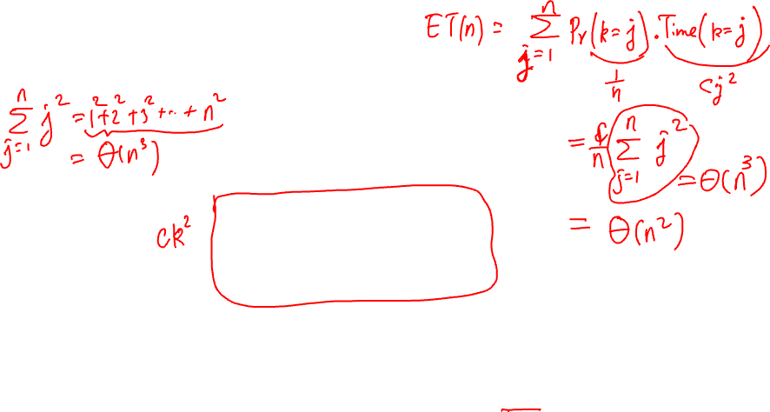
Randomized example 1
$Random\left(n\right):$
returns a number $k$ s.t. the probability that $k=i$ for any $i∈\left[1, n\right]$ is $\operatorname{Pr}\left[k=i\right]=\frac{1}{n}$

Slide 15
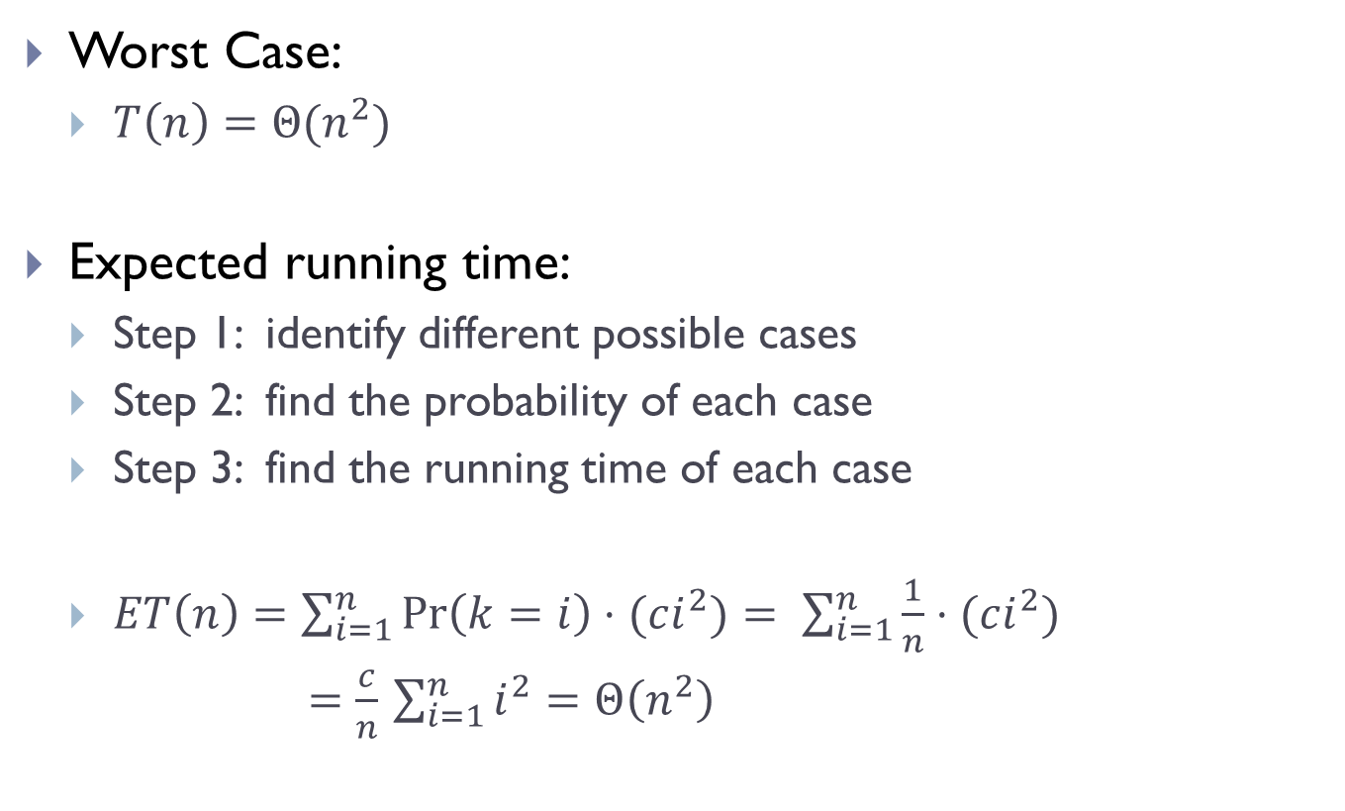
Running time analysis
Worst Case:
$T\left(n\right)=Θ(n^{2})$
Expected running time:
Step 1: identify different possible cases
Step 2: find the probability of each case
Step 3: find the running time of each case
$ET\left(n\right)=\sum_{i=1}^{n}{\operatorname{Pr}\left(k=i\right)⋅(ci^{2})}= \sum_{i=1}^{n}{\frac{1}{n}⋅(ci^{2})}$
$=\frac{c}{n}$ $\sum_{i=1}^{n}{i^{2}}=Θ\left(n^{2}\right)$

Slide 16
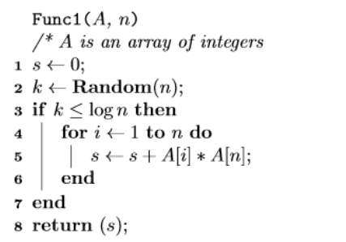
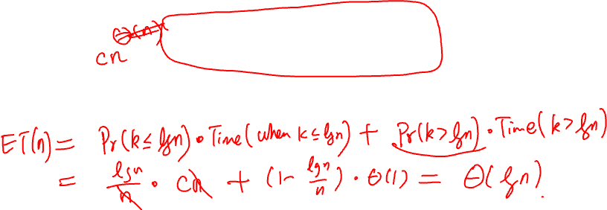
Randomized example 2

Slide 17
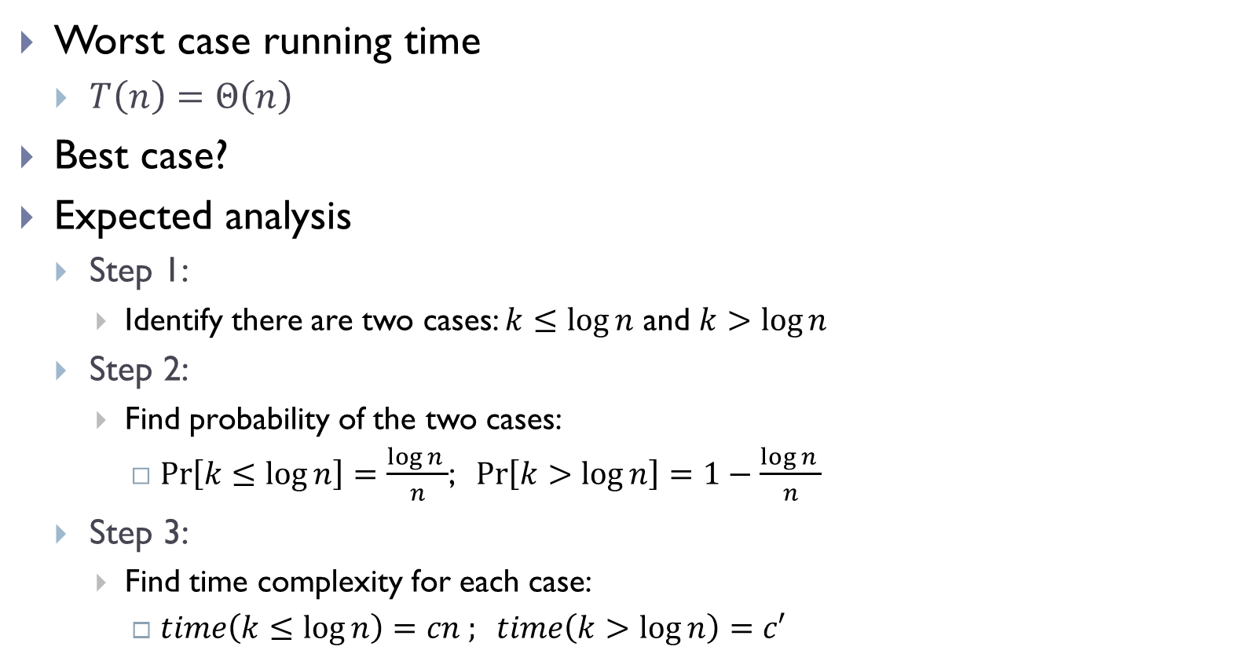
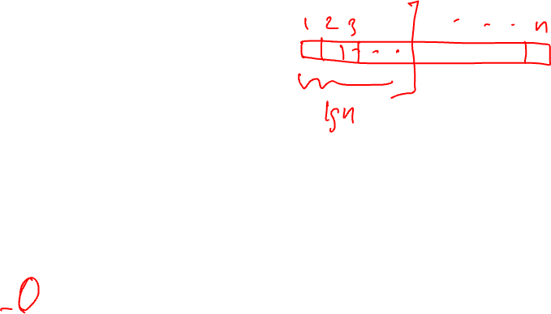
Running time analysis
Worst case running time
$T\left(n\right)=Θ\left(n\right)$
Best case?
Expected analysis
Step 1:
Identify there are two cases: $k≤\log{n}$ and $k>\log{n}$
Step 2:
Find probability of the two cases:
$\operatorname{Pr}\left[k≤\log{n}\right]=\frac{\log{n }}{n}$; $\operatorname{Pr}\left[k>\log{n}\right]=1−\frac{\log{n }}{n}$
Step 3:
Find time complexity for each case:
$time\left(k≤\log{n}\right)=cn ; time\left(k>\log{n}\right)=c′$

Slide 18
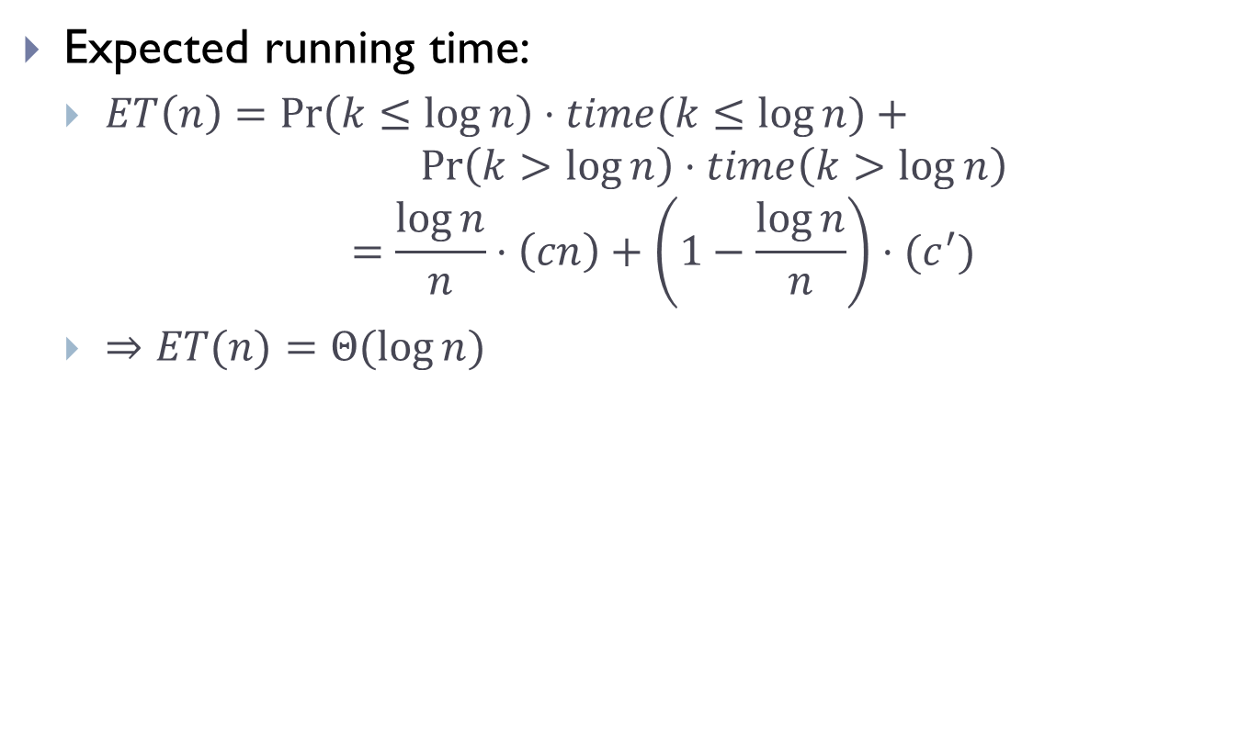
Expected analysis
Expected running time:
$ET\left(n\right)=\operatorname{Pr}\left(k≤\log{n}\right)⋅time(k≤\log{n})+$
$$\operatorname{Pr}\left(k>\log{n}\right)⋅time\left(k>\log{n}\right)$$
$$=\frac{\log{n}}{n}⋅\left(cn\right)+\left(1−\frac{\log{n}}{n}\right)⋅(c^{′})$$
$⇒ET(n)=Θ(\log{n})$
These are artificial examples. We will see later a randomized algorithm for the sorting problem.

Slide 19
Part C: Lower bound theory

Slide 20
Problems and algorithms
There can be many algorithms for solving the same problem.
Some have better time complexity than others.
An important question:
For a given problem, what is the best possible time complexity?
Such questions can be hard to answer
as typically we cannot ``enumerate” all possible algorithms
Often we try to provide a lower-bound
that is as tight as we can
Sometimes we know we have the right (tight) bound when there is an algorithm whose worst-case running time matches this lower bounds

Slide 21
Lower Bound
No algorithm can have a better (worst case) time complexity than a theoretical lower bound.
Definition:
𝑓(𝑛) is a theoretical lower bound for a problem if every possible algorithm’s worst-case time complexity is Ω(𝑓(𝑛)).

Slide 22
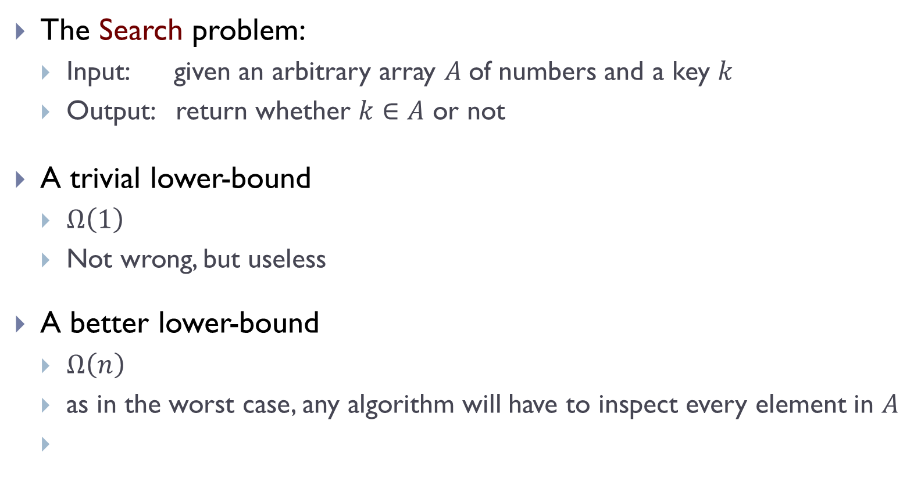

A simple example
The Search problem:
Input: given an arbitrary array $A$of numbers and a key $k$
Output: return whether $k∈A$ or not
A trivial lower-bound
$Ω\left(1\right)$
Not wrong, but useless
A better lower-bound
$Ω\left(n\right)$
as in the worst case, any algorithm will have to inspect every element in $A$
Can we get a better lower-bound?

Slide 23

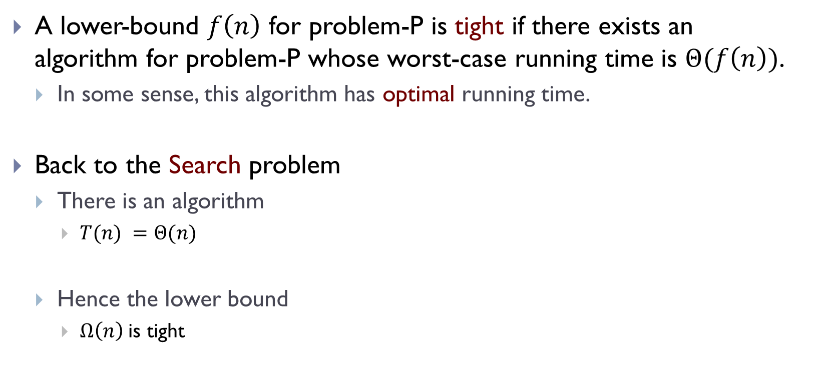

Tight Lower bound
A lower-bound $f\left(n\right)$ for problem-P is tight if there exists an algorithm for problem-P whose worst-case running time is $Θ(f\left(n\right))$.
In some sense, this algorithm has optimal running time.
Back to the Search problem
There is an algorithm
$T(n) =Θ(n)$
Hence the lower bound
$Ω\left(n\right)$is tight
def linear_search($A, k$):
for $i, x$in enumerate($A$):
if $x == k$:
return $i$
return None

Slide 24
FIN

