Slide 1
DSC40B: Theoretical Foundations of Data Science II
Lecture 17: Kruskal’s algorithm for MST, and clustering
Instructor: Yusu Wang

Slide 2
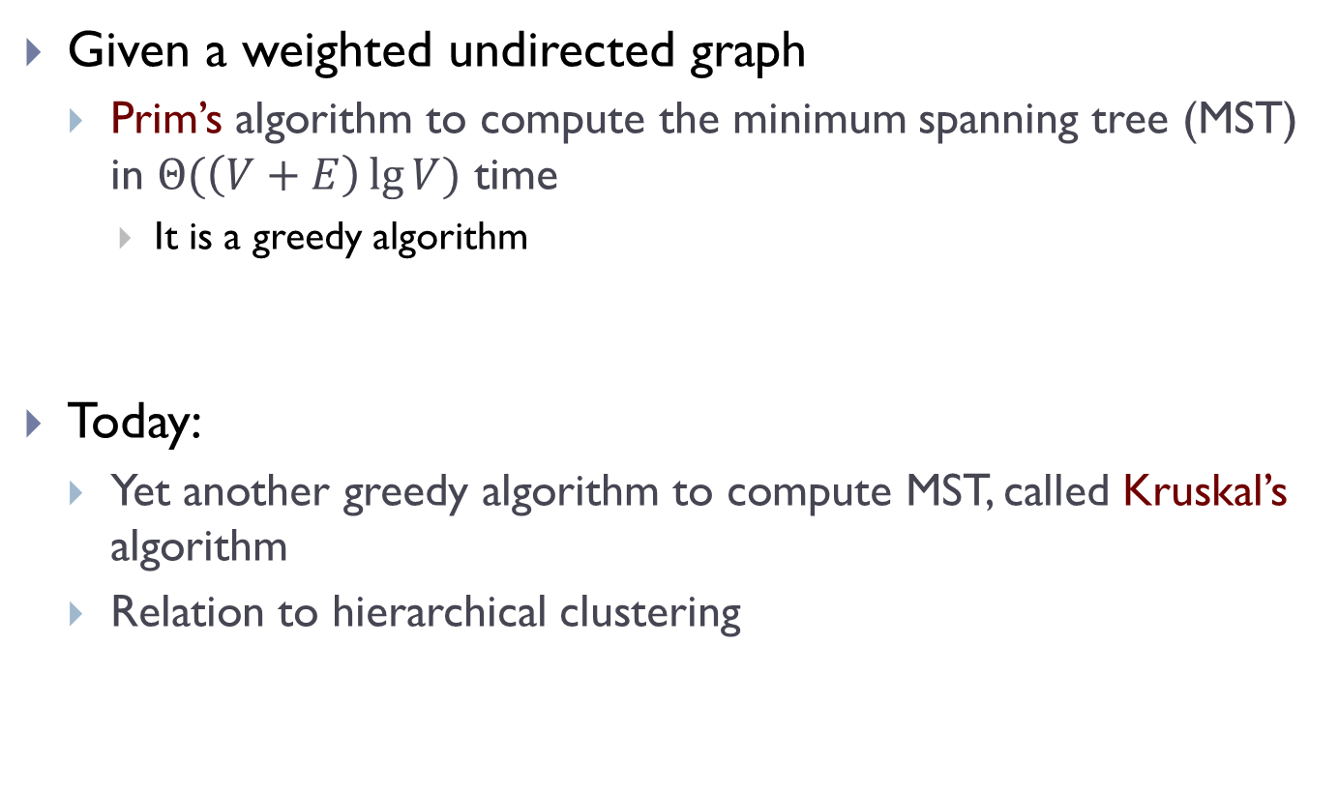
Previously
Given a weighted undirected graph
Prim’s algorithm to compute the minimum spanning tree (MST) in $Θ(\left(V+E\right)\lg{V})$ time
It is a greedy algorithm
Today:
Yet another greedy algorithm to compute MST, called Kruskal’s algorithm
Relation to hierarchical clustering

Slide 3
Kruskal’s Algorithm for MST

Slide 4
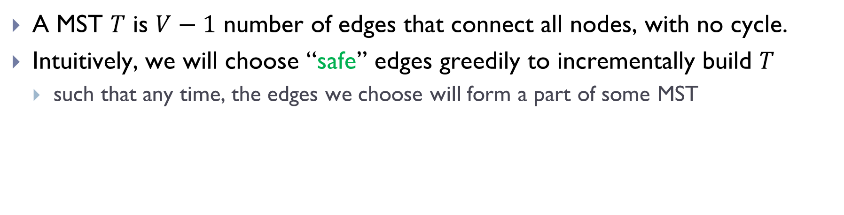
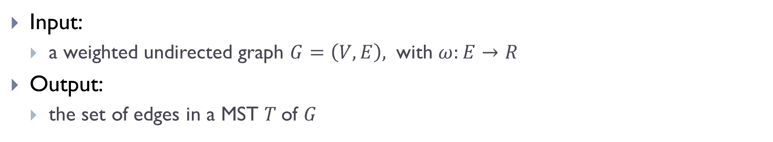
Recall the general greedy idea:
Input:
a weighted undirected graph $G=\left(V,E\right),$ with $ω:E→R$
Output:
the set of edges in a MST $T$of $G$
A MST $T$ is $V−1$ number of edges that connect all nodes, with no cycle.
Intuitively, we will choose “safe” edges greedily to incrementally build $T$
such that any time, the edges we choose will form a part of some MST

Slide 5
Last time: Prim’s algorithm
Starting from any node, it starts to grow a partial tree, by repeatedly choosing the minimum-weight edge to reach an unvisited node, till it connects all graph nodes
Today: Kruskal’s algorithm
We will choose the ``safe” edges in a different order, and still grow the tree edge by edge
However, during the intermediate stages, what we have may not be a partial tree, could be disconnected.

Slide 6
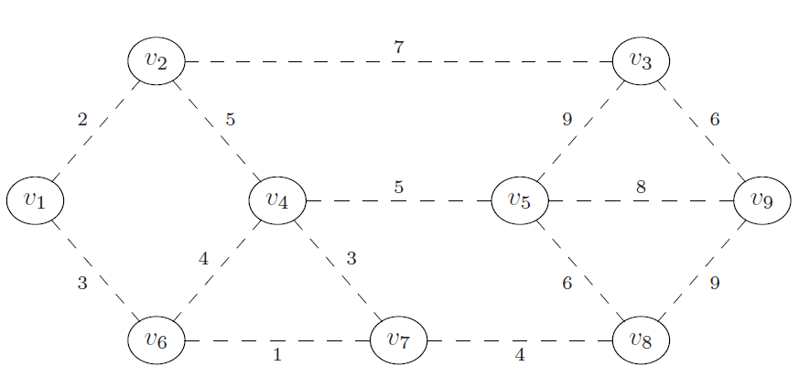
Example
What is a “safe” edge to add first?
What will be the next a “safe” edge to add?

Slide 7
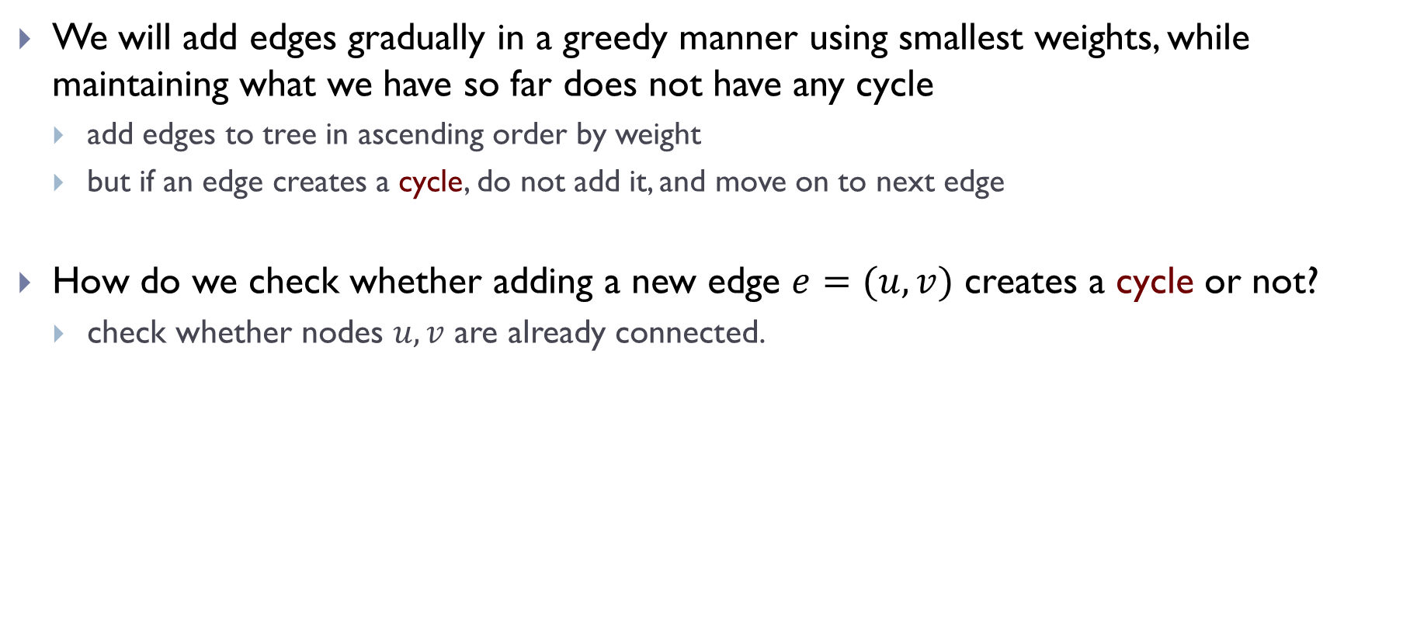
Strategy
We will add edges gradually in a greedy manner using smallest weights, while maintaining what we have so far does not have any cycle
add edges to tree in ascending order by weight
but if an edge creates a cycle, do not add it, and move on to next edge
How do we check whether adding a new edge $e=(u,v)$ creates a cycle or not?
check whether nodes $u, v$ are already connected.

Slide 8
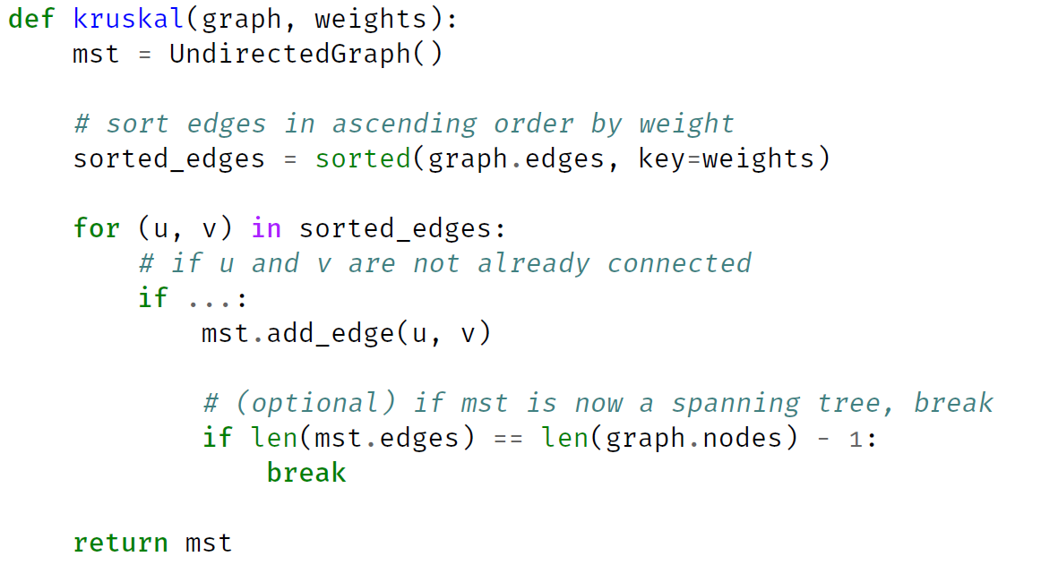
Kruskal’s algorithm (Pseudocode)

Slide 9
Example

Slide 10
Kruskal’s algorithm (Pseudocode)

Slide 11
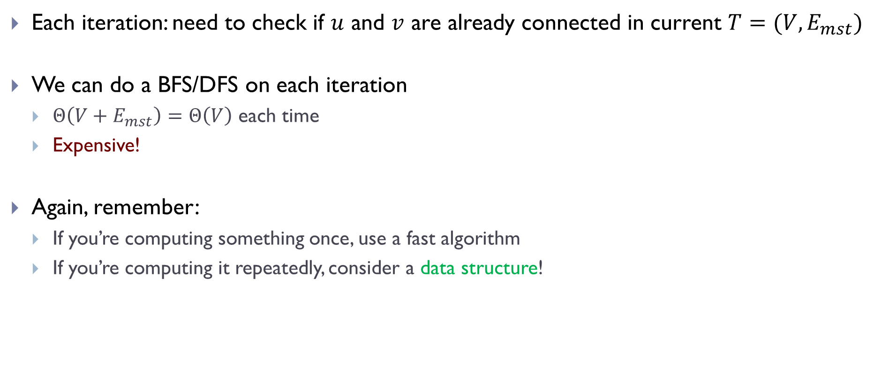
Checking for connectivity
Each iteration: need to check if $u$ and $v$ are already connected in current $T=(V, E_{mst})$
We can do a BFS/DFS on each iteration
$Θ\left(V+E_{mst}\right)=Θ\left(V\right)$ each time
Expensive!
Again, remember:
If you’re computing something once, use a fast algorithm
If you’re computing it repeatedly, consider a data structure!

Slide 12
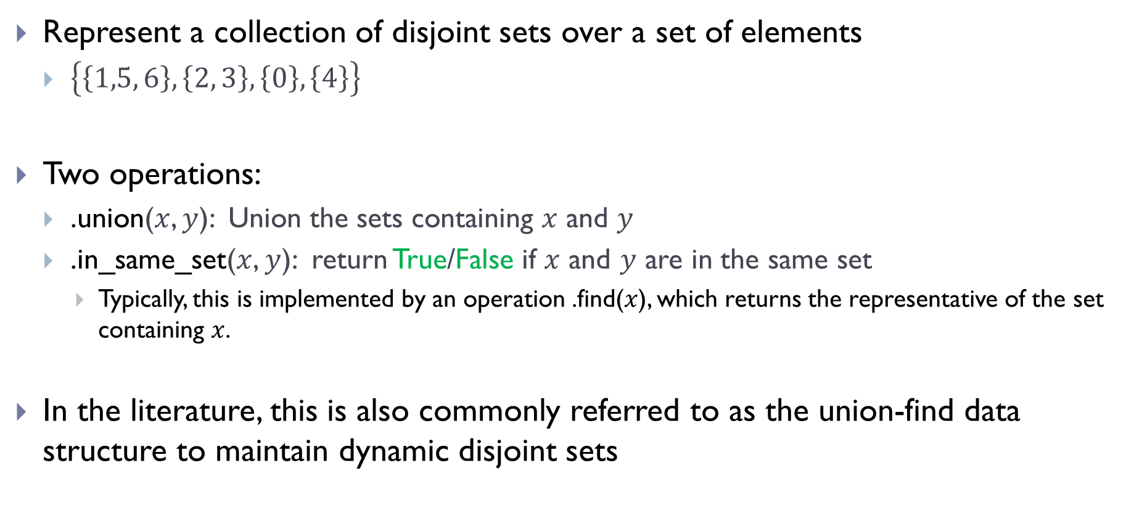
Disjoint Set Forests
Represent a collection of disjoint sets over a set of elements
$\left\{\left\{1,5, 6\right\}, \left\{2, 3\right\}, \left\{0\right\}, \left\{4\right\}\right\}$
Two operations:
.union($x$, $y$): Union the sets containing $x$ and $y$
.in_same_set($x$, $y$): return True/False if $x$ and $y$ are in the same set
Typically, this is implemented by an operation .find($x$), which returns the representative of the set containing $x$.
In the literature, this is also commonly referred to as the union-find data structure to maintain dynamic disjoint sets

Slide 13
Example
>>> # create a DSF with {{0}, {1}, {2}, {3}, {4}, {5}}
>>> dsf = DisjointSetForest([0, 1, 2, 3, 4, 5])
>>> dsf.union(0, 3)
>>> dsf.union(1, 4)
>>> dsf.union(3, 1)
>>> dsf.union(2, 5)
>>> # dsf now represents {{0, 1, 3, 4}, {2, 5}}
>>> dsf.in_same_set(0, 3)
True
>>> dsf.in_same_set(0, 2)
False

Slide 14
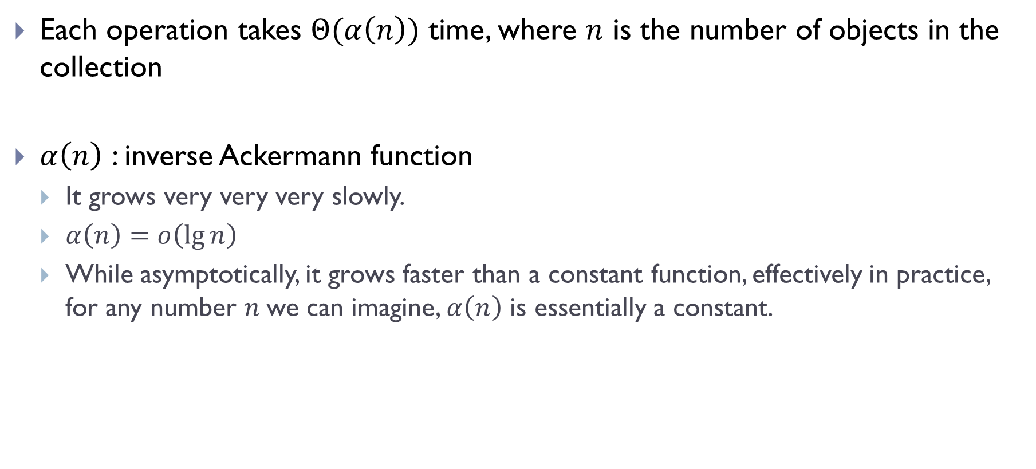
Disjoint Set Forests
Each operation takes $Θ(α\left(n\right))$ time, where $n$ is the number of objects in the collection
$α\left(n\right)$ : inverse Ackermann function
It grows very very very slowly.
$α\left(n\right)=o\left(\lg{n}\right)$
While asymptotically, it grows faster than a constant function, effectively in practice, for any number $n$we can imagine, $α\left(n\right)$ is essentially a constant.

Slide 15
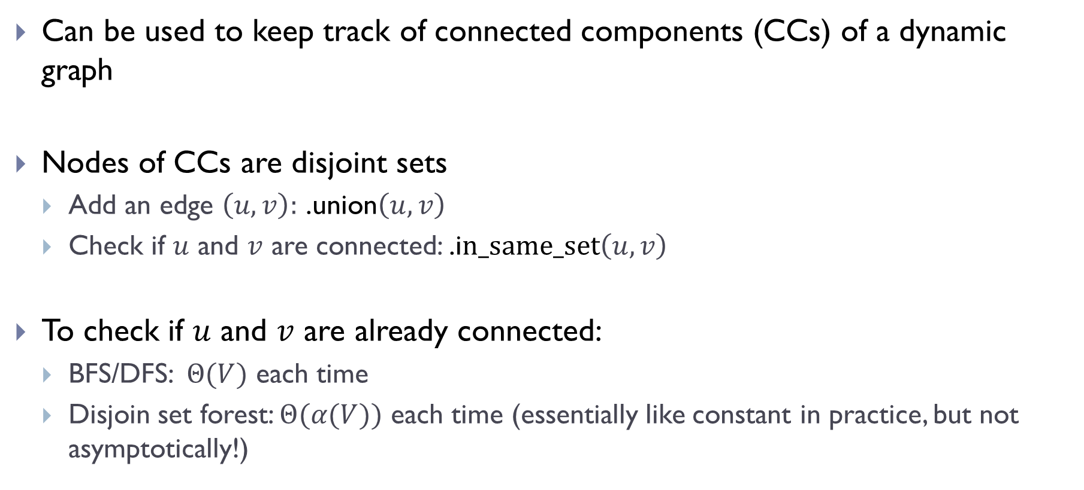
Disjoint Set Forest
Can be used to keep track of connected components (CCs) of a dynamic graph
Nodes of CCs are disjoint sets
Add an edge $\left(u,v\right):$ .union$\left(u,v\right)$
Check if $u$ and $v$ are connected: .i$n_same_set\left(u,v\right)$
To check if $u$ and $v$ are already connected:
BFS/DFS: $Θ(V)$ each time
Disjoin set forest: $Θ(α(V))$ each time (essentially like constant in practice, but not asymptotically!)

Slide 16
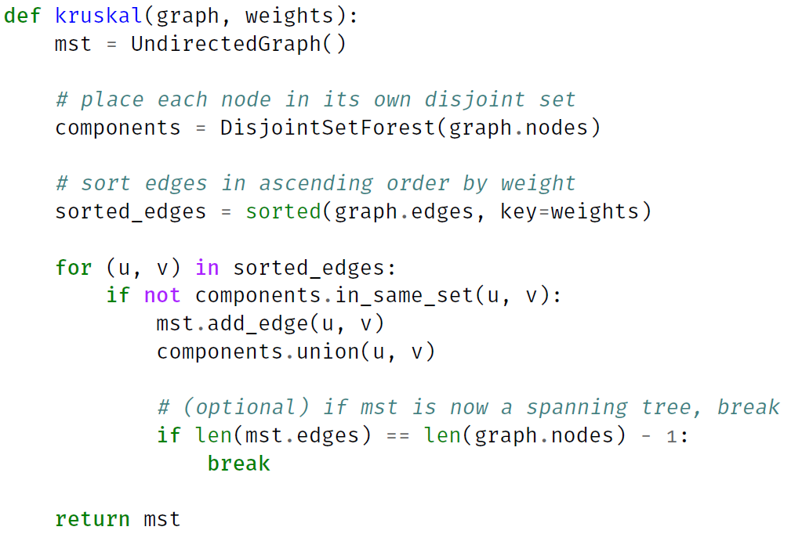
Kruskal’s Algorithm

Slide 17
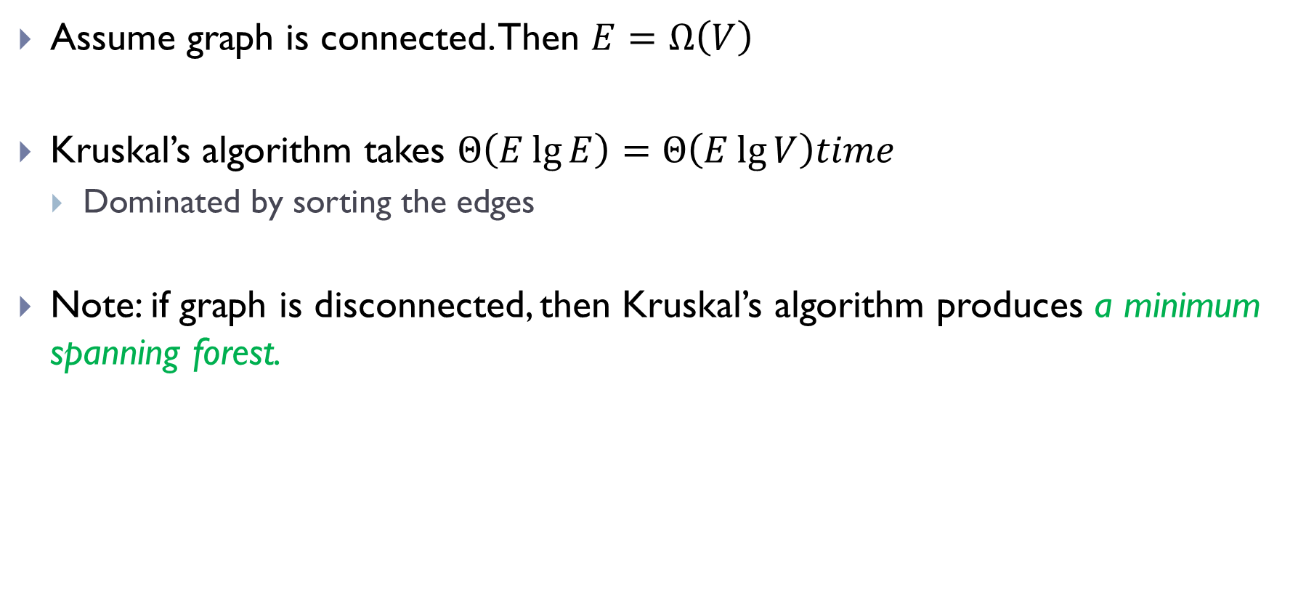
Time complexity of Kruskal’s algorithm
Assume graph is connected. Then $E=Ω\left(V\right)$
Kruskal’s algorithm takes $Θ\left(E\lg{E}\right)=Θ\left(E\lg{V}\right)time$
Dominated by sorting the edges
Note: if graph is disconnected, then Kruskal’s algorithm produces a minimum spanning forest.

Slide 18
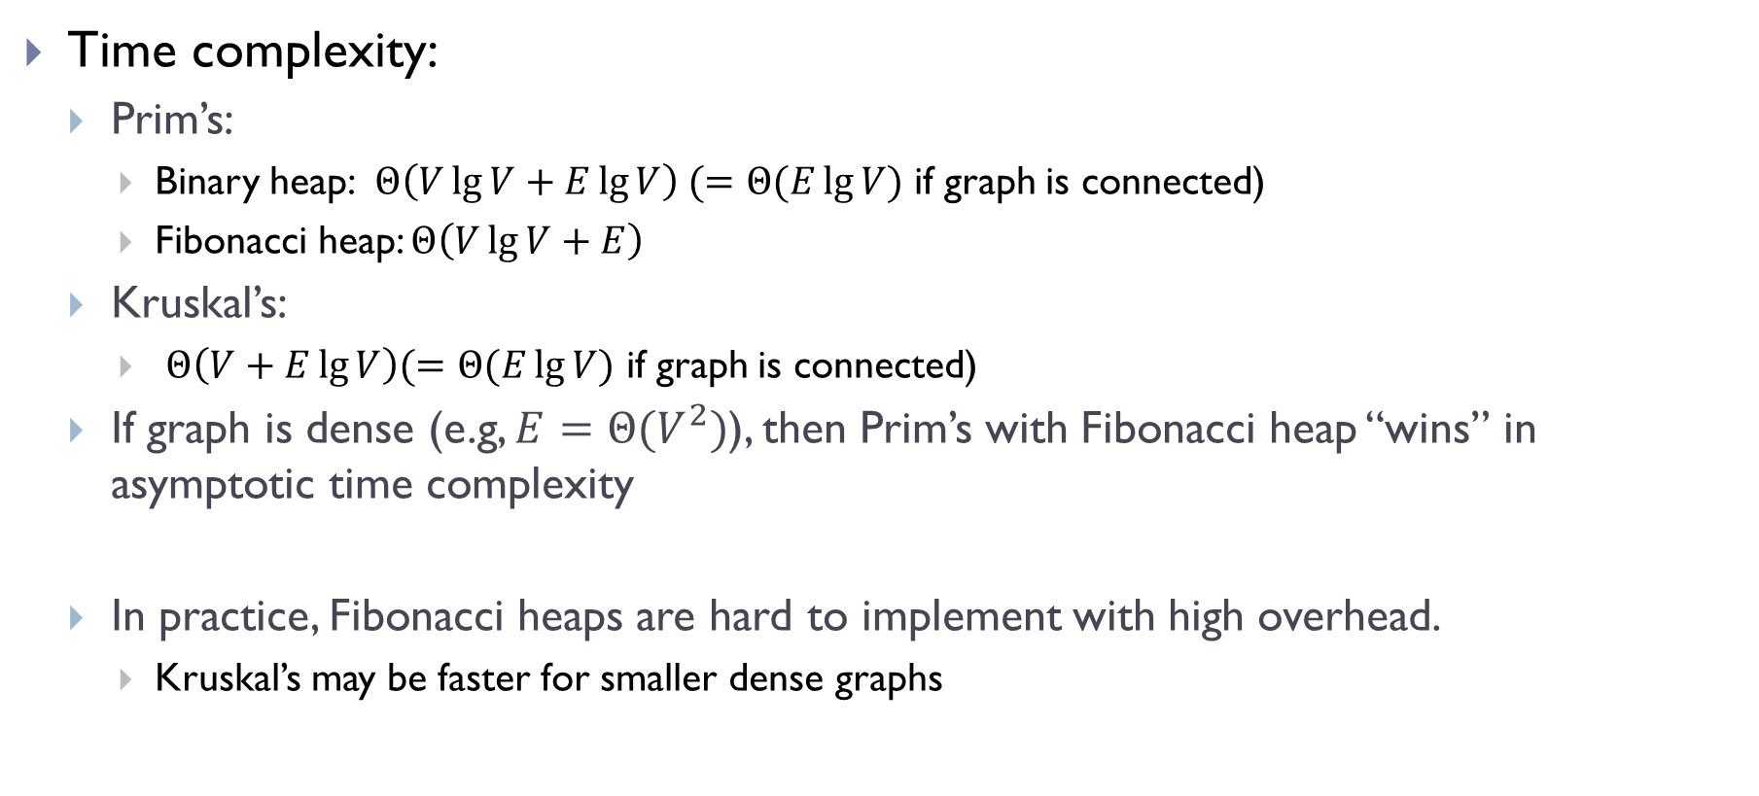
Kruskal’s vs. Prim’s
Time complexity:
Prim’s:
Binary heap: $Θ\left(V\lg{V}+E\lg{V}\right) (=Θ(E\lg{V})$ if graph is connected)
Fibonacci heap: $Θ\left(V\lg{V}+E\right)$
Kruskal’s:
$Θ\left(V+E\lg{V}\right)(=Θ(E\lg{V)}$ if graph is connected)
If graph is dense (e.g, $E=Θ(V^{2})$), then Prim’s with Fibonacci heap “wins” in asymptotic time complexity
In practice, Fibonacci heaps are hard to implement with high overhead.
Kruskal’s may be faster for smaller dense graphs

Slide 19
MSTs and (hierarchical) clustering

Slide 20
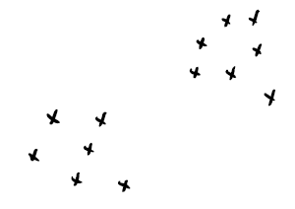
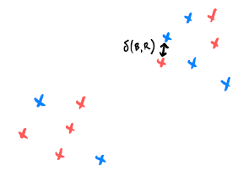
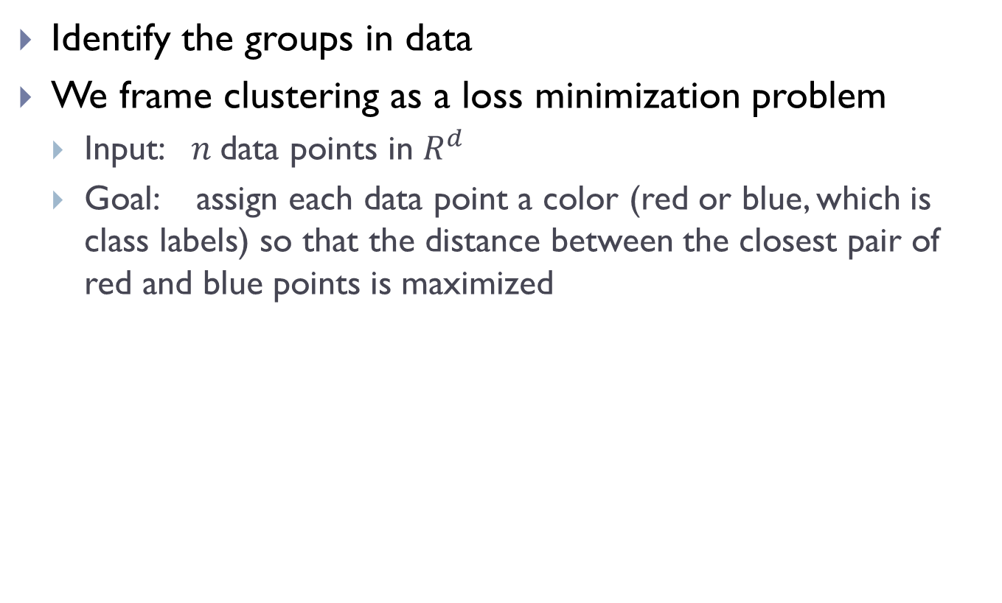
Clustering problem
Identify the groups in data
We frame clustering as a loss minimization problem
Input: $n$data points in $R^{d}$
Goal: assign each data point a color (red or blue, which is class labels) so that the distance between the closest pair of red and blue points is maximized
input points
bad clustering

Slide 21
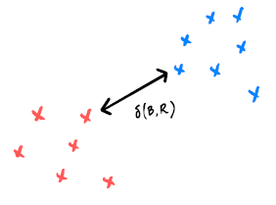
Clustering problem
Identify the groups in data
We frame clustering as a loss minimization problem
Input: $n$data points in $R^{d}$
Goal: assign each data point a color (red or blue, which is class labels) so that the distance between the closest pair of red and blue points is maximized
input points
good clustering

Slide 22

Recall the brute-force solution
Try all possible assignments
there are $2^{n}$ possible assignments! ($n$ is the number of input points)
highly not efficient!
Instead, we will convert it to a graph problem

Slide 23
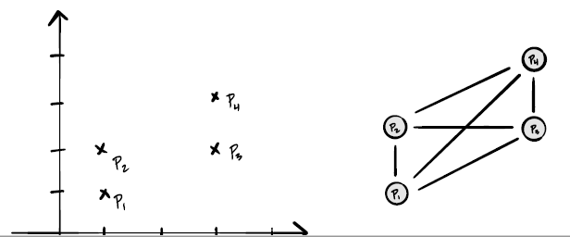
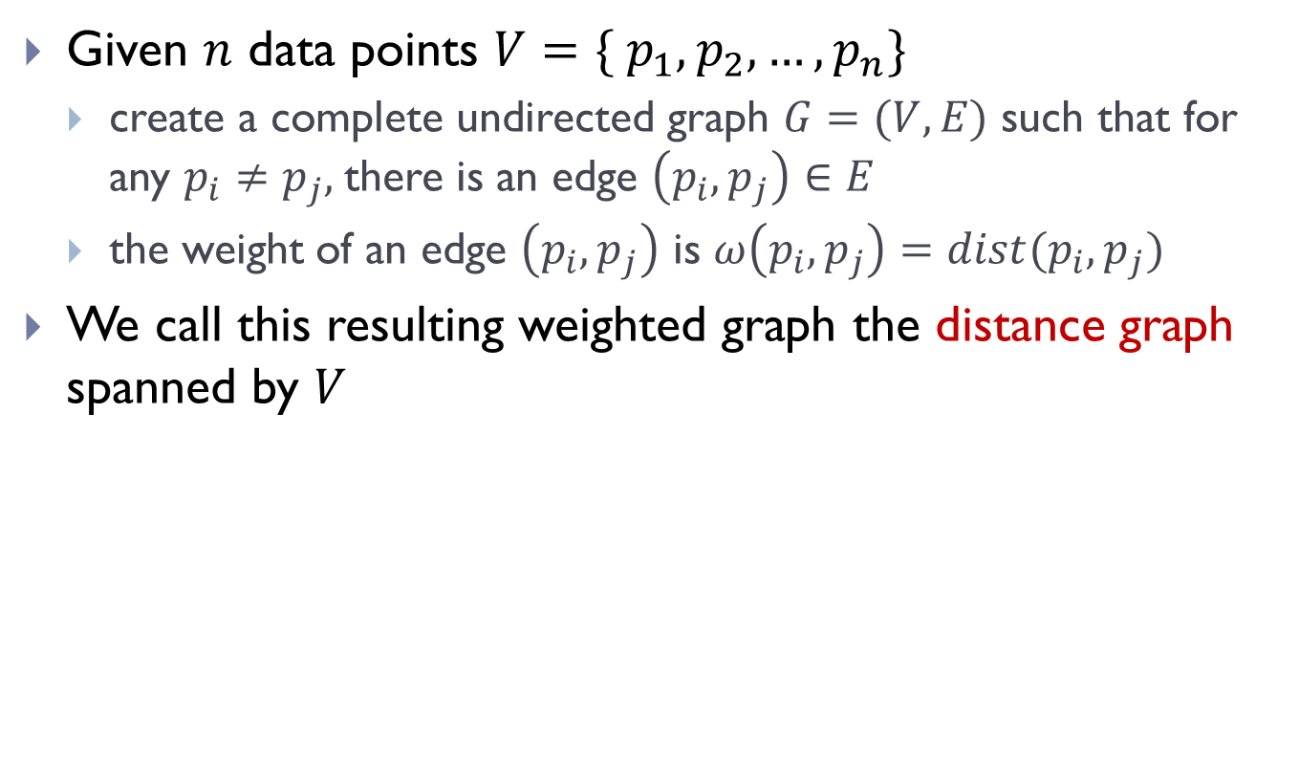
Distance graph
Given $n$ data points $V=\{ p_{1}, p_{2},…, p_{n}\}$
create a complete undirected graph $G=(V, E)$ such that for any $p_{i}≠p_{j},$there is an edge $\left(p_{i}, p_{j}\right)∈E$
the weight of an edge $\left(p_{i}, p_{j}\right)$ is $ω\left(p_{i}, p_{j}\right)=dist(p_{i}, p_{j})$
We call this resulting weighted graph the distance graph spanned by $V$

Slide 24
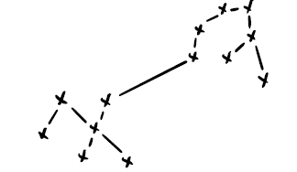
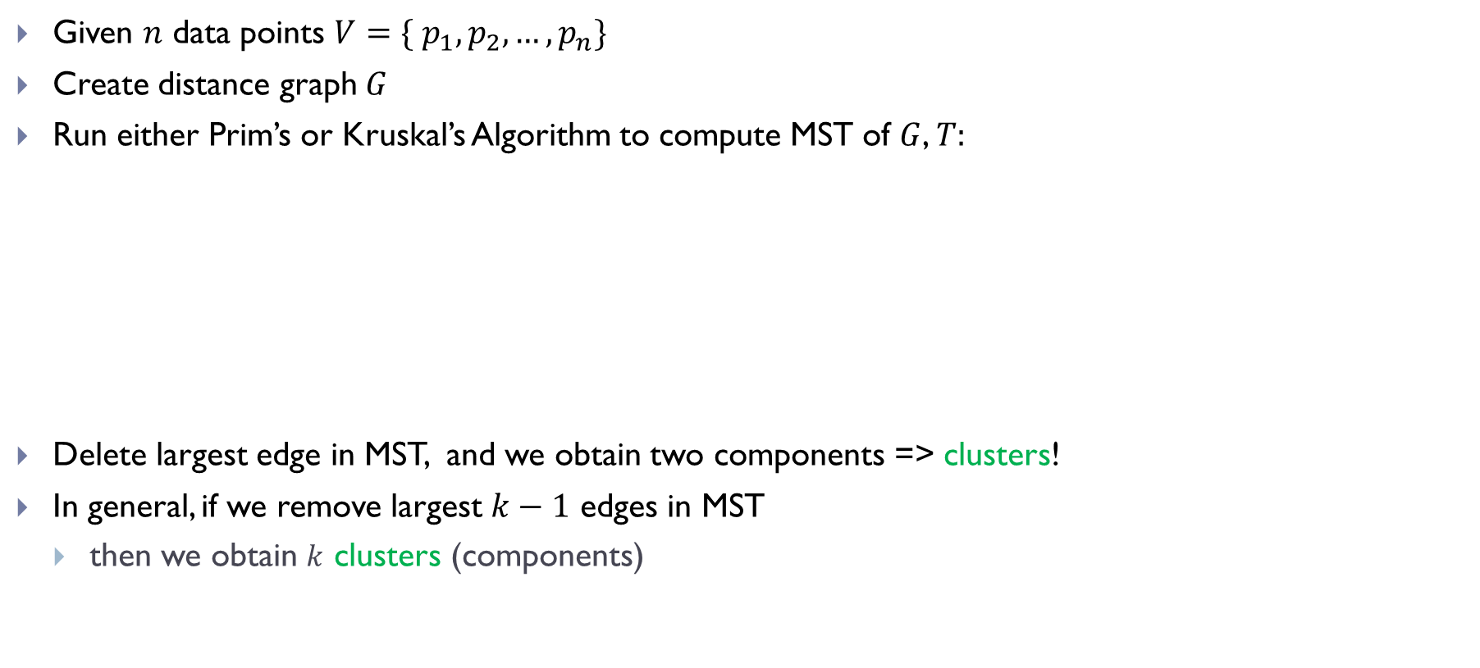
Clustering
Given $n$ data points $V=\{ p_{1}, p_{2},…, p_{n}\}$
Create distance graph $G$
Run either Prim’s or Kruskal’s Algorithm to compute MST of $G$, $T:$
Delete largest edge in MST, and we obtain two components => clusters!
In general, if we remove largest $k−1$ edges in MST
then we obtain $k$ clusters (components)

Slide 25
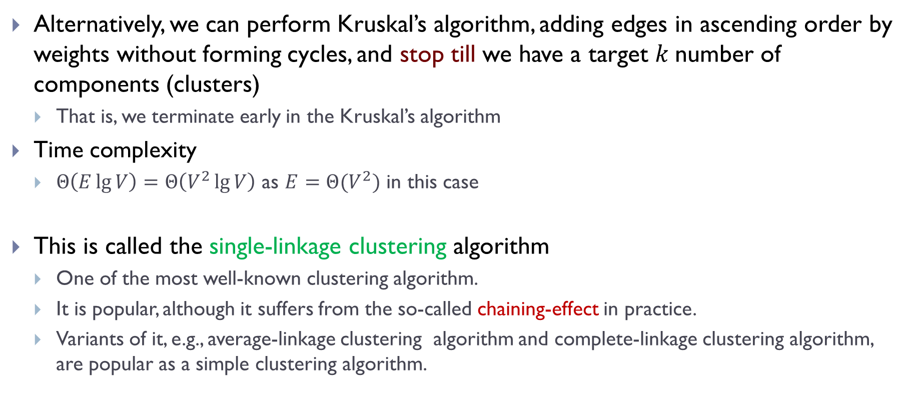
Single linkage clustering
Alternatively, we can perform Kruskal’s algorithm, adding edges in ascending order by weights without forming cycles, and stop till we have a target $k$number of components (clusters)
That is, we terminate early in the Kruskal’s algorithm
Time complexity
$Θ\left(E\lg{V}\right)=Θ\left(V^{2}\lg{V}\right)$ as $E=Θ(V^{2})$ in this case
This is called the single-linkage clustering algorithm
One of the most well-known clustering algorithm.
It is popular, although it suffers from the so-called chaining-effect in practice.
Variants of it, e.g., average-linkage clustering algorithm and complete-linkage clustering algorithm, are popular as a simple clustering algorithm.

Slide 26
Example of chaining effect

Slide 27
Hierarchical clustering, and single linkage clustering algorithm (Optional)

Slide 28
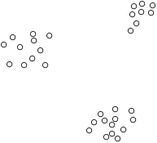
Clustering

Slide 29
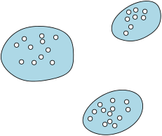
Clustering

Slide 30
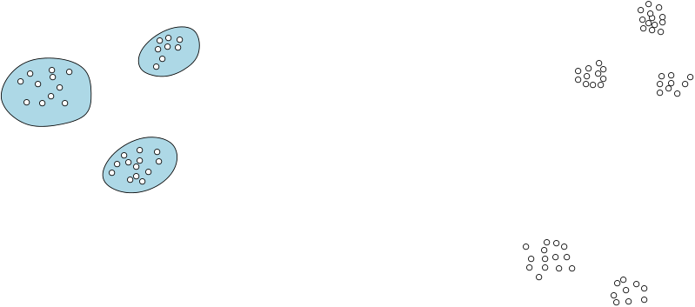
Hierarchical Clustering

Slide 31
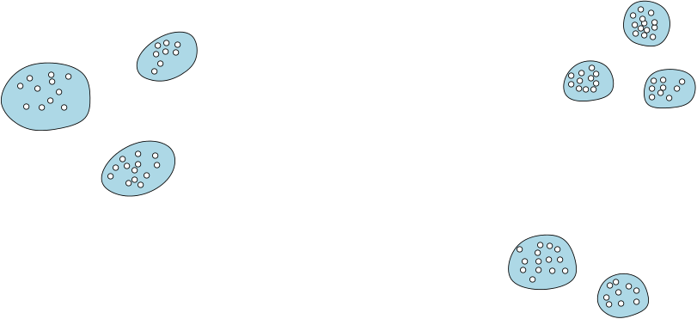
Hierarchical Clustering

Slide 32
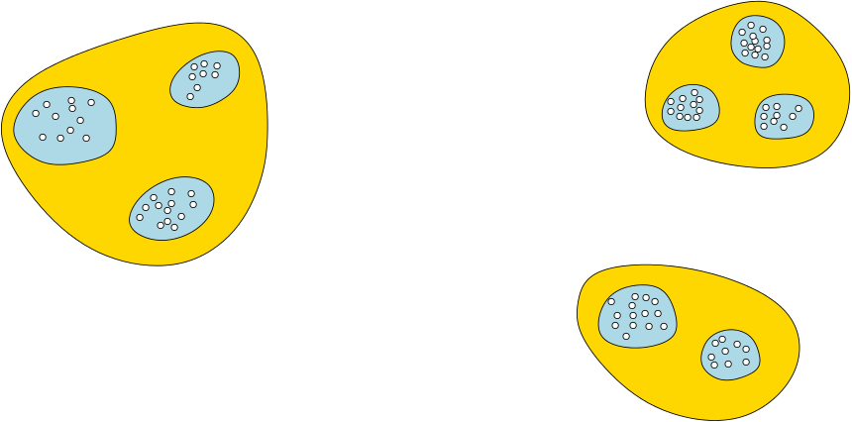
Hierarchical Clustering

Slide 33
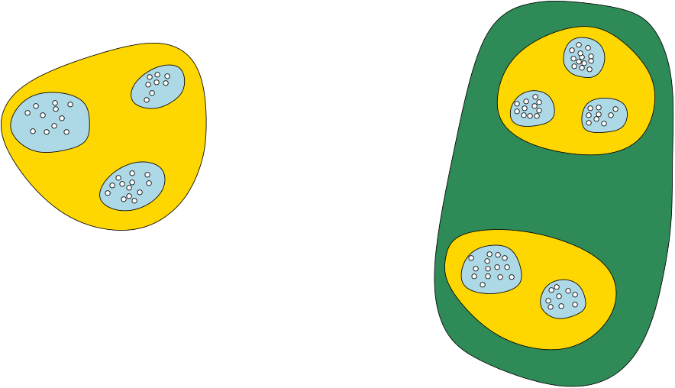
Hierarchical Clustering

Slide 34
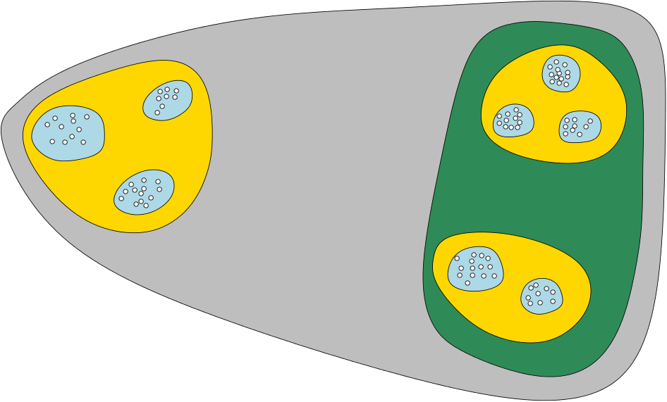
Hierarchical Clustering

Slide 35
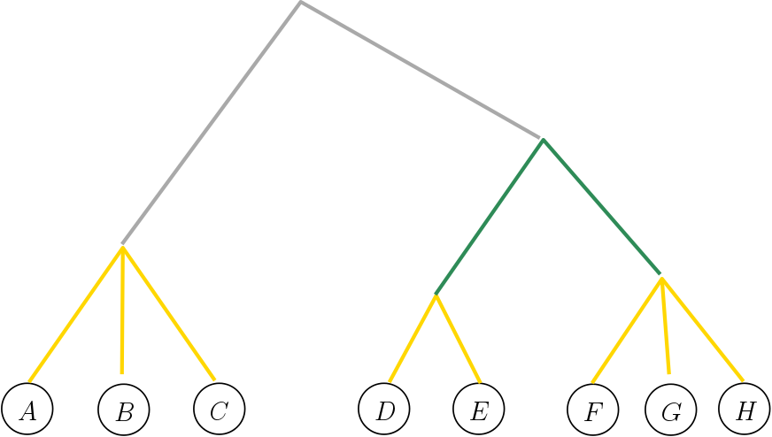

Hierarchical Clustering Tree (HCT)
Each internal tree node indicates a cluster, containing all leaves in subtree
Ancestor/descendent indicates containment relation
Height at each tree node corresponds to certain cost of the corresponding cluster (e.g, tightness of cluster)

Slide 36
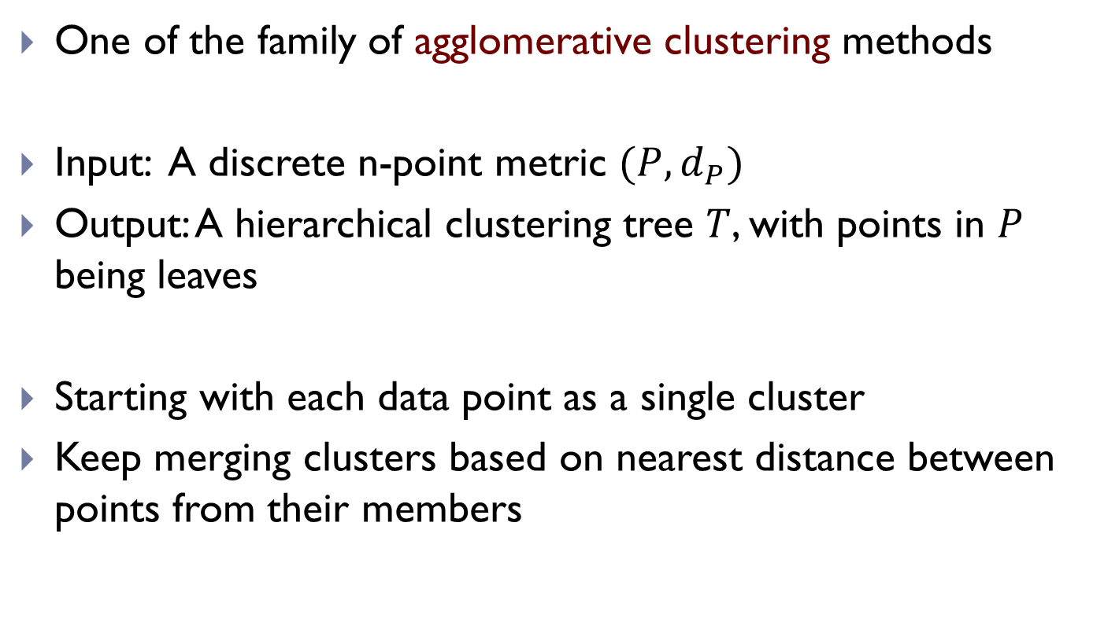
Single Linkage Clustering
One of the family of agglomerative clustering methods
Input: A discrete n-point metric $(P, d_{P})$
Output: A hierarchical clustering tree $T$, with points in $P$ being leaves
Starting with each data point as a single cluster
Keep merging clusters based on nearest distance between points from their members

Slide 37
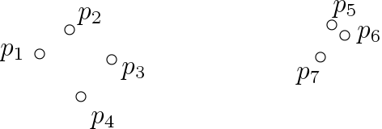
Single Linkage Clustering
Starting with each data point as a single cluster
Keep merging clusters based on nearest distance between points from their members

Slide 38
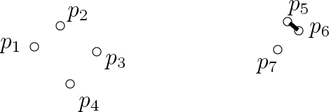
Single Linkage Clustering
Starting with each data point as a single cluster
Keep merging clusters based on nearest distance between points from their members

Slide 39
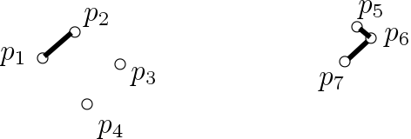
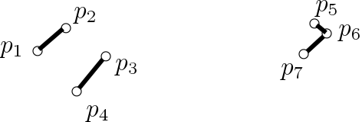
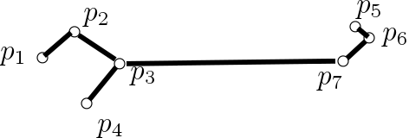
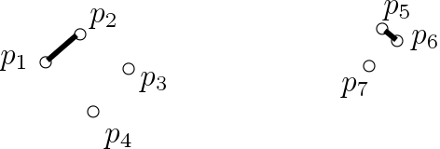
Single Linkage Clustering
Starting with each data point as a single cluster
Keep merging clusters based on nearest distance between points from their members

Slide 40
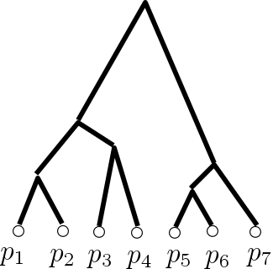
Single Linkage Clustering
Starting with each data point as a single cluster
Keep merging clusters based on nearest distance between points from their members

Slide 41




One Example: Single Linkage Clustering
Starting with each data point as a single cluster
Keep merging clusters based on nearest distance between points from their members
This procedure is exactly Kruskal’s algorithm!
$$d_{6}$$
$$d_{5}$$
$$d_{5}$$
$$d_{6}$$

Slide 42
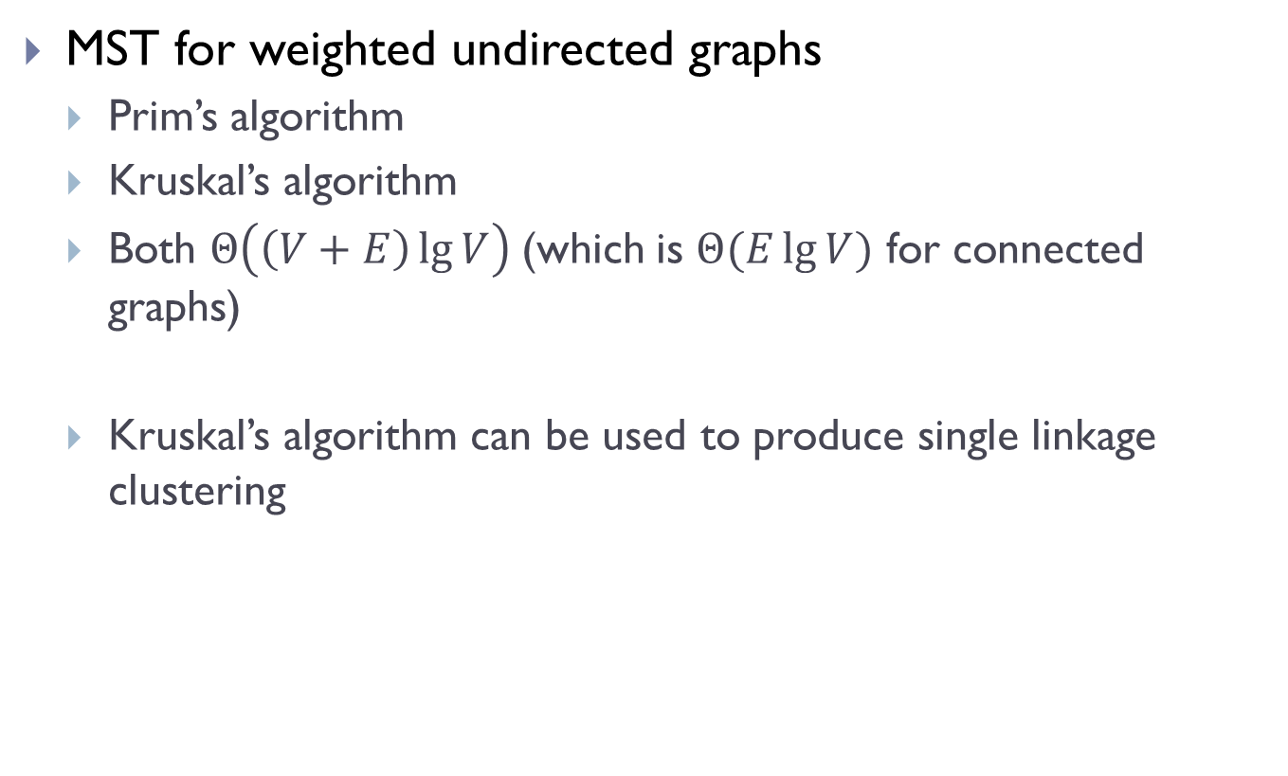
Summary
MST for weighted undirected graphs
Prim’s algorithm
Kruskal’s algorithm
Both $Θ\left(\left(V+E\right)\lg{V}\right)$(which is $Θ(E\lg{V})$ for connected graphs)
Kruskal’s algorithm can be used to produce single linkage clustering

Slide 43
FIN

