Slide 1
DSC40B: Theoretical Foundations of Data Science II
Lecture 13: Depth-First Search (DFS)
Instructor: Yusu Wang

Slide 2
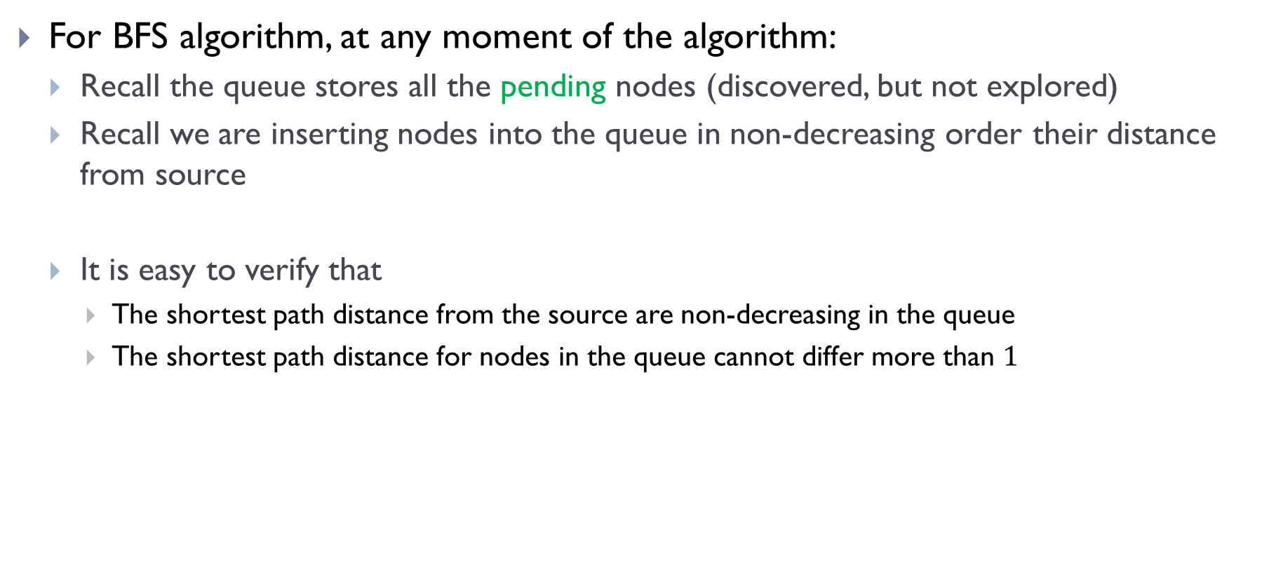
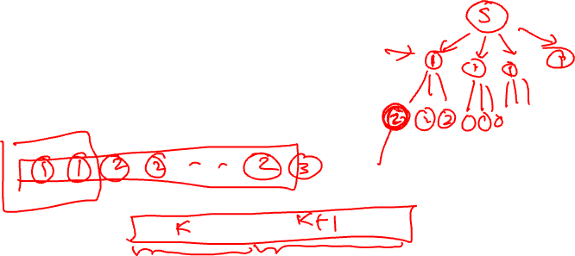
One more property about BFS
For BFS algorithm, at any moment of the algorithm:
Recall the queue stores all the pending nodes (discovered, but not explored)
Recall we are inserting nodes into the queue in non-decreasing order their distance from source
It is easy to verify that
The shortest path distance from the source are non-decreasing in the queue
The shortest path distance for nodes in the queue cannot differ more than $1$

Slide 3
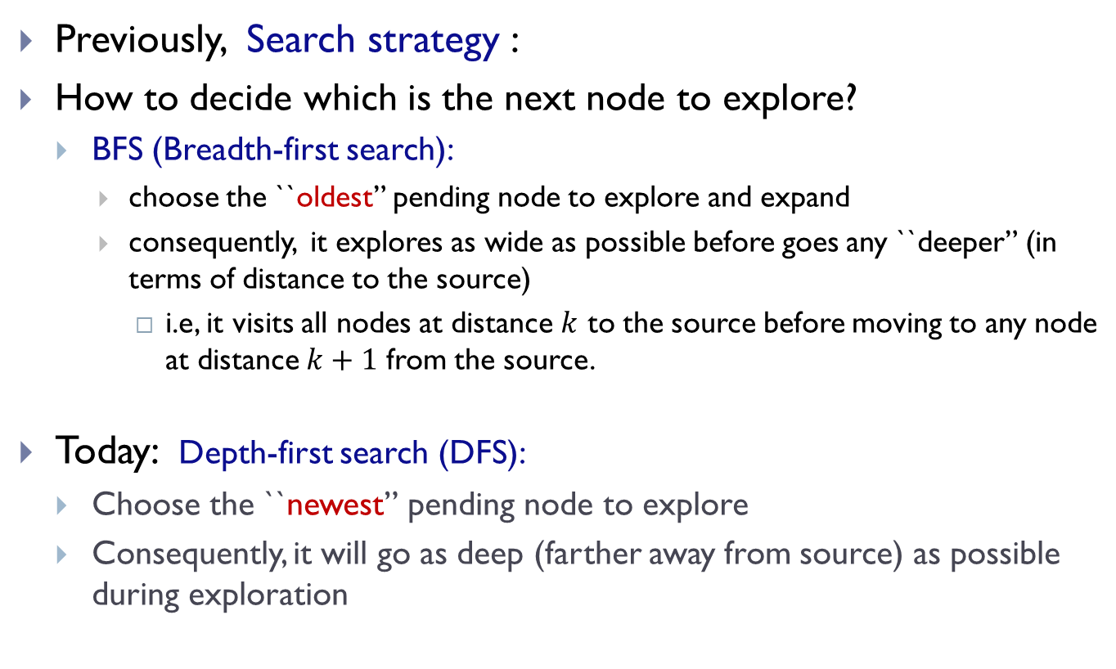
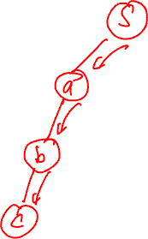
Prelude
Previously, Search strategy :
How to decide which is the next node to explore?
BFS (Breadth-first search):
choose the ``oldest” pending node to explore and expand
consequently, it explores as wide as possible before goes any ``deeper” (in terms of distance to the source)
i.e, it visits all nodes at distance $k$ to the source before moving to any node at distance $k+1$ from the source.
Today: Depth-first search (DFS):
Choose the ``newest” pending node to explore
Consequently, it will go as deep (farther away from source) as possible during exploration

Slide 4
DFS algorithm and time complexity

Slide 5
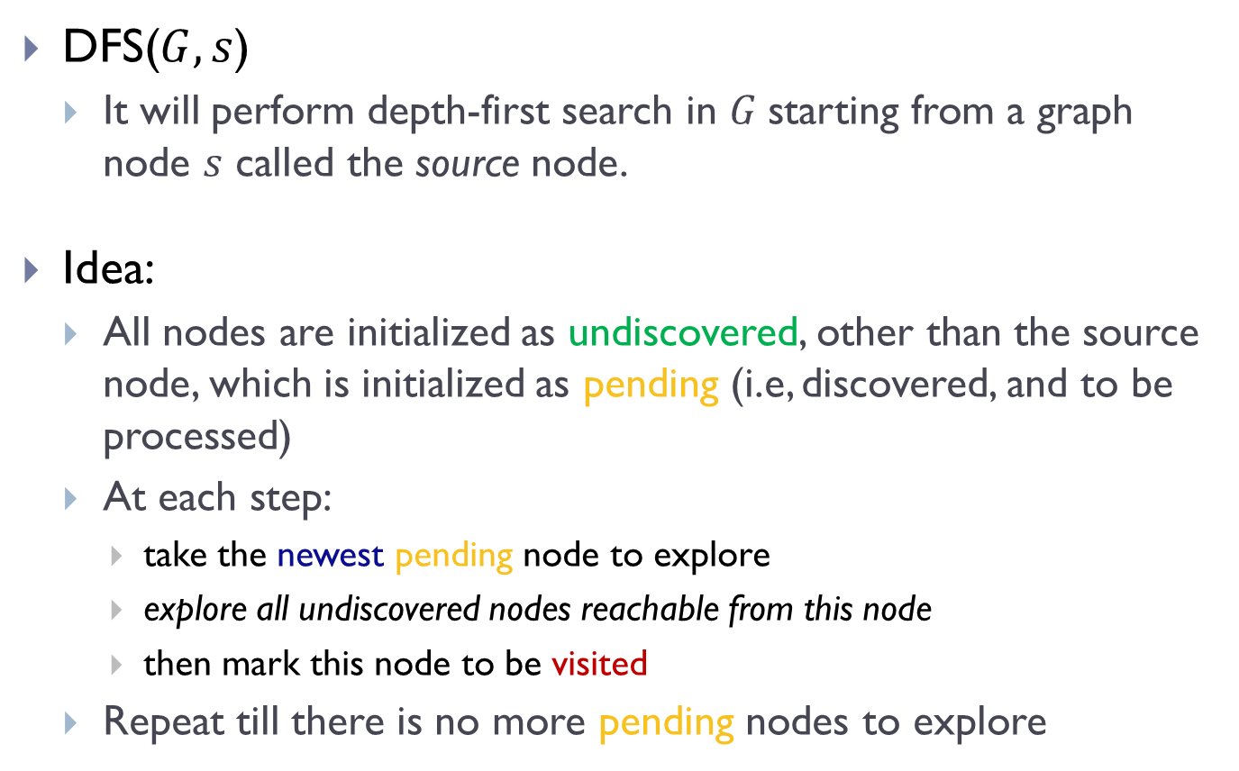
Depth-first Search (DFS)
DFS($G, s$)
It will perform depth-first search in $G$starting from a graph node $s$ called the source node.
Idea:
All nodes are initialized as undiscovered, other than the source node, which is initialized as pending (i.e, discovered, and to be processed)
At each step:
take the newest pending node to explore
explore all undiscovered nodes reachable from this node
then mark this node to be visited
Repeat till there is no more pending nodes to explore

Slide 6
To be able to extract the “newest” pending node
we need a standard stack data structure to provide FILO (first-in-last-out)
In algorithm implementation,
we use recursive algorithm to achieve this FILO/stack idea implicitly

Slide 7
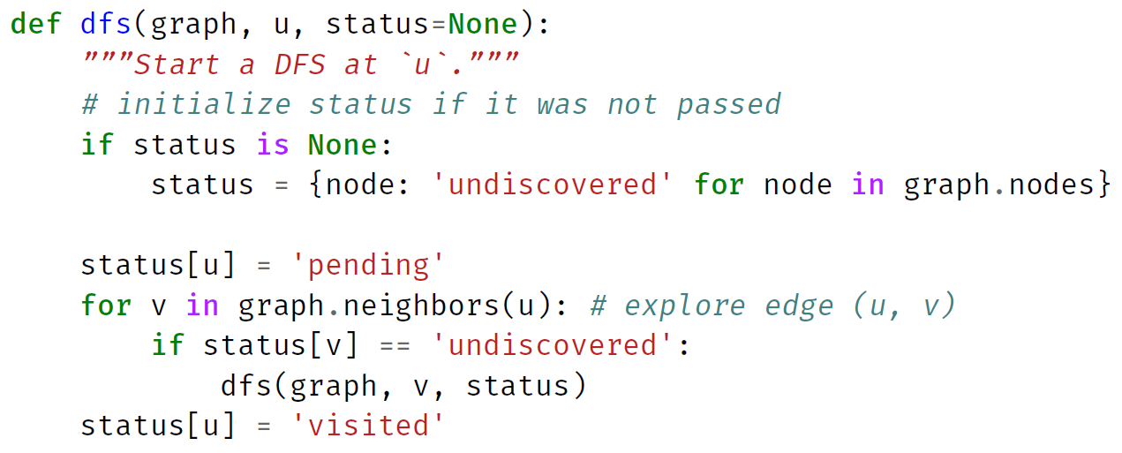
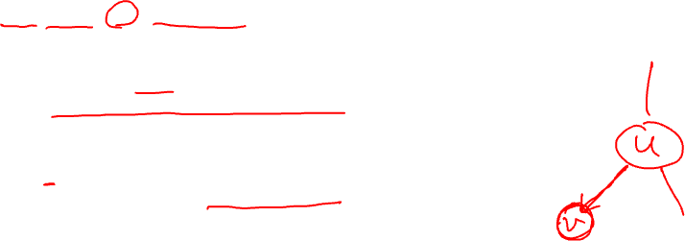
Implementation in Python

Slide 8
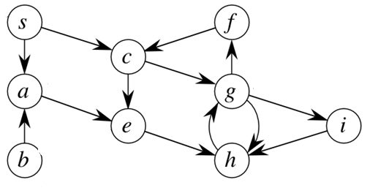
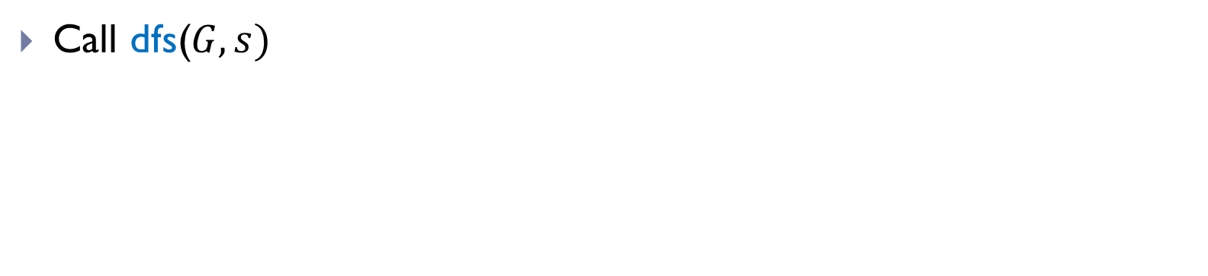
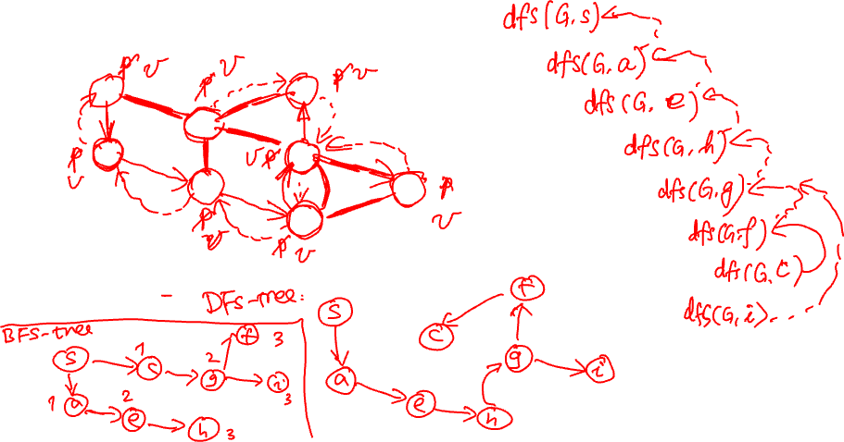

Example
$G$:
Call dfs($G, s)$

Slide 9
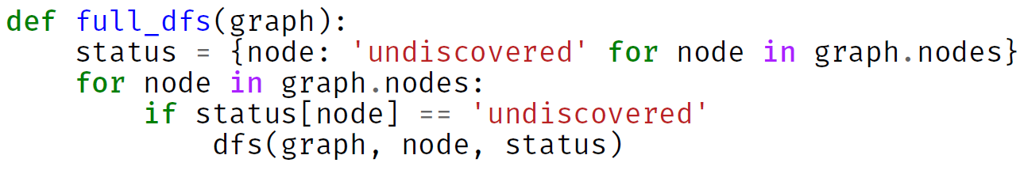

Full DFS
DFS will visit all nodes reachable from the source node
If the input graph is connected, then it will visit all nodes in the same connected component as the source
To visit all nodes in a graph
Needs full-DFS
which requires we restart from undiscovered nodes.

Slide 10
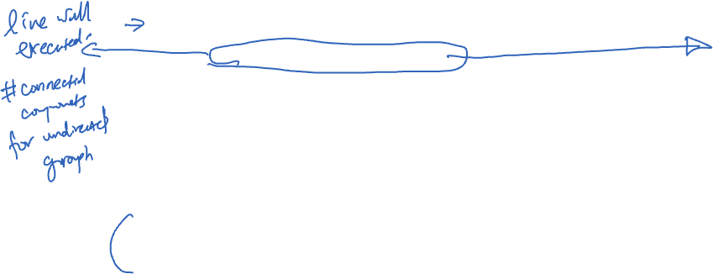
Complete code

Slide 11
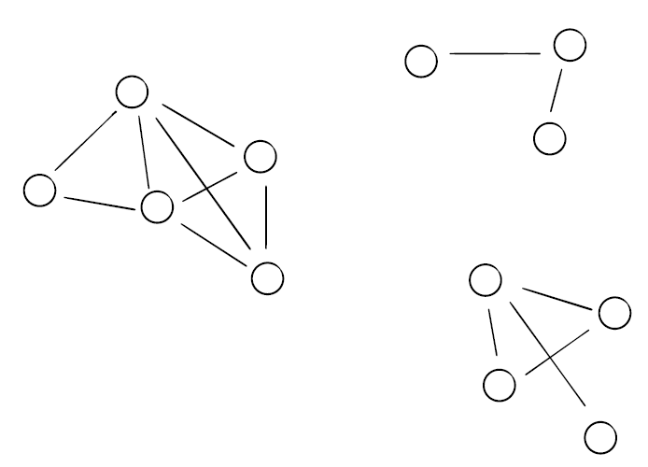





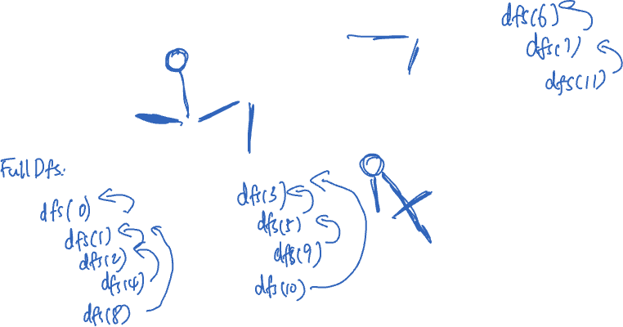







Example
$$6$$
$$7$$
$$0$$
$$11$$
$$2$$
$$8$$
$$1$$
$$4$$
$$3$$
$$9$$
$$5$$
$$10$$

Slide 12
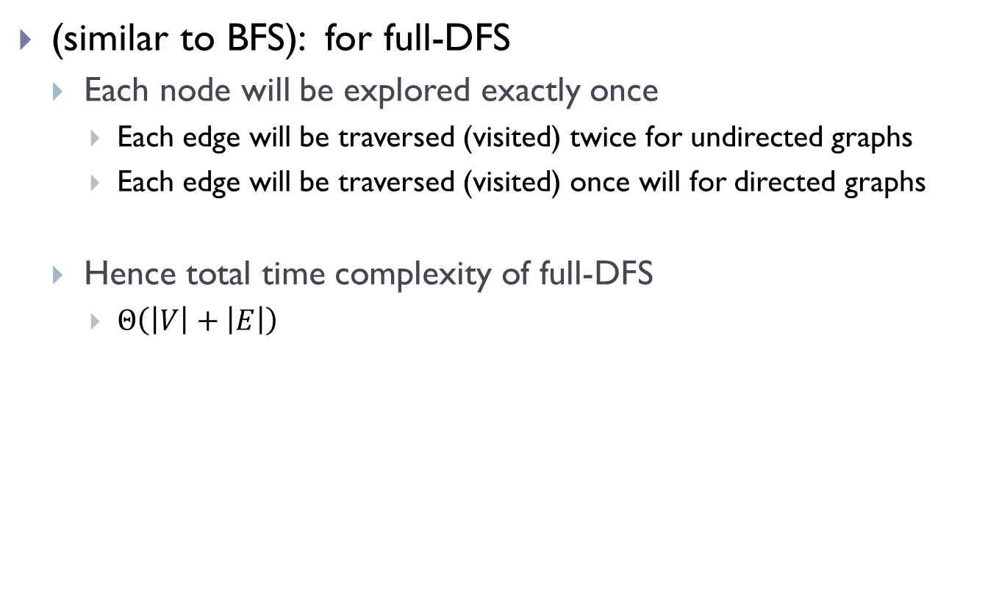
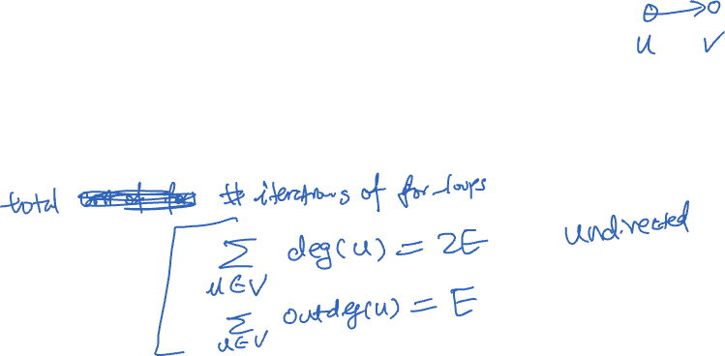
Time complexity analysis
(similar to BFS): for full-DFS
Each node will be explored exactly once
Each edge will be traversed (visited) twice for undirected graphs
Each edge will be traversed (visited) once will for directed graphs
Hence total time complexity of full-DFS
$Θ\left(\left|V\right|+\left|E\right|\right)$

Slide 13
Nesting properties in DFS

Slide 14
full_DFS

Slide 15
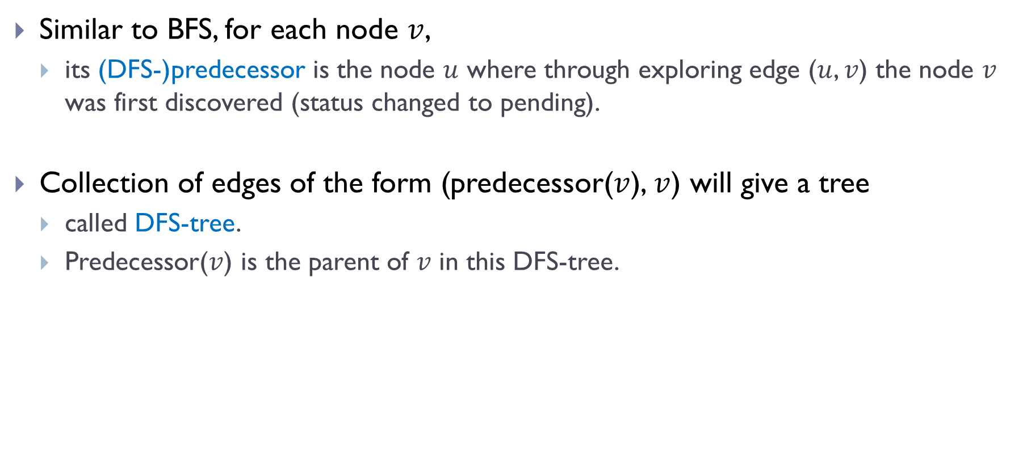
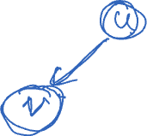
“Parent” (Predecessor) information
Similar to BFS, for each node $v$,
its (DFS-)predecessor is the node $u$ where through exploring edge ($u$, $v$) the node $v$ was first discovered (status changed to pending).
Collection of edges of the form (predecessor($v$), $v$) will give a tree
called DFS-tree.
Predecessor($v$) is the parent of $v$ in this DFS-tree.

Slide 16

Observations
Between marking a node as pending and visited, many other nodes are marked pending or visited.
$G$:

Slide 17
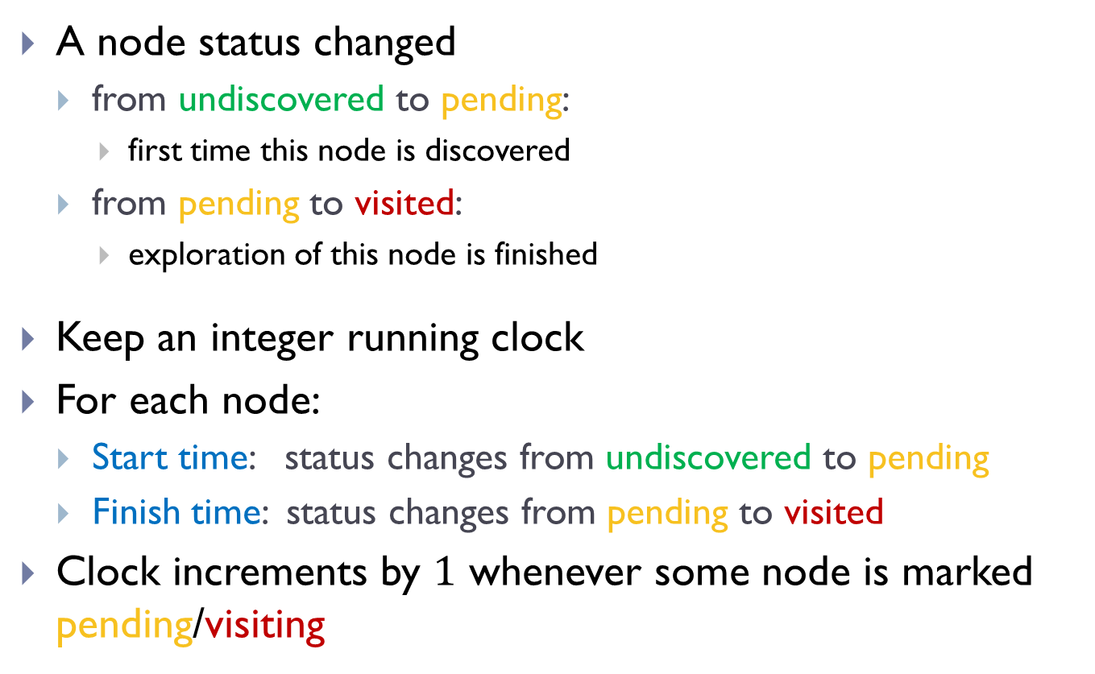
Start and Finish times
A node status changed
from undiscovered to pending:
first time this node is discovered
from pending to visited:
exploration of this node is finished
Keep an integer running clock
For each node:
Start time: status changes from undiscovered to pending
Finish time: status changes from pending to visited
Clock increments by $1$ whenever some node is marked pending/visiting

Slide 18

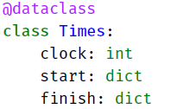
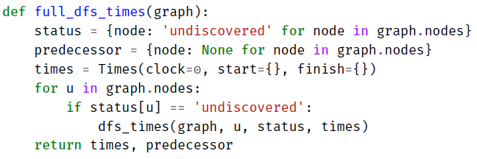
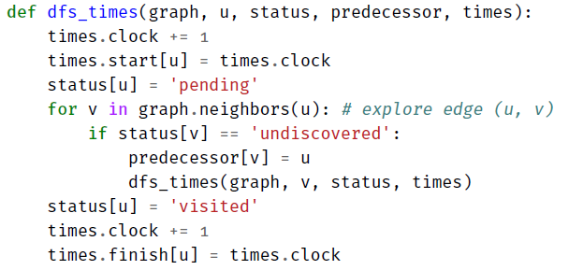
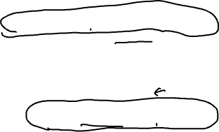
full_DFS_times implementation

Slide 19

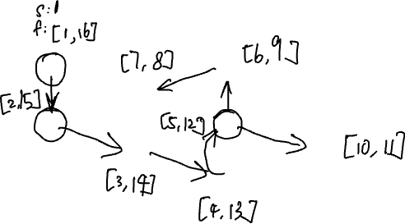
Example
$G$:

Slide 20
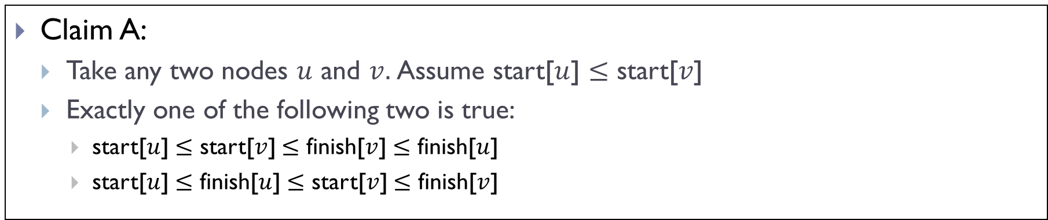
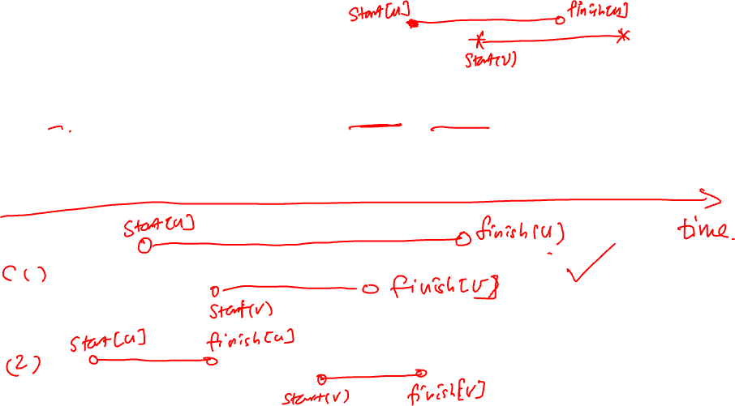
Nesting Property of DFS
Claim A:
Take any two nodes $u$ and $v.$Assume start[$u$] $≤$ start[$v$]
Exactly one of the following two is true:
start[$u$] $≤$ start[$v$] $≤$ finish[$v$] $≤$ finish[$u$]
start[$u$] $≤$ finish[$u$] $≤$ start[$v$] $≤$ finish[$v$]

Slide 21
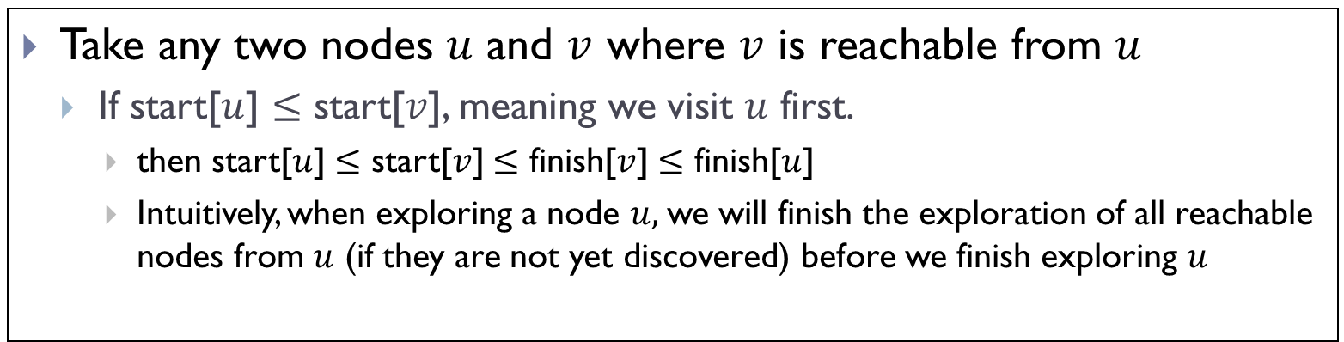
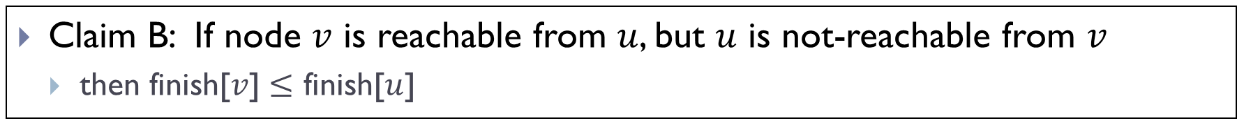
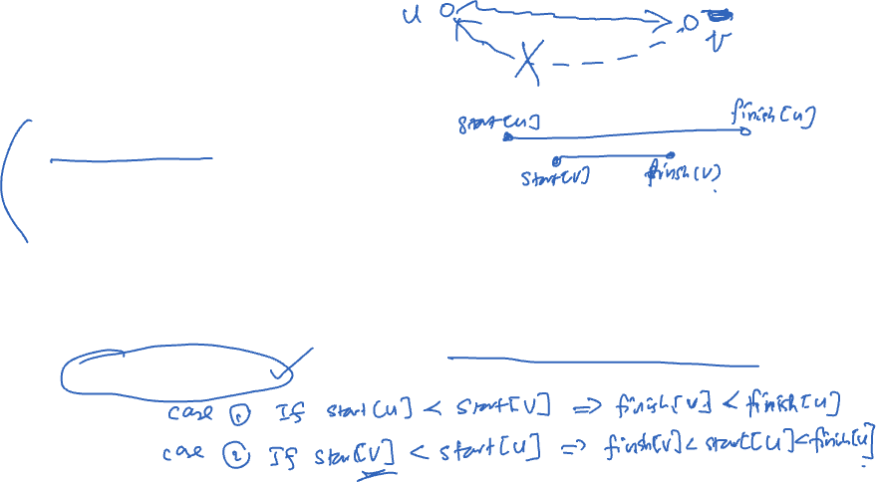
Nesting Property of DFS
Take any two nodes $u$ and $v$ where $v$ is reachable from $u$
If start[$u$] $≤$ start[$v$], meaning we visit $u$ first.
then start[$u$] $≤$ start[$v$] $≤$ finish[$v$] $≤$ finish[$u$]
Intuitively, when exploring a node $u,$we will finish the exploration of all reachable nodes from $u$ (if they are not yet discovered) before we finish exploring $u$
Claim B: If node $v$ is reachable from $u$, but $u$ is not-reachable from $v$
then finish[$v$] $≤$ finish[$u$]

Slide 22
DAGs and topological sort

Slide 23
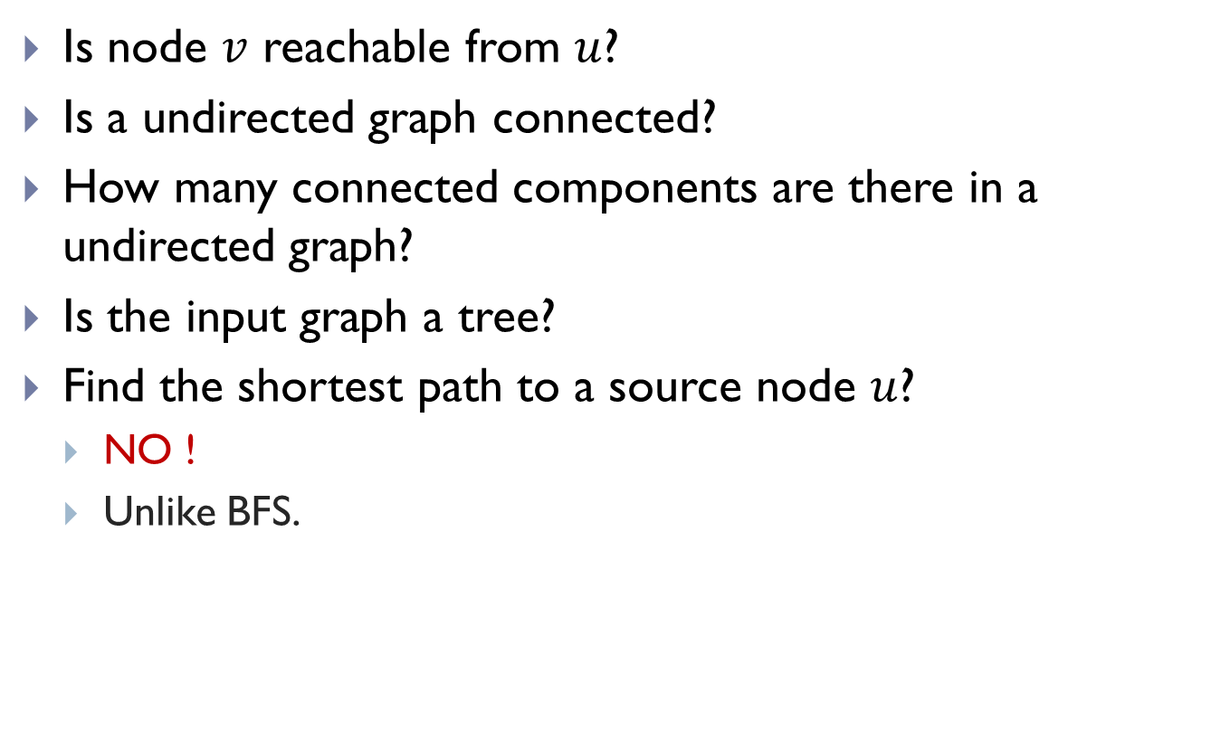
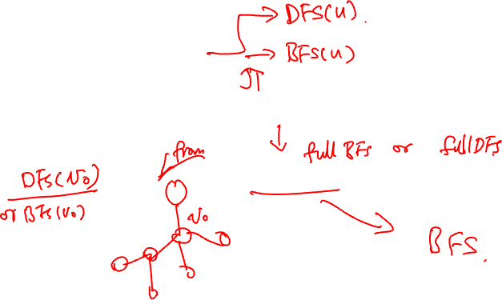
Applications of DFS
Is node $v$ reachable from $u$?
Is a undirected graph connected?
How many connected components are there in a undirected graph?
Is the input graph a tree?
Find the shortest path to a source node $u$?
NO !
Unlike BFS.

Slide 24
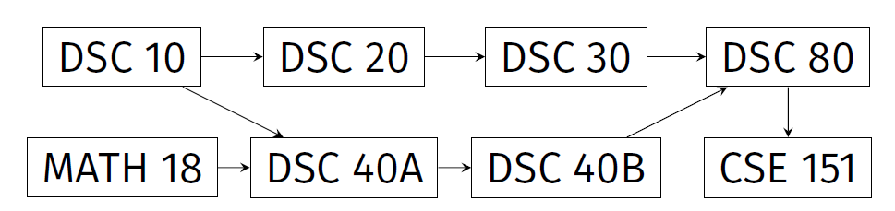
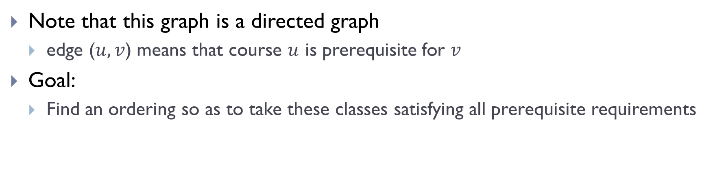
Prerequisite graphs
Note that this graph is a directed graph
edge ($u, v$) means that course $u$ is prerequisite for $v$
Goal:
Find an ordering so as to take these classes satisfying all prerequisite requirements

Slide 25

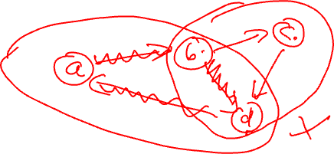
Directed Acyclic Graphs (DAGs)
A directed cycle is a (directed) path from a node to itself.
A directed acyclic graph (DAG) is a directed graph that does not contain any directed cycles
Not a DAG!
$G$:
A DAG!

Slide 26

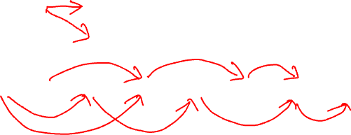
Topological Sorts
Given a DAG $G=(V, E)$, a topological sort of $G$ is an ordering of $V$ such that
for any edge $\left(u, v\right)∈E$, then $u$ comes before $v$ in this ordering
Topological sorts of the same DAG are not unique.
A topological sort:
DSC10, Math18, DSC20, DSC40A, DSC30, DSC40B, DSC80, DSC151
Another topological sort:
Math18, DSC10, DSC20, DSC30, DSC40A, DSC40B, DSC80, DSC151

Slide 27
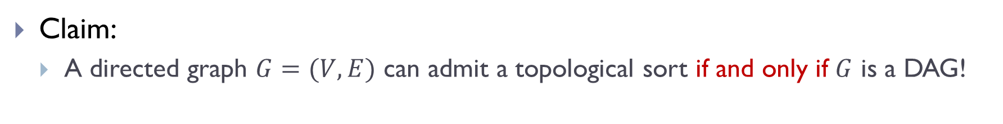
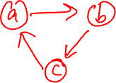
Why DAG?
Claim:
A directed graph $G=(V,E)$ can admit a topological sort if and only if $G$ is a DAG!
Why?
If there is a cycle, then there is no valid ordering for nodes in that cycle!
If it is a DAG, then we will give an algorithm to show we can compute topological sort.
$G$:

Slide 28
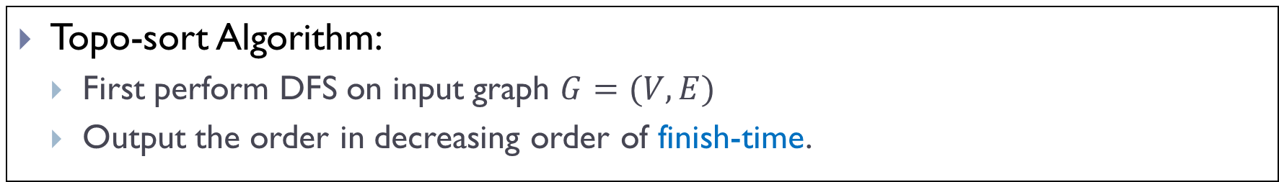
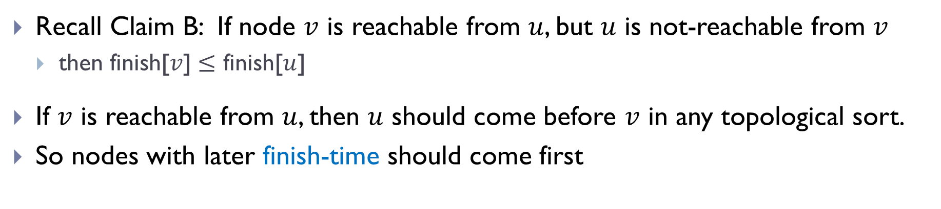
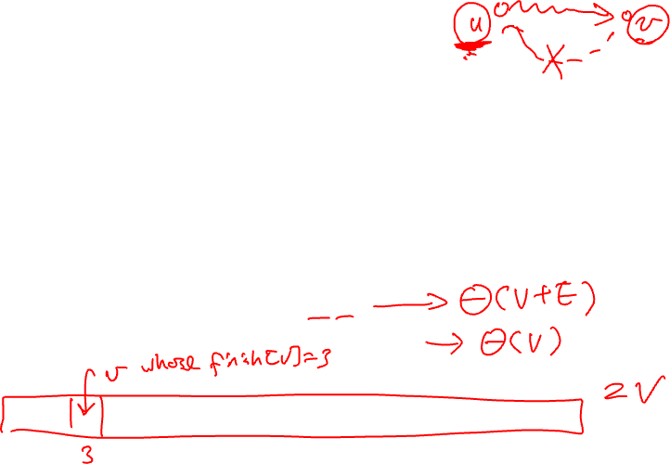

An algorithm to compute topo-sort
Recall Claim B: If node $v$ is reachable from $u$, but $u$ is not-reachable from $v$
then finish[$v$] $≤$ finish[$u$]
If $v$ is reachable from $u$, then $u$ should come before $v$ in any topological sort.
So nodes with later finish-time should come first
Topo-sort Algorithm:
First perform DFS on input graph $G=(V,E)$
Output the order in decreasing order of finish-time.
Time complexity:
$$Θ\left(\left|V\right|+\left|E\right|\right)$$

Slide 29
Example

Slide 30
Remark:
There are many other ways to compute a topological sort for a DAG in the same time complexity, without using DFS.

Slide 31
Summary
DFS:
Yet another graph search strategy
Similarly to BFS, as a graph search strategy, can help solve many problems, such as checking for connectivity, reachability, finding a path and so on.
But has some different properties as BFS
BFS: useful for finding shortest path to the source
DFS: has nesting properties in terms of start/finish times.
An application: Topological sort in DAG

Slide 32
FIN

