Slide 1
DSC40B: Theoretical Foundations of Data Science II
Lecture 8: Binary search tree
Instructor: Yusu Wang

Slide 2

(Dynamic) Set operations
Imagine you are maintaining a database indexed by some keys (real values), and you hope to support the following operations:
Search
Maximum
Minimum
Successor
Predecessor
Insert
Delete
Extract-Max
Increase-key
First approach: sort the array of keys
$Θ\left(\lg{n}\right)$
$Θ\left(1\right)$
$Θ\left(1\right)$
$Θ\left(1\right)$
$Θ\left(1\right)$
$Θ\left(n\right)$
$Θ\left(n\right)$
Using a sorted array can handle all static operations efficiently
Static operations!
How to have a good data structure so we can support all these operations efficiently?
Dynamic operations!

Slide 3
Today
Binary search tree
support all the operations from previous slide
in time proportional to height of tree
(Review): how to implement key operations, and time complexity
search, insert (and delete)
Extension to balanced binary search tree
Select query: augmenting data structure
median, order statistics

Slide 4
Part A: What is binary search tree?

Slide 5
First: Binary tree
A binary tree is a rooted tree
where each node has at most 2 children
Represented by a linked data structure
Each node contains at least fields:
Key
Left
Right
Parent
3
2
4

Slide 6
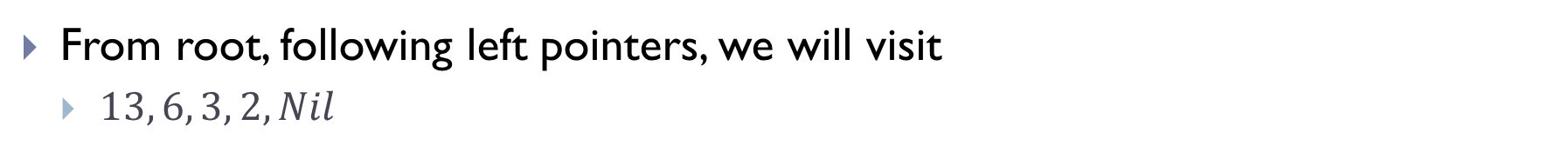
Example
From root, following left pointers, we will visit
$13, 6, 3, 2, Nil$
13
6
18
3
7
17
20
13
2
4
9

Slide 7
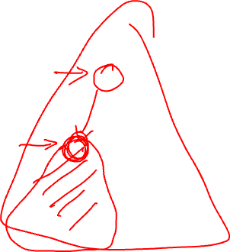
Binary tree
A binary tree is a rooted tree where
each node has at most 2 children
A node is the root of the tree
if its parent is Nil
A node is a leaf
if both children are Nil
Left sub-tree, right sub-tree
A complete binary tree is a binary tree
where each node has two children other than leaves
and each level (except possibly last level) is filled, and all nodes are as left as possible.
3
2
4
5
12
1
6

Slide 8
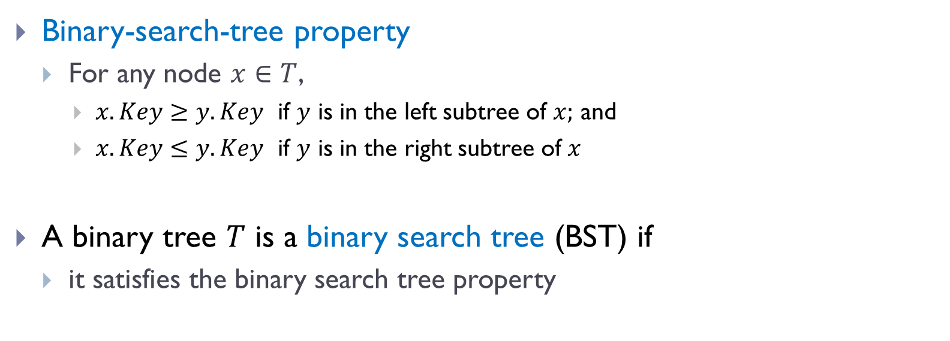
Binary search tree (BST)
Binary-search-tree property
For any node $x∈T$,
$x.Key≥y.Key$ if $y$ is in the left subtree of $x;$ and
$x.Key≤y.Key$ if $y$ is in the right subtree of $x$
A binary tree $T$ is a binary search tree (BST) if
it satisfies the binary search tree property

Slide 9
Example
A valid BST
13
6
18
3
7
17
20
13
2
4
9

Slide 10
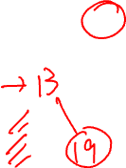
Example
?
13
6
18
3
7
19
20
13
2
8
9

Slide 11
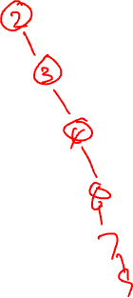
Properties
Given the same set of elements
there are many possible BSTs over them
Minimum?
Does it have to be a leaf?
6
3
7
2
4
9
Notes:
Ask about three nodes, what is the easiest

Slide 12

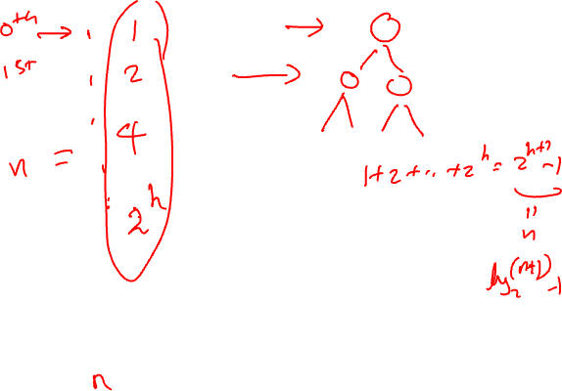


Properties
Given the same set of elements
there are many possible BSTs over them
Minimum?
Does it have to be a leaf?
Maximum?
Given $n$nodes,
Tallest possible BST tree has height $h= __________$
Shortest possible BST tree has height $h=__________$
6
3
8
4
7
9
$$n$$
$$\log_{2}{n=Θ(\lg{n)}}$$
Notes:
Ask about three nodes, what is the easiest

Slide 13
Part B: Operations in BST

Slide 14

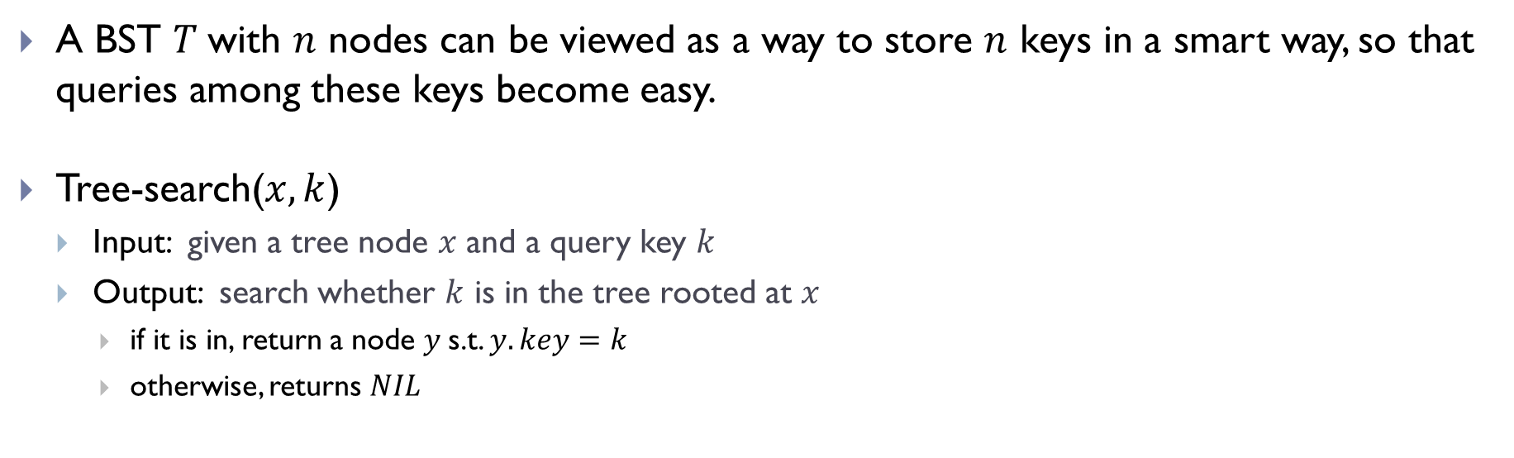



Search operation
A BST $T$with $n$ nodes can be viewed as a way to store $n$ keys in a smart way, so that queries among these keys become easy.
Tree-search($x, k$)
Input: given a tree node $x$ and a query key $k$
Output: search whether $k$ is in the tree rooted at $x$
if it is in, return a node $y$s.t. $y.key=k$
otherwise, returns $NIL$
6
$$x$$
Tree-search($x, 8$)
3
8
Tree-search($x, 4$)
Tree-search($x, 5$)
4
7
9

Slide 15


Tree-search algorithm, recursive version
Tree-search ( x, k)
if x = Nil or k = x.key
then return x
if k < x.key
then return Tree-search( x.left, k )
else return Tree-search( x.right, k )
6
3
8
4
7
9
Given an input tree $T$ and a key $k$
we will start by calling Tree-search($T.$root$, k$)

Slide 16
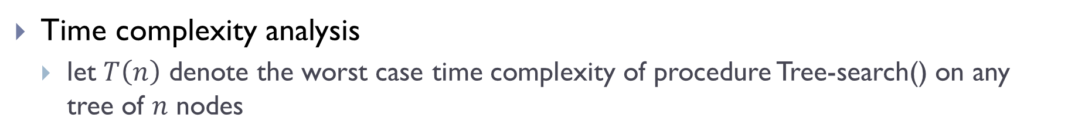
Tree-search algorithm, recursive version
Tree-search ( x, k)
if x = Nil or k = x.key
then return x
if k < x.key
then return Tree-search( x.left, k )
else return Tree-search( x.right, k )
6
3
8
4
7
9
Time complexity analysis
let $T\left(n\right)$ denote the worst case time complexity of procedure Tree-search() on any tree of $n$ nodes

Slide 17
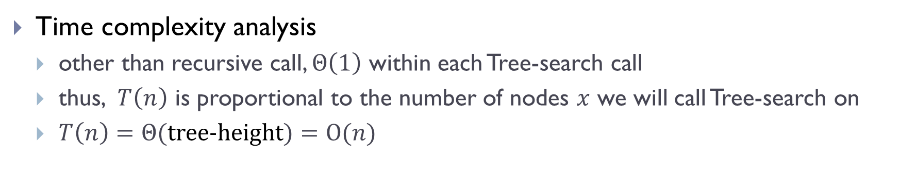
Tree-search algorithm, recursive version
Tree-search ( x, k)
if x = Nil or k = x.key
then return x
if k < x.key
then return Tree-search( x.left, k )
else return Tree-search( x.right, k )
6
3
8
4
7
9
Time complexity analysis
other than recursive call, $Θ\left(1\right)$ within each Tree-search call
thus, $T\left(n\right)$ is proportional to the number of nodes $x$ we will call Tree-search on
$T\left(n\right)=Θ($tree-height$)=O(n)$

Slide 18
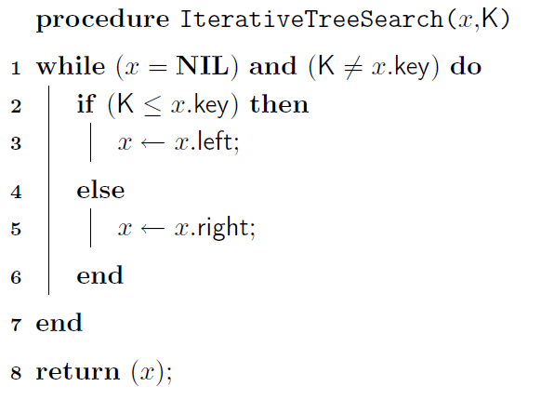
Tree-search: iterative version

Slide 19

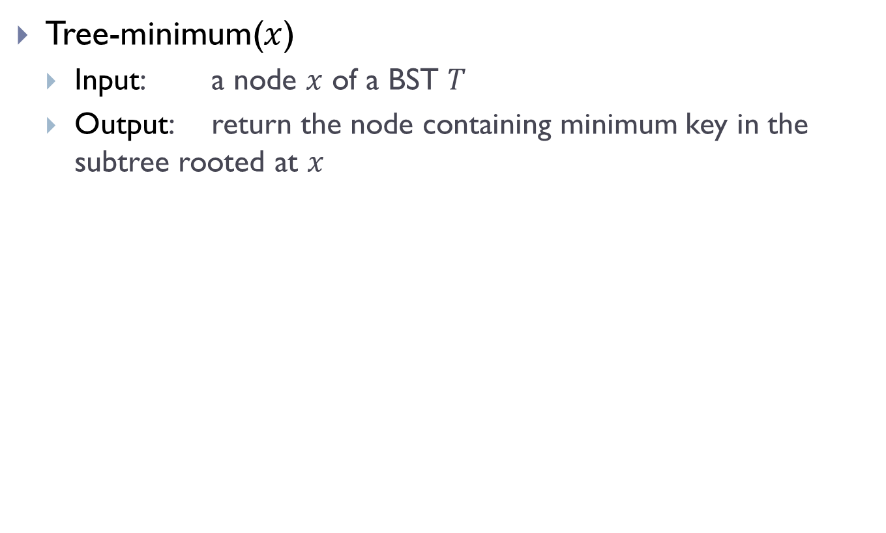

Minimum / Maximum
Tree-minimum($x$)
Input: a node $x$ of a BST $T$
Output: return the node containing minimum key in the subtree rooted at $x$
$$x$$
6
$$y$$
3
8
4
7
9

Slide 20
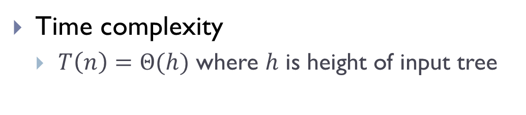
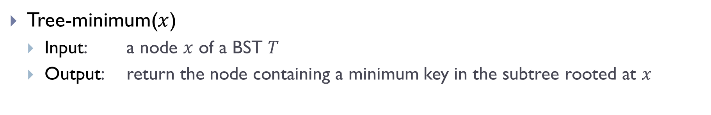
Minimum / Maximum
Tree-minimum($x$)
Input: a node $x$ of a BST $T$
Output: return the node containing a minimum key in the subtree rooted at $x$
Tree-minimum(x)
while ( x.left ≠ Nil)
do x = x.left;
return x;
6
3
8
Time complexity
$T\left(n\right)=Θ(h)$ where $h$ is height of input tree
4
7
9

Slide 21
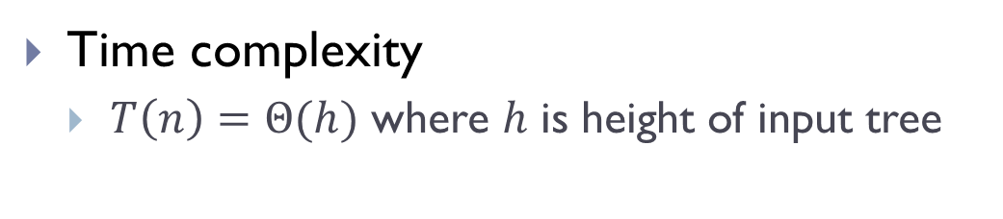
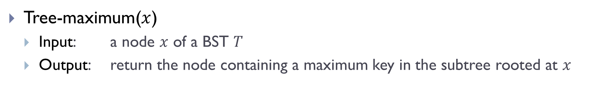
Minimum / Maximum
Tree-maximum($x$)
Input: a node $x$ of a BST $T$
Output: return the node containing a maximum key in the subtree rooted at $x$
Tree-maximum(x)
while ( x.right ≠ Nil)
do x = x.right;
return x;
6
3
8
Time complexity
$T\left(n\right)=Θ(h)$ where $h$ is height of input tree
4
7
9

Slide 22
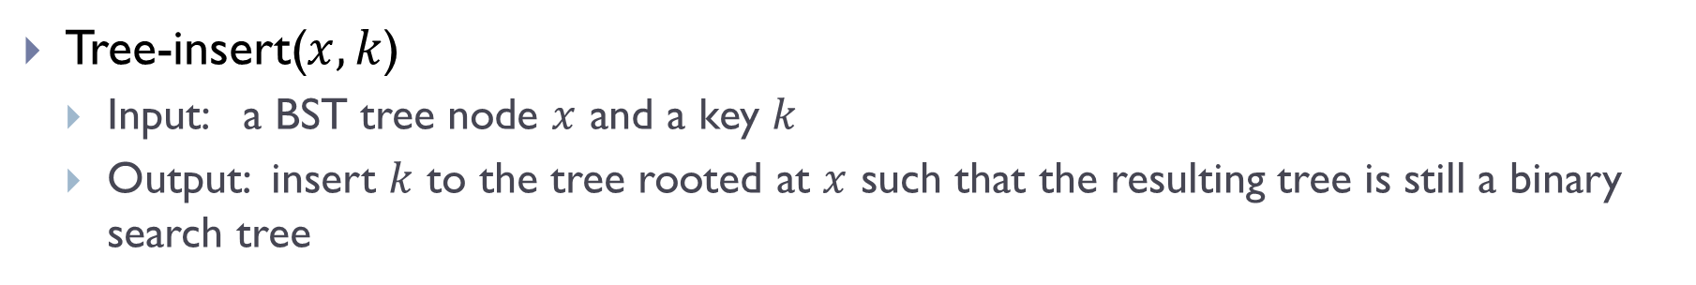
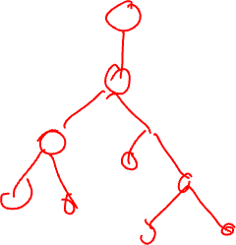
Tree-insert
Tree-insert($x, k$)
Input: a BST tree node $x$ and a key $k$
Output: insert $k$ to the tree rooted at $x$ such that the resulting tree is still a binary search tree

Slide 23
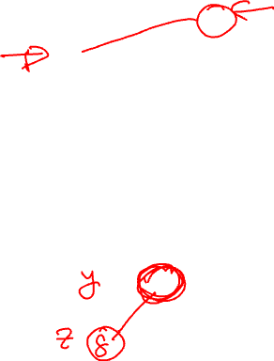
Examples
T.root
15
6
Tree-Insert(T.root, 8)
3
7
Tree-Insert(T.root, 6.5)
2
4
13
9
Use tree-search !

Slide 24


Tree-insert
Tree-insert($T, k$)
y = Nil; x = T.root
z.key = $k;$z.left = Nil; z.right=Nil
while (x ≠ Nil) do
y = x
if ( z.key < x.key )
then x = x.left
else x = x.right
z.parent = y
if (y = Nil) then T.root = z
else if (z.key < y.key)
then y.left = z
else y.right = z
z is the new node to be inserted
Locate potential parent y of z.
Set up z as appropriate child of y

Slide 25

Tree-insert
Tree-insert($T, k$)
y = Nil; x = T.root
z.key = $k;$z.left = Nil; z.right=Nil
while (x ≠ Nil) do
y = x
if ( z.key < x.key )
then x = x.left
else x = x.right
z.parent = y
if (y = Nil) then T.root = z
else if (z.key < y.key)
then y.left = z
else y.right = z
Time complexity
$T\left(n\right)=Θ(h)$, where $h$ is height of input tree

Slide 26

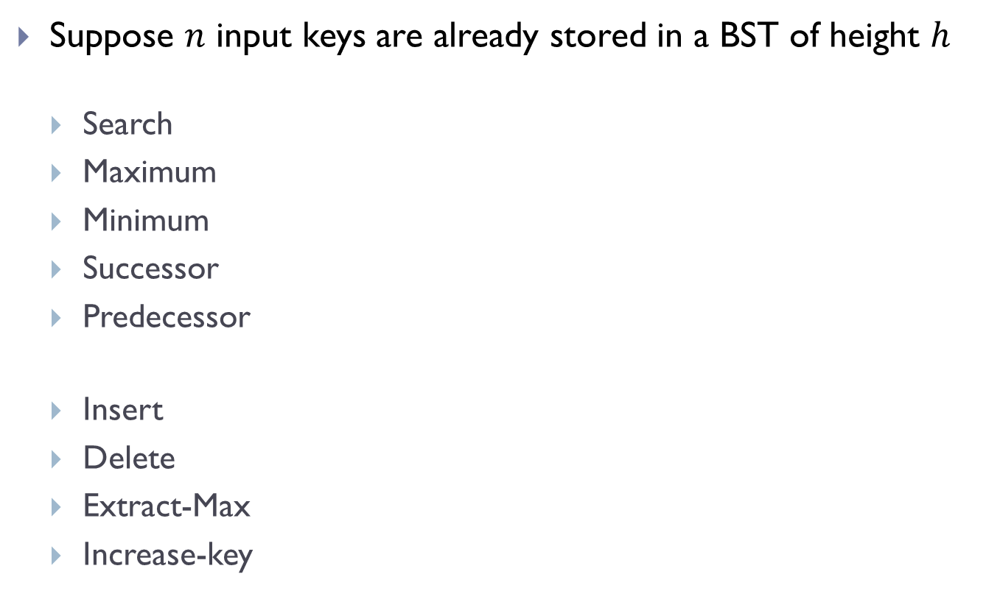

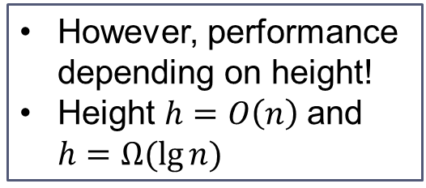






Summary: BST is good for both static and dynamic operations
Suppose $n$ input keys are already stored in a BST of height $h$
Search
Maximum
Minimum
Successor
Predecessor
Insert
Delete
Extract-Max
Increase-key
Time complexity
$$Θ(h)$$
$$Θ(h)$$
However, performance depending on height!
Height $h=O\left(n\right)$and $h=Ω(\lg{n)}$
$$Θ(h)$$
$$Θ(h)$$
$$Θ(h)$$
To have good performance, we want to keep the tree height low!
$$Θ(h)$$
$$Θ(h)$$
$$Θ(h)$$
$$Θ(h)$$

Slide 27
Part C: Balanced binary search tree

Slide 28
Good tree
13
6
18
3
7
17
20
13
19
2
4
6
9

Slide 29
Bad Tree

Slide 30
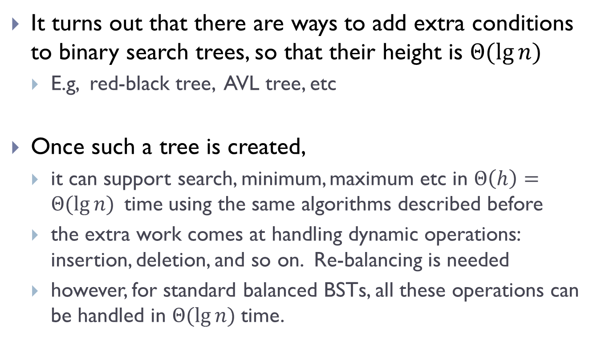
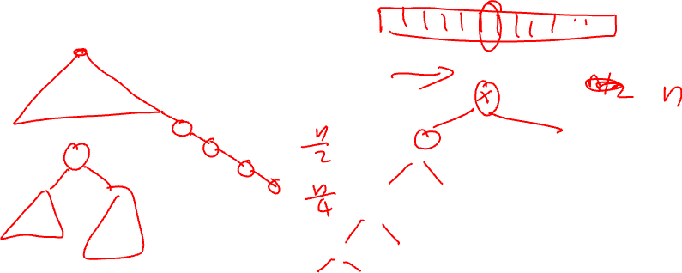
Balanced binary search tree
It turns out that there are ways to add extra conditions to binary search trees, so that their height is $Θ(\lg{n)}$
E.g, red-black tree, AVL tree, etc
Once such a tree is created,
it can support search, minimum, maximum etc in $Θ\left(h\right)=Θ(\lg{n) }$time using the same algorithms described before
the extra work comes at handling dynamic operations: insertion, deletion, and so on. Re-balancing is needed
however, for standard balanced BSTs, all these operations can be handled in $Θ(\lg{n) }$time.

Slide 31
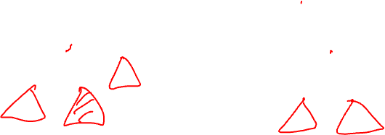
Rotation operation
Left rotation or Right rotation to keep tree height low
x
y
y
right rotation
x
C
A
left rotation
A
B
B
C

Slide 32



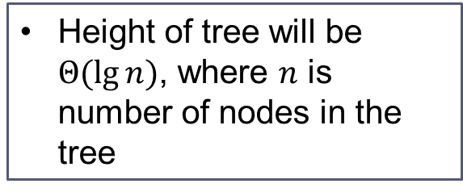







With balanced BST
Suppose $n$ input keys are already stored in a balanced BST
Search
Maximum
Minimum
Successor
Predecessor
Insert
Delete
Extract-Max
Increase-key
Time complexity
$$Θ(\lg{n})$$
$$Θ(\lg{n})$$
$$Θ(\lg{n})$$
$$Θ(\lg{n})$$
Height of tree will be $Θ(\lg{n)}$, where $n$ is number of nodes in the tree
$$Θ(\lg{n})$$
$$Θ(\lg{n})$$
$$Θ(\lg{n})$$
$$Θ(\lg{n})$$
$$Θ(\lg{n})$$

Slide 33
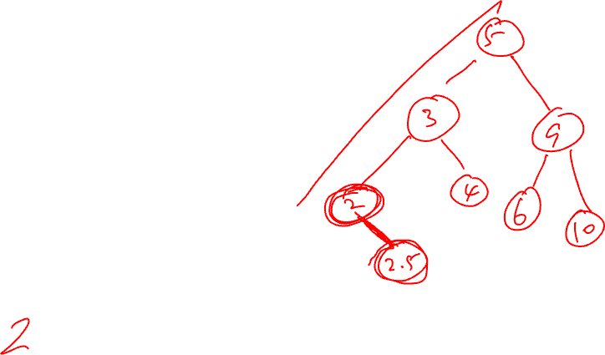
Part D: Select queries augmenting data structure

Slide 34
What if we also want to perform Select operation
BST-Select ( x, k ):
Given a list of records whose keys are stored in a tree rooted at x, return the node whose key has rank k.
We can use QuickSelect to do this in linear time.. Why are we not satisfied?
What if we have to do it many times?
Sort it first
But what if we also have dynamic changes?
Need a data structure that can support Select under dynamic changes

Slide 35
BST
13
6
18
3
7
17
20
13
19
2
4
6
9

Slide 36
What if we also want to perform Select operation
BST-Select ( x, k ):
Given a list of records whose keys are stored in a tree rooted at x, return the node whose key has rank k.
We can do linear search to find it. But can we do better?
Goal:
Augment the binary search tree data structure so as to support Select ( x, k ) efficiently

Slide 37
In particular,
BST-Select ( x, k )
Goal:
Augment the binary search tree data structure so as to support BST-Select ( x, k ) efficiently
Ordinary binary search tree T
O(h) time for BST-Select(T.root, k) where h is height of tree T
Using balanced search tree)
O(lg n) time for BST-Select(T.root, k)

Slide 38
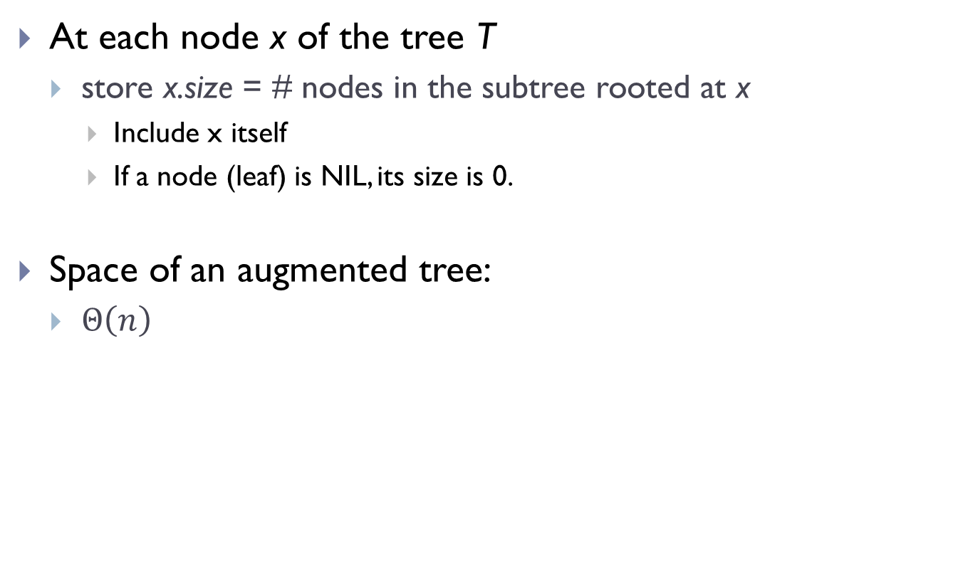
How do we augment a BST T?
At each node x of the tree T
store x.size = # nodes in the subtree rooted at x
Include x itself
If a node (leaf) is NIL, its size is 0.
Space of an augmented tree:
$Θ\left(n\right)$

Slide 39
An example
M
9
C
5
P
3
F
3
T
2
A
1
D
1
H
1
Q
1

Slide 40
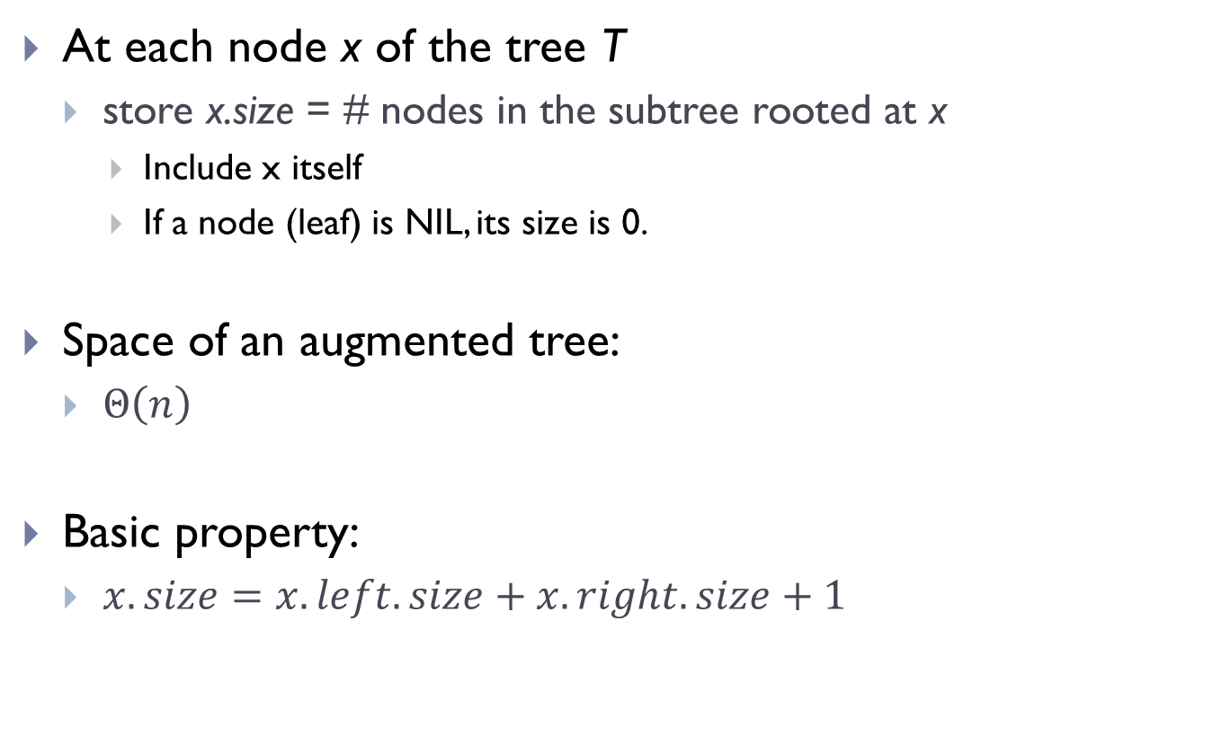
How do we augment a BST T?
At each node x of the tree T
store x.size = # nodes in the subtree rooted at x
Include x itself
If a node (leaf) is NIL, its size is 0.
Space of an augmented tree:
$Θ\left(n\right)$
Basic property:
$x.size=x.left.size+x.right.size+1$

Slide 41
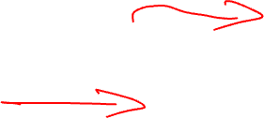
How to set up size information ?
M
9
C
5
P
3
F
3
T
2
A
1
D
1
H
1
Q
1

Slide 42
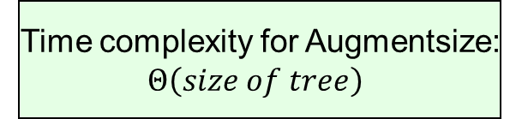
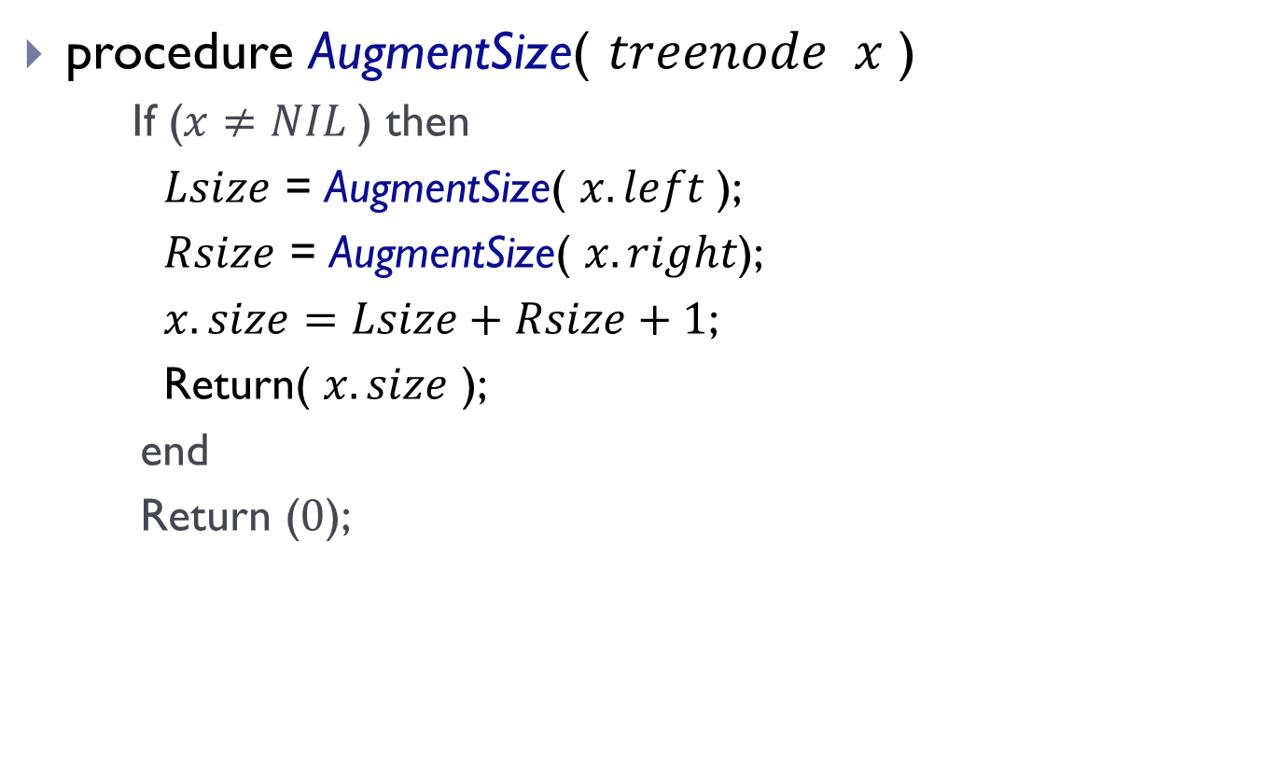
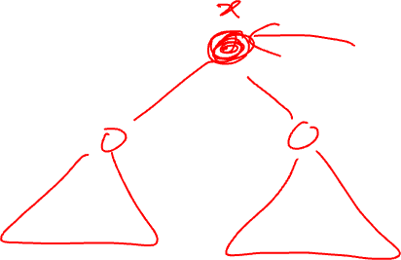
How to setup size information?
procedure AugmentSize( $treenode x$ )
If ($x≠NIL$) then
$Lsize$ = AugmentSize( $x.left$);
$Rsize$ = AugmentSize( $x.right$);
$x.size=Lsize+Rsize+1$;
Return( $x.size$ );
end
Return ($0$);
Postorder traversal
of the tree !
Time complexity for Augmentsize:
$Θ\left(size of tree\right)$

Slide 43
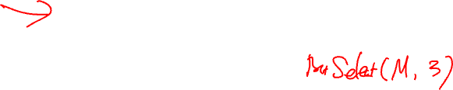
How to perform select with aug-BST?
M
9
Select element
with rank 3?
Select element
with rank 7?
C
5
P
3
Select element
with rank 6?
F
3
T
2
A
1
D
1
H
1
Q
1

Slide 44
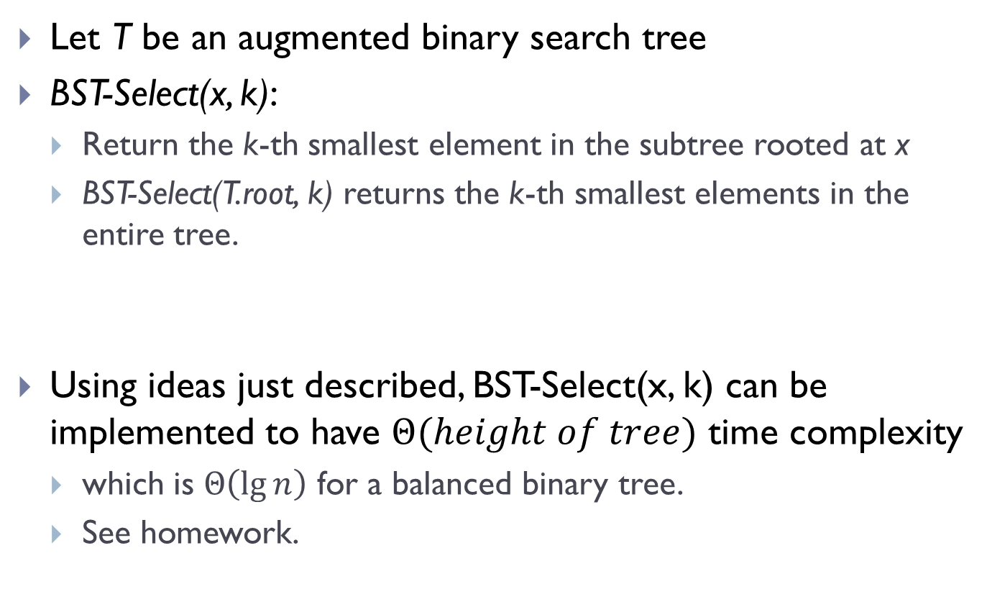
Let T be an augmented binary search tree
BST-Select(x, k):
Return the k-th smallest element in the subtree rooted at x
BST-Select(T.root, k) returns the k-th smallest elements in the entire tree.
Using ideas just described, BST-Select(x, k) can be implemented to have $Θ(height of tree)$ time complexity
which is $Θ\left(\lg{n}\right)$ for a balanced binary tree.
See homework.

Slide 45
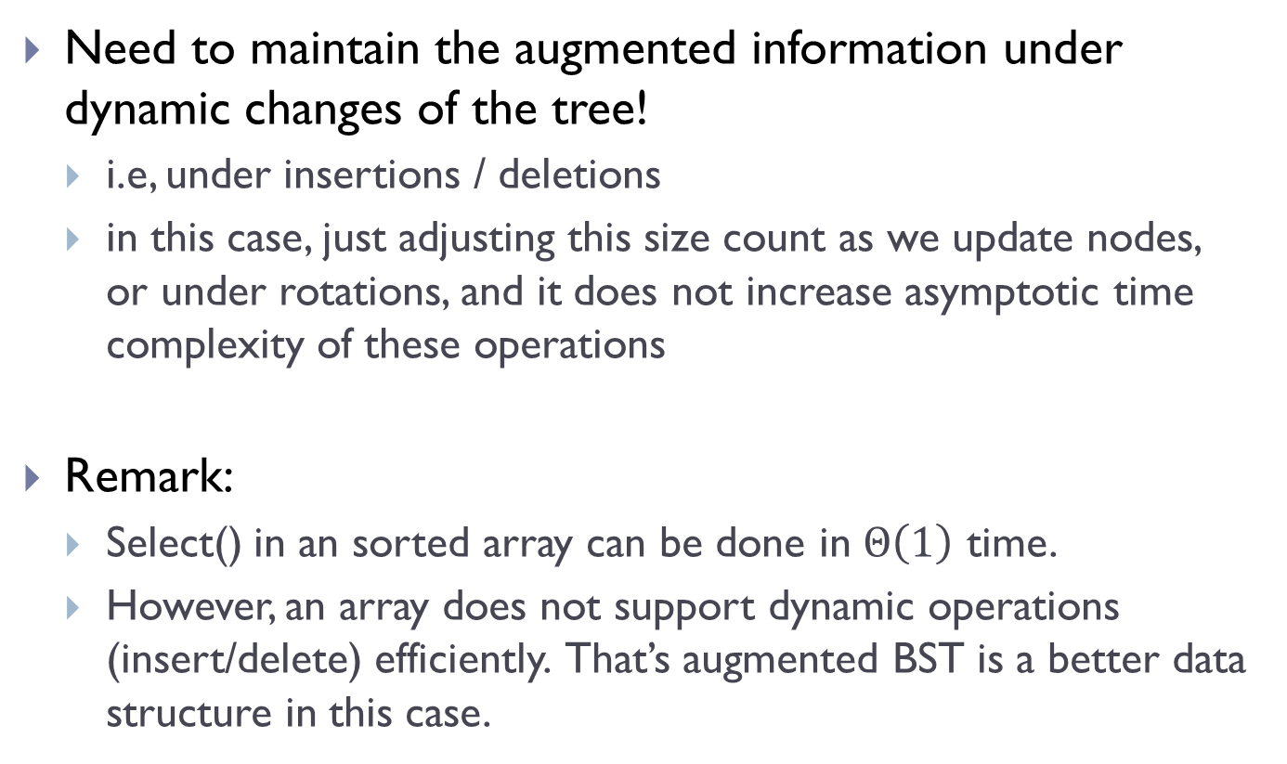
Are we done?
Need to maintain the augmented information under dynamic changes of the tree!
i.e, under insertions / deletions
in this case, just adjusting this size count as we update nodes, or under rotations, and it does not increase asymptotic time complexity of these operations
Remark:
Select() in an sorted array can be done in $Θ\left(1\right)$ time.
However, an array does not support dynamic operations (insert/delete) efficiently. That’s augmented BST is a better data structure in this case.

Slide 46
Summary
Simple example of augmenting data structures
In general, the augmented information can be quite complicated
Can be a separate data structure!
Need to consider how to maintain such information under dynamic changes

Slide 47
FIN

