Slide 1





Netflix Content Analysis: Data-Driven Insights
(A Power BI and SQL Analysis Report)
Play

Slide 2
Contents
Objective
Data Preparation
Data Analysis with MySQL
Data Visualization with Power Bi
Business Problems and Solutions
Conclusion

Slide 3
Objective
Analyze Netflix’s catalog data to uncover trends, viewer preferences, and content insights using MySQL and Power BI.
Provide strategic recommendations for content acquisition and viewer engagement based on data-driven Insights.

Slide 4


Data Preparation
Data Extraction
Netflix’s dataset includes Title, Director, Country, ratings, and release dates.
Tools Used

Slide 5
Steps for Data Preparation
Data Extraction:
Used MySQL to extract relevant data from the Netflix dataset.
Focused on fields like title, genre, release date, rating, and country of release.
Data Cleaning:
Handled missing values by either filling in gaps or removing incomplete entries.
Standardized date formats and corrected any inconsistencies.
Data Transformation:
Created new columns such as ‘Year of Release’ by extracting the year from the release date.
Generated categorical variables for genres.

Slide 6
4. Data Loading:
Imported the cleaned data into PowerBI for visualization.
5. Verification:
Ensured the data was accurate and consistent across different fields.
Performed sample checks to validate the data transformations.

Slide 7
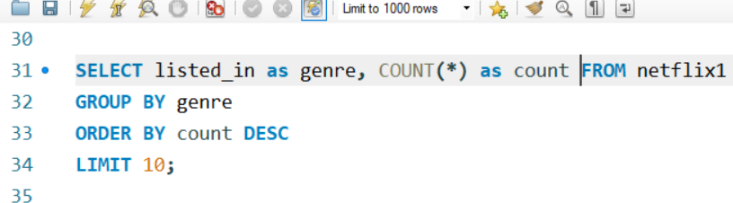
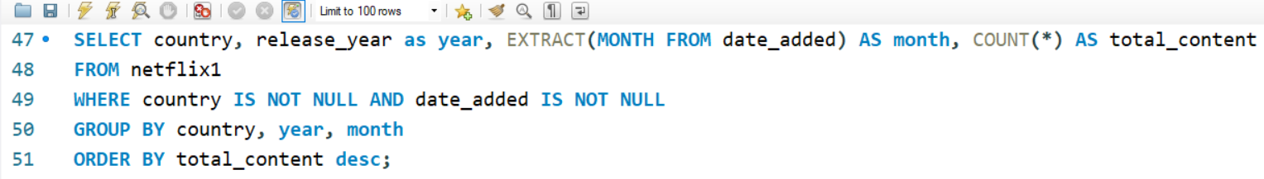
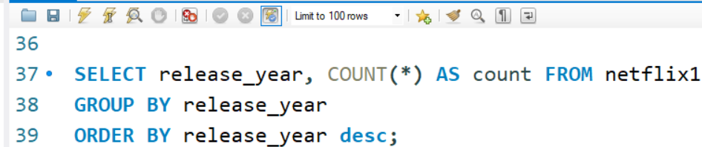
Data Analysis with MySQL
Popular Genres
Monthly Content Additions by Country
Content Release Trends

Slide 8
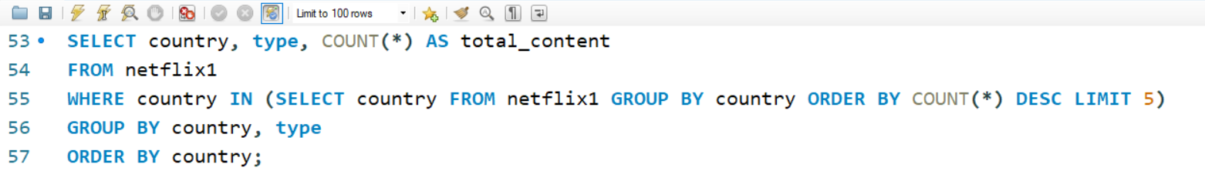
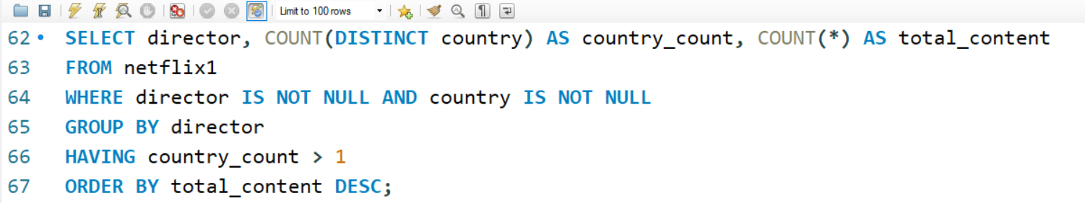
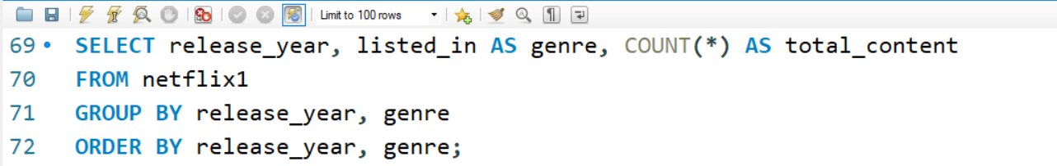
Content Distribution in Top Countries
Directors with Most Content Across Multiple Countries
Popular Genres

Slide 9
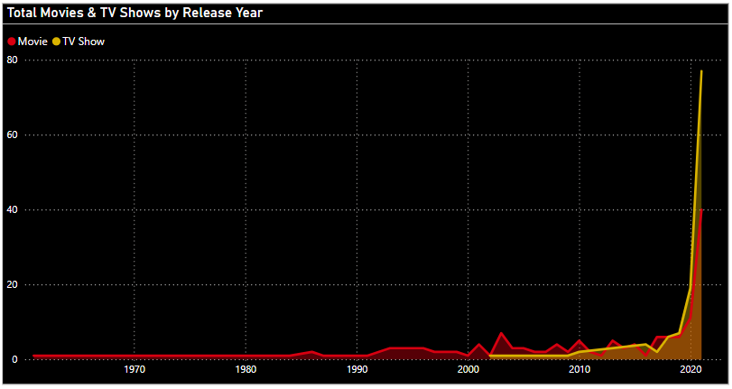
Power BI Dashboard Visualizations
1. Area Chart: Total Movies and TV Shows by Release Year
This chart highlights trends in content release over the years, showing peaks and troughs which can indicate periods of high production activity and the potential impact of market changes.

Slide 10
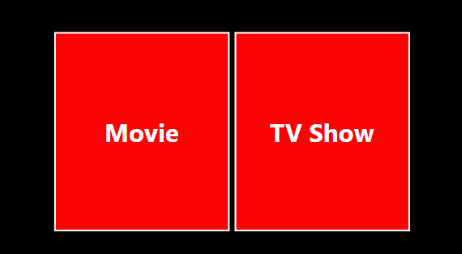
2. Slicer: Movies and TV Shows
Provides flexibility to analyze data separately for movies and TV shows, ensuring a focused analysis of each content type. Allows for deeper insights by isolating data, revealing specific trends and patterns unique to movies or TV shows.

Slide 11
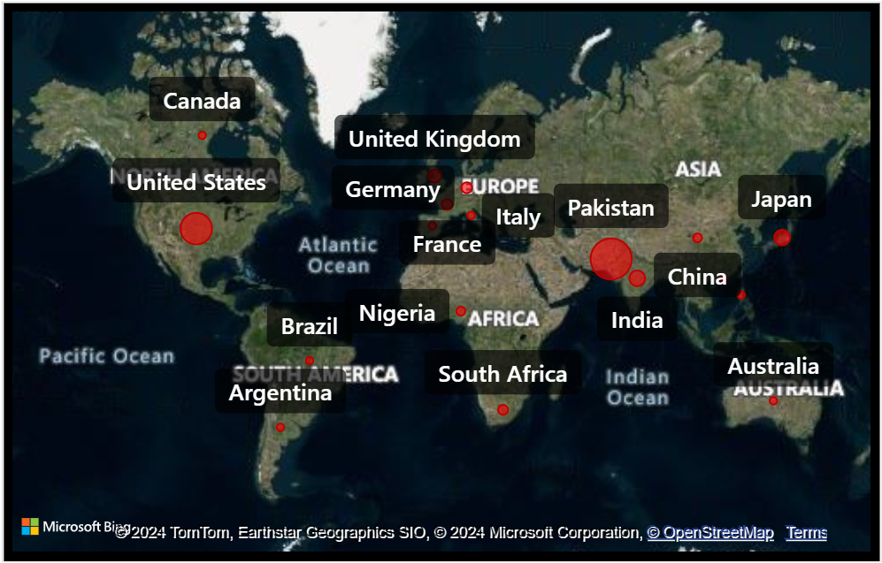
3. Map Visualization: Geographical Distribution
Visualizes the distribution of content across different countries, highlighting regional production-trends and content popularity. Enables analysis of geographic markets, helping to understand where Netflix is expanding and which regions are most active in content production.

Slide 12
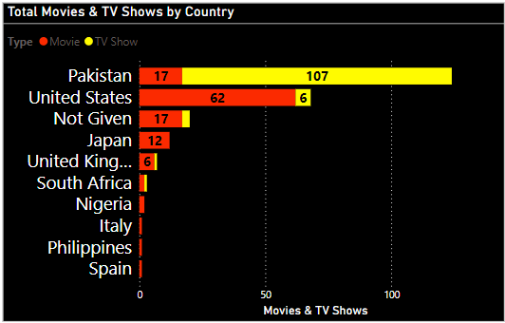
4. Stacked Column Chart: Total Movies and TV Shows by Country
Breaks down the contribution of each country to the overall content library, showing both
movies and TV shows. Reveals leading countries in content production and highlights the diversity of Netflix's content
library across different regions.

Slide 13
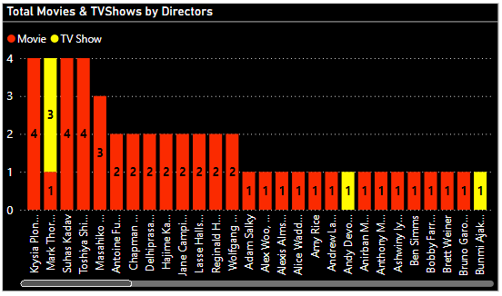
5. Stacked Bar Chart: Total Movies and TV Shows by Directors
Provides insights into the output of individual directors, showcasing prolific directors and their
contributions. Helps identify top directors in terms of content creation, potentially guiding decisions on
collaborations and future content production.

Slide 14
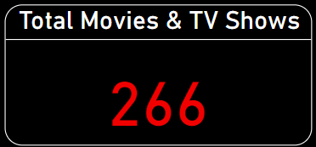
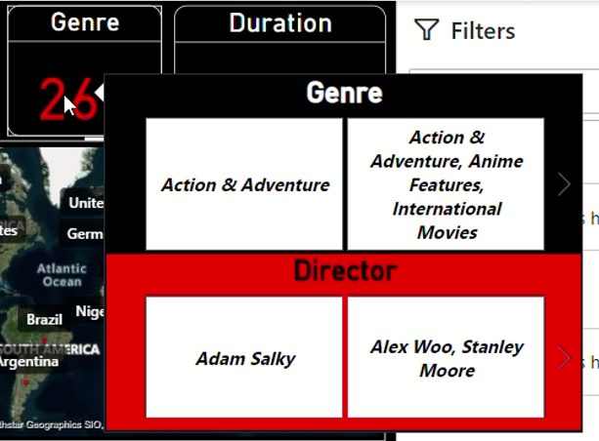
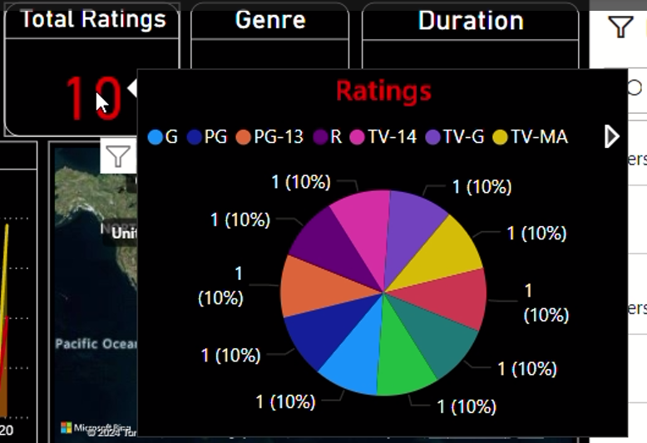
6. Cards for Key Metrics
1. Total TV Shows and Movies:
Displays the total count of TV shows and movies in the dataset
2. Total Ratings and Total Genre:
Shows the total number of ratings for all content, with a tooltip for additional details.
Genre displays the different genres available, with a tooltip for further information.

Slide 15
Business Problems and Solutions
Audience Engagement:
Identify viewer preferences via genre, ratings, and new releases
Geographical Targeting:
Use geographic data to tailor marketing efforts.
Performance Monitoring:
Evaluate key metrics like total shows, movies, and ratings.
Content Acquisition Strategy:
Analyze trends in popular genres, release years, and ratings.

Slide 16
Conclusion
Data Preparation:
Detailed steps for cleaning and structuring Netflix data using MySQL and PowerBI.
Data Analysis: Key findings from MySQL queries, highlighting trends and patterns in Netflix content.
Power BI Visualizations:
Comprehensive visual representation of data insights, including release trends, geographic distribution, and content metrics.
Business Problems and Solutions:
Strategic recommendations to tackle key business challenges using data-driven insights.
Key Insights:
Identification of viewer preferences, content performance, and regional distribution trends.

