Slide 1
FITTRACK
TODAY
FITNESS & WELLNESS
01
Workout planning
that keeps progress visible
training
A React-based workout planner and training log
PLAN
LOG
REVIEW
PROJECT PRESENTATION
Local-first workout planning and history
Name: SIVAGURU D • Register No.: 2116240701517
FITTRACK / FITNESS & WELLNESS
01
Notes:
Introduce FitTrack as a browser-based fitness application for planning workouts, logging training sessions, and reviewing progress. Replace the editable student and registration placeholders before presenting.

Slide 2
PROJECT OVERVIEW
Abstract
FitTrack brings workout planning and session tracking into one simple browser interface.
Users can browse a built-in exercise library, create reusable routines, log sets during a workout, and review completed sessions from the dashboard.
01
02
03
PLAN
TRACK
REVIEW
Build routines from exercises, equipment, and target sets.
Record sets and reps while a session is in progress.
See completed workouts and weekly training summaries.
Project focus: consistent workout planning with progress data saved in the browser.
FITTRACK / FITNESS & WELLNESS
02
Notes:
The application is designed to keep the workout flow in one place. Its React interface uses browser local storage for custom exercises, saved workouts, history, active sessions, and measurement units.

Slide 3
RUN ENVIRONMENT
Software Requirements
Application
FitTrack single-page web application
Frontend
React 18 or later; React DOM
Runtime / setup
Node.js with npm for development and dependency installation
Browser
Current desktop browser with JavaScript and local storage enabled
Operating system
Windows, macOS, or Linux with a supported browser
Persistence
Browser localStorage; no server or database required for this version
Development: npm install → npm run dev
FITTRACK / FITNESS & WELLNESS
03
Notes:
The supplied source describes React and React DOM 18+ as the only runtime dependencies. Node.js and npm are used to install and run the Vite development project. Workout data is stored in localStorage, so this project version does not require a backend service.

Slide 4
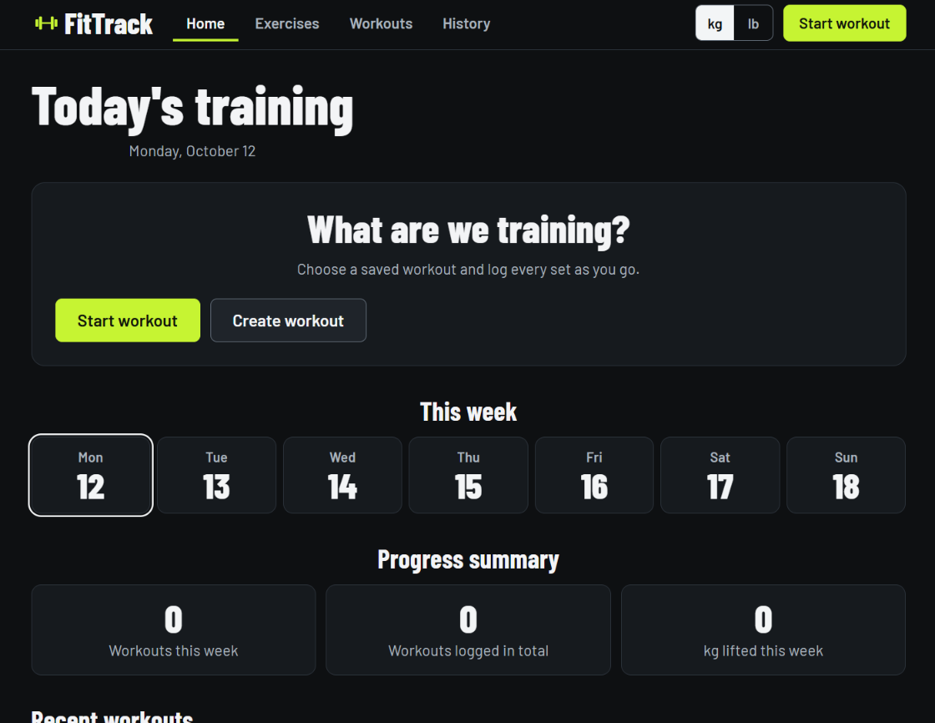
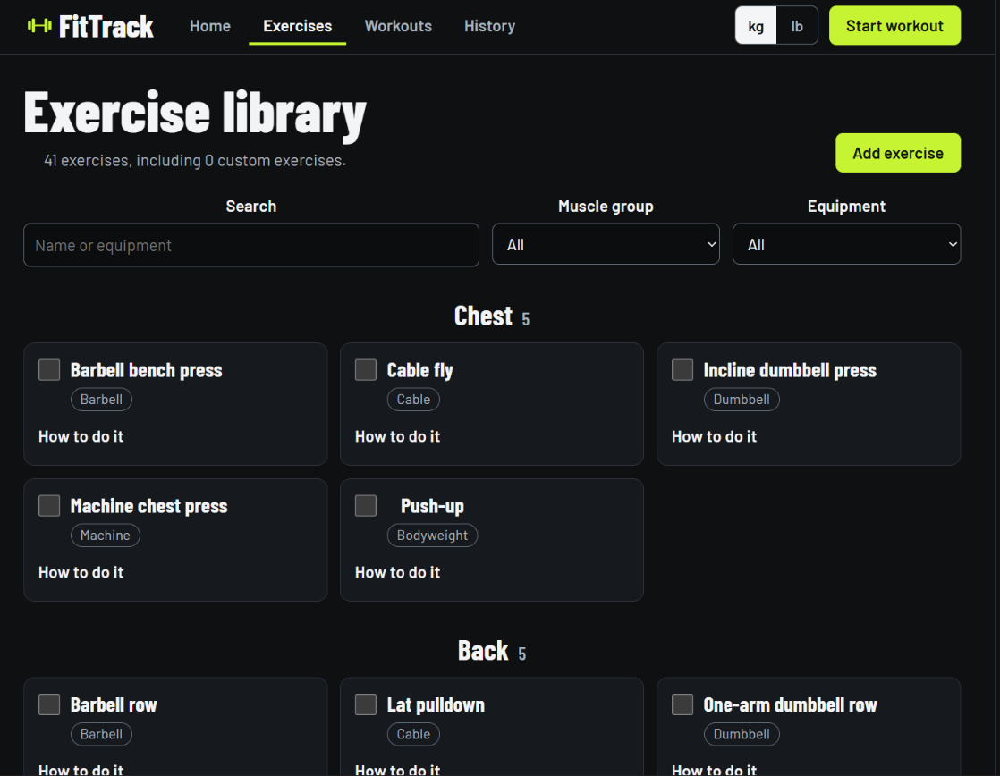
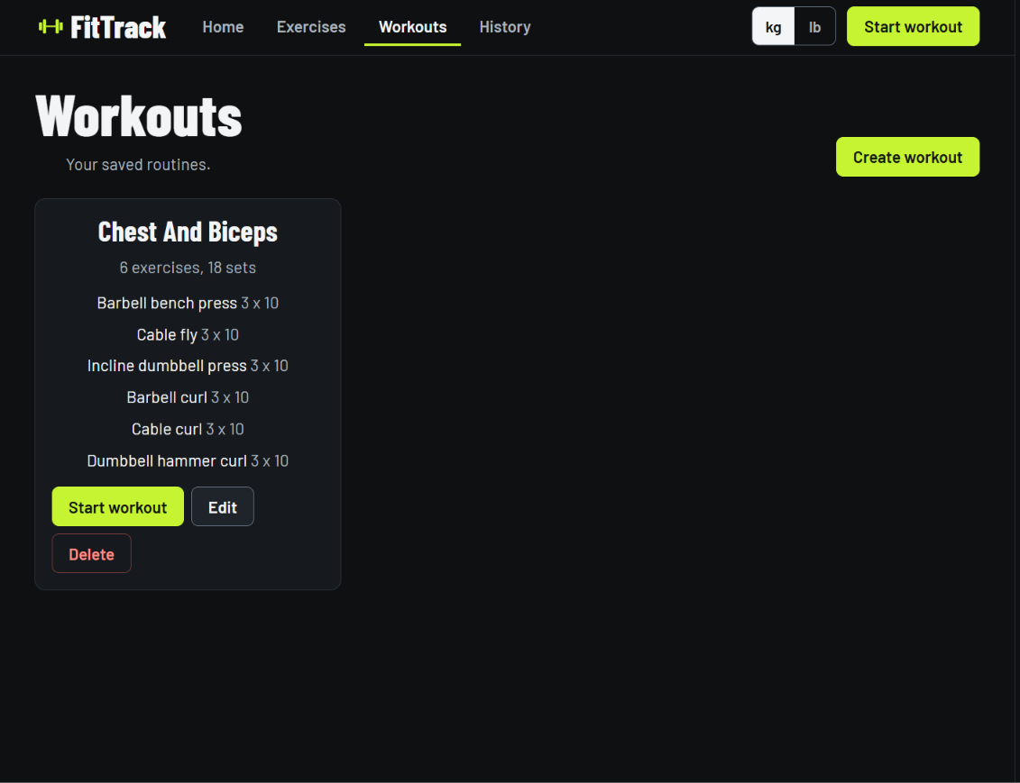
APPLICATION OVERVIEW
Full view of the project
HOME
EXERCISE LIBRARY
WORKOUTS
Daily summary and weekly progress
Search and filter the movement list
Saved routines ready to start
Shared navigation connects planning, exercise selection, and workout review.
FITTRACK / FITNESS & WELLNESS
04
Notes:
These are the three supplied application screenshots. The dashboard summarizes the week, the exercise library organizes movements by muscle group and equipment, and the Workouts page displays saved routines. Images are fitted within their frames to preserve their original proportions.

Slide 5
BROWSER PERSISTENCE
Sample coding
React saves the current app state to local storage when it changes.
WHAT THIS ENABLES
const STORAGE_KEY = "fittrack:data";
useEffect(() => {
Saved routines remain available after refresh.
try {
window.localStorage.setItem(
STORAGE_KEY, JSON.stringify(state)
Workout history is stored in the same browser.
);
setSaveError(false);
} catch {
A save error is handled without crashing the interface.
setSaveError(true);
}
}, [state]);
Illustrative excerpt from the supplied FitTrack.jsx source.
FITTRACK / FITNESS & WELLNESS
05
Notes:
The snippet follows the supplied FitTrack source behavior: each state change is serialized to the fittrack:data localStorage key. Errors are caught and surfaced through the save-error state.

Slide 6
APPLICATION STRUCTURE
Architecture diagram
USER INTERFACE
REACT APP STATE
BROWSER STORAGE
Dashboard • Exercises
Workouts • Session • History
Reducer + hooks
Units • routines • active session
localStorage
fittrack:data
PERSISTED DATA
Exercise library
Workout plans
Active session
History & units
Built-in and custom movements
Saved routines and set targets
In-progress sets and session state
Completed sessions and kg / lb preference
The React UI dispatches user actions; state updates are persisted locally and restored on launch.
FITTRACK / FITNESS & WELLNESS
06
Notes:
Architecture is based on the supplied source: React renders the dashboard, exercise library, workout list, workout session, and history views. Reducer-managed application data is serialized to browser localStorage under fittrack:data and reloaded when the application starts.

Slide 7
USER FLOW
Demo of the project
01 START
Choose a saved routine from Home or Workouts.
02 SELECT ROUTINE
Create or edit routines with exercises and set targets.
03 EXPLORE
Find movements by name, muscle group, or equipment.
FITTRACK / FITNESS & WELLNESS
07
Notes:
Demo sequence: begin on Home, open Workouts to start a saved routine, then use the Exercise Library to select or add movements when preparing a plan. During a session, log sets and reps; completed sessions appear in History and update the progress summary. The three screenshots are shown at their original aspect ratios.

Slide 8
KEY TAKEAWAY
Conclusion
FitTrack connects the workout cycle from plan to progress review.
PLAN
Create reusable routines from a structured exercise library.
TRACK
Log training sets in an active workout session.
REVIEW
Use saved history and weekly summaries to follow activity.
Thank you
FITTRACK / FITNESS & WELLNESS
08
Notes:
Conclude by summarizing FitTrack’s three core jobs: plan routines, track active sessions, and review training history. Invite questions or a live walkthrough.

