Slide 1

Progressive Web Apps: A Modern Approach
Progressive web apps (PWAs) are a new breed of web applications that combine the best of both worlds: the reach and accessibility of the web with the performance and features of native apps.

Slide 2
What is a PWA?
Web-based
PWAs are built using standard web technologies like HTML, CSS, and JavaScript.
Native-like Experience
PWAs offer a user experience that is similar to native apps, with features like offline functionality and push notifications.
Progressive Enhancement
PWAs are designed to work on a wide range of devices and browsers, progressively enhancing functionality as capabilities allow.

Slide 3
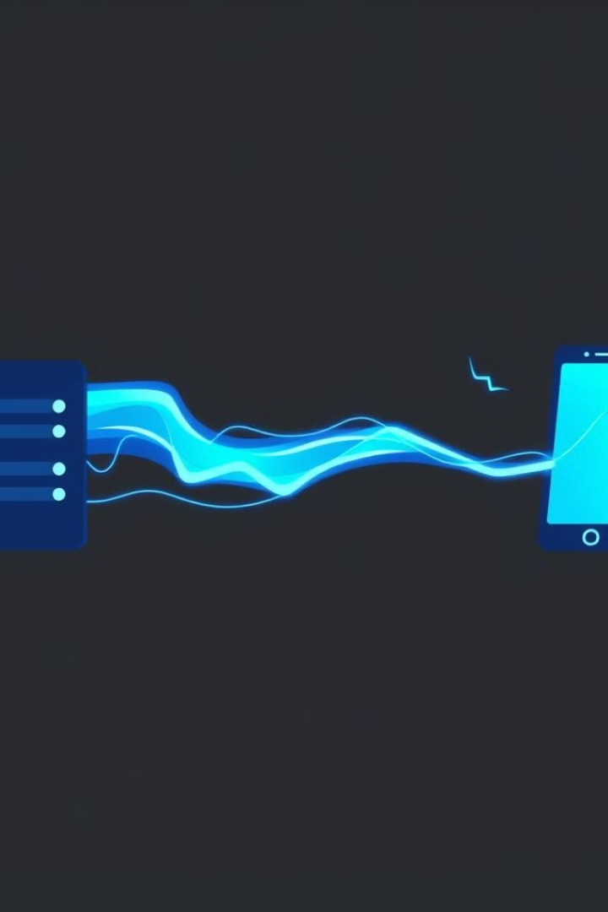
How PWAs Work
1
Server-side Rendering (SSR)
The server renders the initial HTML content, providing a fast initial load.
2
Client-side Rendering (CSR)
The client-side JavaScript handles dynamic content updates, ensuring a smooth user experience.
3
Caching
Content is cached locally, allowing for fast loading times and offline access.

Slide 4
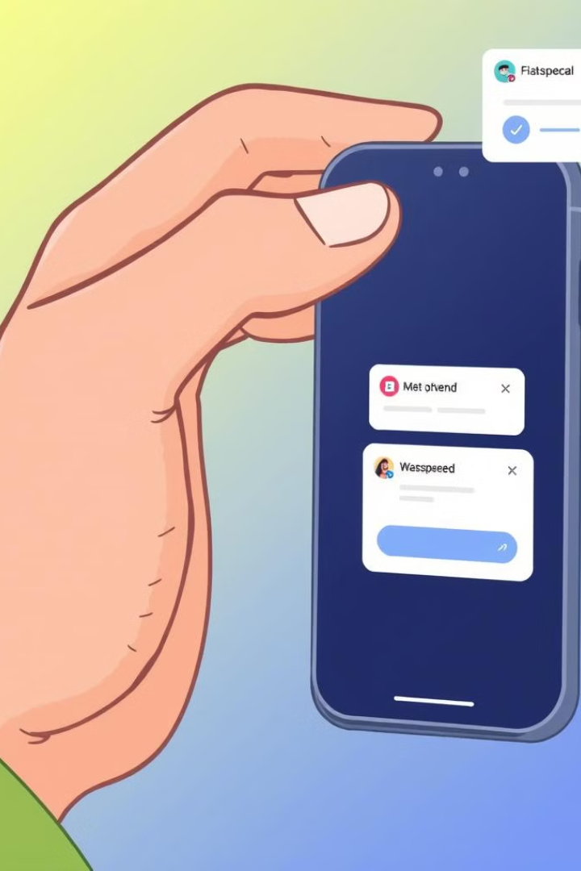
Benefits of PWAs
1
Fast Loading Times
PWAs leverage caching and optimized rendering to deliver a fast and responsive user experience.
2
Offline Functionality
PWAs can function even when there is no internet connection, providing a seamless user experience.
3
Push Notifications
PWAs can send push notifications to users, keeping them engaged and informed.
4
Improved SEO
PWAs are more easily indexed by search engines, improving their visibility and discoverability.

Slide 5
PWA Architecture
App Shell
Service Workers
Web App Manifest
The core user interface and interactions are stored locally for fast loading.
Background scripts manage caching and network requests, improving performance and offline access.
A JSON file provides metadata about the app, enabling features like home screen installation.

Slide 6
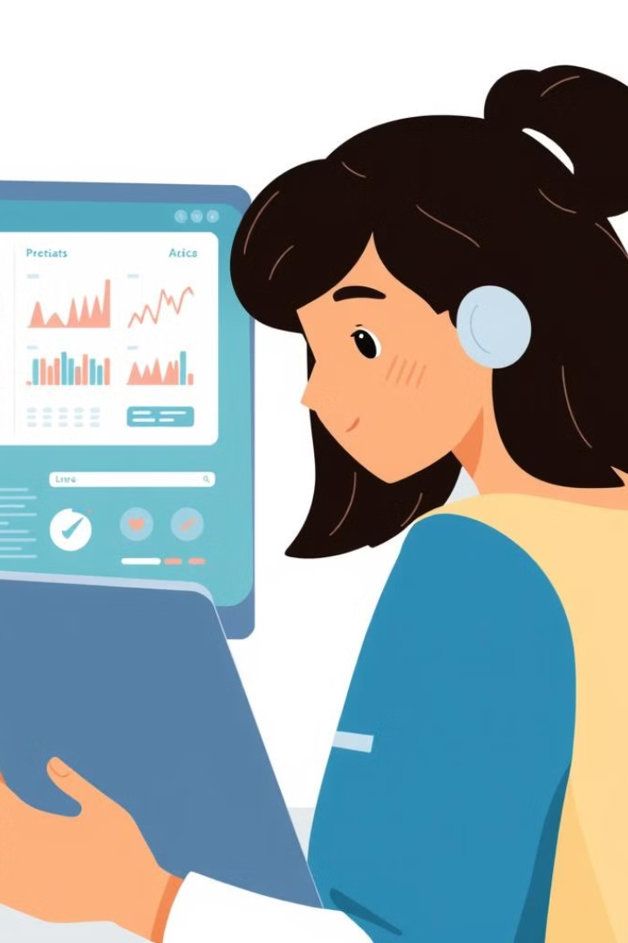
Patient Management Application:
Problem Statement
The Patient Management Application aims to provide a comprehensive platform for managing patient information, streamlining healthcare processes, and enhancing patient care.

Slide 7
Technical Scope: User Stories
User Story
User Story Name
User Story
US_01
Login
As a user, I should be able to login the system with valid credentials.
US_02
Get Patients
As a user, I should be able to get patient in the system.
US_03
Add and Delete Patients
As a user, I should be able to add and delete a patient in the system.

Slide 8
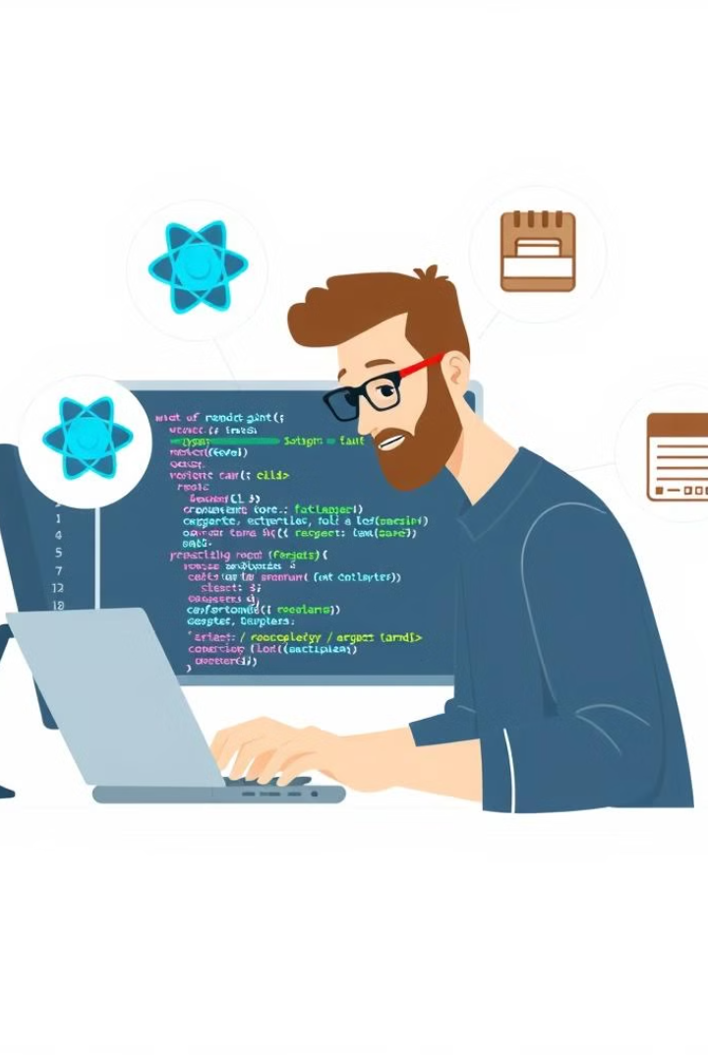




Technical Scope: Skills
Java
The backend will be developed using Java 8 or 11.
React
The frontend will be built using React, a popular JavaScript library for building user interfaces.
PostgreSQL
PostgreSQL will be used as the primary database for storing patient data.
AWS
The application will be deployed on AWS, a cloud computing platform.

Slide 9



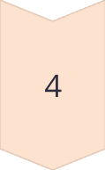
Technical Scope: Implementation Details
Microservice Architecture
The application will be implemented as a set of microservices, each responsible for a specific functionality.
Single Data Store per Microservice
Each microservice will have its own dedicated database, ensuring data isolation and consistency.
RESTful APIs
Microservices will communicate with each other through RESTful APIs, enabling flexible and scalable communication.
Security
Basic authentication will be implemented to secure access to sensitive data.

Slide 10
Thank You

