Slide 1
Machine Learning
By Soham Gandhi, Varun Vejalla, Amish Madhav, and Sathya Gnanakumar

Slide 2
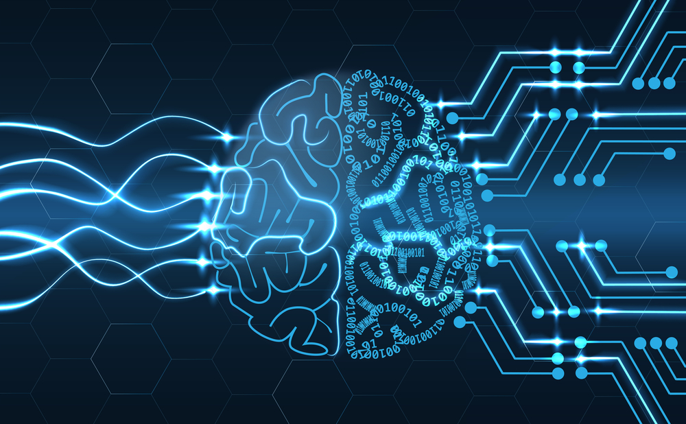
Challenges
Dealing with large datasets
Knowledge of Deep Learning API’s and python
Challenges with front end visualizations

Slide 3
Future Applications
Backend for computers
Predicting large scale datasets
Making educated decisions with more information

Slide 4

Learnt
How to integrate html with python
01
How to collaborate with others on code
02
How to manage time wisely
03
Experiences with splitting up large datasets with Linux
04

