Slide 1

Fourth Quarter Fiscal Year 2016 Outlook

Slide 2
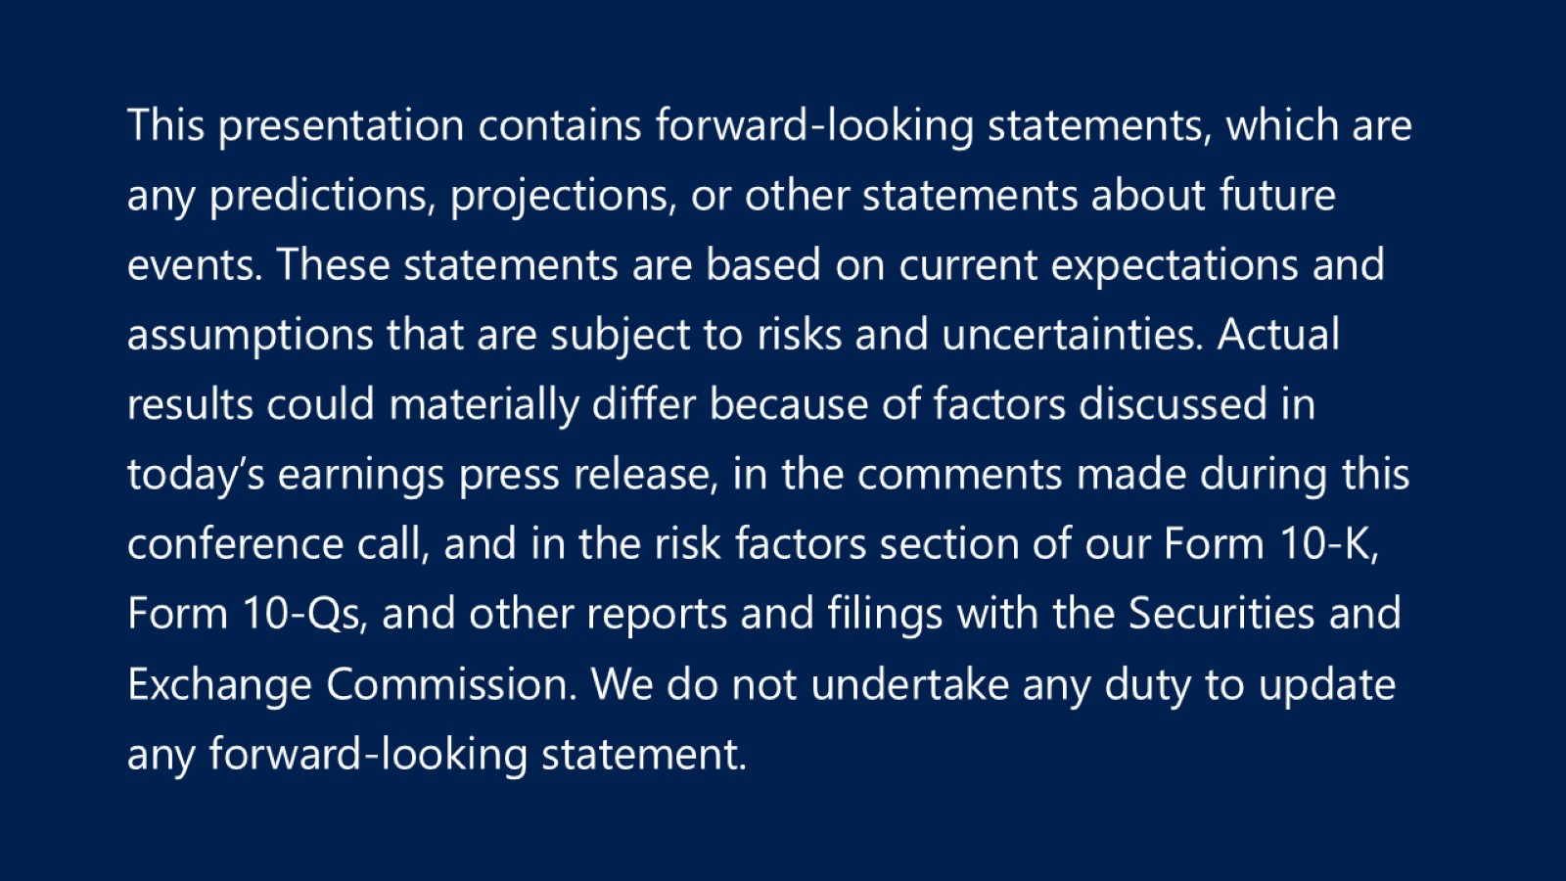

Slide 3
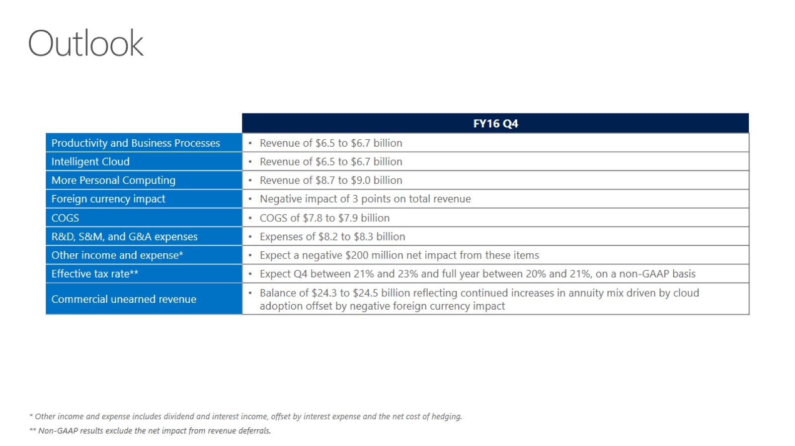
Outlook

Slide 4
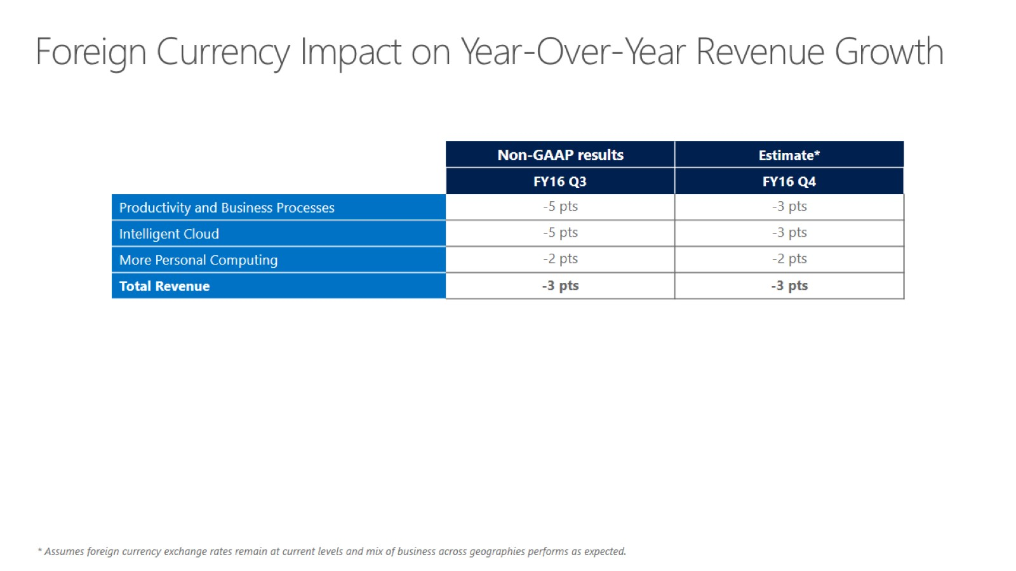
Foreign Currency Impact on Year-Over-Year Revenue Growth

Slide 5


