Slide 1

Third Quarter Fiscal Year 2018 Outlook

Slide 2
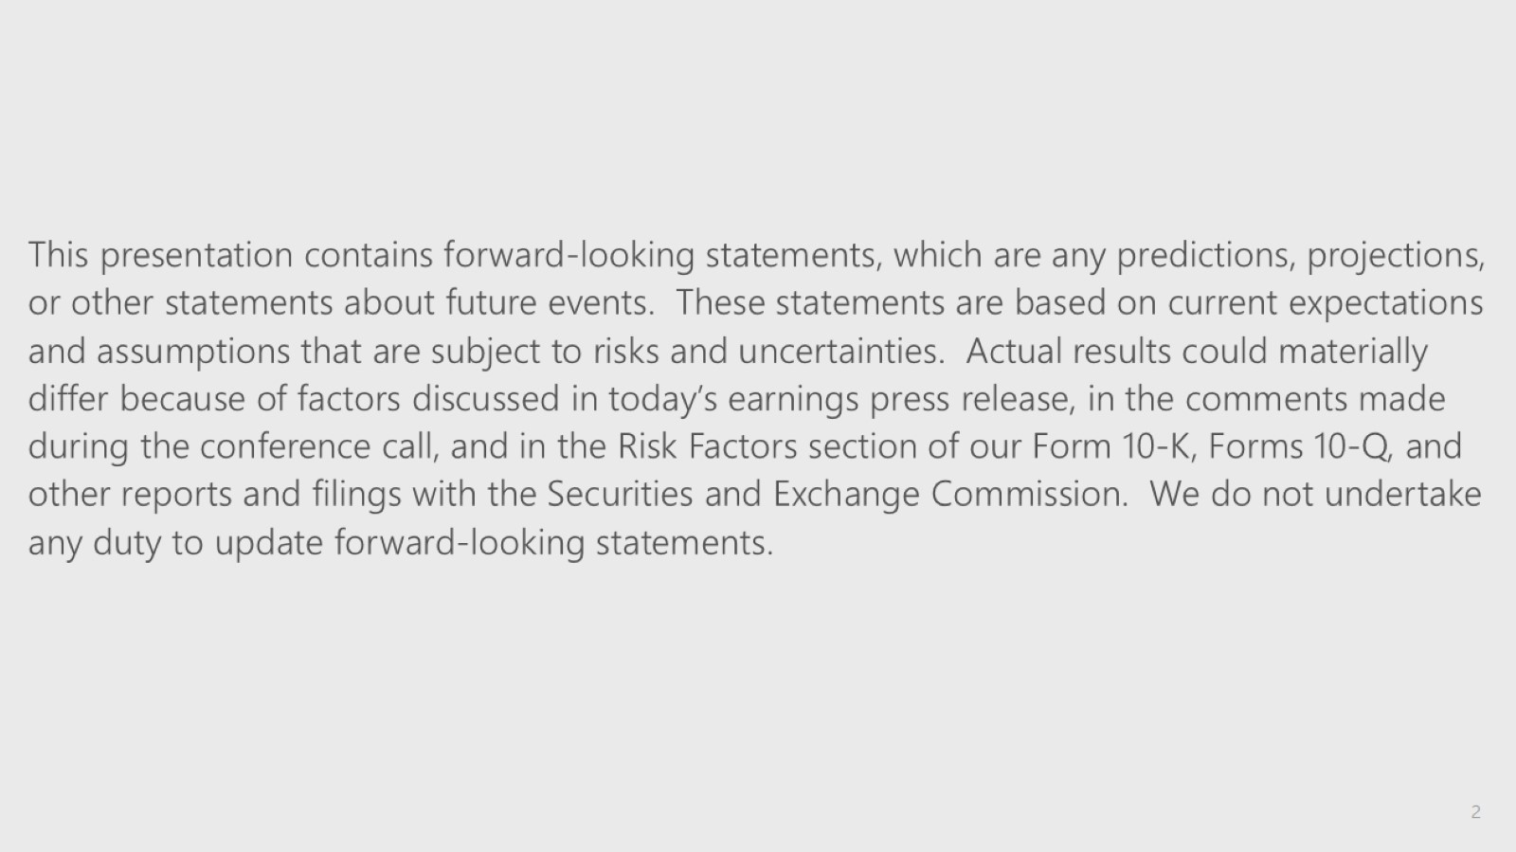

Slide 3
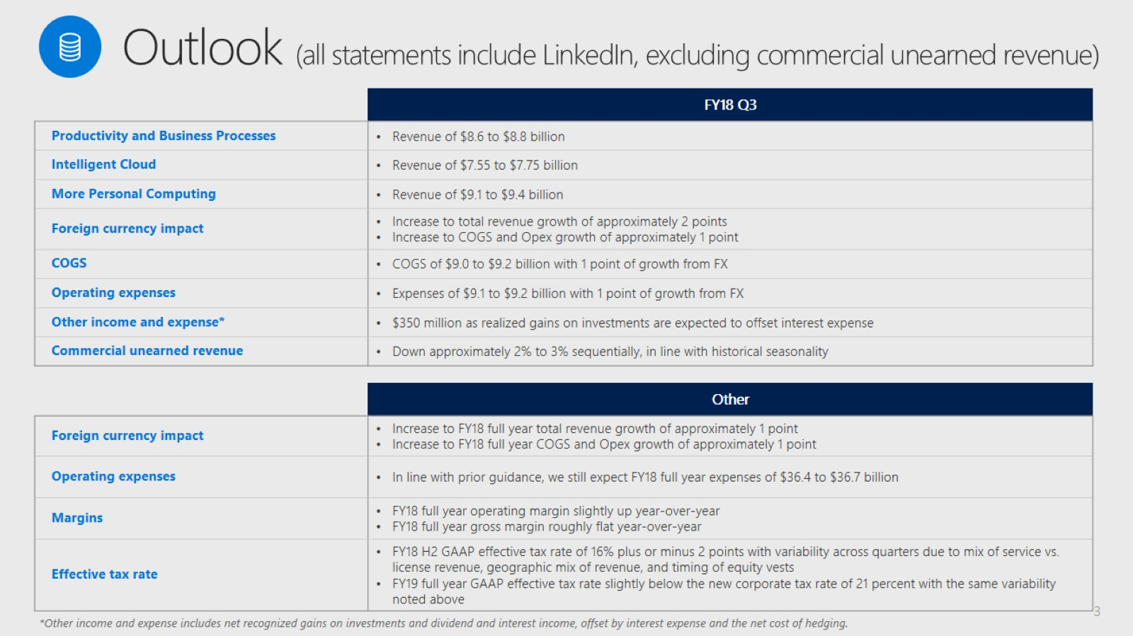

Slide 4


