Slide 1
Introduction to Machine Learning
Chad Boschert
Director of BI, Old Town IT
@chadboschert
LinkedIn, Meetup

Slide 2

Our Challenge
Data sloth sleuth through Titanic survivor data
Predict who survived and who didn’t
Be Kings (and Queens) of the world!!!
Dataset and demo inspired by: Kaggle

Slide 3
Ecosystem
Python
NumPy
Pandas
Scikit-learn

Slide 4
Basic Process
Load training data with known outcomes
Manually analyze the data
Prepare that data - clean, normalize, transform, etc.
Fit our model – create prediction rules
Load test data without known outcomes
Prepare the test data
Make predictions
Score the predictions

Slide 5
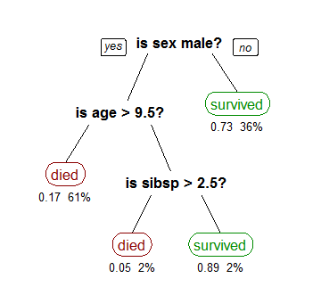
https://en.wikipedia.org/wiki/Decision_tree_learning

Slide 6
sklearn.ensemble.RandomForestClassifier
Ensemble Methods reduce over-fitting by combining the predictions of multiple base estimators through averaging methods or boosting methods
RFC fits a number of decision tree classifiers on various sub-samples of the data set
RFC is a Classifier that averages the weighted outputs from multiple Decision Trees
Notes:
Average the results of independent estimators
Base estimators are built sequentially and one tries to reduce bias of the combined estimator – goal is to produce a power ensemble from several weak models

Slide 7
Uses for Machine Learning
Adaptive Websites
Affective Computing
Computer Vision
Object Recognition
Fraud detection
Natural Language Processing
Recommendation Systems
Search Engines
Sequential Pattern Mining
Speech and handwriting recognition
Stock market analysis
Many others…
https://en.wikipedia.org/wiki/Machine_learning#Applications

Slide 8
Resources & References
Kaggle Titanic Tutorials - https://www.kaggle.com/c/titanic
NumPy Tutorial - http://wiki.scipy.org/Tentative_NumPy_Tutorial
10 Minutes to Pandas - http://pandas.pydata.org/pandas-docs/stable/10min.html
Book: Python for Data Analysis by Wes McKinney
Sklearn - http://scikit-learn.org/dev/modules/generated/sklearn.ensemble.RandomForestClassifier.html

Slide 9
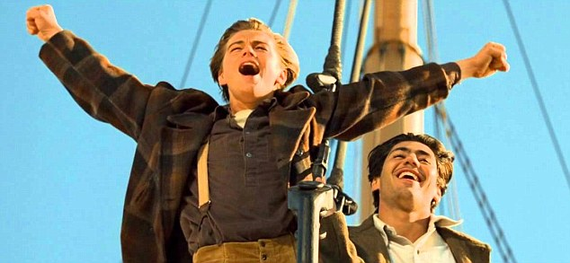
Old Town IT is Hiring!
We are hiring project managers, .NET developers, and Python developers
On the Inc 500/5000 fastest growing privately held companies 4 years in a row
Lots of new and exciting things coming down the pipe – such as a new home for the MO office and a new brand
Chat with me if you’re interested
Chad Boschert
Director of BI, Old Town IT
@chadboschert
LinkedIn, Meetup

