Slide 1
IoT and U can 2
Part 1, sensing the world
Chad Boschert, Gravitate Solutions

Slide 2
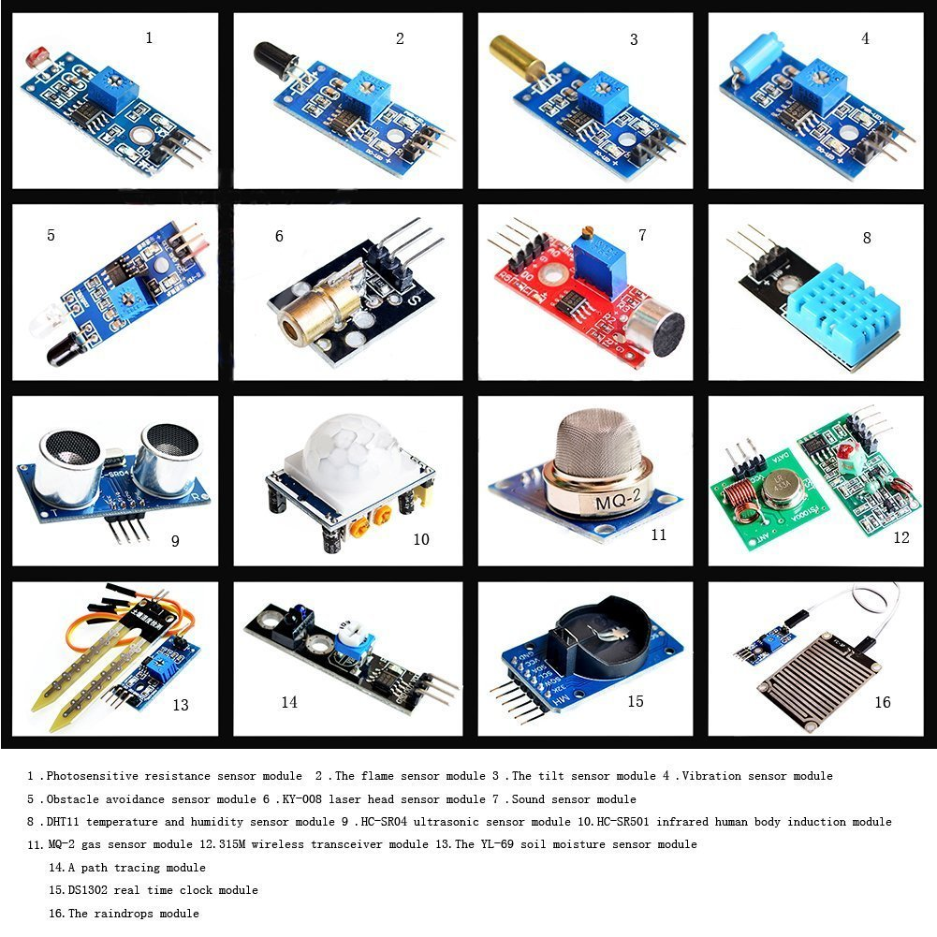
http://goo.gl/OjsfSF

Slide 3
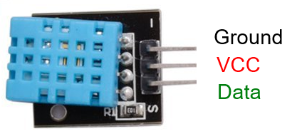
DHT11
Measurement Ranges
Relative Humidity 20-90%
Temperature 0-50°C (32-122°F)
Resolution
1% RH
1°C (1.8°F)
Accuracy
± 5% RH
± 2°C (3.6°F)
http://www.micropik.com/PDF/dht11.pdf
https://github.com/szazo/DHT11_Python

Slide 4
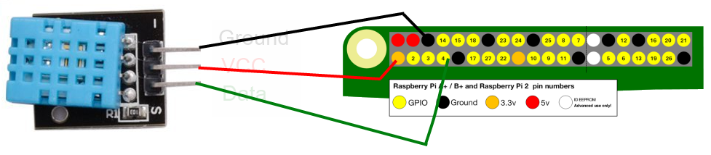
https://www.raspberrypi.org/learning/physical-computing-with-python/worksheet/

Slide 6
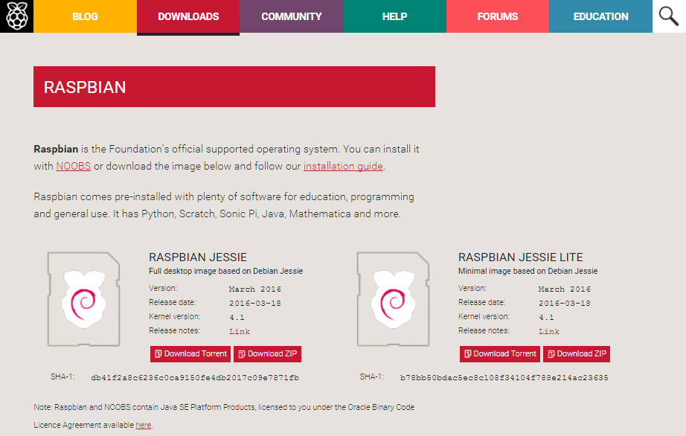
Getting Started
sudo raspi-config
Expand File System
Internationalization Options
Advanced > Hostname
sudo apt-get update
sudo apt-get upgraded
grab coffee or beer…
https://www.raspberrypi.org/downloads/raspbian/
https://www.raspberrypi.org/documentation/configuration/raspi-config.md

Slide 7
MongoDB
Setup
sudo apt-get mongodb
**Requires Jessie build of Raspbian
Start Client
mongo
Useful Commands
show dbs
show collections
use <db_name>
db.<db_name>.help()
db.<db_name>.find()

Slide 8
Flask web microframework
Setup
sudo pip install flask
Why Flask?
Lightweight
Simple to use
Flexible
Extensible
Well documented
https://www.raspberrypi.org/learning/python-web-server-with-flask/

Slide 9
Raspi GPIO
import RPi.GPIO as GPIO
GPIO.setmode(<mode>)
GPIO.BOARD
GPIO.BCM
GPIO.setup(<channel>, <in/out>)
GPIO.OUT
GPIO.IN
GPIO.input(<channel>)
GPIO.output(<channel>,<state>)
GPIO.HIGH
GPIO.LOW
GPIO.cleanup()
https://www.raspberrypi.org/learning/physical-computing-with-python/
https://sourceforge.net/p/raspberry-gpio-python/wiki/BasicUsage/

Slide 10
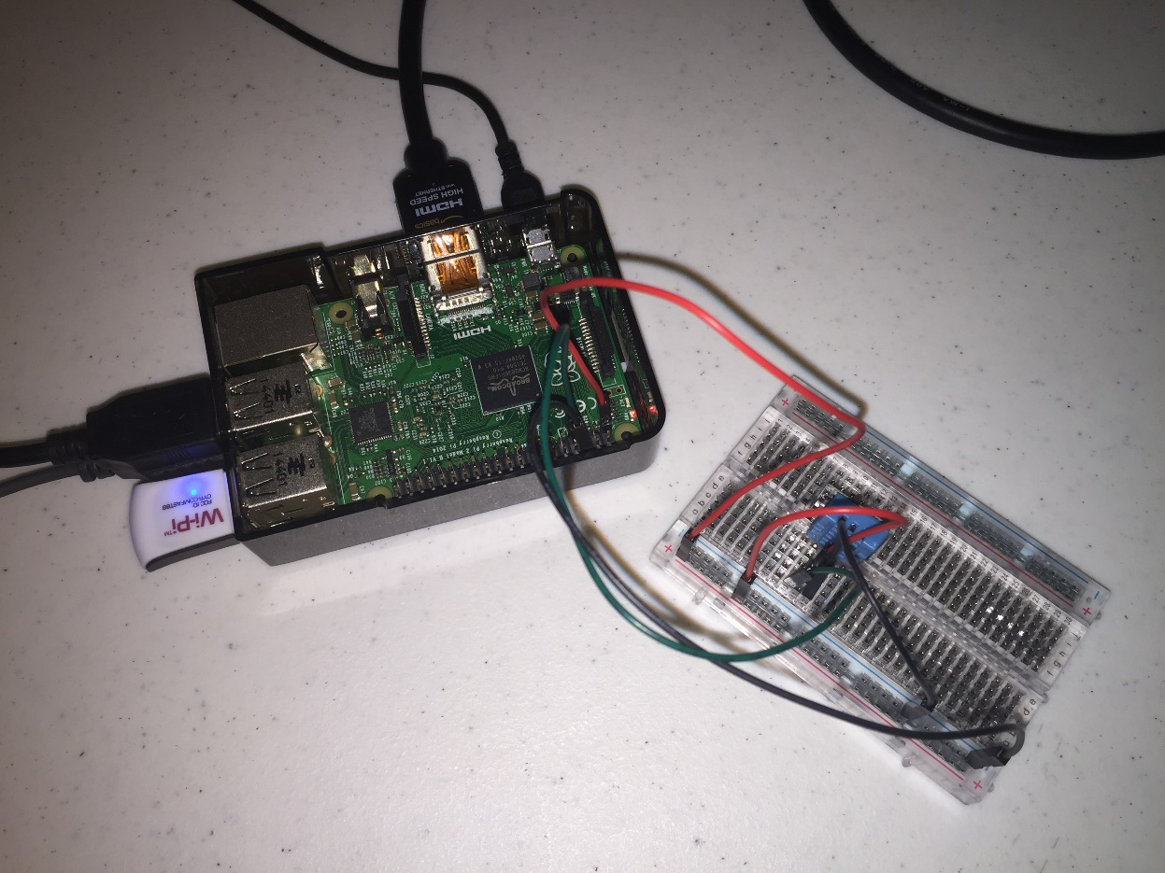

Slide 11
