Slide 1
IoT and U can 2
Part 2, Controlling the World
Chad Boschert, Gravitate Solutions

Slide 2
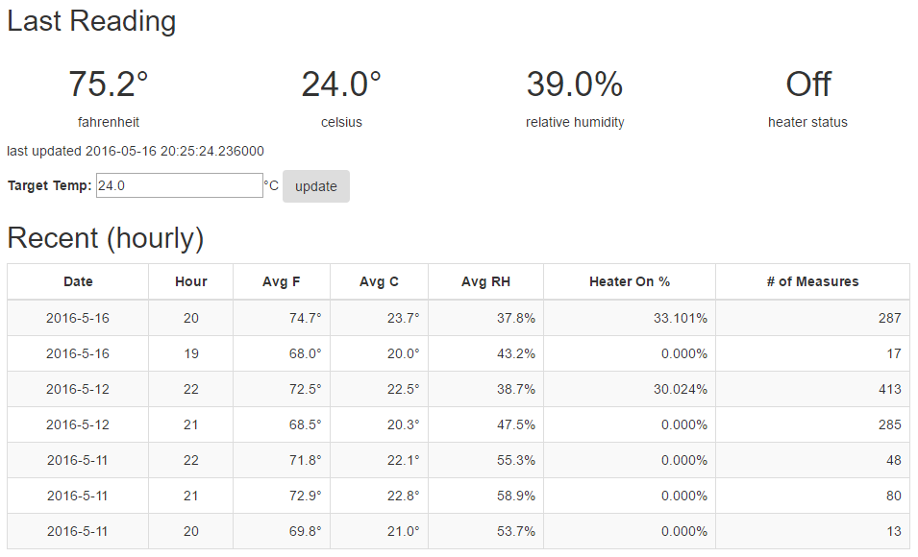
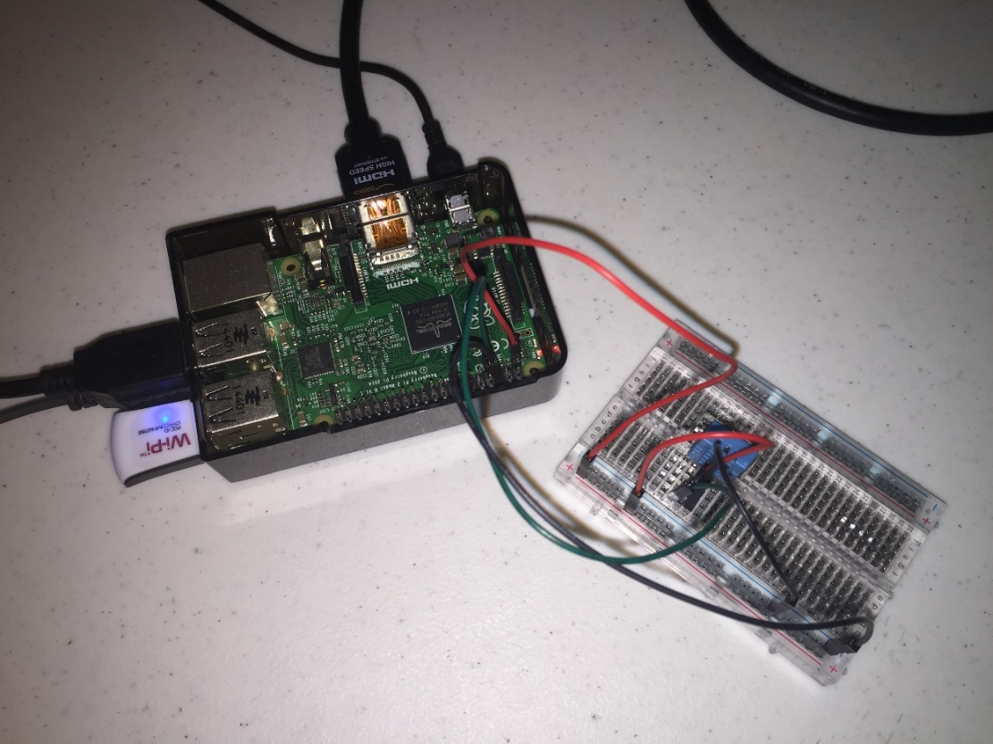
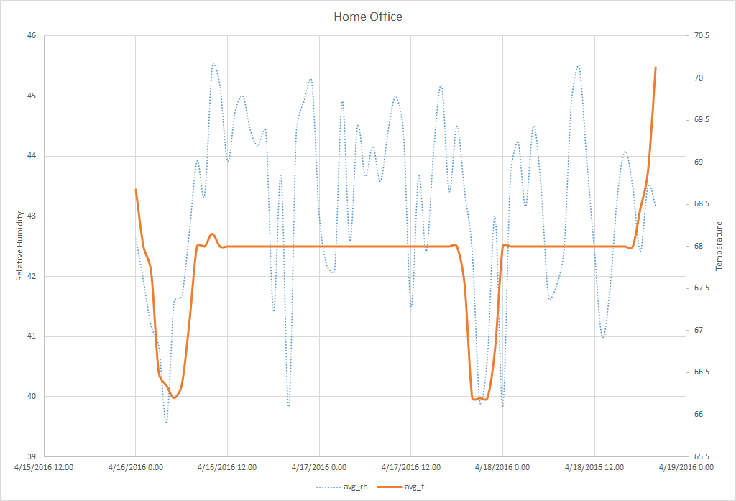
What is the Internet of Things?
Devices + Network Connectivity + Exchange Data
Integrating physical world and computer world
Improved efficiency, accuracy, and economic benefit
https://en.wikipedia.org/wiki/Internet_of_Things
Notes:
Network of physical devices - sensing, recording data, sharing data, interacting with each other and their environments
Estimates as high as 50 billion objects by 2020
Easy prototyping with low-cost microcontrollers – Arduino, Pi, and others

Slide 3
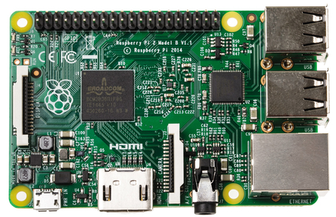
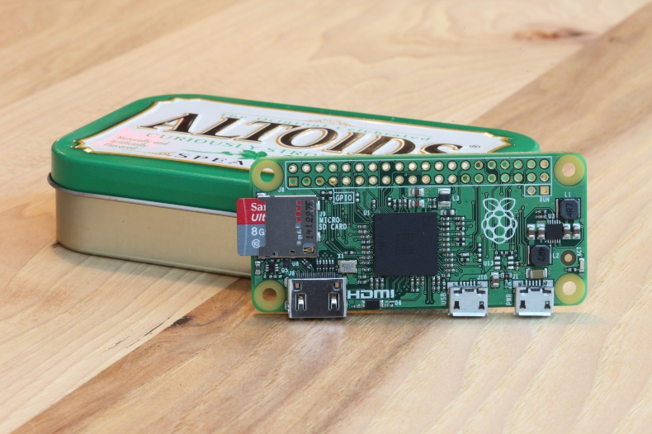
Raspberry Pi
Multiple versions, $5 to ~$40
Raspberry Pi 2
900MHz quad-cord CPU
1 GB RAM
Micro SD card slot
40 GPIO Pins
4 USB Ports
Full HDMI port
Camera & Display interfaces
Combined 3.5mm audio jack & composite video
https://www.raspberrypi.org/products/raspberry-pi-2-model-b/
Notes:
Reference GPIO pins

Slide 4
Fermonitor
DIY Wine Fermentation Temperature Control System

Slide 5
Design Principals
Be lean
Keep it simple
Create value
If it already exists, use it
Make it work, then improve later if needed
YAGNI
Learn

Slide 6
Demo Time

Slide 7
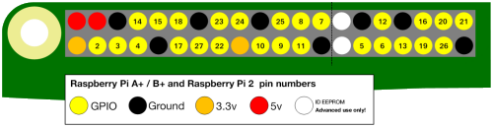
Intro to GPIO
General-Purpose Input/Output
Simply, switches
Inputs – controlled externally
Output – controlled by the Pi
Ground
Zero volts, completes circuits
3.3v
Provides 3.3 volt power supply
5v
Provides 5 volt power supply
GPIO #
Configured as input/output
https://www.raspberrypi.org/learning/physical-computing-with-python/
https://sourceforge.net/p/raspberry-gpio-python/wiki/BasicUsage/

Slide 8
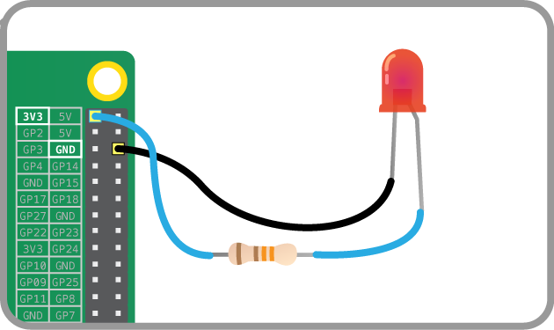
Simple Circuit
Always On
https://www.raspberrypi.org/learning/physical-computing-with-python/worksheet/

Slide 9
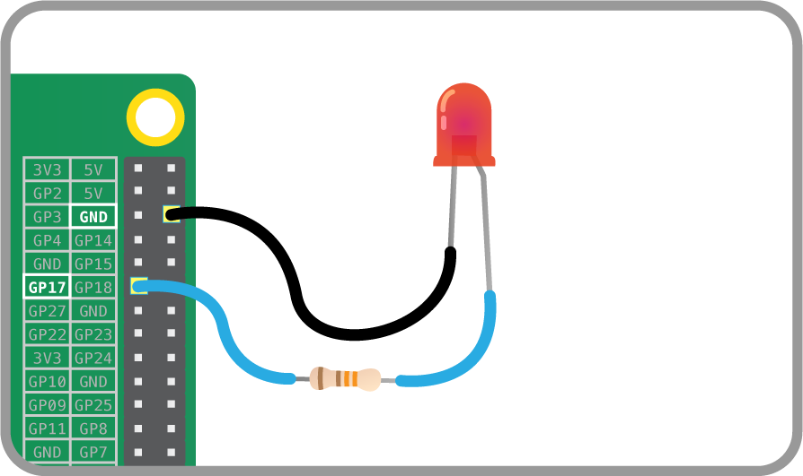
GPIO Circuit
Programmatically interactive
switch off/on
GPIO.output(17, GPIO.LOW)
GPIO.output(17, GPIO.HIGH)
https://www.raspberrypi.org/learning/physical-computing-with-python/worksheet/

Slide 10
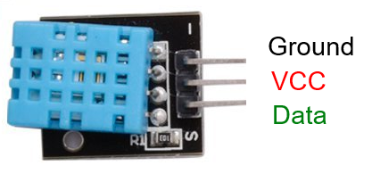
DHT11
Measurement Ranges
Relative Humidity 20-90%
Temperature 0-50°C (32-122°F)
Resolution
1% RH
1°C (1.8°F)
Accuracy
± 5% RH
± 2°C (3.6°F)
http://www.micropik.com/PDF/dht11.pdf
https://github.com/szazo/DHT11_Python

Slide 11
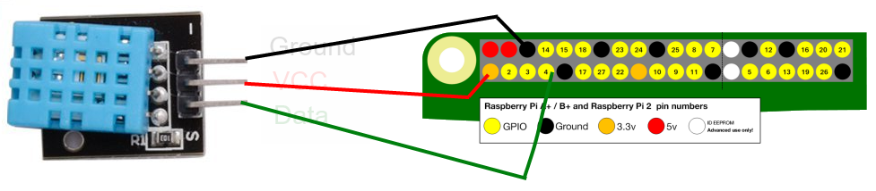
Wiring Diagram – DHT11
https://www.raspberrypi.org/learning/physical-computing-with-python/worksheet/

Slide 12
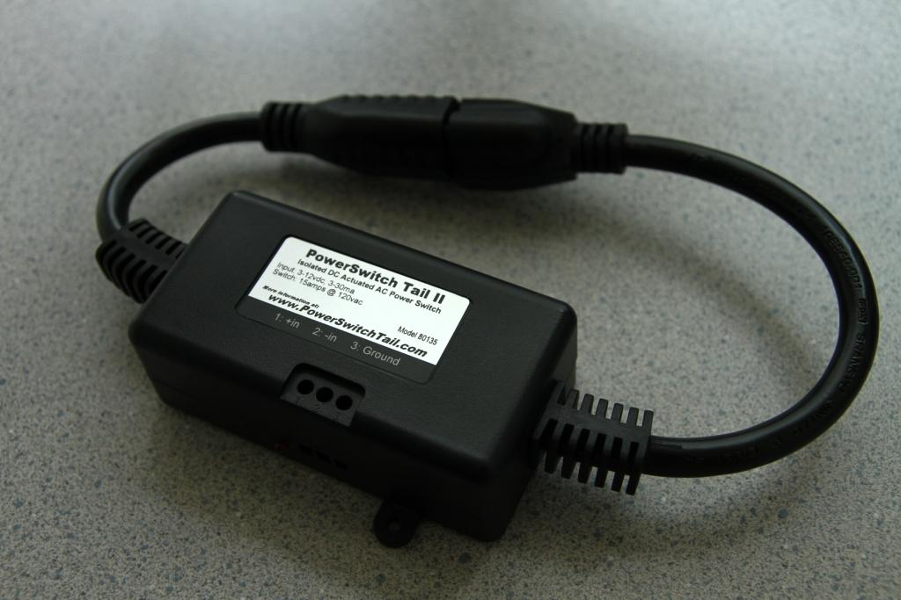
PowerSwitch Tail II
Safely switch 120vac appliances
No dangerous 120vac wiring required
Isolates Raspberry Pi
Up to 15 amp
Convenient, easy to use
Simple as an extension cord
Two-wire control signal connection
LED status indicator for debugging
http://www.powerswitchtail.com/Pages/default.aspx
https://cdn-learn.adafruit.com/downloads/pdf/adafruits-raspberry-pi-lesson-13-power-control.pdf

Slide 13
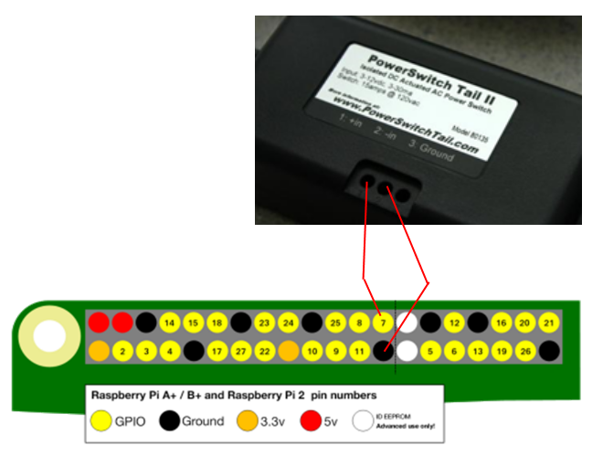
Wiring Diagram – PST II
https://cdn-learn.adafruit.com/downloads/pdf/adafruits-raspberry-pi-lesson-13-power-control.pdf

Slide 14
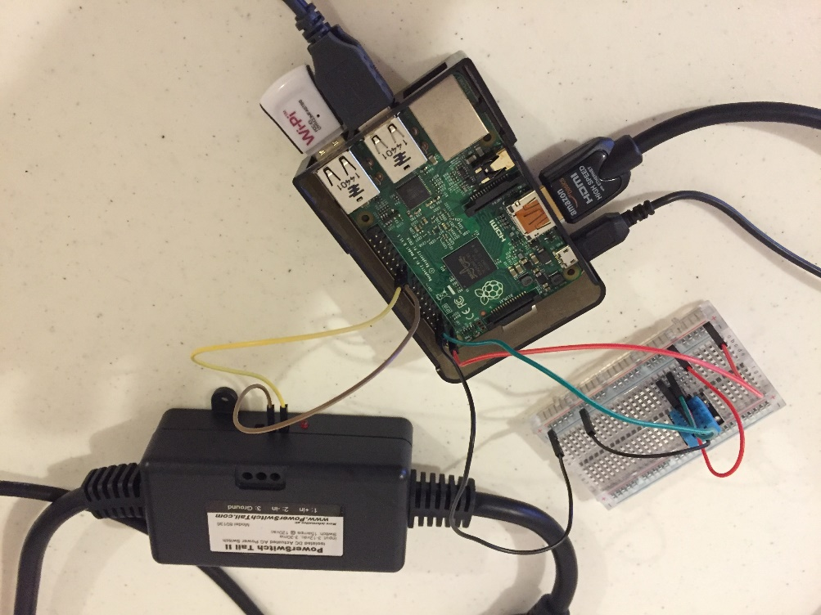

Slide 15
Raspi GPIO
import RPi.GPIO as GPIO
GPIO.setmode(<mode>)
GPIO.BOARD
GPIO.BCM
GPIO.setup(<channel>, <in/out>)
GPIO.OUT
GPIO.IN
GPIO.input(<channel>)
GPIO.output(<channel>,<state>)
GPIO.HIGH
GPIO.LOW
GPIO.cleanup()
https://www.raspberrypi.org/learning/physical-computing-with-python/
https://sourceforge.net/p/raspberry-gpio-python/wiki/BasicUsage/

Slide 16
MongoDB
Setup
sudo apt-get mongodb
**Requires Jessie build of Raspbian
Start Client
mongo
Useful Commands
show dbs
show collections
use <db_name>
db.<db_name>.help()
db.<db_name>.find()

Slide 17
Flask web microframework
Setup
sudo pip install flask
Why Flask?
Lightweight
Simple to use
Flexible
Extensible
Well documented
https://www.raspberrypi.org/learning/python-web-server-with-flask/

Slide 18
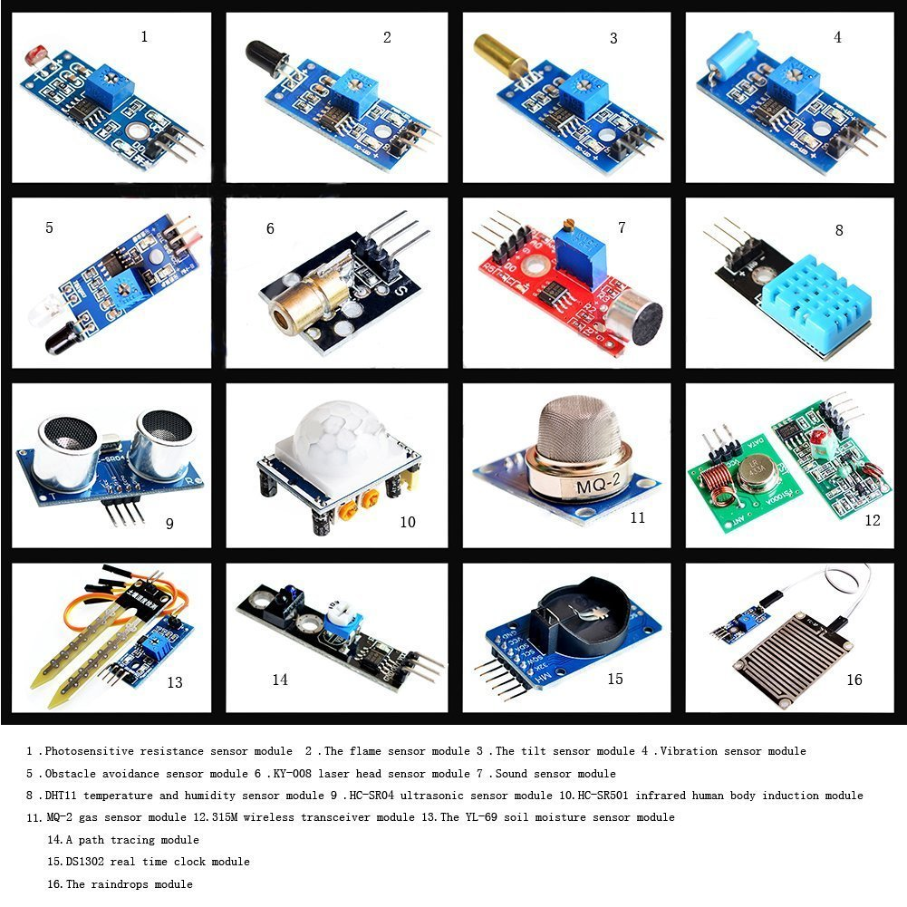
Get Started
16 Sensor starter kit, $30 on Amazon
Solderless Breadboard, ~$3-$10
Jumper Wires < $10
Maybe some resistors, < $10
Get deals with kits and a bit of research
PowerSwitch Tail II, $26
http://goo.gl/OjsfSF

Slide 19

U Can 2!
Chad Boschert
Gravitate Solutions
@chadboschert
www.linkedin.com/in/chadboschert
Notes:
Be cautious, but not scared
Use the internet and books

