Slide 1
IoT and U can 2
Part 1, sensing the world
Chad Boschert, Gravitate Solutions

Slide 2
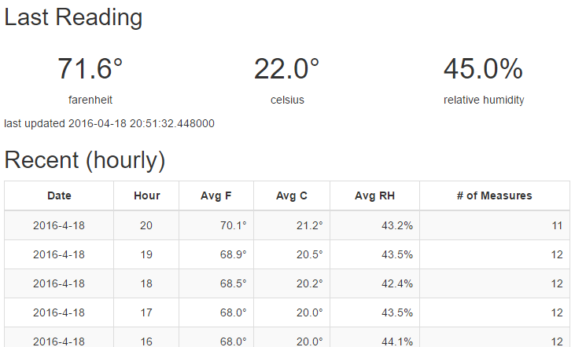
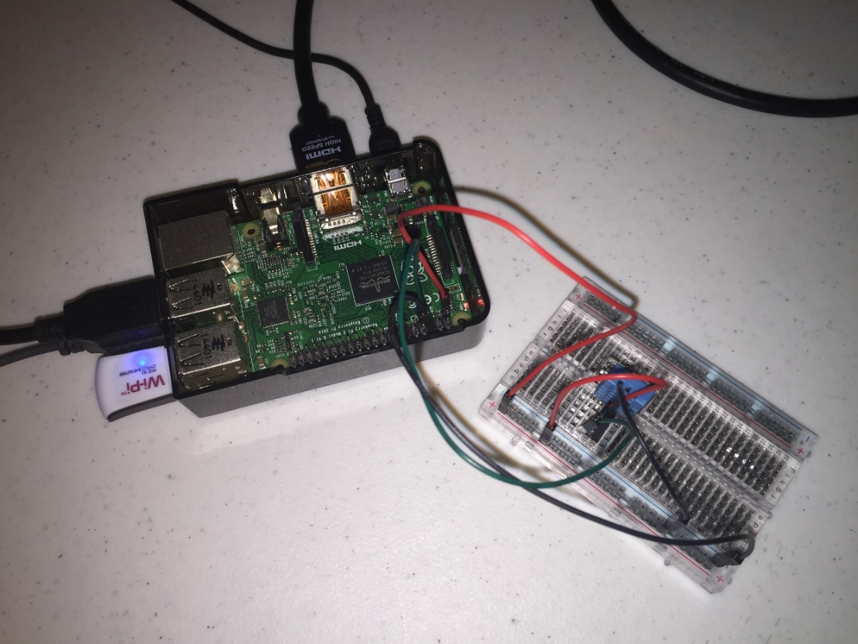
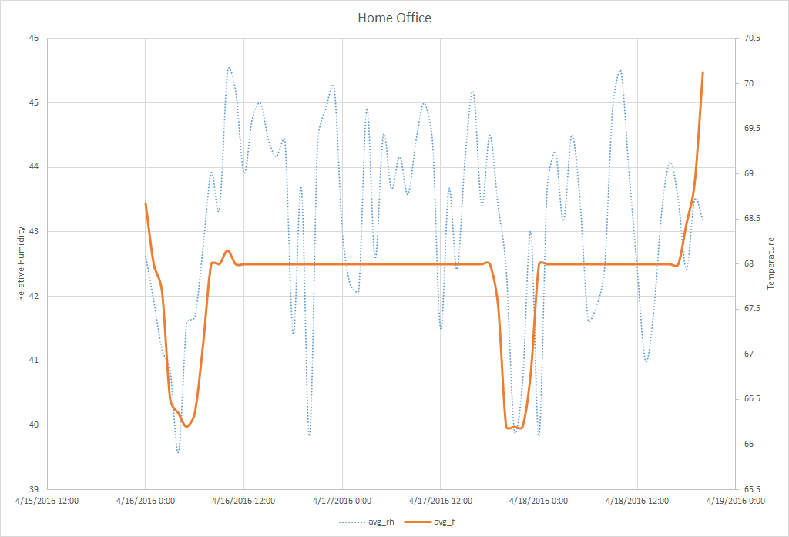
What is the Internet of Things?
Devices + Network Connectivity + Exchange Data
Integrating physical world and computer world
Improved efficiency, accuracy, and economic benefit
https://en.wikipedia.org/wiki/Internet_of_Things
Notes:
The Internet of Things (IoT) is the network of physical objects—devices, vehicles, buildings and other items—embedded withelectronics, software, sensors, and network connectivity that enables these objects to collect and exchange data.^{[1]} The IoT allows objects to be sensed and controlled remotely across existing network infrastructure,^{[2]} creating opportunities for more direct integration of the physical world into computer-based systems, and resulting in improved efficiency, accuracy and economic benefit;^{[3][4][5][6][7][8]} when IoT is augmented with sensors and actuators, the technology becomes an instance of the more general class of cyber-physical systems, which also encompasses technologies such as smart grids, smart homes,intelligent transportation and smart cities. Each thing is uniquely identifiable through its embedded computing system but is able to interoperate within the existing Internet infrastructure. Experts estimate that the IoT will consist of almost 50 billion objects by 2020.^{[9]}

Slide 3
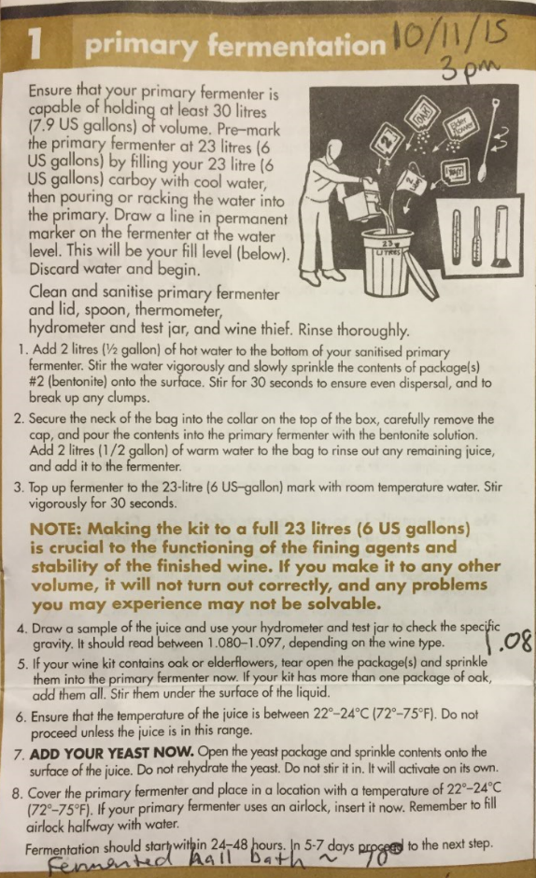
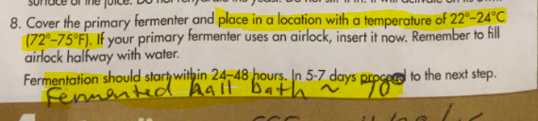
Excuse me while I… whine about wine

Slide 4
Fermonitor
DIY Wine Fermentation Temperature Control System

Slide 5
Demo Time

Slide 6
Design Principals
Be lean
Keep it simple
Create value
If it already exists, use it
Make it work, then improve later if needed
YAGNI
Learn

Slide 7
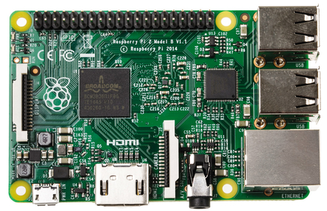
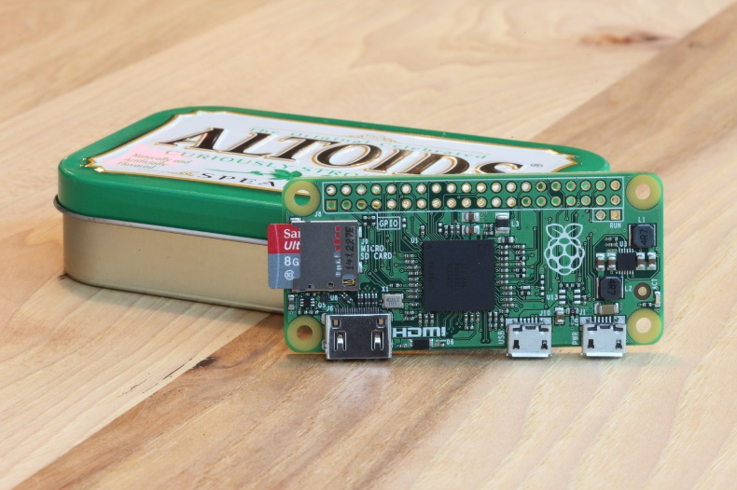
Raspberry Pi
Multiple versions, $5 to ~$40
Raspberry Pi 2
900MHz quad-cord CPU
1 GB RAM
Micro SD card slot
40 GPIO Pins
4 USB Ports
Full HDMI port
Camera & Display interfaces
Combined 3.5mm audio jack & composite video
https://www.raspberrypi.org/products/raspberry-pi-2-model-b/

Slide 8
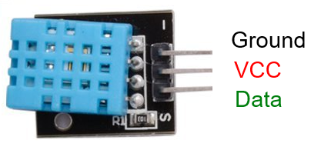
DHT11
Measurement Ranges
Relative Humidity 20-90%
Temperature 0-50°C (32-122°F)
Resolution
1% RH
1°C (1.8°F)
Accuracy
± 5% RH
± 2°C (3.6°F)
http://www.micropik.com/PDF/dht11.pdf
https://github.com/szazo/DHT11_Python

Slide 9
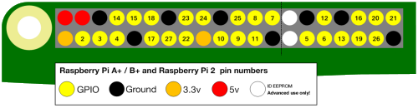
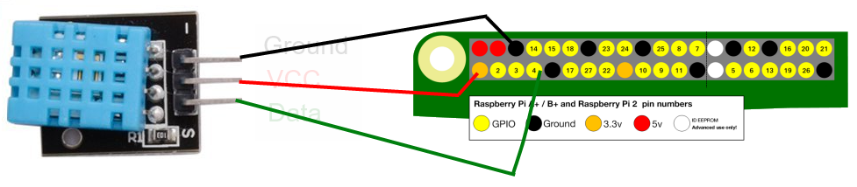
Wiring Diagram
https://www.raspberrypi.org/learning/physical-computing-with-python/worksheet/

Slide 10


Slide 11
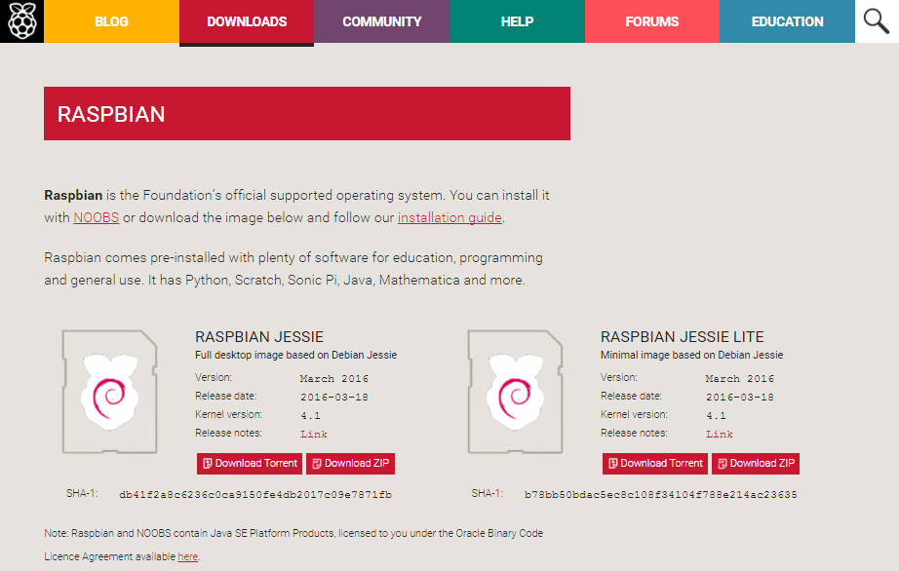
Setup your Pi
sudo raspi-config
Expand File System
Internationalization Options
Advanced > Hostname
sudo apt-get update
sudo apt-get upgraded
grab coffee or beer…
https://www.raspberrypi.org/downloads/raspbian/
https://www.raspberrypi.org/documentation/configuration/raspi-config.md

Slide 12
MongoDB
Setup
sudo apt-get mongodb
**Requires Jessie build of Raspbian
Start Client
mongo
Useful Commands
show dbs
show collections
use <db_name>
db.<db_name>.help()
db.<db_name>.find()

Slide 13
Flask web microframework
Setup
sudo pip install flask
Why Flask?
Lightweight
Simple to use
Flexible
Extensible
Well documented
https://www.raspberrypi.org/learning/python-web-server-with-flask/

Slide 14
Raspi GPIO
import RPi.GPIO as GPIO
GPIO.setmode(<mode>)
GPIO.BOARD
GPIO.BCM
GPIO.setup(<channel>, <in/out>)
GPIO.OUT
GPIO.IN
GPIO.input(<channel>)
GPIO.output(<channel>,<state>)
GPIO.HIGH
GPIO.LOW
GPIO.cleanup()
https://www.raspberrypi.org/learning/physical-computing-with-python/
https://sourceforge.net/p/raspberry-gpio-python/wiki/BasicUsage/

Slide 15
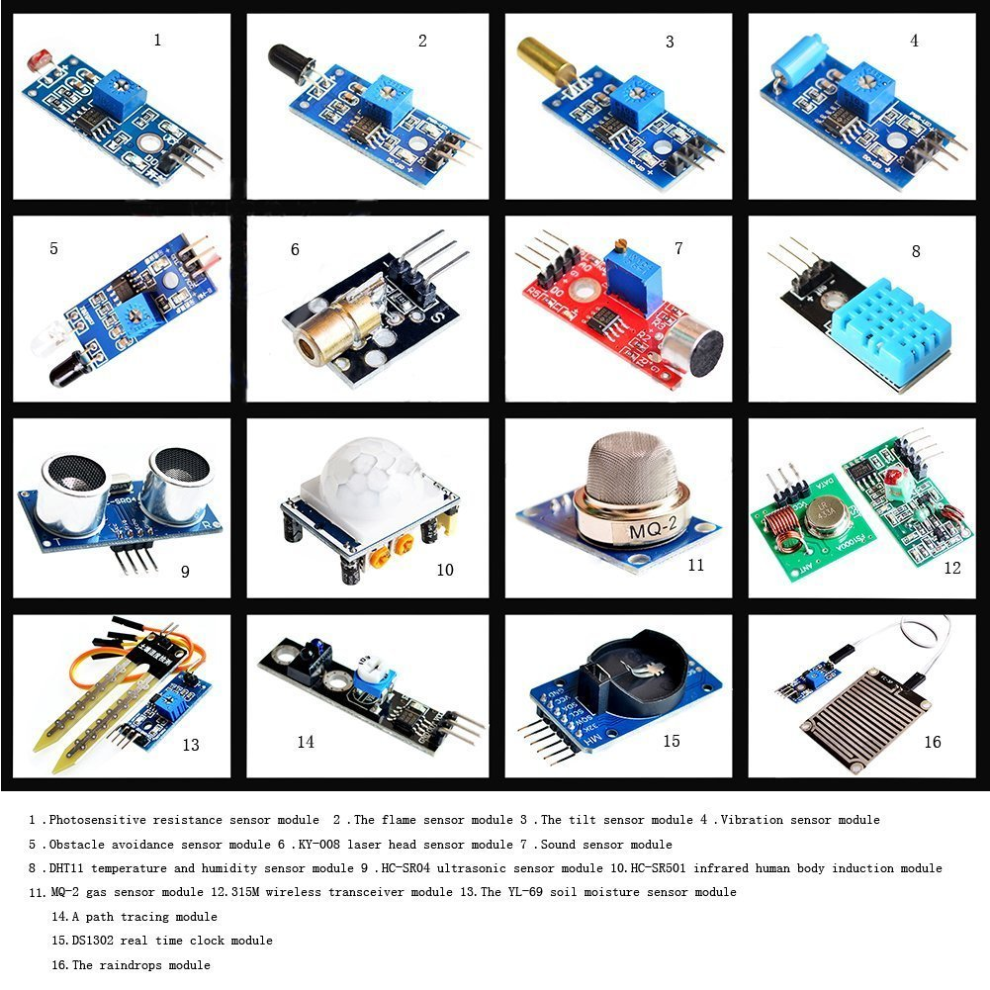
U can 2!
16 Sensor starter kit, $30 on Amazon
Solderless Breadboard, ~$3-$10
Jumper Wires < $10
Maybe some resistors, < $10
Get deals with kits and a bit of research
http://goo.gl/OjsfSF

