Slide 1

CrowdStrike Hackathon - Every Second Counts

Slide 2
Team Name: Invincible_007
Theme Name: CrowdStrike Hackathon - Every Second Counts
Team Members: Sayantan Ghosh Sourav Karmakar Soujanna Dutta Abhinandan Purkait

Slide 3
Background: Identify the problem
Predict Passengers
Each year a large number of flights land in India carrying thousands and lakhs of people form different parts of the world. Predicting the crowd for the upcoming year can help in making the arrangements and facilities better. The prediction can be useful for a large number of business domains.
Task:
The details about the flights and their passenger capacity is provided for different years and quarters and you have to predict the passenger coming to india for the first quarter of the next year.

Slide 4
Definition: Which problem are you trying to solve and why?
It was given the problem that we need to predict the numbres of passengers that come to India from different countries.
When I analyze the given dataset I found there are 6 independent factors to predict the PASSENGERS_TO_INDIA column but when i look into the test dataset there are only 3 columns YEAR, QUARTER,a nd COUNTRY.
It is a real world problem that depicts sometimes data may be missing but its very crucial to find out the future passenger gathering for several statistical analysis and data visualization like tourism analysis, economy etc. So it is a very interesting problem to solve as a ML enthusiast.

Slide 5
Solution: How your idea is solving the problem and making a positive impact on customer experience
As 3 important features (PASSENGERS_FROM_INDIA,FREIGHT_TO_INDIA,FREIGHT_FROM_INDIA) are missing in the test dataset so my first approach to find out the expected values for each of this features one by one.
Step1: I calculated the PASSENGERS_FROM_INDIA column for test data using 3 features YEAR, QUARTER, COUNTRY_NAME using Random Forest regressor.Then, I append the expected value for PASSENGERS_FROM_INDIA in the test data for further use.
Step2: I calculated the FREIGHT_TO_INDIA by using the 4 features from the training data .
Step3: Then, I calculated the FREIGHT_FROM_INDIA by using the 4 features from the training data and finally I calculated the PASSENGERS_TO_INDIA.

Slide 6
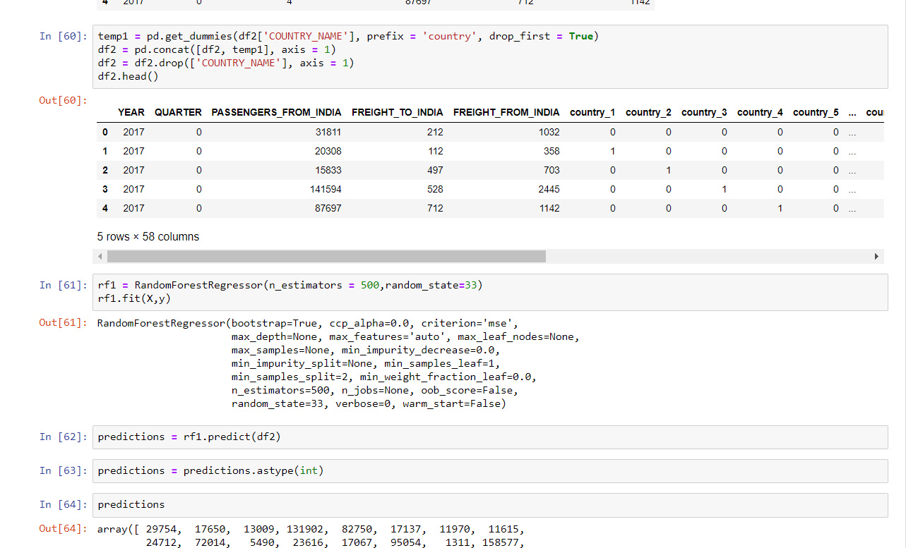
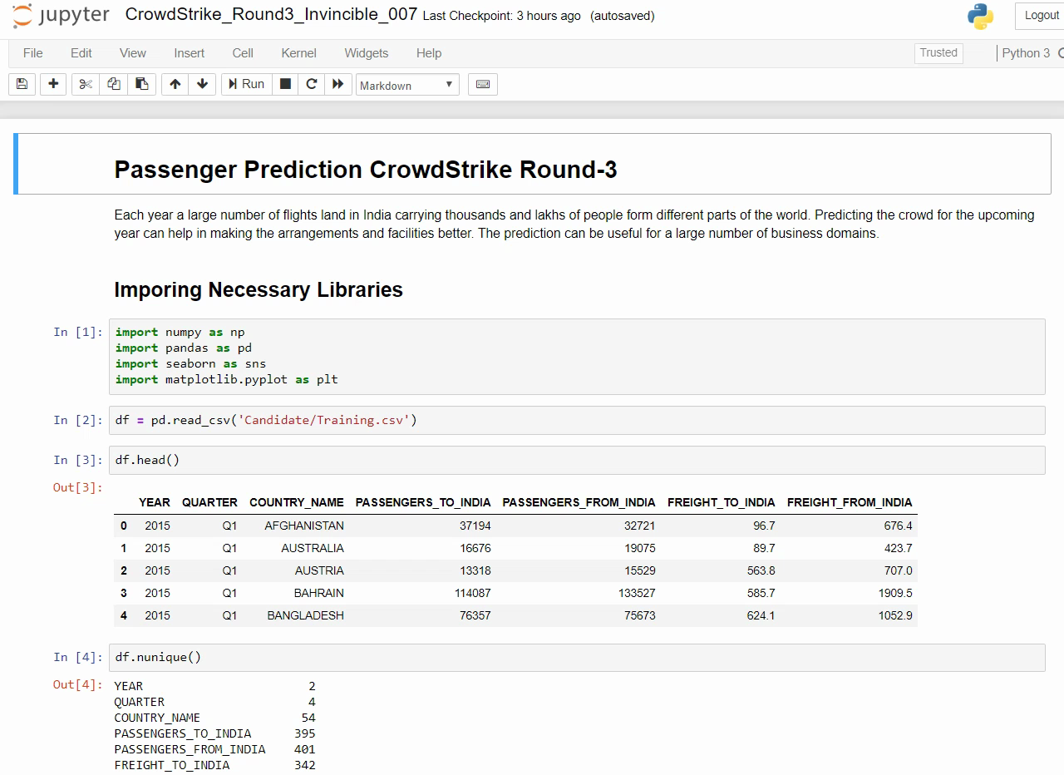
Deliver: Share images of your solution or prototype or provide a demo video link
Code Screenshot
Video_Solution

