Slide 1
Transceiver Block
Sean Gordon and Bryan Friestad

Slide 2
The project
The goal of this device is to more efficiently transmit serial data
A clock line should not be sent
Instead, we can recover the clock line from the data using a PLL
This requires the data to be dense with transitions
We have designed an encoding/decoding scheme to add additional transitions

Slide 3
Requirements
Devise a 4-bit to 5-bit coding scheme that will guarantee at most 4 consecutive 0s or 1s for any input data sequence.
Design a circuit that will take an 8-bit wide parallel data sequence at 10K bytes/sec and serialize it using the 4-bit to 5-bit coding scheme you devised in part (a). This assumes that a 10KHz clock is present that is synchronous with the input data.
Design a receiver that will take the serial data string, decode it, and recreate an 8-bit wide data sequence at the output.
Design a “comma detect” circuit that will allow for proper framing of the received data. The “comma” should be a 10-bit code that cannot represent any data sequence. The “comma” would be inserted in place of a byte in the transmitted data stream for synchronization and the receiver should frame the received data relative to the detected “comma” whenever a comma is detected. After the “comma” is detected, the received should be in synch with the input data sequence.

Slide 4
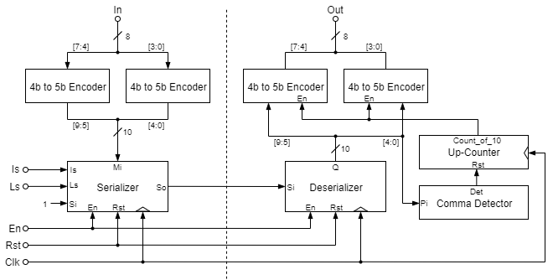
High-level diagram

Slide 5
Designing the Encoding/Decoding Scheme
Needed to devise a 4-bit to 5-bit scheme that guaranteed at most 4 consecutive 0/1s
Design drawback: Non-equal bit disparity
0000 → 00000
0000 → 00100
Input: 0000_0000
Conv: 00000_00000
Input: 0000_0000
Conv: 00100_00100
X
✓

Slide 6
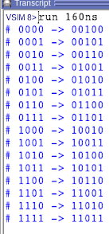
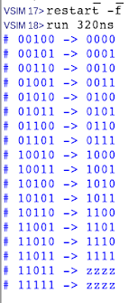
Encoding chart
From 5-bit strings, we selected the most transition heavy
Each byte is split into a low and a high nibble
Each nibble is equivalently encoded
Decoding is just a reverse mapping
All unmapped 5-bit words output Z

Slide 7
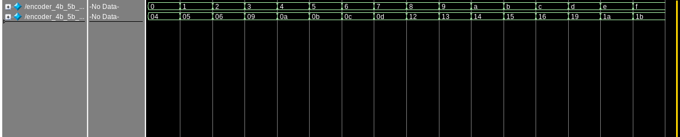
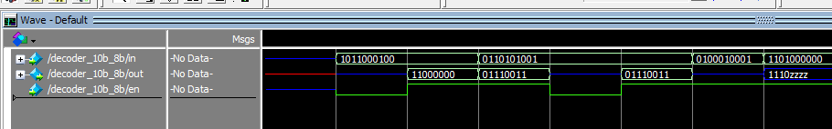
Encoder/Decoder Testbenches

Slide 8
Serializer Block Diagram

Slide 9
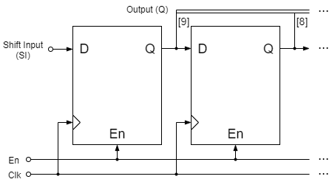
Deserializer Block Diagram

Slide 10
Serializer Testing
#Test Comma
force -deposit Mi 2#11111_111111 0
force -deposit Si 1 0
force -deposit Is 1 0
force -deposit Ls 0 0
run 100
#Test Main Input
force -deposit Mi 2#10101_01010 0
force -deposit Si 1 0
force -deposit Is 0 0
force -deposit Ls 0 0
run 100
#Test Shift Input
force -deposit Mi 2#11111_111111 0
force -deposit Si 1 0
force -deposit Is 0 0
force -deposit Ls 1 0
run 100
#Let shifter propagate out
run 500
force -deposit Si 0 0
run 400

Slide 11
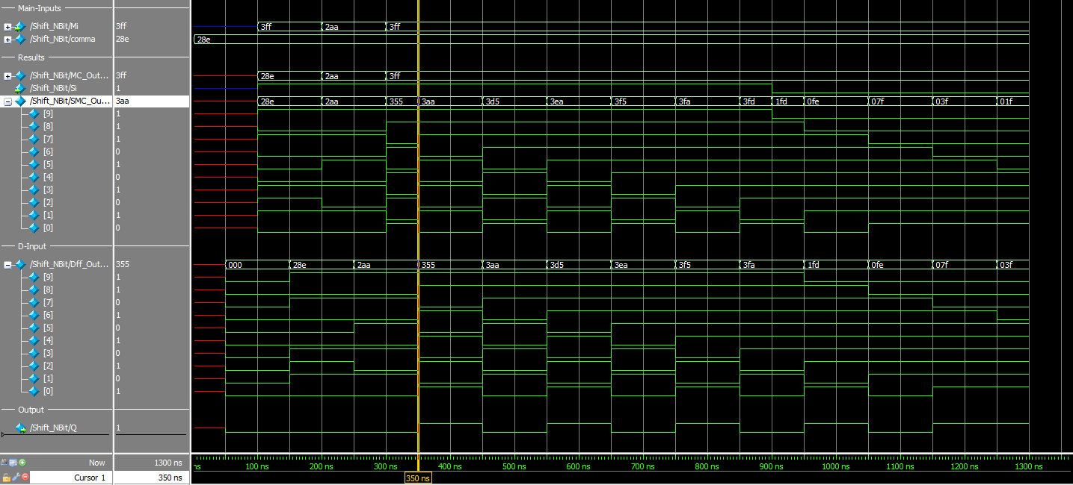
Serializer Waveform

Slide 12
Deserializer Testing
#### Clearing Things ####
force -deposit en 1 0
force -deposit rst 1 0
run 100
##### Commence Test #####
force -deposit rst 0 0
#Test Shift Input
force -deposit Si 1 0
run 100
force -deposit Si 0 0
run 100
force -deposit Si 1 0
run 100
force -deposit Si 0 0
run 100
force -deposit Si 1 0
run 100
force -deposit Si 1 0
run 100
force -deposit Si 0 0
run 100
force -deposit Si 1 0
run 100
#Allow deserializer to propagate
run 900

Slide 13
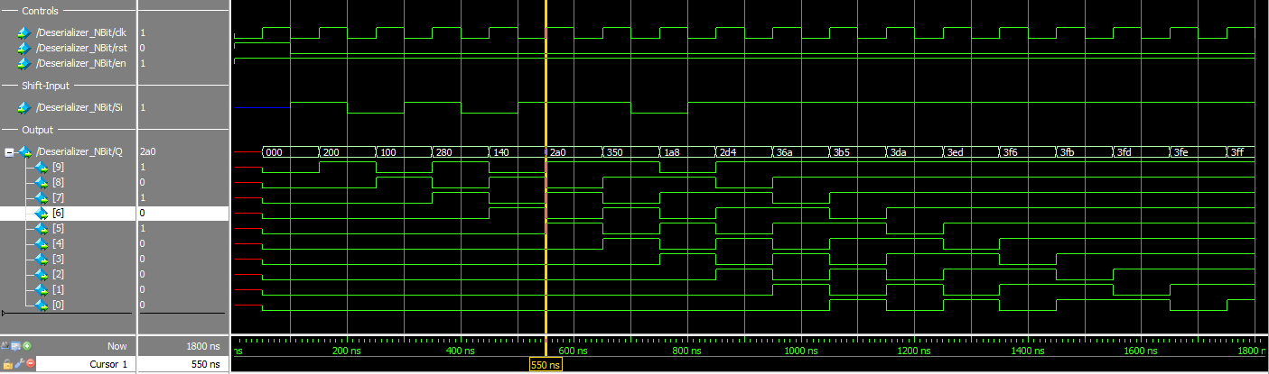
Deserializer Waveform

Slide 14
Receiver Synchronization
In order to detect valid serial input, we need to align the data
As data is shifted into the Deserializer, we want to be able to detect a start message
We can devise a “Comma” which heads all serial messages
When the comma is detected, the decoder is enabled.
Additionally, a counter is reset to keep track of when a new 10-bit word has appeared

Slide 15
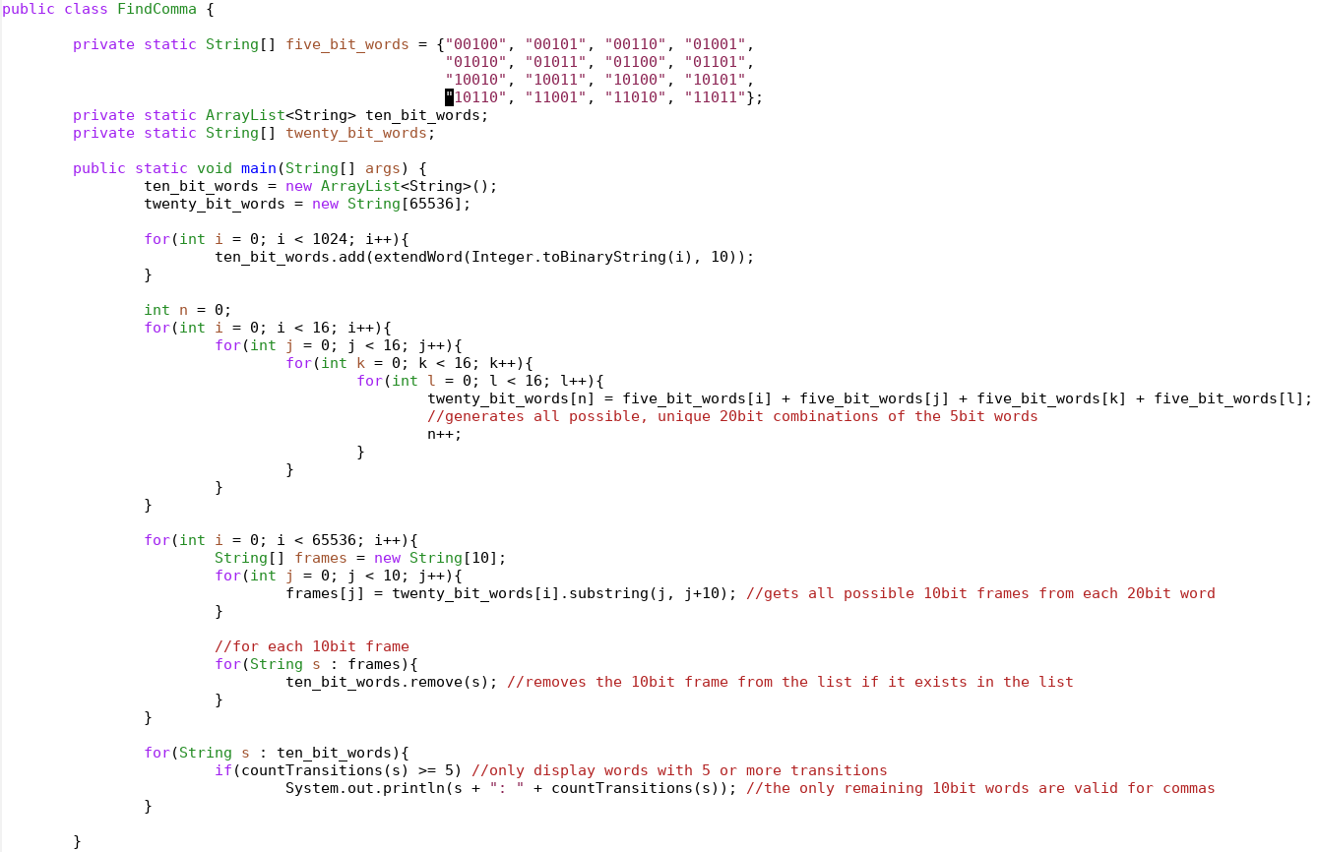
Selecting a Comma
The comma must maintain that there are no more than 4 consecutive equal bits
The comma must not appear in any other valid string of input to the Deserializer.
We wrote a short program to assist in finding an optimal comma
We selected 10_1000_1110

Slide 16
Final Test Conditions
############## IMPORTANT #############
# Make sure when we load we do it on
# the 1000ns mark
# (run 900 -> load, run 100 -> repeat)
#Load Main Input
force -deposit In 2#10101_01010 0
force -deposit Is 0 0
force -deposit Ls 0 0
run 100
#And send it over
force -deposit Is 0 0
force -deposit Ls 1 0
run 900
#Load Main Input-1
force -deposit In 2#10101_01001 0
force -deposit Is 0 0
force -deposit Ls 0 0
run 100
#And send it over
force -deposit Is 0 0
force -deposit Ls 1 0
run 900
#### Clearing Things ####
force -deposit en 1 0
force -deposit rst 1 0
run 100
##### Commence Test #####
force -deposit rst 0 0
#Load Comma
#Setting In to 0xCC to point out that we're loading a 'comma'
force -deposit In 2#00110_01100 0
force -deposit Is 1 0
force -deposit Ls 0 0
run 100
#And send it over
force -deposit Is 0 0
force -deposit Ls 1 0
run 900

Slide 17
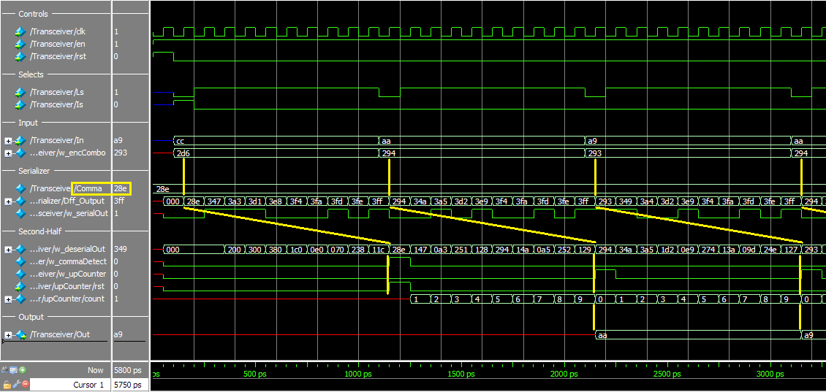
Final Waveform

Slide 18
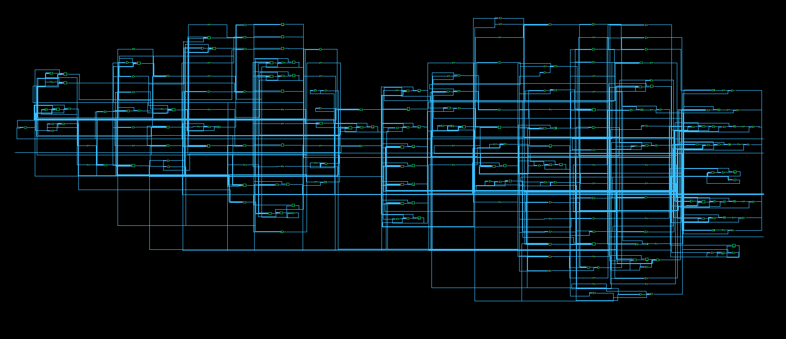
Synthesized Schematic

Slide 19
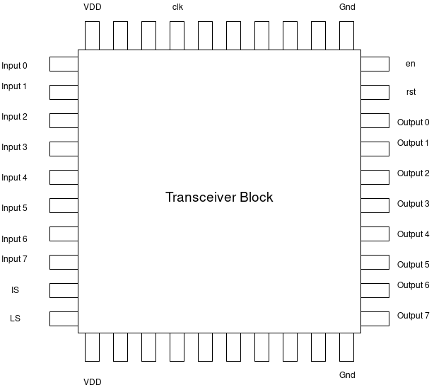
Our planned pinout on a 40-pin frame

Slide 20
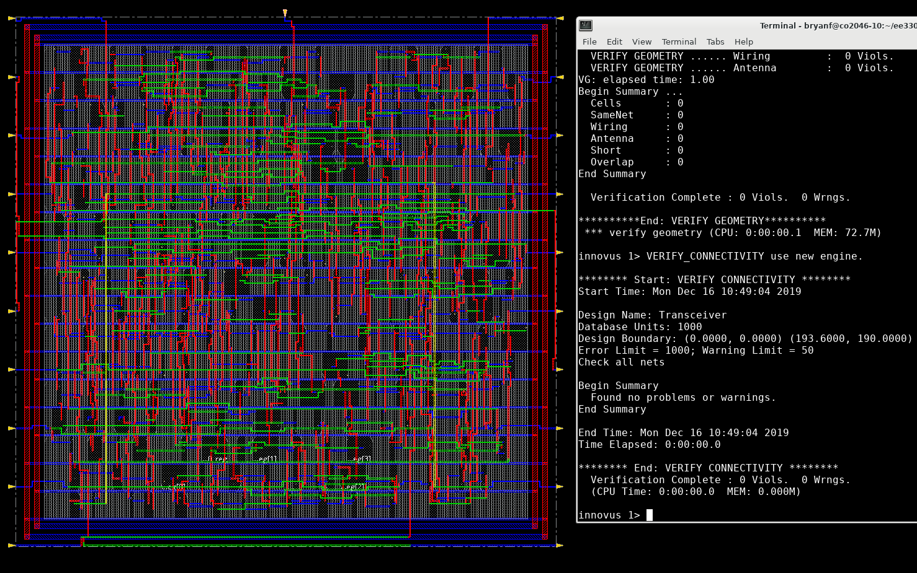
Layout and Routing
We wanted to maintain a roughly square area for the pad frame
We had to set up the pins so that they were spread out
The area was approximately 190 um by 192 um, or .0365 mm^2
Our geometry checks and connectivity checks passed without error

Slide 21
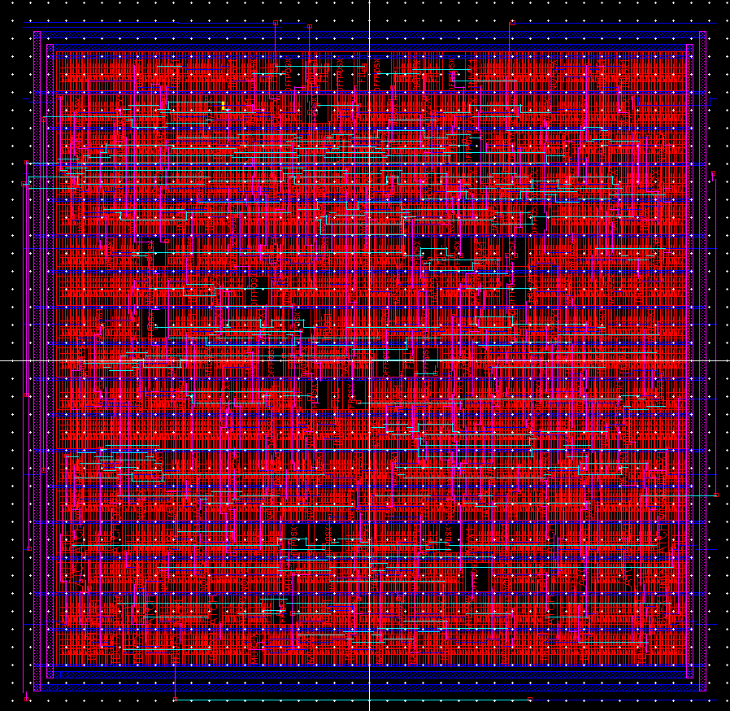
Importing, DRC & LVS
We exported from Innovus and imported into Virtuoso (had to fix a bug)
DRC and LVS both passed after some troubleshooting / bug fixing

Slide 22
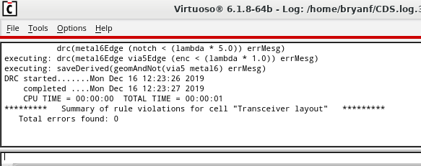
DRC Success

Slide 23
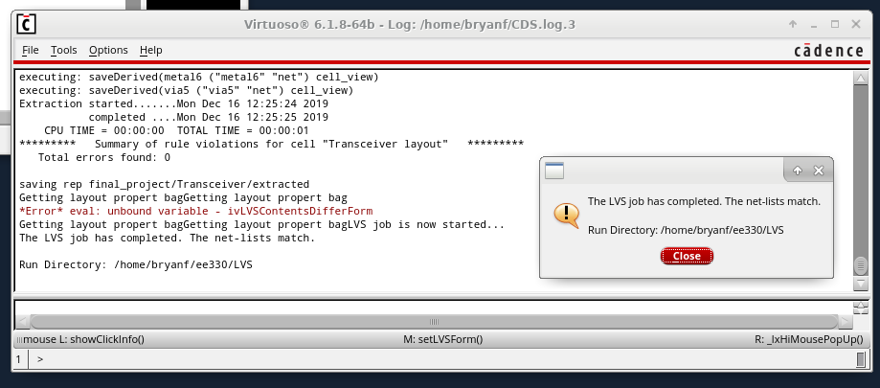
LVS Success

Slide 24
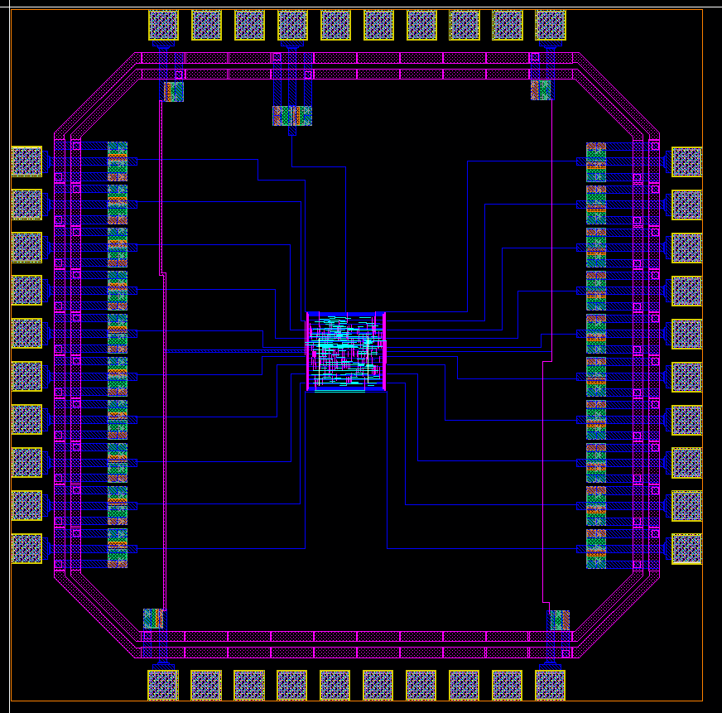
Proof of Concept for Pad Frame

