Slide 1
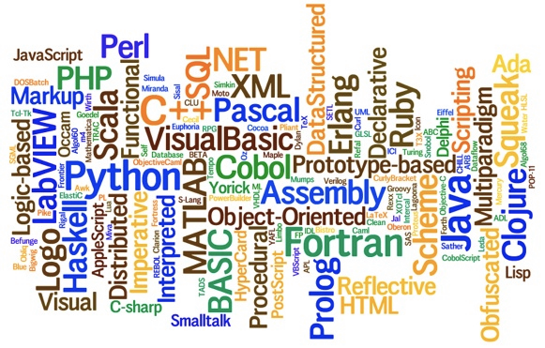
Varlang: A Core language with Variables
Thank Hridesh Rajan for many of the slides

Slide 2

Variable
Means of Abstraction

Slide 3
Revisit: Parts of a Language
Means of: ComputationCombinationAbstraction
X = 200 + 300;
X = x- 50;

Slide 4
Means of Abstraction
Similar to variables in mathematics
Variables abstract away concrete details
Variables provide capability to refer to the (potential complex) definition by referring to the name

Slide 5

Means of Abstraction
Similar to variables in mathematics
Variables abstract away concrete details
Variables provide capability to refer to the (potential complex) definition by referring to the name
Example

Slide 6
Means of Abstraction
Similar to variables in mathematics
Variables abstract away concrete details
Variables provide capability to refer to the (potential complex) definition by referring to the name
Example
x * (y - x)

Slide 7

Means of Abstraction
Similar to variables in mathematics
Variables abstract away concrete details
Variables provide capability to refer to the (potential complex) definition by referring to the name
Example: Variables x and y in the expression below...
x * (y - x)
WHERE,

Slide 8
Means of Abstraction
Similar to variables in mathematics
Variables abstract away concrete details
Variables provide capability to refer to the (potential complex) definition by referring to the name
Example: Variables x and y in the expression below...
x * (y - x)
WHERE,

Slide 9
Advantage of such abstraction?

Slide 10
Means of Abstraction
Similar to variables in mathematics
Variables abstract away concrete details
Variables provide capability to refer to the (potential complex) definition by referring to the name
Example: Variables x and y in the expression below...
Easy to understand
Scalable
x computed once, used twice
x * (y - x)
WHERE,

Slide 11

Definition and Use of A Variable

Slide 12
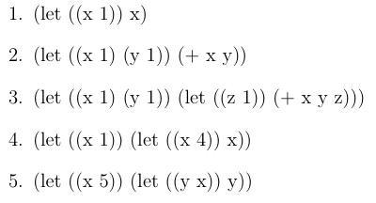
Variable Definition and Usage in Varlang
Expressions
output
1
2
3
4
5

Slide 13
Variable Definition and Usage in Varlang
Expressions
output
1
2
3
4
5
Definition of x
Variable definition is done using ‘let’ expression

Slide 14
Variable Definition and Usage in Varlang
Expressions
output
1
2
3
4
5
Use of x

Slide 15
Variable Definition and Usage in Varlang
Expressions
output
1
2
3
4
5
is similar to,
Let x be 1, and y be 1. Then, the result of x + y is 2.

Slide 16
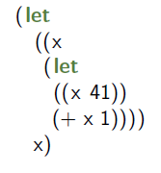
Variable Definition and Usage in Varlang
Expressions
output
1
2
3
4
5
What is the output?

Slide 17

Variable Scoping

Slide 18
Variable Scoping
Match identifiers' declaration with uses
Visibility of an entity
Binding between declaration and uses
The scope of an identifier is the portion of a program in which that identifier is accessible
The same identifier may refer to different things in different parts of the program: Different scopes for same name don’t overlap
An identifier may have restricted scope

Slide 19
Lexical or Static Scoping
Effect of variable definition until the next variable definition with the same name
Scoping rule: variable definitions supersede previous definitions and remain effective until the next variable definition with the same name
Varlang uses lexical scoping, also call static scoping
in C, C++, Java using ‘{‘ and ‘}’
e.g. int x = 1; { int x = 42; res = x + 1; }

Slide 20
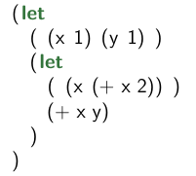
Variable Scoping
Consider the expression below with x and y

Slide 21
Variable Scoping
Consider the expression below with x and y
definition of y

Slide 22
Variable Scoping
Consider the expression below with x and y
definition of y
scope of y

Slide 23
Variable Scoping
Consider the expression below with x and y
definition1 of x

Slide 24
Variable Scoping
Consider the expression below with x and y
definition1 of x
scope of x

Slide 25
Variable Scoping
Consider the expression below with x and y
definition2 of x

Slide 26
Variable Scoping
Consider the expression below with x and y
definition2 of x
Scope of x

Slide 27
Variable Scoping
Consider the expression below with x and y
x = 1, y = 1

Slide 28
Variable Scoping
Consider the expression below with x and y
x = 1, y = 1
x = 3, y = 1

Slide 29
Variable Scoping
Consider the expression below with x and y
x = 1, y = 1
x = 3, y = 1
x = 3, y = 1

Slide 30
Variable Scoping
Consider the expression below with x and y
x = 1, y = 1
x = 3, y = 1
x = 3, y = 1
x = 1, y = 1

Slide 31
A hole in the Scope
Redefine a name creates a “hole”:
So the expression (+ x y) is a hole in the scope of the first definition of x

Slide 32
Free variable and bound variable
free variable, a variable occurs free in an expression
if it is not defined by an enclosing let expression
in program “x”,
the variable x occurs free
in program “(let ((x 1)) x)”,
x is bound in enclosing let expression, hence x is not free

Slide 33

VarLang Grammar

Slide 34
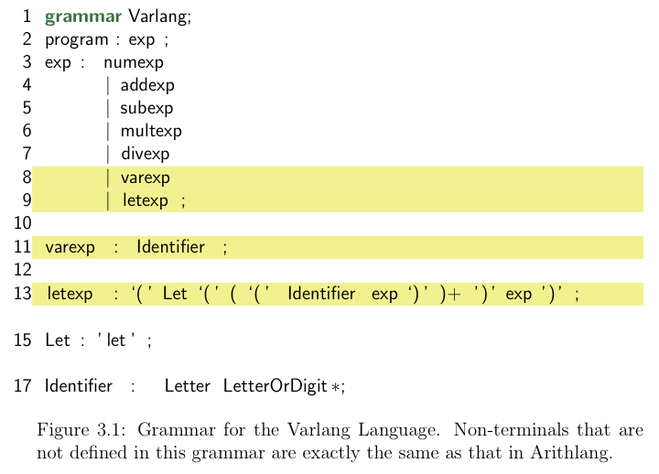
Varlang Grammar

Slide 35
Varlang Grammar
The rule for program is same as Arithlang and highlighted additions
The rule for exp has two additions: varexp and letexp
varexp rule: variable can be identifier; ‘a1’ is valid; ‘1a’ is invalid
letexp rule:
begins with ‘(let’
ends with ‘)’
in between contains one or more variable definitions followed by the body exp
Letter ::= [a-zA-Z$ ] Letter
LetterOrDigit ::= [a-zA-Z0-9$ ] LetterOrDigit

Slide 36
Variable Definition and Usage in Varlang
Expressions
output
1
2
3
4
5

Slide 37
Read Phase Example
Example program: “(let ((x 1)) x)”
Tokens: `(‘, `let’, `(‘, `(‘, Identifier:x, DIGIT:1, `)’, `)’, Identifier:x, and `)’
Syntax analysis (or parsing)
Parse tree ?

Slide 38
Read Phase Example
Example program: “(let ((x 1)) x)”
Tokens: `(‘, `let’, `(‘, `(‘, Identifier:x, DIGIT:1, `)’, `)’, Identifier:x, and `)’
Syntax analysis (or parsing)
Parse tree
program
exp
letexp
identifier
numexp
identifier
`(‘
`let‘
`(‘
`(‘
x
1
`)‘
`)‘
x
`)‘

Slide 39
Object-oriented Form of AST
ASTNode
Program
Exp
exp : Exp
+ accept(visitor)
+ accept(visitor)
CompoundArithExp
operands : List<Exp>
+ accept(visitor)
AddExp
SubExp
MultExp
DivExp
NumExp
val : double
+ accept(visitor)
+ accept(visitor)
+ accept(visitor)
+ accept(visitor)
+ accept(visitor)

Slide 40
Object-oriented Form of AST
ASTNode
Program
Exp
exp : Exp
+ accept(visitor)
+ accept(visitor)
CompoundArithExp
LetExp
operands : List<Exp>
names : List<String>
values: List<Exp>
+ accept(visitor)
+ accept(visitor)
AddExp
SubExp
MultExp
DivExp
NumExp
varExp
val : double
name: string
+ accept(visitor)
+ accept(visitor)
+ accept(visitor)
+ accept(visitor)
+ accept(visitor)
+ accept(visitor)

Slide 41

VarLang Semantics: What is the value of a VarLang program?

Slide 42
Reasoning about value of letExp
What is the value of “(let ((x 3) (y 4)) (+ x y))”?
Two ways of thinking about it,
substitution-based semantics
(let ((x 3) (y 4)) (+ x y))
value?
(let ((y 4)) (+ 3 y))
replacing x with 3
(+ 3 4)
replacing y with 4
(+ 3 4)
value = 7

Slide 43
Reasoning about value of letExp
What is the value of “(let ((x 3) (y 4)) (+ x y))”?
Two ways of thinking about it,
environment-based semantics
valueOf (letexp) = valueOf (letBody) under env
(let ((x 3) (y 4)) (+ x y))
Empty
(let ((y 4)) (+ 3 y))
x->3 :: Empty
(+ 3 4)
y->4:: x->3:: Empty
(+ 3 4)
value = 7

Slide 44
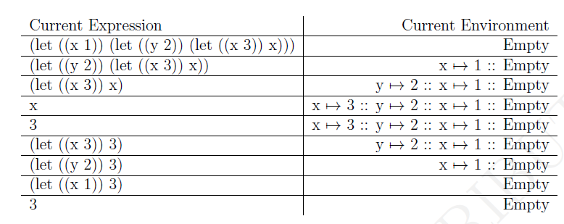

Slide 45
Environment
Environment: support definition and use
An environment is a dictionary that maps variables to values at a program point
The value of a variable is the first value from the left found in the environment
An environment is a data type that provides an operation to look up the value of a variable

Slide 46
Environment Illustrated
Environment
Program
00 main
01 y = 14
02 x = 7
03 y = 8
04 d = 6
05
06 d==6 ??
07 y==8 ??
08 x==7 ??
09 p==4 ??
(empty-env)
Program Counter
What is the environment “data value” at that moment?

Slide 47
Environment Illustrated
Environment
Program
Either point-to or contain.
(empty-env)
00 main
01 y = 14
02 x = 7
03 y = 8
04 d = 6
05
06 d==6 ??
07 y==8 ??
08 x==7 ??
09 p==4 ??
(extend-env ‘y 14 env’ )

Slide 48
Environment Illustrated
Environment
Program
(empty-env)
00 main
01 y = 14
02 x = 7
03 y = 8
04 d = 6
05
06 d==6 ??
07 y==8 ??
08 x==7 ??
09 p==4 ??
(extend-env ‘y 14 env’ )
(extend-env ‘x 7 env’ )

Slide 49
Environment Illustrated
Environment
Program
(empty-env)
00 main
01 y = 14
02 x = 7
03 y = 8
04 d = 6
05
06 d==6 ??
07 y==8 ??
08 x==7 ??
09 p==4 ??
(extend-env ‘y 14 env’ )
(extend-env ‘x 7 env’ )
(extend-env ‘y 8 env’ )

Slide 50
Environment Illustrated
Environment
Program
(empty-env)
00 main
01 y = 14
02 x = 7
03 y = 8
04 d = 6
05
06 d==6 ??
07 y==8 ??
08 x==7 ??
09 p==4 ??
(extend-env ‘y 14 env’ )
(extend-env ‘x 7 env’ )
(extend-env ‘y 8 env’ )
(extend-env ‘d 6 env’ )

Slide 51
Environment Illustrated
Environment
Program
(empty-env)
00 main
01 y = 14
02 x = 7
03 y = 8
04 d = 6
05
06 d==6 ??
07 y==8 ??
08 x==7 ??
09 p==4 ??
(extend-env ‘y 14 env’ )
(extend-env ‘x 7 env’ )
(extend-env ‘y 8 env’ )
1
(extend-env ‘d 6 env’ )

Slide 52
Environment Illustrated [Override]
Environment
Program
(empty-env)
00 main
01 y = 14
02 x = 7
03 y = 8
04 d = 6
05
06 d==6 ??
07 y==8 ??
08 x==7 ??
09 p==4 ??
(extend-env ‘y 14 env’ )
(extend-env ‘x 7 env’ )
2
(extend-env ‘y 8 env’ )
1
(extend-env ‘d 6 env’ )

Slide 53
Environment Illustrated
Environment
Program
(empty-env)
00 main
01 y = 14
02 x = 7
03 y = 8
04 d = 6
05
06 d==6 ??
07 y==8 ??
08 x==7 ??
09 p==4 ??
(extend-env ‘y 14 env’ )
3
(extend-env ‘x 7 env’ )
2
(extend-env ‘y 8 env’ )
1
(extend-env ‘d 6 env’ )

Slide 54
Environment Illustrated
Environment
Program
(empty-env)
5
00 main
01 y = 14
02 x = 7
03 y = 8
04 d = 6
05
06 d==6 ??
07 y==8 ??
08 x==7 ??
09 p==4 ??
4
(extend-env ‘y 14 env’ )
3
(extend-env ‘x 7 env’ )
2
(extend-env ‘y 8 env’ )
1
(extend-env ‘d 6 env’ )

Slide 55
Environment Illustrated
Environment
Program
(empty-env)
5
00 main
01 y = 14
02 x = 7
03 y = 8
04 d = 6
05
06 d==6 ??
07 y==8 ??
08 x==7 ??
09 p==4 ??
Reference to undefined identifier: p
4
(extend-env ‘y 14 env’ )
3
(extend-env ‘x 7 env’ )
2
(extend-env ‘y 8 env’ )
1
(extend-env ‘d 6 env’ )

Slide 56
Environment Defined!
Function from Var to Value
where Var is a finite set of variables (var is in Var)
and Value is the set of all Varlang values (v is in Value).
Specification
(empty-env) = !Φ!
(apply-env !f! var) = f(var)
(extend-env var v !f!) = !g! ,
where g(var1) = v if var1 = var
f(var1) otherwise

Slide 57

Program semantics: the value of a program is the value of its component expression
Assumptions:
Program be the set of all programs in Varlang
Exp be the set of all expressions in Varlang
let p be a program, i.e it is in set Program
e be an expression, i.e. it is in set Exp, such that e is the inner expression of p
Math notation:

Slide 58


Program semantics: In an environment env, the value of a program is the value of its component expression in the same environment env.

Slide 59
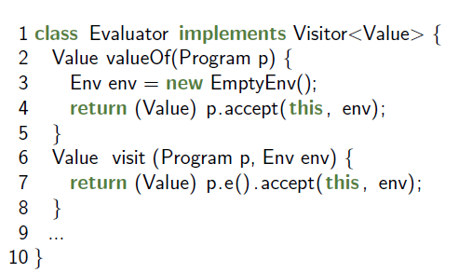

Slide 60

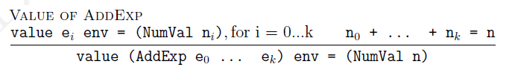
Value of Expressions
Expression that does not change environment
Expression that passes the environment to their subexpressions
The addition expression neither defines new variable nor removes any existing variable definitions. Therefore, an addition expression should have no direct effects on the environment.
All of its subexpressions are evaluated in the same environment.

Slide 61
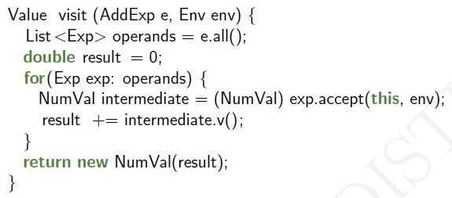

Slide 62

Var Expression
The meaning of a variable expression in a given environment is dependent on the environment in which we are evaluating that expression.
For example, the value of a var expression x in an environment that maps name x to value 342 would be the numeric value 342. On the other hand, in an environment that maps name x to value 441 the value of the same var expression x would be the numeric value 441

Slide 63


Slide 64
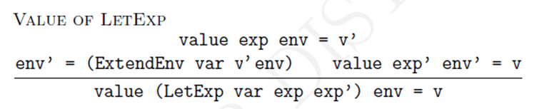
Let Expression
Changes the environment: add new name-value pairs
A let expression is also serving to combine two expressions exp and exp’ into a larger expression

Slide 65
Let Expression
A let expression that only define a single name-to-value mapping:
1. the value of a let expression is the value of its body exp’ obtained in a newly constructed environment env’.
2. It is obtained by extended the original environment of the let expression exp with new bindings (variable name to value mapping).

Slide 66
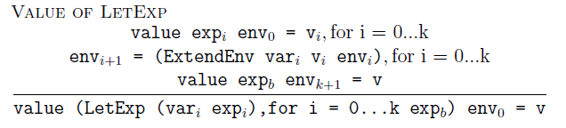
Value of Let Expression
A let expression that defines multiple variables

Slide 67
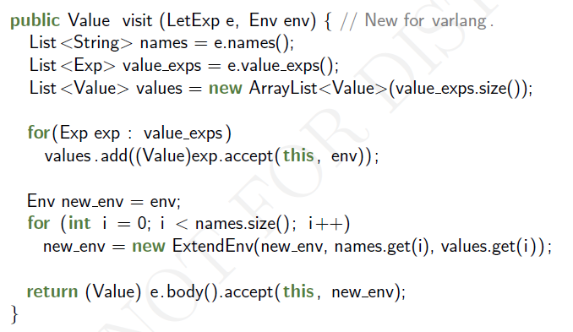

Slide 68
Review
VarLang:
Syntax: AST extending Var Expression and Let Expression Nodes
Semantics: Pass environment to the expression, support Var expression and let expression
Programming Language Concepts
Variable
Scope
Free and bound variables
Environment
Program semantics: value of a program is a value of expression under environment
Reading: Rajan’s Ch 3, Sebesta Ch 5

