Slide 1
Typelang
A language with types

Slide 2
Overview
Concepts
Types
Type system
Type inference
Type checking
Typelang grammar
Type rules (type checking rules)
Constant
Variable
Arithmetic
Compound
Let expression
Lambda expression
Ref
List
Notes:
Concept maps ( how many concepts – not in order, relations between them)

Slide 3
Why do we need types?
( define f (lambda (x y) (y x)))
(f 2 3)
(f 2 (lambda (x) (+ 1 x)))
(f ‘2’ (lambda (x) (+ 1 x))

Slide 4
Types
Type is a property of program constructs such as expressions
It defines a set of values (range of variables) and a set of operations on those values
Classes are one instantiation of the modern notion of the type
fields and methods of a Java class are meant to correspond to values and operations

Slide 5
Type as a Contract or Specification
Contract/specification: agreement between two entities
Procedure: e.g., parameter should be a function
Client that calls the procedure needs to follow
Specification
Ultra lightweight: type
Lightweight annotations: JML
Full mathematical formalism: Z, alloy

Slide 6
Types
Divide program values into kinds: contract between producer and consumer regarding what values to expect
Each kind will define:
Range of the values
Operations on the values

Slide 7
Types
Abstraction:
think in terms of a group of values
Verification:
are we applying the operations correctly?
static and compiler errors
Documentation
this input parameter only can be integers
Performance
language implementation optimize for types (python is slow, c can be faster)

Slide 8
Types
A language is typed: association between expressions are valid only when the types match
Otherwise, the language is not (weakly) typed.
Static vs Dynamic types
Static: can be inferred at compile time
Dynamic: can be inferred at run-time
Sound Static Typing: Dynamic type of an entity is a subset of Static type of the entity

Slide 9
Type Systems
Type-system
The rules of a type system specify: how that contract works for different language features. Similar to legal contracts, the system of rules must cover all eventualities
Purpose
Prevent execution errors
Determine whether programs are well behaved
Where are type-systems implemented?
Compiler

Slide 10
Type Systems
A type system is a collection of rules that assign types to program constructs (more constraints added to checking the validity of the programs, violation of such constraints indicate errors)
A languages type system specifies which operations are valid for which types
Type systems provide a concise formalization of the semantic checking rules
Type rules are defined on the structure of expressions
Type rules are language specific

Slide 11
Type Systems
Expected properties of type systems?
Decidably verifiable
There exists a typechecking algorithm to ensure that a program is well behaved
Transparent
Programmer should be able to predict easily whether a program will typecheck
Enforceable
Type declarations should be statically checked as much as possible otherwise dynamically checked

Slide 12
Execution Errors
Execution errors
w/ symptoms
Illegal instruction faults, illegal memory reference faults
w/o symptoms
Data corruption

Slide 13
Execution Errors
Execution errors
w/ symptoms
Illegal instruction faults, illegal memory reference faults
w/o symptoms
Data corruption
Can type system prevent software faults, such as divide-by-zero and dereferencing nil?
No

Slide 14
Execution Errors
Kinds of execution errors?
Trapped
Causes the computation to stop immediately
Divide-by-zero, accessing illegal address
Untrapped
Go unnoticed (for a while)
Accessing data past the end of an array in the absence of run time bounds checks

Slide 15
Execution Errors
Kinds of execution errors?
Trapped
Causes the computation to stop immediately
Divide-by-zero, accessing illegal address
Untrapped (errors related to language specification not functionality for a specific program/software)
Go unnoticed (for a while)
Accessing data past the end of an array in the absence of run time bounds checks
When the program is safe?
Free from untrapped errors.

Slide 16
Execution Errors
How to ensure no untrapped errors?
Static checks (type system)
Run time checks (untyped languages)
Mixture of static and run time checks
Forbidden errors?
All untrapped errors + a subset of trapped errors.

Slide 17
Type Checking and Type Inferences
Type Checking is the process of verifying fully typed programs
Type Inference is the process of filling in missing type information

Slide 18
Type Checking
Typechecking
Static checking process to prevent unsafe and ill behaved program from ever running
Check if the program confirms to the type rules
Typechecker
Algorithm or a tool that performs typechecking
Ill typed program
program has a type error – errors in the code that violates the type rules
Well typed program
program has no type error and will pass the typechecker

Slide 19
Static Type Checking and Dynamic Type Checking
Dynamic checking?
Enforce good behavior by performing run time checks to rule out forbidden errors
Example
LISP
No static checking
No type system
Type checking can disallow execution (similar to compile time errors)
Type checking can block execution (similar to run time errors)

Slide 20
Design Decisions for a PL: Safe? Typed?
Should languages be safe?

Slide 21
Design Decisions for a PL: Safe? Typed?
Should languages be safe?
No in reality
C is deliberately unsafe
Because of performance considerations
Run time checks are too expensive
Static analysis cannot always ensure

Slide 22
Design Decisions for a PL: Safe? Typed?
Should languages be safe?
No in reality
C is deliberately unsafe
Because of performance considerations
Run time checks are too expensive
Static analysis cannot always ensure
Should languages be typed?
Debatable

Slide 23
Design Decisions for a PL: Safe? Typed?
Should languages be safe?
No in reality
C is deliberately unsafe
Because of performance considerations
Run time checks are too expensive
Static analysis cannot always ensure
Should languages be typed?
Debatable
Conclusion?
Safe & Typed (so that we can learn type systems? ☺)

Slide 24
Design Decisions for a PL: Safe? Typed?
 | Typed | Untyped
Safe | ML, Java | LISP
Unsafe | C | Assembler

Slide 25
Type Soundness
Type soundness? We say a type system is sound if
Well-typed programs are well behaved (free of execution errors)
It is a property of the type system
Intuitively, a sound type system can correctly predict the type of a variable at runtime
There can be many sound type rules, we need to use the most precise ones so it can be useful

Slide 26
Typing Rules
Type rule, typing rule, typechecking rules
The typing rules use very concise notation
They are very carefully constructed
Virtually any change in a rule either:
Makes the type system unsound (bad programs are accepted as well typed)
Makes the type system less usable (perfectly good programs are rejected)

Slide 27
How to Specify a Typing Rule
Logical rules
Assert a Fact
(Fact A)
A
Imply: conditional assertion
(B if A) (C if A and B)
A A B
B C

Slide 28
Summary of the Concepts
Concept Map
Work with your neighbours
Notes:
Discusses with peers

Slide 29
Typelang
Grammar
Type checking rules for
Constant
Atomic expression
Compound expression
Variable
Let expression
Lambda
List
References

Slide 30
TypeLang
How the lecture and text books be organized?
The syntax of each type of expression will be discussed with the typing rules for the expressions later

Slide 31
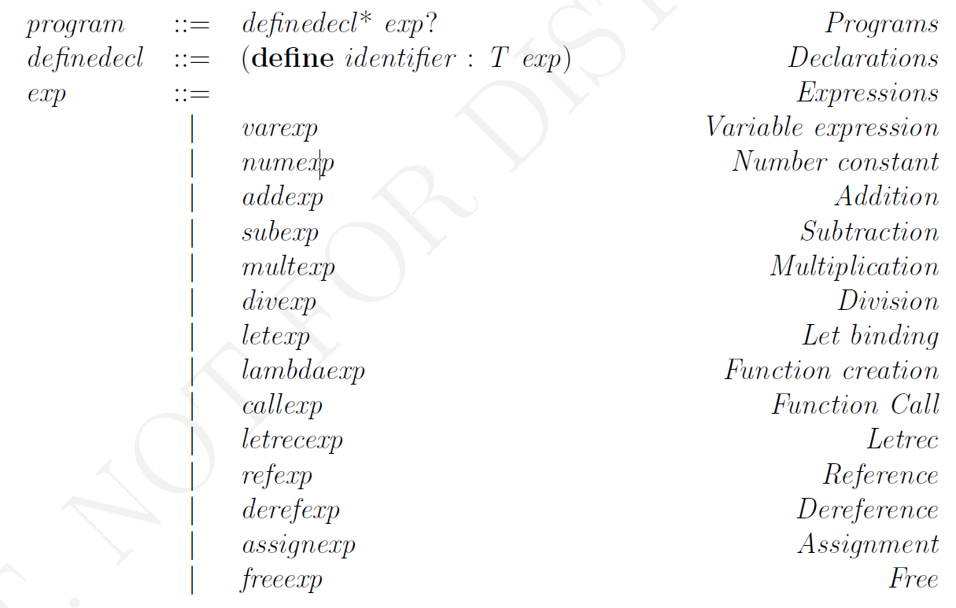
Typelang Grammar: “Define”

Slide 32
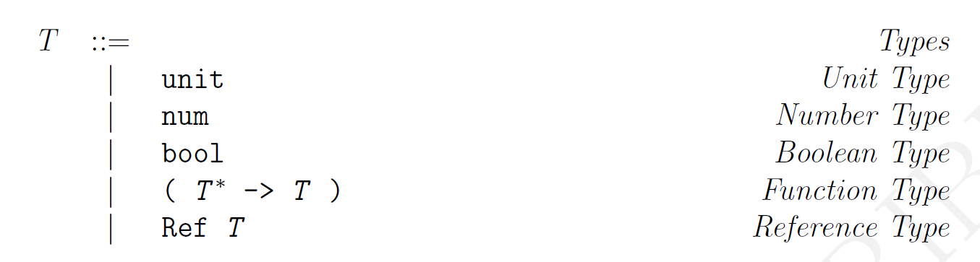
TypeLang: T
Base Type
Recursively-defined types, i.e. their definition makes use of other types: reference, function types

Slide 33
Examples of Typelang: which one is correct, which one is incorrect?
$ (define pi : num 3.14159265359)
$ (define r : Ref num(ref : num 2))
$ (define u : unit (free (ref : num 2)))
$ (define iden : (num −> num) (lambda (x : num) x))
$ (define id : (num −> num) (lambda (x : (num −> num)) x))
$ (define fi : num ”Hello”)
$ (define f : Ref num(ref : bool #f))
$ (define t : unit (free (ref : bool #t)))

Slide 34
TypeChecking Rules for Constant
TypeLang assert that all numeric values (constants) have type num
Notation:
(Num)
n : num
Parts:
Name of the rules
Before ‘:’ expression or program
After ‘:’ type
Reads: n has a type of num

Slide 35
TypeChecking Rules for Constant
TypeLang assert that all Boolean values (constants) have type bool
Notation:
(Num)
n : bool
Reads: n has a type of bool

Slide 36
TypeChecking Rules for Atomic Expressions
Atomic: no subexpressions
(NumExp)
(NumExp n) : num
Producer: produce the expression – promise to produce type num
Consumer: use this expression – expect type num

Slide 37
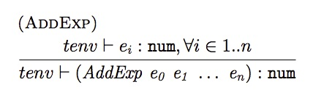
TypeChecking for Compound Expressions
Conditional assertion: if subexpressions of the addition expression always produce values of type num, then the addition expression will produce a value of type num.
if subexpressions e₀ to e_{n} have type num, then the expression (AddExp e₀ , e₁ , . . . , e_{n}) will have type num also

Slide 38
TypeChecking for Compound Expressions
This typechecking rule establishes a contract between producers of values in this context (expressions e₀, e₁, . . . , e_{n}) and the consumer of these values (the addition expression).
It also clearly states the conditions under which the addition expression is going to produce a numerical value.
Notice that the rule does not mention situations where expressions e₀, e₁, . . . , e_{n} might produce a dynamic error. If expressions e₀, e₁, . . . , e_{n} fail to produce a numerical value the addition expression provides no guarantees.

Slide 39
Type Environment
Typing environment (or type environment)
tenv |- should be read as assuming the type environment tenv, the expression e has type t
A record of the types of free variables during the processing of program fragments
In compiler it is just a symbol table
Γ |- M : A, M has type A in static typing environment Γ

Slide 40
Type environment
Notations
M : A has-type
A <: B subtype-of
A = B type equivalence

Slide 41
Type Environment
Value environment (in Varlang)
What should be the value of a variable x?
Similarly, type environment
Defines the surrounding context
What should be the type of a variable?
Map that provides operation to lookup the type

Slide 42
TypeChecking for Compound Expressions
Conditional assertion: if subexpressions of the addition expression always produce values of type num, then the addition expression will produce a value of type num.
if subexpressions e₀ to e_{n} have type num, then the expression (AddExp e₀ , e₁ , . . . , e_{n}) will have type num also

Slide 43
TypeChecking for Compound Expressions
This typechecking rule establishes a contract between producers of values in this context (expressions e₀, e₁, . . . , e_{n}) and the consumer of these values (the addition expression).
It also clearly states the conditions under which the addition expression is going to produce a numerical value.
Notice that the rule does not mention situations where expressions e₀, e₁, . . . , e_{n} might produce a dynamic error. If expressions e₀, e₁, . . . , e_{n} fail to produce a numerical value the addition expression provides no guarantees.

Slide 44
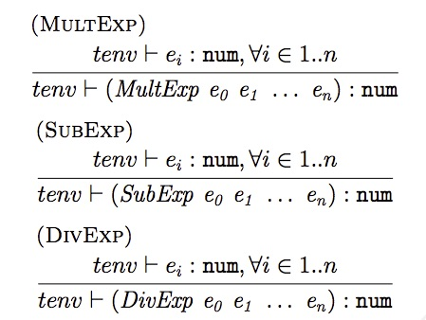
Typing MultExp, SubExp, and DivExp

Slide 45
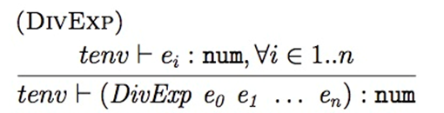
Division Rethink
This is an example of a situation where the type system being developed is insufficient to detect and remove certain classes of errors, e.g. the divide-by-zero errors. How to modify it?

Slide 46
Variable typing
What should be the type of a variable expression x?
What should be a typechecking rule for a variable expression?
w.r.t Type Environment

Slide 47
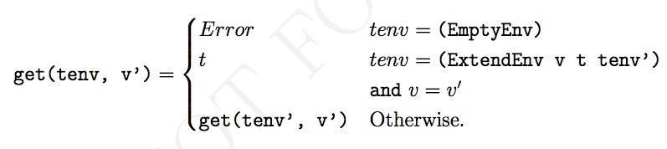
Type Environment

Slide 48
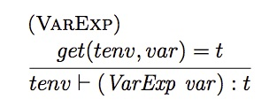
Typechecking rule for VarExp

Slide 49
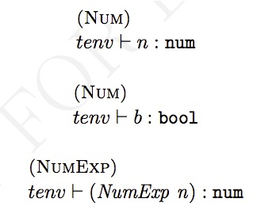
Type Environment Continue
The type environment doesn’t play a major role because values produced (and thus types) of these expressions are not dependent on the context.

Slide 50
Type Environment Continue
type environment used to perform typechecking of subexpressions is the same as that of the addition expression
variables and their types stored in the type environment are not affected by the addition expression

Slide 51
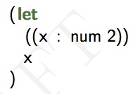
Typing LetExp
Typelang requires that programmer specify types of identifiers in let expression

Slide 52
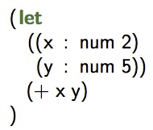
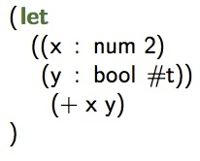
Typing LetExp
Declares two variables x and y with values 2 and 5
Establishes contract b/w producers of these values and consumer (+ x y)
The consumer (+ x y) relies on typechecking rule AddExp
This variable fails to typecheck
AddExp cannot add a number and a boolean

Slide 53
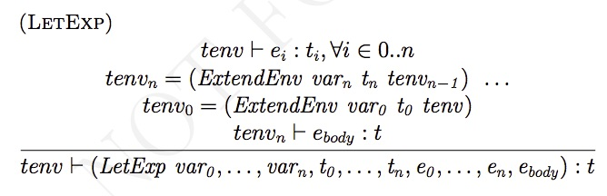
Typing LetExp

Slide 54
Typing Lambda – Function and Calls
Type for a function?
Contract b/w
body (consumer of parameter values and producer of the result value)
and
Caller (producers of parameter values and consumer of the result value)

Slide 55
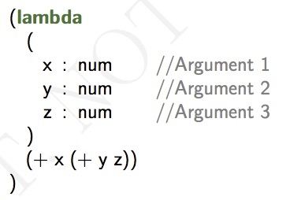
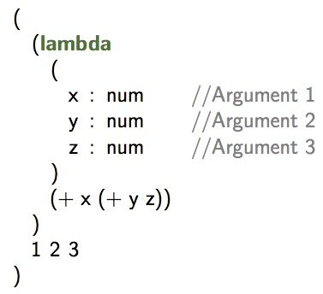
Typing Lambda – Function and Calls
Declares a function with three arguments x, y and z
Type for this function is,
num num num -> num
Return type is num as well
Type checks!
Declares the same function and also calls it by passing integer parameters 1, 2 and 3 for arguments x, y and z
Type checks!

Slide 56
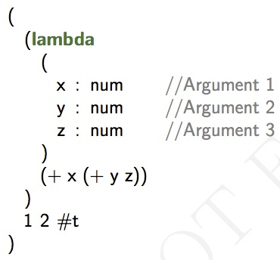
Typing Lambda – Function and Calls
Won’t typecheck
#t is of bool type not a num type

Slide 57
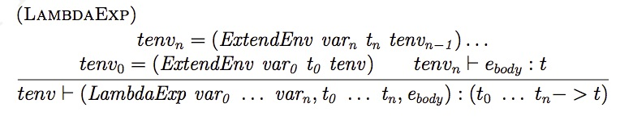
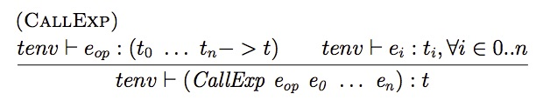
Typing Lambda – Function and Calls

Slide 58
Typing Refs
refexp : ‘(‘ ‘ref’ ‘:’ T exp ‘)’
(ref : num 2)
Allocates a memory location of type number with value 2
(ref : Ref num (ref : num 2))
Allocates a memory location of type to a reference which its content is 2.

Slide 59
Typing Refs
(let
(
(r : Ref Ref num (ref : Ref num (ref : num 5)))
)
(deref (deref r))
)

Slide 60
Typing Refs
(let
(
(r : Ref Ref num (ref : Ref num (ref : num 5)))
)
(deref (deref r))
)
Declares r as reference to a reference with value number 5 and evaluation of the program returns 5

Slide 61
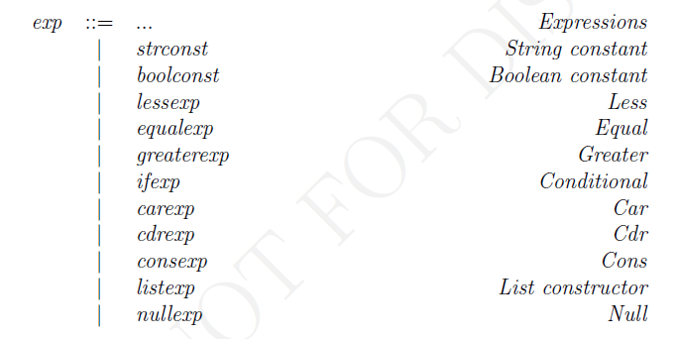
Typing Other Expressions

Slide 62
Typing Lists
listexp : ‘(‘ ‘list’ ‘:’ T exp* ‘)’
Examples
(list : num 1 2 3)
Constructs a list with elements 1, 2 and 3 of type number.
Typechecks?
(list : num 1 2 #t)
Typechecks?

Slide 63
Typing Lists
More examples
(null? (cons 1 2))
Typechecks?
(cons 1 2) : constructs a pair type (num, num)
(list : List<num> (list : num 2))
Typechecks?
(list : List<num> (list : bool #t))
Typechecks?

Slide 64
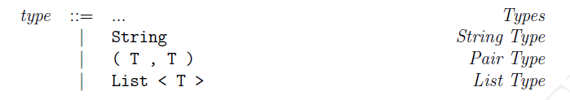
Additional Types

